Slide 1
Universal Design for Learning Meeting the needs of ALL learners
School Support and Improvement
Notes:
Hello, and welcome to Support and Innovation's module about Universal Design for Learning. In this module, you will gain a basic understanding of Universal Design for Learning and how it can be introduced to school communities.

Slide 2
Essential Questions
What is Universal Design for Learning (UDL)?
How is it applied to student learning?
How can UDL it be implemented successfully?
Notes:
This presentation serves to answer the following essential questions :
– what is universal design for learning, or UDL?
- How is it applied to student learning?
- and how can UDL be implemented successfully?

Slide 3
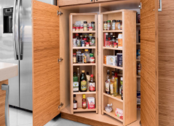
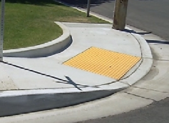
Universal Design
Principle 1: Equitable use
Principle 2: Flexibility in Use
Principle 3: Simple and Intuitive Use
Principle 4: Perceptible Information
Principle 5: Tolerance for Error
Principle 6: Low Physical Effort
Principle 7: Size and Space for Approach and Use
Notes:
Universal Design for Learning stems from the same ideals as Universal Design.
Universal Design is defined as "the design and composition of an environment so that it can be accessed, understood and used to the greatest extent possible by all people regardless of their age, size, ability or disability". Universal design was built upon the foundations of civil and human rights movements initiated in the onset of the 20th century. In 1997, a group of designers, engineers and researchers led by American architect, Ronald Mace, conceptualized universal design into 7 principles shown here.
Universal design has a two pronged approach one – pushing the boundaries of products, services and environments to include as many people as possible, and two – design to reduce barriers and customize for particular users. We see universal design everyday in a variety of contexts.
Universal Design for Learning uses the same concepts to support learners within a proactive, flexible, inclusive environment and context.

Slide 4
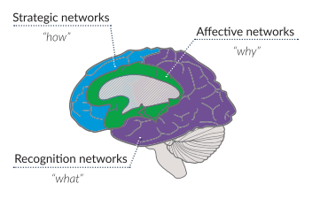
Our Learning Brain
Affective Networks
Recognition Networks
Strategic Networks
Notes:
The foundations of Universal Design for Learning are grounded in cognitive neuroscience and other research related to learning and the brain.
Universal Design for Learning is driven by three sets of networks within the brain –
The affective networks- an area in the center of the brain are related to how we develop interest in the world through emotions, past experiences, and other connections, as learners this relates to engagement – what catches our attention, keeps us interested and motivated.
The recognition networks – in the back of the brain… empower us to identify and interpret information by gathering facts through what we see, hear and read or even taste, then categorize that information to begin to process it into memory. As learners, it is beneficial to have content provided to us in different ways to tap into these networks.
The strategic networks - in the front of the brain - enable us to plan, execute and monitor actions for ourselves. This is where executive function and self-regulation skills are critical.
As learners, we tap into these networks when working on projects, listening to lecture, and taking notes. The strategic and recognition networks work together to help us learn to read, solve problems, and plan and complete projects and other assignments.
As facilitators of learning, the more we know about how to help our learners' brains process information more effectively, the better the potential for long term learning success. In addition, understanding that there is no one particular way a brain will perceive, engage with, or execute a task, namely – variability - is an important consideration for thinking about the differences between learners and planning for different contexts.

Slide 5
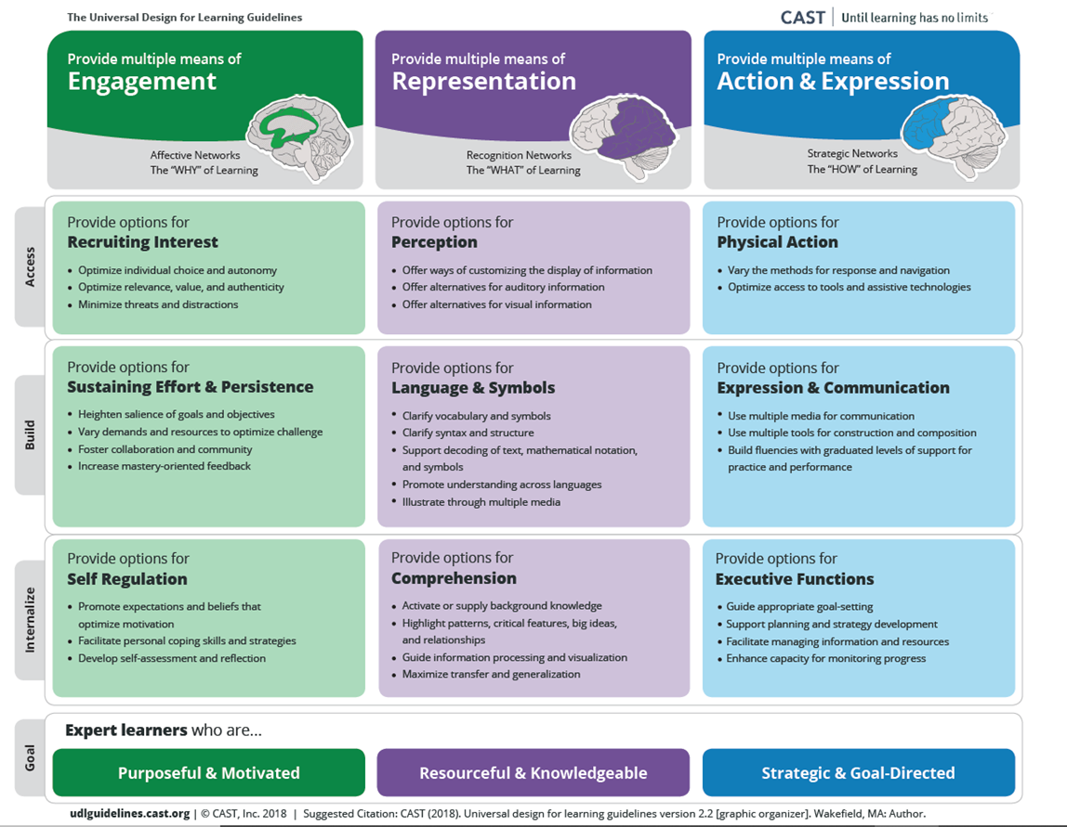
Notes:
Universal design for learning (UDL) is a brain-based teaching approach that works to accommodate the variability of all learners and eliminates unnecessary hurdles in the learning process. UDL works to meet the widest range of learners while acknowledging there will always be students who require individualization, however when educators use the UDL framework, shown here, as a guide to proactively plan for variability, the need for individualization decreases. This means developing a flexible learning environment in which information is presented in multiple ways, students engage in learning in a variety of ways, and students are provided options when demonstrating their learning.
Universal Design for Learning is grounded by three principles:
Provide multiple means of Engagement – this connects to the why of what we are learning and the affective brain network- Students are motivated to learn for different reasons and vary in the types of learning activities that keep them engaged. This principle means providing multiple ways for engaging in course activities. A precursor to this is knowing our students’ interests. It is important to make connections as we learn and the more we know about our students' interests, the more effectively we can help them connect with new learning and keep them focused on their learning goals.
Provide multiple means of Representation – connected to the what of learning - Based on the idea that learners access information differently, this principle means providing flexible and multiple ways to present information.
Provide multiple means of Action and expression - how we show what we have learned - Since learners vary in their abilities to demonstrate their learning in different ways, this principle means providing flexible ways to allow students to express their knowledge or demonstrate their skills. For example, providing students a variety of options to complete a research project to show what they have learned
A link to a copy of this framework is available for you to download below this recording.

Slide 6
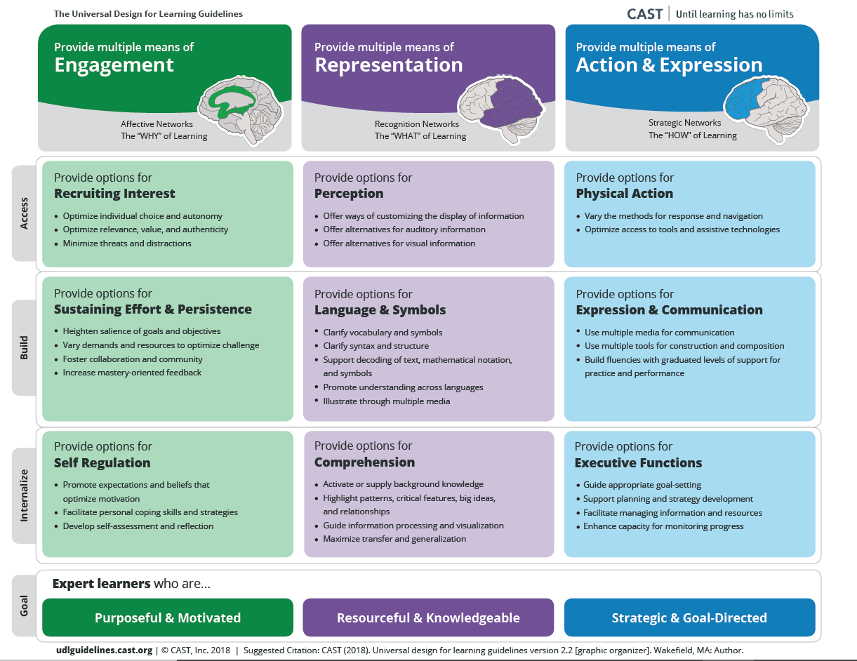
UDL Framework
3 principles
9 guidelines
31 checkpoints
Notes:
In looking at how the guidelines are structured. - (advance animation) there are three principles, 9 guidelines, and 31 checkpoints. Typically we might look at them vertically, and each of the guidelines may seem like a continuum. The ultimate goals of each of the principles are at the bottom in the 'internalize' sections. It is then helpful to look horizontally. In thinking about backwards design, these are areas to really get to know and understand. This is the planning lens for UDL. When looking vertically, you can also think about an outside, inside perspective.... When thinking about the implications for planning and implementation at a lesson level – don't plan to OR expect that every lesson will incorporate EVERY checkpoint. The three principles should consistently be considered though. Then depending on the context, concept, and learning goals – relevance guidelines and checkpoints should then be considered. "What makes sense for your students and the goals" You are going to build a tool that can be used to support planning – either with students for classroom instruction or the adult learners in professional development areas
The goal of UDL is to plan and utilize a variety of teaching methods to remove any barriers to learning and give ALL students equal opportunities to succeed.

Slide 7
Notes:
UDL and differentiated instruction have a variety of similarities and differences. UDL principles are included from the very beginning of lesson planning, back at the level of identifying a learning goal to support a wider range of learners’ needs. Differentiation is a way for teachers to make a lesson more accessible to a group of
students that isn't already being reached by adding options in for learners. Differentiation is included in a lesson plan in the final stages of planning.
UDL principles are designed to reach all individual learners, whereas differentiation includes learners on the fringe at the end of the process. UDL begins with the curriculum, while differentiated instruction begins with the students. UDL is proactive, occurring before instruction and differentiated instruction is reactive; instruction that responds to individual student needs. UDL integrates methods, materials, and assessments usable by all and removes the barriers of curriculum. Differentiated instruction works around barriers. Both ensure equity and work to meet individual needs. They also work to provide access to high quality curriculum and use multiple methods to develop and express learning.

Slide 8
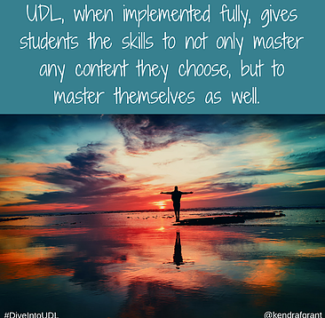
Benefits to Learners
Equity-based
Support variability
Reduce barriers
Promote self-awareness
Notes:
So why should we be design thinkers as we plan learning? Not only is there a wealth of research to support this framework of practices, but incorporating universal design principles enhances an inclusive learning environment, is equity-based and proactive.
In addition, no two learners are alike. Learner variability is the norm, not the exception. Designing learning to accommodate a wider variety of needs through UDL can help to eliminate potential learning barriers or unnecessary learning obstacles. If barriers can be reduced in the onset, then why not design learning this way? Providing learners with multiple means of perceiving, comprehending, and expressing their learning allows them to engage with the material in a way that most benefits them, and also encourages students to engage with material to improve in areas in which their skills are not as strong. Embracing Universal Design for Learning also means getting to know ourselves as learners – our strengths and challenges when we approach new learning and show what we know and understand.

Slide 9
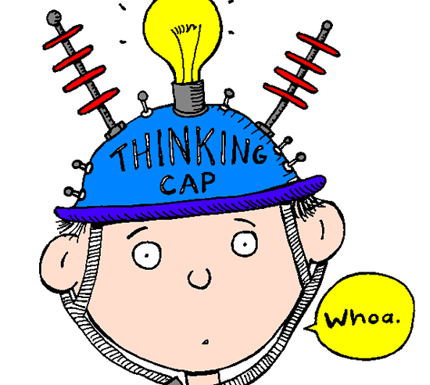
What's an expert learner?
Strategic and goal directed
Resourceful and knowledgeable
Purposeful and motivated
Notes:
Getting to know ourselves as learners and communicating this to others is an important part of embracing the ideals of Universal Design for Learning. Universal Design for Learning incorporates the concept of 'expert learners' to support this. Educators using UDL practices dedicate time to intentionally get to know the learners they work with. They get to know their interests, learn how their students best learn, and help their students get to know themselves as learners. This helps them tap into and extend strengths and also identify areas of need that, with some intensified focus can be overcome.
Expert learners formulate plans for learning, devise effective strategies and tactics to optimize learning; they organize resources and tools to facilitate learning; they monitor their progress toward mastery; they recognize their own strengths and weaknesses as learners; and they abandon plans and strategies that are ineffective.
They bring considerable prior knowledge to new learning; they activate that prior knowledge to identify, organize, prioritize and assimilate new information. They recognize the tools and resources that would help them find, structure, and remember new information; and they know how to transform new information into meaningful and useable knowledge.
Their goals are focused on mastery rather than performance; they know how to set challenging learning goals for themselves and how to sustain the effort and resilience that reaching those goals will require, and they can monitor and regulate emotional reactions that would be impediments or distractions.

Slide 10
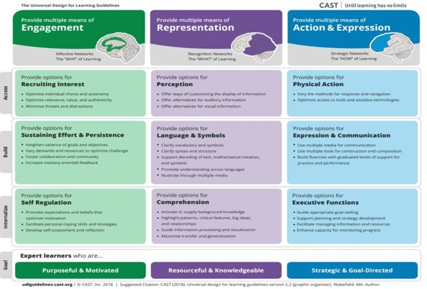
UDL Lesson Design
Standard(s)
Learning Goals
Evidence
Barriers
Variability
3 principles
Reflection
Students and teacher
Notes:
Here are the essentials when planning a lesson using the UDL guidelines. As the state standards are always the first consideration, and should be on hand, it is also beneficial to have the UDL guidelines accessible when planning to select practices within the checkpoints that align to the concept and context of learning. Remember integrating UDL is not just good teaching – it is about purposeful use of these effective practices.
When thinking about designing lessons, educators that implement UDL have the following questions at the forefront of their planning:
What are the learning goals for the lesson? – target(s), objectives, sub-objectives - Goals form the basis for instruction and assessments. Adopting a UDL mindset may require you to reconsider your overall assessment philosophy. Goal-based planning in combination with rubrics, especially rubrics created with the help of students, is one strategy used in UDL classrooms to help promote successful achievement of learning goals and mastery of standards.
Beginning with the end in mind, what evidence will be used to demonstrate students understand, are on a trajectory to mastery, or may need additional support? What is the assessment in our lesson and what will success look like? – question and discussion, student activities, exit tickets -
What are the possible barriers leading to misconceptions? What may cause confusion and how will I address it? What additional supports might I have ready? What resources and materials will I use to support students?
Based on what I know about my students and the possible barriers that may arise, how will the three principles be applied and which checkpoints should I explicitly incorporate into this lesson? What will our context be and what will be the most effective support or supports for successful learning?
How will our learning community reflect on our learning? Will students discuss their learning to reflect? Will they answer a question independently? Will we reflect together as a class?

Slide 11
UDL-based Environments
Notes:
Creating the kind of emotional and physical classroom environment in which students can flourish is vital to a UDL approach. Students need to feel that their classroom is a safe place to express their individuality, take risks and learn from mistakes.
The class is where it all happens for students so establishing an environment that is inviting and welcoming is important to helping students learn. The physical layout of the classroom contributes greatly to the learning climate. When students feel comfortable, they are able to concentrate and engage more with the content, retain more information, and enjoy the learning process. Student work is displayed to celebrate learning, desks are arranged so that students can collaborate, flexible seating is available to support different learning tasks and contexts, and materials are easily accessible tpromote students' sense of self-agency and management with their learning and work.
Another important consideration is that in UDL based classrooms, making mistakes while learning is accepted and welcomed. Making mistakes and learning from them can make learning more meaningful. Not only allowing for mistakes, but having a culture that allows for second chances reduces anxiety and promotes positive risk taking.
Finally, as you continue to think about implementation of these practices, think about what you consider the instructional environment within your learning communities. An instructional environment is where learning takes place, so if we consider the instructional environment beyond just the 4 walls of a classroom, how might the principles of UDL be infused throughout the school community?

Slide 12
Implementation
How do we start?
What do we focus on first?
How do we engage all stakeholders?
Notes:
Three questions you may consider as you think about implementation are shown here -
Where and how do we start? - In thinking about this idea, consider whether you have a tool to perform some sort of needs assessment, reflect upon observations within classrooms, other innovations that are in implementation stages and which ideas would have mutual support. It is important to remember that this will take time – possibly a few years to really infuse into your culture.
What do we focus on first? - First, consider what the adults need to know or do in order to best support your students and community. What common understandings need to be solidified. It may be best to begin with what it means to be an expert learner. Or, has increasing student engagement been an area of focus? If so, the principle of engagement may be a good place to start.
How do we engage all stakeholders? - What will you do to get the word out? How will this innovation be communicated and shared? Consider the UDL principles when planning staff professional development. What should families know? Communication should be ongoing and in multiple ways – consider the UDL principle multiple means of representation when you begin to think about how to communicate the information needed to build understanding. You may consider the principle of multiple means of engagement when you are planning a family event.

Slide 13
Implementation
Build common understandings
Determine and communicate expectations for implementation and integration
Jump in and do it – apply to multiple contexts and learn together
Notes:
As you begin to consider the steps on the path to implementation, here are some ideas that can support your inquiry and planning.
It is critical to build shared understanding. What will your common language be? In the context of UDL, it is key to start with the why behind it. UDL is grounded in brain research and cognitive neuroscience. Take the time to learn the principles, guidelines, and checkpoints. What are they and what to do they look like with students? This initial exploration of learning can lead to greater buy-in as you begin.
Next, it's important to consider the expectations for use of the innovation, in this case application of the UDL guidelines. It is important to define the expectations, communicate them clearly in a variety of ways, model them in practice, and be prepared to offer the support needed to help stakeholders meet those expectations, possibly through a range of coaching.
Third, jump in and do it! We learn by doing and take time to reflect. We learn through assessing and reflecting upon our progress.

Slide 14
UDL Café Menu
Appetizers (choose 1):
Get out and look around your world – what evidence of Universal Design do you see?
Read the short article, UDL & the Learning Brain at: https://tinyurl.com/ya3eh2tg
Main Course (choose 1):
Create a free account and sign in to CAST’s new book UDL Theory and Practice. What supports have been built into the digital version that would not be available in the print version? http://udltheorypractice.cast.org/login
Watch David Rose’s hour-long introduction to UDL entitled From Bach to Lady Gaga. What UDL supports have been provided for this presentation? http://udlseries.udlcenter.org/presentations/bach_to_gaga.html
Complete the UDL learner profile located below this module and learn more about yourself as a learner.
Dessert
Notes:
Using a UDL approach, here is a menu for your three course Universal Design for learning meal! These provide some additional activities to help you get a good taste of UDL.
- UDL learner profile to be placed below recording

Slide 15
Resources
CAST
www.cast.org (definitions, UDL framework resources, lesson ideas)
Centre for Excellence in Universal Design
http://universaldesign.ie/
Think UDL
https://thinkudl.org/ (podcasts)
Notes:
Here are a few more places with access to additional resources.

