Slide 1
Building Fluency
Scott Adamson, Ph.D.
Chandler-Gilbert Community College
s.adamson@cgc.edu

Slide 2
Square Roots
$$\sqrt{9}$$
$$=3$$

Slide 3
Square Roots
$$\sqrt{36}$$
$$=6$$

Slide 4
Square Roots
$$\sqrt{121}$$
$=$11

Slide 5
Square Roots
$$\sqrt{7}$$
$$=2?3?$$

Slide 6
Square Roots
$$\sqrt{7}$$

Slide 7
Square Roots
$$2$$
$$\sqrt{7}$$

Slide 8
$$2$$
$$.$$
$$\sqrt{7}$$
$$0 0$$
$$0 0$$
$$0 0$$
$$.$$
$$4$$
$$3$$

Slide 9
$$2$$
$$.$$
$$\sqrt{7}$$
$$0 0$$
$$0 0$$
$$0 0$$
$$0 0$$
$$.$$
$$4$$
$$4$$
$1×1$
$$3$$
4 1

Slide 10
$$2$$
$$.$$
$$\sqrt{7}$$
$$0 0$$
$$0 0$$
$$0 0$$
$$.$$
$$4$$
$$4$$
$2×2$
$$3$$
$$0 0$$
$$8 4$$

Slide 11
$$2$$
$$.$$
$$\sqrt{7}$$
$$0 0$$
$$0 0$$
$$0 0$$
$$.$$
$$4$$
$$4$$
$3×3$
$$3$$
$$0 0$$
$$1$$
$$2 9$$

Slide 12
$$2$$
$$.$$
$$\sqrt{7}$$
$$0 0$$
$$0 0$$
$$0 0$$
$$.$$
$$4$$
$$4$$
$4×4$
$$3$$
$$0 0$$
$$1$$
$$7 6$$

Slide 13
$$2$$
$$.$$
$$\sqrt{7}$$
$$0 0$$
$$0 0$$
$$0 0$$
$$.$$
$$4$$
$$4$$
$5×5$
$$3$$
$$0 0$$
$$2$$
$$2 5$$

Slide 14
$$2$$
$$.$$
$$\sqrt{7}$$
$$0 0$$
$$0 0$$
$$0 0$$
$$.$$
$$4$$
$$4$$
$6×6$
$$3$$
$$0 0$$
$2$
$$7 6$$

Slide 15
$$2$$
$$.$$
$6$
$$\sqrt{7}$$
$$0 0$$
$$0 0$$
$$0 0$$
$$0 0$$
$$.$$
$$4$$
$$4$$
$6×6$
$$3$$
$$0 0$$
$2$
$$7 6$$
$$2 4$$

Slide 16
$$2$$
$$.$$
$6$
$$\sqrt{7}$$
$$0 0$$
$$0 0$$
$$0 0$$
$$.$$
$$4$$
$$4$$
$6×6$
$$3$$
$$0 0$$
$2$
$$7 6$$
$$2 4$$
$$0 0$$
$$52$$
$1×1$
$$5 2 1$$

Slide 17
$$2$$
$$.$$
$6$
$$\sqrt{7}$$
$$0 0$$
$$0 0$$
$$0 0$$
$$.$$
$$4$$
$$4$$
$6×6$
$$3$$
$$0 0$$
$2$
$$7 6$$
$$2 4$$
$$0 0$$
$$52$$
$2×2$
$$1 0 4 4$$

Slide 18
$$2$$
$$.$$
$6$
$$\sqrt{7}$$
$$0 0$$
$$0 0$$
$$0 0$$
$$.$$
$$4$$
$$4$$
$6×6$
$$3$$
$$0 0$$
$2$
$$7 6$$
$$2 4$$
$$0 0$$
$$52$$
$3×3$
1 $5 6 9$

Slide 19
$$2$$
$$.$$
$6$
$$\sqrt{7}$$
$$0 0$$
$$0 0$$
$$0 0$$
$$.$$
$$4$$
$$4$$
$6×6$
$$3$$
$$0 0$$
$2$
$$7 6$$
$$2 4$$
$$0 0$$
$$52$$
$4×4$
$$2 0 9 6$$

Slide 20
$$2$$
$$.$$
$6$
$4$
$$\sqrt{7}$$
$$0 0$$
$$0 0$$
$$0 0$$
$$.$$
$$4$$
$$4$$
$6×6$
$$3$$
$$0 0$$
$2$
$$7 6$$
$$2 4$$
$$0 0$$
$$52$$
$4×4$
$$2 0 9 6$$

Slide 21
We do…
Calculate, to the nearest thousandths place, $\sqrt{29}$. Check your work with your shoulder partner.

Slide 22
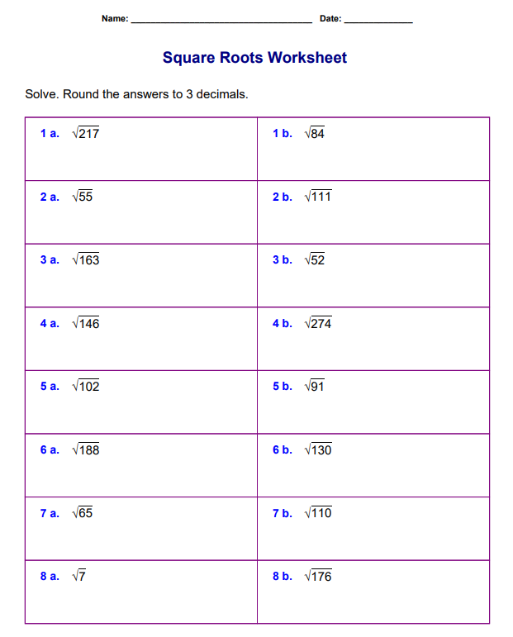
You do…

Slide 23
Fluency
Fluently includes engaging efficiently, accurately, flexibly, and appropriately.
Students are able to choose flexibly among methods and strategies to solve contextual and mathematical problems, they understand and are able to explain their approaches, and they are able to produce accurate answers efficiently.
Efficiency—carries out easily, keeps track of sub-problems, and makes use of intermediate results to solve the problem.
Accuracy—reliably produces the correct answer.
Flexibility—knows more than one approach, chooses a viable strategy, and uses one method to solve and another method to double-check.
Appropriately—knows when to apply a particular procedure.

Slide 24
Reflect
Reflect on your experience with the square root algorithm and the definition of fluency. How could fluency be developed?
Efficiency—carries out easily, keeps track of sub-problems, and makes use of intermediate results to solve the problem.
Accuracy—reliably produces the correct answer.
Flexibility—knows more than one approach, chooses a viable strategy, and uses one method to solve and another method to double-check.
Appropriately—knows when to apply a particular procedure.

Slide 25
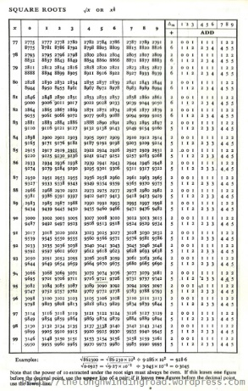
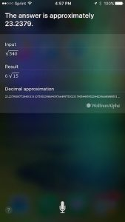
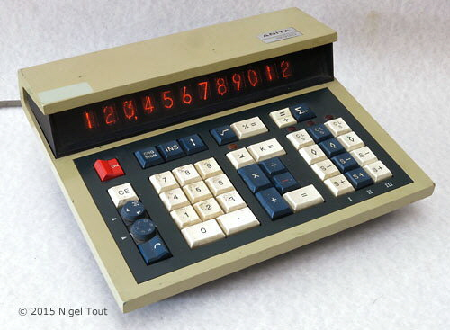
What happened to the square root algorithm?
1970’s – Table in the back of the book
1990’s – Calculators
2000’s – Ask Siri
ANITA 1233D

Slide 26
Building Procedural Fluency of Subtraction Algorithms from Conceptual Understanding

Slide 27
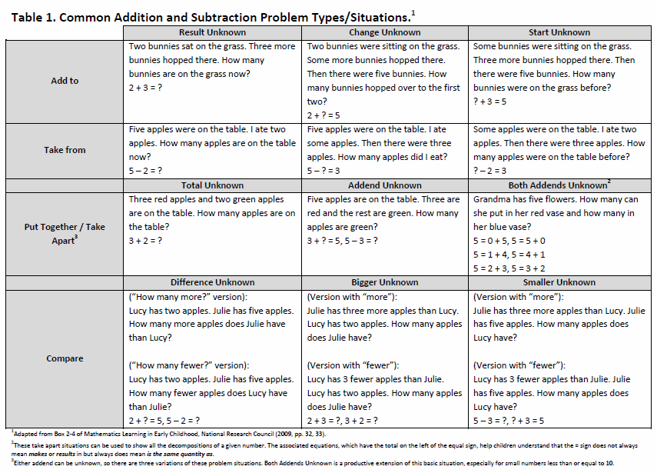
What Does Subtraction Mean?

Slide 28
Consider…
I have $76 and you have $90. How much more money do you have than I have?
Share strategies
You saved $3200 to buy new furniture. You buy furniture for a total cost of $2998. How much money do you have remaining from your savings?
Share strategies

Slide 29
Subtraction Algorithm
What shall we mean by “subtraction?”
Andrew had 332 baseball cards. He gave 157 of them to his little brother, Zachary. How many baseball cards does he have left?
Use the base 10 blocks to represent this problem
Model the problem pictorially. Use □ to represent “hundreds”, Ι to represent “tens” and ○ to represent “ones”.
Record on paper your work with the base 10 blocks
Share

Slide 30
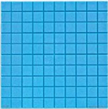
Base-10 Blocks

Slide 31
Base-10 Blocks

Slide 32
Base-10 Blocks

Slide 33
Base-10 Blocks

Slide 34
Base-10 Blocks

Slide 35
Base-10 Blocks

Slide 36
Base-10 Blocks

Slide 37
Base-10 Blocks

Slide 38
Base-10 Blocks
100
70
5

Slide 39
Base-10 Blocks
Suppose students used the manipulatives as shown…
Capture what actually happened using numerical symbols.
Now, work to capture what actually happened in the most efficient way that you can!

Slide 40
Subtraction Algorithm
What shall we mean by “subtraction?”
Andrew had 332 baseball cards. He gave 157 of them to his little brother, Zachary. How many baseball cards does he have left?
Make sense of what the student did to answer the question.
Discuss the advantages to using the alternative algorithm.

Slide 41
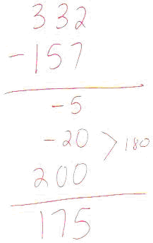
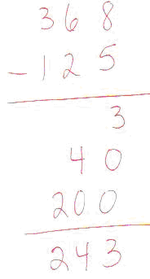

Slide 42
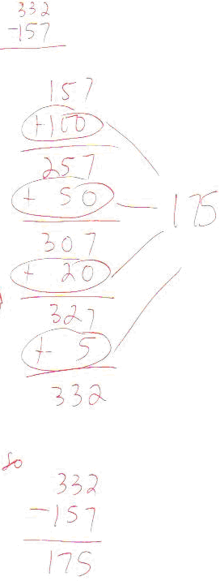

Slide 43
Gretchen Video
go to http://www.sci.sdsu.edu/CRMSE/IMAP/overview.html for information about this video

Slide 44
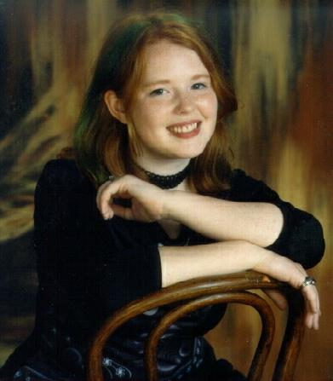

Slide 45
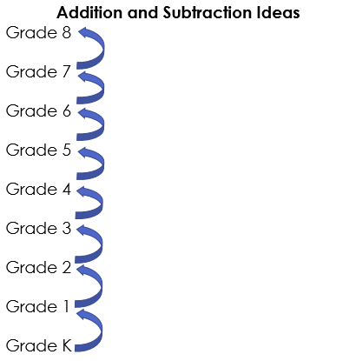
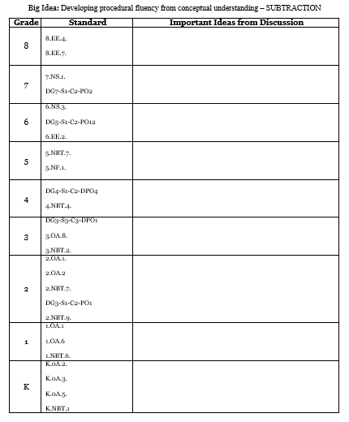
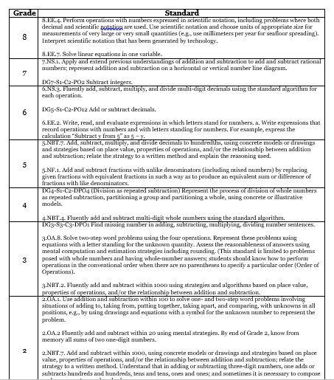
Vertical Alignment

Slide 46
Vertical Alignment Example
387 + 132
387 – 132
332 – 187
12 – 8
-12 – (-8)
-8 – (-12)

Slide 47
Addition – left to right???
387
+ 132
400
110
9
519

Slide 48
Addition – left to right???
387
+ 132
4
9
11

Slide 49
Addition – left to right???
387
+ 132
4
519
9
11

Slide 50
Subtraction – left to right???
387
- 132
200
50
5
255

Slide 51
Subtraction – left to right???
1
1
332
- 187
1
200
4
50
5
145

Slide 52
Algorithmic Danger
1
12
- 8
4

Slide 53
Vertical Alignment
K
C
C
-12 – (-8)
-12
+
8

Slide 54
Vertical Alignment
K
C
C
12 – 8
12
+
-8

Slide 55
Vertical Alignment
-12 – (-8)

Slide 56
Vertical Alignment
-12 – (-8)

Slide 57
Vertical Alignment
-12 – (-8)

Slide 58
Vertical Alignment
-12 – (-8)

Slide 59
Vertical Alignment
-12 – (-8)

Slide 60
Vertical Alignment
-12 – (-8)

Slide 61
Vertical Alignment
-12 – (-8)

Slide 62
Vertical Alignment
-12 – (-8)

Slide 63
Vertical Alignment
-12 – (-8)

Slide 64
Vertical Alignment
-8 – (-12)

Slide 65
Vertical Alignment
-8 – (-12)

Slide 66
Vertical Alignment
-8 – (-12)

Slide 67
Problem Solving
1
2
3
4
6
8
0
4
5
7
8
9
Create two 2 digit numbers and
compute the difference

Slide 68
Problem Solving
2
3
0
1
3
4
5
6
7
8
9
7
Create two 2 digit numbers and
compute the difference

Slide 69
Conjecture
Share any conjectures about this situation
Test your conjecture
Any new conjectures? Now test these…
Share viable arguments and critique the reasoning of others

Slide 70
http://www.globaledresources.com/resources.html
Curious Subtraction video - Japan

Slide 71
Wrap Up
Reflect on today’s work…choose one or more idea that you will take back to your class “on Monday”.
Write it/them down…
Share with your group

Slide 72
Contact
s.adamson@cgc.edu
www.getrealmath.com
@getrealmath

