Slide 1
Arizona Migrant Education Program
Please view the Web Portal: Public User Navigation Tutorial first before viewing this tutorial!
Web Portal: MEP User Tutorial

Slide 2
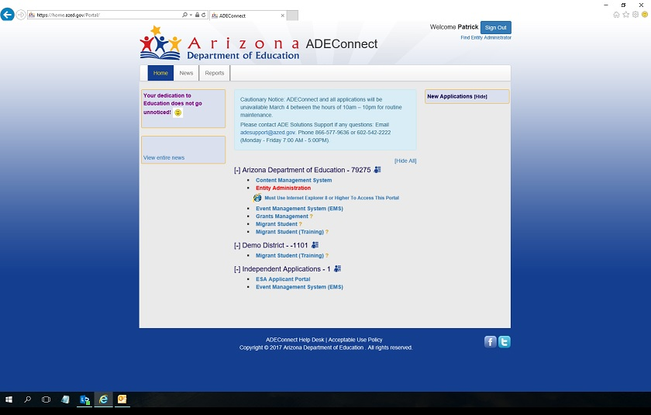
ADE Connect
The Migrant Education Web Portal can be accessed by MEP Users in ADE Connect by selecting Migrant Student for the portal, or Migrant Student (Training) for the training environment.
ADE Connect

Slide 3
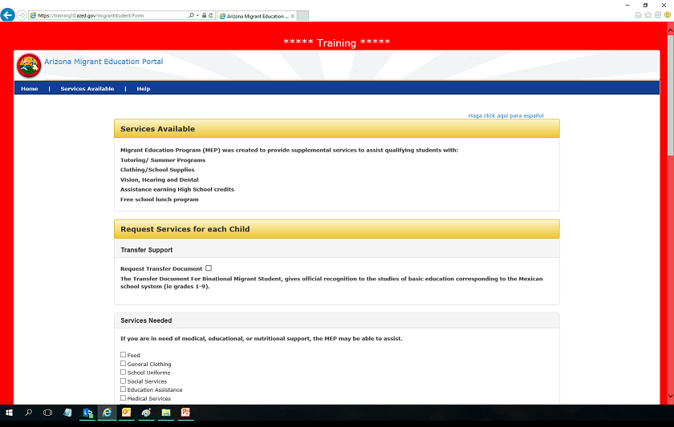
Training
The MEP Training Environment can be easily identified by the red border surrounding it
that says *****Training*****. If you do not see this border, it means you are in the real
MEP Portal and should not enter practice data!!

Slide 4
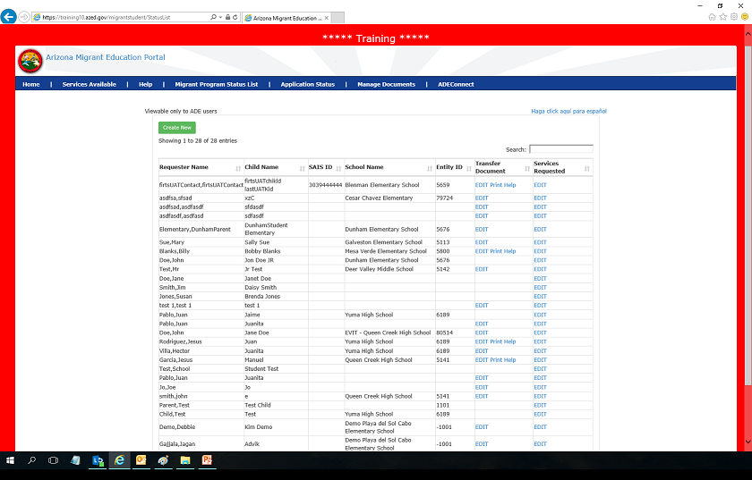
Training 2
When MEP Users login to the Web Portal through ADE Connect, it immediately takes them to
the Migrant Program Status List. This list shows every Request for Services the user is
authorized to see base on their access level. The menu options change depending on access level.
Public & MEP Users all have Home, Services Available, and Help tabs in the menu.
(Application Status & Manage Documents are for State Administrators only!)

Slide 5
Migrant Program Status List
The Transfer Document can only be signed by a Migrant Student: School Signer user. This is the
Official document for students coming to the United States from Mexico. Transfer Documents
and Service Requests can be accessed by clicking the EDIT link next to each student name.
In this example, the EDIT links would work for the student named Mary Sue. The information
in the Service Request is the same as what is shown in the public tutorial.

Slide 6
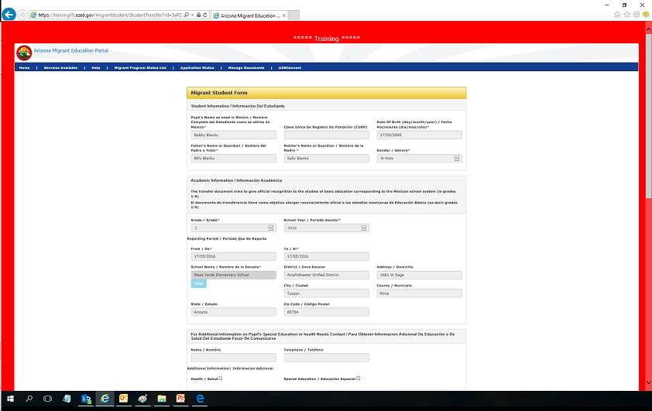
Transfer Document 1
If you click EDIT in the Transfer Document column in the Migrant Program Status List (as
shown on previous slide), it will take you to the Migrant Student Form (Transfer Document).
All fields will need to be completed before you will be able to print off the form. Mandatory
fields are marked with an *. (This is the view of the form in the Portal, and will be continued
on the next slide in this tutorial)

Slide 7
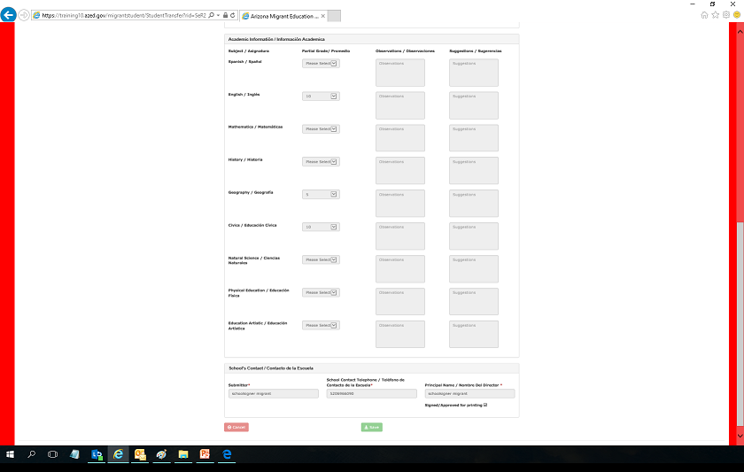
Transfer Document 2
This is the bottom half of the Transfer Document in the MEP Portal. After you finish adding
Information, click Save and you will now be able to print the Transfer Document from the
Migrant Program Status List.

Slide 8
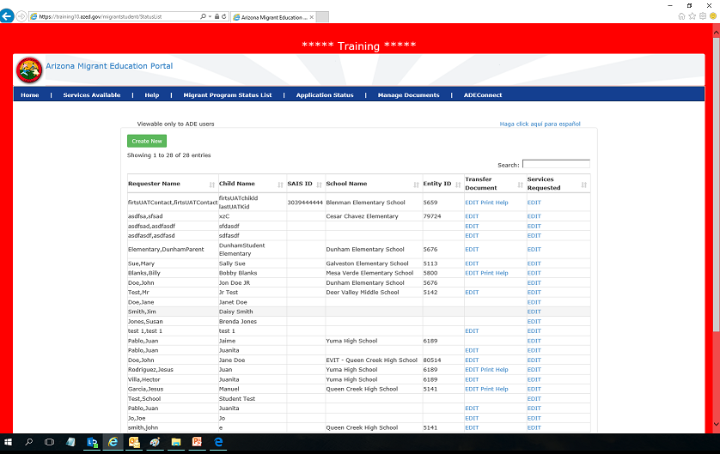
Transfer Document Menu
When you are ready to print the Transfer Document, you will need to click Print in the
Appropriate link in the Migrant Program Status List. For example, I would print the Transfer
Document for Billy Blanks by clicking the print button being pointed at by the red arrow. The
Help link next to the print link will assist you if you have any problems.

Slide 9
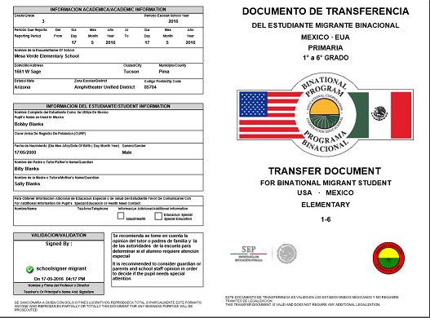
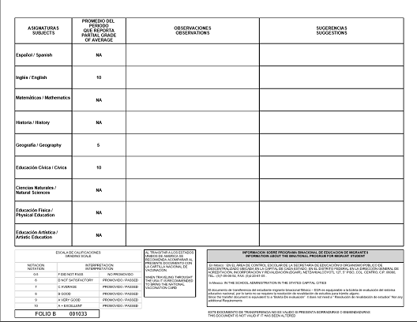
Transfer Document Printed
When you print the Transfer Document from the MEP Web Portal after completing all
of the information, it will look like this two-page example below:

Slide 10
Contact Info
If you need any additional help with the MEP Web Portal, please
contact Patrick Bohanan at:
Patrick.Bohanan@azed.gov
(602) 364-1805
You can also view the Portal User Guide at the Arizona Migrant Education Program Website
for additional clarification on user roles and portal operation.

