Slide 1
State Tutoring Program
General Information, Tutorials, and Requirements
This information pertains to Coordinators and Tutors

Slide 2
Introduction
Tutoring is individualized, supplemental, standards-based instruction. The outcome of tutoring is student academic progress, encompassing measures of both proficiency and academic gain as stated in § A.R.S. 15-241 (K).
Implementation of topics and requirements presented in this PowerPoint are mandatory for an LEA to receive payment from ADE.

Slide 3
Eligibility for State Tutoring
In accordance with § A.R.S. 15-241 (K): The ADE State Tutoring Program represents the program available to all pupils in a school assigned a letter grade of D or F. The parents or guardians of pupils attending a school assigned a letter grade of D or F may select an alternative tutoring program in academic standards from an approved provider.
Please refer to the FY19 Eligible Schools List for eligibility.

Slide 4
Tutors
Key Points:
Responsible for CSI Forms updated and parent signed 2x a year.
Tutoring should be individually focused with no more than five students per group.
Tutors are responsible for developing the method to demonstrate academic progress on identified standards.
General tutoring is not allowed by this grant and, as such, tutoring is centered around a specific Arizona academic standards.
Tutoring should not be used as a homework club or drop-in program.
Tutoring is not 1 to 1.
Tutoring should not be on a computer.

Slide 5
Supplemental State Tutoring
If tutoring is to take place during school hours, it must be during a non-core class. The following classes are considered core classes:
Core Content Areas
American Government | Foreign Language | Physics
Art | General Science | Political Science
Biology | Geography | Reading
Chemistry | Mathematics | Reading Interventions
CTE Classes | Math Interventions | SEI Classroom
Earth & Physical Sciences | Music | Social Studies
Economics | Performing Arts | SPED
English | Physical Education | Visual Arts

Slide 6
Coordinators
A coordinator’s role is the organization, implementation, support, and execution of the tutoring program in accordance with the grant requirements.
The gross rate for each coordinator is $600 for the school year (2019-2020 School Year). A coordinator may only be used if there are 5 or more other tutors at one location*. The Coordinator can tutor but the site must already have at minimum 5 other tutors.
The coordinator oversees the following:
Coordinate eligibility of all tutors and tutoring participants.
Assist in completion and maintain Certificates of Supplemental Instruction
Verify the accuracy of Sign-in Sheets and hours in ADEConnect
Assist tutors with online access for logging hours
Assistance with tutoring resources and measures of student progress
Coordinate all site materials for tutoring and required forms.
*The State Tutor Staff reserves the right to withhold coordinator payment for lack of performance or if the total number of tutors falls below five.

Slide 7
Tutor Verification Form
The Tutor Verification Form requires teachers and providers to document evidence of content qualifications in the content area(s) of tutoring instruction.
All tutors must complete the form and provide documentation (i.e., transcripts, certificates) to their administrator and be kept at the school sites for documentation (refer to the Accountability Section of the School year 2019-2020 Announcement Letter for more details).
If a paraprofessional does not meet the criteria on the Tutor Verification Form, documentation with justification may be provided to ADE State Tutoring for review.
The Principal or LEA/Vendor Administrator must sign the Tutor Verification Form indicating eligibility of the tutor.
The Tutor Verification form can be found in the Tutor Resource section at http://www.azed.gov/state-tutoring/

Slide 8
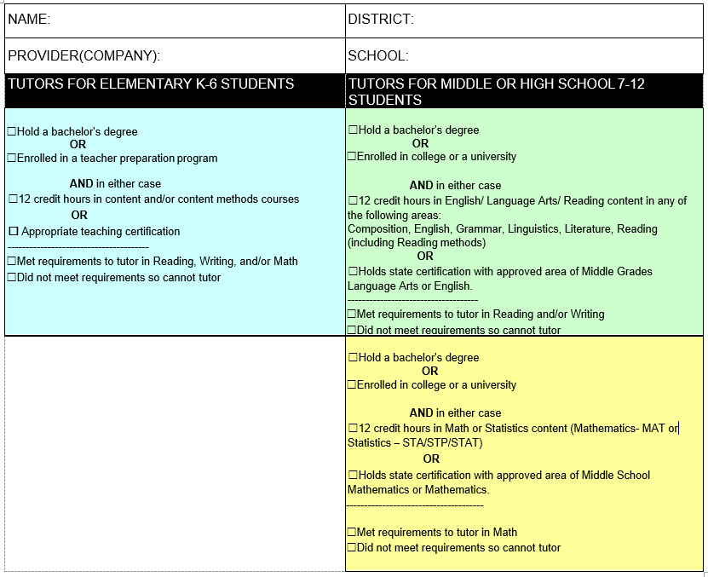
Tutor Verification Form
Please review the eligibility requirements for Tutors as stated on this form.

Slide 9
Tutor Responsibilities
Complete Tutor Verification Form and provide supporting documentation to principal or administrator for approval
Complete the State Tutoring Checklist before tutoring begins. Coordinators/site lead will submit to ADE as a single file.
Ensure Contact list is current and submitted to statetutor@azed.gov
Maintain current and accurate Certificate of Supplemental Instruction (CSI) for each student
Use data to determine AZ Academic Standards for individual instructional focus.
Provide evidence of academic progress
Complete the CSI a minimum of 2 times per year; before beginning tutoring, by December 20th, and by February 14th.

Slide 10
Tutor Responsibilities (cont.)
Maintain records
Sign in sheets
Weekly student and tutor time entry in ADEConnect
Updated and accurate CSI for each student
Provides planned, targeted instruction that is supplemental to classroom first instruction
Communicate to parents, teacher of record and administration as to status of academic progress including measures of proficiency and growth.

Slide 11
Certificates of Supplemental Instruction (CSI)
The tutor is responsible for filling out all portions of the certificate and obtaining other involved parties’ signature(s). Completed certificates should be kept at the site of tutoring (vendors may keep it with their respective business office).
The certificate is used to initiate an agreement of tutoring between the tutor and student and parent/guardian. Before any tutoring is to take place, it should be filled out completely. The certificate is to be completed 2 times per year with the correct time checked on the form and update targeted standards and academic progress measures.

Slide 12
Certificates of Supplemental Instruction (CSI)
Student Information
The SSID number, Date of Birth and relevant eligibility checkboxes must be recorded on the document.
Arizona Academic Standards
Areas to be tutored must be relatable to what the student’s needs are in the areas of math and/or reading, writing, ELA. Specific state standards must be listed. “To improve reading” is not acceptable.
Tutoring Dates
Should be filled out prior to tutoring beginning and should match what is to be logged on the sign-in sheets. This can be adjusted later to reflect major changes.
Communication
Indicate how and when tutor will communicate with parents.
Signatures and Contact information
Tutor sign and date; parent sign and date and provide contact information; Principal to sign if tutoring is during teacher prep time.
With each new CSI (Sept, Oct, Feb), a principal/CEO/administrator signs the previous CSI for an attestation of improvement.

Slide 13
Tutoring Dates and Times
The number of sessions should be predetermined PRIOR to tutoring beginning.
Complete this section on your CSI to clearly communicate to parents/guardians.

Slide 14
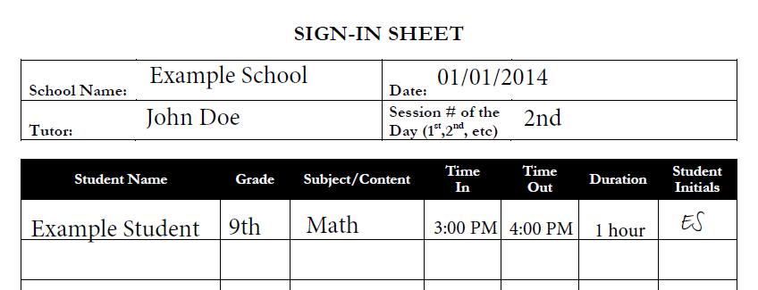
Sign-in Sheets
Supporting documentation which provides ADE records to match with logged tutor hours. All sign-in sheets must be signed or initialed by attending students. Use these to log hours in ADEConnect and turn into your coordinator or administrator.

Slide 15
ADEConnect
All student and tutor information, including hours, will be entered in ADEConnect.
Usernames and passwords will be determined by the district or LEA administrator.
You must provide your FCC# (fingerprint clearance card number) the first time you log in. If afterwards you still have issues, please contact State Tutoring fund staff.
Communicate with the person/people coordinating the program to ensure that your hours/sessions get logged properly and you do not exceed the allocations for your LEA.
Log your hours WEEKLY! The principal/coordinator should check to ensure this is done.

Slide 16
ADE Connect Link
ADEConnect is located on the main page of the Arizona Department of Education Website: http://www.azed.gov/

Slide 17
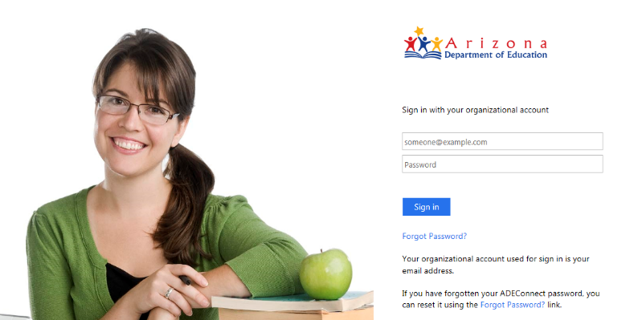
Logging into ADEConnect
1. Enter your username and password
Sign in using your district email address and the password you created for ADE Connect.
Forgot your password? Click here to create a new one!

Slide 18
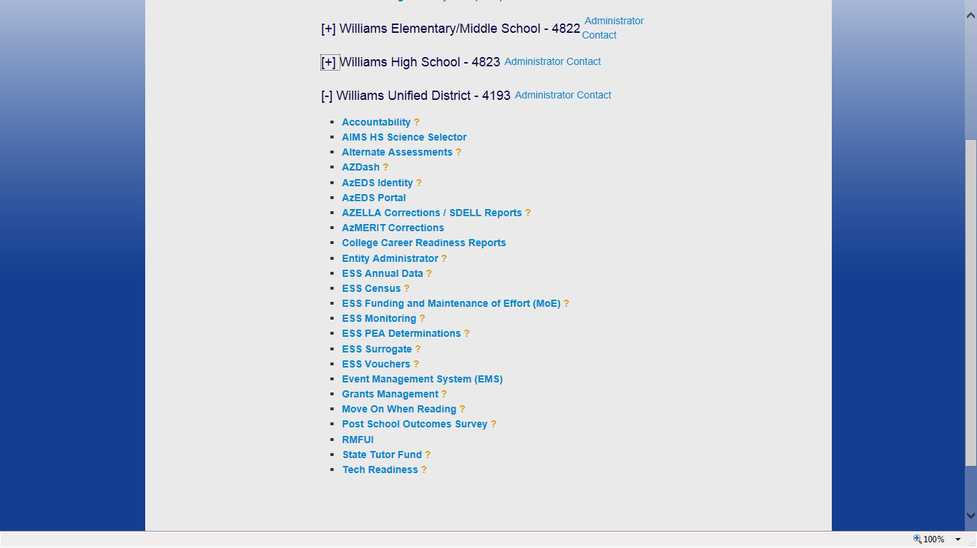
Using ADEConnect
2. Click on ‘State Tutor Fund’
Use the [ + ] and [ – ] to expand or collapse the menus.
Click here to access the State Tutor Fund website.

Slide 19
Using ADEConnect
Click on the menu items to enter data, view the FAQ, contact ADE, etc.
Need help? Read the System Directions for guidance on how to manage students, enter data, etc.

Slide 20
Using ADEConnect
Menu Guidance
Register a student is where you add students to be tutored
Please note if you are not the first tutor to register a specific student it will say ‘student already registered’ as an error message, but it will add the student to your list
Modify Profile – Change name/email
Add a session – Students who you have registered will show up on a list for you to add them to tutoring sessions
Review sessions – Lets you edit (by deleting so you can re-create) previous sessions

Slide 21
Reports in State Tutor Fund
When logged into the State Tutor Fund, click Reports.
After clicking on the Reports tab, you will then see your options for various kinds of reports to click and see.

Slide 22
Reports Cont’d.
Once you click on a report, you will then need to click on the save icon below to save the report to your desktop so that you may save it and filter it.

Slide 23
Other Requirements
The following documentation should be kept in a single place at the school. These forms will be reviewed during ADE Monitoring of the State Tutoring Program.
Tutor Verification Forms with documentation supporting tutor eligibility
State Tutor Checklist for each tutor
Coordinator Checklist
Certificates of Supplemental Instruction (CSI)
The appropriate month needs to be checked on each CSI, there will be a minimum of 2 forms completed throughout the year
Documentation showing evidence of academic progress should be kept with all Certificates
Sign-in sheets signed or initialed by attending students

Slide 24
Information and Contacts
All relevant documentation and information can be found at the following web sites:
ADE State tutor website: http://www.azed.gov/state-tutoring/
Email: statetutor@azed.gov
Suzi Mast
State Tutoring Coordinator
Arizona Department of Education State Tutoring 1535 West Jefferson Street, Bin 5 Phoenix, Arizona 85007

Slide 25
Completion Survey
Please verify that you have reviewed this presentation by completing the questions contained in the link below:
Verification of Completion
This step is required!!! Please note the date this survey was completed on your Tutor or Coordinator Checklist.

