Slide 1
State Tutoring Fund
General Information, Tutorials, and Requirements

Slide 2
Introduction
Tutoring is individualized, supplemental remedial instruction of specific standards-based skills and concepts. The goal is skill development and measurable improvement.
Implementation of topics presented in this PowerPoint are mandatory in order for an LEA to receive payment from ADE.

Slide 3
Eligibility for State Tutoring
The state statute has not changed, therefore we will continue to use the opinion of the Attorney General’s office.
An informal opinion from the Attorney General’s Office states that students attending a school that demonstrates a below average level of performance, are eligible to receive services from the State Tutoring Grant.
“A.R.S. 15-241 R: The parent or the guardian of the pupil may apply to the department of education, in a manner determined by the department of education, for a certificate of supplemental instruction from the failing schools tutoring fund established by this section. Pupils attending a school assigned a letter grade of D or F or a pupil who has failed to pass one or more portions of the Arizona instrument to measure standards test in grades eight through twelve in order to graduate from high school may select an alternative tutoring program in academic standards . . .”

Slide 4
Supplemental State Tutoring
Key Points:
Tutoring should be individually focused with no more than five students per group and is to be delivered in a separate classroom or workspace.
Tutors are responsible for developing the method to demonstrate improvement for each student.
General tutoring is not allowed by this grant and, as such, tutoring has to be centered around a specific weakness.
Not to be used as a homework club or drop-in program.

Slide 5
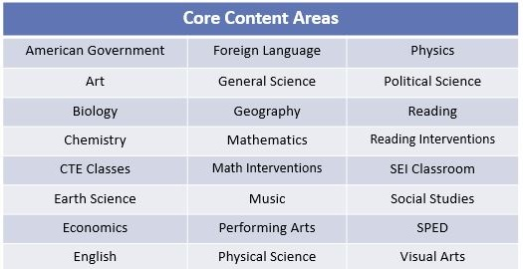
Supplemental State Tutoring
If tutoring is to take place during school hours, it must be during a non-core class. The following classes are considered core classes:

Slide 6
Coordinators
A coordinator’s role is the organization, implementation, and execution of the tutoring program in accordance with the grant requirements. The rate for each coordinator is $300 per session (fall/spring). New for FY18, a coordinator may only be used if there are 5 or more tutors at one location*.
The coordinator oversees the following:
Eligibility of all tutoring participants
Completed Certificates of Supplemental Instruction
Accuracy of Sign-in Sheets
Helping tutors with online access for logging hours
Assistance with attesting student improvement
Remaining informed about any State Tutoring Program changes
*The State Tutor Fund Staff reserves the right to withhold coordinator payment for lack of performance or if the total number of tutors falls below five.

Slide 7
Tutoring Checklist

Slide 8
Certificates of Supplemental Instruction (CSI)
The tutor is responsible for filling out all portions of the certificate minus the attestation of improvement and other involved parties’ signature(s). Completed certificates should be kept at the site of tutoring (vendors may keep it with their respective business office).
The certificate is used to initiate an agreement of tutoring between the tutor and student/parent. Before any tutoring is to take place, it should be filled out completely, except for the signed attestation of improvement. After tutoring is completed and the student has shown progress, the attestation of improvement should be signed.

Slide 9
Certificate of Supplemental Instruction (CSI)
Student Information
The SAIS number, Date of Birth and relevant eligibility checkboxes must be recorded on the document.
Skills/Concepts
Areas to be tutored must be relatable to what the student’s needs are in the areas of math and/or reading. Specific skills must be listed. “To improve reading” is not acceptable.
Tutoring Dates
Should be filled out prior to tutoring beginning and should be similar to what is to be logged on the sign-in sheets. Can be adjusted later to reflect major changes.
Communication
Indicate how and when tutor will communicate with parents.
Signatures and Contact information
Tutor sign and date; parent sign and date and provide contact information; Principal to sign if tutoring is during teacher prep time.
Once tutoring is finished, a principal/CEO/administrator signs the CSI for an attestation of improvement.

Slide 10
Certificates of Supplemental Instruction (CSI)
Also available in Spanish

Slide 11
Supplemental State Tutoring
The number of sessions should be predetermined PRIOR to tutoring beginning. Determine the start and end dates of tutoring (1). Then determine the time of day for each session (2) and then mark which days you will see that student (3). Using a calendar, count how many days you will see that student between your start date and end date. That number goes in the Total Number of Sessions field (4). We understand there are ½ days, holidays, in-service days, etc… so this number may not match exactly to your final report but it should be close. Any major changes to the schedule should be noted on the CSI.
Please make sure to note if you are tutoring during your Prep time. Principal Authorization Required.
YES!!! It’s that easy!
9/1/17
11/25/17
35
4:00 pm
5:15 pm

Slide 12
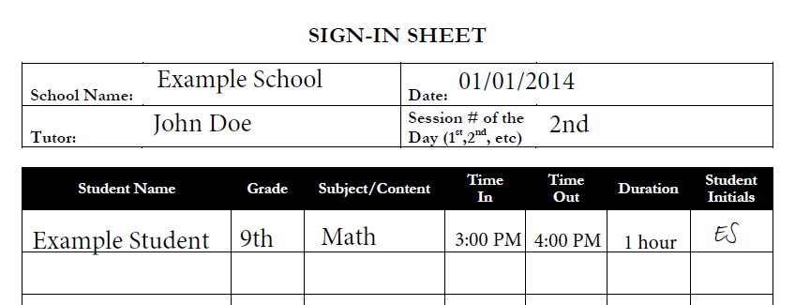
Sign-in Sheets
Supporting documentation which provides ADE records to match with logged tutor hours. All sign-in sheets must be signed or initialed by attending students.

Slide 13
Tutor Logging System
Overview
Usernames and passwords will be determined by the administrator at each LEA, unless you work for a vendor, and then ADE staff will issue log in and passwords. Please retain your log-in information for sequential terms. You do not need a new login or password for every session.
You must provide your FCC# (fingerprint clearance card number) the first time you log in. If afterwards you still have issues, please contact state tutoring fund staff.
Communicate with the person/people coordinating the program to ensure that your hours/sessions get logged properly and you do not exceed the allocations for your LEA.
Progressively log your hours; do not wait until the last week to report all of your hours, as this will cause a shut down of the system. It also causes confusion and will delay the final AP report for payment .
Additional sessions will not be created after the end date. Tutors will only get paid according to what is logged in the system. If there are errors in the system, they must be corrected before the last day to enter information.

Slide 14
Tutor Logging System
To access the new system, you will be going to ADEConnect and you will select State Tutor Fund. In order to log in to ADEConnect, you will be requesting login and password information from your entity administrator. This will be a different person for each district but it should be someone from the district level who has the authority to issue access to the website.
Features for tutors include:
Easier sessions to enter
The student grade levels will no longer be needed
Registering students faster (Name, Date of Birth and SAIS number are the only requirements now)
You will be able to make corrections if anything is entered incorrectly
You will be able to enter time tutored down to the minute as opposed to 15 minute increments
You will no longer have to take screen shots of hours and sessions entered
You will have access to run your own reports
At the district level, there is a new feature:
Maintain control of who is accessing the system
Adding the FCC#
Running reports at the school level and the district level. State Tutoring staff will still run reports at the end of each session.
At the school level, coordinators will now be able to:
Monitoring sessions online
Run reports

Slide 15
Tutor Logging System
Here are some important links for walkthroughs and changes to the system:
Arizona Department of Education Portal
This is used as the login interface for the state tutor fund for tutors.
The logging system is still referred to as ‘State Tutor Fund’:
ADEConnect State Tutor Fund
A training site (see the training section towards the bottom of the blog box) for entity administrators to add and remove tutors within their entity (this only applies to LEAs)
For further questions and information, please visit our website:
ADE State Tutor Fund website

Slide 16
Tutor Logging System
Our logging system is located at Arizona Department of Education website
At the top left, click on MENU

Slide 17
Tutor Logging System
Then click on the ADEConnect icon

Slide 18
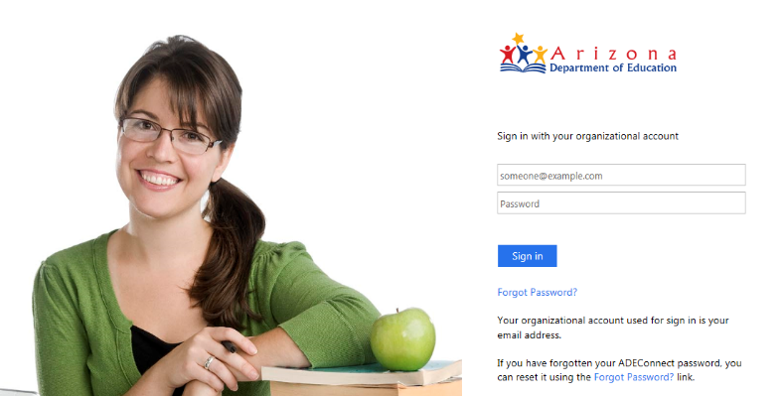
Tutor Logging System
Logging In Continued…
1. Enter your username and password
Sign in using your district email address and the password you created for ADE Connect.
Forgot your password? Click here to create a new one!

Slide 19
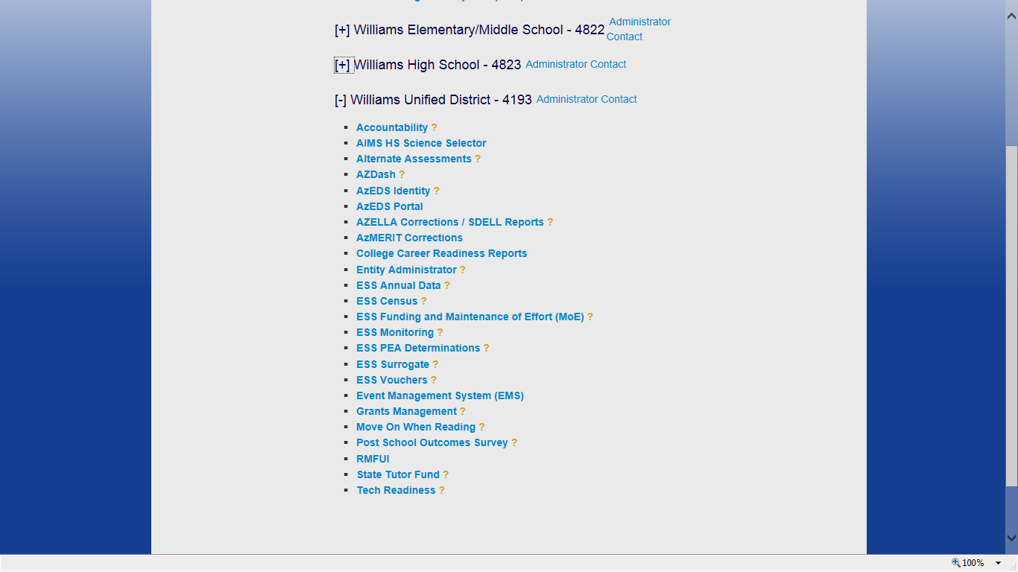
Tutor Logging System
2. Click on ‘State Tutor Fund’
Use the [ + ] and [ – ] to expand or collapse the menus.
Click here to access the State Tutor Fund website.

Slide 20
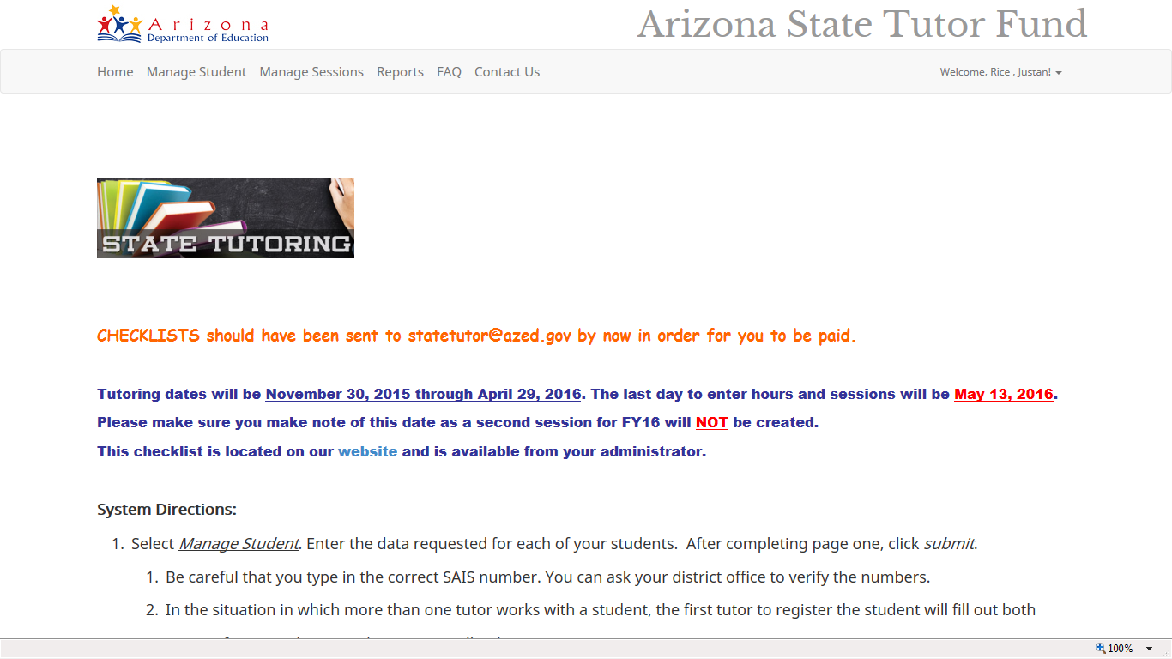
Tutor Logging System
Click on the menu items to enter data, view the FAQ, contact ADE, etc.
Need help? Read the System Directions for guidance on how to manage students, enter data, etc.

Slide 21
Tutor Logging System
Menu Guidance
Register a student is where you add students you have tutored
Please note if you are not the first tutor to register a specific student it will say ‘student already registered’ as an error message, but it will add the student to your list
Modify Profile – Change name/email
Add a session – Students who you have registered will show up on a list for you to add them to tutoring sessions
Review sessions – Lets you edit (by deleting so you can re-create) previous sessions
Student Progress – Lets you indicate what type of progress the student has achieved once tutoring is complete
Please note you must pick an answer to be eligible for payment

Slide 22
Tutor Logging System
Adding a session information
Sessions are a continuous block of tutoring time for students
If the attendance of students change, you add sessions with proper duration blocks to represent that change
Accurate session logging is critical as they will be matched up with sign-in sheets for monitoring

Slide 23
Reports in State Tutor Fund
When logged into the State Tutor Fund, click Reports.
After clicking on the Reports tab, you will then see your options for various kinds of reports to click and see.

Slide 24
Reports Cont’d.
Once you click on a report, you will then need to click on the save icon below to save the report to your desktop so that you may save it and filter it.

Slide 25
Other Requirements
During a monitoring of your LEA from ADE, the following documentation will be reviewed:
Certificates of Supplemental Instruction (CSI)
Any documentation which supports the attestation of improvement should be kept with the CSI
Sign-in Sheets signed or initialed by attending students
The certificates and examples of sign-in sheets can be found on the state tutoring website.

Slide 26
Q & A
All relevant documentation and information can be found at the following web sites:
ADE State Tutor website
ADE State Tutor website - Tutor Documents
Stephanie Washington | Joanna Heinz statetutor@azed.gov 602-542-7466 | 602-542-4755 | Arizona Department of Education State Tutoring 1535 West Jefferson Street, Bin 32 Phoenix, Arizona 85007

Slide 27
Completion Survey
Please acknowledge that you have reviewed this presentation by taking a short quiz after clicking the link below:
Survey / Quiz

