Slide 1
Compliance or Conversion?
Evaluating the Depth of Implementation

Slide 2
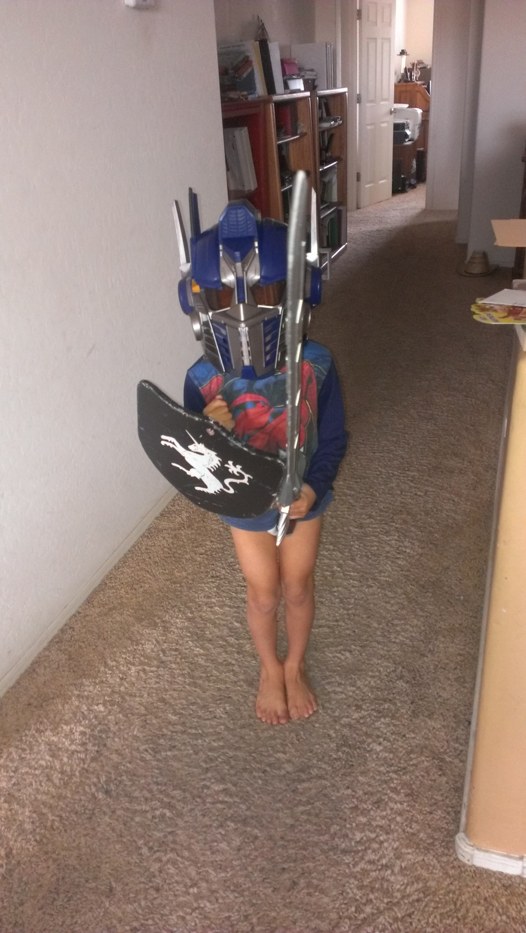

Slide 3
Email Subject Line
Does it matter HOW he takes out the trash?

Slide 4
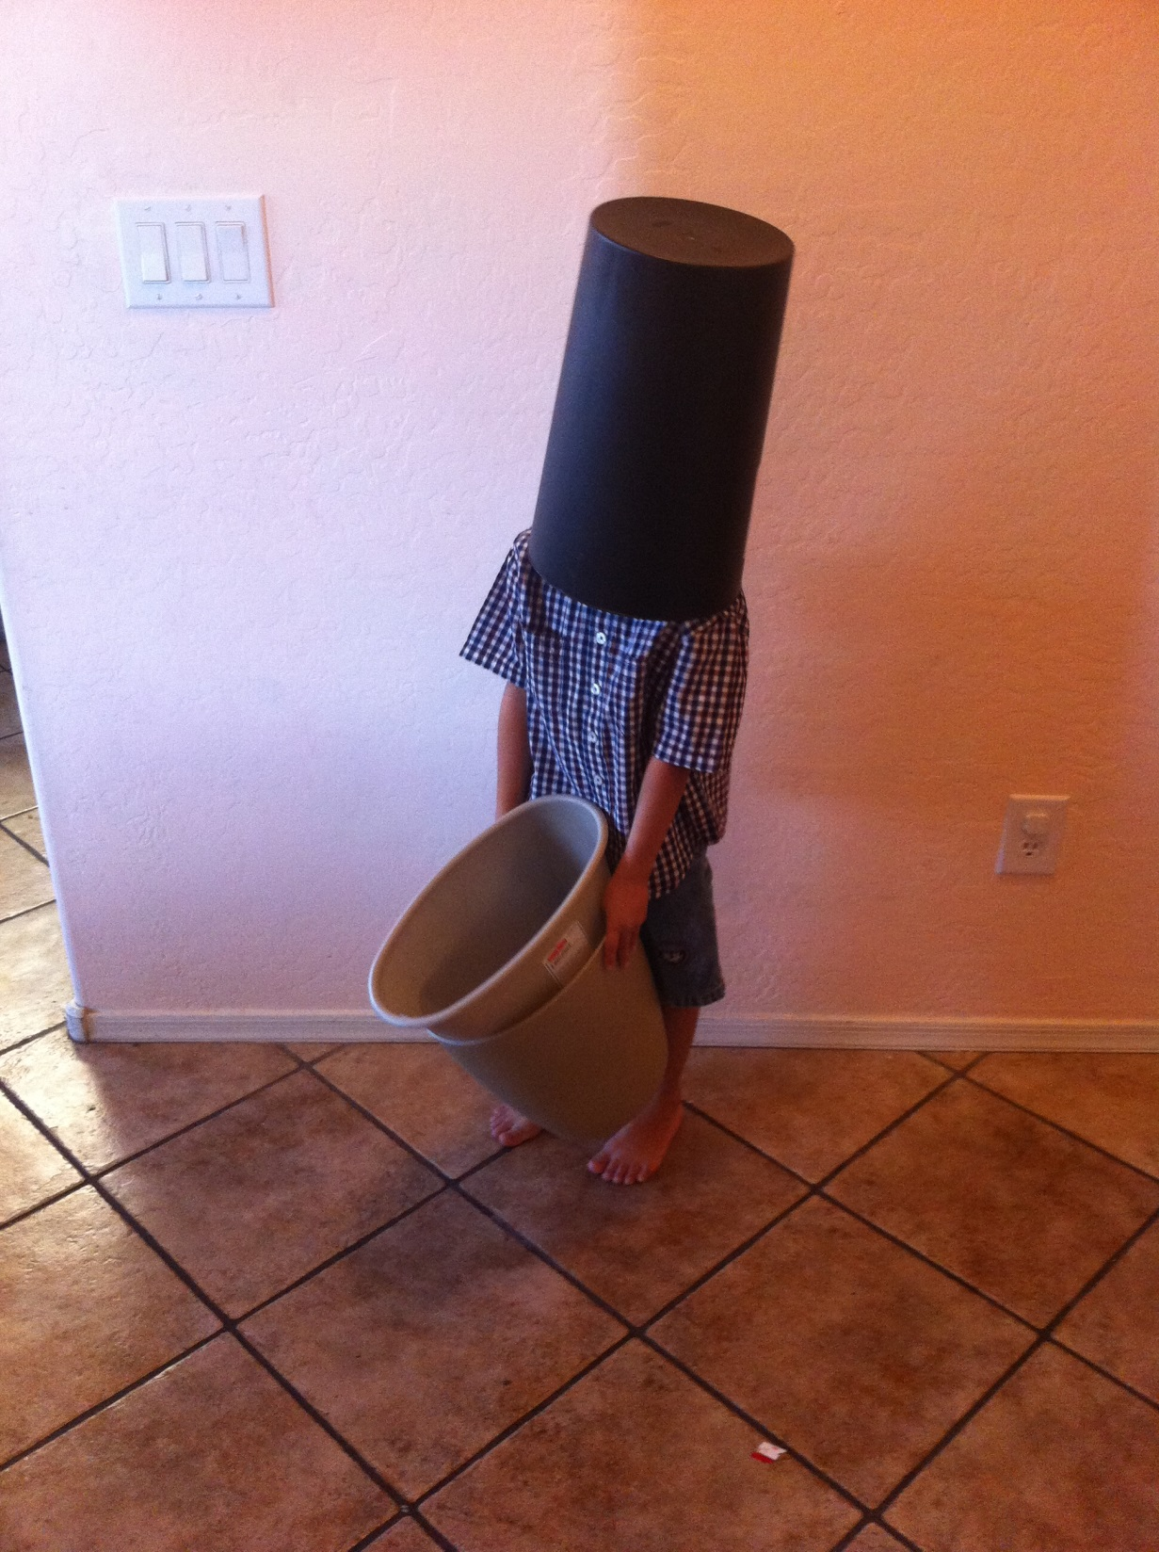
What does he need to become a better helper?

Slide 5
Compliance or Conversion?
Evaluating the Depth of Implementation
Goal: Stimulate your thinking about how you might begin to evaluate the depth of evaluation for an important effort in your school or district.

Slide 6
SCHOOLS OF EXCELLENCE AND EQUITY: CLOSING ACHIEVEMENT GAPS VIA ACADEMIC OPTIMISM
Jen Benkovitz
AJ Muttillo
Thad Urban
Under the direction of Dr. Kathleen M. Brown
MSAN Institute, April 27, 2011
North Carolina

Slide 7
Research Question
How are principals of K-5 public “Honor Schools of Excellence” pursuing…excellence, and systemic equity in a suburban southeastern county?

Slide 8
Data Sample
24 Similar and High Performing
Half Small Gap Schools (SGS)
Half Large Gap Schools (LGS)
Minority Population 18%+
12 LGS = 15 to 30% gaps [65 to 78% proficient]
12 SGS = 8 to 14% gaps [81 to 87% proficient]

Slide 9
7 Similarities in Collective Efficacy
Learning through staff development
Learning through observation
Collaboration through leadership teams
Grade-level collaboration
Interview teams
Support for teachers
Caring about teachers

Slide 10
Student Achievement is a Collective and Collaborative Effort
SIMILARITIES
Parents and community members support student achievement.
The Leadership Team serves as a vehicle for decision-making.
Implementation of the Professional Learning Community model.
DIFFERENCES
While Parent and Community involvement was evident at both small and large gap schools, it was much more prevalent in the small gap schools.
While Leadership Teams were used for decision-making at both small gap and large gap schools, the practice was much more prevalent at the small gap schools.
While the PLC model was implemented at both small and large gap schools, it was more prevalent in the small gap schools and was also much more focused on individual student’s needs, planning, student work, various assessments, and instructional methodology/resources.

Slide 11
Student Achievement is a Collective and Collaborative Effort
SIMILARITIES
Parents and community members support student achievement.
The Leadership Team serves as a vehicle for decision-making.
Implementation of the Professional Learning Community model.
DIFFERENCES
While Parent and Community involvement was evident at both small and large gap schools, it was much more prevalent in the small gap schools.
While Leadership Teams were used for decision-making at both small gap and large gap schools, the practice was much more prevalent at the small gap schools.
While the PLC model was implemented at both small and large gap schools, it was more prevalent in the small gap schools and was also much more focused on individual student’s needs, planning, student work, various assessments, and instructional methodology/resources.

Slide 12
Pause and Praise
Summary of one large-gap school principal interview and one small-gap school principal to follow.
The task was to describe PLC at their school.
What can you praise about each answer?

Slide 13
Principal 1’s Description of PLC
We are trying to form more coherent and more cohesive professional learning communities so that we can examine the data and make sure that the curriculum is covered accurately every nine weeks… so that they don’t get to the end-of-grade test in the spring and realize that they still have half of the curriculum goals left.

Slide 14
Principal 2’s Description of PLC
There is a real emphasis on collaboration. Our (grade-level) teams plan together at least twice a week. And in that planning we recognize that every teacher won’t be doing the same thing in the same way. But they’re talking about instruction, they’re talking about lesson plans, they’re talking about student achievement, and they’re looking for ways to help each other be successful, and they’re sharing resources. But everybody doesn’t have to do the same work alone because we share the instructional planning, we share looking for resources, and we share looking at assessments. Then you can build on everything.

Slide 15
Conversion!!!
They didn’t just do PLCs
They morphed into a Professional Learning Community

Slide 16
Big Idea 1
Yes, you should monitor/evaluate compliance.
HOWEVER,
Evaluating conversion will tell you the true depth of implementation.

Slide 17
Implementation Research
Dean Fixsen considered the Father
http://nirn.fpg.unc.edu/
https://www.youtube.com/watch?v=sNlAhPtiP8Y

Slide 18
Paper Implementation
Actions really only take place on paper
Typical when the only worry is some outside agency requires a paper trail
Dean Fixsen

Slide 19
Process Implementation
The only actions are those designed to allow the program to operate such as new procedures, new positions created and filled, professional development is given
Mission statements revised, culture discussed
Perhaps even information is gathered and analyzed

Slide 20
PLC
They are explained and everyone is trained
People meet in their new PLC’s
Forms are filled out, collected and maybe even analyzed

Slide 21
Performance Implementation
The program is internalized and benefits are tangible

Slide 22
Performance Implementation
Core components are not only observable, but seem to be at home
The intended effects become evident

Slide 23
Principal 2’s Describe PLC
There is a real emphasis on collaboration. Our (grade-level) teams plan together at least twice a week. And in that planning we recognize that every teacher won’t be doing the same thing in the same way. But they’re talking about instruction, they’re talking about lesson plans, they’re talking about student achievement, and they’re looking for ways to help each other be successful, and they’re sharing resources. But everybody doesn’t have to do the same work alone because we share the instructional planning, we share looking for resources, and we share looking at assessments. Then you can build on everything.

Slide 24
PLC
Teachers not only meet in PLCs but they seem to think in a PLC manner
Teachers make changes in their teaching out of a professionally thoughtful and reflective demeanor

Slide 25
Big Idea 2
Compliance checks are fairly straight forward
Conversion checks are trickier

Slide 26
Why Try?
The use of a fidelity measure helps leaders and others discriminate
implementation problems
from
intervention problems and
helps guide problem solving to improve outcomes

Slide 27
Conversion Matrix
 | High conversion | Low conversion
Good Outcomes | Celebrate! | Re-examine the intervention and Modify the conversion assessment
Poor Outcomes | Modify the intervention | Start over

Slide 28
Two Types of Assessments
Accountability and compliance assessments | Fidelity (conversion) assessments
These are evaluations of teachers that are conducted by principals and other staff and are typically used to determine teacher status (promotion, pay increase, retention) or to meet state and federal legislative mandates. | These assessments are comprehensive and require extensive preparations and longer observations in order to obtain valid and reliable information (Danielson, 2013; Marzano, 2007). Comprehensive conversion assessments can provide relevant and actionable information. Because they are typically comprehensive, they also are cumbersome. The time and effort required to conduct them mean they are not practical for frequent

Slide 29
Resources
PBIS Fidelity Evaluation Tool
http://www.pbis.org/blueprint/evaluation-tools
Implementation Drivers: Assessing Best Practices
http://implementation.fpg.unc.edu/sites/implementation.fpg.unc.edu/files/NIRN-Education-ImplementationDriversAssessingBestPractices.pdf
NIRN Active Implementation Hub
http://implementation.fpg.unc.edu/

Slide 30
Big Idea 3
Checking for conversion is easier if you know what the core components are for your program.

Slide 31
Does he need an assessment or a conversation or what?

Slide 32
PBIS Evaluation Tool Revisited
Can you list the core components of your program?
Can your teachers or administrators?
Can your students?

Slide 33
Remember my goal?
Stimulate your thinking about how you might begin to evaluate the depth of evaluation for an important effort in your school or district.

Slide 34
Thanks for participating!
Questions?
Contact info
Robert.gray@azed.gov
602-364-2202
Links to resources mentioned: http://www.azed.gov/improvement-intervention/webinar-resources/

