Slide 1
Evidence-Based Writing Arizona Department of education Assessment Section January 2019

Slide 2
AzMERIT Rubrics
Purpose, Focus, and Organization
The response is fully sustained and consistently focused within the purpose, audience, and task; and it has a clear controlling idea and effective organizational structure creating coherence and completeness.
Evidence and Elaboration
The response provides thorough and convincing support, citing evidence for the controlling idea or main idea that includes the effective use of sources, facts, and details.
Notes:
The AzMERIT rubric focuses on two main indicators for writing – Purpose, Focus, and Organization and Evidence and Elaboration. There is no requirement on the number of paragraphs in the essay; while many students provide four to five paragraphs, many three-paragraph essays have also received the highest score rating. It is the quality of the response along with support for the main idea that determines the rating the essay receives.

Slide 3
AzMERIT Writing Prompt – Informative Essays
Write an informative essay about . . . . Use information from the passages in your essay.
Manage your time carefully so that you can
• read the passages;
• plan your response;
• write your response; and
• revise and edit your response.
Be sure to
• use evidence from multiple sources; and
• avoid overly relying on one source.
Your response should be in the form of a multiparagraph essay. Write your response in the space provided.
Notes:
Using evidence from the text is a key component of the AzMERIT rubric.

Slide 4
AzMERIT Writing Prompt – Argumentative Essay
Write an argumentative essay about . . . . Use information from the passages in your essay.
Manage your time carefully so that you can
• read the passages;
• plan your response;
• write your response; and
• revise and edit your response.
Be sure to
• include a claim;
• address counterclaims;
• use evidence from multiple sources; and
• avoid overly relying on one source.
Your response should be in the form of a multiparagraph essay. Write your response in the space provided.
Notes:
Whether the prompt is Argumentative or Informative, using information from the text to support ideas is critical.

Slide 5
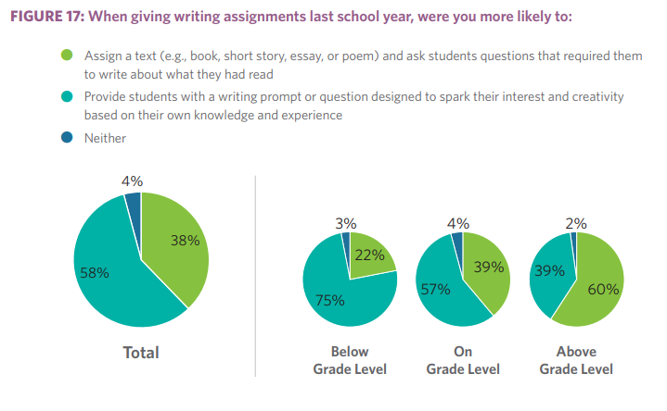
Text-Based Writing
Notes:
Note that the students who are below grade level have less access to writing based on a text. Compare 22% of writing assignments given to students who are below grade level to 60% of the writing assignments given to above grade level students. Providing text sets or your adopted classroom materials for ALL students to refer to will increase everyone’s ability to use evidence from text.
Sawchuk, S. (2018, August 16). The State of Common-Core Reading and Writing in 5 Charts. Retrieved from http://blogs.edweek.org/edweek/curriculum/2018/07/the_state_of_common-core_reading_5_charts.html

Slide 6
Evidence-Based Writing
Sentence Frames
Examples for emergent writers:
I think _________ because ____________.
For example, ____________.
Another example is ________.
What are some sentence frames that would be stage and grade level appropriate for your students?
Notes:
For many students, having a sentence frame can help them begin in using evidence from the text to support their ideas.

Slide 7
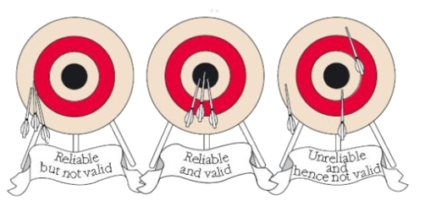
Evidence-Based Writing
Getting Started – Classroom Assignments
Gather Sources
Check Validity of Sources
Identify Main Points
Notes:
Getting Started: For a classroom assignment, you might want to use this process.
Research a topic and then align with one side. Gather points and counter-points in preparation for building a thesis.
Gather sources
Mark two or three main points that best captures the message of the text
Sufficient evidence
Examine, sort, prioritize ideas
Determine validity of source
Credibility of author/source
Purpose of text
Identify existing biases

Slide 8
Evidence-Based Writing
Getting Started – AzMERIT
Read or listen to passages
Identify main points
Use evidence from multiple sources
Notes:
Getting Started: AzMERIT
For AzMERIT, students are provided with sources so they need to read or listen to the passages and gather points and counter-points in preparation for building a thesis.
It is up to students if they create a rough draft on paper or begin composing and editing directly on the computer.

Slide 9
ELA Testing Time – AzMERIT 2018
Grade | Average Time Hours : Minutes | Maximum Time Hours : Minutes
3 | 3:48 | 21:57
4 | 3:44 | 18:42
5 | 4:04 | 19:22
6 | 4:03 | 21:57
7 | 3:45 | 19:03
8 | 3:26 | 19:21
ADE Suggested Times
2:15 - 4 hours
Notes:
The suggested total time for all three ELA sessions is 2 and ¼ to 4 hours. ADE suggests 75 minutes for Part 1 and Part 2 of the test and 90 minutes for the Writing session. For the last two years, the average time for writing has been 75-80 minutes across the grade levels.
Some students require an additional 30 minutes to an hour for writing and 30 minutes per reading tests. For those students, 5-6 hours for all three sessions may be appropriate if they are working productively.
If you look at the table, you will see the total time that students in grades 3-8 took for the Spring 2018 ELA test. As you see, the average time of students is in alignment with the recommended time. The last column shows the maximum time that a class took for the ELA test. Notice that these are three and a half to four times the state average and are concerning. AzMERIT Writing is an on-demand sample of student’s ability to listen or read a passage and respond to a prompt using evidence from the passages. You can prepare students during instruction by providing time expectations for your students. You might want to start by using one passage and a prompt and build up to using two or more passages or sources (maps, picture, ad, audio, etc.).

Slide 10
State Standards
Writing Standard 10
Write routinely over extended time frames (time for research, reflection, and revision) and shorter time frames (a single sitting or a day or two) for a range of discipline‐specific tasks, purposes, and audiences.
AzMERIT’s range of writing fits in the shorter time frame of a single sitting “for a range of discipline‐specific tasks, purposes, and audiences.”
Notes:
The writing session of AzMERIT measures many of the writing standards – producing clear and coherent writing (Standard 4), gather relevant information from print and digital sources (Standard 8), draw evidence from informational texts to support analysis, reflection, and research (Standard 9) – but also requires writing over a single setting of 90 minutes.

Slide 11
Testing Time
I thought students could test until the end of the school day.
While students can have until the end of the school to finish the test, this direction was to provide schools with flexibility in case there was a fire drill, students needed to go to the nurse, or there were technology issues.
This flexibility for school schedules was not intended to be interpreted as students working productively on a test session for more than the suggested times.
Notes:
In our documents for District Test Coordinators and Test Administrators, we write that students must complete the test session by the end of the school day. We recommend that you schedule adequate time for test sessions, particularly those starting in the afternoon, that a student or two who is working productively and may need an additional half hour to work can finish before the end of the regular school day.
Remember that AzMERIT testing should mimic classroom instruction and students should complete the writing and reading sessions within the allocated timeframe just as they are expected to complete classroom assignments within the ELA block of time.

Slide 12
Integrating Evidence
Quoting
Use a direct quote from the original source.
Example:
According to the article, "Your helmet should have a sticker that says it meets standards set by the Consumer Product Safety Commission” (Dowshen, 2014).
Quoting
Paraphrasing
Summarizing*
Natural Evidence
Notes:
Remind students to include proper citation with any outside evidence, even if they have paraphrased or summarized the work.

Slide 13
Integrating Evidence
Paraphrasing
Rephrase the quote in your own words.
Example:
The KidsHealth article states that you should look for a helmet with a sticker from the Consumer Product Safety Commission (CPSC).
Quoting
Paraphrasing
Summarizing*
Natural Evidence
Notes:
Please remind students that without proper citation, a paraphrased sentence or paragraph could be construed as plagiarism.

Slide 14
Integrating Evidence
Summarizing*
Using only the main points of the source in your own words.
Example:
The KisdHealth article discusses why bike safety is important, how to use a bike helmet, where to ride, road rules, and using hand signals.
Quoting
Paraphrasing
Summarizing*
Natural Evidence
Notes:
Summarizing*: Students will often write essays summarizing the information outlined in each of the provided texts. Remind students that an evidence-based essay isn’t about the texts. It’s about the student’s point of view and analysis; the texts are only there to provide support.
This means no information from the text should be included unless it helps further the student’s overall argument or point.

Slide 15
Integrating Evidence
Natural Evidence Integration
Taking phrases from the source and use them in your argument.
Example:
Wearing a bike helmet is so important that the government created stickers for those helmets that meet "standards set by the Consumer Product Safety Commission (CPSC)."
Quoting
Paraphrasing
Summarizing*
Natural Evidence
Notes:
Natural Evidence - When done correctly, if you were to remove the quotation marks, you should not be able to tell where your words end and the evidence begins. This technique strengthens your writing, and it is the preferred method in college.

Slide 16
Evidence-Based Writing
Connection to AzMERIT - Citations
For professional or formal writing, students can include in-text citations as long as there is a corresponding entry in their reference list. APA citation style uses the author’s last name and the year of publication.
The AzMERIT rubric does not specify how to reference sources so you should encourage students to use the appropriate grade level format you use during instruction.
Grades 3-5: Relevant evidence integrated smoothly and thoroughly with references to sources
Grades 6-11: Smoothly integrated, thorough, and relevant evidence, including precise references to sources
Notes:
Many people ask us the requirements in AzMERIT for citing sources. There is an expectation that students reference the text but there is not a specific method for doing this. Here are some ideas for citing evidence in writing.

Slide 17
Evidence-Based Writing
Connection to AzMERIT - Citations
For AzMERIT, students in younger grades might mention the passage and paragraph:
It’s important to use a helmet according to “Bike Safety” (paragraph 5).
In paragraph 3 of the first passage, the author tells us…
For AzMERIT, students in older grades might use in-text citations.
It’s important to use a helmet because a “head injury can mean brain injury” (Dowshen, 2014).
“A head injury can mean brain injury,” according to Dowshen (2014).
Notes:
Remind students prior to testing to continue to use whichever method they use regularly during instruction. Also remind students that to receive a score, at least 30% of their response must be original text, so only 70% can be quotes or paraphrasing from the passages or prompt.

Slide 18
Contact
Please contact us at
AzMERIT@azed.gov
if you have any questions.
Notes:
Please contact us at AzMERIT@azed.gov if you have any questions.

