Slide 1
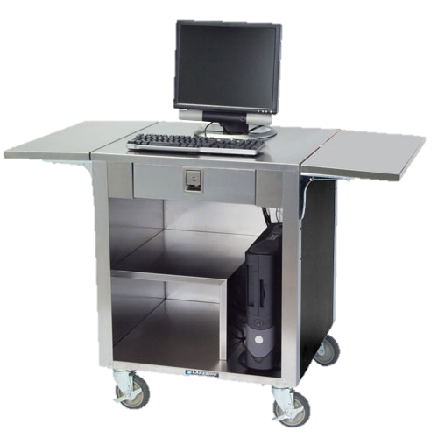
M
M
Updated March 2016

Slide 2
Meal or No Meal
Length: 15 minutes Professional Standards Learning Code: 2310
Objective: Recognize reimbursable lunches according to meal pattern requirements for Offer Versus Serve at the Point of Service (OVS).
In game format, attendees will be provided 9 different trays in which they must identify if the tray is reimbursable for lunch for Offer vs. Serve. Training can be completed by single user or used by a facilitator in a group training.

Slide 3
Facilitator Directions
Using Slide Show mode, click on each tray number to reveal a tray with served food.
Ask group to determine if that tray would be considered a reimbursable meal at lunch.
Click on the tray with the food items to reveal the answer: Reimbursable or Not Reimbursable.

Slide 4
Professional Standards
This training may count towards Professional Standards if the training is job specific for the employee. This training is for any employee that needs to be able to count reimbursable meals at the point of service when the site is operating offer versus serve (OVS).
If this training was delivered by the School Nutrition Program Director or Manager to program staff, the training may count toward his/her own annual training. If this session is offered multiple times, only the time spent on one of the training sessions may count towards the annual training hours. (Per Q.18, USDA Memo SP 38-2016)

Slide 5
Documenting Training for Professional Standards
Please track the following information:
Employee Name in attendance or Director/Manager delivering the training
Training Title: Meal or No Meal
Professional Standards Learning Code: 2310
Professional Standards Key Area: 2000
Length of time: 15 minutes*
*Note, if this training has been modified, please document the amount of time the training took.
Please note, ADE will not be able to grant a training certificate for this training. You may contact ADESchoolNutrition@azed.gov for a copy of ADE’s fillable training certificate or the school may create their own.

Slide 6
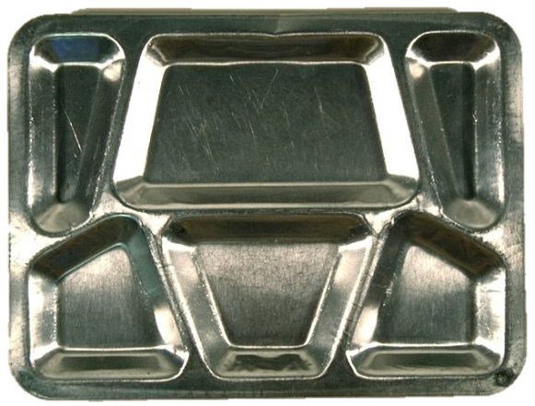
1
2
3
4
5
6
7
8
9

Slide 7
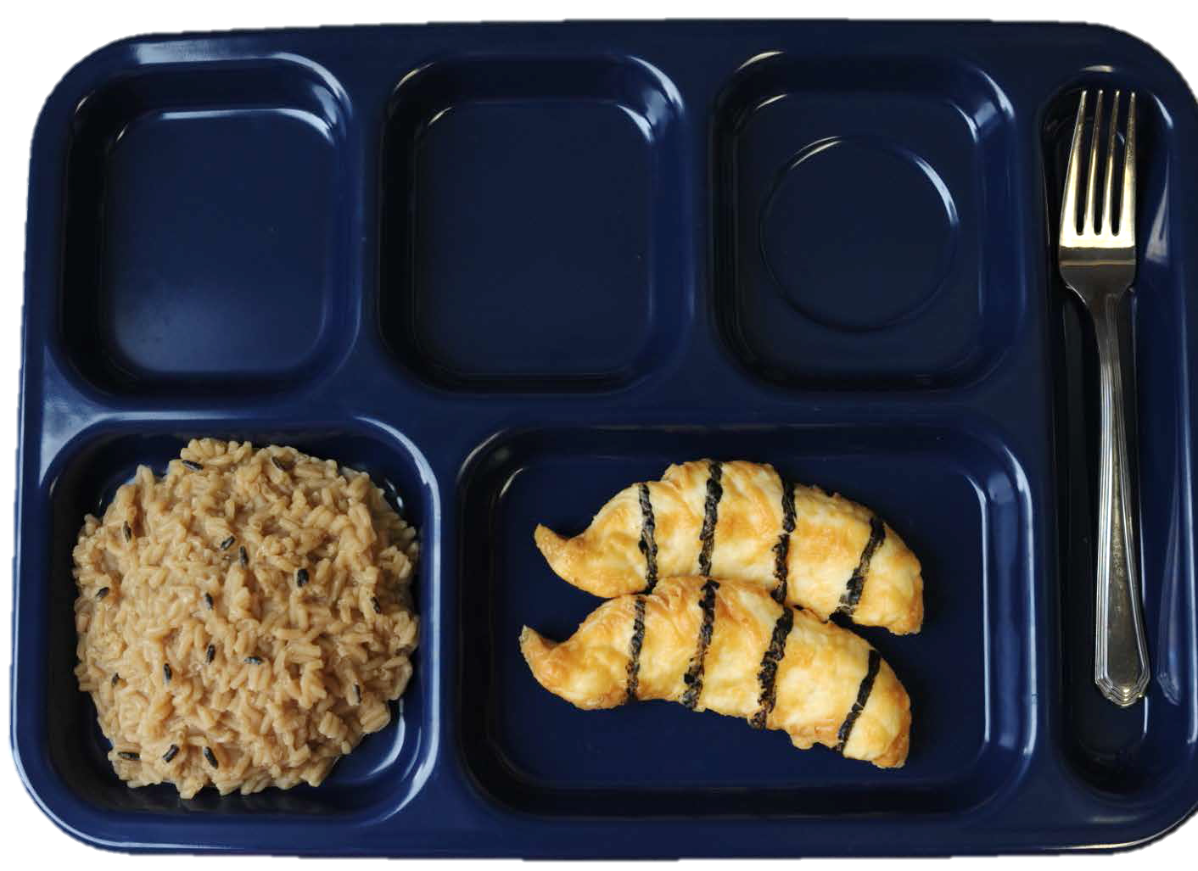
Grilled chicken – 2oz. Eq.
Brown Rice – 2 oz. eq.
Notes:
Grilled chicken – 2oz. Eq.
Brown Rice – 2 oz. eq.

Slide 8
NOT Reimbursable
Only 2 Components
No Fruit or Vegetable

Slide 9
1
2
3
4
5
6
7
8
9

Slide 10
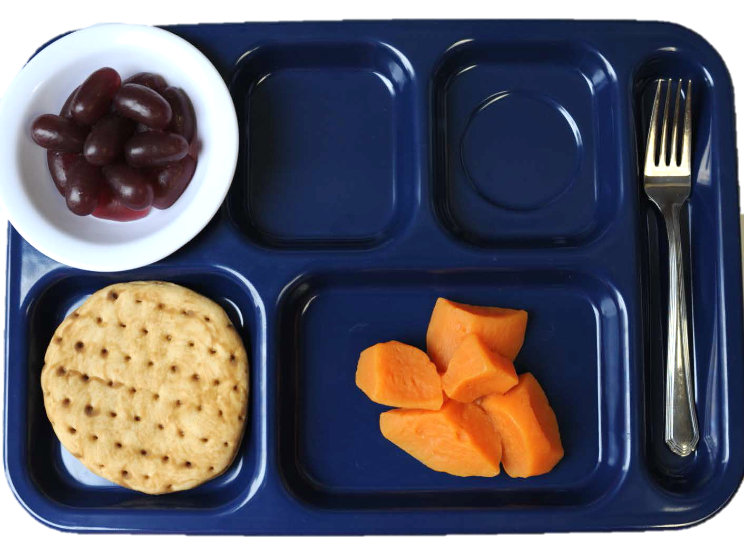
Whole grain flatbread 2 oz. eq.
Sweet Potato Chunks 1 cup
Grapes 1/2 cup
Notes:
Whole grain flatbread (2 oz. eq.)
Sweet Potato Chunks (1 cup)
Grapes (1/2 cup)

Slide 11
Reimbursable
Since there is 1 cup of sweet potatoes, ½ cup of grapes and 2 oz/eq pita bread

Slide 12
1
2
3
4
5
6
7
8
9

Slide 13
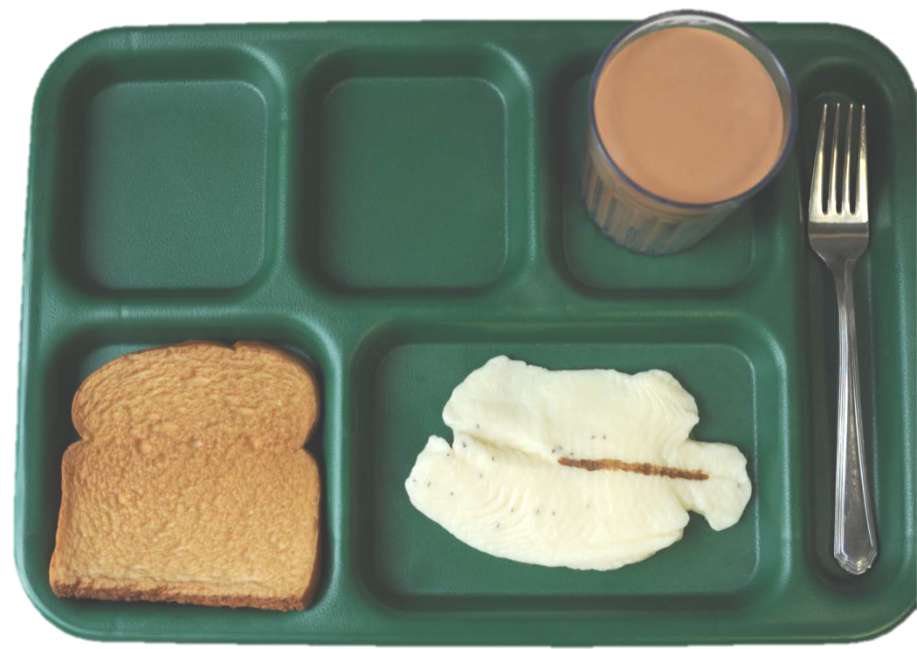
Broiled fish 2 oz. eq.
Whole Grain Bread 2 oz. eq.
Fat Free Chocolate milk 1 cup
Notes:
Broiled fish 2 oz. eq.
Whole Grain Bread 2 oz. eq.
Fat Free Chocolate milk 1 cup

Slide 14
NOT Reimbursable
No Fruit or Vegetable

Slide 15
1
2
3
4
5
6
7
8
9

Slide 16
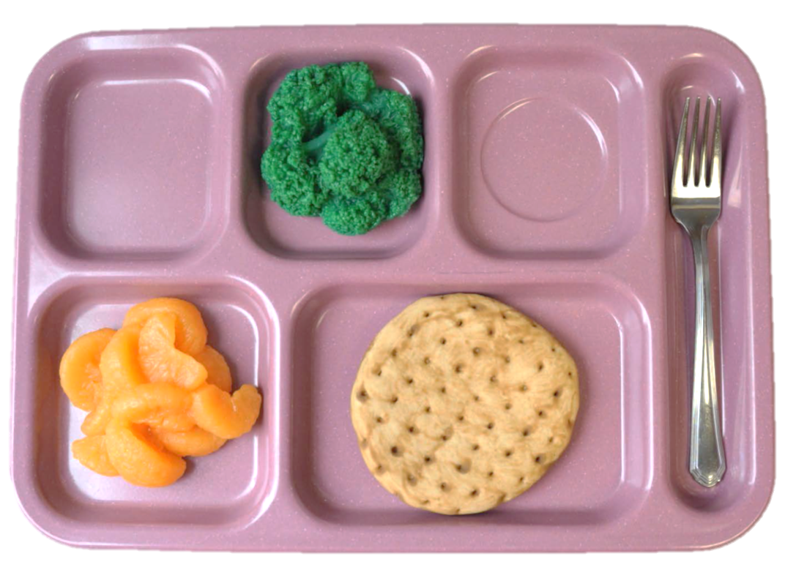
Broccoli ½ cup
Whole grain flatbread 2 oz. eq.
Mandarin oranges ½ cup
Notes:
Broccoli ½ cup
Whole grain flatbread 2 oz. eq.
Mandarin oranges ½ cup

Slide 17
Reimbursable for K-8 only
NOT reimbursable for 9-12
If three components are taken for 9-12 and 2 of them are a fruit and a vegetable, if the student takes a half cup of the fruit, a full cup needs to be taken for the vegetable
And vice versa
Notes:
If three components are taken for 9-12 and 2 of them are a fruit and a vegetable, if the student takes a half cup of the fruit, a full cup needs to be taken for the vegetable
And vice versa

Slide 18
1
2
3
4
5
6
7
8
9

Slide 19
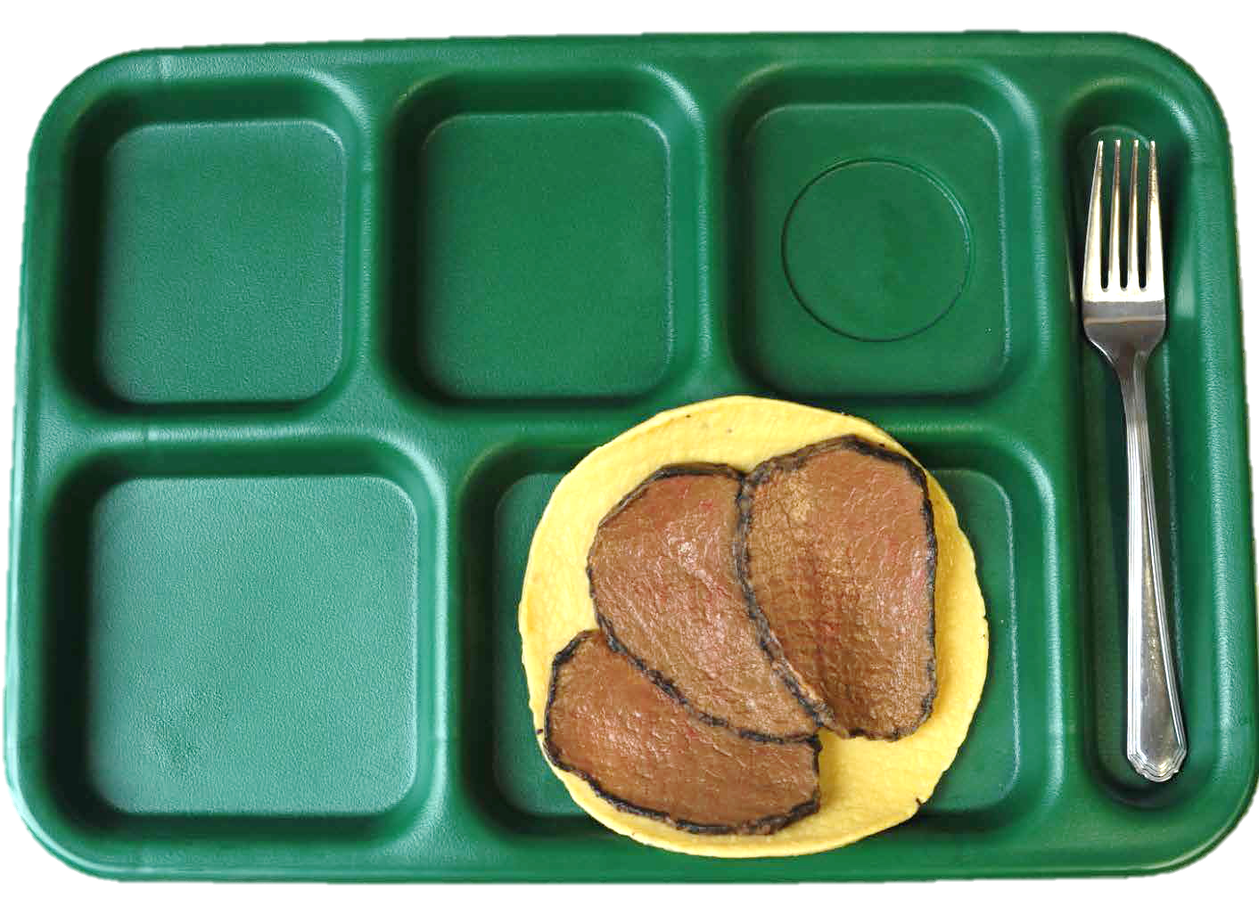
Sliced beef 2 oz. eq
Whole Corn tortilla 2 oz eq
Notes:
Sliced beef 2 oz. eq
Corn tortilla 2 oz eq

Slide 20
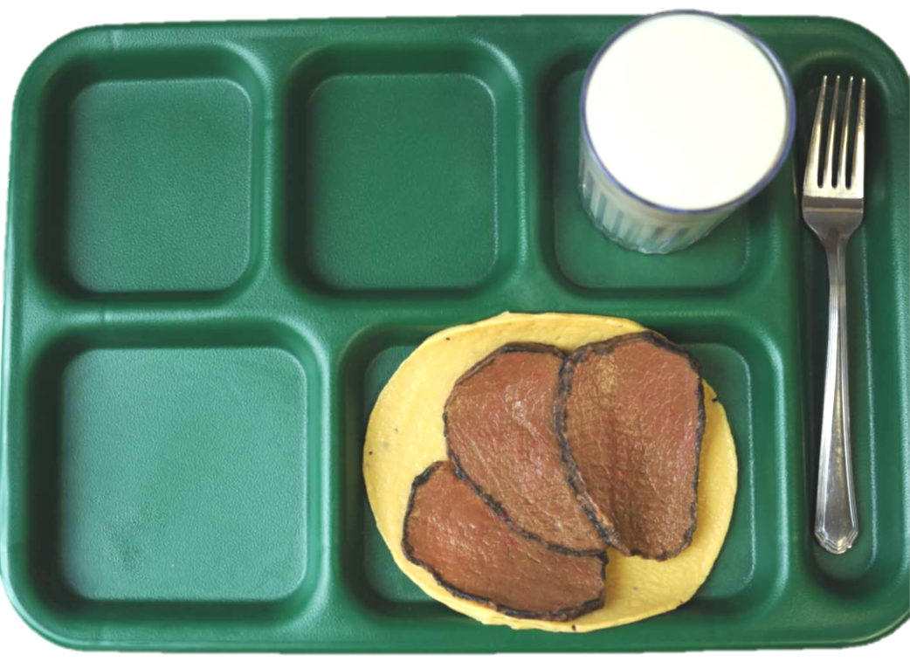
How About Now?
Sliced beef 2 oz. eq
Corn tortilla 2 oz eq
1 cup low-fat milk

Slide 21
1st tray: Not Reimbursable, only 2 components
No Fruit or Vegetable
2nd tray: Not Reimbursable, 3 components
No Fruit or Vegetable

Slide 22
1
2
3
4
5
6
7
8
9

Slide 23
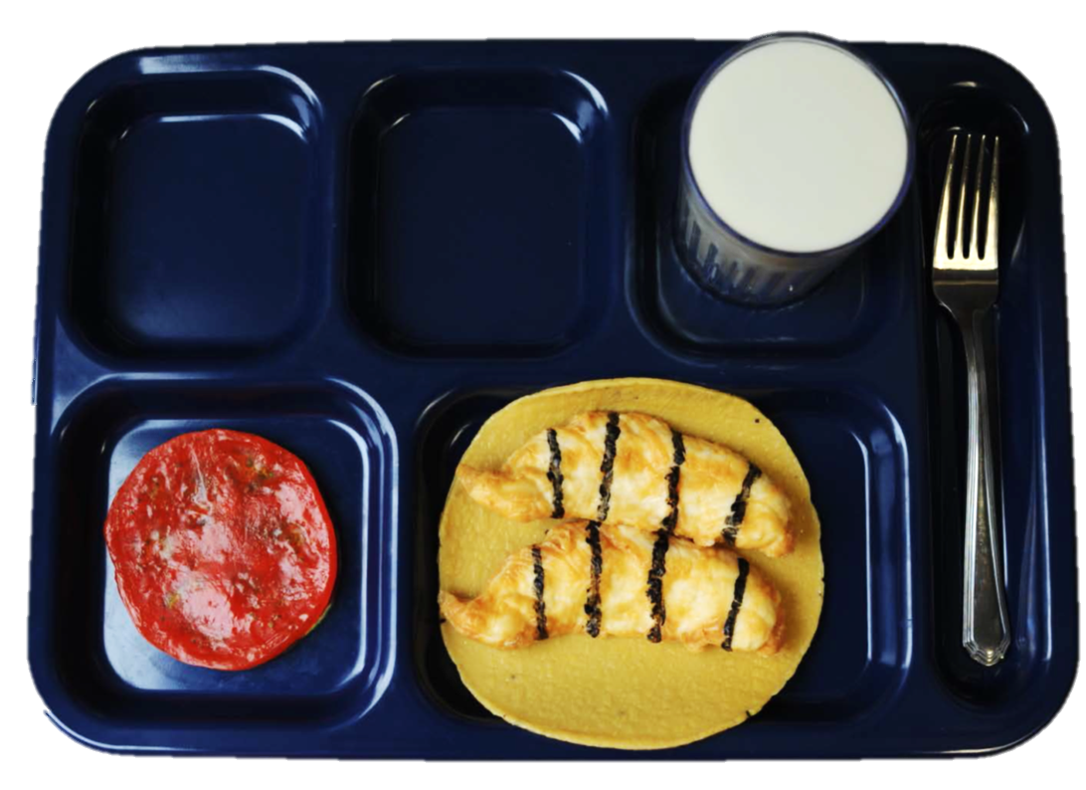
Grilled chicken 2 oz. eq.
Corn tortilla 2 oz. eq.
Tomato slice ¼ cup
Fat free milk 1 cup
Notes:
Grilled chicken 2 oz. eq.
Corn tortilla 2 oz. eq.
Tomato slice ¼ cup
Fat free milk 1 cup

Slide 24
Not Reimbursable Does not contain ½ cup fruit or vegetable
(tomato only ¼ cup)

Slide 25
1
2
3
4
5
6
7
8
9

Slide 26
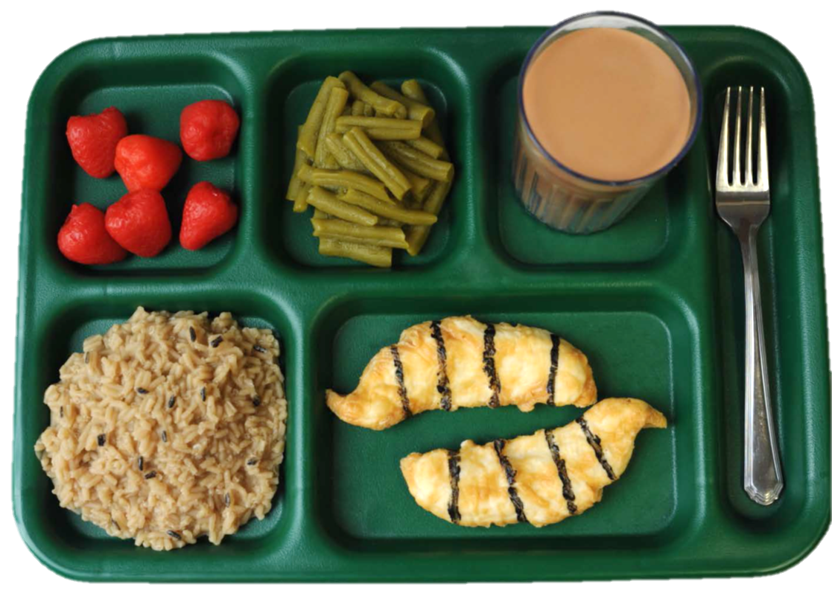
Ginger Chicken 2 oz. eq.
Strawberries 1/2 cup
Green Beans 1/2 cup
Brown Rice 2 oz. eq.
Fat-free Chocolate Milk 1 cup
Notes:
Ginger Chicken 2 oz. eq.
Strawberries 1/2 cup
Green Beans 1/2 cup
Brown Rice 2 oz. eq.
Fat-free Chocolate Milk 1 cup

Slide 27
Reimbursable

Slide 28
1
2
3
4
5
6
7
8
9

Slide 29
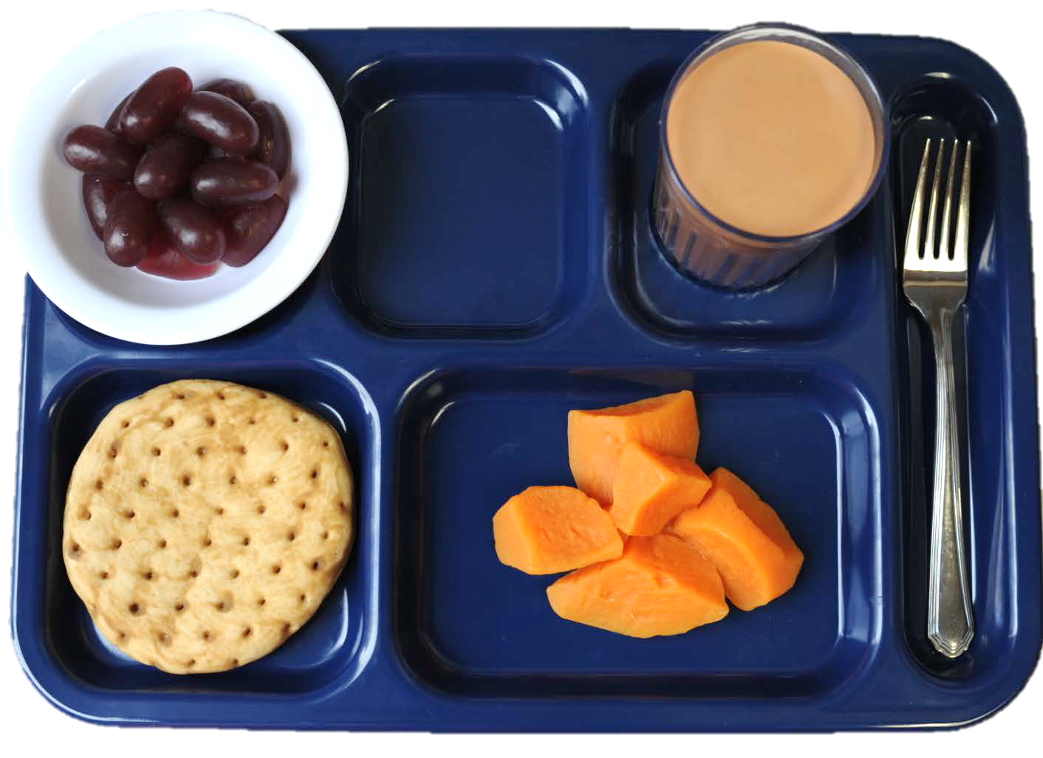
Whole grain flatbread 2 oz. eq.
Sweet Potato Chunks 1/2 cup
Grapes 1/2 cup
Fat-free Chocolate Milk 1 cup
Notes:
Whole grain flatbread 2 oz. eq.
Sweet Potato Chunks 1/2 cup
Grapes 1/2 cup
Fat-free Chocolate Milk 1 cup

Slide 30
Reimbursable

