Slide 1
Welcome
Current Practices
As we wait to begin, think about one PRACTICE that works at your school.
Record it on the index card.
This Photo by Unknown Author is licensed under CC BY
Notes:
30 seconds a person
Note card size for written reflection (collect for future review of what the field is doing)

Slide 2
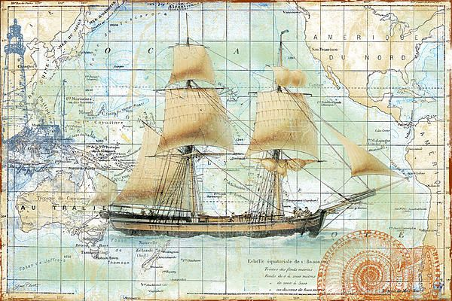
Maximizing Family Engagement
Lisa Kluge- 21st CCLC Program Specialist
Molly Kemp– 21st CCLC Program Specialist
New Grantee Leadership Orientation
Fiscal Year 2019
Family engagement is a JOURNEY, not a destination.
Notes:
Welcome
Introduce ourselves
FE is a journey, not a destination. As we navigate through the waters, we will find practices that work for our families.

Slide 3
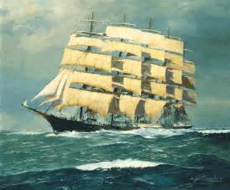
Today’s Objectives
Participants will receive the knowledge and skills needed to increase family engagement at their sites.
Participants will collaborate with their own teams and other sites to understand researched based and AZ practices that increase family engagement.

Slide 4
Parking Lot
Parking Lot:
Please place your name and contact information
(email and/or phone number)
Your question
We’ll answer it by September 7th, 2018

Slide 5
Current Practices/Background Knowledge
Think about one PRACTICE that works at your school.
Record it on the index card.
Share it with your tablemates.
As a table, decide on one to share out. (all will be collected and shared)
This Photo by Unknown Author is licensed under CC BY
Notes:
Background Knowledge:
What is working in for your community? Practices can be anything that connects families to school. It could be a simple communication strategy. It could be a strategy for building relationships.. What is one way you involve families at your site?

Slide 7
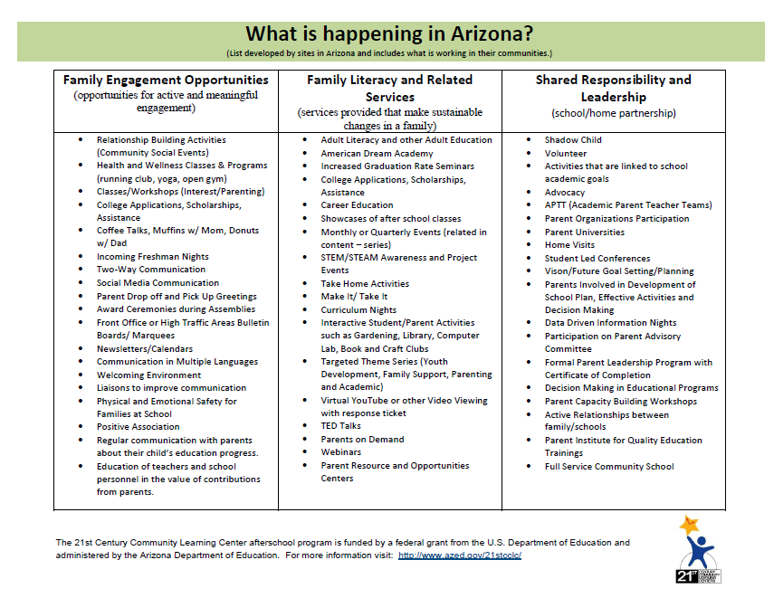

Slide 8
Readiness
Where is your School?
Partnership School (Decision Making)
Open-Door School (Welcoming)
Come-if-We-Call School (By Invitation Only)
Fortress School (Disconnected)

Slide 9
What the RESEARCH says
Children learn best when their parents play a variety of roles in their learning:
Helping at home.
Volunteering at school.
Planning their child’s future.
Participating in key decision making

Slide 10
HOW CAN EDUCATORS AND PARENTS STRENGTHEN AND SUSTAIN HEALTHY SCHOOLs?
Family Engagement
What do we mean by a HEALTHY SCHOOL for families?
A safe and nurturing PLACE is…
A welcoming environment for ALL
A “Partnership School”
A “family-like” school and “school-like” families
Notes:
Survey – Successful family engagement (listed on our tool) will include families in the planning through planning. One way many sites do this is through surveys. What information should we collect to help us decide on future practices? Sometimes we are collecting the wrong information to support the big picture.

Slide 11
Family Engagement
Involvement - Good
School leading with self desires.
School leads with their mouths.
Pushing parents into something we perceive is important.
One way communication.
Parents are directed towards completing tasks.
Parent is a client.
Engagement - Better
Schools lead with parents self interest.to something about what they feel is important.
Develop a trusting relationships.
School is community organizer who help parents do things for themselves and listens to parents ideas.
Partnership - Best
All engagement plus…
Two way communication.
Transformational change.
Empowerment.
A well thought out process involving the entire school community, NOT a series of events.
A set of day-to-day practices, attitudes, beliefs and interactions that support learning at home as well as at school. NOT a one-time program.
Notes:
Similar to Levels of Cognition – Time and place for all columns.
Visualize the comic activity.

Slide 12
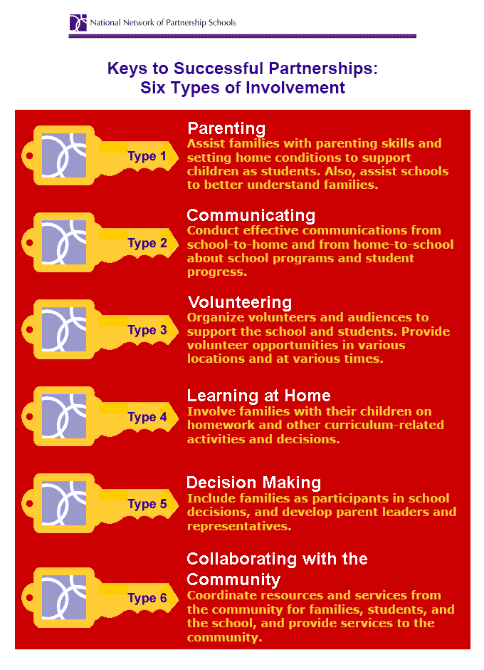
Keys Types of Involvement

Slide 13
Activity
Promising Practices Book
Locate one practice that could work at your site or that you feel is a great idea.
Which key does it follow under?
Share Out

Slide 14
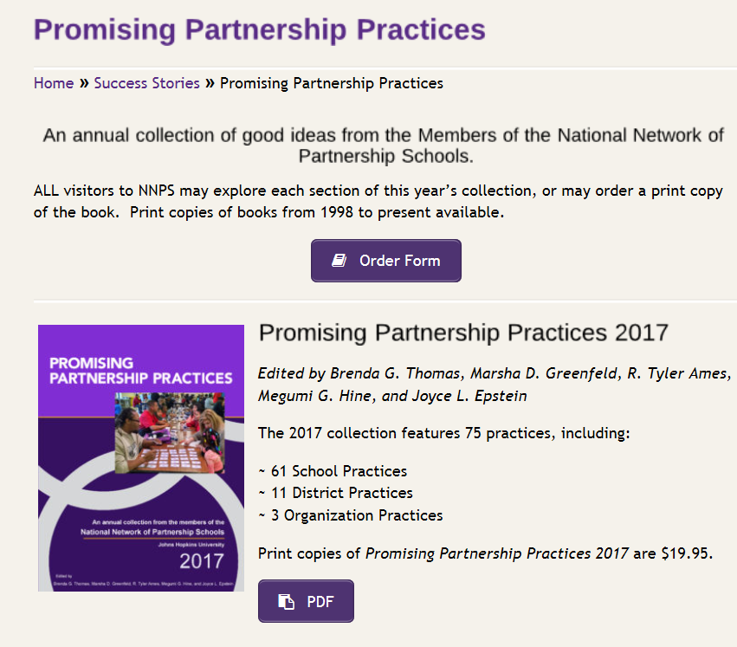
Activity
http://nnps.jhucsos.com/success-stories/ppp/

Slide 15
Intentional planning
Creating a Plan
Notes:
Family Engagement on Demand – Like the Doctors. Sorted topics, could tell how many “watches”. Place to submit questions, etc.

Slide 16
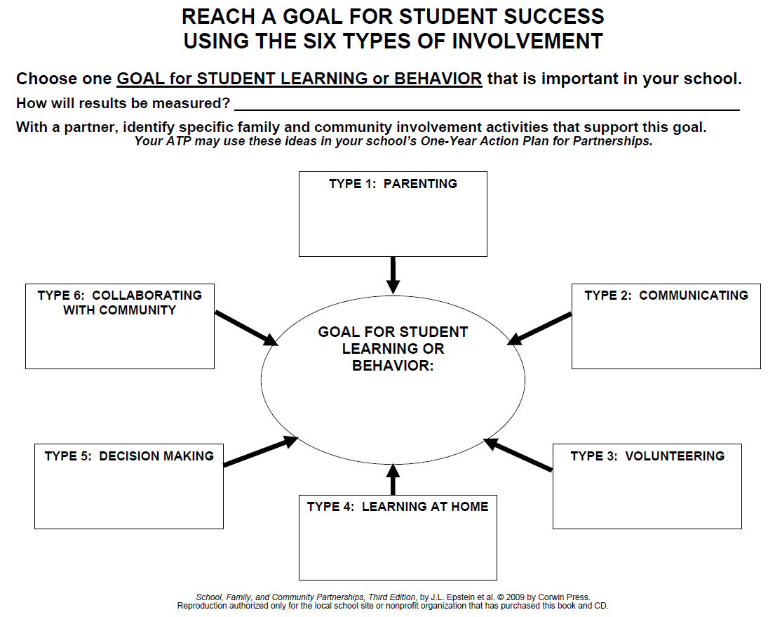
Notes:
Moving away from how many hours a week to a FE plan. If there is a plan with ongoing practices, the hours of week of support will satisfy the number of hours a week a site must provide services for families.

Slide 17
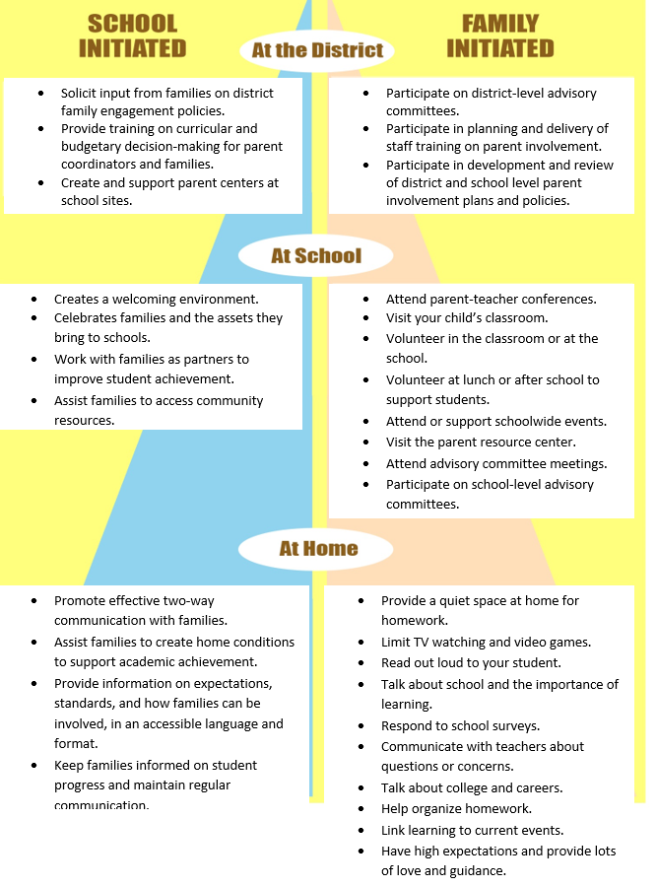

Slide 18
Record Keeping
APR, Continuing Application
How many Family Members did you serve?
(Taking Attendance)
Family Members consist of any family member or adult figure in the child’s life. Attendance should be kept for each practice and aligned to the Summary of Classes. There is no expected way to record attendance. Find a system that works best for you.
Recommendation: Attendance Sheet (evidence) for Summary of Classes
T:

Slide 19
Record Keeping
Summary of Classes
Practices align with the original approved application. Attendance reflects the participation for each event as a whole. Sites may add these numbers up to determine the number that will be reported on the APR. Family participants counted should be family members of 21stCCLC students.
Site Evaluation Report
States progress on objectives and SWOT reflection.
T:

Slide 20
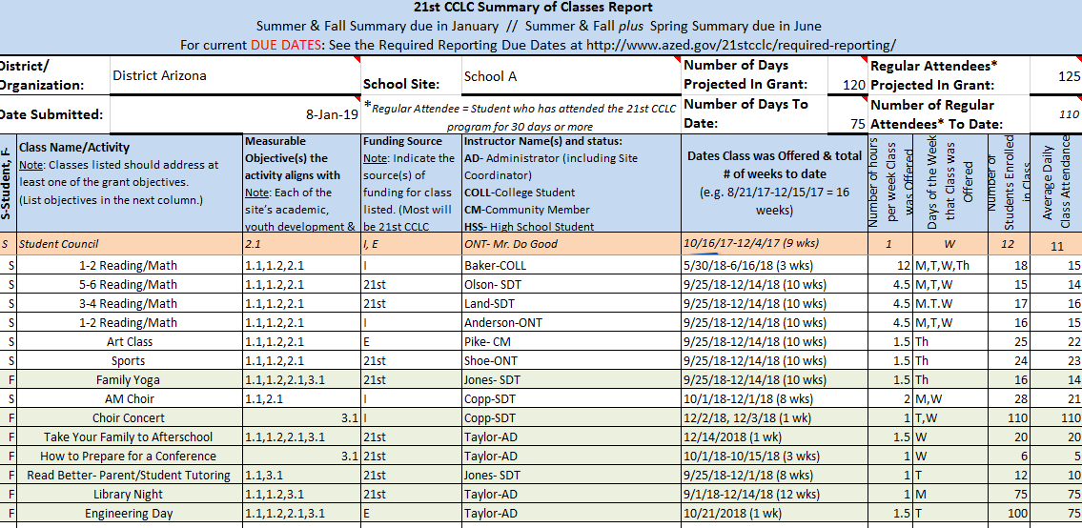
Summary of Classes
Total = 309

Slide 21
Policy & Program Goals
Confidence:
Individual Level of Self-Efficacy
The sense of comfort related to partnership activities needs to be present

Slide 22
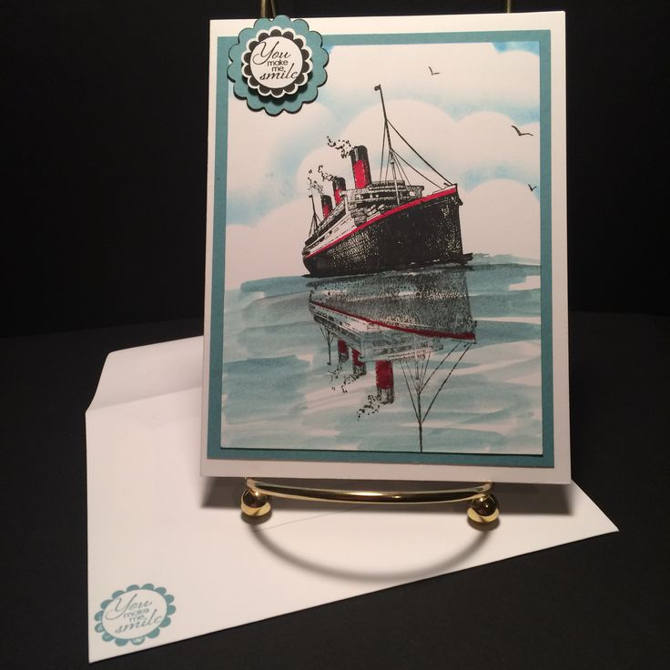
Today’s Objectives
(Reflections)
Participants will receive the knowledge and skills needed to increase family engagement at their sites.
Participants will collaborate with their own teams and other sites to understand researched based and AZ practices that increase family engagement.
Notes:
Ticket out the door

Slide 23
Parking Lot
Parking Lot:
Please place your name and contact information
(email and/or phone number)
Your question
We’ll answer it by September 7th, 2018

Slide 24
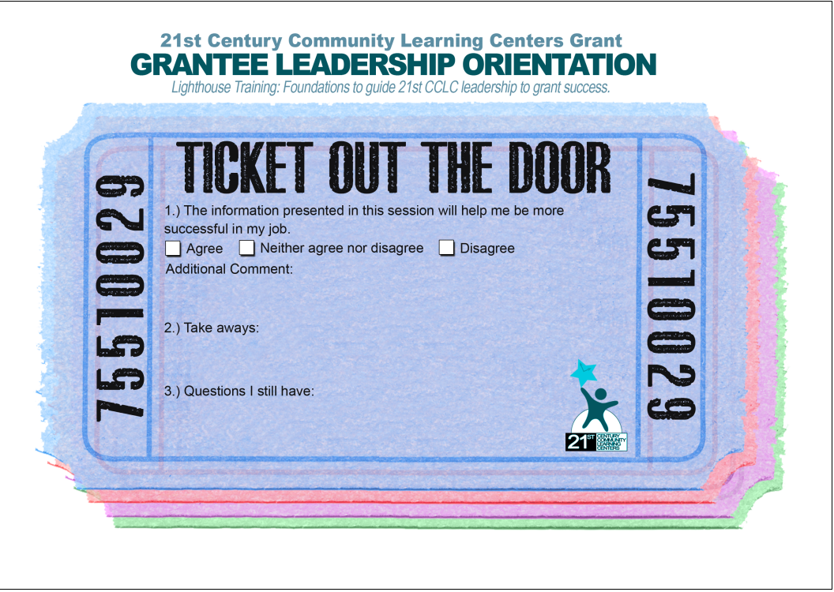
Ticket Out The Door!

Slide 25
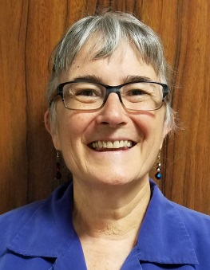
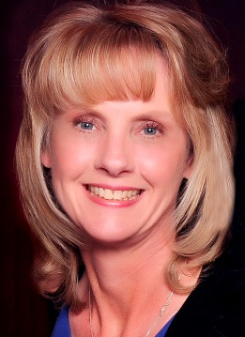
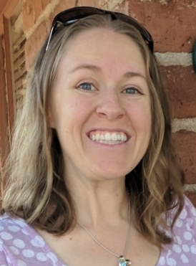
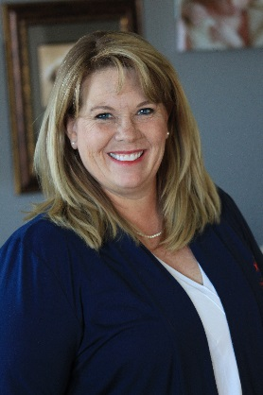
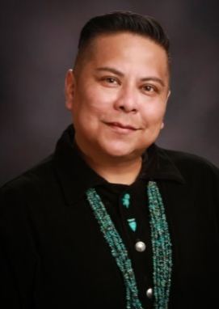
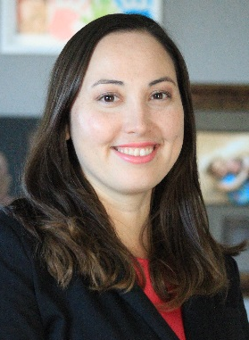
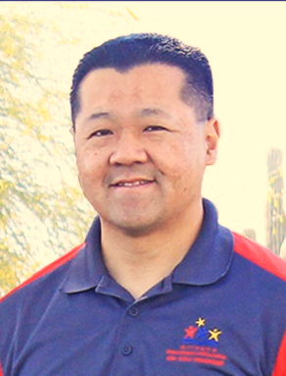
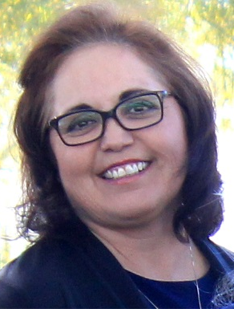
Contact your specialist for support!
21stCCLCInbox@azed.gov
Catherine Evilsizor
21st CCLC State Director
602.364.2319
Catherine.Evilsizor@azed.gov
Lisa Kluge
Education Specialist
602.542.9431
Lisa.Kluge@azed.gov
Kim Logan
Education Specialist
520.770.3763
Kim.Logan@azed.gov
Molly Kemp
Education Specialist
602.542.9432
Molly.kemp@azed.gov
Anderson Yazzie
Education Specialist
928.637.1860
Anderson.Yazzie@azed.gov
Dawn Fitzhugh
Education Specialist
602.364.2324
Dawn.Fitzhugh@azed.gov
Ray Gee
Education Specialist
520.770.3885
Raymond.Gee@azed.gov
Emma Chavez
Education Specialist
520.770.3895
Emma.Chavez@azed.gov
Randy Huckabone
Project Specialist
602.364.2349
Randy.Huckabone@azed.gov
Arizona Department of Education 1535 W. Jefferson St, Bin #7 Phoenix, Arizona 85007
21stCCLCInbox@azed.gov
Notes:
If you have questions or concerns reach out to your program specialist for support.
21stCCLCInbox@azed.gov

