Slide 1
Conducting a Comprehensive Needs Assessment and Root Cause Analysis to Drive The Integrated Action Plan
Fall 2018
Notes:
Welcome and introductions
Heather – Slides – 1-2

Slide 2
Training Topics
Continuous Improvement Process
FY20 Requirements and Timelines
School Leadership Teams
Comprehensive Needs Assessment
Root Cause Analysis
Next Steps

Slide 3
Notes:
Sue – Slides – 3 & 4

Slide 4
Continuous Improvement
A process that unfolds progressively and is sustained over time. It encompasses the general belief that improvement doesn’t start and stop. It requires an organizational and professional commitment to an ongoing process of learning, self-reflection, adaptation, and growth.
What is a needs assessment??
A needs assessment is a systemic set of procedures that are used to determine needs, examine their nature and root causes, and set priorities for future action. A needs assessment leads to action that will improve systems, services, processes and operations.
The ”NEED” refers to the gap or discrepancy between a present state (what is) and a desired ideal outcome (what school be).
The ”NEED” is neither the present nor the future state; it is the gap between them.

Slide 5
FY20 Requirements for all LEAs and Charters
Each school conducts a new comprehensive needs assessment (CNA)
Use updated spreadsheet
A root cause analysis (RCA) is conducted for each primary need identified from the CNA
Use the fishbone method
Create a new school integrated action plan (SIAP)
Create a new LEA integrated action plan (LIAP)
Utilize the school CNAs and IAPs to develop the district plan
Notes:
To frame our conversation today, here are the FY20 requirements for all Title I schools.
Heather/Sue – Slides 5-7

Slide 6
Creating Meaningful Change
Notes:
This is not about checking off boxes or doing things how we’ve always done, top-down, externally driven compliance for each grant or program area – This is about meaningful change that starts from within each school by honestly and openly reflecting on your unique challenges and strengths and agreeing on what to maintain and what to discard. It’s about creating a sense of urgency and making the status quo no longer acceptable. It’s about focusing all your efforts and funding sources to meet the needs of your students. It is the creation of a true integrated action plan.

Slide 7
Suggested Timeline for LEAs
Processing CNA - November through January
Root Cause Analysis – February through March
Development of IAP for all Programmatic Areas – March through April
Submission of grants aligned to Integrated Action Plan (SIAP & LIAP) – May 1
Notes:
We recommend planning ahead for the work that needs to be done. Here is our suggested timeline of the components that need to be completed and submitted by May 1.

Slide 8
“No one person has the capacity to hold all the qualities to transform a culture by oneself, you need a team.” –Anthony Mohammad
Notes:
This continuous improvement process starts with building a school leadership team that is committed to a set of shared values, purpose, and vision. This work cannot be done by one person. So let’s discuss school leadership teams.
Collaborative, face-to-face communication
Jennifer – Slides 8-14

Slide 9
Additionally…
Research suggests that school leadership team members should:
Be committed to school-wide change
Be respected by colleagues
Possess leadership potential
Demonstrate effective interpersonal skills
Be able to start projects and “get things done”
Successful leadership teams are typically made up of volunteers (Marzano et al., 2005) so it is important that participants be invited to serve on the leadership team, rather than assigned to serve.
Notes:
Research suggests…

Slide 10
What does a Leadership team do?
Action Plan Creation
Professional Learning
Data Analysis
Facilitates Communication
Reflection
Notes:
So what does a school leadership team do? They develop the school’s action plan for improving instruction and student learning and monitor progress on the plan. They support and leverage the professional learning system through: creating effective coaching relationships, develop capacity of teacher teams and planning impactful professional development. They also learn through analyzing data on what is and isn't working and makes adjustments. The school leadership team also, facilitates two way communication and engages all staff on the school’s strategic focus and engages in regular reflections on the teams own processes and effectiveness and takes action to improve.

Slide 11
School Leadership Team
School Leadership (Principal, Asst. Principal, Dean, etc.)
Teachers
Paraprofessionals
Parents
Students
Other Specialized Staff Support (ex: Counselor, Specialists, etc….)
Community Members
Others?
Section 1111 Comprehensive Support & Improvement / Targeted Support & Improvement
Section 1114 Schoolwide
Section 1115 Targeted Assistance Program
Notes:
What stakeholders should be a part of the team?
Checks & Balances – No Consultants
District level personnel may assist. But may not complete in lieu of the school
No survey results only

Slide 12
Principal’s Tool
Notes:
Take a moment to think of the work that needs to be accomplished and your potential team members. Who do you want on your dream team?
We have a tool to help you ensure you have the right people on your train.

Slide 13
Notes:
This tool will help you explore possible options for your school leadership team members. In the first column list possible team members. Then based on what you know of them mark x’s in the other columns to identify their attributes. Then based on your own attributes determine who might compliment you with the attributes that are underdeveloped in yourself.

Slide 14
Think – Write – Pair - Share
Reflect on the school leadership team information shared.
What are your next steps in this area?
Notes:
Take a moment to quietly reflect… jot your next steps… discuss with shoulder partner

Slide 15
Notes:
Here is a linear view of the school improvement process. On the left in the red circle is our CNA that we complete with a review of data. From that process we identify 3 or 4 primary needs to focus on for improvement.
Once we have our primary needs identified, we move to our “bridge” to our action plan – the root cause analysis. This is the connection to identifying key factors contributing to your primary need and allows you to extinguish those factors to increase positive student outcomes and reach your desired state which is done through implementation of your evidence based strategies and actions over the course of the year.
Rosalva/Sue – Slides 15-26

Slide 16
Comprehensive Needs Assessment (CNA)
Systematic
Needs or Gaps
Causes or Factors
Stakeholder Involvement
Set Priorities for Action
Authentic vs. Compliance
Foundational to Integrated Action Plan
Drives Improvement
Notes:
As we embark on the school improvement process, we must start with a comprehensive needs assessment. This is a systematic process to help us identify, understand, and address educational challenges in a prioritized manner. It is the examination of the gap that exists between the current state of the school and our desired state. We need to uncover our strengths and challenges that will inform our growth and improvement – this is the foundation to our action plan. This is a collaborative process undergone at the school level.

Slide 17
The 6 Principles
CNA
Effective Leadership
Effective Teachers and Instruction
Effective Organization of Time
Effective Curriculum
Family and Community Engagement
Conditions, Climate and Culture
Notes:
ADE’s framework includes 6 principles of effective school systems – The framework was developed collaboratively by a team from ADE program areas and representatives from LEA’s, both traditional and charter, large and small, rural and urban.
When you conduct your school’s CNA, you will evaluate yourself on all 6 areas.

Slide 18
Within each principle
Principle 5 Conditions, Climate and Culture
Elements
Rating
Evidence
Indicator
(5.1, 5.2, 5.3, 5.4, 5.5)
Definition
Notes:
Within each principle there are several indicators and elements that further define best practices. When you complete your CNA you rate yourself on each element.

Slide 19
Principle 5 - Conditions, Climate, and Culture
Definition: Inclusive schools are conducive to student learning, fulfillment and well-being, as well as professional satisfaction, morale and effectiveness. Students, parents, teachers, administrators and other stakeholders contribute to their school’s culture, as do other influences such as the local community, the policies that govern how it operates and the school’s founding principles. School conditions, climate and culture are impacted by the beliefs, perceptions, relationships, attitudes and written and unwritten rules that shape and influence every aspect of how a school functions. They also encompass concrete issues such as student physical and emotional safety, a healthy school environment, the orderliness of classrooms and public spaces and the degree to which a school embraces and celebrates racial, ethnic, linguistic, academic and cultural diversity.
Notes:
When starting your self-assessment, read the definition of the principle and look at key phrases to fully understand the meaning of the principle.
Highlight the key phrases.
Here is the definition for Principle 5 – what stands out to you?

Slide 20
Indicator | Output | Element | Evidence/Notes
5.1 Our staff has high expectations for learning for all students. | Students view themselves as integral members of an inclusive school community which increases student efficacy. | Are inclusive beliefs and practices evident and part of the school culture? Does staff engage in the development and understanding of policies/procedures and plans that explicitly outline continuous improvement and high expectations for learning for all students? | (Possible items could be…) Mission statement Climate surveys Leadership team meeting minutes
Notes:
Next, Look at the key words/phrases of each indicator
Connect key words to key phrases in the output
Determine what evidence you have at your site to show proof of the elements. The evidence is to help facilitate conversations with your staff when completing the CNA.
You will repeat this process for each indicator in the principle.

Slide 21
Rate Yourself!
Notes:
Add link to FY20 tool – from website
You will rate yourself on each element using the rubrics in the tool. Be sure to identify the evidence you used and add any additional notes as needed. There are possible evidence items listed, but you may have additional items you use.
As you complete your ratings on each element, the tool auto averages each indicator and principle.

Slide 22
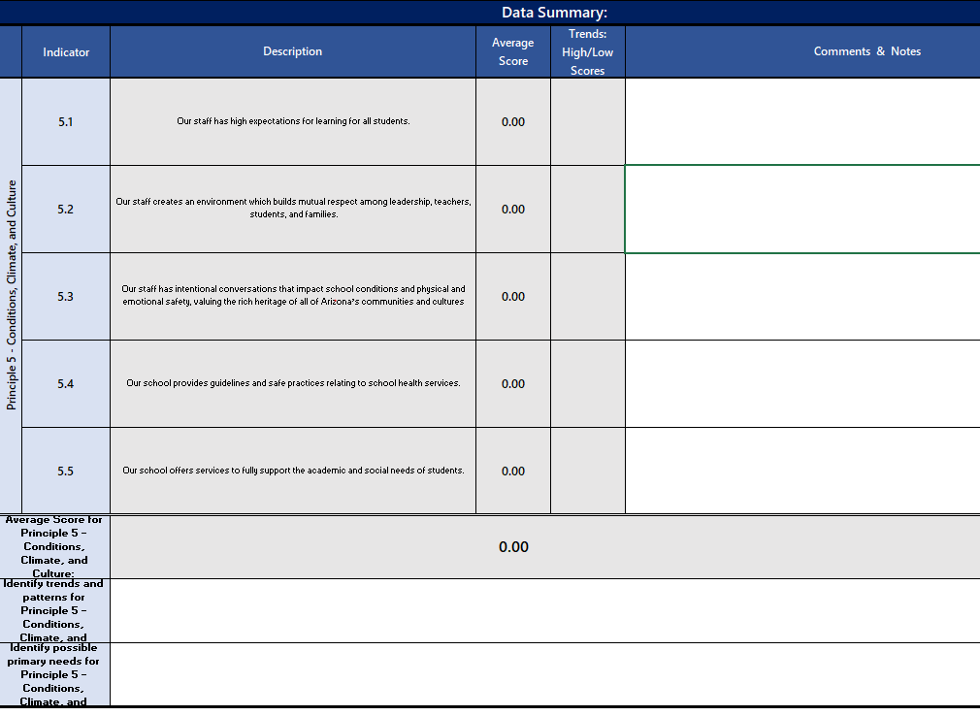
Data Summary
Identify your trends and patterns for the principle
Identify any possible primary needs for the principle
Notes:
After you complete your ratings for all indicators and elements, scores will be averaged and displayed on the data summary at the bottom of the page. Complete the trends and patterns area as well as identify any possible primary needs for the principle.

Slide 23
Data Drives Decisions & Identifies Needs
Leading Data Indicators
Dropout Rate
Discipline Incidents
Truancy
Teacher Attendance
Student Attendance
Benchmark Assessments
Lagging Data Indicators
State Assessment (grade, course, subgroups)
EL proficiency (AZELLA)
Graduation Rate
Notes:
A successful needs assessment utilizes a rigorous data analysis of multiple data sets to have a balance of qualitative and quantitative information.
Look at leading indicators which are formative and enable us to track progress along the way and make course corrections if needed
Look at lagging indicators which are summative, longer term outcomes, and are used for reflection to consider the impact of our strategies
Your needs manifest in your data and you could be overlooking key issues without digging into your data. As you rate yourself in each principle, have your data sets available as evidence to refer to.
Reference the Data Sheets in the CNA tool to collect K-8 AzMerit, HS Data, Misc Data and Teacher Data

Slide 24
CNA Completion
Schedule time with your team to complete all 6 principles of the CNA
Plan for multiple sessions
Consider the evidence needed for each principle
Complete the ratings for all indicators in all 6 principles
Complete the data summary boxes for all 6 principles
Review the Final Summary tab and identify your top 3-4 overall primary needs.
Biggest areas of concern
Most impactful overall

Slide 25
Final Summary Tab
Notes:
At the bottom of your final summary page – list your top 3-4 primary needs – which indicators does your school need to focus on to make meaningful improvement?
Here is a sample completed with three primary needs

Slide 26
Think – Write – Pair - Share
Reflect on the CNA information shared.
What are your next steps in this area?

Slide 27
Notes:
Now that we have completed the CNA and identified our top primary needs, we move to the bridge – the Root Cause Analysis of our primary needs.
Christina – Slides 27-43

Slide 28
Have a problem? Now what?
Notes:
How many times have you tried to fix a problem but it still keeps coming back? Have students not complete assignments constantly? No matter how much you modify it but they just don’t do it. Or do you have late students that are always late no matter how much you talk to them or what incentives you dangle? Sometimes our solutions are temporary solutions because we didn’t analyze the situation to determine the root of the problem. Instead, we needed to fix the problem quickly and so we used a solution that we used in the past or someone else used to see if it worked.
A root cause analysis allows you to use a strategic method to dig down into the problem and determine causes and contributing factors. Often times during the discussion of causes we find different perspectives of the same situation and get a enhanced picture of the problem. At the end of the root cause analysis we are able to find the major cause and determine what needs to happen in order to remove the problem.
Today we will use the fishbone analysis to discuss factors that are contributing to your problem and help you determine targeted solutions to your 3 primary needs you identified. Let’s watch a quick video on the fishbone problem solving process.

Slide 29
Fishbone Technique
Notes:
https://www.youtube.com/watch?v=I0c6Gd26Fxw

Slide 30
2.4 Our teachers do not implement evidence based, rigorous instruction as evidence from classroom observations, lesson plans, and % proficient on AzMERIT.
Notes:
Let’s walk you through a fishbone sample. You can see the three main parts of the fish: head, body and tail. In the head you see the indicator that was identified as a primary need in the CNA: “2.4 Our teachers are not implementing evidence based rigorous and relevant instruction” as evidence from classroom observations, lesson plans and the % proficient on AZ Merit. We combined what evidence we used and what data was used to determine that it was a primary need.

Slide 31
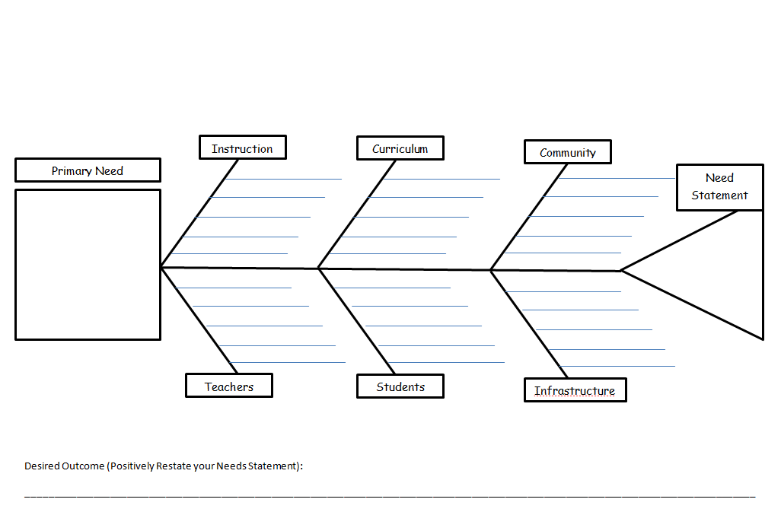
2.4 Our teachers do not implement evidence based, rigorous instruction as evidence from classroom observations, lesson plans, and % proficient on AzMERIT.
Notes:
In the body we chose the 6 categories (Instruction, Curriculum, Community, Teachers, Students, Infrastructure), these 6 categories are frequently used in education. Think of these categories as the who, what, and why that are contributing to the primary need problem.
Sometime people leave categories blank and feel them in as they go, sometimes the categories are the same sometimes they are different depending what the primary need is. In your discussion with your team you might choose different categories but these are guiding categories if you get stuck.

Slide 32
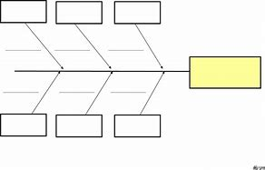
Possible additional fishbone categories
Leadership
Assessment
Transportation
Attendance
Time
Professional development
Climate/culture
Technology
Subgroups
Notes:
Here are possible additional categories we have seen schools use depending on the primary need identified; there could be many others

Slide 33
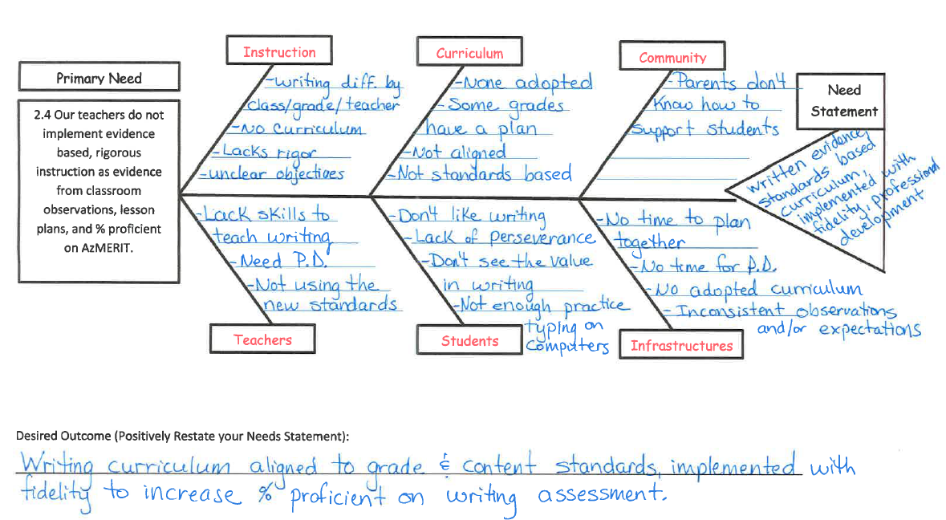
Notes:
Here is our sample fishbone. The team and I brainstormed all the causes for my teachers not implementing evidence based, rigorous writing instruction. We used some target questions to help guide our work. How do our teachers contribute to the problem – what are they doing or not doing? How is instruction contributing? What barriers are in place? How do we know the problem exists? This is the time for the team to be honest and put it all on the chart.
After we brain stormed all our ideas we looked for any common trends or patterns. It can be helpful for you to highlight or underline key words or phrases that are in common.
You can see we found that we have low level instruction, lack of alignment to standards, varied materials being used, no planning time, lack of professional development, and students lack perseverance. We concluded that teachers are not implementing rigorous writing instruction because they lack a solid curriculum and training. So you can see that in the tail we wrote out needs statement: We need an evidence and standards based curriculum, implemented with fidelity as well as professional development. We then ask ourselves, “If what is in the fishbone tail were corrected, would the problem continue?” We feel if we implement an evidence based curriculum with fidelity after receiving professional development, then we would no longer have our primary need.
After we completed the Needs statement we turned it into a desired outcome. Write that at the bottom. The desired outcome is our target goal.

Slide 34
Sample Target Questions for Root Cause Analysis
How do you know the problem exists?
What are your teachers or staff doing or not doing to contribute to the problem?
What are students doing or not doing to contribute to the problem?
What is the community or family doing or not doing to contribute?
What school systems support the problem?
What systems do not support the problem?
What barriers are in place?
How does the curriculum contribute?
How does time contribute?
Does the school schedule play a role in the problem?
What causes the teachers to contribute to the problem?
How does instruction contribute to the problem?
Notes:
Here are some target questions that we use to facilitate the conversation and help dig deep down to evaluate our factors contributing to the root cause.

Slide 35
Creating Your Need Statement (fishbone tail)
Problem
Action Needed
Need Statement
Teachers are not effectively differentiating instruction
Design instruction and assessment that differentiates
Teachers need to plan for instruction to differentiate effectively.
Notes:
After you determine the root cause to your problem, you will need to formulate your need statement – the tail of the fishbone. Your need statement is a statement of the problem and the action you will take.
For example: If the major factor that we found was teachers are not effectively differentiating instruction and they need to design lessons that differentiate then your need statement could be: Teachers need to plan for instruction to differentiate effectively.

Slide 36
What if my tail is too big?
Notes:
At the end of your discussion reread the tail of your fishbone and ask your self this? If I do this will my primary need go away? If it could then you are good to go forward to create a plan of action.
If your answer is no, then your need statement, or your tail, is too big and is not getting to the root of the problem.

Slide 37
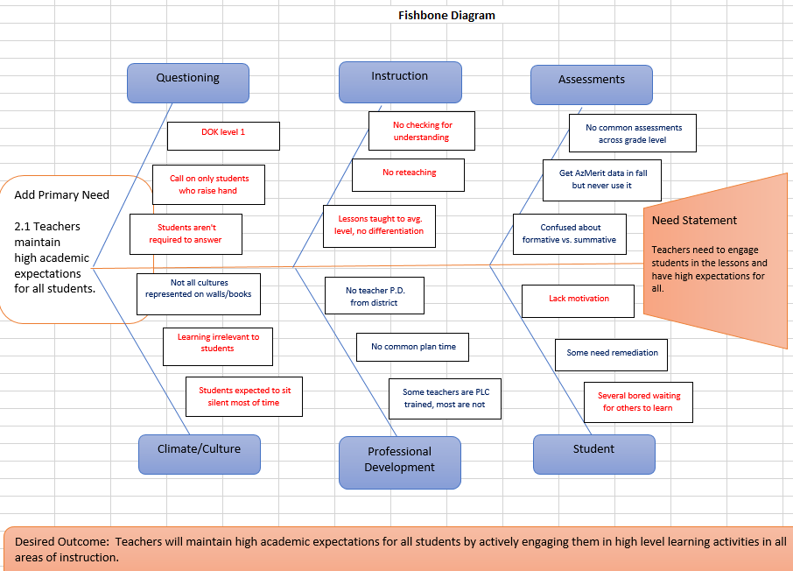
Notes:
Let’s take a look at a different fishbone example. This school had a primary need of 2.1 – teachers maintain high academic expectations for all students.
After listing the challenges – the school looked for a common theme (highlighted in red). As you see, sometimes there is more than one theme that emerges, but there should be one common one
After conducting their root cause analysis, they generated their need statement and desired outcome… but this is still very general and is really just a restatement of the primary need, so let’s dig deeper.

Slide 38
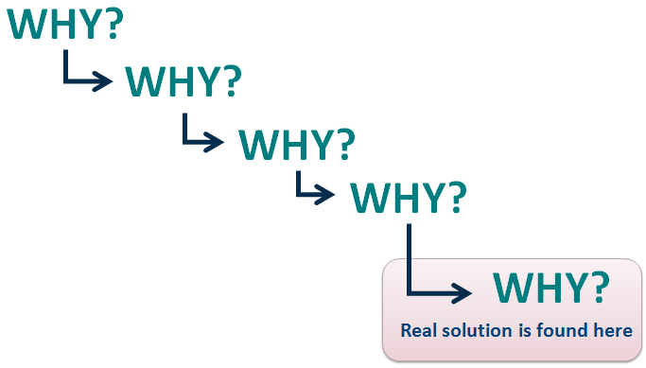
Sometimes you have to dig a little deeper…
Notes:
Sometimes our root cause analysis leads us to identify a general problem so we may need to drill down even deeper. Using the 5 Whys method allows us to move beyond obvious answers and reflect on less obvious explanations. Like an inquisitive toddler, asking why in response to each suggested cause and asking why to get insight at a level that can be addressed. You will know when you have reached your final why because it does not make logical sense to ask why again.
Let’s watch another quick clip on how to use this method.

Slide 39
How to Use the 5 Whys
Notes:
https://www.youtube.com/watch?v=N7cR2gArCFE

Slide 40
Why do teachers have low expectations for student achievement?
They don’t understand the students’ needs.
They don’t take time to build relationships with students.
They don’t know how to build a relationship.
They don’t have strategies to build relationships with students.
Why? Why? Why? Why? Why?
WHY?
WHY?
WHY?
Notes:
So taking the tail of the previous fishbone that was very general (having high expectations for students), we asked why several times and we got to a deeper root cause. Now we can start to identify our need statement and desired outcome.

Slide 41
Creating Your Desired Outcome
Need Statement
Connects to Primary need
Desired Outcome
Impact on Student Outcomes
Teachers need to plan for instruction to differentiate effectively.
In order to provide rigorous instruction (2.4, 4.5)
Teachers will create lesson plans for differentiated instruction in order to provide rigorous instruction to increase student proficiency.
Increase student proficiency
Notes:
Once you have your need statement you will need to create your desired outcome. Your desired outcome is your need statement plus how the action will affect your primary need and student outcomes.
For example: Let’s take this need statement “teachers need to plan for instruction to differentiate effectively”. If we connect that to our primary need 2.4 and 4.5 teachers need to plan rigorous instruction and how it impacts students we get our desired outcome. “Teachers will create lesson plans for differentiated instruction in order to provide rigorous instruction to increase student proficiency.”

Slide 42
Additional Sample Need Statements and Desired Outcomes
Need Statements
Desired Outcomes
Need to provide opportunities for parents and community to get involved in the school
Need a written evidence and standards based math curriculum implemented with fidelity and professional learning for evidence based math instruction.
Provide multiple opportunities for parents and community to get involved to promote collaboration and increase student achievement.
Evidence and standards based math curriculum aligned to grade level and content standards implemented with fidelity to increase math proficiency on state assessment.
Notes:
Here are a few more needs statements and possible corresponding desired outcomes for you to review as examples.

Slide 43
Think – Write – Pair - Share
Reflect on the Root Cause Analysis information shared.
What are your next steps in this area?

Slide 44
Where do you get the Primary Need, Root Cause, Needs Statement and Desired Outcome?
Root Cause: The 1 major contributing factor that led to need statement
Desired Outcome: ______________________________________________________________________________
Notes:
Let’s review the components of your fishbone diagram. Click to bring in images.
This is important to note that you will need to transfer these 4 information pieces to your IAP.
Nicole – slides 44-46

Slide 45
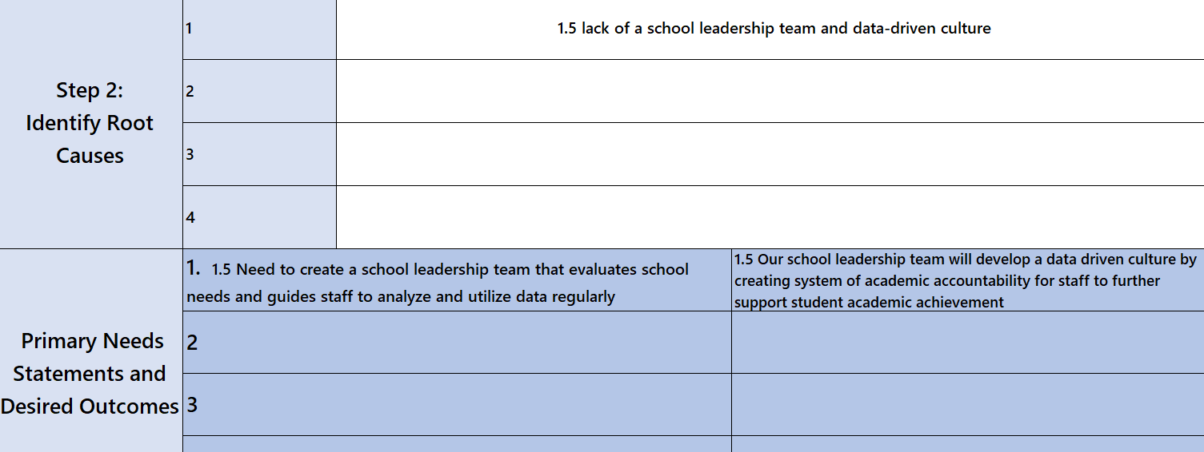
Back to the CNA Final Summary Tab
Notes:
After you complete your root cause analyses, you will go back to the bottom of your CNA final summary page to complete.
– list the root causes you identified for each primary need
List the corresponding primary needs and desired outcomes
Here is a sample for one principle

Slide 46
Uploading to ALEAT
https://www.ade.az.gov/CommonLogon/Logon.aspx
Upload CNA to the school’s file cabinet in ALEAT
Upload a fishbone diagram for each primary need to the school’s file cabinet in ALEAT
Click on the paper clip at the top of the page of the school IAP
Click on “Choose File” link and choose your document
Then uncheck the check next to “use file name”
Rename the file: “FY20 CNA,” “FY20 Fishbone 1.5”, etc.
Then click “attach”
Notes:
Upload your CNA and fishbone diagrams into your school’s ALEAT file cabinet.

Slide 47
Notes:
Let’s take a look at what we have accomplished and what to do next.
We have completed our CNA and data review to identify our top primary needs. We then conducted a root cause analysis for each primary need and developed our need statements and desired outcomes for each. As we begin to move into the creation of our action plan we need to set goals.
Sue – slides 48-52

Slide 48
Impact goals
Process goals
Impact on student achievement
Show growth or proficiency
State assessment
Attendance
Discipline incidents
Subgroups
Graduation rate
Related to implementation of a desired outcome, strategy, or system
i.e. By October 1st we will implement a new walkthrough data collection form
i.e. By January 15th all teachers will be trained in the use of Kagan cooperative learning structures
Notes:
After creating our desired outcomes, the next step is to create SMART goals to work towards. There are 2 types of goals that can be created:
-Impact goals – impact on student achievement – to show growth or increase proficiency
-Process goals – implementation, system
Always write in SMART format – see handout for examples of impact goals

Slide 49
ALEAT – IAP Principle Summary Box
The following 4 items must be included in the principle summary box for each primary need:
Primary need from CNA (head of fishbone)
Root cause
Need statement (tail of fishbone)
Desired outcome
Add any SMART goals as needed per program area
Notes:
You will transfer the 4 required areas from your fishbone or CNA final summary tab into the corresponding principle summary box in your IAP in ALEAT.

Slide 50
School Integrated Action Plan Development
Develop evidence-based strategies and action steps to achieve your desired outcomes
Include how you will monitor and evaluate the effectiveness of the strategies
Ensure there is coherence between your need statements, desired outcomes, goals, strategies, and action steps = ALIGNMENT
Include ESSA requirements for Title programs, MOWR, and School Improvement
Add your program tags
Determine which action steps need funding and add your funding tag
Notes:
Now you can develop your action plan to address your primary needs and desired outcomes. Be creative and innovative – do you need to conduct research? Do you need training? Do you need resources?

Slide 51
LEA Integrated Action Plan Development
Developed to support the implementation of the school integrated action plans
Include evidence-based strategies and action steps
Demonstrate how the LEA is aligning their resources to meet the needs of their schools as determined by a review of all schools’ CNA results
Include ESSA requirements for Title programs and School Improvement
Set monitoring and evaluation measures to ensure implementation and goal attainment
Add appropriate program and funding tags
Notes:
After the school plans are created, the LEA develops its plan for how it will support the implementation of the school plans and align resource to meet the needs of the schools.

Slide 52
Think – Write – Pair - Share
Reflect on the SMART goal and IAP information shared.
What are your next steps in this area?

Slide 53
Notes:
By developing your action plan, you are setting yourself on a course of continuous improvement.
Heather – Slides 53-57

Slide 54
Suggested Timeline for LEAs
Processing CNA - November through January
Root Cause Analysis – February through March
Development of IAP for all Programmatic Areas – March through April
Submission of grants aligned to Integrated Action Plan (SIAP & LIAP) – May 1
Notes:
Again – here is a suggested timeline to complete each step of the process

Slide 55
Resources
http://www.azed.gov/cna/
FY20 CNA tool (updated 11/2018)
CNA Rubrics & Resources (updated 11/2018)
Workshop/Conference handouts
CNA IAP Guidance (coming soon)

Slide 56
Now What???
Assemble the District Leadership Team to review this information
Bring Principals together and train them on new requirements
Assist Principals in creating or modifying their School Leadership Team
Help Principals get started on the improvement process beginning with the CNA
Set timelines for your schools

Slide 57
Thank you! Any Questions?

