Slide 1

School Finance Webinar
Calendar Data Submission
Irene Garcia-Hobbs
July 27, 2021

Slide 2
Agenda
Instructional Calendar Submission
Integrity Errors and Troubleshooting
Calendar Reports
Deadlines
Questions
Notes:
Sabah

Slide 3
Calendar Submission

Slide 4
Instructional Calendar
Every district is required to establish and submit an instructional calendar for the school year to AzEDS.
  AOI schools and DRP schools that only serve DRP students do not submit calendars.
  ASDB submits their own calendars (previously submitted calendars should not be used if they can’t be deleted).
The instructional calendar must be certified and pass Integrity before any student detail information can be processed through Integrity and the ADM calculation engine (ACE) in AzEDS.

Slide 5
Data Requirements
Calendar Code – specific to your LEA/School
Calendar Type – based on number of days per week and grades
Declared Begin Date, End Date, and Instructional Days – submitted by the SIS when the calendar is created
Date Descriptors – each day must be associated with a descriptor (must use required holiday descriptors on actual holiday)

Slide 6
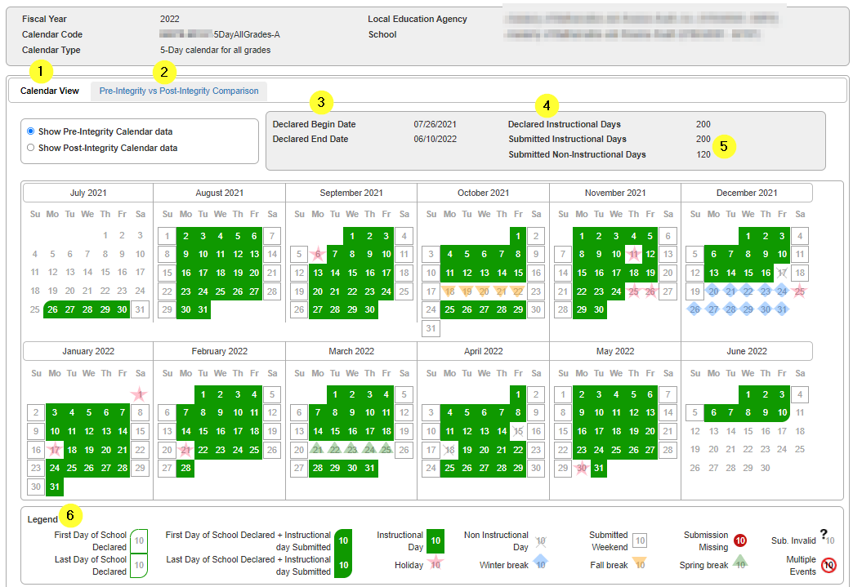
Instructional Calendar

Slide 7
Integrity Errors

Slide 8
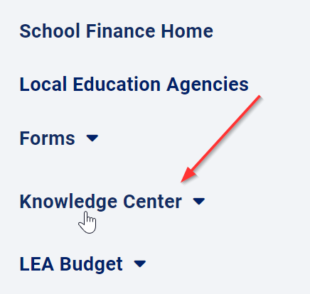
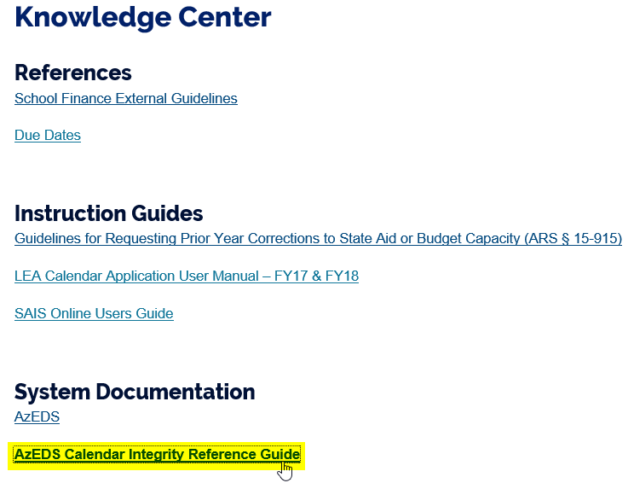
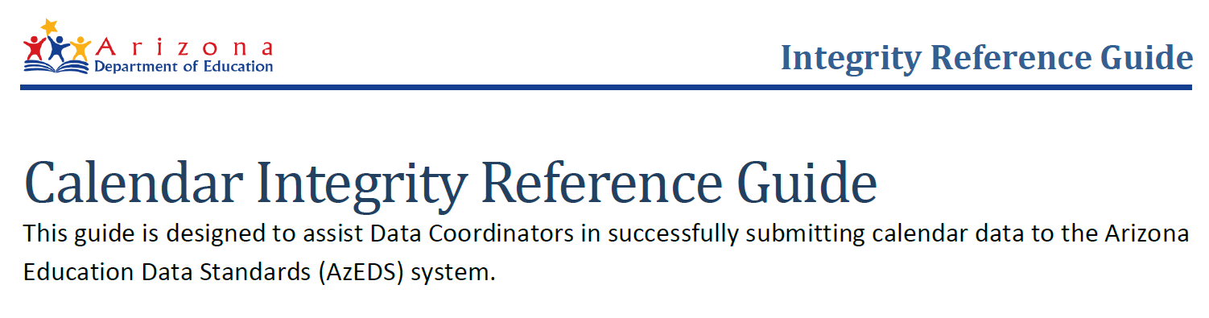
Calendar Integrity Reference Guide
https://www.azed.gov/sites/default/files/finance/files/2019/07/AzEDS-Calendar-Integrity-Troubleshooting-Guide-20190719.pdf

Slide 9
Top Integrity Errors
-90003 - Public schools are expected to recognize the Veterans' Day holiday. Please include this required holiday in the school calendar on the required date. See A.R.S. 15-801 for more information.
-90007 - Only one Winter Break is allowed.

Slide 10
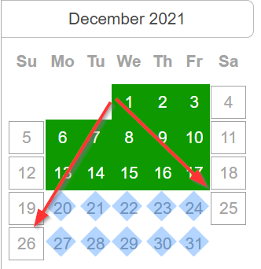
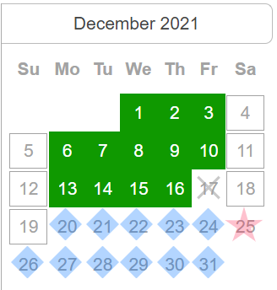
Top Integrity Errors
-90007 - Only one Winter Break is allowed.
The break descriptors must be used consecutively and can only be interrupted by required holidays.

Slide 11
Calendar Reports

Slide 12
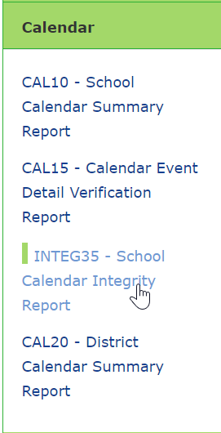
Calendar Reports
CAL10 – Submitted fields, calendar summary, days not in session, holidays
CAL15 – Calendar event descriptor and calendar event resource ID for each
CAL20 – Summary of all calendars submitted for the district, separated by school
https://www.azed.gov/finance/training-videos

Slide 13
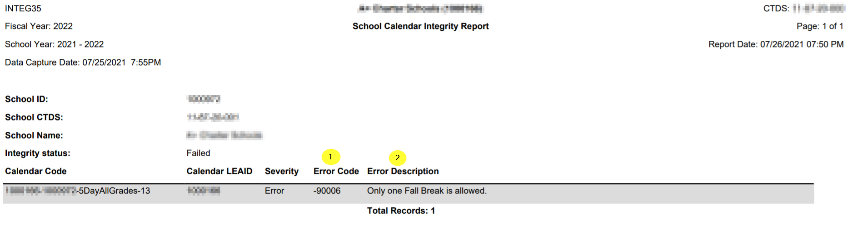
Calendar Reports
INTEG35 – Shows calendar Integrity errors (failures must be resolved for the calendar to pass Integrity)

Slide 14
Deadlines

Slide 15
Deadlines
Data capture date for September payment is Tuesday, 8/3.
  Calendars are required for student data submission so your calendars must be submitted, passing Integrity, and certified.
Calendars can be submitted and modified freely until 8/31.
  After this date you must submit a Help Desk ticket to request access to a calendar.

Slide 16
ADE, School Finance
  (602) 542-5695
  SchoolFinance@azed.gov
  http://www.azed.gov/finance
School Finance
  http://helpdeskexternal.azed.gov
    Student Data
    School District Employee Report
    Instructional Calendars
    Transportation Reporting
    915s
SF Account Analysts
Phone Option 3
  SFPaymentTeam@azed.gov
    APOR
    CHAR
    CSF
    IIF
SF Payments Team
Phone Option 1
  SFBudgetTeam@azed.gov
    Expenditure Budgets
    Annual Financial Reports
    BUDG25, BUDG75, BUDGAGD
SF Budget Team
Phone Option 2

Slide 17

Questions?

