Slide 1

CTE ADMINISTRATORS MEETING
September 15, 2021
Vision:
Develop Arizona’s competitive workforce through the power of Career and Technical Education.
Mission:
Career and Technical Education will engage Arizona learners in relevant experiences leading to purposeful and economically viable careers.

Slide 2


TEAMS NORMS
Video
We will be recording each session. Please have your camera off if you do not want to have your name or picture appear
Feel free to TURN ON Closed Captions individually
Microphone
Remain muted during the session
Chat Box
Please post all comments and questions in the chat box
We will monitor and provide discussion opportunities at the end of the session

Slide 3
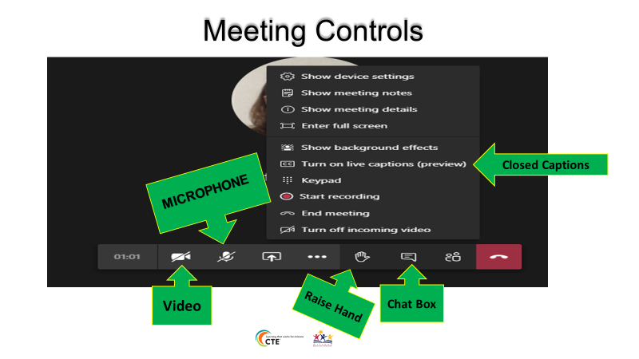

Slide 4
Agenda
Welcome – Introductions
ADE Updates:
CTSOs
Updates: ACOVA, CTE Leads
Program Services and Monitoring
School Counselors and My Future AZ
Updates: SIROW-Project Change
Allocations and Industry Credential Funding
Break
Grants
Accountability
Updates: ACTEAZ - Premier Program Series, AZ CTE Curriculum
Consortium
Technical Standards and Assessments
Closing

Slide 5
Welcome and Updates
Introductions:
Dr. Felica Durden, Associate Superintendent
Presidential scholar applications
We are moving this fall!
100 N 15th Avenue
Our mailing address will remain the same.
Certification will be on first floor

Slide 6
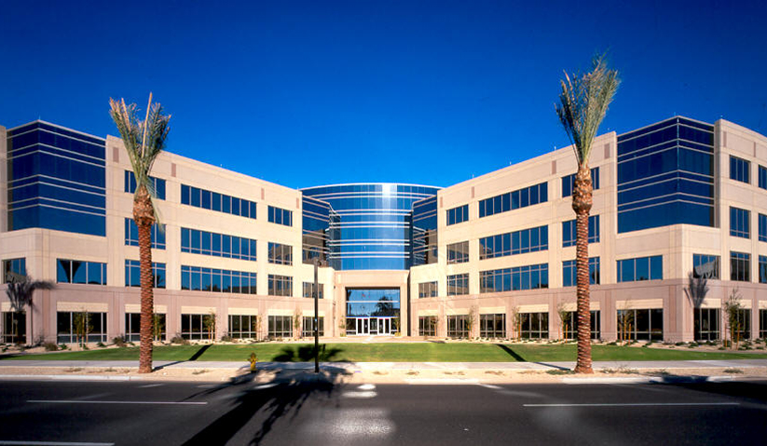

ADOA Building

Slide 7
Regions for for CTED 4th year Funding
CTED Workforce Region
CAVIAT Coconino & Yavapai
CAVIT Pinal County
CTD Cochise, Graham & Greenlee
CVIT Apache, Gila, & Navajo
EVIT Maricopa County
GIFT Cochise, Graham, & Greenlee
MICTED Yavapai County
NATIVE Apache, Gila, & Navajo
NAVIT Apache, Gila, & Navajo
Pima County JTED Pima & Santa Cruz Counties
STEDY Yuma County
VACTE Coconino & Yavapai
WAVE Mohave & LaPaz Counties
West-MEC Maricopa County

Slide 8
This year….
the great unknown
Cathie’s number:
602-364-2211
Notes:
We have all been through a tough 18 months and it does not look like it will get back to normal anytime soon.
I am amazed at the perseverance of you CTE administrators and teachers.
We need to look outside the box to find solutions to the unexpected issues we face in our programs.
We at ADE intend to work with you to problem solve teacher shortages, the everchanging delivery of your programs, and our expectations that may need to change where we can.
I have some tasks for you:
Take care of yourself both personally and professionally, call us when you are overwhelmed
Listen to your teachers about their challenges, offer support and help when you can
Sit in your classrooms and hear what students are saying
SHARE ALL THE INFORMATION FROM THIS MEETING WITH YOUR TEACHERS
As my dear late friend Carolyn Warner used to quote at the end of every speech:
“DO ALL THE GOOD YOU CAN.
BY ALL THE MEANS YOU CAN.
IN ALL THE WAYS YOU CAN.
IN ALL THE PLACES YOU CAN.
AT ALL THE TIMES YOU CAN.
TO ALL THE PEOPLE YOU CAN.
AS LONG AS EVER YOU CAN.”
John Wesley

Slide 9
“DO ALL THE GOOD YOU CAN.
BY ALL THE MEANS YOU CAN.
IN ALL THE WAYS YOU CAN.
IN ALL THE PLACES YOU CAN.
AT ALL THE TIMES YOU CAN.
TO ALL THE PEOPLE YOU CAN.
AS LONG AS EVER YOU CAN.”
John Wesley
Notes:
We have all been through a tough 18 months and it does not look like it will get back to normal anytime soon.
I am amazed at the perseverance of you CTE administrators and teachers.
We need to look outside the box to find solutions to the unexpected issues we face in our programs.
We at ADE intend to work with you to problem solve teacher shortages, the everchanging delivery of your programs, and our expectations that may need to change where we can.
I have some tasks for you:
Take care of yourself both personally and professionally, call us when you are overwhelmed
Listen to your teachers about their challenges, offer support and help when you can
Sit in your classrooms and hear what students are saying
SHARE ALL THE INFORMATION FROM THIS MEETING WITH YOUR TEACHERS
As my dear late friend Carolyn Warner used to quote at the end of every speech:
“DO ALL THE GOOD YOU CAN.
BY ALL THE MEANS YOU CAN.
IN ALL THE WAYS YOU CAN.
IN ALL THE PLACES YOU CAN.
AT ALL THE TIMES YOU CAN.
TO ALL THE PEOPLE YOU CAN.
AS LONG AS EVER YOU CAN.”
John Wesley

Slide 10








CTSOs

Slide 11
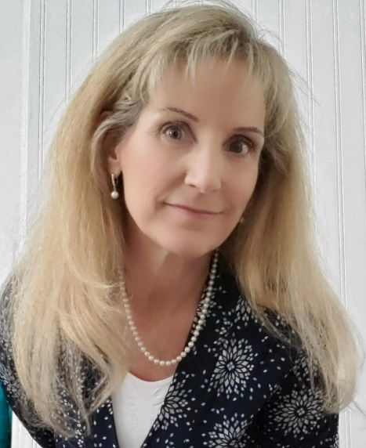
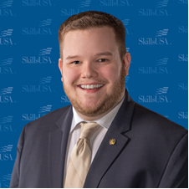


Daniel Kelly
Dixie Harvey
New Educators Rising and SkillsUSA State Advisors

Slide 12
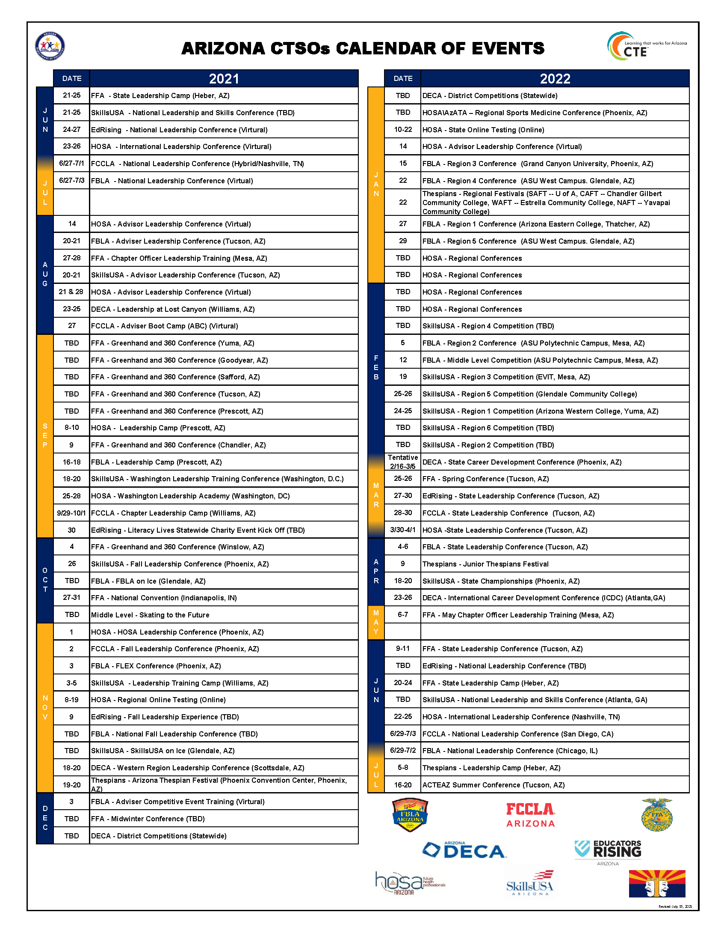
Calendar of Events
In folders and on ADE Website
Updated Calendar of Events

Slide 13

New Advisor
Training
Cost: Free
Dates:
Saturday October 2nd 8:00am-3:30pm – Virtual
Wednesday December 8th 8:00am-3:30pm - Virtual
Sign up: https://fblaarizona.wufoo.com/forms/w9y13nl19006cq/

Slide 14

Advanced Advisor
Training
(mini-sessions)
Cost: FREE
Time: 4:00pm-6:00pm
Dates: December 6th-10th
Monday – “Establishing a Firm Foundation for your CTSO”
Tuesday – “Growing your Program”
Wednesday – “Building a Solid Officer Team”
Thursday – “Successfully Implementing a Program of Work”
Friday – “Running an Effective Meeting” (parli pro)
Sign up: https://fblaarizona.wufoo.com/forms/wh8c7zp1eqclbu/

Slide 15
FAQ
DECA:
WRLC – Providing an option not to stay
EDRISING:
Do not have to purchase curriculum
Membership will be sent to State

Slide 16


CTSOs
New & Exciting
ON
DEMAND
RESOURCES
Coming Soon

Slide 17

Skating to the Future
Middle Level Leadership Conference
SAVE THE DATE:
NOVEMBER 10TH 2021

Slide 18
Questions, Concerns, Comments
Julie Ellis
Email
Julie.Ellis@azed.gov
Work
602-542-5350
Cell
520-465-3655
Thank You!

Slide 19

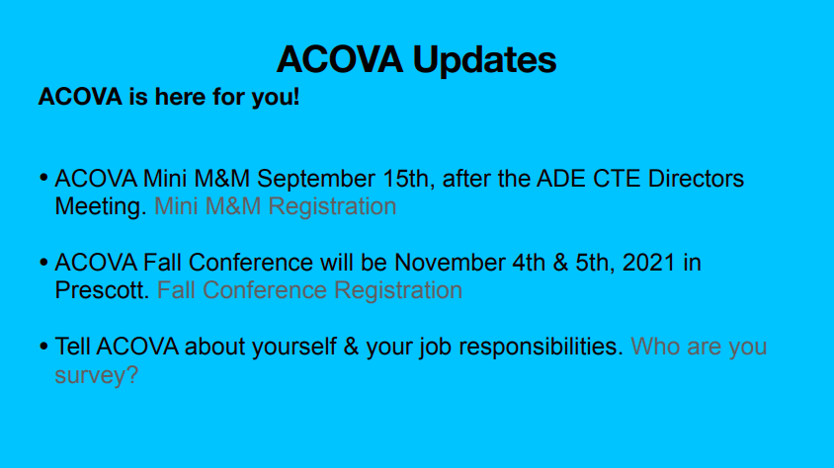

Slide 20

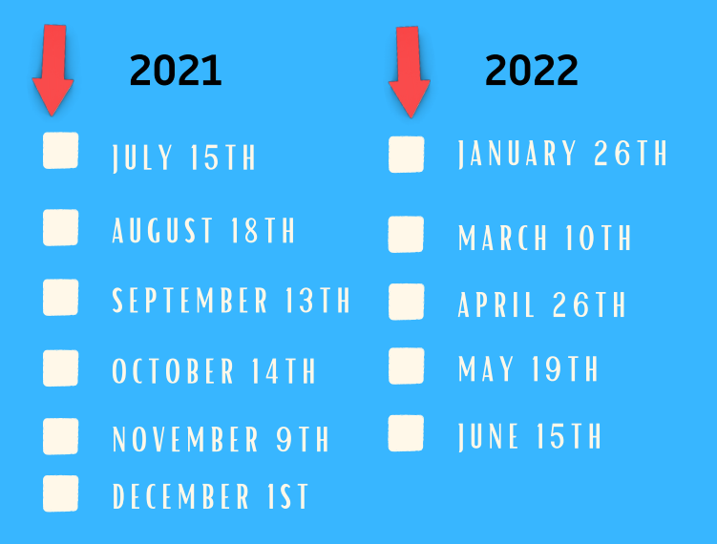



Slide 21


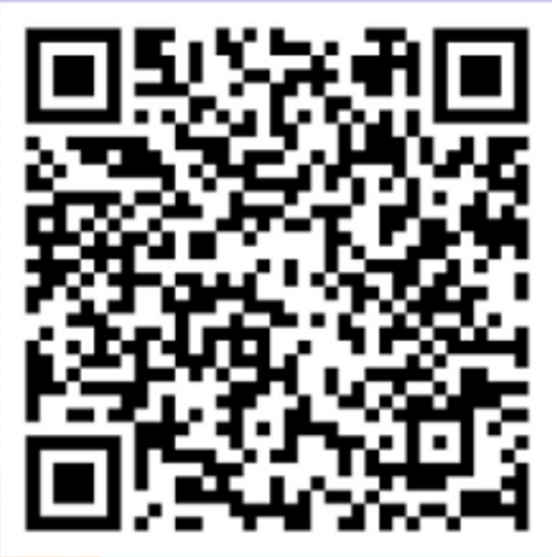
2021
2022
September 23, 2021
National/State CTE Legislative Priorities: (Virtual)
November 18, 2021
February 17, 2022
April 21, 2022
3 Ways to register
Bit.ly/Sept23thinktank
https://pdcircle.west-mec.org/courses/think-tank
Notes:
Not available for registration yet because we will put these into the new regist system.
Facilitator Actions:
Participant Actions:

Slide 22
Program Services Updates
Cindy Gutierrez
Director, CTE Program Services
Career and Technical Education
Arizona Department of Education
Office: 602-542-4365
Cindy.Gutierrez@azed.gov

Slide 23
Program Services Team
Program Specialists
Tracie Carmel - Family and Consumer Sciences
Dixie Harvey - Education and Training/Educators Rising CTSO
Aden Ramirez - Health Science Technologies
Tracy Rexroat - Engineering ,Information Technologies,
and Manufacturing
Elena Sobampo - Business and Marketing Education;
Communication Media Technologies
Bruce Watkins - Agriculture and Welding
Jason Wojcik - Public Services Careers,
Transportation Technologies
Vacant - Construction Science Technologies
Support Staff
Janai Nesby - Program Project Specialist
Gwen Lamb - Administrative Assistant

Slide 24
Industry Recognized Credentials
Why?
Perkins V Performance Measure SDLP: 33% must meet 90% of SDLP
CTED eligibility: State Statute 15-391 “…leads to certification or licensure”
College and Career Readiness Index (School A-F): Industry recognized credential generates .5 up to 1.0/2.0
AZ Industry Credentials Incentive Program: State Statute 15-249.15, CTE programs in specific Industry Sectors
For lists and details:
https://www.azed.gov/cte/cte-industry-credentials

Slide 25
Credential
Updates and changes
All credential lists available on the CTE Industry Credentials webpage - https://www.azed.gov/cte/cte-industry-credentials
With color-coded updates
Changes for 21-22:
Green = Newly Added to List
Yellow = Name/Status Updated
Red = Removed

Slide 26
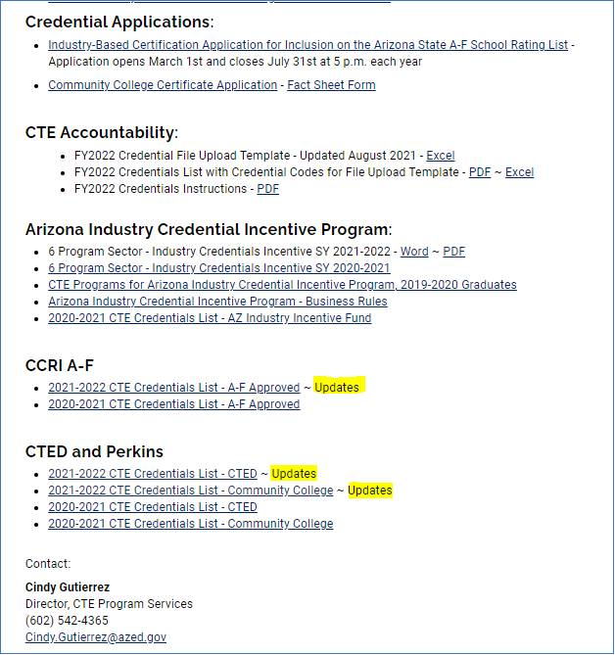
Credentials continue webpage view

Slide 27
Credentials continued
Please Note:
Industry credentials change or are retired often
CTE Directors/Program teachers know your credentials and the providers
Fact Sheets with provider information on CTE Credential webpage
Contact CTE Program Services if you know of any changes throughout the year

Slide 28
Industry Credential
Application Process
Industry credential application process:
opens on March 1st each year
closes on May 31st
Please note the change to the closing date
Submissions:
Made by Districts with input from Industry partners
Statewide or nationally recognized
Vendor submissions will not be considered
Applications available at
https://www.azed.gov/cte/cte-industry-credentials

Slide 29
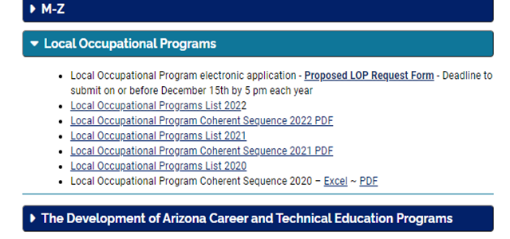
Local Occupational Programs https://www.azed.gov/cte/programs
LOP
Reflects local need
Not on the CTE Approved Program List
Significantly different than any approved CTE Program
Must apply for LOP
Cannot just add it even if on the current list
Application information on CTE website
If submitting, due Dec.15th
to CTED@azed.gov

Slide 30
CTE Program Monitoring
Quality and Compliance, Accountability
Why?
AZ State Perkins V plan
…secondary subrecipient programs will be monitored annually on a five-year rotating basis. Programs
that do not meet compliance for a specific indicator will have thirty days to submit documentation of compliance for that indicator.
ARS 15-391 V.
CTED legislation
…every five years CTE division of ADE shall review CTED and district programs to ensure compliance, quality and eligibility.

Slide 31
CTE Program Monitoring
Continued
ADE CTE - year two of rotation
SY 21-22 = 37 schools, 4 CTEDs
Planning for on-site visits per district approvals
New this year:
District level forms to reduce redundancy
Separate Program level forms
CTED Community College forms
CTSO state advisors will verify CTSO indicators
Schedule, Guides and Information on webpage - https://www.azed.gov/cte/programs
Note:
CTE Grants Specialists reviewing Perkins Inventory during Program Monitoring

Slide 32
CTE Program Monitoring
Continued
Districts Scheduled for SY 22-23
Colorado City USD – Perkins only
Phoenix Union HSD - Perkins only
MICTED and all member districts
STEDY and all member districts
WAVE and all member districts
SY 22-23 District notifications:
Announced today, Sept 15, 2021
Email notification in November TBD
Required Training in February TBD
District only meetings in April-May TBD

Slide 33
Questions

Slide 34


Slide 35


Slide 36
FREE
Created for us - not a “canned” platform
Open to all students – focus on middle/high school
Open system – registration is not required to explore – registration is required to save information
Easy to create accounts – easy to reset passwords
Students never lose access to their account – even if they move schools
Easy to document ECAP attributes
Schools can customize certain aspects of the platform to individualize for their school
Easy to share with parents

Slide 37

My Future AZ –www.myfutureaz.pipelineaz.com

Slide 38
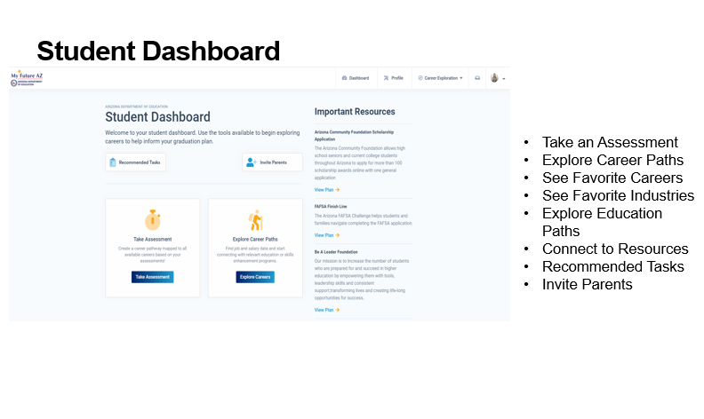

Slide 39
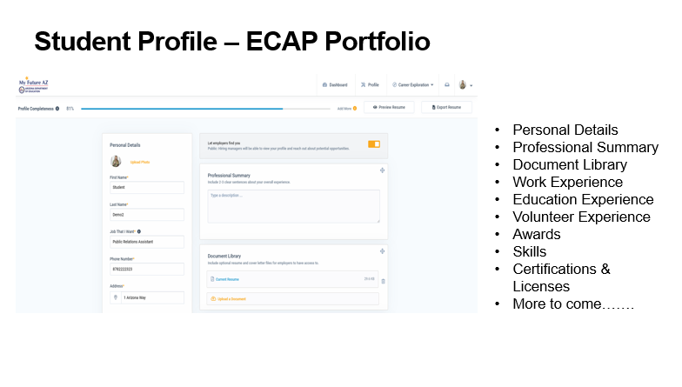

Slide 40
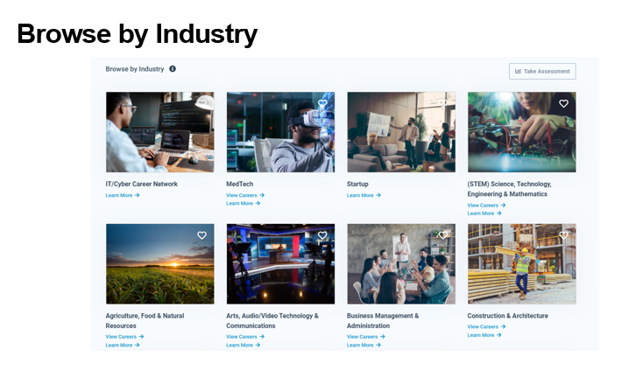

Slide 41
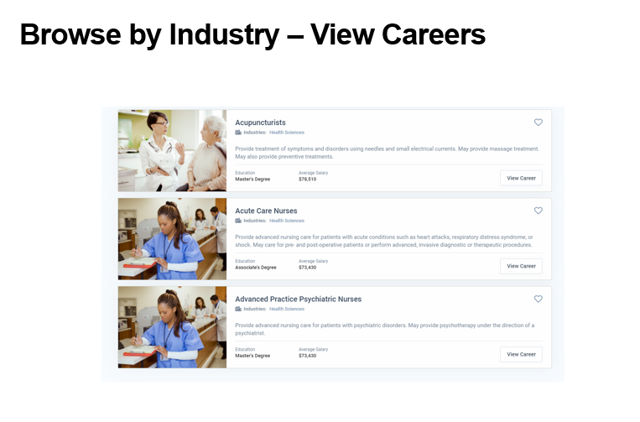

Slide 42


Slide 43
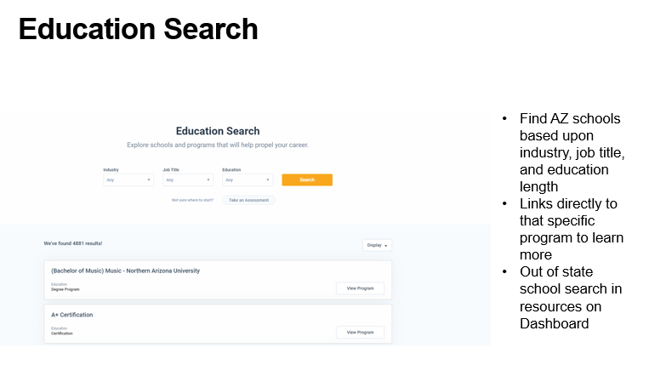

Slide 44
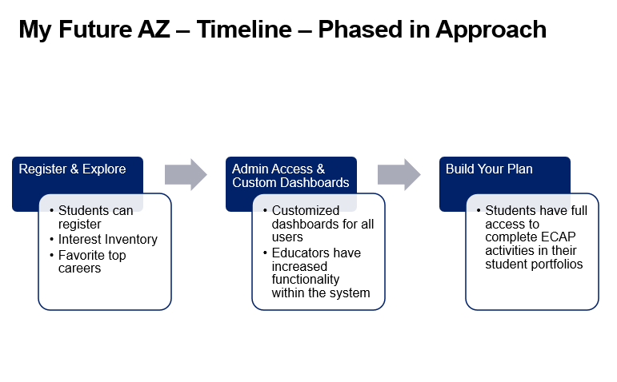

Slide 45
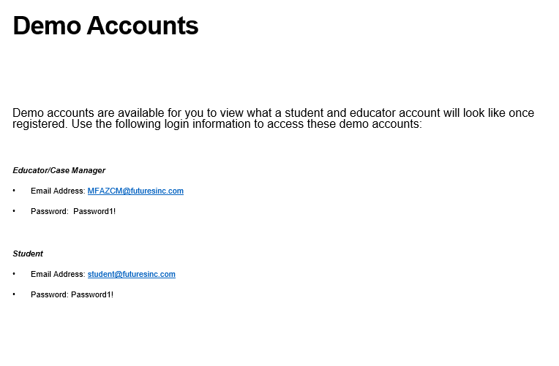

Slide 46
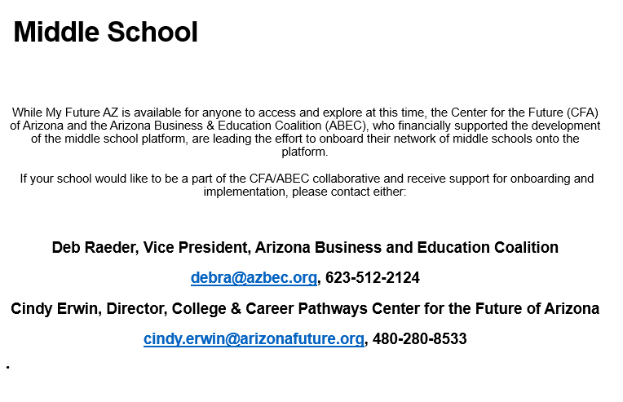

Slide 47
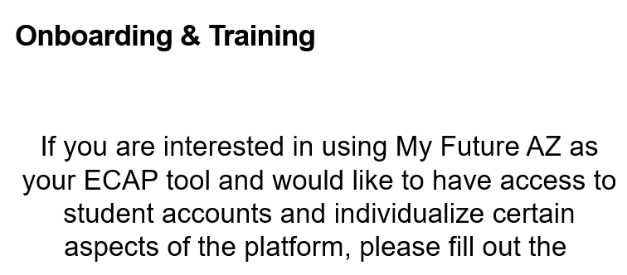
Interest Form for Onboarding

Slide 48
Amanda Nolasco
School Counselor Specialist
Arizona Department of Education
amanda.nolasco@azed.gov
www.azed.gov/cte/ecap
602.542.5353
Sign Up for Counseling Newsletter

Slide 49

Project CHANGE
Increase gender nontraditional CTE enrollment
Promote safe and healthy schools
Recruitment + Retention of Nontraditional students
Gender, CTE, and Nontraditional Career Success
Stop Sexual Harassment
Stop Cyberbullying + Promote Positive Digital Citizenship
tylerlepeau@email.arizona.edu
timwernette@msn.com

Slide 50

Project CHANGE
We are happy to present in person again! Along with in-person presentations, we are also offering Project CHANGE presentations in these online and/or video formats:
Live online sessions on Zoom or Google Meet (works best with groups of about 10-40 participants).
Pre-recorded video presentations along with optional interactive Google slide activity.
Presentations and workshops are provided at no cost.
Educator presentations provide professional development hours.
Presentations run approximately an hour to accommodate a typical class period (shorter for pre-recorded video).

Slide 51
Funding Update: Perkins, Priority, Incentive Funding
Bobby Neves
Fiscal, Grants & Accountability Director
Career and Technical Education
Arizona Department of Education
Phone: 602-542-5137
Bobby.Neves@azed.gov

Slide 52
FY 21-22 Perkins Funds
$32,139,650 to Arizona
$22,470,187 Secondary Districts
$4,932,480 Community College Districts
$871,781 Reserved
$80,000 Nontraditional
$110,000 State Institutions
$1,783,218 State Administration
$1,606,982 Basic Administration

Slide 53
How are Secondary Funds Allocated
District allocations based on census data:
  -30% of funds based on the total number of 5-17 year olds by county
  -70% of formula funds based on the number of 5-17 year olds in families below the poverty line by county
Perkins funds are NOT affected by school enrollment, CTE enrollment or number of CTE programs

Slide 54
Where Does Census Data Come From?
US Census Bureau (SAIPE)
  New Report Published every December
  This allocation we will use the report published in December 2020 which accounted for 2019 census data

Slide 55
FY22 CTE State Priority
$9,000,942 Total for Arizona
$100,000 Reserved
Allocation Based on Enrollment and Placement
  Number of 11th and 12th grade students enrolled in CTE approved classes (40th and 100th day enrollment)
        75% of funding comes from this calculation
        2020-2021 $57.26/student
        2021-2022 $60.32/student
  Related placements-if student placed in work, military or school which was related to CTE program.
        25% of funding comes from related placements
        2020-2021 $134.24/placement
        2021-2022 $153.75/placement

Slide 56
CTE Arizona Industry Credentials Incentive Program
Final Narrative
  A final narrative will need to be completed and uploaded to the related documents section in the funding application
  This will allow ADE to have better insight on what was expended using these funds
Carryover
  In order to carryover funds, you must indicate this on the “Completion Report Adjustments” page when you do your Completion Report

Slide 57
Continued…
FY22 applications are open
  Please go in and submit your applications ASAP. You can make revisions later if needed
  Remember to only spend funds on the qualified programs

Slide 58
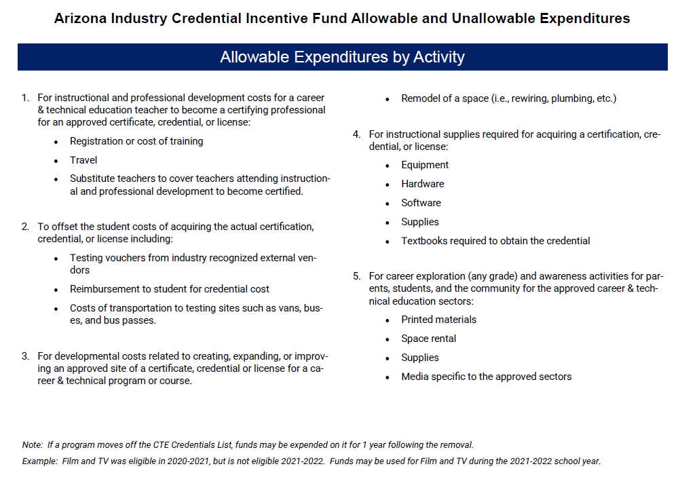

Slide 59
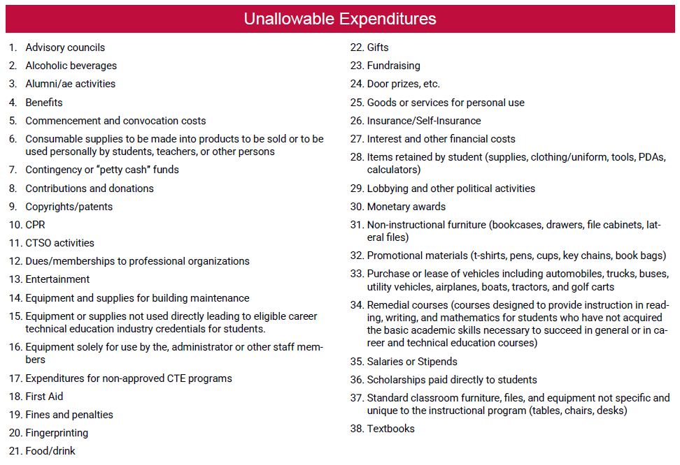

Slide 60
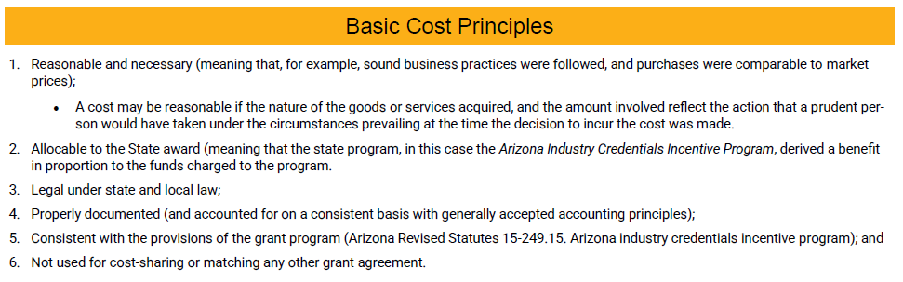

Slide 61


Managing Your Federal Perkins and
State Priority Grants
September 15, 2021

Slide 62
Grant Specialist Team
Shelley Baudean – Grants Program Specialist
Audrey Dieken – Grants Program Specialist
Don Dolin – Grants Program Specialist
Mark McManus – Grants Program Specialist
John Jones – OCR Special Populations Program Specialist
Mary Medina – CTE Grants Supervisor

Slide 63
CTE Grant Application Important Dates
FY2021
CTE Federal Perkins Grant Final Narratives due: September 15, 2021
CTE State Priority Grant Completion Report due September 30, 2021
CTE Federal Perkins Grant Completion Report due: December 30, 2021
FY2022
CTE Federal Perkins and State Priority submission due: July 1, 2021
Funding year for CTE Federal Perkins Grant: July 1, 2021 – September 30, 2022
Funding year for CTE State Priority Grant: July 1, 2021 – June 30, 2022

Slide 64
FY2022 Grant Successes
99% of FY2022 CTE Federal Perkins applications approved
99% of FY2022 CTE State Priority applications approved

Slide 65
FY2021 Reimbursement Requests
State Priority
96%
Paid out as of 7/1/2021
Perkins
75%
Paid out as of 9/8/2021

Slide 66
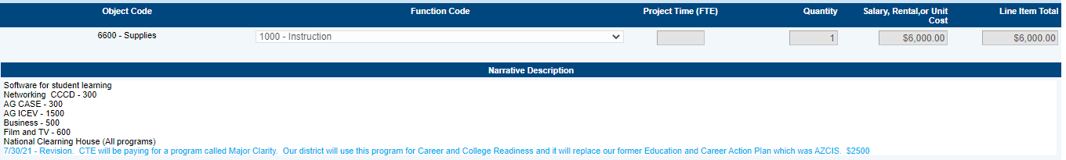
Managing Your FY2022 Grants
Ensure you have grant user access role
Purchase capital and supplies at beginning of school year to ensure timely delivery
Work with your Business Manager to ensure regular submission of reimbursement requests
Read all History Log communications
Focus on FY2022 CLNA & goals/targets
Adhere to grant specific deadlines
Provide narrative details for revisions (below)
****Spend your allocated funding****

Slide 67
Capital Outlay
All Capital should be specialized equipment for CTE programs
  Use CTE program equipment list which is located on the CTE website: https://www.azed.gov/cte/programs
  If item is not on the equipment list, please contact your assigned GPS to seek approval
Must be part of the inventory control system
  Tagged, on inventory list, etc…
  Adhere to EDGAR §200.313 requirements

Slide 68
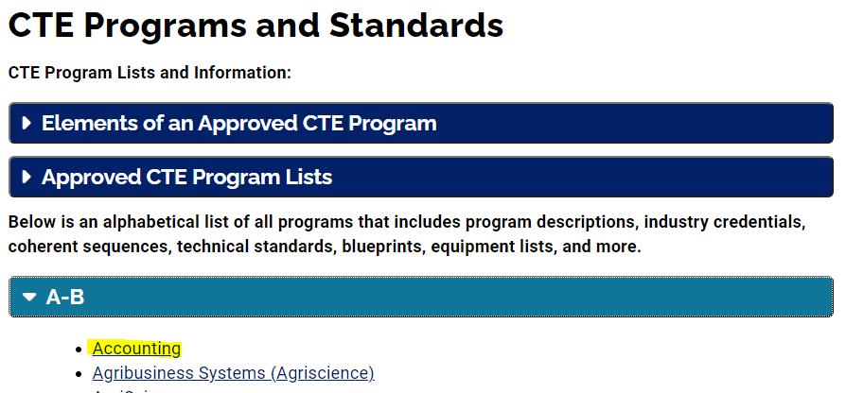
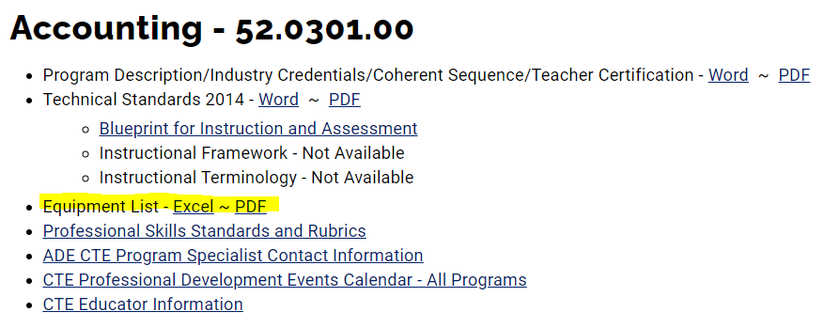

Slide 69
Things That May Affect Your Grants
Ordering equipment / supplies not listed in grant
Procrastination in purchasing = irregularity in reimbursement request submissions
Limited / vague information in budget narratives when submitting grant revisions
Global Holds prevent your grants from being approved. Resolve Global Holds with GME as soon as possible.
**Contact GPS for review prior to submission if you are unsure about any of your revisions

Slide 70
Thinking Ahead
Schedule meetings with CLNA Leadership Team in September/October 2021 and in February 2022 to discuss progress relating to this year’s CLNA goals / targets as this is year 1 of the biennial cycle
Based on CLNA Leadership Team meeting discussions, begin planning FY2023 Perkins Grant Measurable Objectives to be included in the FY2023 Perkins grant application due May 2022
Start planning your Perkins and State Priority budgets for the FY2023 applications due May 2022

Slide 71
Visual of Timelines
Month → Grant Year: | Sept 2021 | Oct 2021 | Nov 2021 | Dec 2021 | Jan 2022 | Feb 2022 | Mar 2022 | Apr 2022 | May 2022
 | FY2021Perkins ends & FN due FY2021 Priority CR due | Order items Revise budgets (alloc.) Plan FY2022 CLNA review team meeting |  | FY 2021 Perkins CR due |  |  |  |  | FY2022State Priority ends next month (June)
 |  |  |  |  | Revise FY2022 budgets (alloc.) | Plan CLNA review team meeting for FY2023 Grants | Plan new MO’s for FY2023 Perkins grant | Work on new FY2023 Perkins & State Priority grants | FY2023Perkins & State Priority Grants DUE in GME
*FN=Final Narratives *CR=Completion Report *MO=Measurable Objectives

Slide 72
Reminder
Loan of equipment due to COVID–19
Please be sure to have documentation outlining the process / procedures as well as the timeframes for return of the equipment to LEA. Follow through on timeframes for return of equipment.
Update inventory list when equipment is returned.

Slide 73
Contact Information
Shelley Baudean John Jones
Grant Program Specialist OCR Special Populations Program Specialist
shelley.baudean@azed.gov john.jones@azed.gov
602-542-5323 970-216-6740
Audrey Dieken Mark McManus
Grant Program Specialist Grant Program Specialist
audrey.dieken@azed.gov mark.mcmanus@azed.gov
602-350-5064 602-542-8744
Don Dolin Mary Medina
Grant Program Specialist CTE Grants Supervisor
don.dolin@azed.gov mary.m.medina@azed.gov
602-518-6526 505-426-6681

Slide 74
Email Address Change:
Mary Medina
mary.m.medina@azed.gov

Slide 75
CTE Administrators Meeting
Accountability & CTE Data Portal
September 15, 2021

Slide 76
FY 2022 Calendar
CTE data reporting calendar is available online at:
https://www.azed.gov/cte/cte-data-portal-information
Look for “FY 2022 CTE Data Portal Important Dates and Deadlines”.

Slide 77
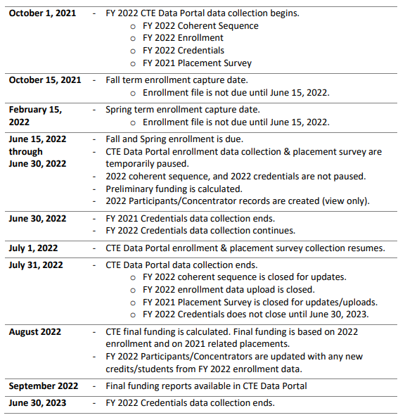
FY/SY 2021-2022 CTE Data Portal Dates/Deadlines
https://www.azed.gov/cte/cte-data-portal-information

Slide 78
FY/SY 2021-2022 CTE Data Portal Dates/Deadlines
https://www.azed.gov/cte/cte-data-portal-information
System is open
New data collection dates
System is closed
Except for Credentials
System is open
System is closed
Except for Credentials

Slide 79
FY/SY 2021-2022 CTE Data Portal Dates/Deadlines
https://www.azed.gov/cte/cte-data-portal-information
System is open
Major deadline #1
System is closed
Except for Credentials
System is open
Major deadline #2
System is closed
Except for Credentials

Slide 80
FY 2022 Data Collection Starting October 1
CTE data reporting for school year 2021-2022 will begin
October 1, 2021.
- Update coherent sequence
- Upload student-level course enrollment
- Record student credentials for 2021 or 2022
- Record placement surveys for 2021 graduates

Slide 81
FY 2022 Data Collection Starting October 1
Enrollment data is reported by term for students enrolled on:
- Fall term: 10/15/2021
- Spring term: 2/15/2022
This replaces 40th and 100th day enrollment reporting.
All data is manually entered or uploaded into CTE Data Portal. The system will not interface with AzEDS to bring in any data.
CTE Data Portal will still verify enrollment through AzEDS.

Slide 82
FY 2022 Upload Templates
All CTE Data Portal Upload Templates have been updated and are now available on the CTE website.
Enrollment templates (https://www.azed.gov/cte/cte-enrollment)
- District Nonarticulated
- District Articulated
- District Postsecondary Articulated
- NEW! CTED Enrollment Template*
Placement Survey template (https://www.azed.gov/cte/cte-placement)
* This template is for CTED central campuses. CTE Districts/Charters will not use this template.

Slide 83
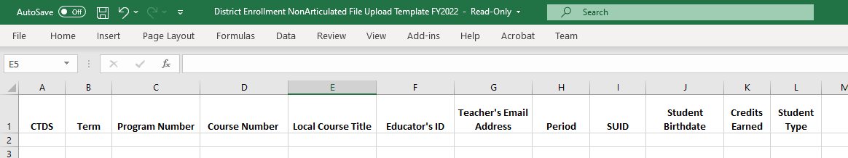
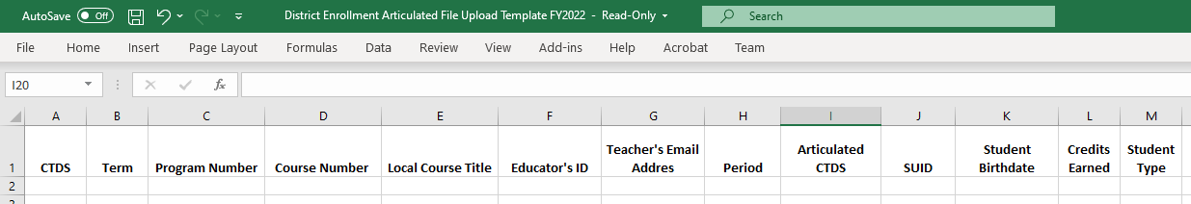
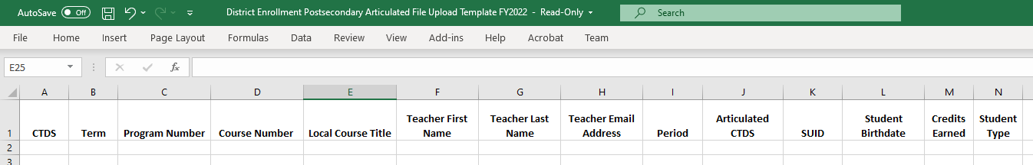
FY 2022 Upload Templates - Districts
Nonarticulated
Articulated
Postsecondary Articulated
Notes:
Use Nonarticulated Template for courses taught at the school. Use Articulated for courses that are taught elsewhere, except for those taught at a community college. For community college courses (including those that go through the CTED) (“CTED at postsecondary site”), use the Postsecondary Articulated template.

Slide 84
FY 2022 Upload Templates - Districts
Changes to 2022 Enrollment Templates:
Columns for “Minutes per Week” and “Number of Weeks” have been removed.
New column for “Student Type” has been added.
“Student Type” is a codified value:
1 – CTE participating public school/charter school
2 – Homeschool (non-ESA recipient)
3 – Non-CTE participating public school/charter school
4 – Private school/private charter school
- Used for data reporting & comparison.
- Will allow you to report students that attend CTE at your school, but are homeschooled, etc.

Slide 85
CTEDs are now in the CTE Data Portal
CTED central campuses will report:
- A coherent sequence
- Fall and Spring term enrollment data
- Credential attainment data
- Starting with 2022 graduates, placement survey data
Districts will continue to report:
- A coherent sequence, including CTED articulated courses
- Fall and Spring term enrollment data, including CTED articulated enrollment
- Credential attainment data*
- Placement survey data*

Slide 86
CTEDs are now in the CTE Data Portal
CTED central campuses will now report student-level data.
Districts will continue to report articulated enrollment where the course is taught at a CTED central campus. This will result in “duplicated” data – reported by both the student’s district & by the CTED central campus.
CTE Data Portal will identify “matching” records – matched on:
- CTE Program and Course Numbers
- Course Location ( “Articulated CTDS in district file must match CTED central campus CTDS)
- Term
- Class Period
- Local Course Title
- Teacher (Educator ID number if provided, teacher name if EIN is not provided).

Slide 87
CTEDs are now in the CTE Data Portal
“CTED/School Enrollment Discrepancy Report” will show “mismatched” or missing enrollment records.
“Student Type” indicator is used in comparing CTED-reported enrollment to District-reported articulated enrollment.
For each district articulated enrollment record where course location is a CTED central campus, system will expect a matching record at the CTED (uploaded by CTED).
For each CTED enrollment record (uploaded by CTED) where student type is “CTE Participating School”, system will expect a matching articulated record at the student’s school.

Slide 88
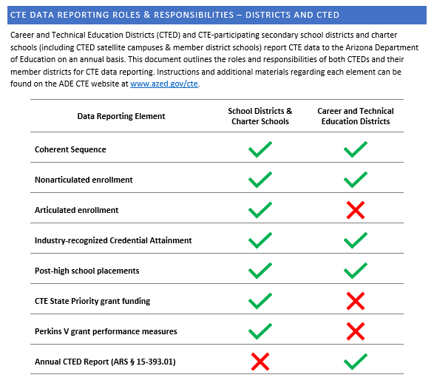
CTEDs are now in the CTE Data Portal
Handout
CTE Data Reporting Roles & Responsibilities – Districts and CTED document is available on CTE website.
Details (by data element) what districts and CTEDs are responsible for when it comes to CTE data reporting in the CTE Data Portal.
Districts and CTEDs should work together to ensure that both are submitting quality, consistent, and matching data.

Slide 89
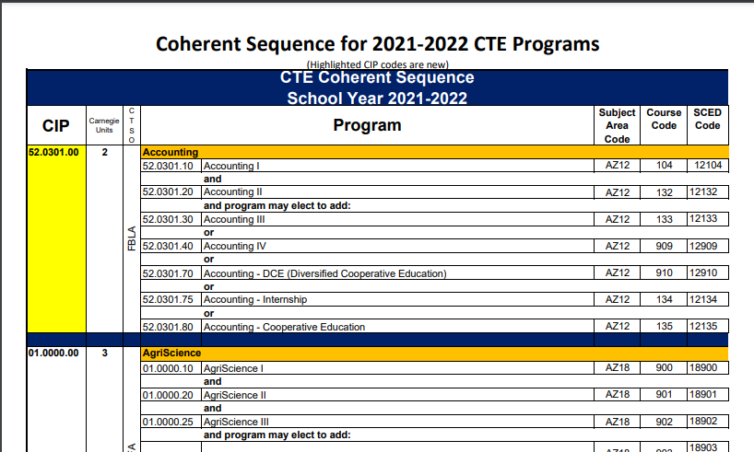
Other Updates – CIP Update for FY 2022
Reminder: Some program and course numbers (CIP) have changed for FY 2022. Ensure that your district systems have the new numbers.
Coherent Sequence document (with new CIP) is on CTE website with changes highlighted in yellow (like Accounting):

Slide 90

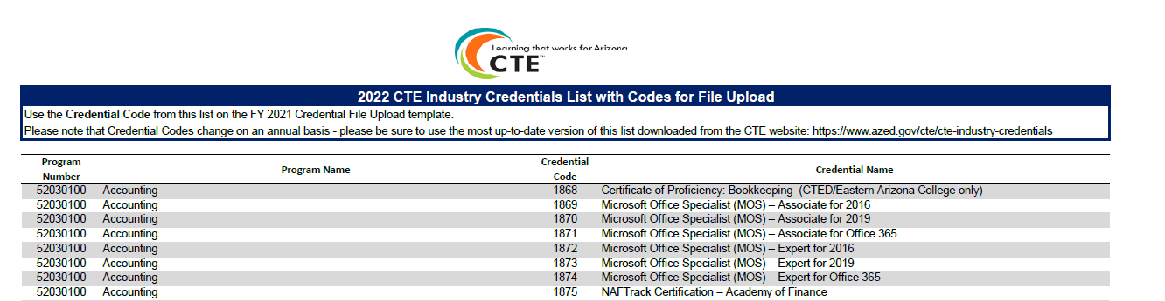
Other Updates – Industry Credentials Reporting
Industry Credentials template, code list, and instructions have also been posted on CTE website: https://www.azed.gov/cte/cte-industry-credentials.
CTE Accountability
FY 2022 Credential File Upload Template
NEW! FY 2022 Credentials List with Credentials Codes for File Upload Template
FY 2022 Credentials Instructions

Slide 91
Other Updates – Industry Credentials Reporting
Industry Credentials for SY 2020-2021 are still due by September 30, 2021.
We are working with our IT developers to make it possible to report two years' worth of credentials data simultaneously (2020-2021 and 2021-2022).
This solution would allow you to report each school year’s credentials from the start of data collection through June 30th of the following fiscal year (12 month overlap).
Example: SY 2020-2021 credentials would be reportable until June 30, 2022.
We have developed this update and it is working as expected. We are still working on minor updates to reports.
After all updates are complete, the SY 2020-2021 credential deadline will be extended to June 30, 2022. SY 2021-2022 credentials will be reportable from October 1, 2021, through June 30, 2023.
Reminder: student must still have enrollment record in that year for a credential to be reported!
Example: to report a credential for SY2021, a student must have an enrollment record in FY2021.

Slide 92
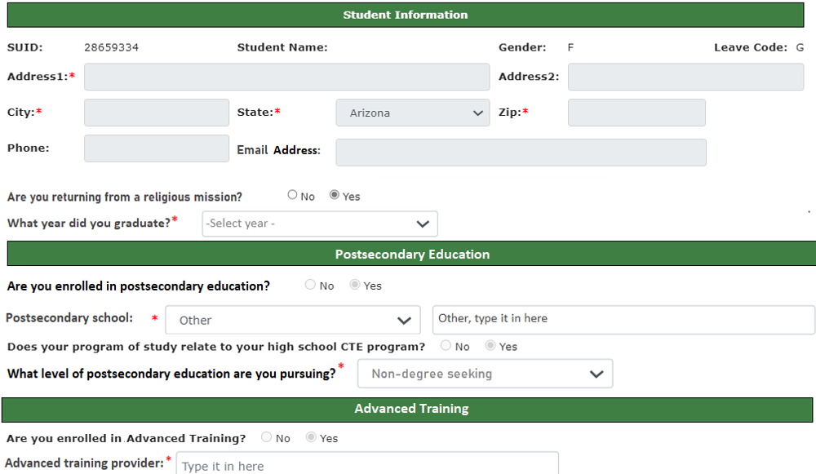
Other Updates – Placement Survey
New Placement Survey Questions:
Postsecondary education and advanced training have been split into two categories
Level of education for postsecondary placement
Apprenticeship option for advanced training and employment
Job duties for employment and military service
National Service Program name for NSP placement
Resources available at: https://www.azed.gov/cte/cte-placement
Notes:
Template has been updated to match.

Slide 93
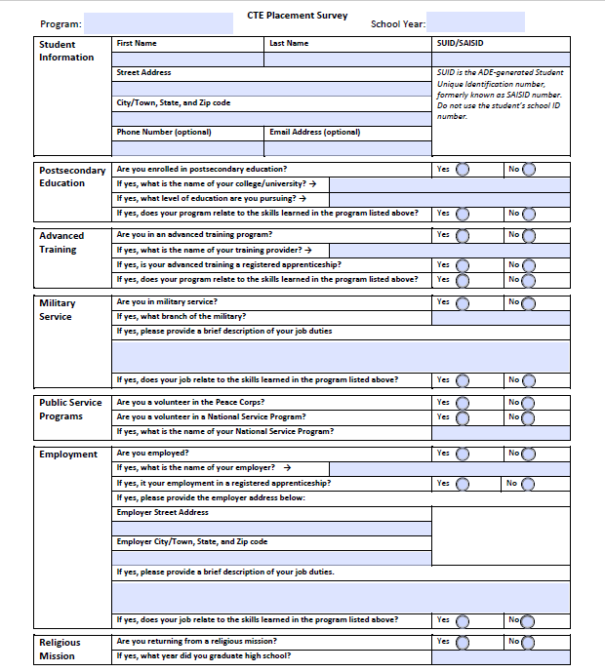
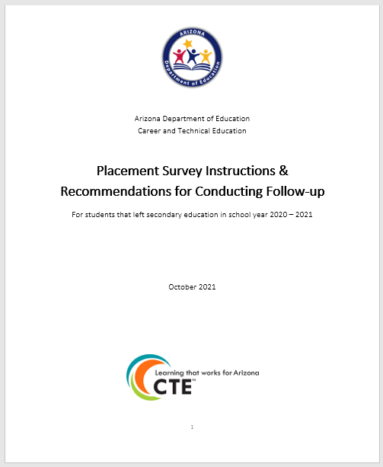
Other Updates – Placement Survey Resources
Revised “paper form” survey with all new questions for 2021
Placement Survey Follow-up Guide, including instructions for CTE Data Portal

Slide 94
Upcoming Training for CTE Data Portal
Date | Time | Location | Topic
Friday, October 8, 2021 | 10:00 – 12:00pm | Virtual | CTE Data Portal – Districts
Tuesday, October 26, 2021 | 1:00 – 3:00pm | Virtual | CTE Data Portal – Districts
Thursday, November 4, 2021 | 2:10pm – 4:10pm See agenda | In-Person @ ACOVA | CTE Data Portal – Districts
Other Helpful Resources:
CTE Data Portal User Guide (Updated for FY 2022)
“Click here for instructions” pages (Updated for FY 2022)
CTE website
CTE staff

Slide 95


CTE Accountability Contact Information
Tammie Chavez
Tammie.Chavez@azed.gov
602-542-3839
Donna Kerwin
Donna.Kerwin@azed.gov
602-542-7881
Janet Silao
Janet.Silao@azed.gov
602-542-5485
Samuel Irvin
CTE Accountability Lead
Samuel.Irvin@azed.gov
602-364-1946

Slide 96

CTE Administrators Meeting
September 2021

Slide 97
AZ CTE Summer Conference 2021
The AZ CTE Summer Conference ended on August 26th when we took down all the videos and shut down the conference app.
Thanks to all of you who attended and worked on it and made it a great conference.
Speaker, Exhibitor, and Sponsor information is still available on the Summer Conference website.

Slide 98

Passport Contest Winners
The Summer Conference Passport Contest Winners are as follows:
Grand Prize Winner ($200 Amazon gift card):
  Jill Ranucci
Additional Winners ($50 Amazon gift card):
  Shannon Rachal
  Brian Ulmer
  Diane Parsons
  Kara Dellisanti

Slide 99

Next Upcoming Event

Slide 100
ACTEAZ Fall Fest
Fall Fest is a virtual conference geared toward
New CTE Teachers!
Sessions will be available for on-demand viewing from October 28 to December 13, 2021. Enjoy all the videos at your convenience.
We will be using Whova for this event, so you can still participate in the community boards, virtual hangouts, and more.
Cost will be $25.00, and registration will be available at www.acteaz.org shortly. Attendees will be awarded 10 Professional Development Hours.

Slide 101
Information to Come
Read your e-blasts and check the ACTEAZ.org website for upcoming information on the following:
  Fall Fest Virtual Symposium (sessions available on-demand Oct. 28 – Dec. 13, 2021)
  Midwinter Conference proposal submissions
  CTE Month activities
  Professional Development Opportunities Calendar
  Awards and Scholarship submissions
  ACTEAZ Affiliates
  Job postings on ACTEAZ website

Slide 102

Want More Information?
Rahsaan Bartet, ACTEAZ President
rahsaanbartet@acteaz.org
Pam Ferguson, ACTEAZ Executive Director
pamferguson@acteaz.org
Shelly York, ACTEAZ Asst. Executive Director
shellyyork@acteaz.org
(623) 826-6399
Robert Waller, Premier Series Coordinator
premierseries@acteaz.org

Slide 103


Slide 104


Slide 105
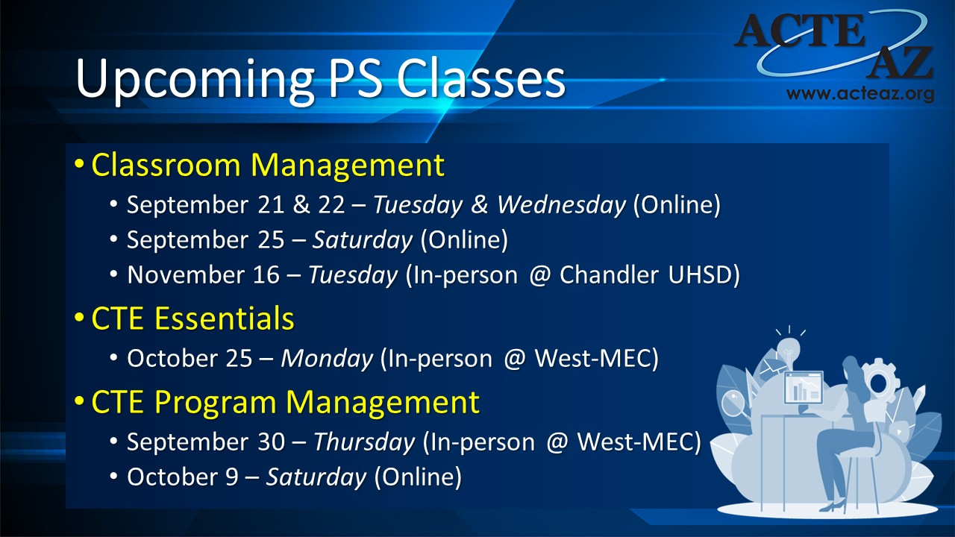

Slide 106
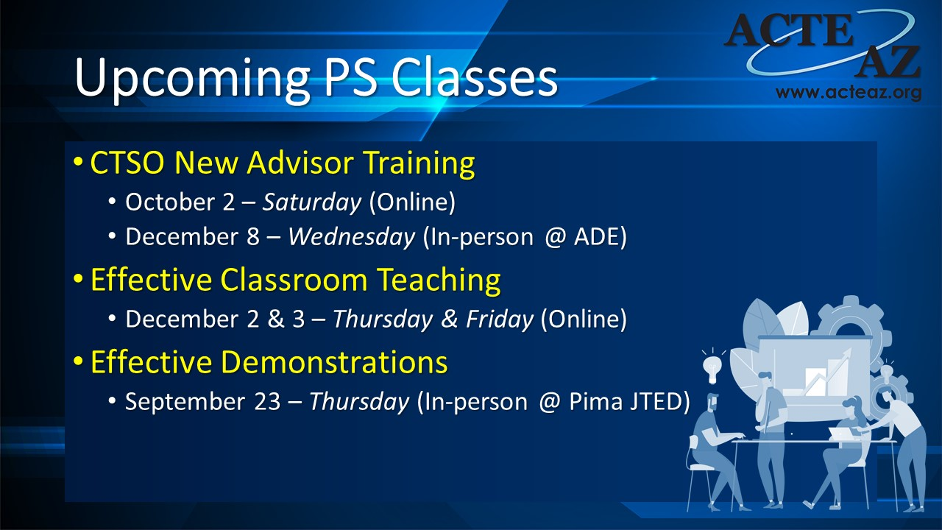

Slide 107
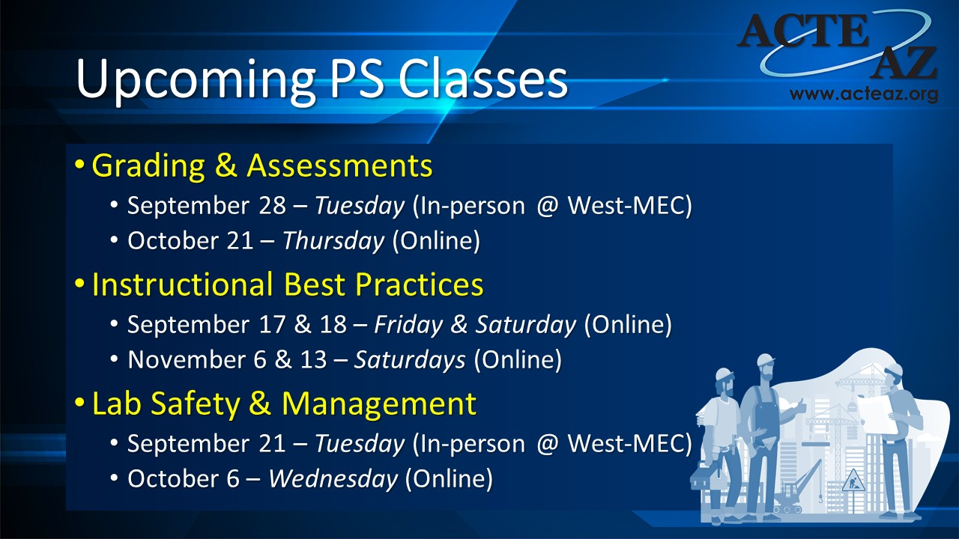

Slide 108
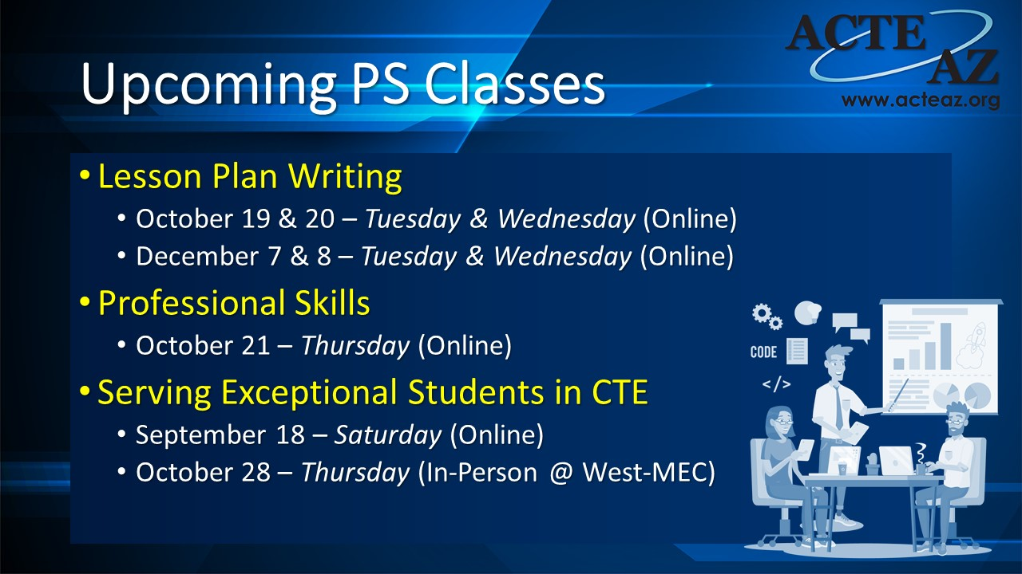

Slide 109
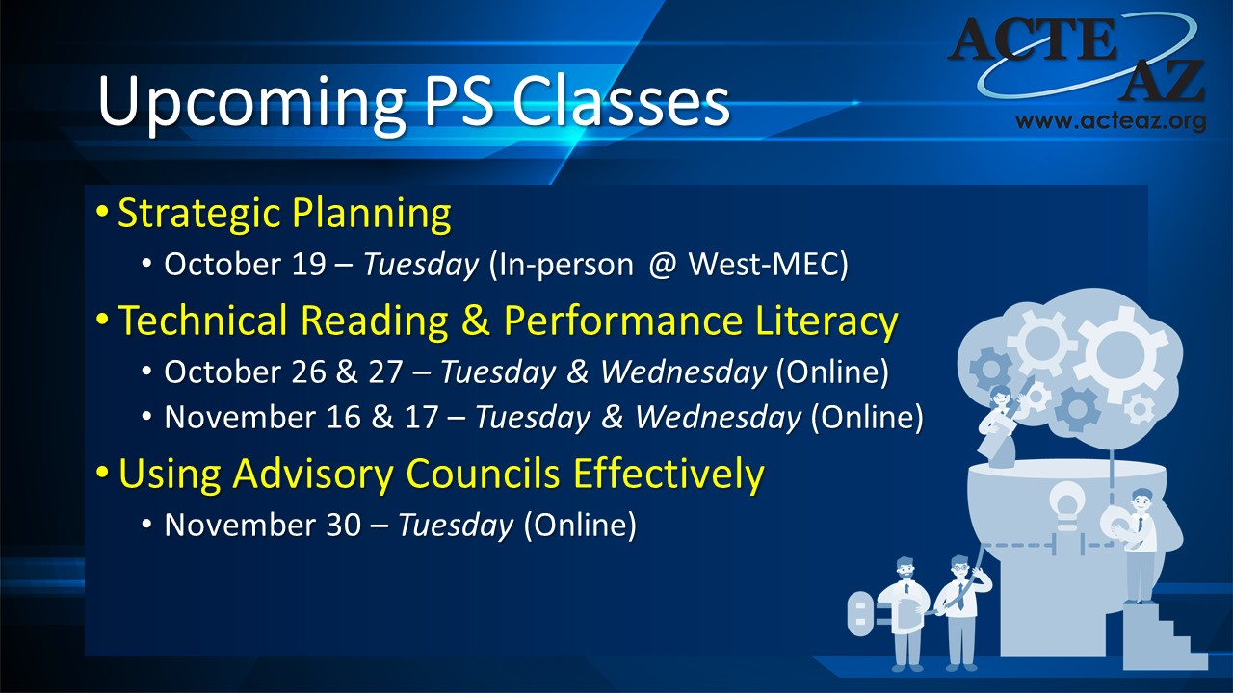

Slide 110
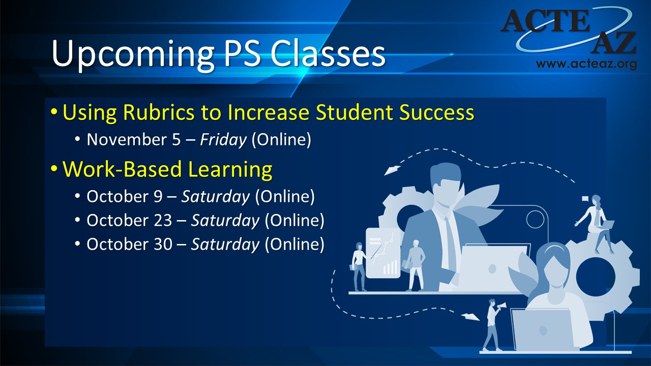

Slide 111
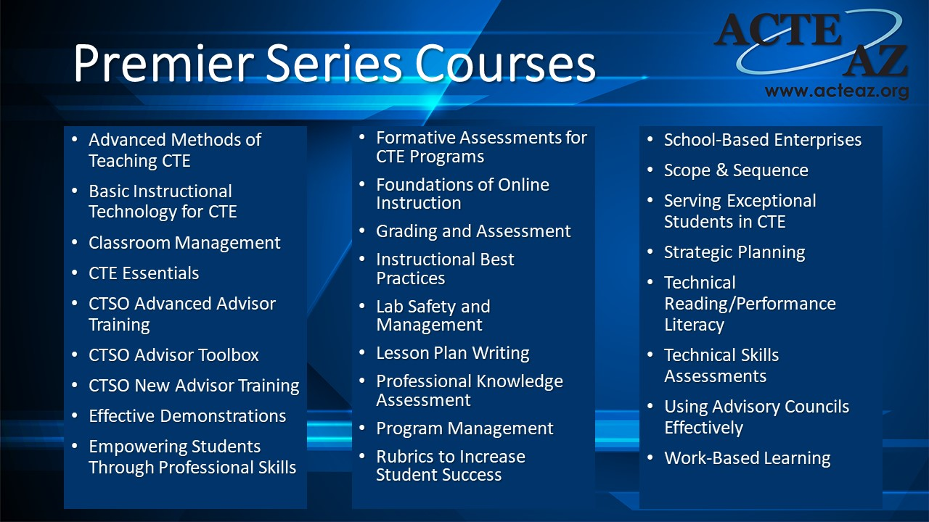

Slide 112
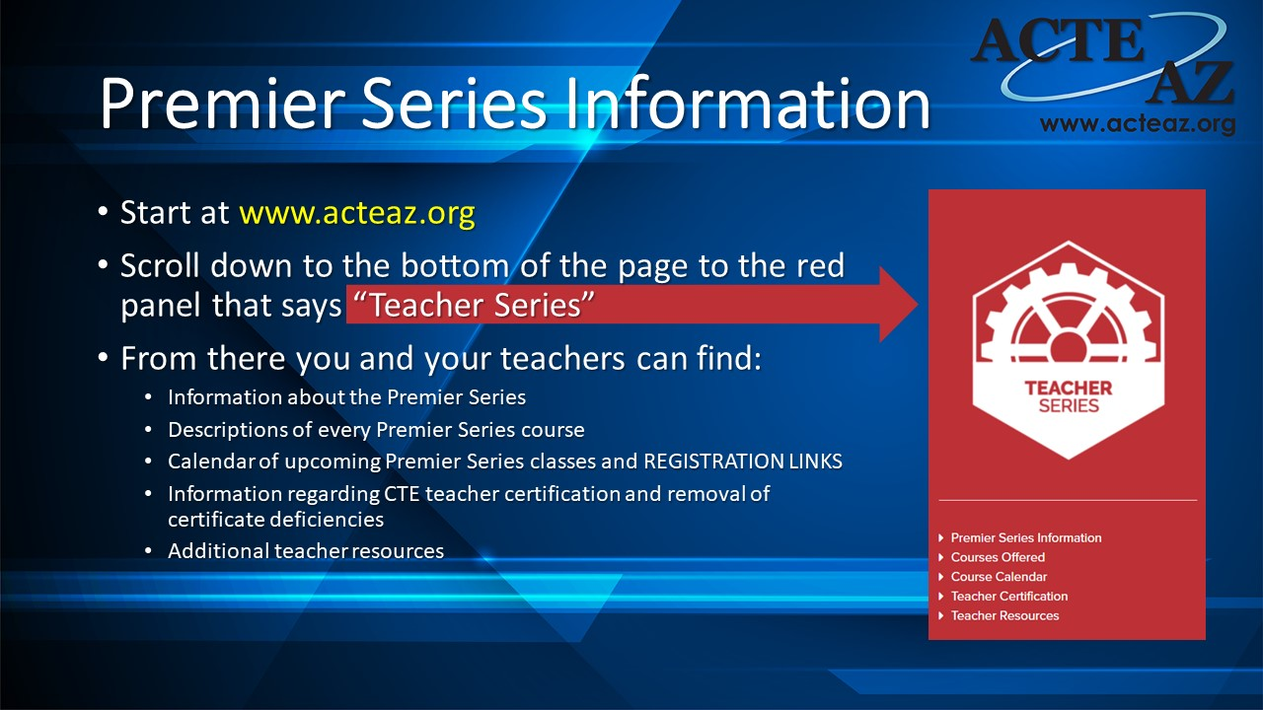

Slide 113
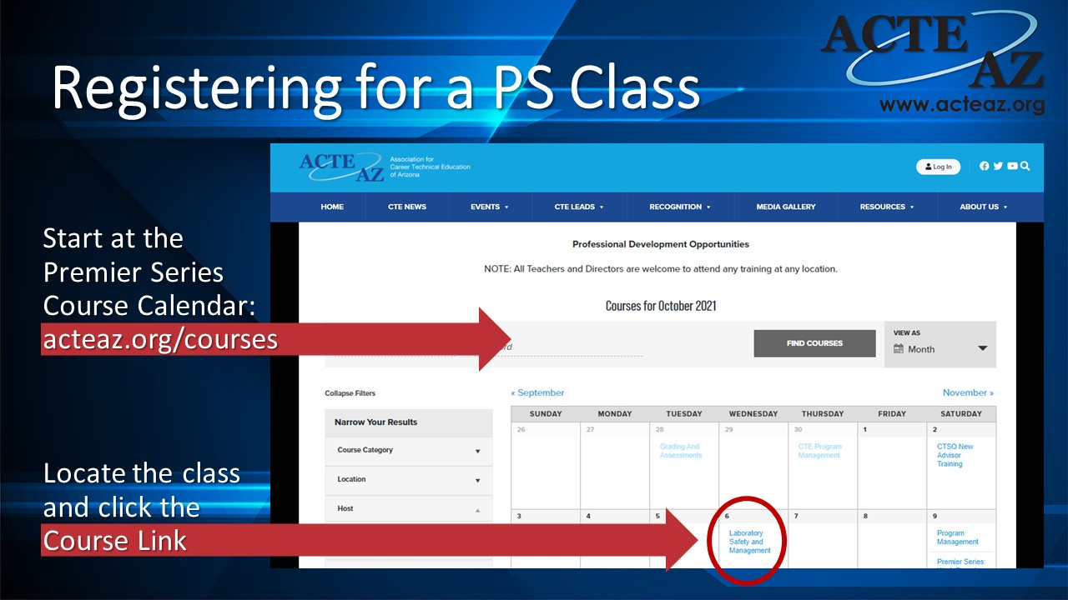

Slide 114
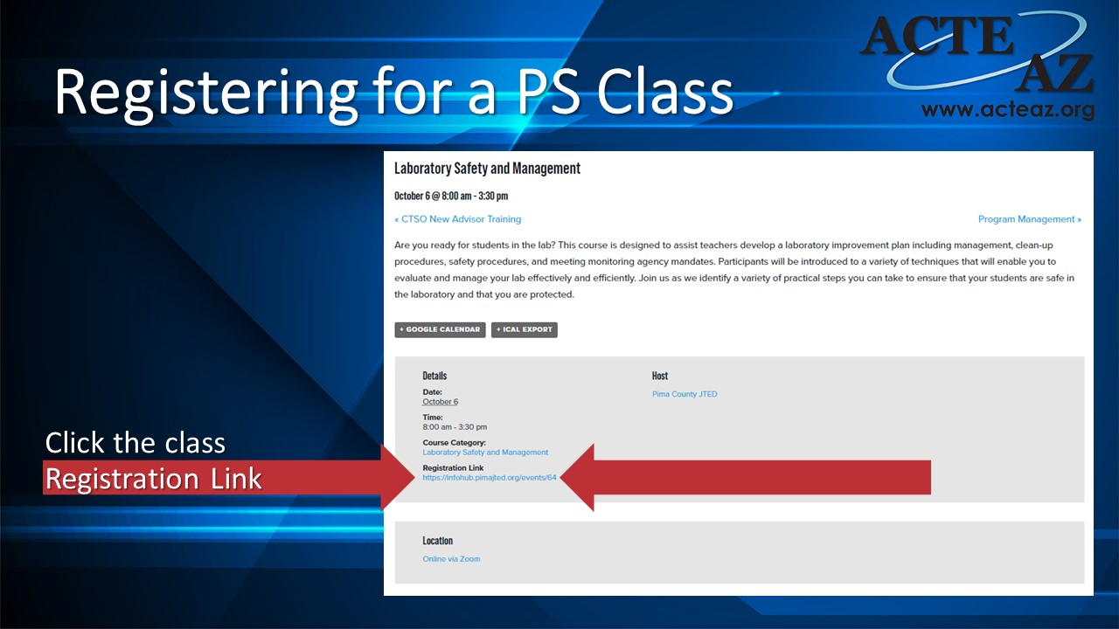

Slide 115
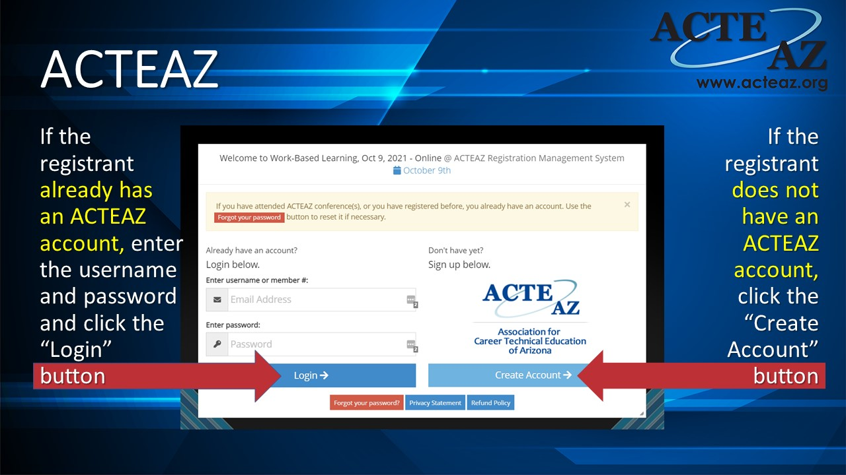

Slide 116
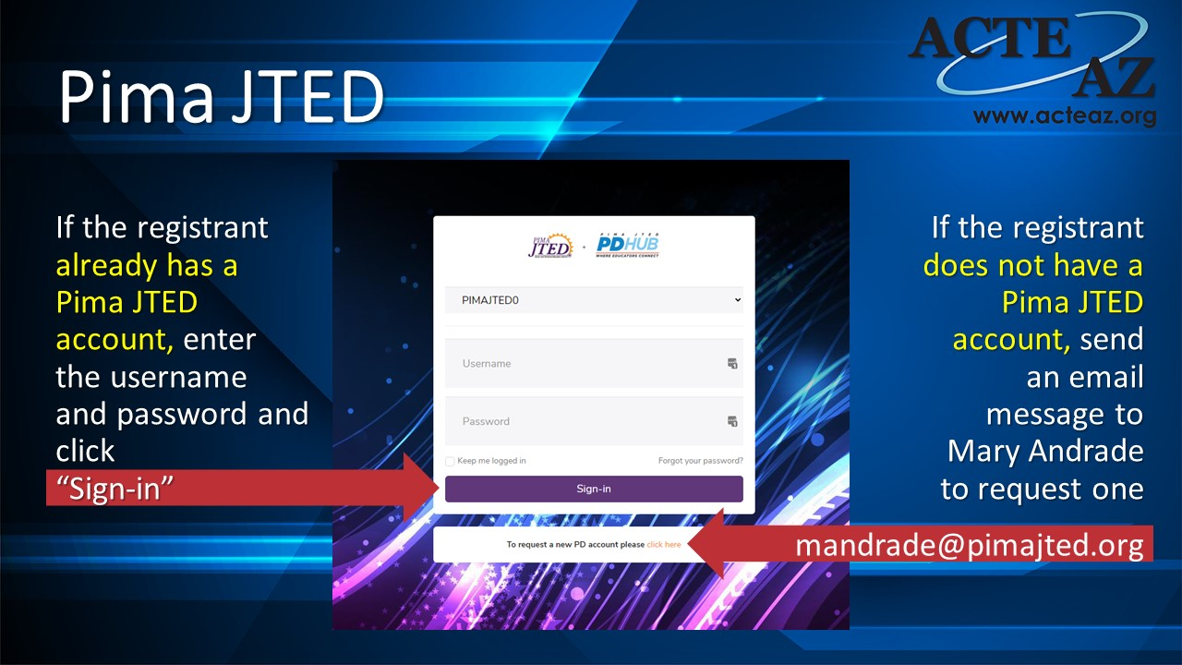

Slide 117
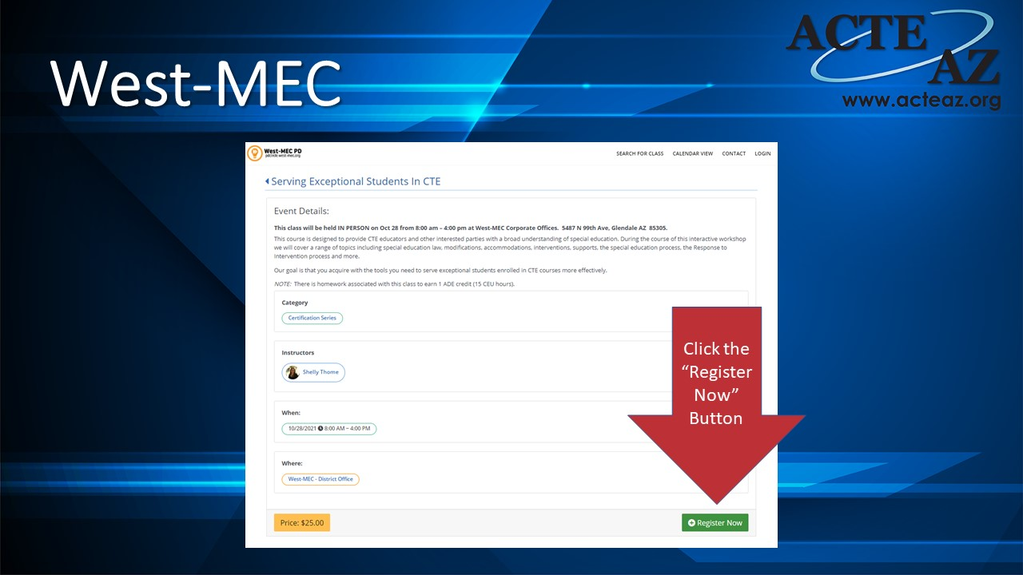

Slide 118
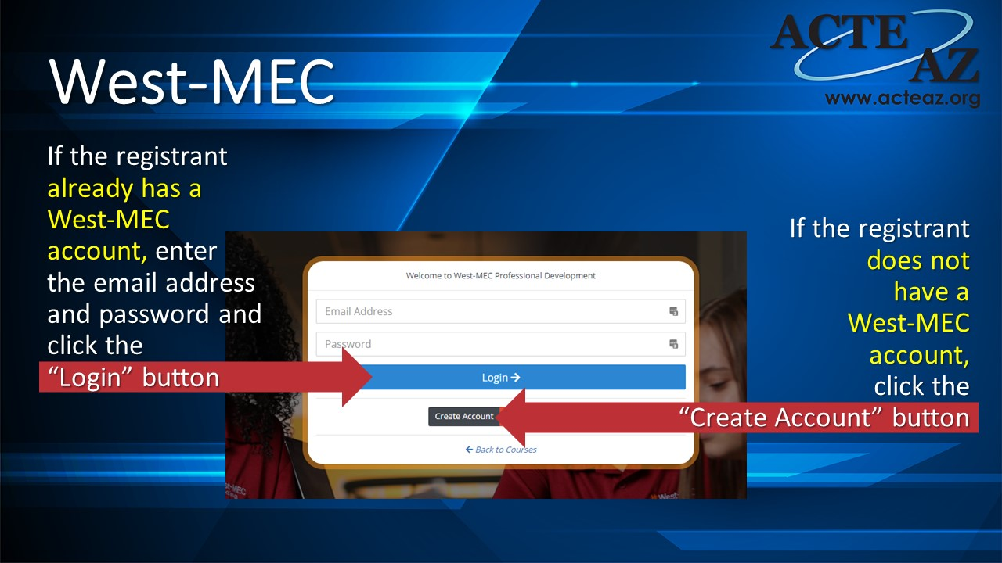

Slide 119
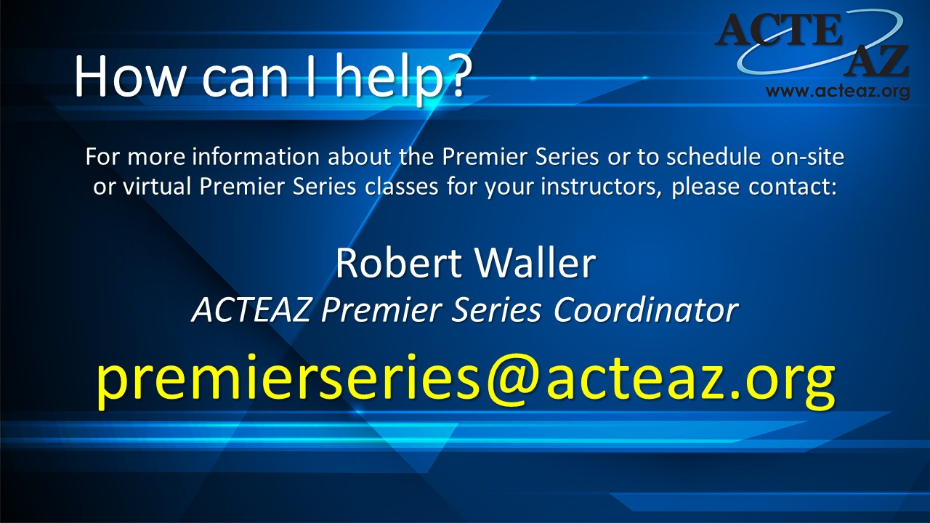

Slide 120


News and Updates
CTE Curriculum Connection
Upcoming Events
2021-22 Meeting Dates

Slide 121

CTE Curriculum Connection
Have you Checked the Connection site
  CTE Program Instructional Resources
    Video links
New Resources
  Announced via Discussion Forum
  Links in email
Training and Support
  Please reach out for a training session

Slide 122

Upcoming Events
Blueprint & Instructional Framework
Virtual Events (Asynchronous and Synchronous)
During Non-contract hours
Eligible for Project Payment
Programs
Accounting
Architectural Drafting
Automotive Collision Repair
Precision Machining
Mechanical Drafting
Diesel Engine Repair
Electronic Technologies
Welding
Nominate Today:
https://bit.ly/ConsortiumBlueprintEvent22

Slide 123
Meeting Dates
Quarterly Meeting
October 27, 2021 10:00am - 12:00pm
    Virtual via Zoom
    Collaboration Session
Future Quarterly Meetings
  February 9, 2022
  April 20, 2022

Slide 124




Reach us: support@ctecaz.org
Follow on Social Media:

Slide 125



Six Ways to Ensure Student and Program Success on the Technical Skills Assessments (TSAs)
Teach
Teach the content of the technical standards.
Use
Use the Blueprint for Instruction and Assessment, Instructional Framework, and Instructional Terminology to inform teaching and learning.
Use
Use the Assessment Reports as a planning tool.
Ensure
Ensure the best time for your students to take the test.
Know
Know the programs that are being tested and the testing schedule.
Prepare
Prepare your students to take the test.

Slide 126

Technical Standards
Teach the Content of the Technical Standards
Why?
The program standards (S/MCs) emphasize learning goals focused on key knowledge and skills.
They provide a strong sense of what students and teachers are expected to do.
When?
A discussion with the Program Specialists, teacher requests, and change and advancement in industry are critical in determining the need for standard review.
How?
Notes:
Use the table from About Standards to expand on bullets
Why: Not only in curriculum and instruction but also for assessment purposes. Look for contextual detail and enough specificity to assure a common understanding of learning expectations. Look for a clear progression of knowledge and skills and missing knowledge, skills, strategies, or processes.

Slide 127

Technical Standards
Teach the Content of the Technical Standards
Who?
The Arizona Career and Technical Education Quality Commission is the validating authority of the standards.
When?
Once endorsed, the completed standards are uploaded to the CTE website and further disseminated to teachers by the Program Specialists.
What?
Header, standards and measurement criteria, i.e. and e.g.

Slide 128


Use Blueprint for Instruction and Assessment, Instructional Framework, and Instructional Terminology to Inform Teaching and Learning
Items on Test
Domain 1 – 36 items
Domain 2 – 24 items
Domain 3 – 16 items
Domain 4 – 4 items
Provides additional and clear direction with measurement criteria
Domains align with the Blueprint
Standards and instructional time

Slide 129



Technical Skills Assessment
Use Assessment Reports as a Planning Tool
TSA reports provide a numerical description of what students learn and how well programs perform.
The Program Assessment Report shows the percentage of correct responses for all students for each standard. Results identify program strengths and weaknesses that can be used to facilitate best practices among campuses.
The Statewide Performance Report shows highest to lowest results for one program sorted by CTED/Non-CTED, district, and school. Each district/school performance can be viewed relative to other districts/schools offering the same program.
The Total Program Report shows highest to lowest results for one or all programs sorted by CTED/Non-CTED, district, and school. Each district/school performance can be viewed relative to other district/school performances.
Notes:
What to consider when comparing the program results:
Number of students being tested
Number of students requiring special accommodations
Newness of program technical standards
Teacher background and experience
Commitment to the standards and the Blueprint for Instruction and Assessment

Slide 130





Technical Skills Assessment
FAST FACTS
Fact 1
Fact 2
Fact 3
Fact 4
Fact 5
TSA scores are shown as percentages (60% of 80 operational items).
TSA results are shown at the standard level not the measurement criterion level.
Test configuration is based on available TSA Items for the Blueprint Domains.
Overall design of the TSA is to encourage teaching to the standards and not to the test.
COLLABORATE!
COLLABORATE!
COLLABORATE!
Most Importantly: Ensure the Best Time for your Students to Take the Test.
Notes:
FAST FACTS
TSA scores are shown as percentages (60% of 80 operational items).
Do the math. If a student’s test result is 78%, he answered 62 of the 80 questions correctly. If his result is 98%, he answered 78 of the 80 questions correctly. Percentages are neither rolled or down.
2. TSA results are shown at the standard level not than the measurement criterion level.
The test configuration differs from testing period to testing period. For example, this year Standard 1.0 may have items on Measurement Criteria 1-4-7-9 and next year Standard 1.0 may have items on Measurement Criteria 2-3-5-10. Therefore, it’s important to teach all the content of each standard.
3. Test configuration is based on available TSA Items for the Blueprint Domains.
The Blueprint for Instruction and Assessment suggests the percentage of instructional time for each domain and the standards within those domains. The instructional percentage for each domain equates to the percentage of assessment items on the TSA.
4. Overall design of the TSA is to encourage teaching to the standards and not to the test.
The key to success on the test is to use the Instructional Framework to understand the content of the standards and Blueprint for Instruction and Assessment to structure learning time and assessment review. Remember! Teachers develop the Blueprint, Instructional Framework, and TSA Items.
5. COLLABORATE! COLLABORATE! COLLABORATE!

Slide 131

Technical Skills Assessment
Why the change?
Phase 1 - 2006
100 items for all TSAs
Each TSA with its own pass score
Phase 2 - 2016
100 items for all TSAs (80-20 configuration)
Pass score of 60% of 80 operational items for all TSAs
Test results shown at standard level for reliability and security
Test results shown at measurement criterion level
Blueprint for Instruction & Assessment and Instructional Framework
TSA data for A-F Report Card and Perkins Program Compliance
Fact 2
TSA results are shown at the standard level not the measurement criterion level.
Notes:
Domain 1 is highlighted in each report. Notice the variation in percentages. There are 2 factors that effect the TSA from year to year in which breaking the reports down to M/C will never change…Configuration and Scores.

Slide 132
Technical Standards and Skills Assessment
Questions
Judy Balogh
Judy.Balogh@azed.gov
Cathy Reed
Cathy.Reed@azed.gov

Slide 133
Next CTE Administrators Meeting – November 4, 2021
Prescott Resort

