Slide 1
COVID Impact
Enrollment and Mobility

Slide 2

Content and Notes
Continuation of the September 27, 2021 presentation on Enrollment and Mobility
Enrollment
Mobility

Slide 3
Enrollment
Unique count of students enrolled from July 1 to June 30

Slide 4
Overall Findings
State:
  Enrollment declined across the state during the 2020-2021 school year
  Lower grade levels saw more impact, especially early childhood grades
  Homeless saw the largest program drop in the 2020-2021 school year
  Little to no change in the Hispanic enrollment in 2020-2021 school year
County:
  66% of the counties saw a +/- 3% change in 2019-2020, 48% of the counties in 2020-2021 experience the same level of change
  Navajo county experienced the largest decline in enrollment overall
  Gila County had approximately 7% more students in their schools in 2020-2021 compared to the prior year

Slide 5
Overall Findings
LEA (District and Charter Holders):
  54% of the LEAs saw a +/- 5% change in 2019-2020,
    42% of the LEAs saw a +/- 5% change in 2020-2021
    Lower grade levels saw more impact, especially early childhood
  In 2019-2020 54% of LEAs saw a decrease in students enrolled
    In 2020-2021 62% of LEAs saw a decrease in students enrolled
Two established AOI LEAs did see their numbers more than double in 2020-2021
Biggest declines in students enrolled for 2020-2021 school year were schools that served early education students or unique configuration

Slide 6
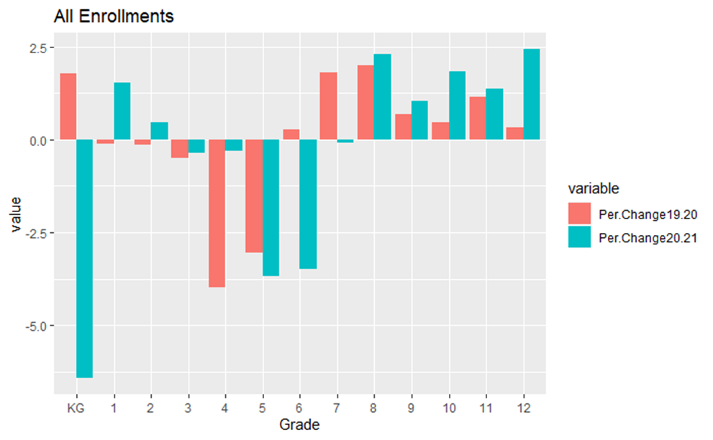
Enrollment Percent Change by Grade

Slide 7
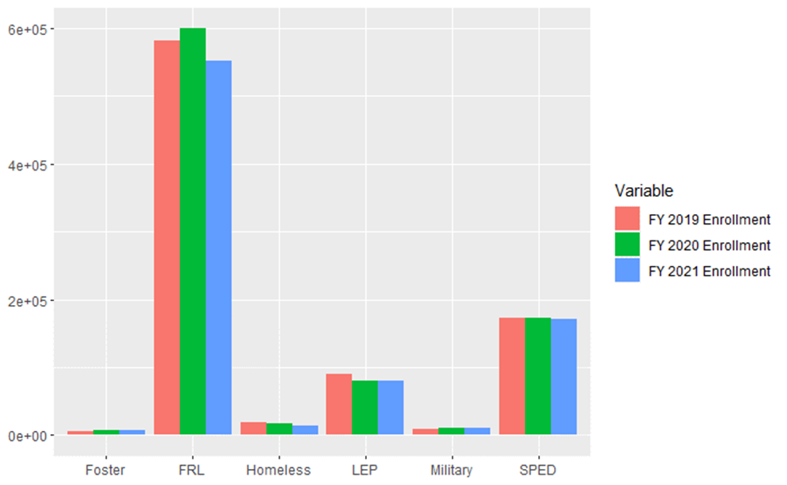
Program Participation

Slide 8
Mobility
Analysis of withdrawal, year end codes and entry codes

Slide 9
Overall Findings
Student moved around more in 2020-2021 than they had in the previous two years
Alternative Schools and Arizona Online schools saw less fluctuation than the Brick-and-Mortar schools
More mobility is seen in the elementary grade levels versus the high schools
There was increase movement from district to charters and charters to district in the 2020 2021 school year, changing the overall patterns
Large percent of students who left for homeschool returned in 2020-2021 or at the start of 2021-2022

Slide 10

Movement between District Schools and Charter Schools

Slide 11
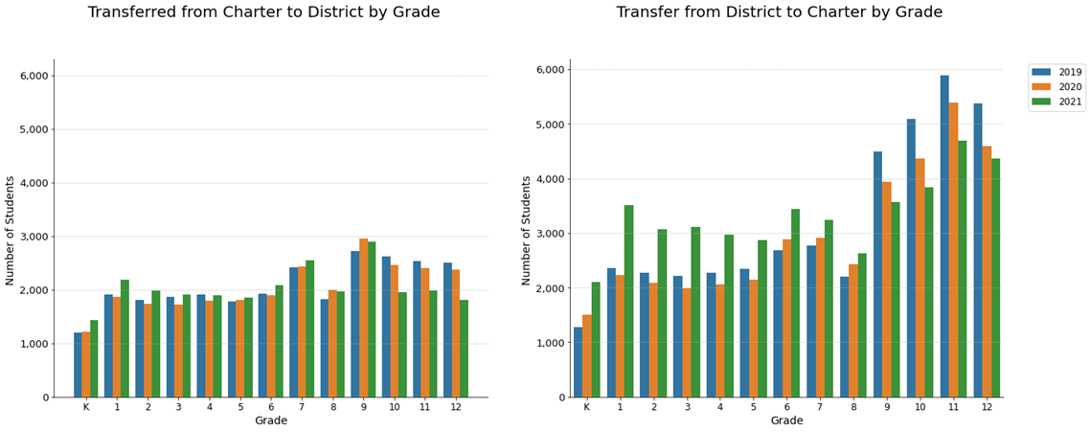
Mobility Between District and Charter
During a fiscal year, July 1 through June 30

Slide 12
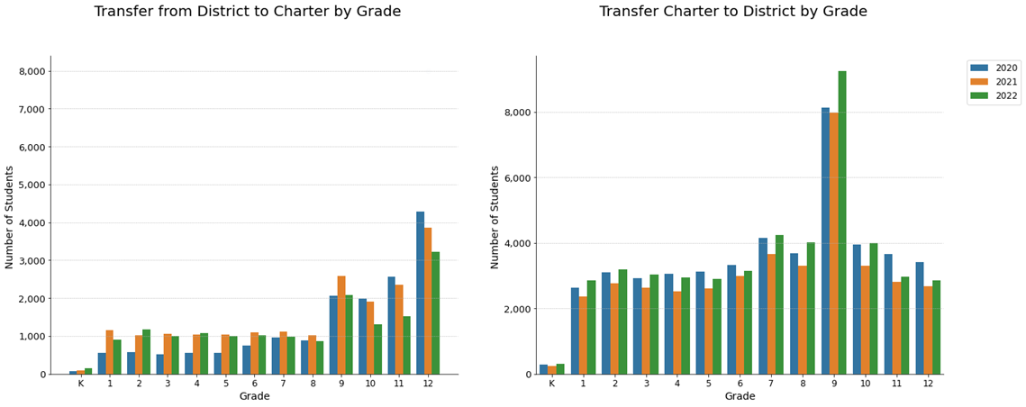
Mobility Between District and Charter
From the end of one school year to the beginning of the next

Slide 13
Movement of Homeschool students

Slide 14
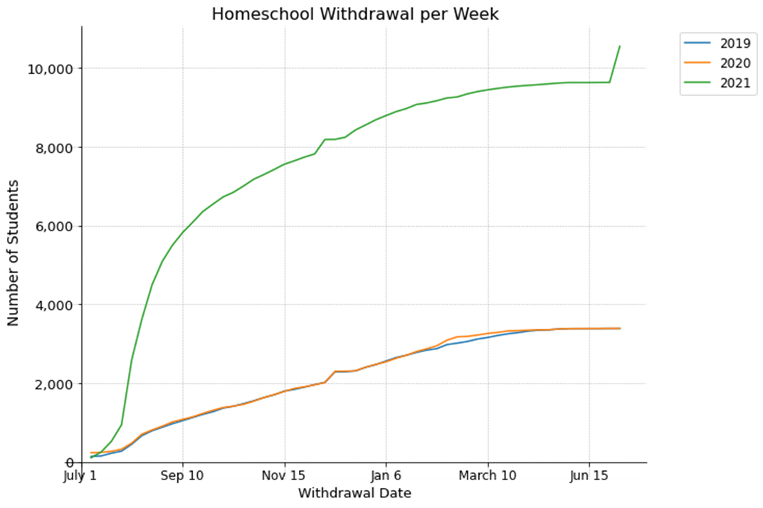
Counts of Students Using Homeschool Withdrawal Codes

Slide 15
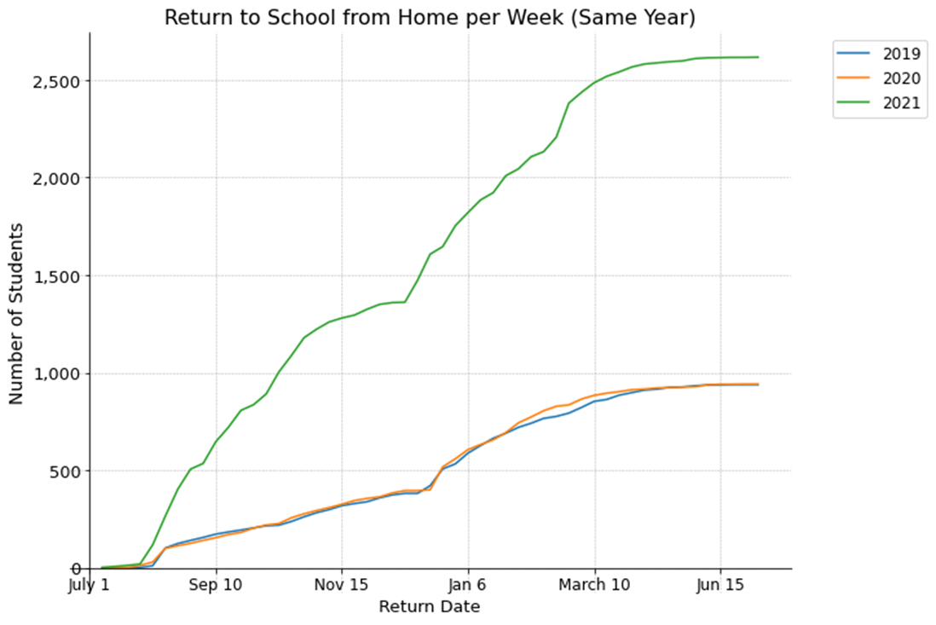
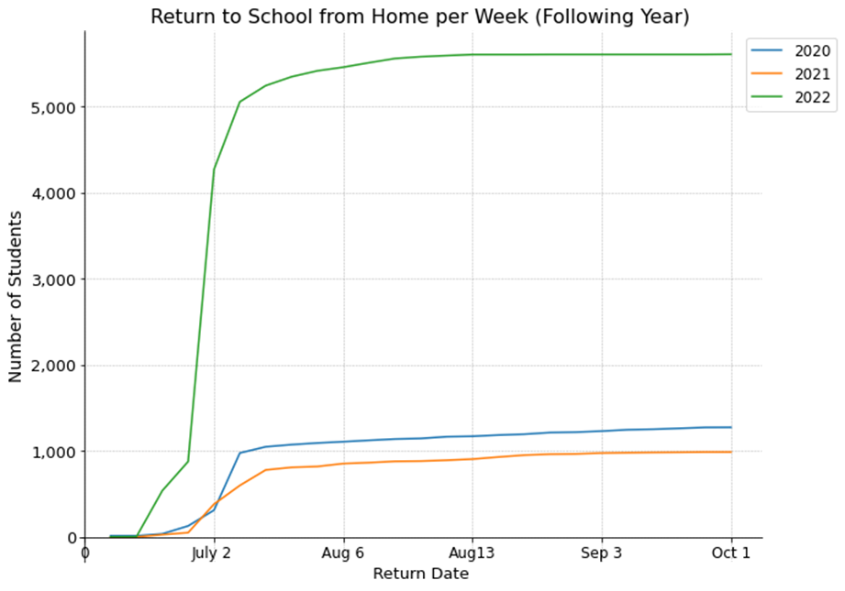
Counts of Students Returning to Public Schools
Students who ended the year as homeschool status,
but return within the first 90days
Students returning in the fiscal year from July 1 to June 30

Slide 16
Additional Information
Enrollment spreadsheets
Mobility spreadsheets
Additional slide deck with more graphics of the changes with enrollment and mobility
How To & Resources available in spreadsheets

Slide 17
Conclusion
Questions

