Slide 1
Early Examination of the Impacts of COVID on EL
Dr. Eric Hedberg, Senior Associate, Abt Associates
Dr. Paul Perrault, Senior Vice President – Community Impact and Learning, Helios Education Foundation

Slide 2
Why This Study?

Slide 3
Losses in effect size gains
The purpose of this analysis to the assess how growth across two-year intervals (e.g., end of 3rd to end of 5th) changed during COVID
We use an effect-size measure of learning, which is often used as a benchmark for natural learning patterns across grades.
While this analysis does not conclusively identify the loss due specifically to COVID…
  in many cases the earlier periods’ consistency provides support for COVID as a major cause,
  but not in all cases.
These Results are Preliminary

Slide 4
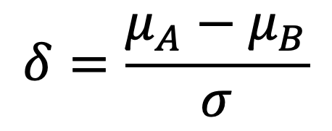
What is an effect size?
There are many effect sizes to quantify statistical relationships in “standard” units, e.g., correlation
Standardized differences in means divide the difference between two averages by a standard deviation
  Treatment vs. Control
  Female vs. Male
  5th grade vs. 3rd grade
Since the standard deviation and the averages are in the same units (e.g., AZMerit points, ACT scores, SAT scores) the effect size is simply in standard deviation units.
$$δ=\frac{{μ_{A}−μ}_{B}}{σ}$$

Slide 5
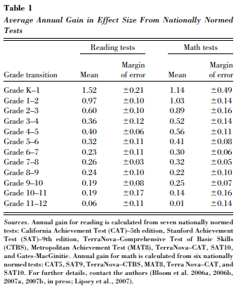
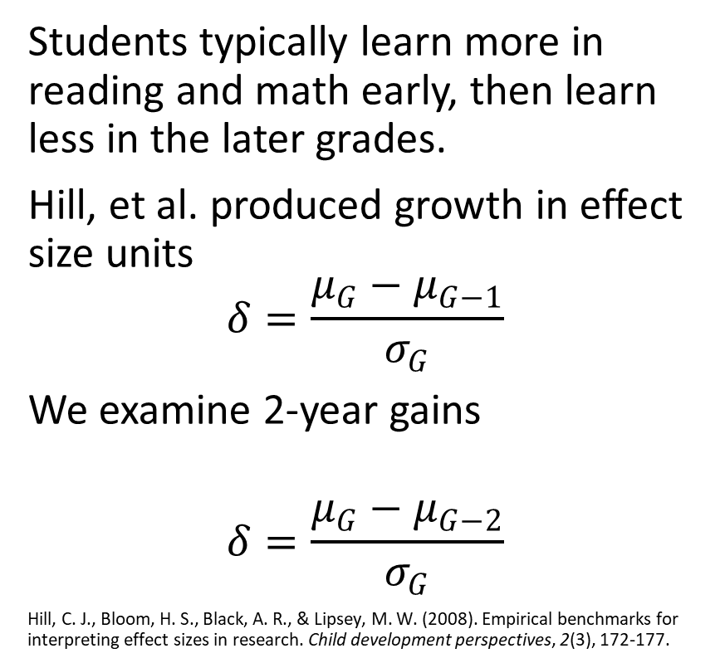
Growth as an effect size
Students typically learn more in reading and math early, then learn less in the later grades.
Hill, et al. produced growth in effect size units
$$δ=\frac{{μ_{G}−μ}_{G−1}}{σ_{G}}$$
We examine 2-year gains
$$δ=\frac{{μ_{G}−μ}_{G−2}}{σ_{G}}$$
Hill, C. J., Bloom, H. S., Black, A. R., & Lipsey, M. W. (2008). Empirical benchmarks for interpreting effect sizes in research. Child development perspectives, 2(3), 172-177.

Slide 6
Data and methods
This table shows number of students in each analysis
These are students in AZ who were eligible for EL services between 2016-2021
  Grades 3-6 in 2016-2019
  Grades 5-8 in 2017-2021s
These Results are Preliminary

Slide 7
Data and methods continued
Table show number of students in each analysis
Analysis is the average within-student growth across two grades of students who were eligible for EL services in the staring and latter year with test scores in both years
  Growth standardized with latter-grade SD
  Models controlled for demographics and participation in ELL programs and used random effects for districts and schools in each year
These Results are Preliminary

Slide 8
Data Summary
These Results are Preliminary
% Female and Latino consistent across samples (45% and 90%)
% Low SES lower during COVID (85% pre COVID to 75% post)
COVID scores lower, bigger differences for earlier grades
Standard deviations (variance) in English scores consistent
Standard deviations in reading are larger (more variance)
Standard deviations in math are much larger (more variance)

Slide 9
End
Standard
Deviations
These Results are Preliminary
The variation in scores increased dramatically in 2021
Additional analyses used growth in AZMerit metrics reported similar findings

Slide 10
Gains in Score
These Results are Preliminary

Slide 11
Effect sizes
These Results are Preliminary
Growth in effect size units reduced for all analyses during COVID
In some cases, there is also a successive drop before COVID
  e.g., grades 5-7

Slide 12
These Results are Preliminary

Slide 13
These Results are Preliminary

Slide 14
These Results are Preliminary

Slide 15
These Results are Preliminary

Slide 16
Summary and Next Steps
In all analyses, gains in effect size units were lower during COVID years
  Some evidence that these losses were impacted by non-COVID related trends (e.g., growth from grades 5-7 in reading)
  Large differences in the percent low-SES and much higher standard deviations leave the strict interpretation inconclusive
Next iteration: Compute loss for districts and correlate with district variables to understand COVID adaptation associations* with loss
  will use propensity weighting (likelihood of taking the State Test) to account for confounding factors
  compute the percent of variation associated with schools and districts
  *not causes!

