Slide 1
COVID Impact Reporting
Arizona Department of Education
Arizona State Board of Education
Center for Assessment
Helios Education Foundation
Arizona State University
Abt Associates
Arizona State Board of Education Technical Advisory Committees

Slide 2
Reporting
Center for Assessment – Growth Analysis
ADE Accountability – Proficiency Analysis
Helios and Abt Associates – English Learner Analysis
ADE Accountability – Enrollment and Mobility
Notes:
This is state level data –
LEA and School (maybe) data not available until October-
Multiple Points of data

Slide 3
Looking at Impact through Growth
Dr. Damian Betebenner is a senior associate at the Center for Assessment where his work focuses on the development, implementation, integration and reporting/communication of state level growth analyses.
He is the architect of the student growth percentile (SGP) model, which began in Colorado and has since been adopted in more than two-dozen other states. He is the co-author of the open-source software used to calculate student growth (the R based SGP package). In 2021, Dr. Betebenner has worked with states to prepare for the use of their state data to help understand the academic impact on students brought about by the pandemic.
Adam VanIwaarden is an associate at the Center for Assessment where he co-leads state work on growth analyses. Adam is co-author of the SGP package. In 2021 he led much of the analytic innovation required to understand missing student assessment data and what effect it had on understanding student performance during the pandemic.
Dr. Xiaoyuan Tan is a Senior Data Analyst with the Arizona Department of Education Accountability Unit. Dr. Tan has been responsible for the calculation of the A-F growth scores since their commencement in 2012. She stands as an expert in the accountability data, its calculations and interpretation for almost a decade.
Damian Betebenner, Ph.D.
Adam VanIwaarden, Ph.D.
Xiaoyuan Tan, Ph.D.

Slide 4
Pandemic Related Academic Impact in 2021
A look at results from Arizona
Damian Betebenner & Adam Van Iwaarden
Center for Assessment
Arizona State Board of Education Meeting
September 27st, 2021
Notes:
Scott

Slide 5
Pandemic Related Academic Impact
We are all aware that the pandemic greatly disrupted the lives of people worldwide over the last 18 months.
Students were dramatically impacted as education was delivered in many new ways to students nationwide.
A concern of many is to what extent the pandemic impacted students: Academically, emotionally, physically.
The Center for Assessment has been working with a dozen states to investigate the extent to which the pandemic has impacted student learning.

Slide 6
What do we mean by “Academic Impact”?
The pandemic and all the ensuing disruptions functions as a kind of “academic headwind”, impeding (in general) the academic progress of students.
Headwinds impede progress in two ways:
  They slow one’s rate of progress
  The slower rate of progress leads to less distance being travelled.
In education these two outcomes represent themselves as:
  Decrease in student growth.
  Decrease in student attainment.

Slide 7
Pandemic related academic impact
Understanding pandemic related impact necessarily requires looking back to pre-pandemic results.
The impulse of stakeholders to want to compare 2021 results with 2019 results is the correct impulse at both the individual, school, district, and state level.
Wanting to look at 2019 to 2021 change is an attempt to investigate impact.
The challenge is making 2019 to 2021 comparisons apples-to-apples comparisons.
Supporting these comparisons requires having a complete understanding is who constitutes the missing data.

Slide 8
Analyses for 2020-2021
With comparable results we can quantify pandemic related academic impact:
  At the state level
  Demographic subgroups including ethnicity, poverty
  Academic subgroups (special education, low/high achievers)
  By region/district/school
  By mode of education (remote/hybrid/in-person).
  Attendance
  English Language Learner impact can be evaluated using AZELLA results.

Slide 9
Incomplete Data
A threat to the validity of academic impact results in 2021 is less that normal participation in state assessments
In some school/districts, participation on AzM2 assessments was below that traditionally observed.
Would results for the school/district/state been the same if all students had tested? Would academic impact appear the same?
As part of Arizona’s academic impact analyses we employed multiple imputation to determine to what extent missing data impacts summary results, flagging results that are likely different due to student non-testing.

Slide 10
Looking forward to 2021-2022
As we (hopefully) transition from pandemic to recovery, AzM2 data from 2021-2022 will provide an excellent basis to understand what type of recovery students are demonstrating:
V-shaped,
U-Shaped,
L-Shaped, or
No recovery
Using data for these purposes is not the typical use of data for “accountability” and requires using results in ways not related to accountability. This can be a delicate balancing act.
I’m optimistic about ADE’s use of AzM2 2020-2021 data to evaluate academic impact and subsequently to monitor and inform recovery in 2021-2022.

Slide 11
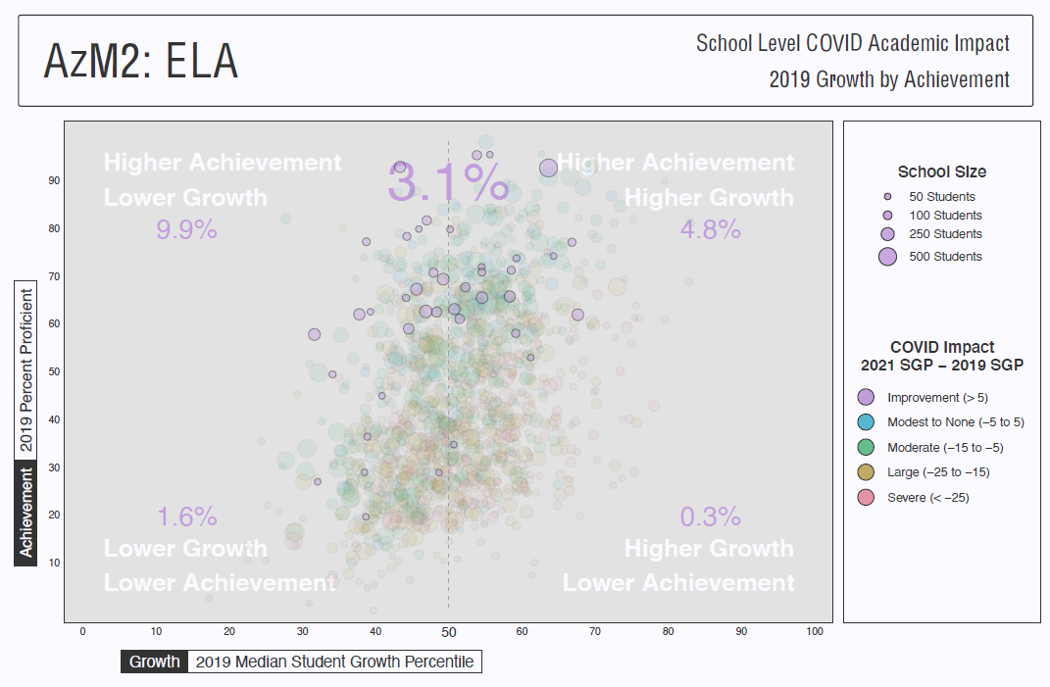
Notes:
Be sure to reiterate this is for “IMPROVEMENT”

Slide 12
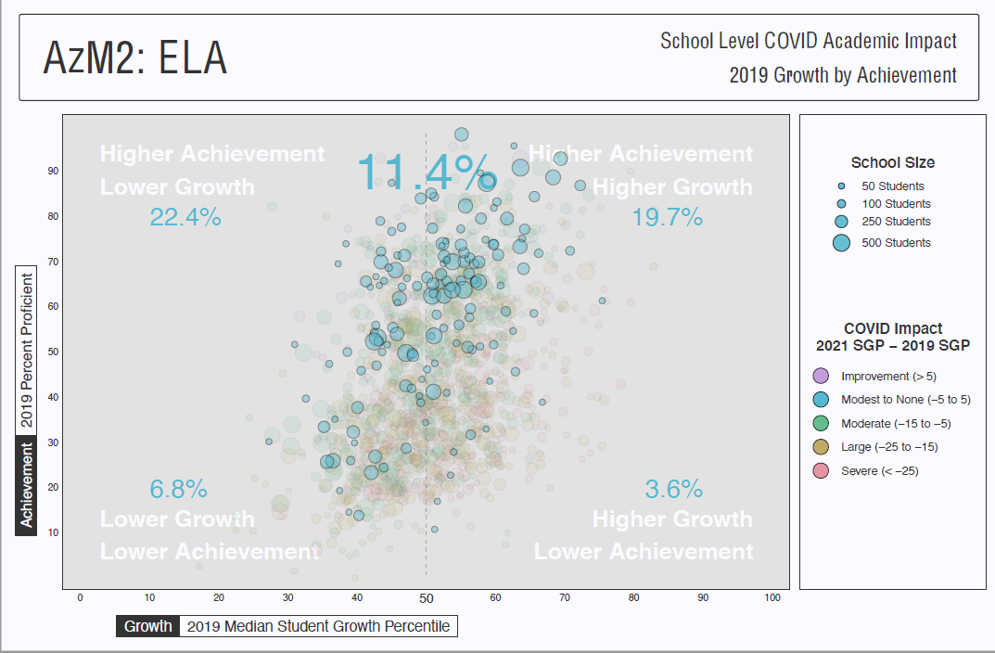

Slide 13
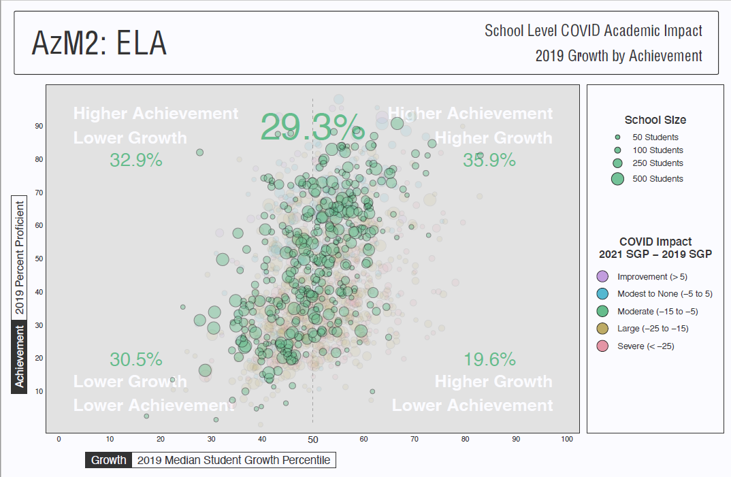

Slide 14
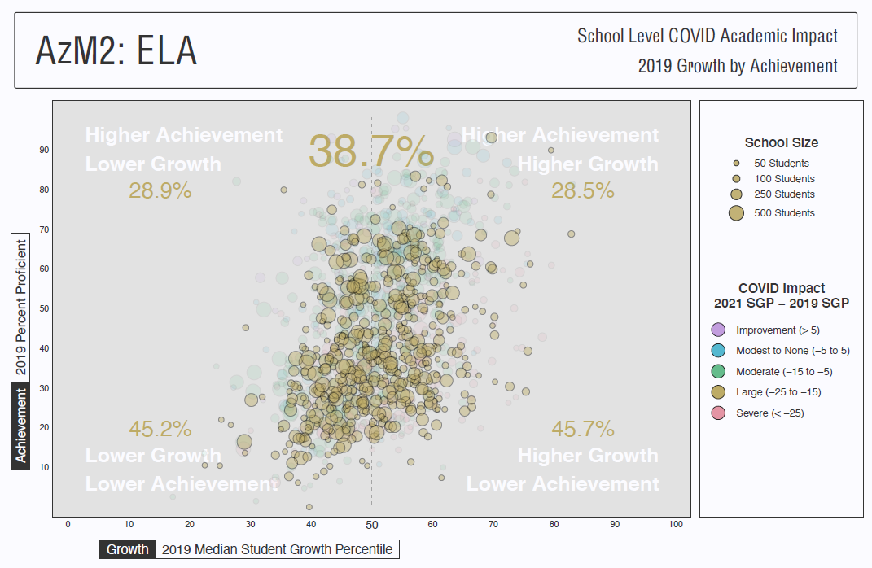

Slide 15
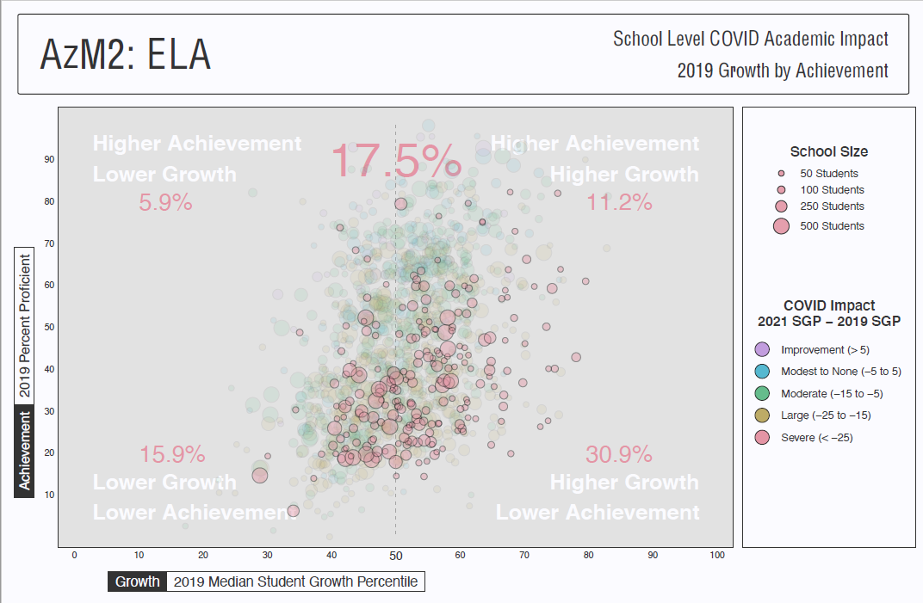

Slide 16
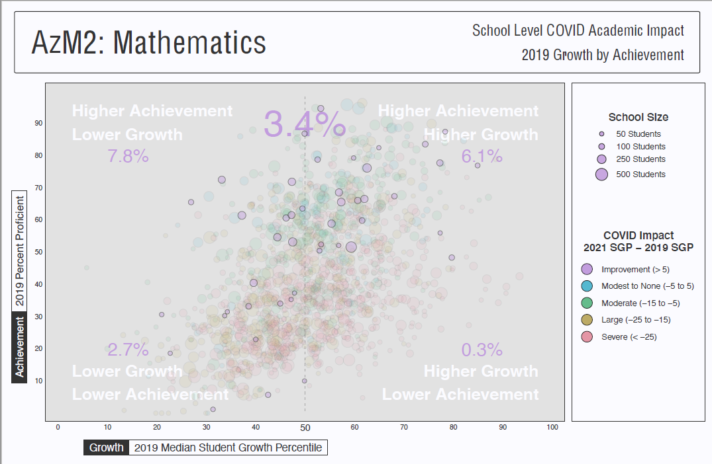

Slide 17
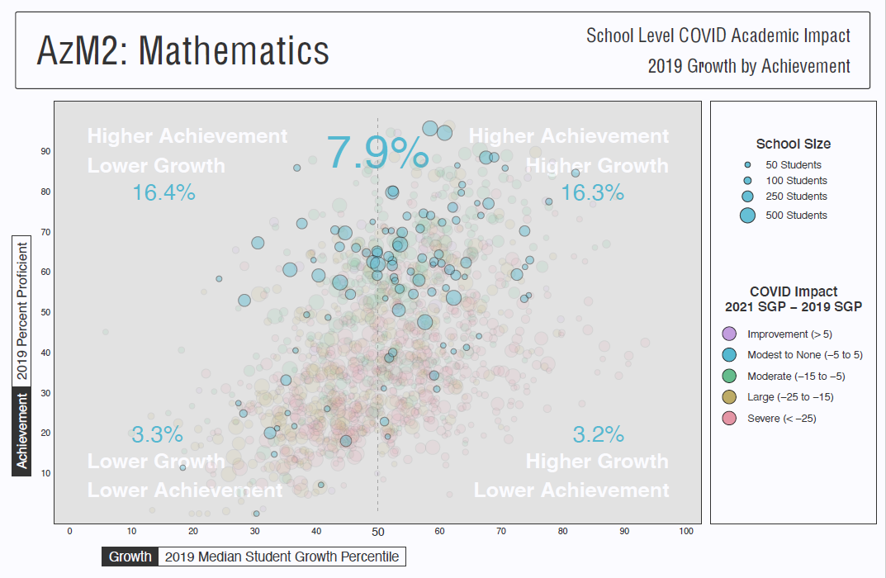

Slide 18
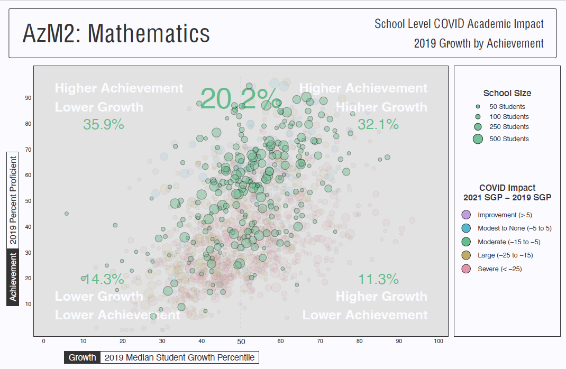

Slide 19
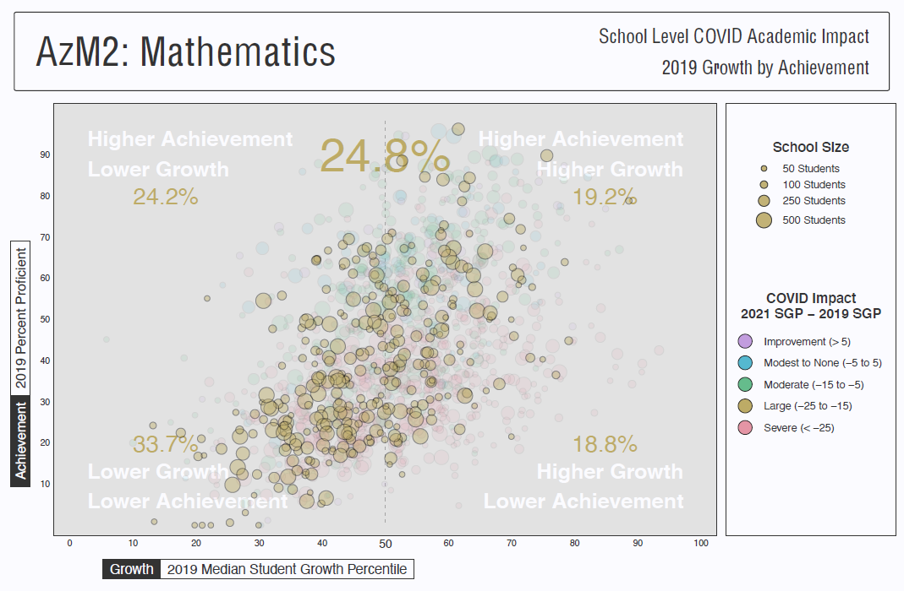

Slide 20
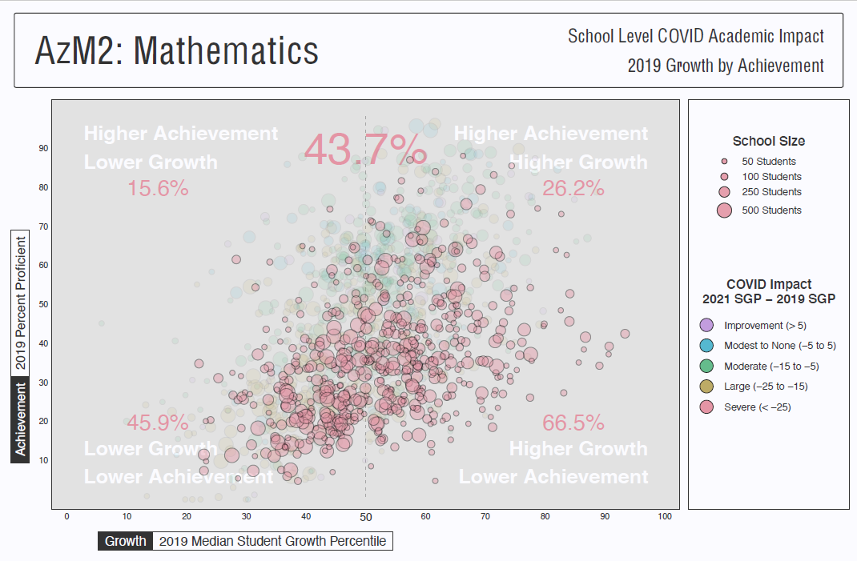

Slide 21

Questions

Slide 22
Looking at Impact through Proficiency
Kimberly Shinault serves as the Data Analyst with ADE. She has a Master’s of Public Health in Biostatistics from the University of Oklahoma, and a Master’s of Science in Psychology-Research Methodology from Walden University. Her responsibilities include data analysis on a variety of projects within the Accountability department, specializing primarily in the analysis and presentation of English Learner data and enrollment.
Jessica Mueller currently works as a Research and Data Analyst with the Arizona State Board of Education. She received her Master Degree in Social work in the field of policy, administration and community practice. She worked with Arizona State University in the support and evaluation of psycho-social programs targeting anxiety in elementary schools. She has worked on many research programs regarding children.
Kimberly Shinault
Jessica Mueller

Slide 23
Andrew Ho, Harvard School of Education
Three test-score metrics that all states should report in the COVID-19 affected spring of 2021
“The Match Rate
Accurate interpretation of aggregate scores requires an accurate answer to the question, what population does this report describe? In a typical year, this answer is straightforward: the students in grade, school, or district.2 The percentage of tested students is typically high, with targets above 95%. Longitudinally, many schools have nontrivial grade-to-grade mobility rates, where students leave or enter some schools more frequently between school years than other schools. However, mobility rates are typically steady over time.
In this school year, there may be substantial numbers of enrolled students who may not have comparable scores, whether they opt out of testing or test remotely in noncomparable conditions. In addition, there may be substantial and atypical numbers of students who are not in school who otherwise would be enrolled, above and beyond typical mobility rates.”

Slide 24
First Look at Impact In Grade Levels (3, 6 & 10) for English Language Arts
Grade Level | 2017 Percent Tested | 2017 Percent Proficient | 2018 Percent Tested | 2018 Percent Proficient | 2019 Percent Tested | 2019 Percent Proficient | 2021 Percent Tested | 2021 Percent Proficient
Grade 3 | 96.94 | 43.10 | 93.87 | 43.65 | 93.89 | 46.11 | 88.83 | 34.79
Grade 6 | 96.98 | 41.14 | 93.78 | 38.82 | 94.09 | 42.10 | 87.22 | 37.13
Grade 10 | 87.90 | 31.75 | 83.74 | 31.98 | 70.65 | 33.51 | 71.36 | 31.68
Notes:
Take out “Not Tested”

Slide 25
First Look at Impact In N.E. Arizona in Mathematics
Group | 2017 Percent Tested | 2017 Percent Proficient | 2018 Percent Tested | 2018 Percent Proficient | 2019 Percent Tested | 2019 Percent Proficient | 2021 Percent Tested | 2021 Percent Proficient
Native American | 83.00 | 20.23 | 78.19 | 21.16 | 76.06 | 21.11 | 41.25 | 10.95
Apache County | 83.26 | 22.69 | 81.28 | 27.15 | 81.53 | 27.92 | 25.16 | 28.50
Coconino County | 79.96 | 32.92 | 79.65 | 34.60 | 71.29 | 32.83 | 49.78 | 22.03
Navajo County | 83.20 | 29.38 | 81.81 | 31.80 | 80.91 | 33.50 | 55.88 | 27.68

Slide 26
Looking at Impact through Arizona’s English Learner
Dr. Paul G. Perrault is Senior Vice President, Community Impact and Learning for Helios Education Foundation with more than 15 years of research and evaluation experience. Prior to joining Helios, he was a researcher at the Institute for Social Research at the University of Michigan, where he served as a lead investigator on Arizona’s Move On When Ready evaluation and as principal investigator on Yuma’s Ready Now Yuma evaluation.
Eric Christopher (E. C.) Hedberg earned his Ph.D. in Sociology from the University of Chicago in 2009. Most known for his work on evaluation design, Hedberg is an interdisciplinary quantitative methodologist with solid sociological training. Hedberg’s research interests include areas of methodology related to evaluation and analysis of ego-centric networks, and relatedly, the substantive areas of education, criminology, and social capital. Currently, Hedberg is a Senior Associate at Abt Associates, an Accredited Professional Statistician ® by the American Statistical Association, and a Sociologist. Hedberg's current areas of research include investigating the design of evaluations in education and criminology, in addition to measuring social capital through social network contextual effects. He is best known for estimating and publishing important experimental design parameters. Hedberg has authored or co-authored over 30 methodology-focused papers and books that have appeared in education, medical, and criminological journals, while also contributing to numerous reports and presentations at major research conferences such as APPAM, AERA, SREE, ASA, and ISNA.
Eric Hedberg, Ph.D.
Paul Perrault, Ph.D.

Slide 27
Achievement of Current EL Students
(3rd graders in 2015 - 7th graders in 2019
Notes:
Eric

Slide 28
Achievement of Current and Former EL Students
Notes:
Eric

Slide 29
Looking at Impact through Arizona Enrollment and Mobility
Dr. J. David Selby serves as the Director of Accountability. He received his Ph.D. in Public Policy and Public Administration from Arizona State University in 2020. He holds a Master of Public Policy from George Mason University. He specializes in quantitative analysis, performance management, and education policy. Previously, David worked as a high school teacher in Richmond, Virginia where he taught Computer Science, Economics, and Personal Finance.
Dr. Cristi Guevara holds a Ph.D. in Mathematics and a M.S. in Business Analytics from ASU. Her areas of focus include big data analysis and modeling, process improvement, mathematics education, teacher education, adult and underserved learners and diversity issues.
J. David Selby, Ph.D.
Cristi Guevara, Ph.D.

Slide 30
Enrollment – Students Count Just Once
Students | FY2019 | FY2020 | FY2021 | Percent Change 2019 – 2020 | Percent Change 2020 – 2021
ALL | 1,238,732 | 1,239,765 | 1,228,262 | 0.08 % | -0.93 %
Students with Disabilities | 172,334 | 172,273 | 171,197 | -0.04 % | -0.63 %
Poverty (Income Eligibility I & 2 | 582,546 | 600,264 | 553,172 | 3.04 % | -7.85 %

Slide 31
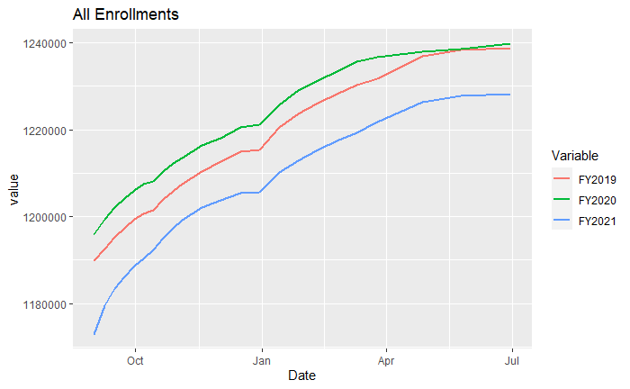
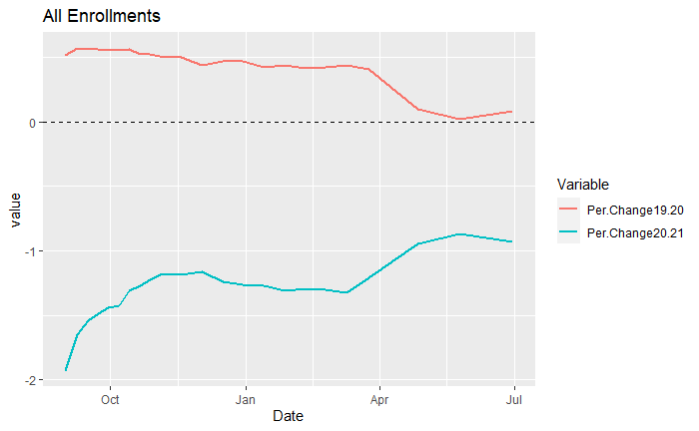
Total Enrollment

Slide 32
Mobility Data
Not unique withdrawals
  Same student may have multiple withdrawals
Withdrawal codes monitored
  W1 – Transfer within state
  W4 – 10 Day Drop
  W5 – Dropout
  W9 – Homeschool
  W21 – Transfer to other state

Slide 33
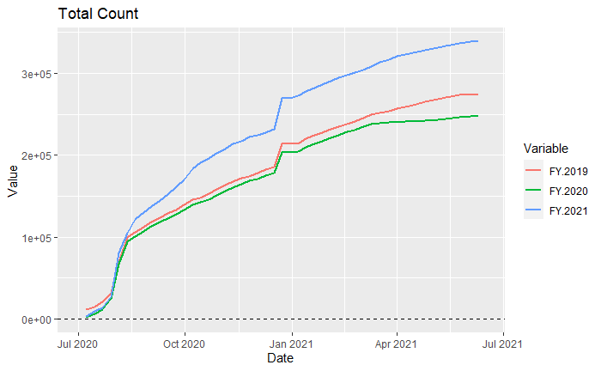
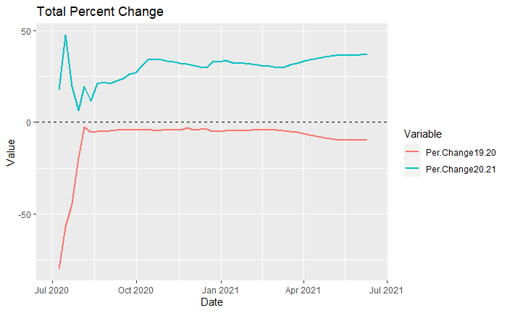
Total Withdrawals

Slide 34
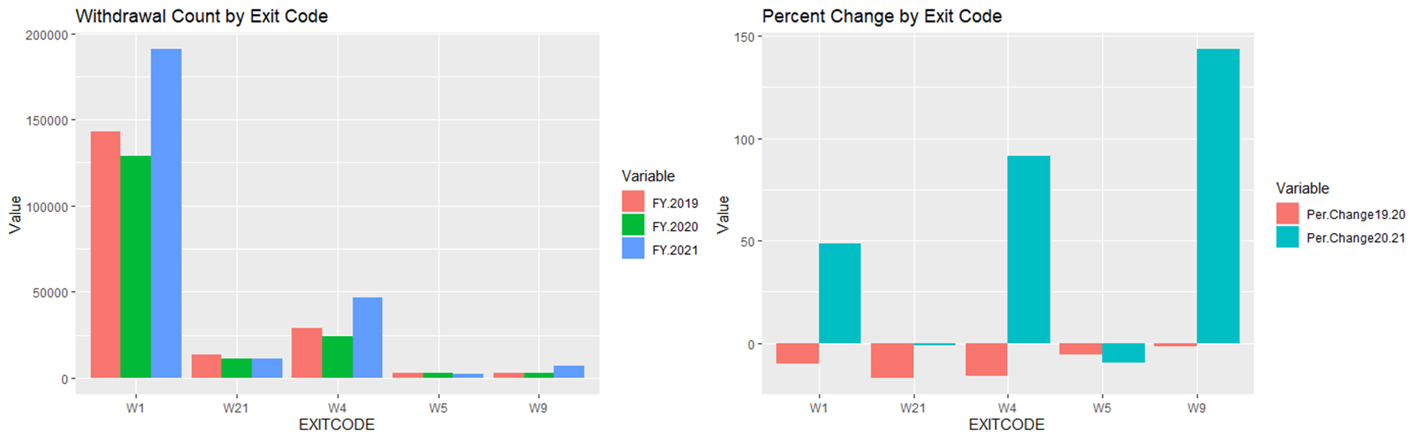
Mobility
  W1 – Transfer within state
  W4 – 10 Day Drop or Unverified Enrollment
  W5 – Dropout
  W9 – Homeschool
  W21 – Transfer to other state

Slide 35
What Analyses to Expect in October
Growth bubble plots by grade level and subgroups
Proficiency deep dive by grade level and subgroups
English Language Learner statewide student profile
Mobility and enrollment across FY19, FY20, and FY21

Slide 36
Further Discussion
Conclusion
Notes:
Jessica to bring it home

