Slide 1
Characteristics of CTE Participants and Concentrators
Career and Technical Education

Slide 2
Definitions & Notes
CTE: Career and Technical Education
CTE Participant: At the secondary level, a student that passes not less than one course worth at least one credit in a CTE program
CTE Concentrator: At the secondary level, a student that passes not less than two courses worth at least one credit each in a single CTE program.
Once a student becomes a participant or concentrator, they maintain that status until they exit secondary education

Slide 3
Definitions & Notes
All data in presentation is for Cohort 2021 CTE students except where otherwise noted.
Data is deduplicated within groups (i.e., students in multiple programs are counted only once), but students may be counted in multiple groups (i.e., a student that transfers to a charter school may be counted in both the Public and Charter school data.
Students are counted in only one race/ethnicity category, including Hispanic/Latino. Students that are not Hispanic/Latino and have multiple races are classified as “Two or More Races”.

Slide 4
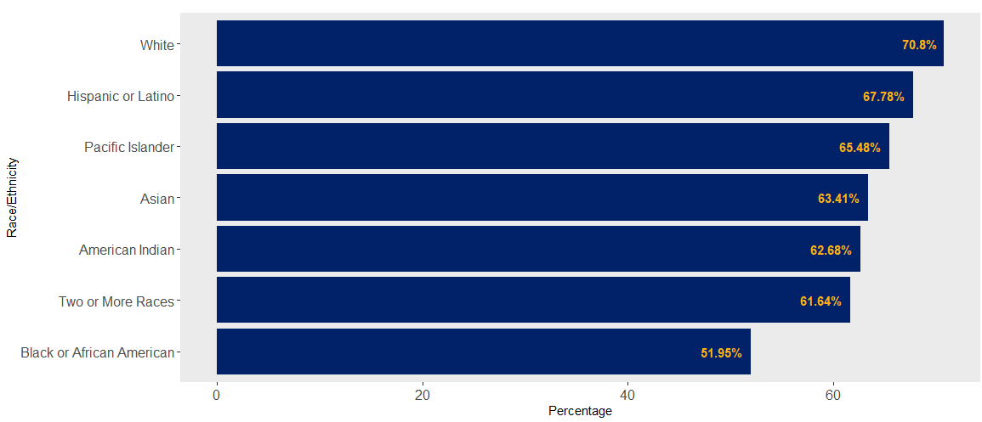
Percentage of Cohort that Participated in CTE
Percentage shown is the number of CTE participants in the cohort divided by the total number of students in the cohort (by race/ethnicity).

Slide 5
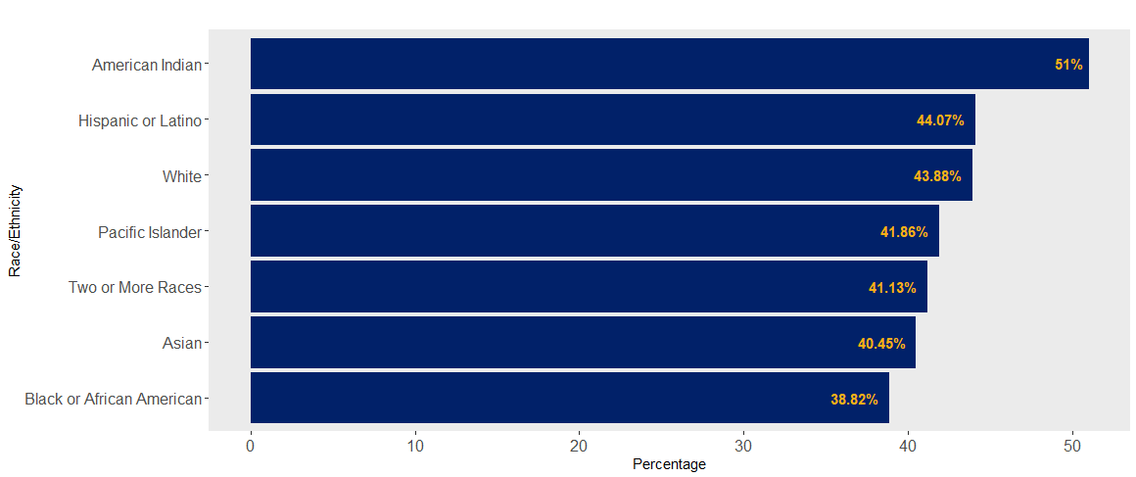
Percentage of Cohort that Concentrated in CTE
Percentage shown is the number of CTE concentrators in the cohort divided by the total number of participants in the same cohort (by race/ethnicity).

Slide 6
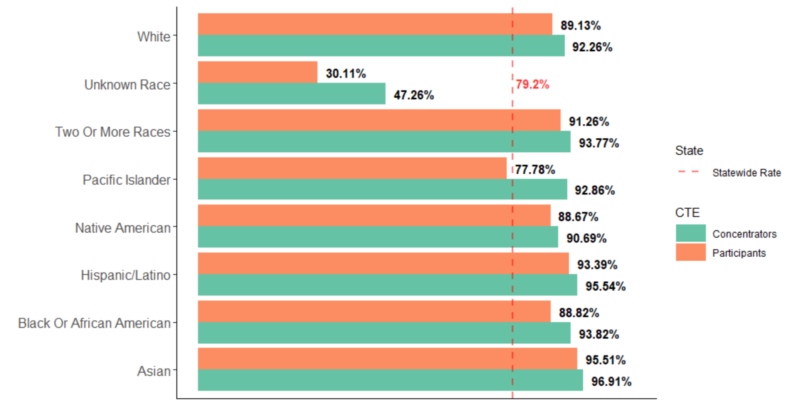
Graduation Rate of CTE Participants & Concentrators
Cohort 2020

Slide 7
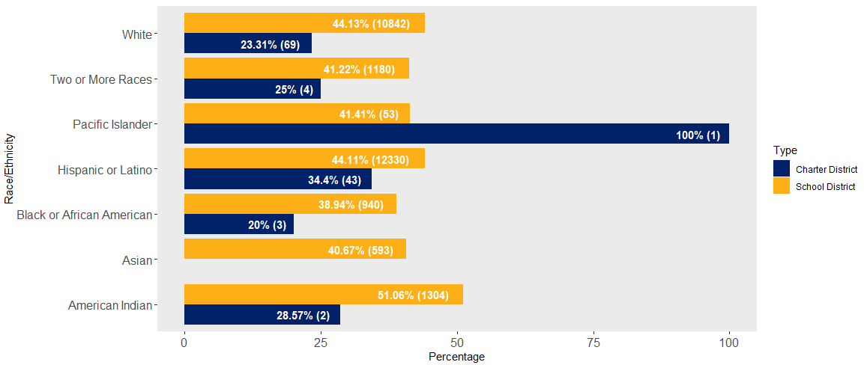
Percentage of CTE Concentrators in Cohort by School Type
Charter
District
Percentage shown is the number of concentrators in the cohort divided by the number of participants in the same cohort (by race/ethnicity), by school type (charter district or school district).

Slide 8
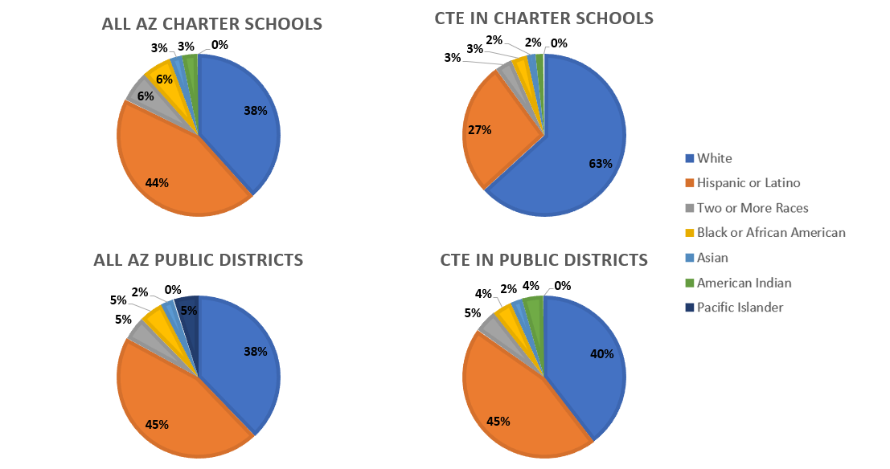
CTE Participants Compared to All Students in Cohort by Type of School
All AZ - Charter
CTE - Charter
All AZ - Districts
CTE - Districts

Slide 9
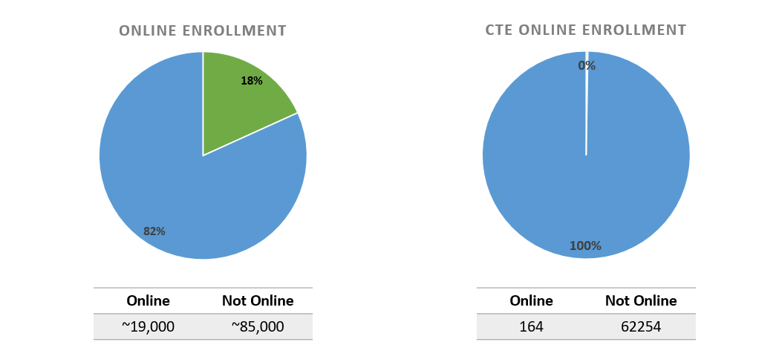
Online School Enrollment (both Charter and Districts)

Slide 10
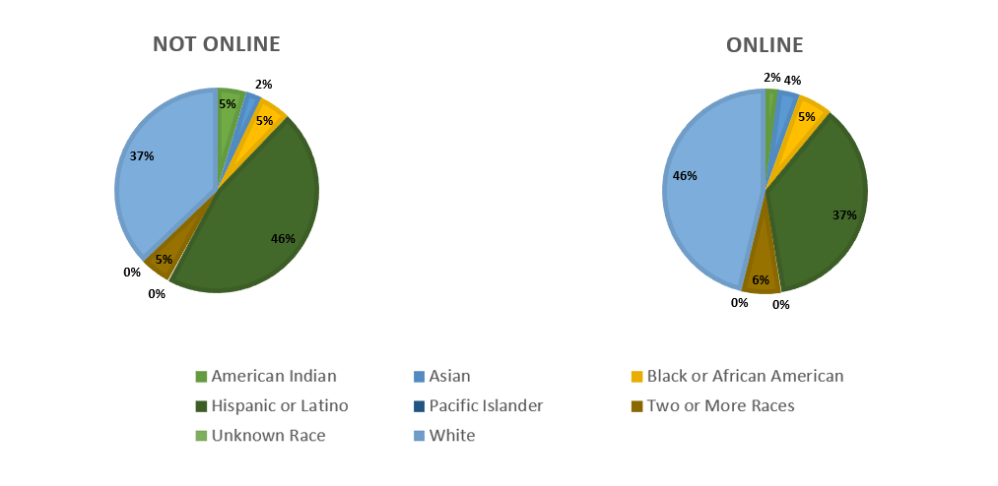
Online School Enrollment in CTE (both Charter and Districts)

Slide 11
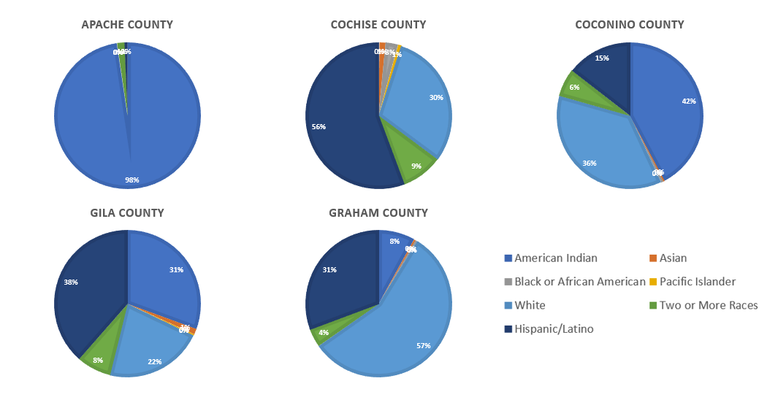
Race/Ethnicity of CTE Participants by County (1 of 3)

Slide 12
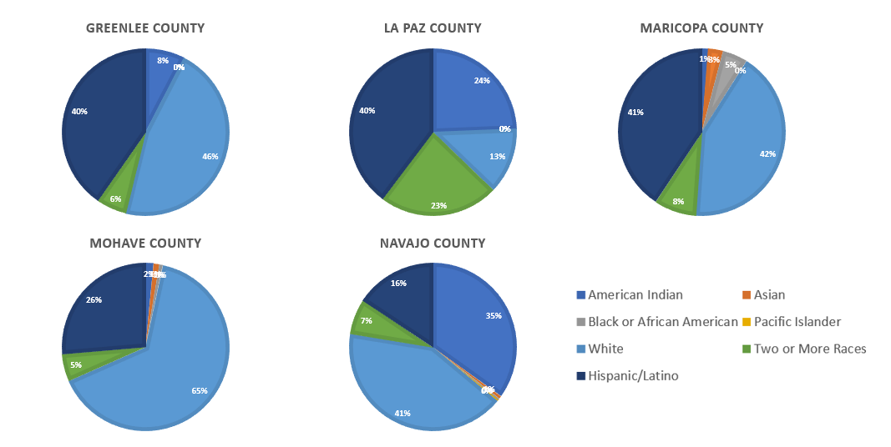
Race/Ethnicity of CTE Participants by County (2 of 3)

Slide 13
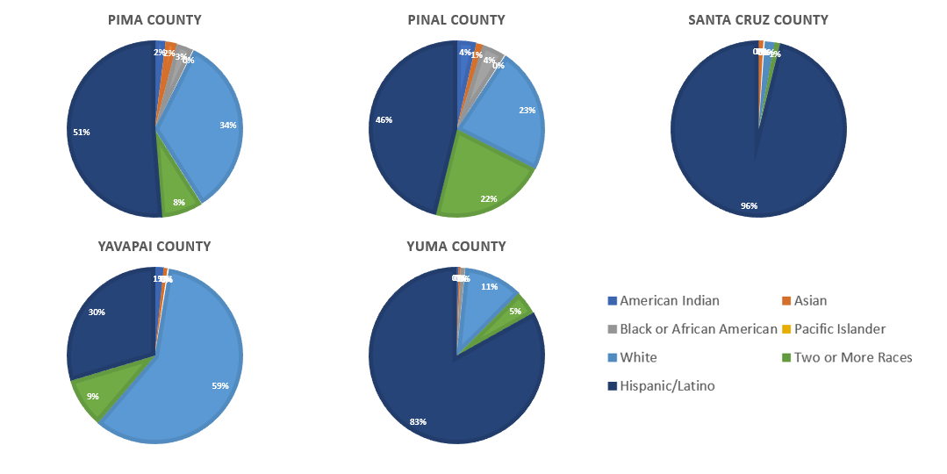
Race/Ethnicity of CTE Participants by County (3 of 3)

Slide 14
Race/Ethnicity of CTE Participants by County (Table)
County | American Indian | Asian | Black or African American | Pacific Islander | White | Two or More Races | Hispanic/Latino
APACHE | 501 | 0 | 0 | 0 | 1 | 8 | 3
COCHISE | 4 | 22 | 46 | 13 | 517 | 157 | 953
COCONINO | 465 | 4 | 5 | 0 | 400 | 68 | 159
GILA | 100 | 4 | 0 | 1 | 71 | 25 | 126
GRAHAM | 41 | 2 | 2 | 0 | 289 | 21 | 157
GREENLEE | 9 | 0 | 0 | 0 | 55 | 7 | 48
LA PAZ | 57 | 0 | 0 | 0 | 30 | 54 | 93
MARICOPA | 502 | 1185 | 1981 | 83 | 17592 | 3421 | 16978
MOHAVE | 21 | 15 | 9 | 2 | 916 | 74 | 371
NAVAJO | 591 | 9 | 6 | 5 | 703 | 115 | 265
PIMA | 160 | 169 | 253 | 16 | 2753 | 632 | 4185
PINAL | 80 | 30 | 99 | 5 | 526 | 490 | 1053
SANTA CRUZ | 0 | 7 | 2 | 0 | 14 | 8 | 764
YAVAPAI | 18 | 8 | 1 | 2 | 657 | 103 | 332
YUMA | 12 | 11 | 25 | 2 | 340 | 140 | 2603

Slide 15
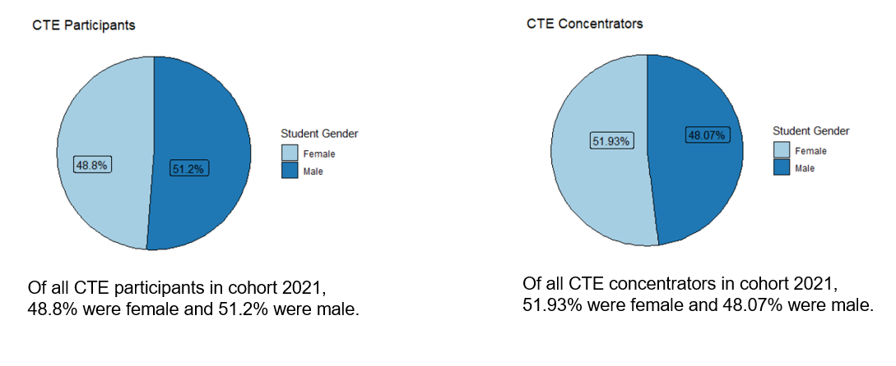
CTE Participants and Concentrators by Gender
Of cohort 2021:
- 64.5% of females participated in CTE
- 70.4% of males participated in CTE

Slide 16
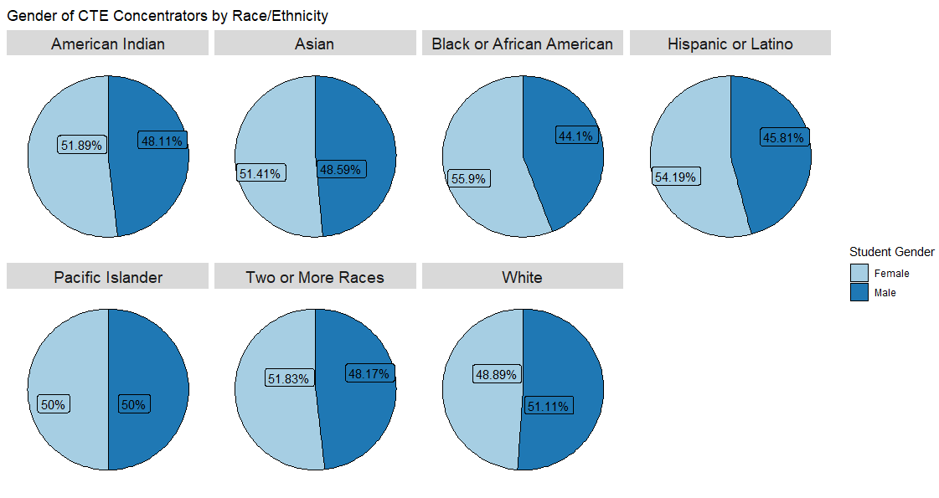
CTE Concentrators by Gender and Race/Ethnicity

Slide 17
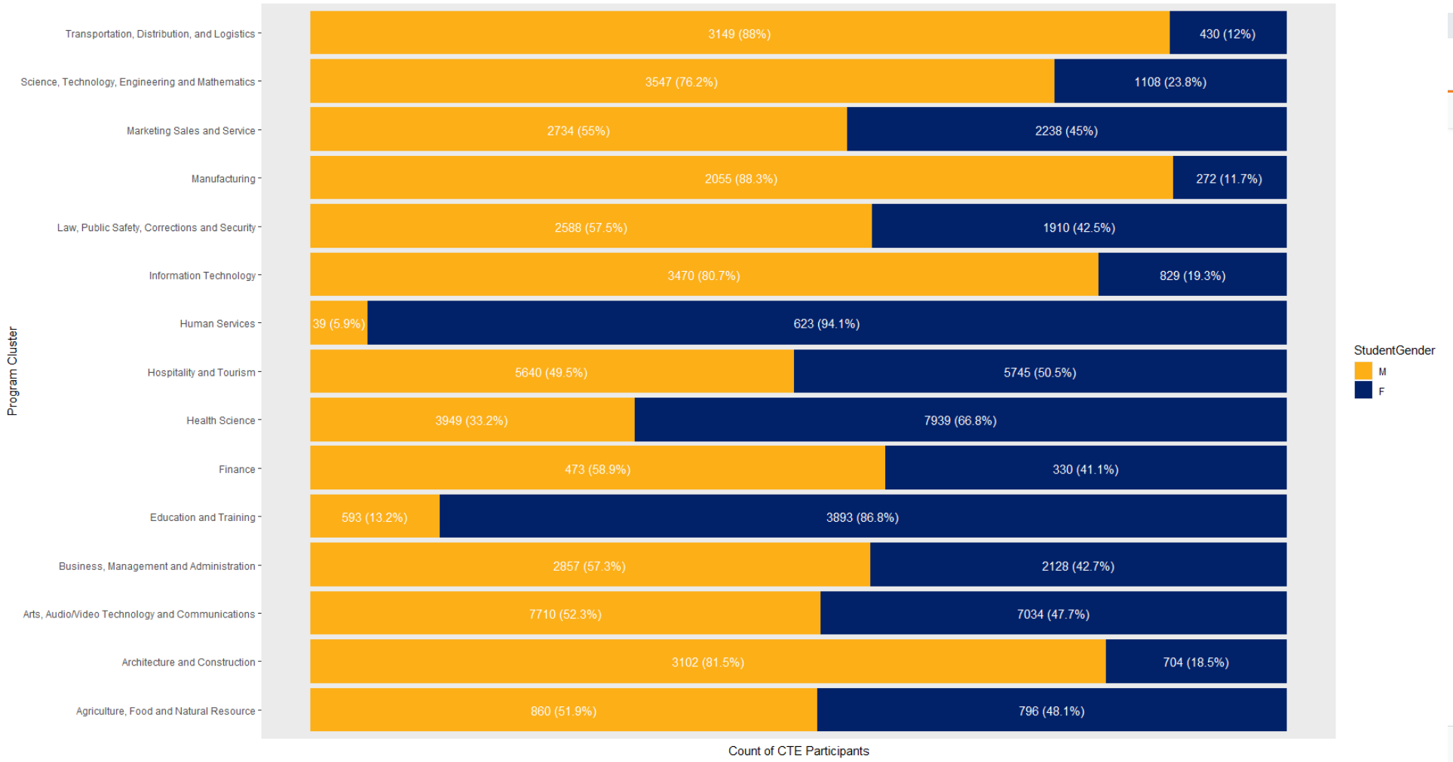
CTE Participants by Gender and CTE Program Cluster

Slide 18
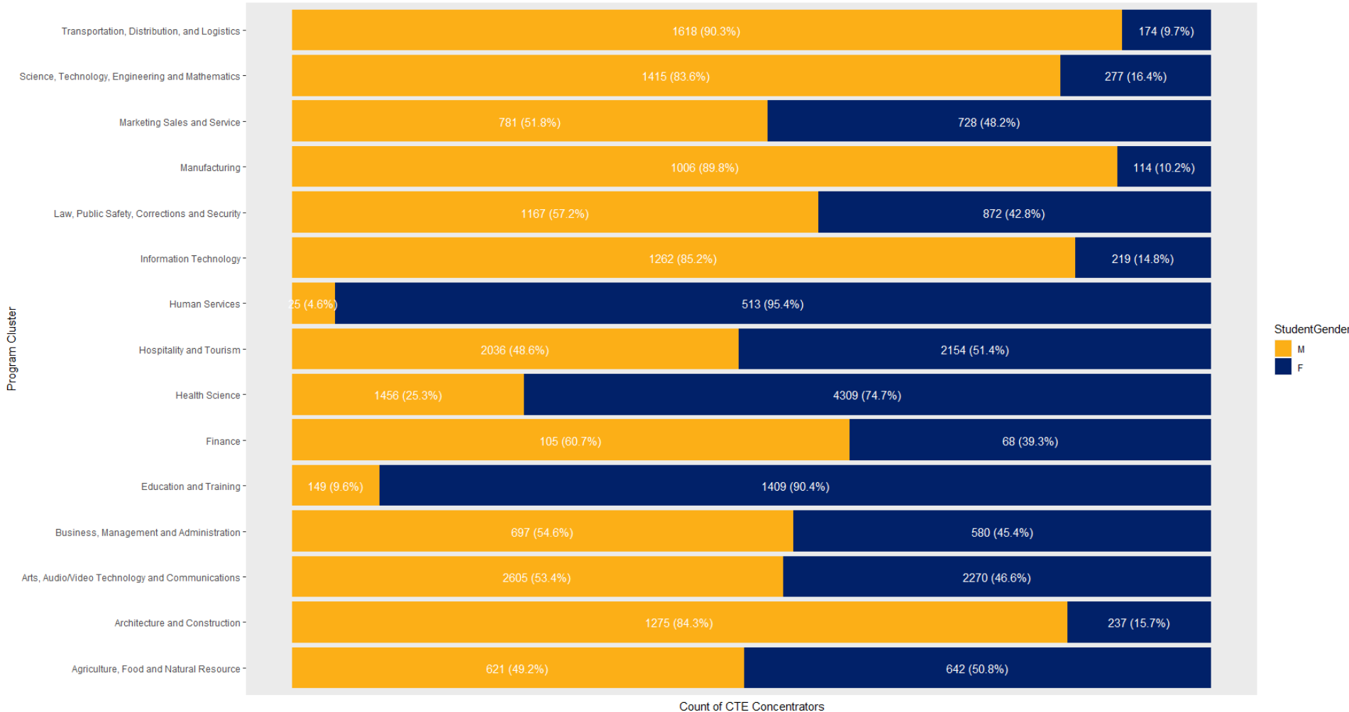
CTE Concentrators by Gender and CTE Program Cluster

Slide 19
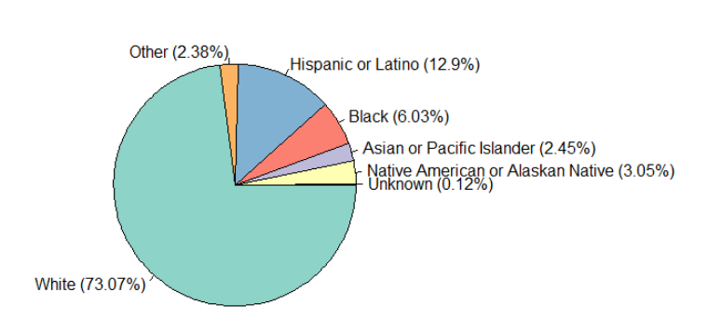
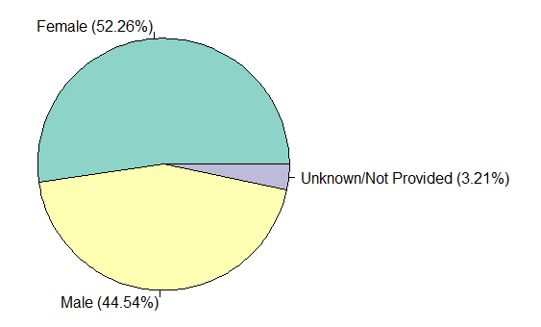
CTE-certified Staff Race and Gender
Values shown are of all CTE-certified staff where race and/or gender was provided.

Slide 20
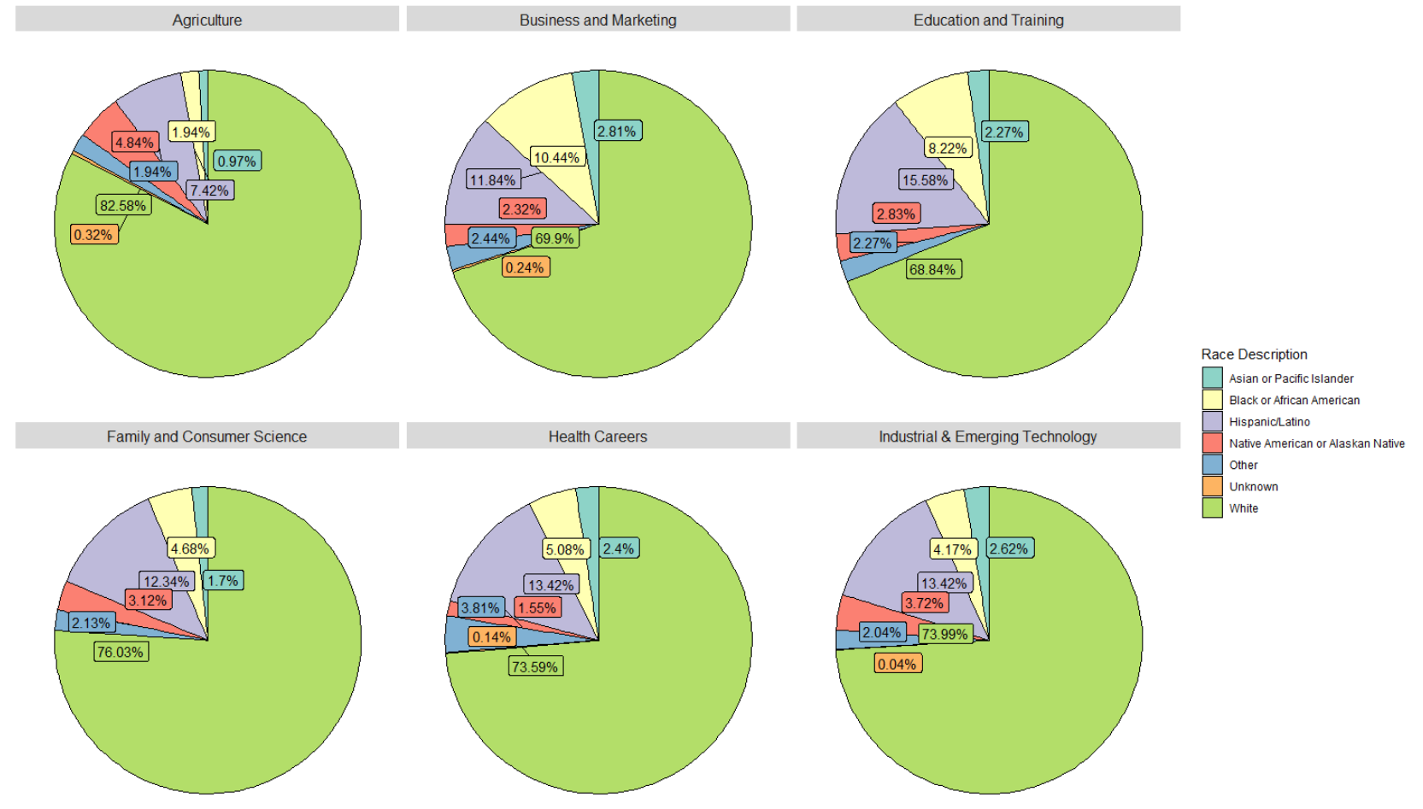
CTE-certified Staff Race by Certification Type

Slide 21
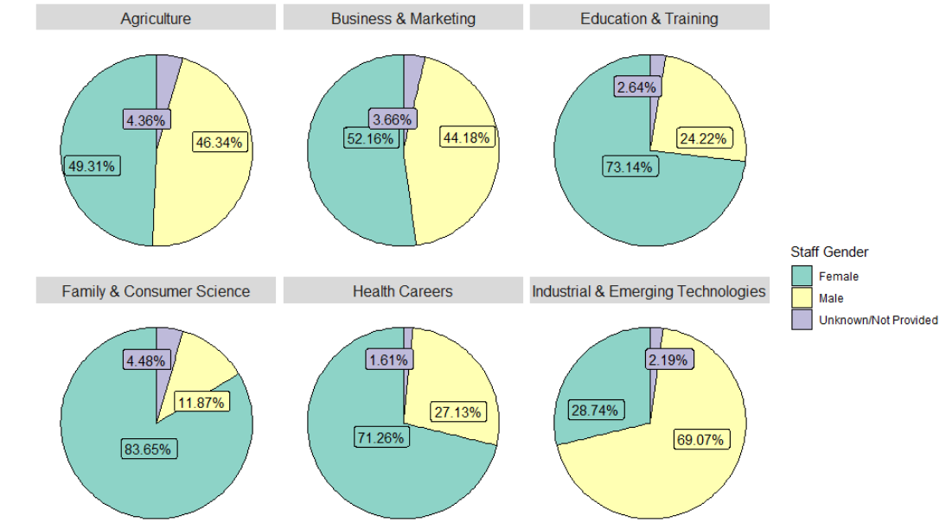
CTE-certified Staff Gender by Certification Type

