Slide 1
ADE School Finance
GPEMC Meeting Update
3/25/2022
Charlie Martin
Deputy Associate Superintendent

Slide 2
Agenda
Average Daily Membership (ADM) Update
Gifted Group B Add-on
Student Data Reports (AzEDS)
  SUPP11 (student need verification)
  ADM30 (school-level ADM)
  New: RBFINC (% income eligibility by school)
  New: AOIADM15 (Arizona Online Instruction ADM)
Financial and Compliance Audit Reports
Questions

Slide 3
Average Daily Membership (ADM) Update

Slide 4
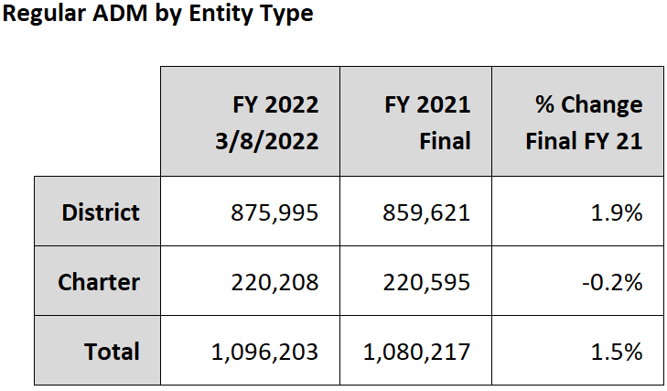
ADM Update

Slide 5
Gifted Group B Weight

Slide 6
Gifted Group B Weight
Funding will be added as an adjustment to the May payment
136 districts and charters representing about 70% of statewide ADM have reported at least one student that will generate gifted add-on funding
Over 34,000 students have been reported with a qualifying gifted need
  Approximately $1 million total funding

Slide 7
Gifted Group B Weight
New 0.007 funding weight added for FY 2022
Limited to students that score at or above the 97th percentile on qualifying tests
  Quantitative (Math) Giftedness
  Language Arts (Verbal) Giftedness
  Non-Verbal Reasoning Giftedness
There is more information about reporting gifted students in the September Hot Topic on the School Finance website

Slide 8
Student Data Reports (AzEDS)

Slide 9
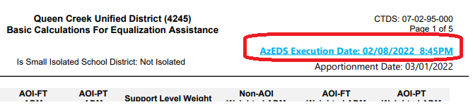
Student Data Reports
Student data reports in AzEDS can be accessed from ADEConnect
Many reports display data as of a specific date (for example, Execution Date listed in BSA55)

Slide 10
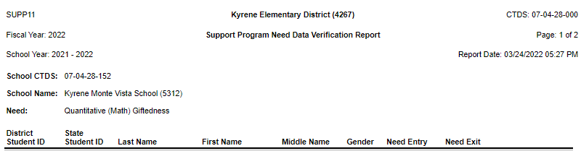
Student Data Reports – SUPP11
SUPP11 displays student-level support program needs
  Report can be filtered to display specific needs

Slide 11
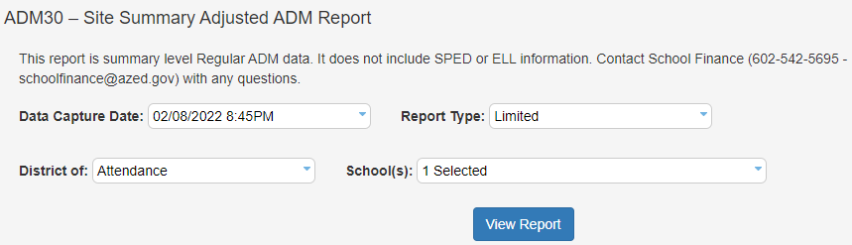
Student Data Reports – ADM30
ADM30 summarizes ADM by school site
Should match SFB student counts for the same data capture date

Slide 12
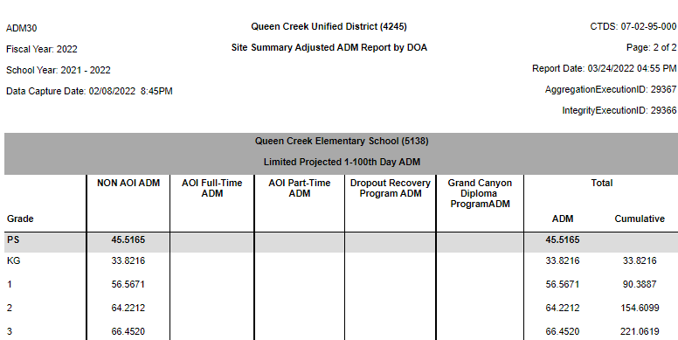
Student Data Reports – ADM30

Slide 13
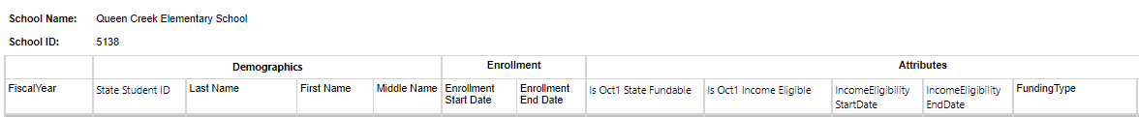

Student Data Reports – RBFINC
RBFINC is a new Results-Based Funding income eligibility report
Displays student enrollment and income eligibility data used to determine Results-Based Funding eligibility
CSV export includes school-level totals used in Results-Based Funding calculation

Slide 14
Student Data Reports – AOIADM15
AOIADM15 is a new report that will be published soon
Report will display data used to determine Average Daily Membership for Arizona Online Instruction (AOI) students
  Actual minutes of instruction reported
  Projected minutes of instruction
  Required minutes for grade level
  Average Daily Membership (ADM)

Slide 15
Financial and Compliance Audit Reports

Slide 16
Viewing Financial and Compliance Audits
Submitted financial and compliance audits are available to view/download
209 districts and charters have submitted reports as of 3/23/22
School Finance will update the report links to include additional files in May and at the end of the fiscal year

Slide 17
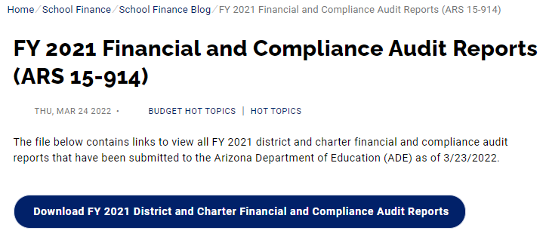
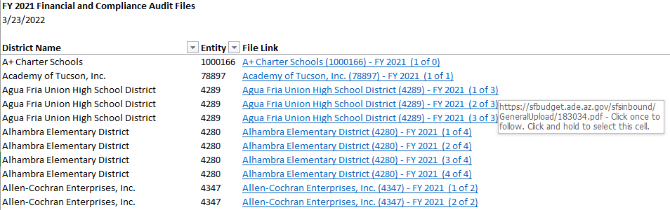
Viewing Financial and Compliance Audits

Slide 18
Submitting Financial and Compliance Audits
Districts and charters are now required to submit financial and compliance audit report files to ADE (Laws 2021, Chapter 7)
School Finance published a Hot Topic with instructions to upload required files
Files should be submitted in the same way as budgets and AFRs
  Since the legacy budget system does not extract data from PDF files, the message “File Failed to Process” will display even after successful upload

Slide 19
Contact Us
  (602) 542-5695
  SchoolFinance@azed.gov
  http://www.azed.gov/finance/
School Finance
  http://helpdeskexternal.azed.gov
    Student Data
    School District Employee Report
    Instructional Calendars
    Transportation Reporting
    915s
SF Account Analysts
Phone Option 3
  SFPaymentTeam@azed.gov
    BSA District
    BSA Charter
    CSF
    IIF
SF Payments Team
Phone Option 1
  SFBudgetTeam@azed.gov
    Expenditure Budgets
    Annual Financial Reports
    BUDG25, BUDG75, BUDGAGD
SF Budget Team
Phone Option 2

