Slide 1
Perkins & State Priority 2023
Grant Application & CLNA Training
Secondary LEAs
March 7, 2022

Slide 2
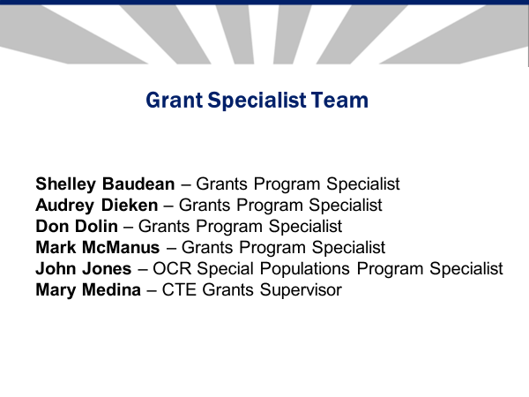

Slide 3
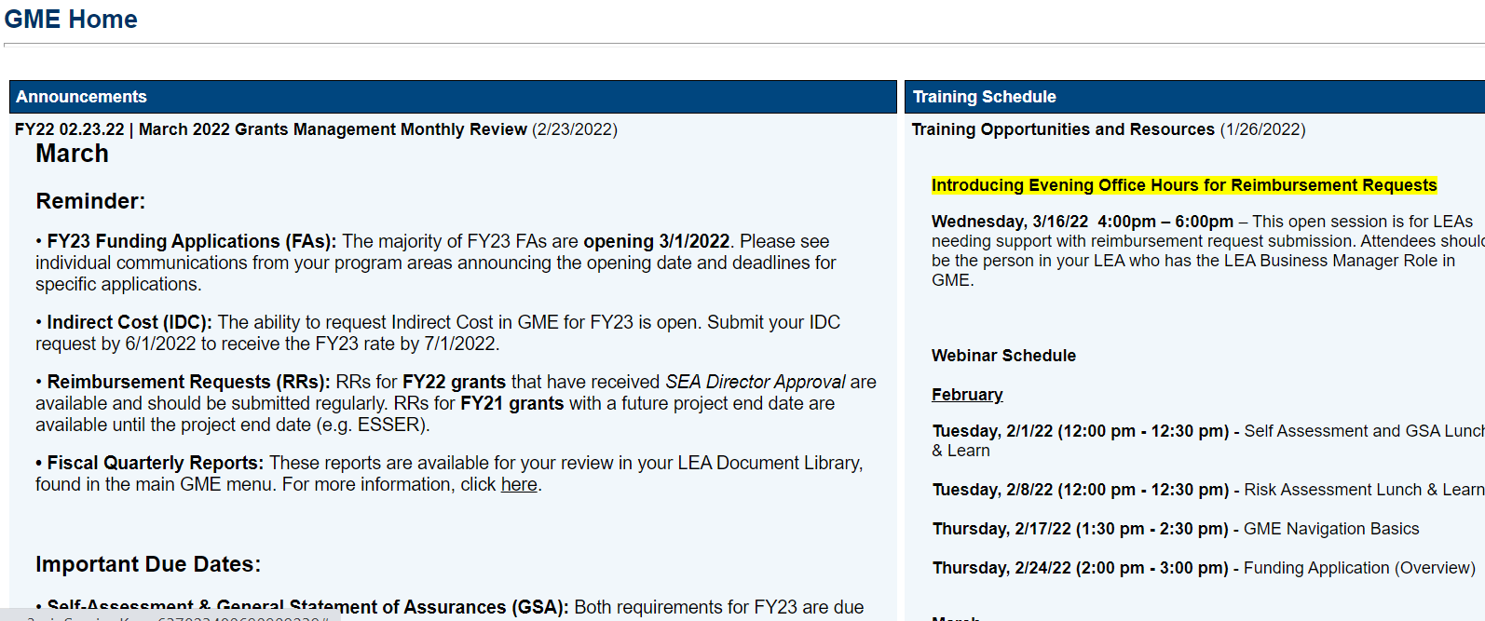
GME Home Page

Slide 4
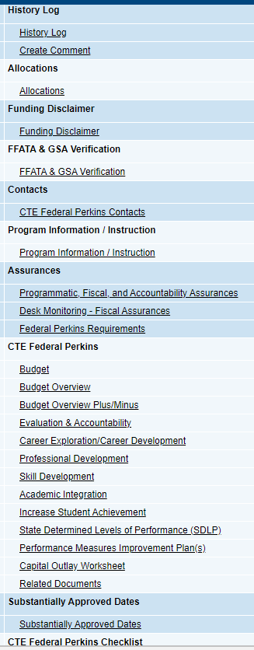
Sections Page:

Slide 5
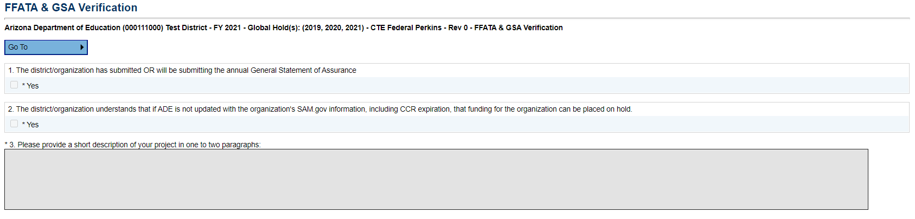
FFATA & GSA Verification
Click “yes” for Boxes 1 and 2, if applicable.
Type a description of your district’s Perkins-funded CTE programs into Box 3.
MUST include a list of all programs that will be funded by Perkins V. Please ensure Coherent Sequence is complete prior to grant submission.

Slide 6
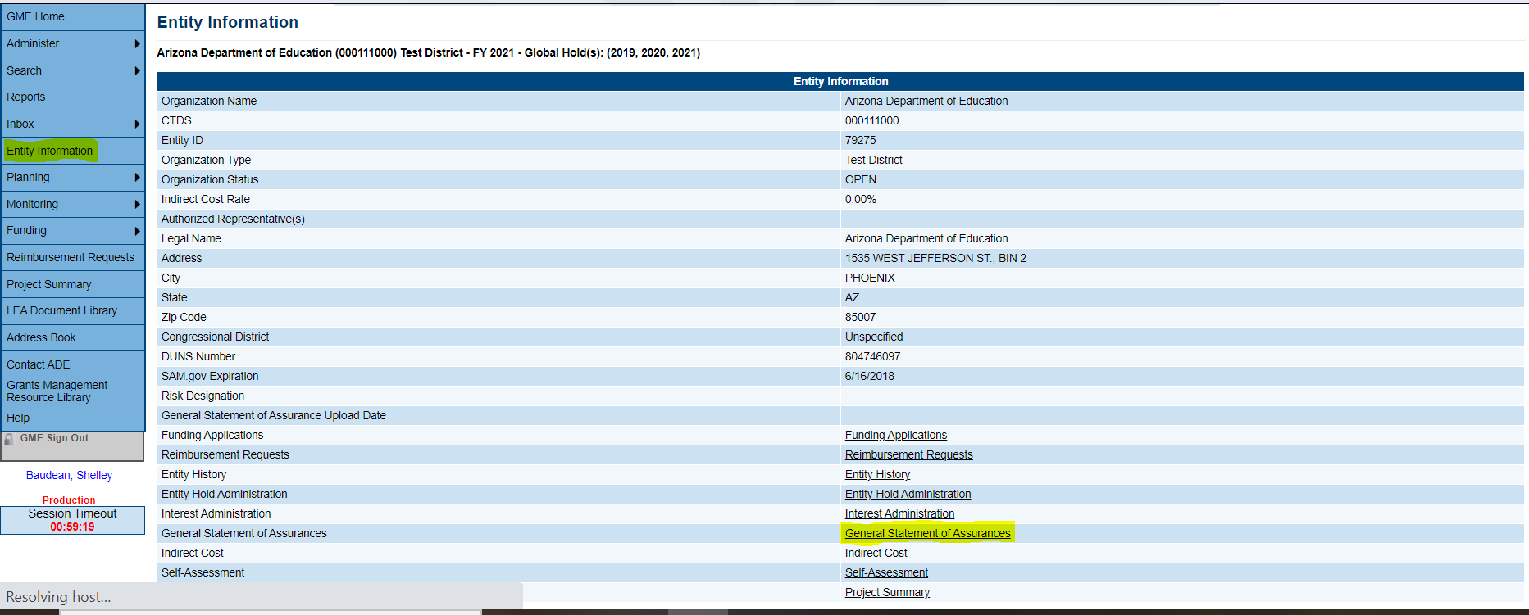
General Statement of Assurance
MUST be approved by Grants Management prior to grant review (check with Business Manager)
See below for where to locate GSA approval status

Slide 7
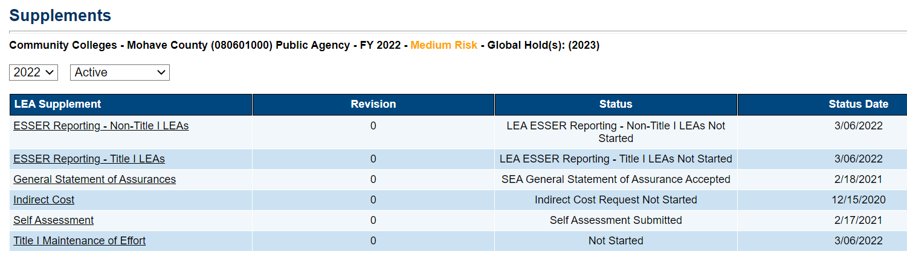
GSA Verification
Confirmation of Supplements

Slide 8
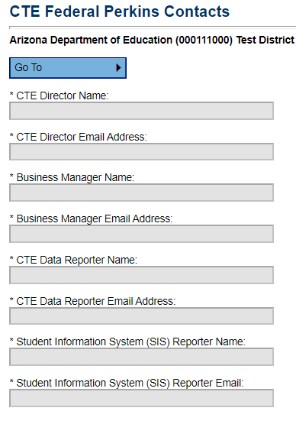
Contacts
Fill out with most up-to-date information
Update throughout the year if this information changes

Slide 9
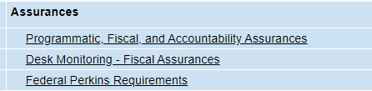
Assurances
Answer ‘yes’ or ‘no’ as applicable to all questions
Fill in boxes with dates/names where requested
Can work with Business Manager to fill these out

Slide 10
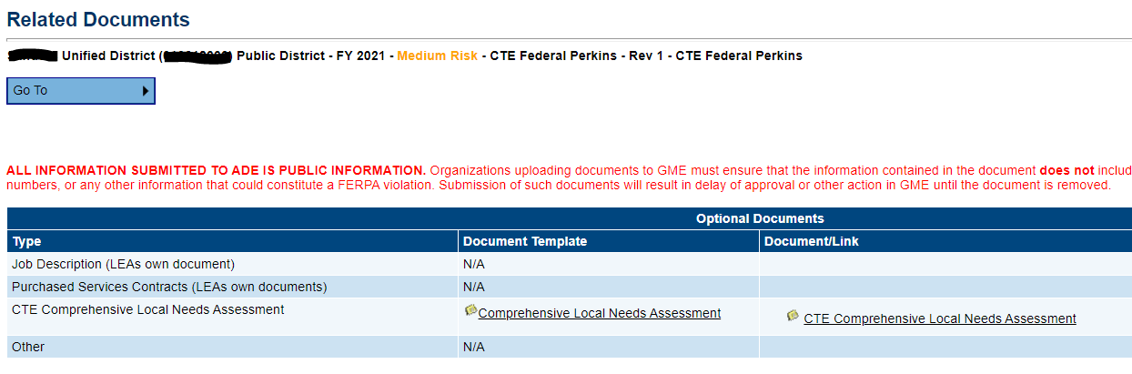
Comprehensive Local Needs Assessment (CLNA)
Year Two of Biennial cycle
Upload completed CLNA into Related Documents as shown in screenshot below
Use last year’s document, color code updates

Slide 11
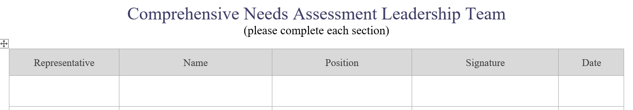
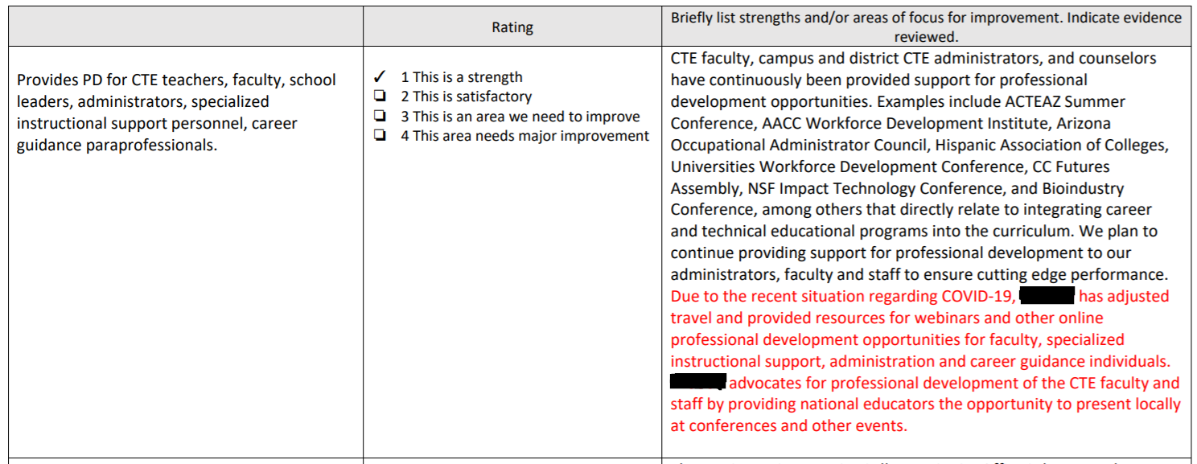
Adding Updates to FY22 CLNA for
Year 2 of Biennial Cycle (FY23)
CLNA review must reflect current meeting dates
Change rating, if applicable
Color-code updates in each box
*Members may change from year to year
*If in person, or indicate if virtual

Slide 12
Preparation Materials for CLNA Leadership Planning Meeting
Last year’s CLNA
Program of Study (POS) review summaries
Objective pages from FY2022 grant application
Budget
Program of Study (POS) accomplishments
List of areas/items to be addressed
Evidence/data: https://documentcloud.adobe.com/link/review?uri=urn:aaid:scds:US:b50b36b2-bf77-31b4-87e4-d28153d39b7d

Slide 13
CLNA Activity
INCREASE STUDENT ACHIEVEMENT--“Provides participants with access to industry-recognized certification examinations or other assessments leading toward a recognized post-secondary credential.”
Evidence Reviewed
Documentation of certifications purchased and pass rates
Number of students tested/passed
Reports from testing vendors
TSA data
Performance measure results

Slide 14
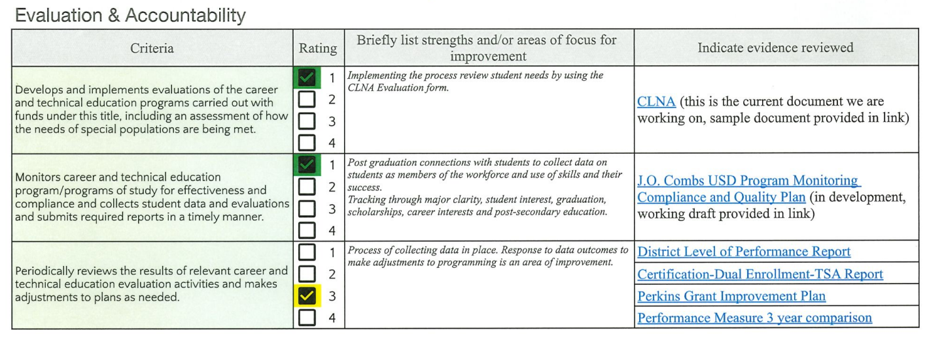
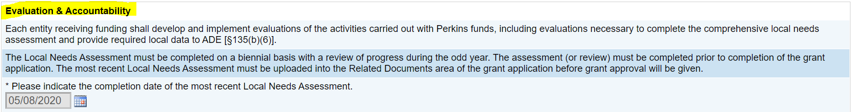
CLNA Drives the Plan
Each section of the CLNA…
Corresponds with one section of the grant…

Slide 15
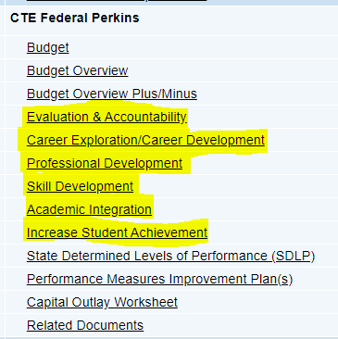
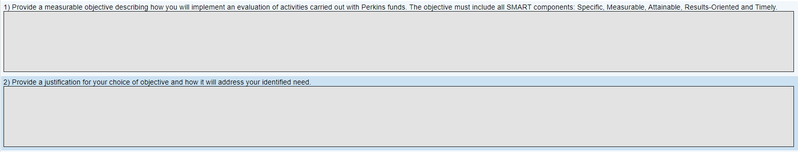
Measurable Objectives
Pull from CLNA—
areas of need
Top section is a summary of CLNA
At least one MO per each of six categories
Box 1: SMART goal
Box 2: Justifications
*Box 3 “Progress Summary/Final Narrative” not due until Sept 15th 2023 (but can be completed earlier)…NO Midyear Narrative!

Slide 16
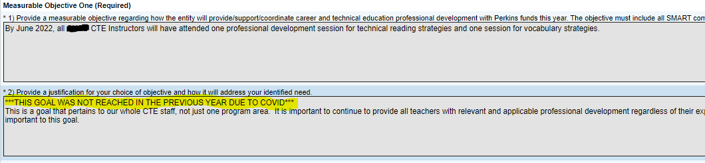
Objectives for Year 2 of Biennial Cycle (FY23)
If you are on track to achieve FY22 objective(s):
Start fresh with new objective(s) for FY23
Pick a different area of focus to improve for FY23 & write goal(s)
If you are NOT on track to achieve FY22 objective(s):
You may continue with the same objective, or slightly tweak for FY23
In Box 2—Justification, explain why you are continuing with same
Example below:

Slide 17
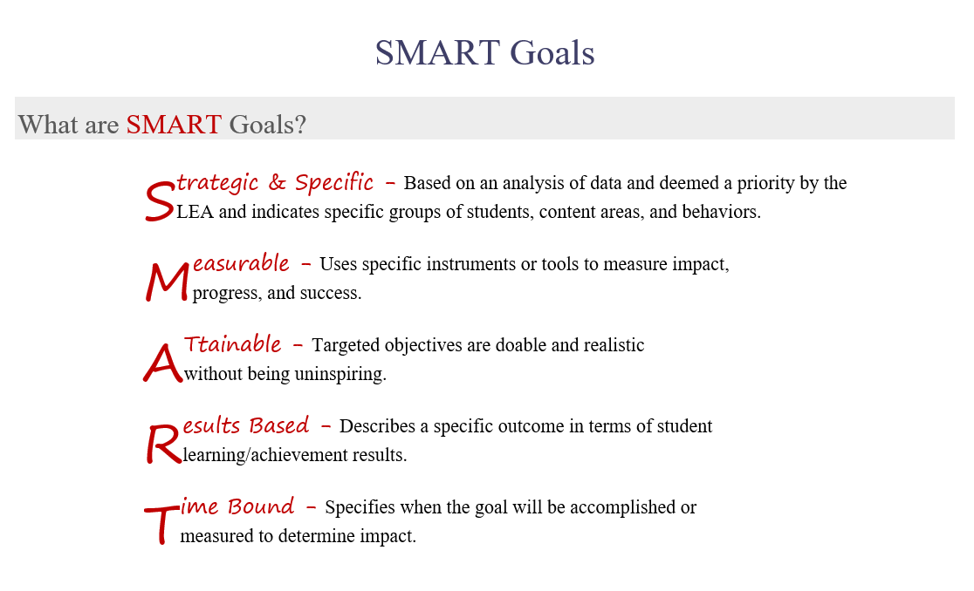

Slide 18


Slide 19
SMART Goal Activity
In the chat box: How can each of these statements be turned into a SMART goal?
Review data.
Host a career event.
Increase certifications/credentials.
Answers…
By June 30, 2022, district testing data will be reviewed and compared to previous years data to establish areas of improvement.
Host a career day at XXX High School with the SUSD foundation in Spring 2022.
By end of SY 2023, LEA will increase certifications/ credentials for all CTE programs by 20% from SY 2022.

Slide 20
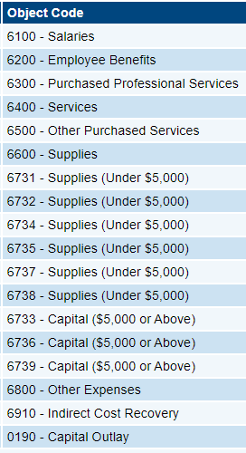
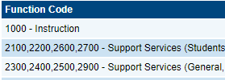
Budget
Budget entire allocation, leave none remaining—
can revise later
Dictated by CLNA/MO’s
Perkins Allowable Chart Quick Reference Guide
USFR Chart of Accounts
Equipment lists:
https://www.azed.gov/cte/programs
Computers—check with your Grants Specialist

Slide 21
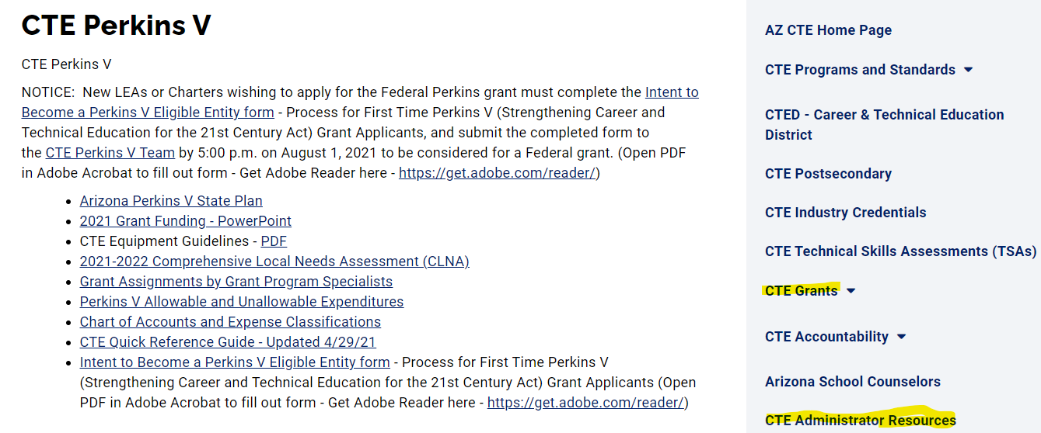

Slide 22
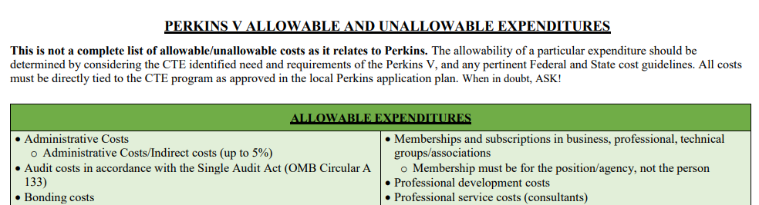
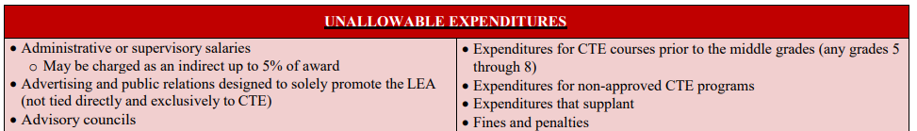

Slide 23
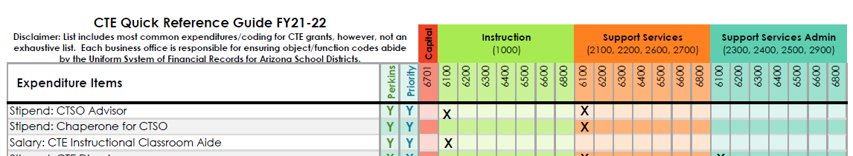
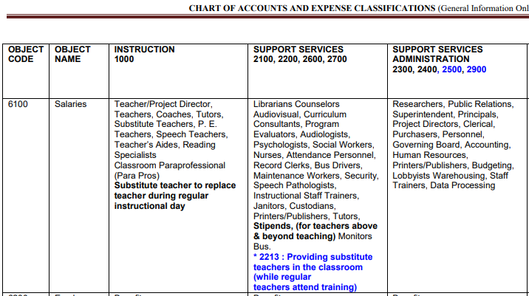

Slide 24
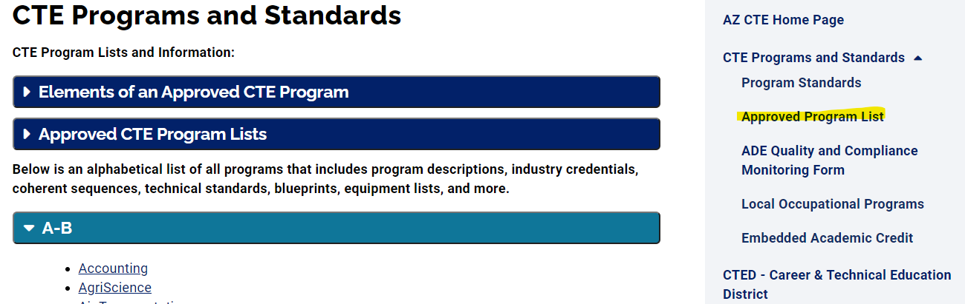
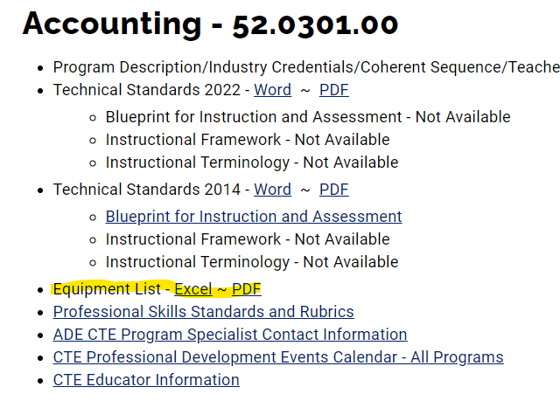

Slide 25
Coding: Common Expenses
6100: CTE Salaries (1000) and Stipends (2100)
6200: Benefits for above
6300: CTE staff professional development costs/ conference registration (2100), testing (1000)
6400: CTE equipment repair/maintenance (2100)
6500: CTE staff travel/hotel/food (2100)
6600: Instructional supplies—consumables (1000), career guidance materials (2100)
6731/6732 (under $5000)/6733 (over $5000): Furniture & Equipment (must be specialized!)
6737/6738 (under $5000)/6739 (over $5000): Technology equipment
6800: CTSO fees, student travel, etc. (2100)

Slide 26
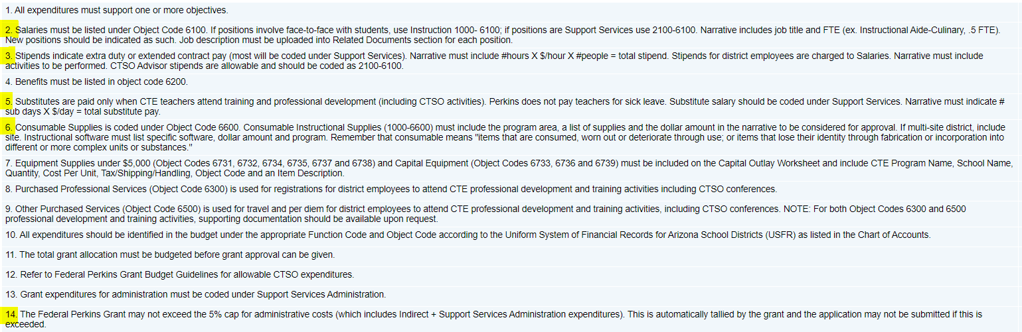
From Perkins Checklist

Slide 27
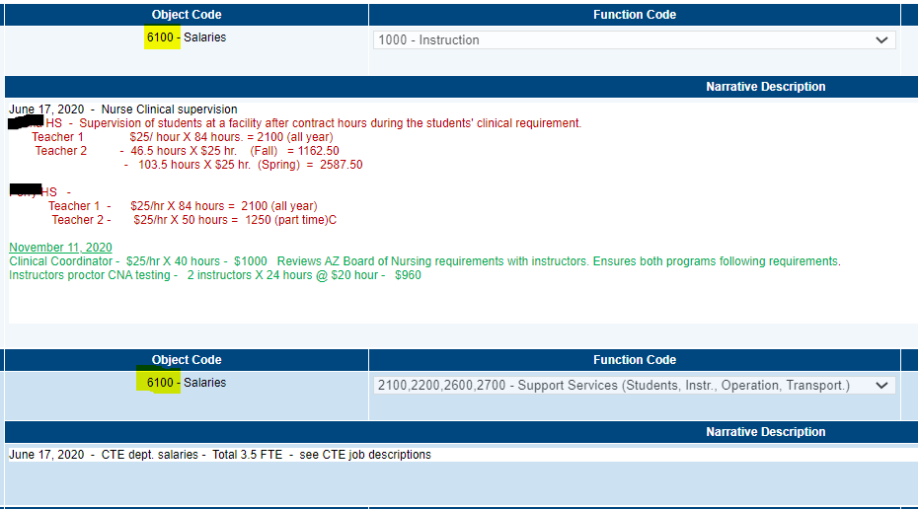
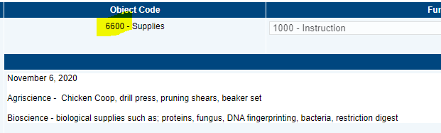
Narrative Descriptions
*Dating and/or Color-coding your Revisions is appreciated!

Slide 28
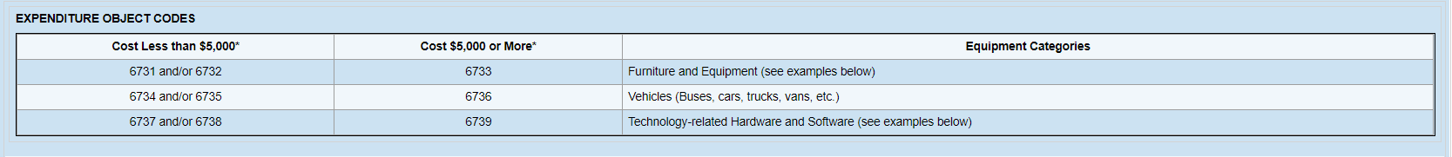
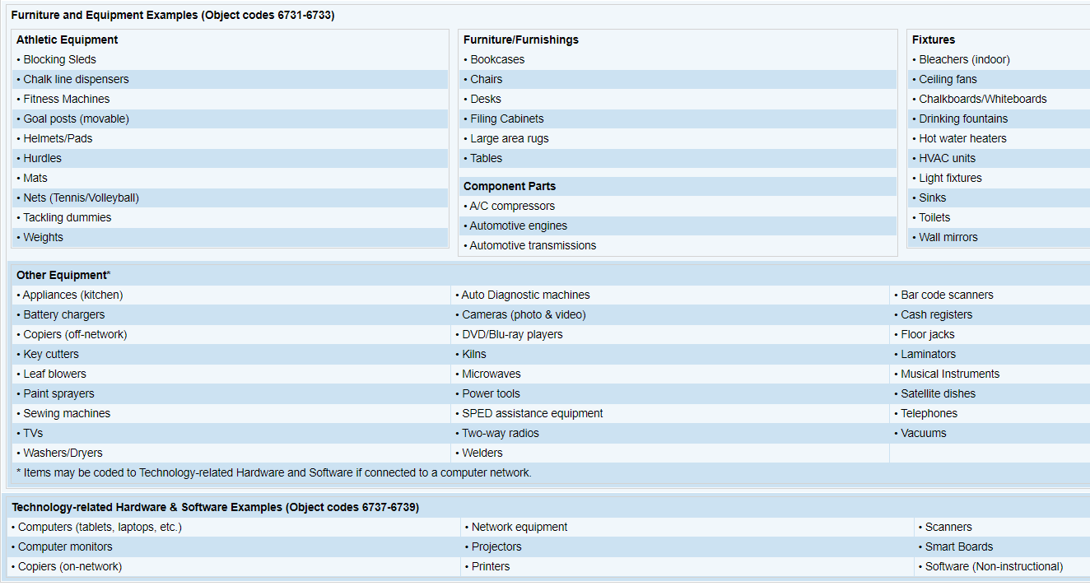
67XX Codes
*Cost is per item,
not total cost!

Slide 29
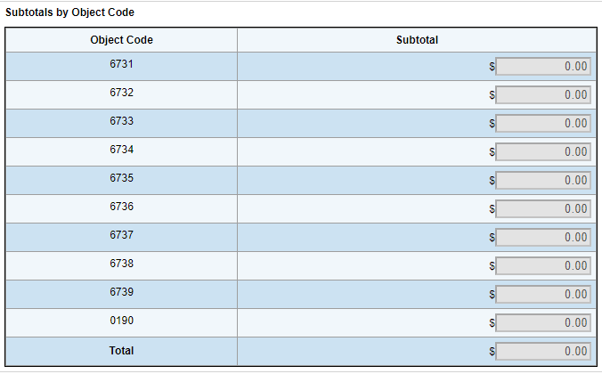
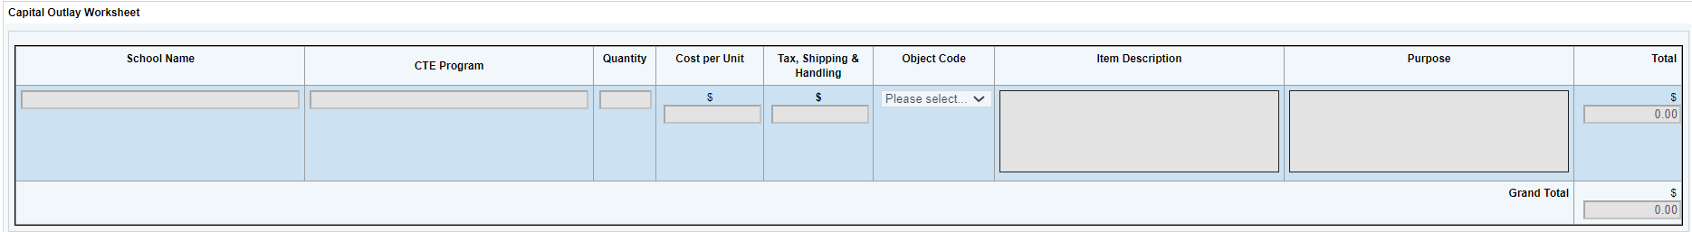
Capital Outlay Worksheet
Typically has a useful life of more than one year.
Typically repaired rather than replaced when worn or damaged.
Totals must match amounts in the budget.
*CHARTERS: everything coded 6600 unless Capital over $5000 (0190)…no 67XXs!
*Please use Program of Study name vs. class title

Slide 30
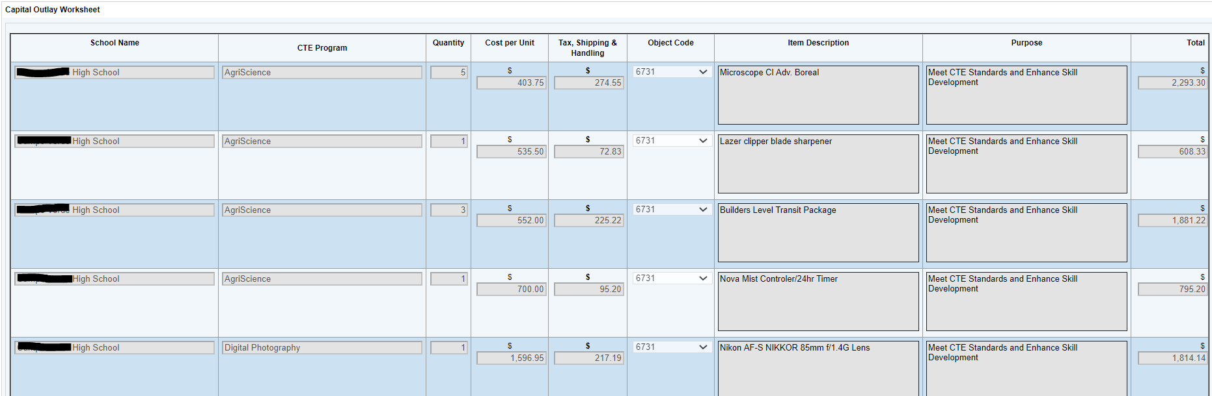
Capital Outlay Example
Be specific in “Item Description”, not vague-- include brand, size, etc. when possible.
Purpose can include reasons such as “part of equipment list”, “to meet standards”, etc.
Use full school names, not abbreviation.

Slide 31
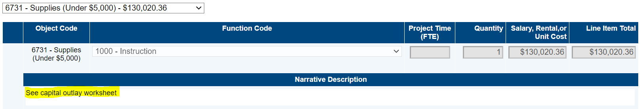
Tips for Budget and Capital Outlay
Tax/Shipping is not broken out in the Budget like it is in Capital Outlay Worksheet
Put total amount on “Line Item Total”
Can put “See Capital Outlay” OR list all items in the Narrative Description
In past grants, this was not always the case
Do NOT group items in Capital Outlay, unless part of a kit purchased altogether

Slide 32
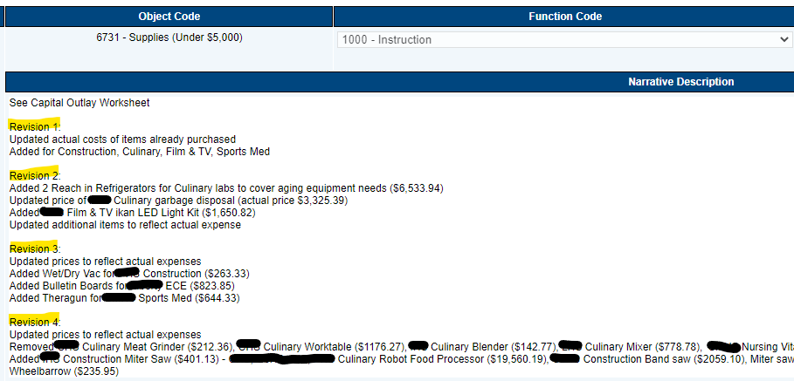
It is very helpful if you add a note in Narrative Description for added capital each revision:

Slide 33
Budget Activity
In the chat box: Which codes do each of the following belong in (Object AND Function Code)…
CTE program supplies
CTSO student travel
Teacher desks
Answers…
6600/1000
6800/2100 (Priority ONLY)
Not allowable

Slide 34
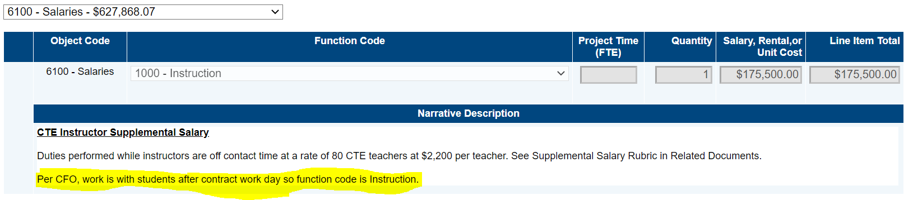
Business Manager Coding Preferences
If your Business Manager has a different coding preference than the norm, please indicate this in the Narrative Description of the Budget.

Slide 35
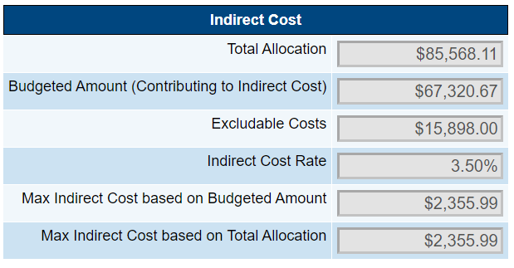
Indirect Costs
Indirect rate is negotiated with Grants Management for ALL grants
HOWEVER, cannot exceed 5% for Perkins (also includes Administrative Costs)
If not including indirect costs, please make a note in History Log with explanation

Slide 36
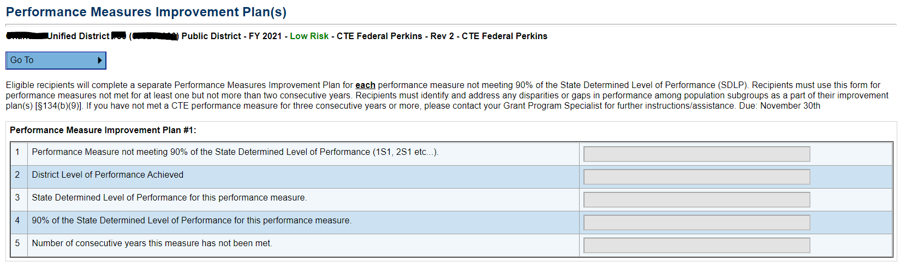
Improvement Plans
Not required yet, leave it blank for now please. You will be reminded of the due date in the grant cycle.
*Reminder: 22 grant plans due March 1st, 2022. *Midyear narratives will be due on June 30th, 2022.

Slide 37
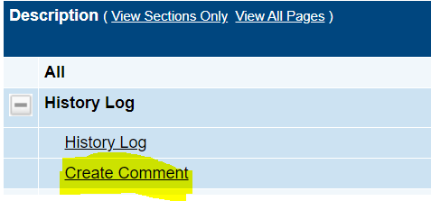
History Log Notes
Whenever computing devices are included/added in an Initial Submission or Revision, please put a note in History Log indicating amount as well as which programs they are for.
*Example: “Revision 1—5 Dells added for Accounting program student use.”

Slide 38
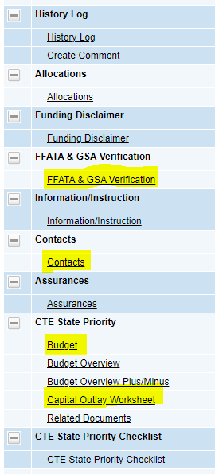
State Priority 2023
Need to complete the four highlighted sections (Capital Outlay only if using any 6700 funds).
Commonly utilized for CTSO expenditures, as students are directly benefiting (but not limited to this only).
Example: student membership fees, travel, etc.

Slide 39
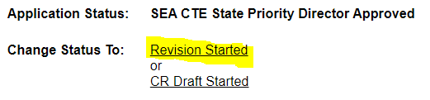

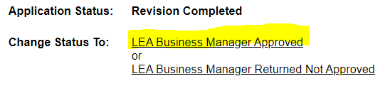
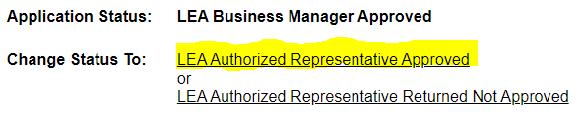
Steps to Submitting a Grant

Slide 40
QUESTIONS?
Contact your GPS if you have any follow up questions or need further training.
Please submit grants by 5/2/22 due date.
For questions specific to GME (reimbursement requests, indirect costs, system issues, etc.), contact (602) 542-3901 or https://helpdeskexternal.azed.gov

Slide 41
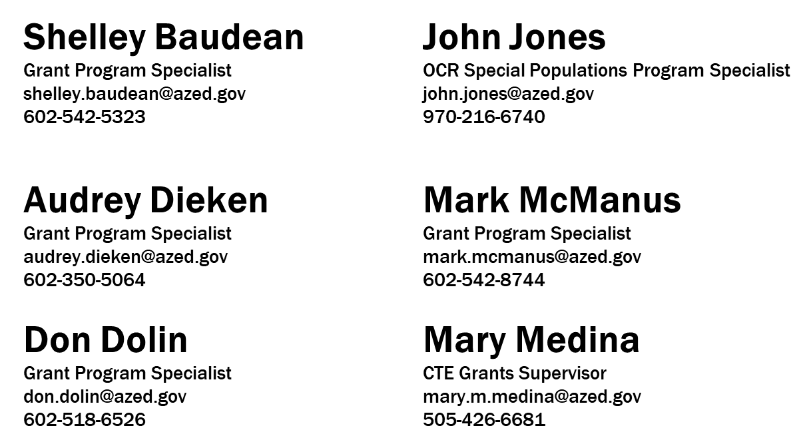

Slide 42
Other Helpful Resources/Contacts
Scroll to bottom of pages for contact information:
Accountability: https://www.azed.gov/cte/cte-data-portal-information
CTSO’s: https://www.azed.gov/cte/ctso
Technical Skills Assessments: https://www.azed.gov/cte/assessments
ACOVA (Association): https://acova.org/
ACTE (Association): https://www.acteaz.org/
Premiere Series (Professional Development): https://www.acteaz.org/cte-leads-2/teacher-series/

