Slide 1
Assessments and Accountability
Overview
2021-2022 School Year

Slide 2
Accountability is Moving Forward
2021-2022

Slide 3
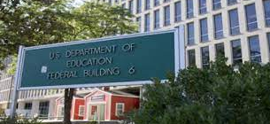
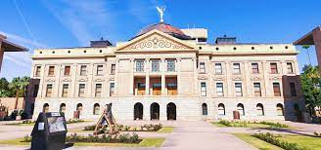
There are no State or Federal Waivers for Accountability

Slide 4
The Pandemic and Accountability Components

Slide 5
The Pandemic and Its Impact To Accountability Components
On-going monitoring of all components
  Report to the State Board of Education
Chronic absenteeism (Pending Federal Approval)
  Changes in weighting for K-8 Federal Accountability
  2 points possible in K-8 Acceleration Readiness
95% participation and penalty impact
  Current penalty will add students to the denominator to reach 95% participation
  State Board will receive specific feedback in relation to participation rates

Slide 6
2021-2022 State A-F Models
What to expect

Slide 7
Main Considerations
Keeping the models as close as possible to the 2020-2021 accountability component model which will allow comparison to prior year data
  Also provides the ability to identify possible changes and/or improvements to the prior year performance
Gathering data on the change in assessment platform for grades 3-8 and statewide administration of ACT in 11th grade, while working towards a statewide five-year plan for accountability
Monitoring the continuing COVID-19 impact on individual components
Evaluating the AOI school performance using the traditional models for future cut-point modeling
Capture date for ACT (pending)

Slide 8
K-8 Traditional Model
Growth
  Return to traditional growth measure (one-year versus skip-year growth) utilizing Student Growth Percentiles (SGP) for the first-year administration of Arizona Academic Standards Assessment (AASA).
Science Bonus Point
  Tiered Bonus point awarded based upon a school’s average proficiency level at or above the state average.
  As calculated in 2018-2019 school year

Slide 9
K-8 Traditional Model
Acceleration and Readiness
  All components based on improvement utilizing results from the 2020-2021 school year compared to the 2021-2022 school year.
AOI Chronic Absenteeism
  Calculate Chronic Absenteeism for AOIs using a separate cut-point based on modeling converting minutes to days.
  Closely monitoring AOI component outcomes for modeling and potential future considerations

Slide 10
9-12 Traditional Model
Growth
  One-year measure utilizing SGP
  Compare 2020-2021 AzM2 (10th Grade) to the 2021-2022 ACT assessment (11th grade)
Science Bonus Point (Same as K-8)
  Tiered bonus point awarded based upon a school’s average proficiency level at or above the state average.
  As calculated in 2018-2019 school year

Slide 11
9-12 Traditional Model
College and Career Readiness Index: EdReady
  EdReady added to CCRI with point values consistent with Accuplacer
  Six assessments or max of 2.10 points
College and Career Readiness Index: Diploma Seals
  Modify CCRI spreadsheet to collect school/student data on Diploma Seals
  For analysis purposes and potential addition to CCRI as part of 5-Year Accountability Plan

Slide 12
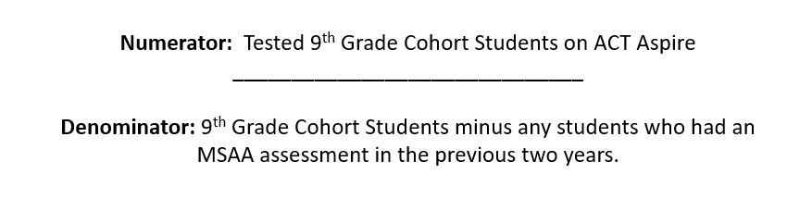
9-12 Traditional Model
ACT Aspire Bonus Point
  Opportunity for additional bonus point based on Grade 9 participation in the ACT Aspire
  Mirrors AzSci Test Bonus Point from 2020-2021 school year
  95% tested will mirror how AzM2 was handled in 2020-2021 in regard to potential MSAA students

Slide 13
9-12 Alternative Model
College and Career Readiness Index: ACT
  Modify ALT CCRI to allow Alternative school student to earn CCRI points for Proficiency level 2 on ACT.
  Coincides with previous AzMERIT/AzM2 Alternative CCRI component
College and Career Readiness Index: EdReady
  EdReady added to CCRI with point values consistent with Accuplacer
  Six assessments or max of 2.10 points
College and Career Readiness Index: Diploma Seals
  Modify CCRI spreadsheet to collect school/student data on Diploma Seals
  For analysis purposes and potential addition to CCRI as part of 5-Year Accountability Plan

Slide 14
9-12 Alternative Model
ACT Aspire Bonus Point
  Opportunity for additional bonus point based on Grade 9 participation in the ACT Aspire
  Mirrors AzSci Test Bonus Point from 2020-2021 school year
  95% tested will mirror how AzM2 was handled in 2020-2021 in regard to potential MSAA students

Slide 15
State A-F 5-Year Accountability Plan
Where are we headed?

Slide 16
State A-F
5-Year Accountability Plan
State Board of Education
  https://azsbe.az.gov/f-school-letter-grades
  Five-Year Accountability Plan
    5-Year Accountability Plan
Major items
  District Letter grades
  Middle School Models for Traditional and Alternative
  Updating CCRI for both Traditional and Alternative
  K-2 Model
  Small School Model

Slide 17
Additional Resources
A-F Letter Grade Technical Manuals
  Fiscal Year 2022 K-8 Traditional Schools Business Rules
  Fiscal Year 2022 9-12 Traditional Schools Business Rules
  Fiscal Year 2022 Alternative Schools Business Rules
  Updated Resources
  https://www.azed.gov/accountability-research/state-accountability
Achieve
  (602) 542-5151
  Achieve@azed.gov

Slide 18
Federal Accountability
2021-2022

Slide 19
Federal Accountability for 2021-2022
Comprehensive School Improvement – Low Achievement (CSI-LA) (Pending Federal Approval)
  SQSS Indicator – Chronic Absenteeism will go from 10 points to 2 points and growth will increase from 20 to 28 points
  Combination schools will have Chronic Absenteeism removed dropping total points from 100 to 95
Additional Targeted Support and Improvement – (ATSI)
  Follows CSI-LA at the subgroup level
Targeted Support and Improvement – (TSI)
  Three most recent years of available data

Slide 20
Federal Accountability for 2021-2022
Pending Federal Approval
In order to ensure schools do not remain in improvement due to a COVID anomaly, schools identified in fall of 2022 based on data from the 2021-2022 school year, will be able to exit fall of 2023 based on 2022-23 data.
Exit Criteria:
  • a minimum of one years of consecutive achievement; and
  • implementation of school improvement goals, strategies, and action steps, in state required Integrated Action Plan; and
  • above bottom 5% of Title l schools considering all applicable criteria.

Slide 21
More Information & Resources
ADEConnect to see data for 2020-2021 was posted
Federal Business Rules pending
School Support and Improvement: https://www.azed.gov/improvement

Slide 22
Summary
Questions, please contact Achieve
Achieve@azed.gov
(602)542-5151

