Slide 1

CTE Accountability &
CTE Data Portal
CTE Administrator’s Meeting – Nov 3, 2023

Slide 2
Important Dates
October 15, 2022
Data Capture Date for Fall enrollment
Students only need to be enrolled, not actually in attendance
Credits might not be available yet – not due until January
January 15, 2023
Fall term enrollment due with credits earned

Slide 3
Important Dates
February 15, 2023
Data Capture Date for Spring enrollment
Students only need to be enrolled, not actually in attendance
Credits might not be available yet – not due until June
June 15, 2023
Spring term enrollment due with credits
Can still make corrections to Fall data until this date
2022 Placement Surveys due

Slide 4

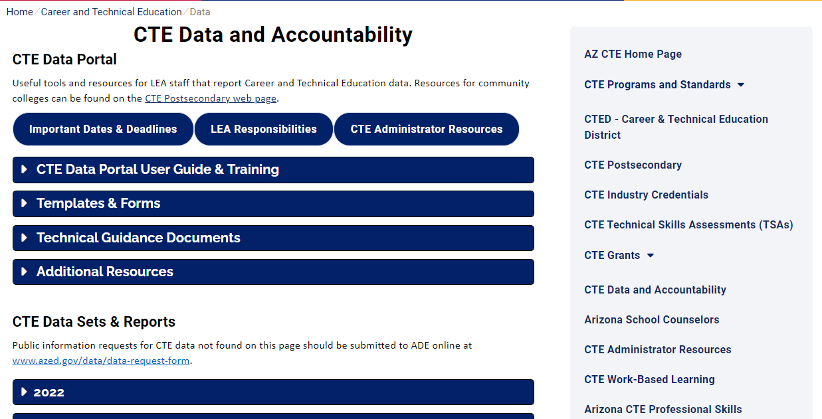
Website has been revised/simplified.
CTE Accountability Website: www.azed.gov/cte/data
Be sure to update your bookmarks!

Slide 5

What should I be doing now in the CTE Data Portal?
Enter Contact Information ASAP.
Review your Coherent Sequence and make sure it is up to date.
Begin to enter your Fall term enrollment when reporting opens – due January 15, 2023.
Begin to conduct/report your 2022 Placement Surveys – due June 15, 2023.
Report student credentials as they are attempted – due June 30, 2023 (for FY 2022 enrollment) OR June 30, 2024 (for FY 2023 enrollment).

Slide 6

Final Performance Measures Reports are available.
(For Perkins grant recipients)
Final performance measure reports are now available in the CTE Data Portal.
If your district did not meet at least 90% of the state determined level of performance (SDLP) for any measure, a performance improvement plan is required.
Performance Improvement Plans are entered into the Perkins grant application as a revision, due November 30, 2023.
Contact your CTE Grant Specialist for assistance.

Slide 7


Tammie Chavez, CTE Enrollment Specialist
Tammie.Chavez@azed.gov
602-542-3839
Charles Jarvis, Education Program Specialist
Charles.Jarvis@azed.gov
602-542-3823
Janet Silao, Education Program Specialist
Janet.Silao@azed.gov
602-542-5485
Donna Kerwin, CTE Business Analyst
Donna.Kerwin@azed.gov
602-542-7881
Samuel Irvin, CTE Accountability Lead
Samuel.Irvin@azed.gov
602-364-1946
CTE Accountability
New team member!

