Slide 1



CTE Administrators Meeting
November 3, 2022
ADE Vision – Equity for all students to achieve their full potential.
ADE Mission – The Arizona Department of Education advances equity and excellence for all students by serving school leaders, educators and staff, collaborating with communities, and leading with data-driven best practices
CTE Vision: Develop Arizona’s competitive workforce through the power of Career and Technical Education.
CTE Mission: Career and Technical Education will engage Arizona learners in relevant experiences leading to purposeful and economically viable careers.

Slide 2

Welcome – Clarkdale/Cottonwood Rooms
Introduction and ADE Updates: Strategic Plan
Presidential Scholars
Allocation Update
Grants and Comprehensive Local Needs Assessment (CLNA)
Accountability
Updates: ACTEAZ
Program Monitoring, Local Occupational Programs, Regional In Demand List
Updates: AZ CTE Curriculum Connection
Break
Updates: Premier Program Series, Project Change
School Counselors
Standards and Assessment Update, TSA Meetings, Website
CTSO
Update: ACOVA
Reminders and Closing
Adjourn at 11:50 am
AGENDA

Slide 3


New ADE Staff
Emily Brown: School Counselor Director
Kylie Chamblee: Education and Training and Family Consumer Science Program Specialist.
Welcome and Updates

Slide 4

Meetings were held September 19 and October 27
Vision and Mission have been revisited and in the process of updating language.
ADE/CTE Strategic Plan and Perkins V Revisions

Slide 5
US Presidential Scholars in CTE Applicants
52 Applied
Scores are due November 4
Top 5 are sent to Superintendent Hoffman to submit to USDOE

Slide 6

ALLOCATION
Update

Slide 7

Our Next
CTE Administrators Meeting will be in
Prescott on February 2, 2022 –
Mid-Winter Conference

Slide 8
Grant Specialist Team
Shelley Baudean – Grants Program Specialist
Audrey Dieken – Grants Program Specialist
Don Dolin – Grants Program Specialist
Mark McManus – Grants Program Specialist
John Jones – OCR Special Populations Program Specialist
Mary M. Medina – CTE Grants Supervisor

Slide 9

Federal Perkins and State Priority Grants

Slide 10

CTE Grant Application Important Dates
FY2022
CTE Federal Perkins Grant Completion Report opened October 1, 2022. Please submit your Completion Report no later than December 30, 2022

Slide 11
CTE Perkins Grant Application Important Dates
FY2023
Performance Measures Improvement Plans Due 11/30/2022
Performance Measures Mid-Year Grant Narratives Due 3/31/2023
Measurable Objectives Final Grant Narratives Due 9/15/2023
State Priority Completion Reports Due 9/30/2023
Perkins Completion Reports Due 12/31/2023

Slide 12
What is New?
Perkins
CLNA

Slide 13
Perkins CLNA
Incorporated Year 1 & Year 2 requirements
Condensed Criteria requirements
Incorporated Gap Analysis where applicable
*** Attend Shelley Baudean’s today session for more specifics

Slide 14
Helpful Tips
Ensure you have grant user access role
Purchase Capital Equipment
Work with Business Manager to ensure regular submission of reimbursement requests
Focus on CLNA goals / targets
*Spend your allocated funding

Slide 15
Planning Ahead
Schedule meetings with CLNA Leadership Team February 2023 to discuss / begin documenting FY2024 grant year’s CLNA goals / targets as this is year 1 of the biennial cycle
Based on CLNA Leadership Team meeting discussions, begin planning FY2024 Perkins Grant Measurable Objectives to be included in the FY2024 Perkins grant application due May 2023
Start planning your Perkins and State Priority budgets for the FY2024 applications due May 2023

Slide 16
Resources
Revised CLNA
Chart of Accounts
CTE Quick Reference Guide
Allowable/Unallowable Expenditures
CTE Dates / Deadlines

Slide 17
Contact Information
Shelley Baudean John Jones
Grant Program Specialist OCR Special Populations Program Specialist
shelley.baudean@azed.gov john.jones@azed.gov
602-542-5323 970-216-6740
Audrey Dieken Mark McManus
Grant Program Specialist Grant Program Specialist
audrey.dieken@azed.gov mark.mcmanus@azed.gov
602-350-5064 602-542-8744
Don Dolin Mary M. Medina
Grant Program Specialist CTE Grants Supervisor
don.dolin@azed.gov mary.m.medina@azed.gov
602-518-6526 505-426-6681

Slide 18
Mary M. Medina – CTE Grants Supervisor
Mary.M.Medina@AZED.gov
505-426-6681
Thank You

Slide 19

CTE Accountability &
CTE Data Portal
CTE Administrator’s Meeting – Nov 3, 2023

Slide 20
Important Dates
October 15, 2022
Data Capture Date for Fall enrollment
Students only need to be enrolled, not actually in attendance
Credits might not be available yet – not due until January
January 15, 2023
Fall term enrollment due with credits earned

Slide 21
Important Dates
February 15, 2023
Data Capture Date for Spring enrollment
Students only need to be enrolled, not actually in attendance
Credits might not be available yet – not due until June
June 15, 2023
Spring term enrollment due with credits
Can still make corrections to Fall data until this date
2022 Placement Surveys due

Slide 22

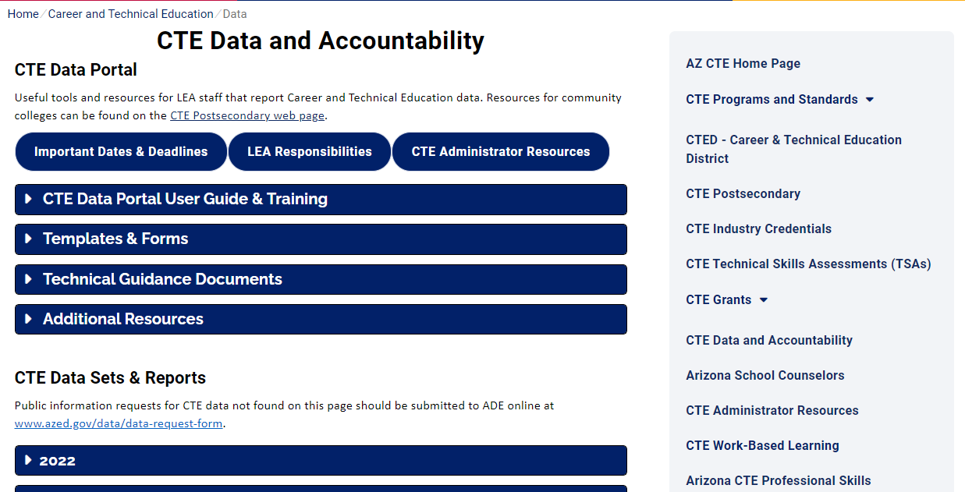
Website has been revised/simplified.
CTE Accountability Website: www.azed.gov/cte/data
Be sure to update your bookmarks!

Slide 23

What should I be doing now in the CTE Data Portal?
Enter Contact Information ASAP.
Review your Coherent Sequence and make sure it is up to date.
Begin to enter your Fall term enrollment when reporting opens – due January 15, 2023.
Begin to conduct/report your 2022 Placement Surveys – due June 15, 2023.
Report student credentials as they are attempted – due June 30, 2023 (for FY 2022 enrollment) OR June 30, 2024 (for FY 2023 enrollment).

Slide 24
Final Performance Measures Reports are available.
(For Perkins grant recipients)
Final performance measure reports are now available in the CTE Data Portal.
If your district did not meet at least 90% of the state determined level of performance (SDLP) for any measure, a performance improvement plan is required.
Performance Improvement Plans are entered into the Perkins grant application as a revision, due November 30, 2023.
Contact your CTE Grant Specialist for assistance.

Slide 25

Tammie Chavez, CTE Enrollment Specialist
Tammie.Chavez@azed.gov
602-542-3839
Charles Jarvis, Education Program Specialist
Charles.Jarvis@azed.gov
602-542-3823
Janet Silao, Education Program Specialist
Janet.Silao@azed.gov
602-542-5485
Donna Kerwin, CTE Business Analyst
Donna.Kerwin@azed.gov
602-542-7881
Samuel Irvin, CTE Accountability Lead
Samuel.Irvin@azed.gov
602-364-1946
CTE Accountability
New team member!

Slide 26

CTE Administrators Meeting
November 2022

Slide 27

Midwinter (Feb. 2 – 3, 2023)
Registration & Call for Presentations currently live
Proposal submissions due Dec. 16
Hotel reservations open now –
Call-in information on website.
  For issues, please contact Pam Ferguson at pamferguson@acteaz.org
For more information, visit acteaz.org/events/mid-winter/

Slide 28
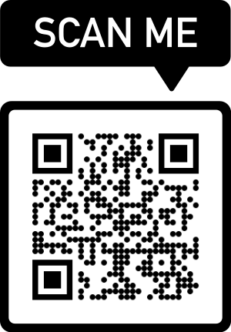
Membership Survey
Opened Oct. 26
Closes Nov. 9
To access, visit: https://www.surveymonkey.com/r/2RLBHXT
or scan the QR code

Slide 29
Information to Come
Please read your e-blasts and ACTEAZ.org for updates on the following:
  ACTE National & Region V events
  CTE Month video contest & flyers on website
    Video contest ends Jan. 6. Winners will be announced Feb. 1.
  Professional Development Opportunities calendar
  Awards and Scholarships
    Submissions opened Nov. 1 and close March 10, 2023
  2023 Summer Conference (July 14 – 19, 2023)
    Call for Presentations goes live Nov. 9

Slide 30
ACTE National & Region V Events
ACTE National Conference: Nov. 30 – Dec. 3, 2022 –
Las Vegas, NV
National Policy Seminar (NPS): March 20 – 22, 2023 –Arlington, VA
Region V Conference: Apr. 12 – 15, 2023 –
Fargo, ND
For more information, visit acteaz.org/events

Slide 31

AZ CTE Summer Conference

Slide 32




Follow Us on Social Media
facebook.com/acteaz
@actearizona
linkedin.com/company/acteaz
@acteaz

Slide 33
Want More Information?
Lindsay Duran
ACTEAZ President
lindsayduran@acteaz.org
Pam Ferguson
ACTEAZ Exec. Director
pamferguson@acteaz.org
Shelly York
ACTEAZ Asst. Exec. Director
shellyyork@acteaz.org
(623) 826-6399
Shelby Freytag
Premier Series
Coordinator
premierseries@acteaz.org
Alec Damiano
Marketing & Event Technology Manager
alecdamiano@acteaz.org
Kailyn Gillette
Administrative Assistant
eventsupport@acteaz.org

Slide 34
CTE Program Services
Updates
Cindy Gutierrez
Notes:
Good Morning, I am sharing with you today information about CTED 4th year fund list, local occupational programs, and program monitoring

Slide 35
CTE Program Services Team
Bruce Watkins - Agriculture and Welding
Elena Sobampo - Business and Marketing Education; Communication Media Tech.
Joseph Grieco - Construction Science Technologies
Kylie Chamblee - Education and Training/Family and Consumer Sciences
Tracy Rexroat - Engineering, Information Technologies, Manufacturing
Wesley Wood - Health Science Technologies
Jason Wojcik - Public Services Careers, Transportation Technologies
Janai Nesby - Program Project Specialist
Gwen Lamb - Administrative Assistant
Notes:
Our Program Services team consist of 7 Program Specialist and 2 support staff.
As Cathie announced, we have our new Education and Training FCS program Specialist, Kylie Chamblee. She began on Monday and is excited to serve Arizona CTE.

Slide 36
CTE Program
Monitoring school year 23-24
Districts Scheduled for SY 23-24
CAVIT and member districts
EVIT and member districts
Ray Unified School District
Cave Creek Unified School District
SY 23-24 District notifications and training:
Email notifications coming soon from CTELocalPrograms@azed.gov
Required Training February 1, 2023, Mid-Winter, Prescott Resort, 1-4 pm.
Specific CTED and member district only meetings in April-May TBD, begin submissions
2023 Summer Conference Monitoring support sessions TBD
Notes:
Program Monitoring!
These are the districts that will be monitoring next year, in SY23-24
CAVIT and member districts
EVIT and member districts
Ray Unified School District
Cave Creek Unified School District
Please add CTE Local Programs @ azed.gov to your email contacts. All monitoring correspondence goes through this email
Please put February 1, 2023 on your calendar to attend the training at Mid-Winter Conference.
Between now and the training please make an effort to begin reading the monitoring resources- document, monitoring guide and process guide

Slide 37
Districts for SY 24-25
Cochise Technology District and member districts
Gila Institute for Technology and member districts
Pima JTED and member districts
Feel free to join the training.
Any district is welcome to attend the Program Monitoring Training
CTE Program
Monitoring school year 24-25

Slide 38
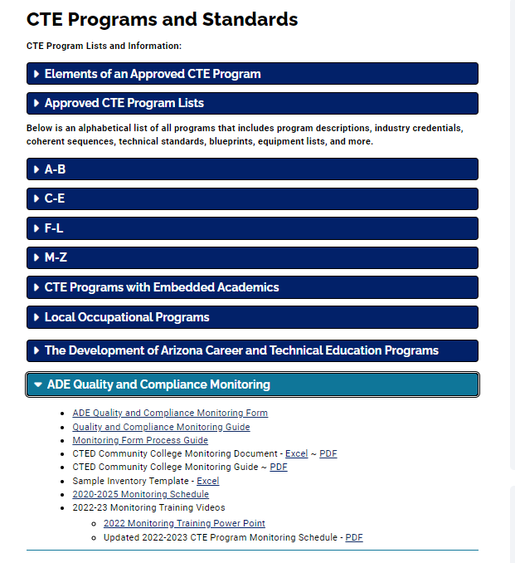
Monitoring
Resources
and
Guidance
https://www.azed.gov/cte/programs
Notes:
On the CTE program and standards webpage there is a blue ribbon reading: ADE Quality and compliance Monitoring
Under that ribbon are Monitoring resources including the
ADE Quality and Compliance Monitoring Form

Slide 39
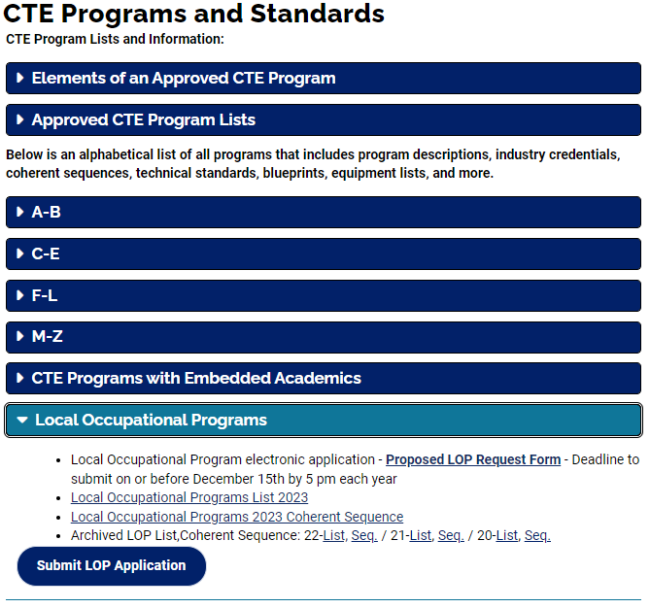
LOP - Process
Electronic application deadline:
on or before December 15th by 5 pm
Submissions:
  By CTED for central or satellite member programs
  By District only for District
If approved, added to the CTE Data portal only for eligible entities.
Webpage link: https://www.azed.gov/cte/programs
Notes:
A local Occupational Program is a Local program justified by local/regional labor market data that is focused on meeting the needs of the specific community.
Since a LOP is not on the CTE Approved Program List, there is an application process that a CTED or District may submit in order to be eligible to offer a new LOP program in their district.
The LOP application process is an electronic submission utilizing the JotForms online process which is available on the Industry Credential webpage.
Applications are due by December 15th to be considered for the following school year.

Slide 40
Regional In-Demand Program List
Copies in your packet
CTED 4th year funding
Programs by county groups
Includes LOP programs
2023-2024 Regional
In-Demand Programs for CTED 4th Year Funding

Slide 41
COMING – February 2023!
2024 CTE Approved Programs List
Based on:
High Skill,
High Wage,
OR
In-demand occupations
2024
CTE Approved Programs List
Notes:
WE are currently working with OEO on the 2024 CTE program list
That list will be available at the February meeting

Slide 42
Cindy Gutierrez, Director, CTE Program Services
Cindy.Gutierrez@azed.gov
(602) 542-4365
Thank You

Slide 43






CRAFTING CURRICULUM | CONNECTING EDUCATORS
New Published Resources
  Announced in Group Discussions
Upcoming Events
  Nomination Process
    Teacher Self Nomination
    Director/Administrator
  Blueprint/Instructional Framework & Benchmark Assessments
  Scope and Sequence/Task Analysis
Administrators’ Group
Brought to you by:
Reach us:
support@ctecaz.org
Follow on Social Media:

Slide 44
CRAFTING CURRICULUM | CONNECTING EDUCATORS
Scope & Sequence and Task Analysis Event:
Automation and Robotics
Automotive Collision Repair
Business Operations
Digital Animation
Digital Communications
Finance
Interior Design
Pharmacy Support Services
Technology Devices Maintenance
Teacher nomination closes January 11, 2023 for Scope and Sequence event.
Blueprint for Instruction & Assessment and Instructional Framework Project
Accounting
Education Professions
Electronic Technologies
Emergency Medical Services
Fire Service
Heavy Equipment Operations
Laboratory Assisting
Marketing
Mechanical Drafting
Precision Machining
Link to nominate will be available on Quarterly Newsletter and in Administrators’ Group

Slide 45

PREMIER SERIES

Slide 46


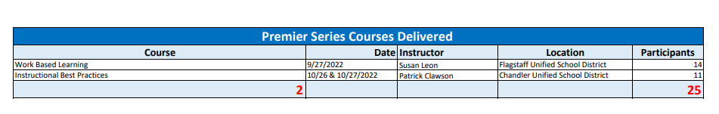
Premier Series Courses Delivered
Premier Series
FY 2022-2023 as of November 3, 2022

Slide 47
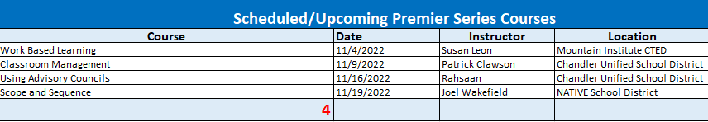
Scheduled/ Upcoming Premier
Series Courses
Premier Series
FY 2022-2023 as of November 3, 2022
ACTEAZ Premier Series currently has other class inquiries that are being scheduled as well.

Slide 48
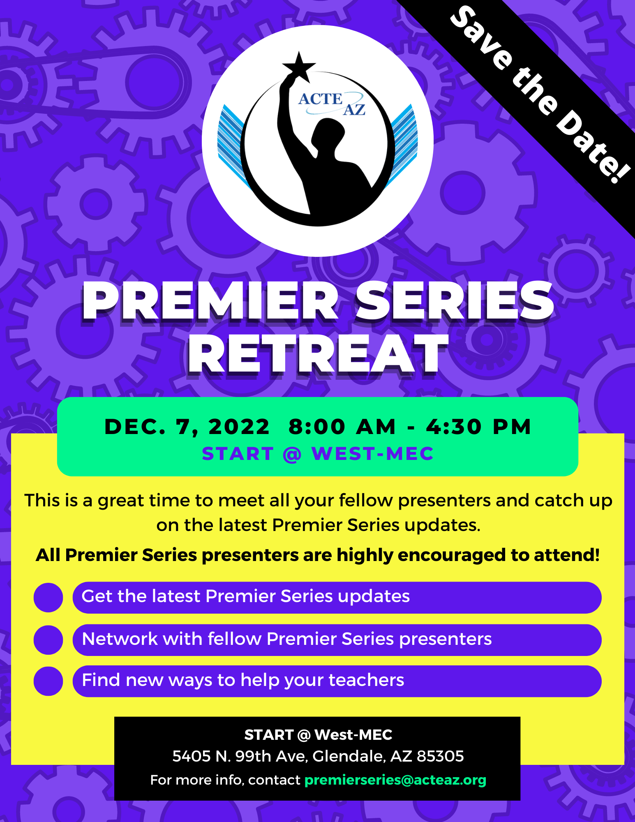
Premier Series Retreat
This event is specifically for all Premier Series vetted instructors, we invite all instructors to attend!
Premier Series
FY 2022-2023 as of November 3, 2022

Slide 49
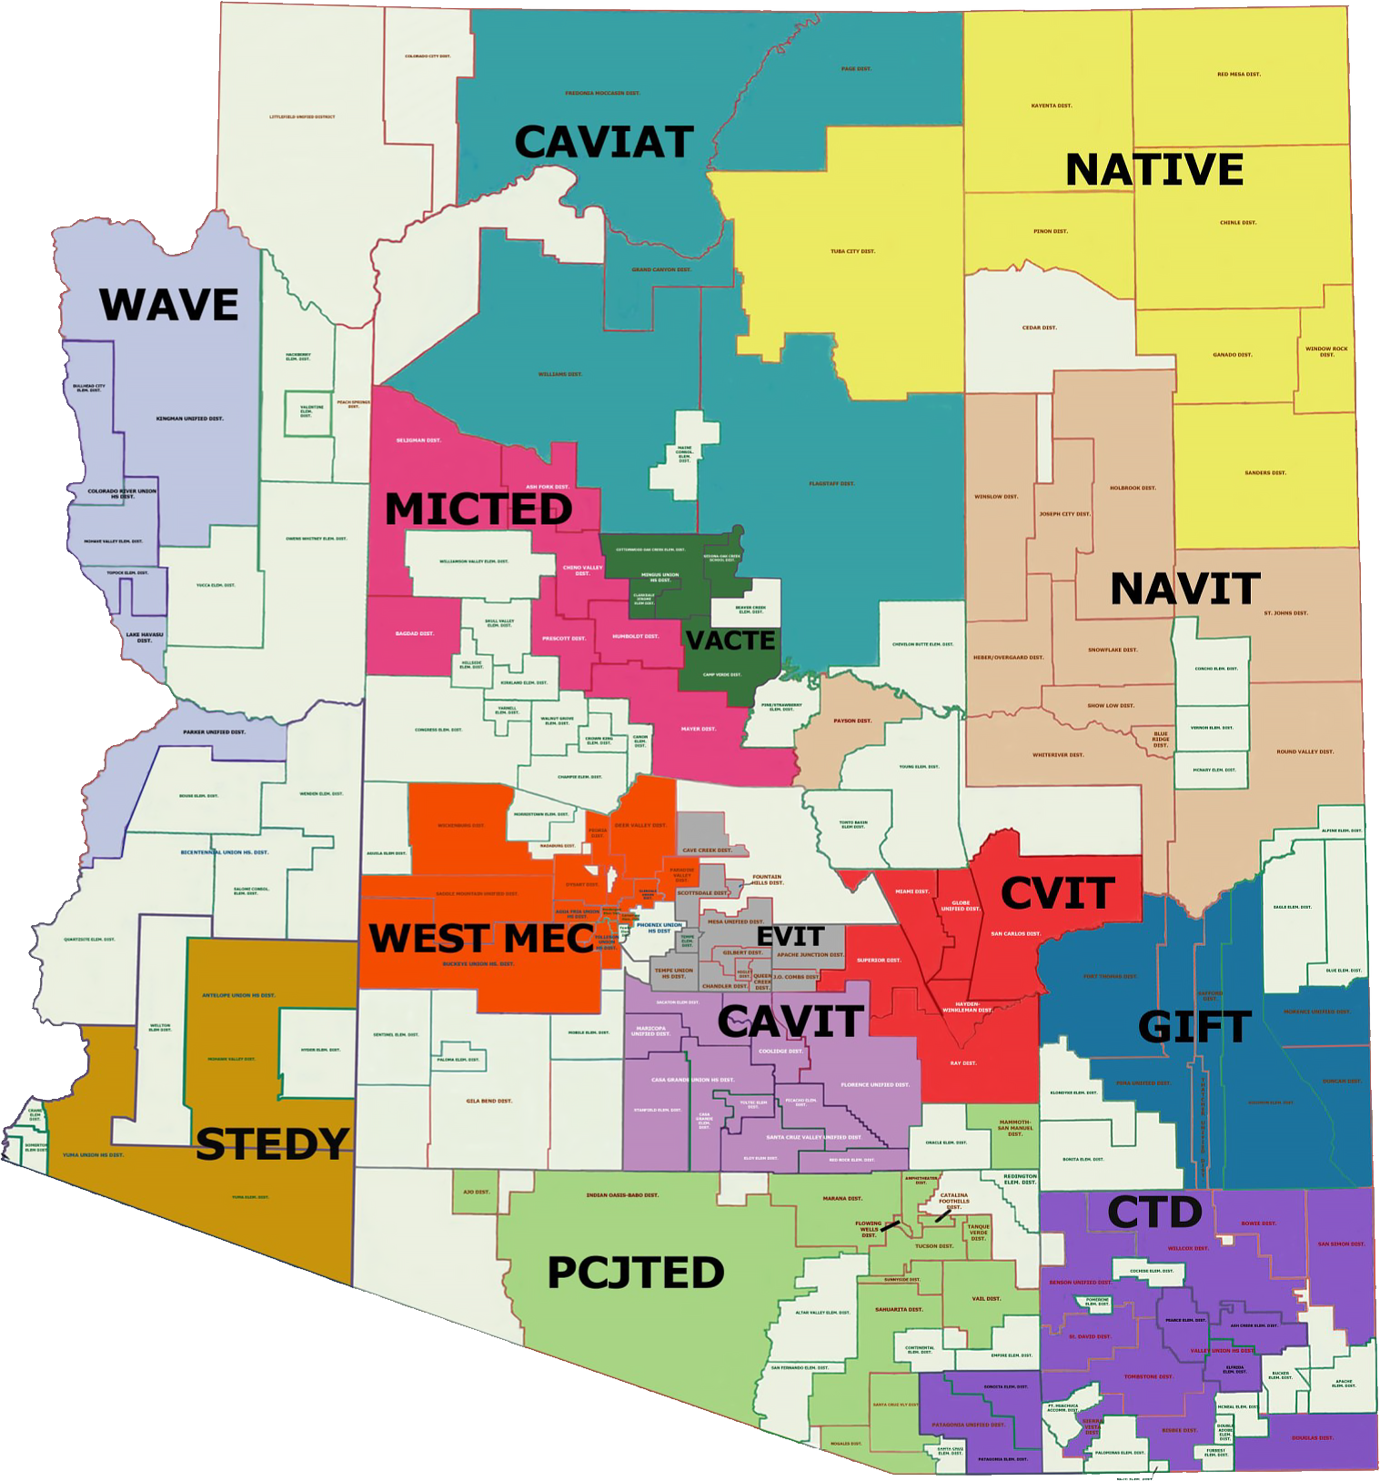
Statewide Partnerships
The Premier Series is offered throughout Arizona by:
  - ACTEAZ
  - Pima JTED
  - West-MEC
With a handful of courses available through:
  - CTD
  - NAVIT
  - EVIT
  - WAVE
Premier Series
FY 2022-2023 as of November 3, 2022

Slide 50
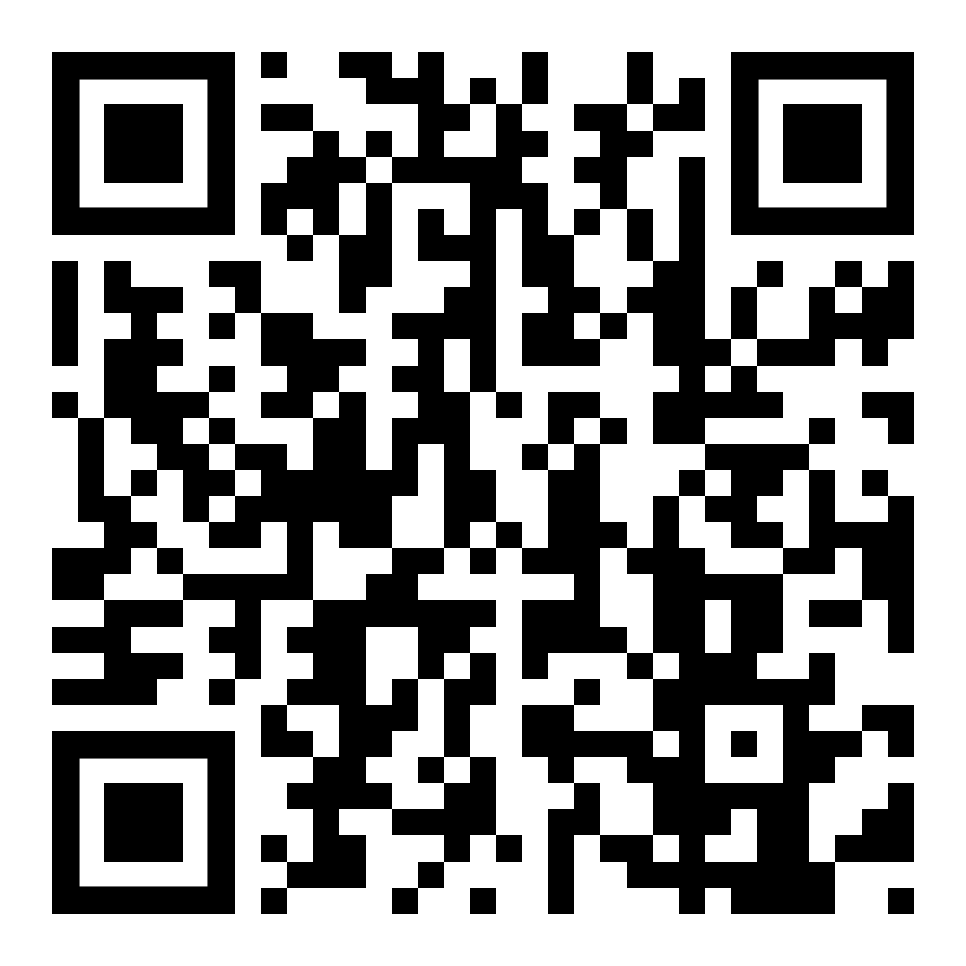
Course Offerings/ Calendar
For more information on ACTEAZ Courses & Course Calendar please visit the ACTEAZ Website.
https://www.acteaz.org/cte-leads-2/about-the-teacher-series/
Premier Series

Slide 51
How Can I Help?
For more information about the Premier Series or to schedule Premier Series classes for your instructors, please contact:
Shelby Freytag
Email: Premierseries@acteaz.org
Phone: (928) 941-0204
Premier Series

Slide 52

Project CHANGE
Increase gender nontraditional CTE enrollment
Promote safe and healthy schools
Recruitment + Retention of Nontraditional students
Gender, CTE, and Nontraditional Career Success
Stop Sexual Harassment
Stop Cyberbullying + Promote Positive Digital Citizenship
tylerlepeau@email.arizona.edu
timwernette@msn.com

Slide 53

Project CHANGE
We are happy to present in person again! Along with in-person presentations, we are also offering Project CHANGE presentations in these online and/or video formats:
Live online sessions on Zoom or Google Meet (works best with groups of about 10-40 participants).
Pre-recorded video presentations along with optional interactive Google slide activity.
Presentations and workshops are provided at no cost.
Educator presentations provide professional development hours.
Presentations run approximately an hour to accommodate a typical class period (shorter for pre-recorded video).

Slide 54
School Counselor Director Introduction
Emily Brown

Slide 55

Over 12 years of experience working as a School Counselor with grades K-12 in both Arizona and Ohio
My Background:

Slide 56
Continue monthly newsletter with resources for School Counselors
Goals:

Slide 57

Update My Future AZ
-Resources
-School Builder Pages
Goals:

Slide 58
School Counselor Institute
-One day in the summer of 2023
Goals:

Slide 59
Emily Brown, School Counselor Director
Emily.Brown@AZED.gov
(602) 542-5353
Thank You!
I look forward to working with all of you and helping in anyway I can.

Slide 60
Technical Standards
Embedded Academic Crosswalks
Technical Skills Assessments

Slide 61
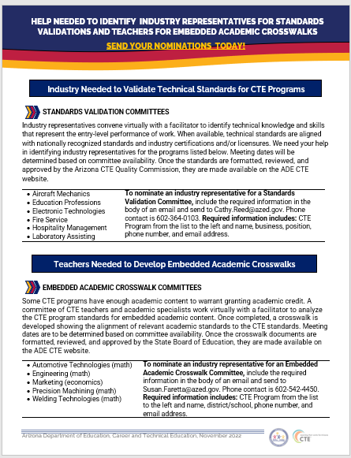
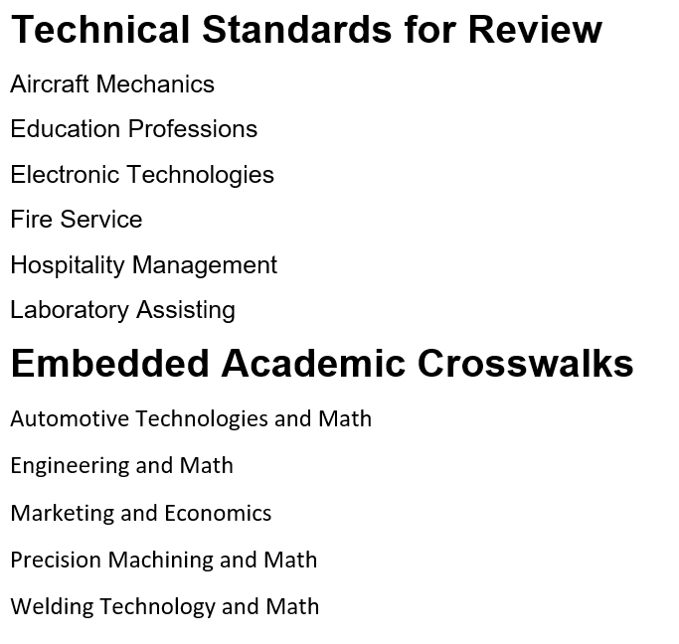

Slide 62
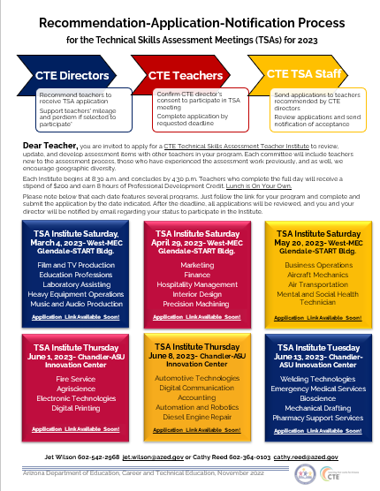
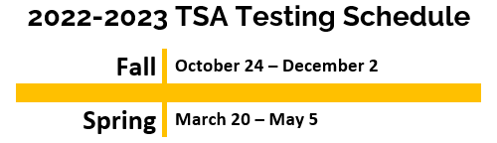
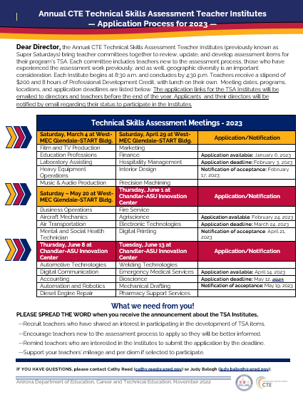
The Annual CTE TSA Teacher Institutes to work with Teacher Committees to review, edit, and develop assessment items will be held March through June.

Slide 63

Staying for the ACOVA Conference?
Please join us this afternoon.
Verde A from 2:10 to 3:05
DIRECTORS! RAISE YOUR TSA IQ

Slide 64
Judy Balogh | Director, Standards-Assessment-Career Development
Arizona Department of Education, Career and Technical Education
Office: 602-542-4155: Email: Judy.Balogh@azed.gov
Thank You

Slide 65








CTSOs

Slide 66
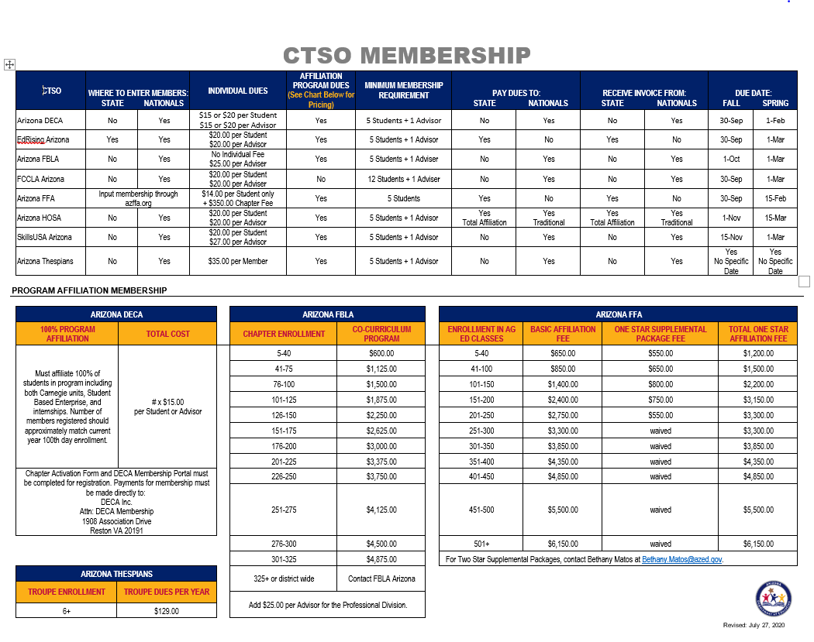
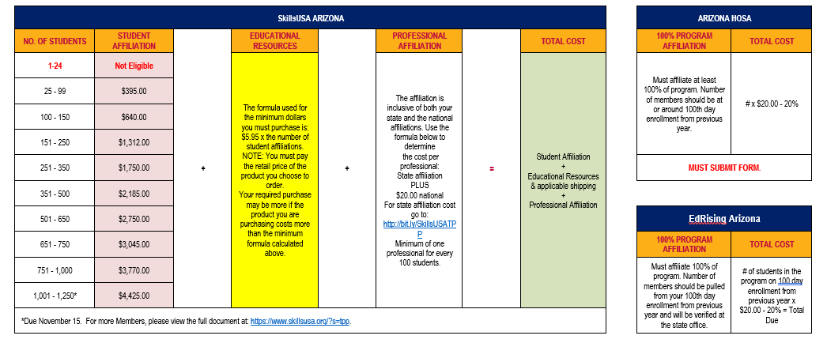
CTSO
Membership
Breakdown sheet with each CTSO
On ADE Website
ALL MEMBERSHIP DUES GO TO
NATIONAL OFFICES (except FFA)

Slide 67
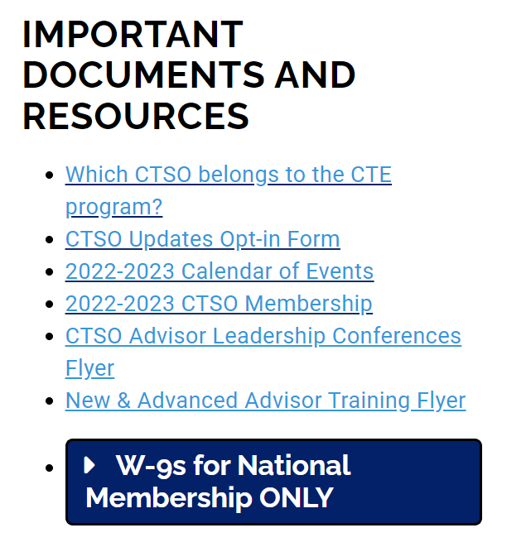
ADE/CTE/CTSO
Website
Career and Technical Student Organizations - CTSOs | Arizona Department of Education (azed.gov)

Slide 68
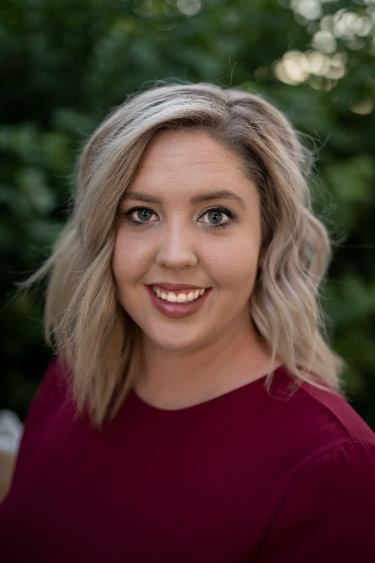
WELCOME
New DECA State Advisor
Lacy Beanland-Kirk

Slide 69

New Advisor
Trainings
Cost: Free
Dates:
Wednesday November 30th 8:00am-3:30pm – ADE North Campus
Sign up: https://fblaarizona.wufoo.com/forms/ctso-new-advisor-training-2022/

Slide 70

Advanced Advisor
Trainings
Cost: Free
Dates:
Monday-Friday December 5th-9th 4:00pm - Virtual
Sign up: https://fblaarizona.wufoo.com/forms/ctso-advanced-training-2022/

Slide 71
Questions, Concerns, Comments
Julie Ellis
Email
Julie.Ellis@azed.gov
Work
602-542-5350
Cell
520-465-3655
Thank You!

Slide 72

ACOVA
Professional Organization for CTE Administrators
www.acova.org
We need your contact information please.

Slide 73
ACOVA
Join us for the Fall conference-following ADE meeting
Live networking auction tonight!

Slide 74
Join us on social media!
Like and follow us on social media: Twitter
New! Facebook and Instagram

Slide 75


Slide 76
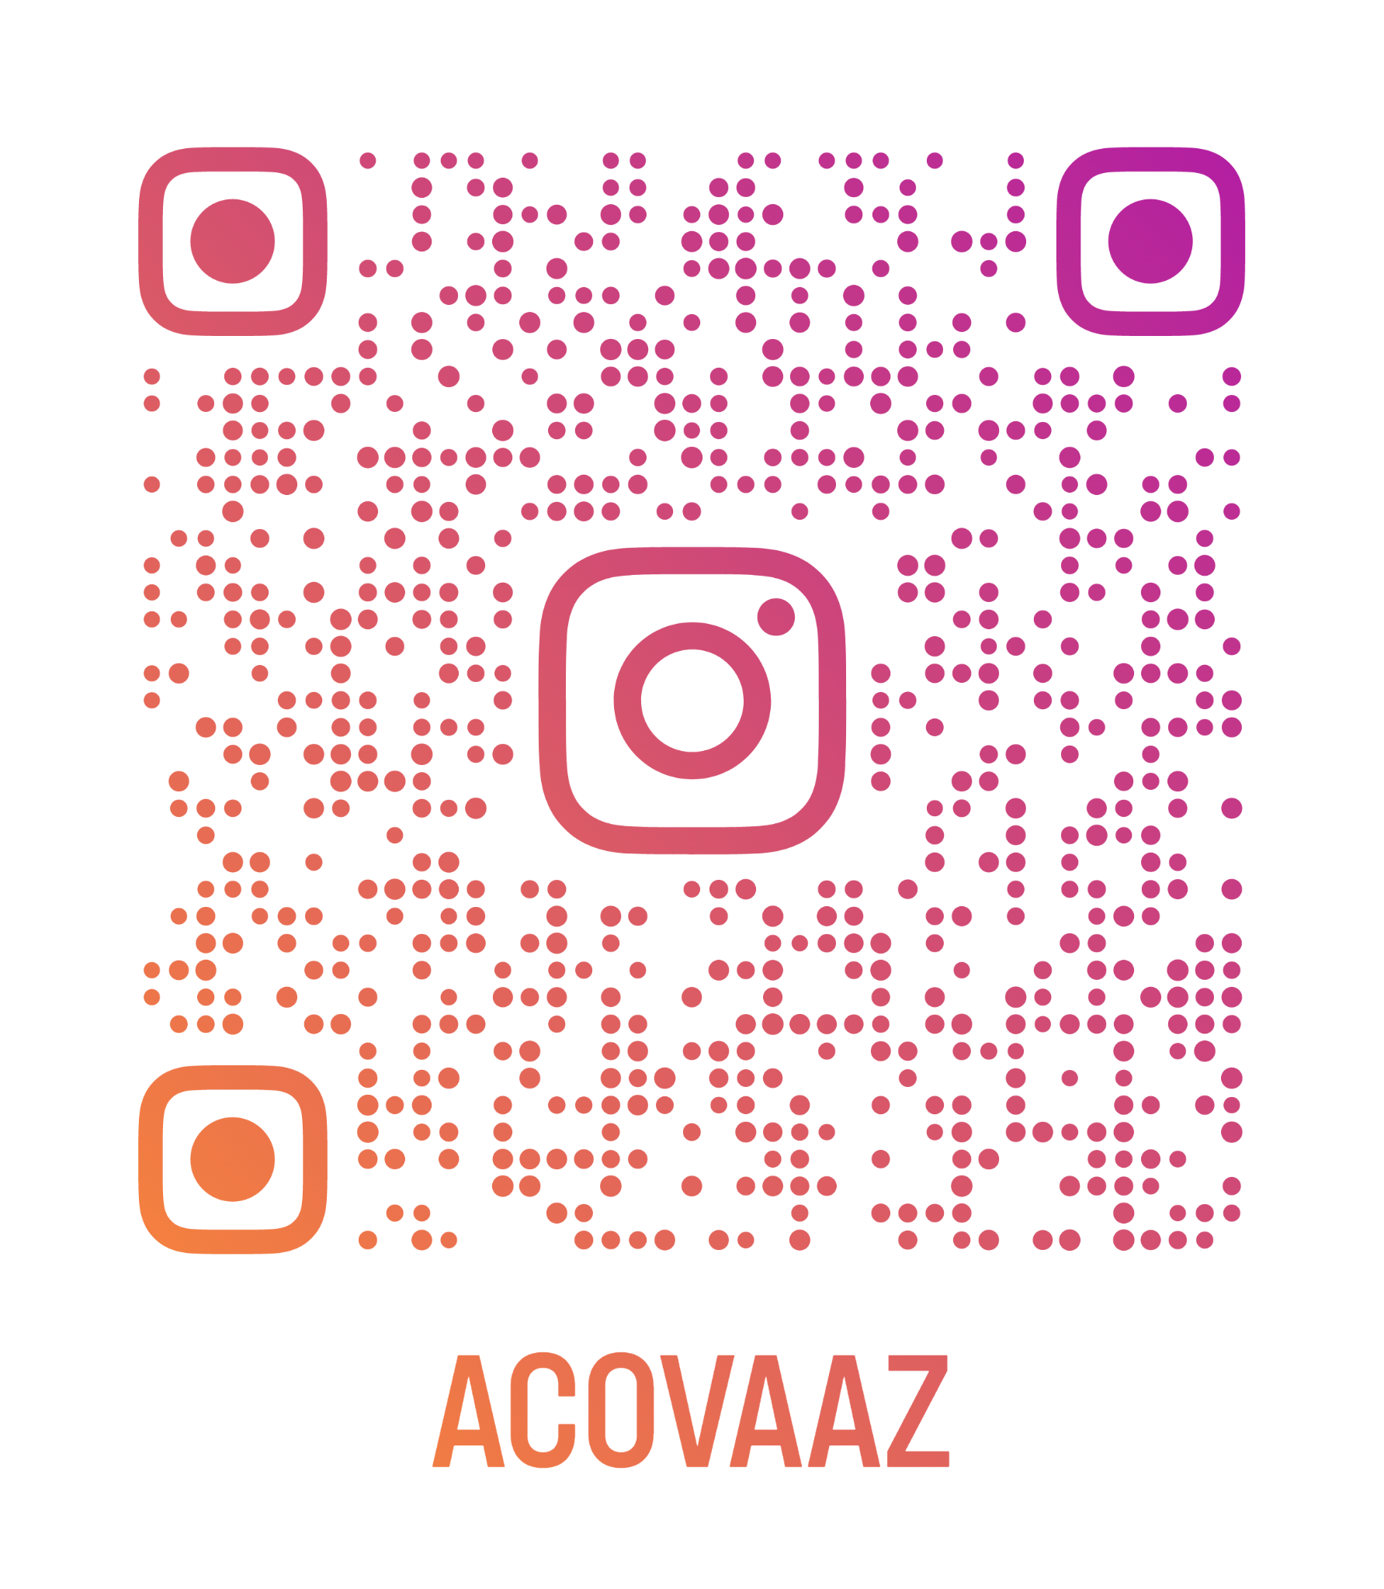
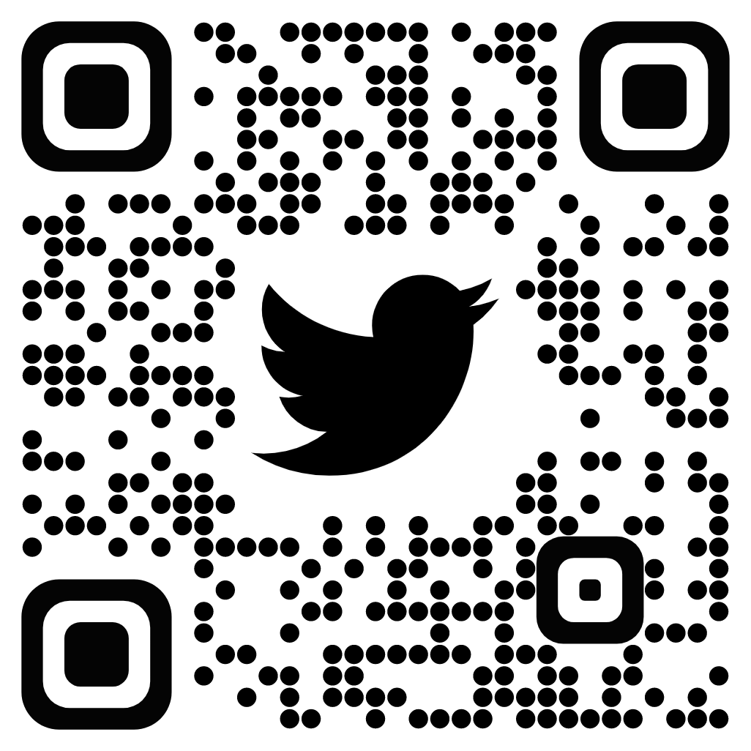

Slide 77
Our Next
CTE Administrators Meeting will be in
Prescott on February 2, 2022

