Slide 1

AASBO Meeting Update
ADE School Finance
11/9/2022
Notes:
This is a title page – please do not use for bulleted content

Slide 2

Agenda
FY 2023 ADM Update
New Group B Weights
Aggregate Expenditure Limit
Budget Reports
Other Updates

Slide 3

Average Daily Membership Update
ADE SCHOOL FINANCE
SECTION 1
Notes:
This is a title page – please do not use for bulleted content

Slide 4
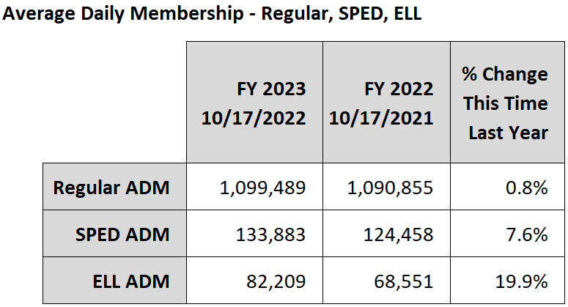

ADM Update

Slide 5
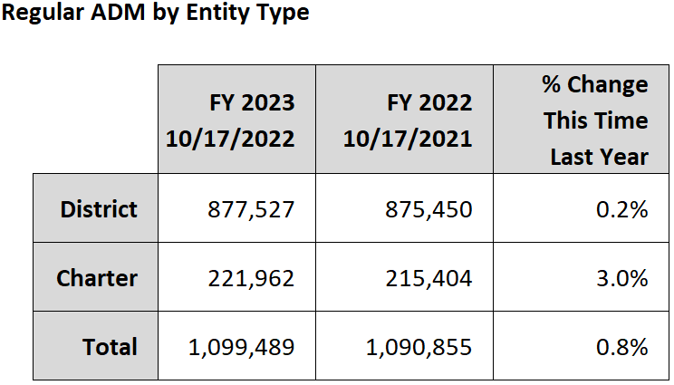
ADM Update

Slide 6
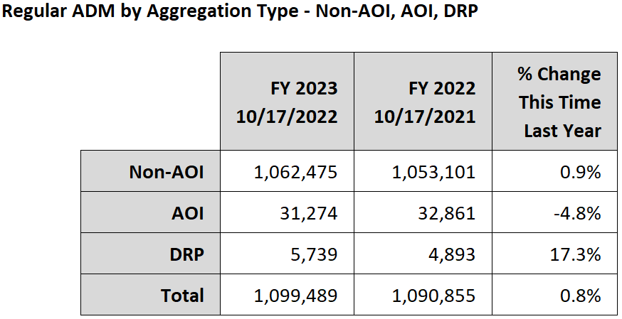
ADM Update

Slide 7
New Group B Weights
ADE SCHOOL FINANCE
SECTION 2
Notes:
This is a title page – please do not use for bulleted content

Slide 8
Gifted Group B Weight
Group B weight funding for gifted students will be calculated manually again for FY 2023
  Same process as for FY 2022
Funding will appear as an adjustment to the base support level in BSA 55 Reports and the supporting calculation will be published on the School Finance website
GIFT11 report shows students reported with a qualifying need; ADM15 report shows ADM generated by students

Slide 9
FRPL Group B Weight
FRPL weight is 0.018, which is about $86 per eligible student
Funding for this weight will be calculated manually for FY 2023
  Similar to the process used for Gifted
The SUPP72 report in AzEDS shows students for which a qualifying need has been reported
Plan to fully implement FRPL and Gifted weights in AzEDS and the payment system, but the timeline is not yet known

Slide 10
Aggregate Expenditure Limit
ADE SCHOOL FINANCE
SECTION 3
Notes:
This is a title page – please do not use for bulleted content

Slide 11
Aggregate Expenditure Limit
Article 9, Section 21 of the Arizona Constitution defines the expenditure limitation for school districts
The Economic Estimates Commission calculates the limit
School Finance calculates statewide expenditures subject to the limit
If budgeted expenditures exceed the limit, legislature may approve or school districts are required to reduce budgets

Slide 12
School Finance Calculation
BUDG-AGD reports extract certain values from budget files submitted by school districts based on the definition of expenditures subject to the limit
Expenditures in most school district funds are excluded
Several specific items within otherwise included funds are also excluded
Adjustments are made for items that are not possible to separate from district budgets
Individual district numbers roll up to the statewide calculation

Slide 13
FY 2023 Aggregate Expenditure Limit
BUDG-AGD reports showing the FY 2023 calculation for each district were published last Tuesday (11/1)
Details the at risk budgeted expenditures for each district
Legislature may approve expenditures in excess of the limit by March 1st
If the Legislature fails to authorize excess expenditures, districts will be notified of required reductions by March 5th

Slide 14
Budget Reports
ADE SCHOOL FINANCE
SECTION 4
Notes:
This is a title page – please do not use for bulleted content

Slide 15
BUDG-25 Report
BUDG-25 reports are now available for FY 2023
  Compares district’s current-year budget to ADE calculations
  Currently based on September payment data
  Will be updated for October payment data this week and November payment data later this month
BUDG-25 letters notifying of required revisions have also been published
Reminder: continue to monitor the BUDG-25 report

Slide 16
BUDG-75 Report
BUDG-75 report were published last week
  Compares prior-year budget/AFR to ADE calculations
It is possible to correct errors in the Annual Financial Report
  Correcting AFRs and School-Level Reports
BUDG-75 letters will be published in early February
Certain values in the current-year BUDG-25 will reflect data from the prior-year AFR after the next update

Slide 17
Other Updates
ADE SCHOOL FINANCE
SECTION 5
Notes:
This is a title page – please do not use for bulleted content

Slide 18
Other Updates
School District Employee Report (SDER) data is now published at schoolfinancereports.azed.gov
Submission reports are also available on our website
Revisions are possible February 1st through March 1st
School District Employee Report Manual and Training Video
    https://www.azed.gov/finance/instruction-manuals
    https://www.azed.gov/finance/training-videos

Slide 19
Results-Based Funding
FY 2023 award amounts will be based on FY 2021 assessment results and poverty measures
  Current-year student counts for charters; Prior-year for districts
Based on the percentage of students passing FY 2021 assessments
Payments will be made in November and May

Slide 20
Results-Based Funding
$400 per student count
  Top 13% of 60%+ FRL schools
$225 per student count
  Top 27% of 60%+ FRL schools
  Top 13% of all schools

Slide 21
Charlie Martin, Deputy Associate Superintendent
Charlie.Martin@AZED.gov
(602) 542-8026
Thank You

