Slide 1

Payment and Budget Reports
ADE School Finance
Notes:
This is a title page – please do not use for bulleted content

Slide 2

Agenda
Introduction to School Finance
Payment Reports
Budget Reports
Questions

Slide 3

Introduction to School Finance
ADE SCHOOL FINANCE REPORTS
SECTION 1
Notes:
This is a title page – please do not use for bulleted content

Slide 4

Introduction to School Finance
School Finance distributes about $6B in state funding for education each year in accordance with formulas in state law
15 staff divided between two teams
One team focuses on collecting the data necessary to calculate payments and related reporting
  Help Desk or (602) 542-5695
One team uses the data to calculate and process payments and manages the collection of budgets/financial reports and corresponding reporting
  SFBudgetTeam@azed.gov
  SFPaymentTeam@azed.gov

Slide 5
Introduction to School Finance
State funding is determined primarily by current year student enrollment
Student-specific, district-specific, and charter-specific factors affect funding:
  Add-on funding for students with special education needs, English learners, and certain grades
  Small districts/charters receive more per pupil
  TEI, base level adjustments (teacher compensation, 200 day calendar)

Slide 6
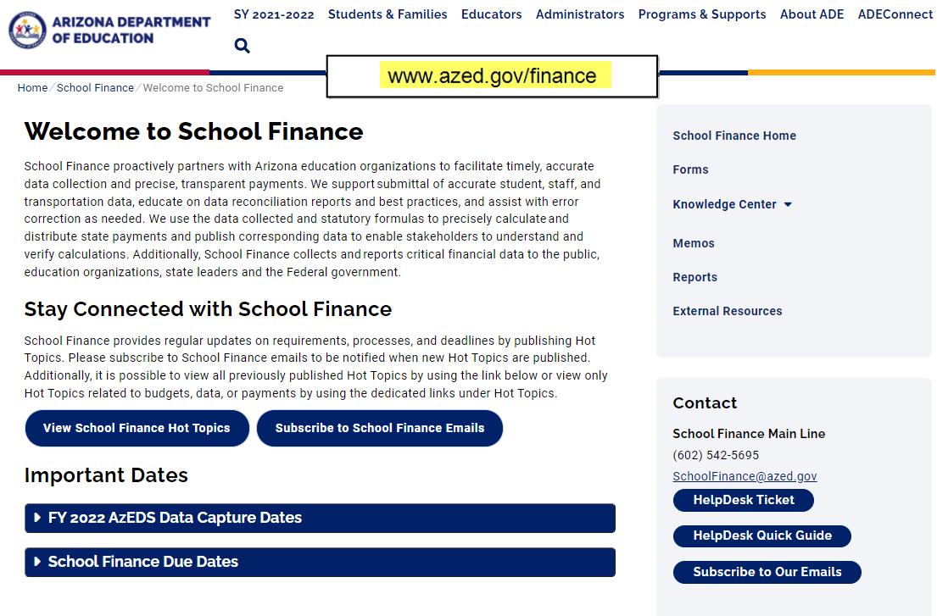
www.azed.gov/finance

Slide 7
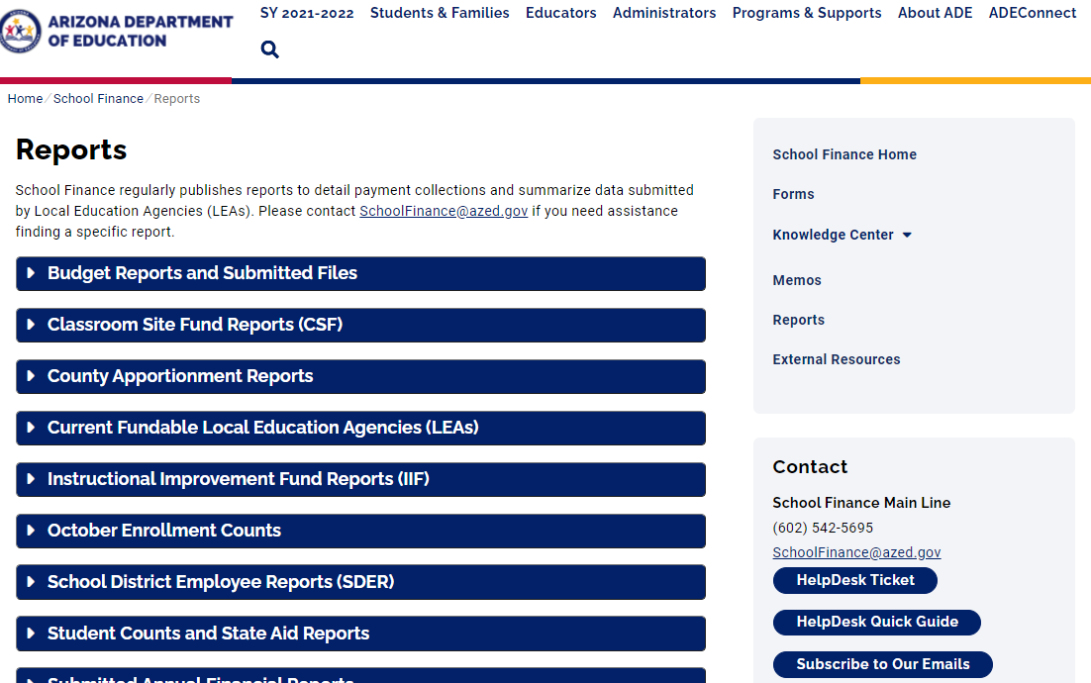
School Finance Reports

Slide 8
Payment Reports
ADE SCHOOL FINANCE REPORTS
SECTION 2
Notes:
This is a title page – please do not use for bulleted content

Slide 9

Payment Reports
Basic State Aid Reports
  BSA55 – Basic Calculations for Equalization Assistance
  BSA64 – Equalization Assistance and State Aid Payment Details
Other Reports
  SDER96 (TEI)

Slide 10
Payment Reports
BSA 55-1: District Equalization Report
  Summarizes annual equalization base and equalization assistance calculation based on student data and district characteristics
  Previously known as APOR 55-1
BSA 64-1: Equalization Payment Schedule Detail
  Summarizes each monthly payment calculation based on annual equalization assistance, amounts received in prior months, and any adjustments
  Previously known as APOR 64-1

Slide 11
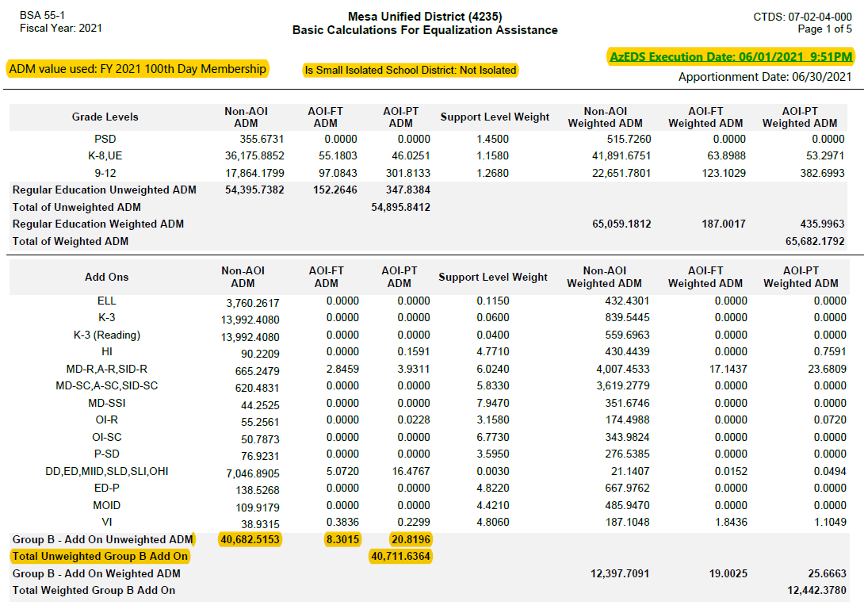

Slide 12

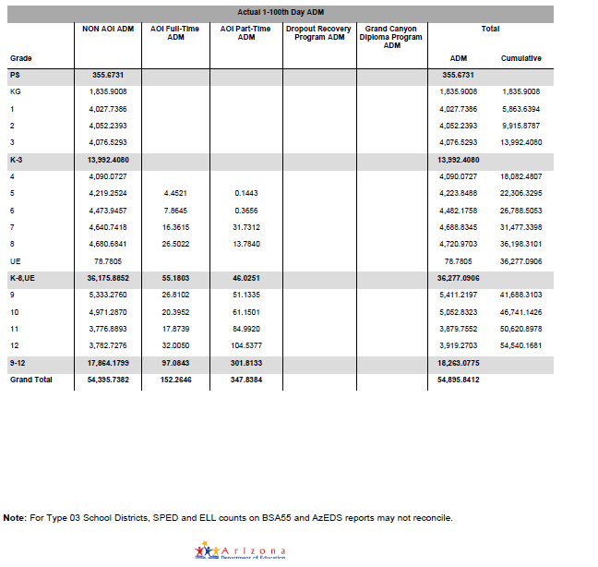


Slide 13
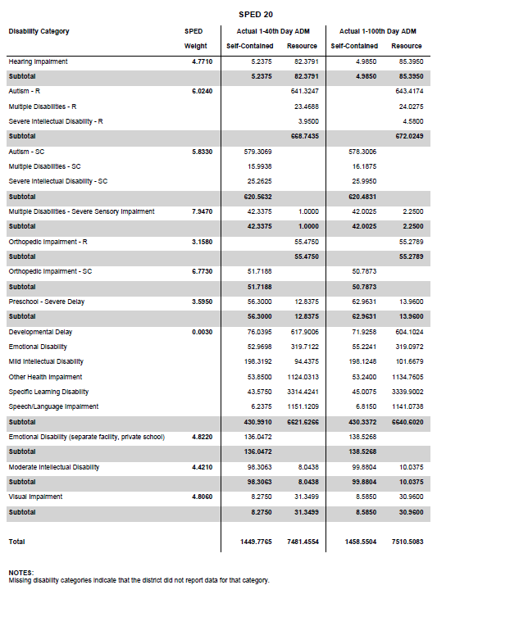

Slide 14
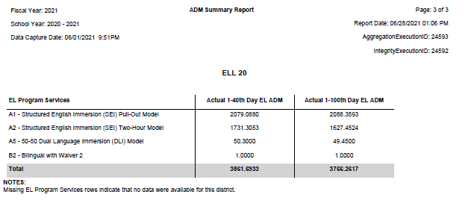

Slide 15
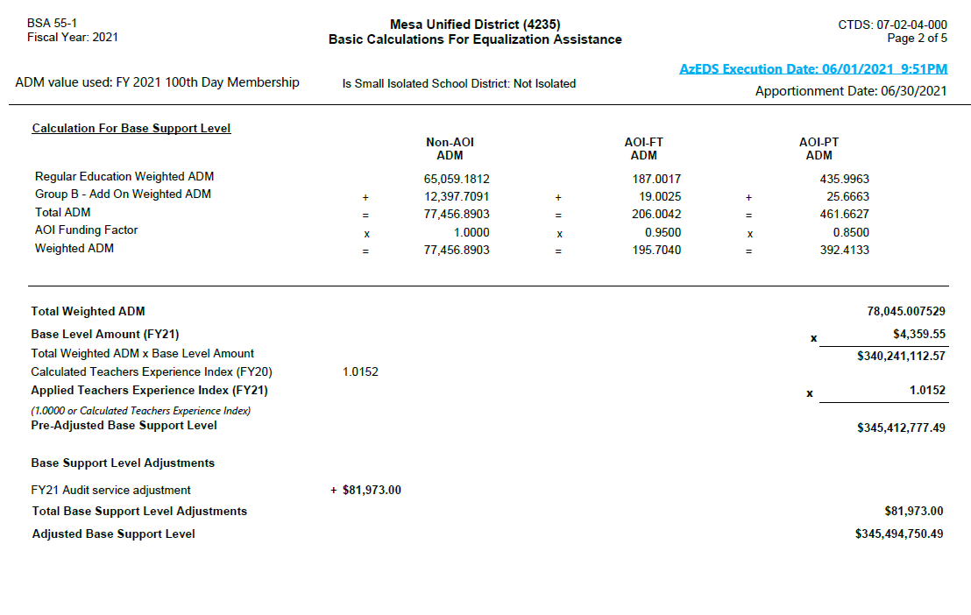

Slide 16
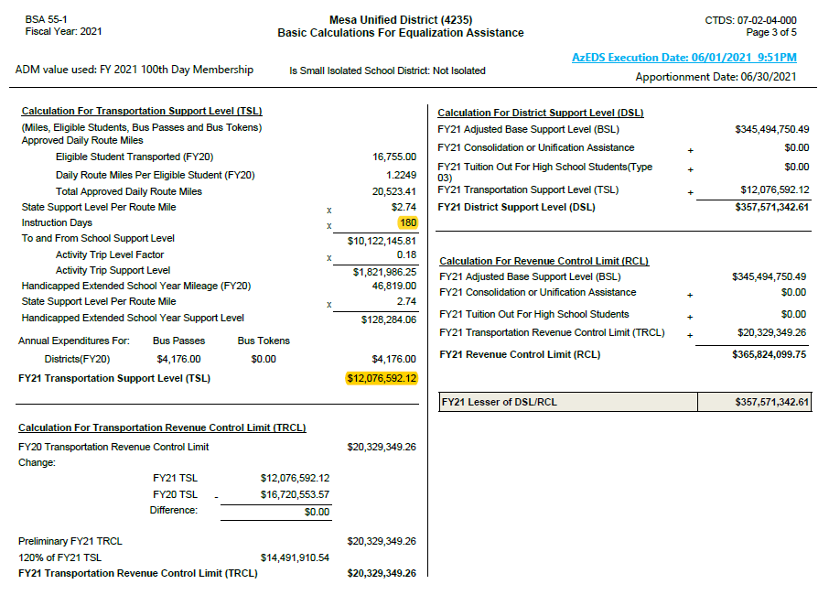

Slide 17
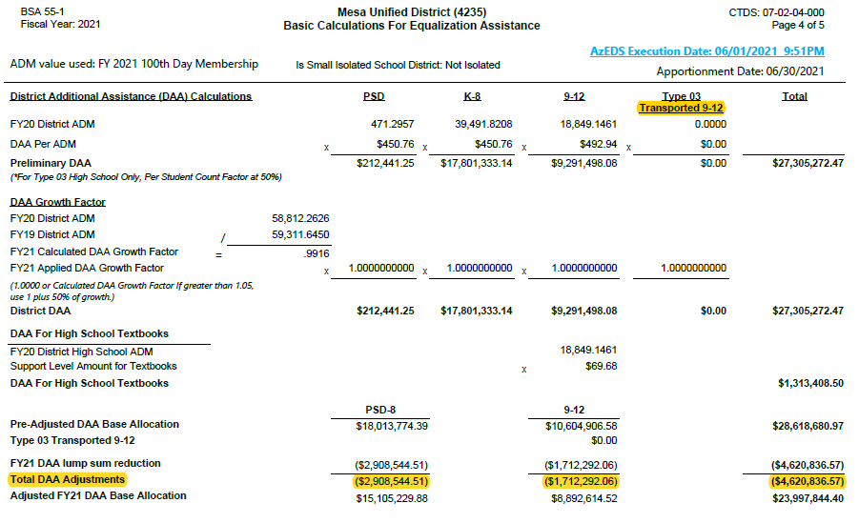







Slide 18
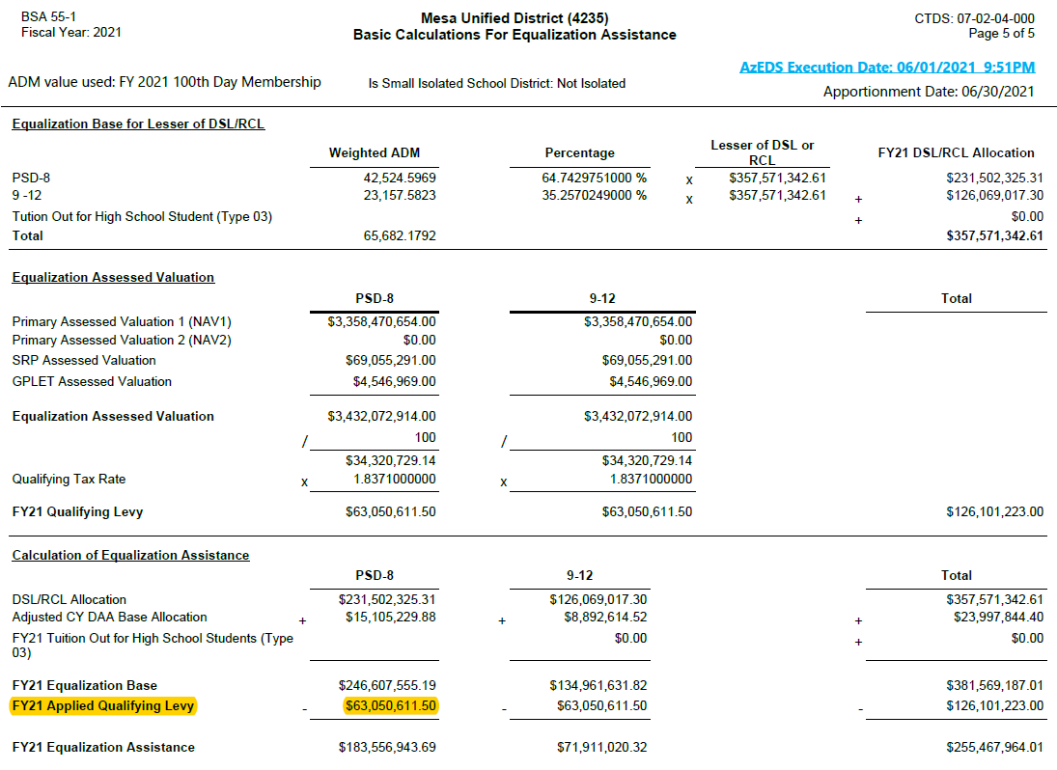








Slide 19
New District Payment Reports
BSA 55-1: District Equalization Report
  Summarizes annual equalization base and equalization assistance based on student data and district characteristics
  Previously known as APOR 55-1
BSA 64-1: Equalization Payment Schedule Detail
  Summarizes monthly payment calculation based on annual equalization assistance, amounts received in previous months, and any adjustments
  Previously known as APOR 64-1

Slide 20
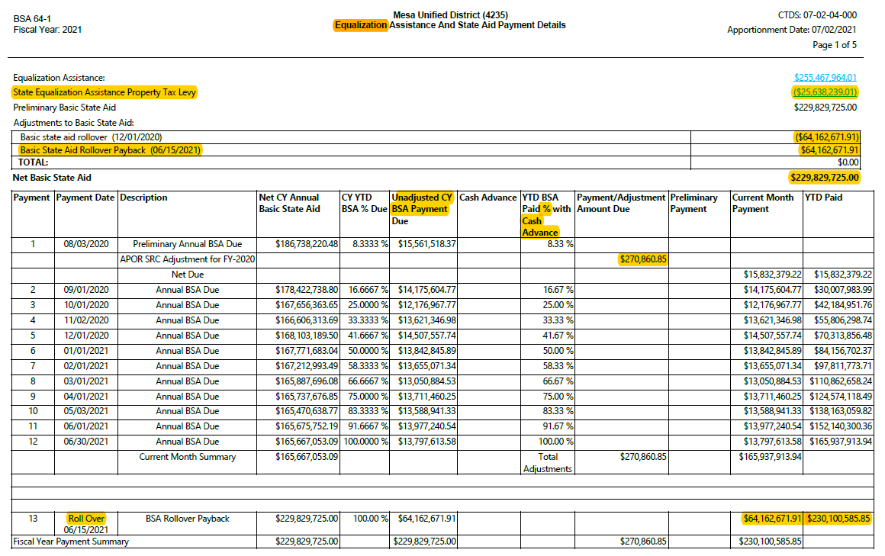
Unadjusted CY BSA Payment Due:
Net CY Annual Basic State Aid * CY YTD BSA % Due for a payment period - Sum of Prior positive Unadjusted Due Value

Slide 21
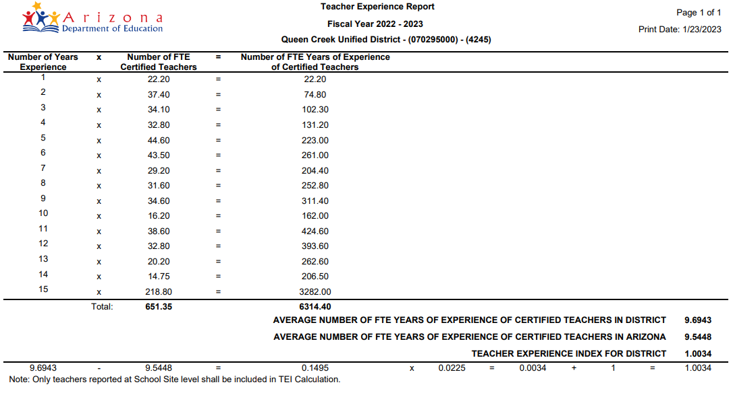
Teacher Experience Index (TEI) / SDER96

Slide 22
Budget Reports
ADE SCHOOL FINANCE REPORTS
SECTION 3
Notes:
This is a title page – please do not use for bulleted content

Slide 23

Budget Reports
BUDG-25
  Compares budget to ADE calculations for the current fiscal year
BUDG-75
  Compares actual expenditures for the previous fiscal year to the budget
BUDG-AGD
  Shows district share of expenditures subject to the Aggregate Expenditure Limit and at-risk expenditures

Slide 24
BUDG-25
To comply with A.R.S. 15-905
Compares budget to ADE calculations for the current fiscal year
First report is published in October, then will be updated monthly after each state aid payment cycle
BUDG-25 report compares the district’s budgeted expenditures to ADE calculated values and expenditure limits for the district
The BSA 55-1 report can be used to assist districts in aligning their student counts, TRCL, Type 03 Tuition, and RCL to ADE calculated values
BUDG-25 Letters are published in October and notify of over/under-budgeted expenditures

Slide 25
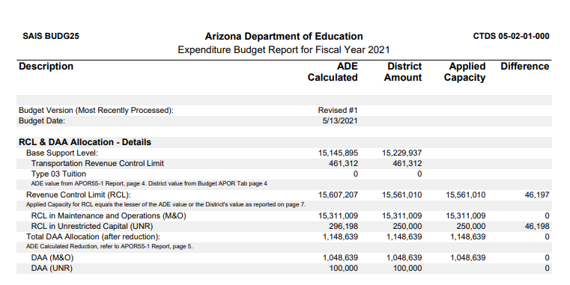
BUDG-25 Report

Slide 26
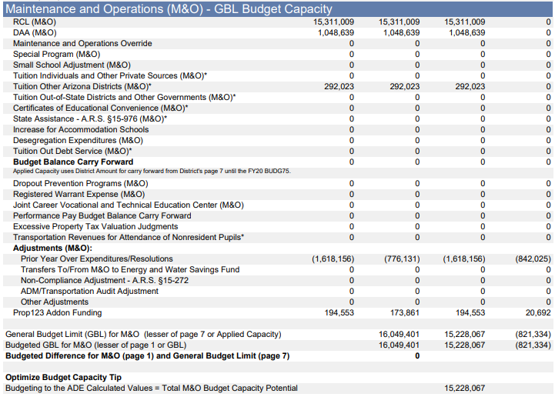
BUDG-25 Report

Slide 27
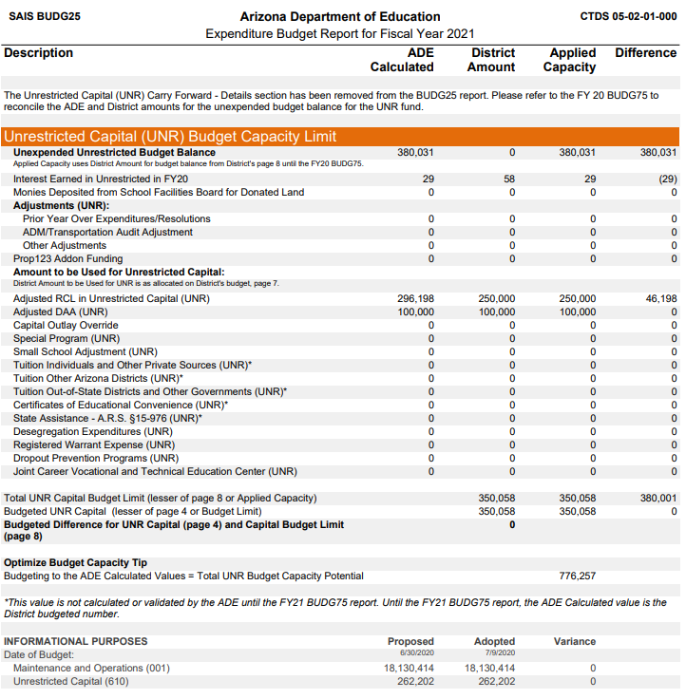
BUDG-25 Report

Slide 28
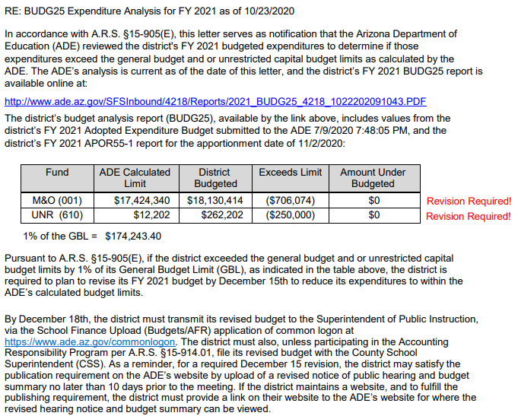
BUDG-25 Letter

Slide 29

BUDG-75 Reports
BUDG-75 reports are published in November of the next fiscal year. This is the first notification of over expenditure for districts
Compares Districts Actual Expenditures from the AFR to ADE calculated actual expenditure limits for the district

Slide 30
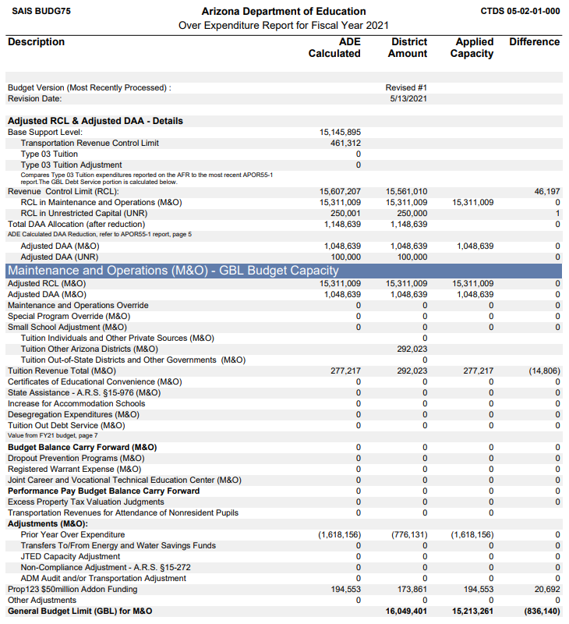

Slide 31
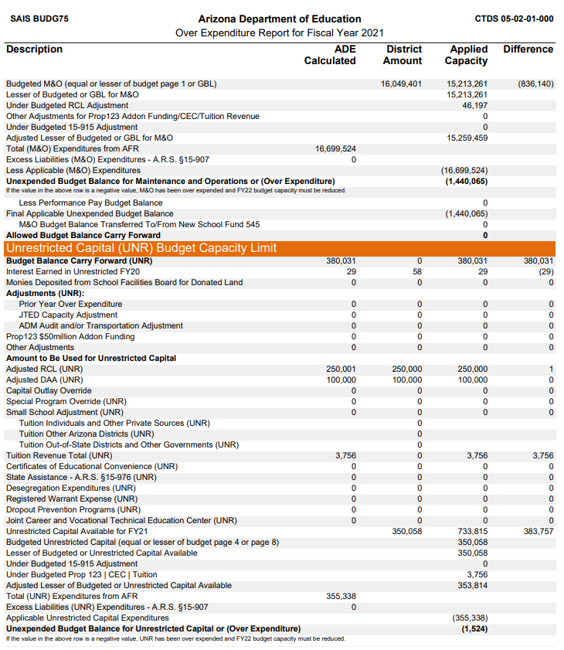

Slide 32

BUDG-75 Letters
BUDG-75 Letters are published in early February and notify districts of over/under of actual expenditures
If AFR Corrections are needed, please reach out to the SF Budget Team: SFBudgetTeam@azed.gov
Reduction in current year
Hardship Application: https://www.azed.gov/sites/default/files/2022/07/Hardship-Application.docx
Helpful Hot Topic on Correcting AFRs and School Level Reports: https://www.azed.gov/finance/correcting-afrs-and-school-level-reports

Slide 33
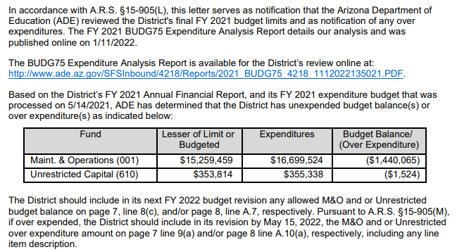

Slide 34
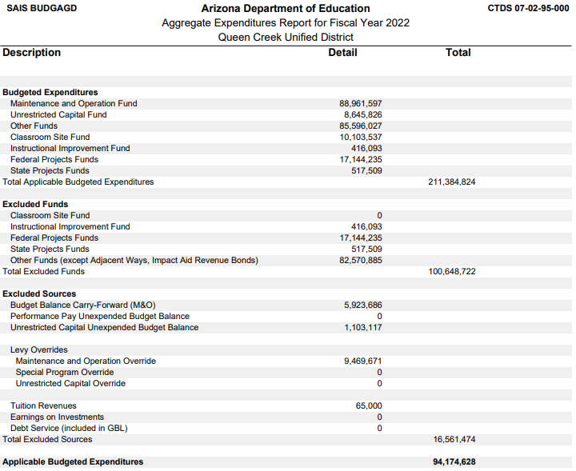
BUDG-AGD Report
Top of the report summarizes the calculation of applicable budgeted expenditures (expenditures subject to AEL)
Bottom shows statewide values and calculation of at-risk expenditures

Slide 35
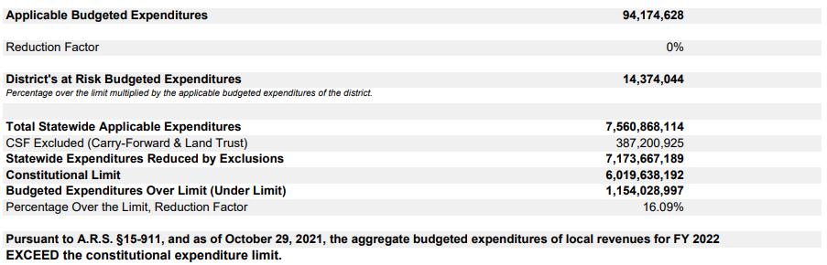
BUDG-AGD Report

Slide 36
Charlie Martin, Deputy Associate Superintendent
Charlie.Martin@AZED.gov
(602) 542-8026
Thank You

