Slide 1



CTE Administrators Meeting
February 2, 2023
CTE Vision: Develop Arizona’s competitive workforce through the power of Career and Technical Education.
CTE Mission: Career and Technical Education will engage Arizona learners in relevant experiences leading to purposeful and economically viable careers.

Slide 2

Welcome/Introductions and CTE Updates Cathie Raymond
Grants and Comprehensive Local Needs Assessment (CLNA) Mary Medina/Audrey Dieken
Allocations and Accountability Bobby Neves, Samuel Irvin
Updates: ACOVA, AOAC
New Program List, Program Monitoring, Industry Credentials Cindy Gutierrez
Updates: Curriculum Connection
Updates: Project Change
School Counselors Emily Brown
Technical Standards, Testing, TSA Teacher Institutes Judy Balogh
CTSO Julie Ellis
Updates: ACTEAZ, Premier Series
Closing Remarks Cathie Raymond
AGENDA

Slide 3

Meetings were held September 19, October 27, and January 12.
Vision was revised and Mission was kept the same.
ADE/CTE Strategic Plan and Perkins V Revisions

Slide 4
Vision:
Every Arizona student has a developed career pathway.
Mission:
Career and Technical Education will engage Arizona learners in relevant experiences leading to purposeful and economically viable careers.
Arizona CTE NEW Vision

Slide 5

Hurshneet Chada: Mountain Ridge Deer Valley
Marissa Partida: Desert View Sunnyside
Tej Desai: Paradise Valley HS
Sara Pirone: Verrado Agua Fria
Kiersten Morris: CDO & Pima JTED
US Presidential Scholars in CTE

Slide 6
CTE is now in the same division as Exceptional Student Services / Child and Adult Services.
Colette Chapman is the Associate Superintendent for this division.
ADE Reorganization

Slide 7


Our Next
CTE Administrators Meeting will be in
Tucson – 2023
Summer Conference

Slide 8

Federal Perkins V and State Priority Grants

Slide 9
Grant Specialist Team
Shelley Baudean – Grants Program Specialist
Audrey Dieken – Grants Program Specialist
Don Dolin – Grants Program Specialist
Mark McManus – Grants Program Specialist
John Jones – OCR Special Populations Program Specialist
Mary M. Medina – CTE Grants Supervisor

Slide 10

CTE Grant Application Important Dates
FY2023
CTE Perkins SDLP Performance Measures Improvement Plans due January 13, 2023
CTE Perkins SDLP Performance Measures Improvement Plans Mid-Year Narratives due March 31, 2023
CTE State Priority Grant Completion Report due June 2023
CTE Perkins Final Grant Narratives due in GME September 15, 2023
CTE Perkins Completion report due in GME December 31, 2023

Slide 11
CTE Grant Application Important Dates
FY2024
CTE Federal Perkins Grant application opens March 1, 2023 with a due date of May 1, 2023
CTE State Priority Grant application opens March 1, 2023 with a due date of May 1, 2023
CTE Statewide Leadership and Innovative Grant applications open March 1, 2023 with a due date of May 1, 2023

Slide 12
CTE FY2024 Grants Important Dates – Continued
Funding year for the FY2024 CTE Federal Perkins Grant is July 1, 2023 – September 2024
Funding Year for the FY2024 CTE State Priority Grant is July 1, 2023 – June 2024
Funding year for the FY2024 CTE State Leadership and Innovative Grants is July 1, 2023 – September 2024
General Statement of Assurances (GSA) & Self Assessment due to GME by March 1, 2023
Indirect Cost Request due to GME by February 1, 2023 in order to receive the FY2024 rate by March 1, 2024
***SAM.gov registrations must be active for GSAs, funding applications, reimbursement requests and completion reports approvals***

Slide 13
What is New?
FY2024 Perkins
and CLNA

Slide 14
FY2024 Perkins CLNA
Incorporated Year 1 & Year 2 CLNA requirements
Condensed CLNA criteria requirements
Incorporated Gap Analysis into the CLNA where applicable
Aligned the FY2024 Perkins Grant application with the new CLNA template
*** Attend Audrey Dieken’s session today for more specifics

Slide 15
FY2024 Perkins CLNA
The Comprehensive Learning Needs Assessment (CLNA) must
be completed on a biennial basis with a review of the progress
every other year (2nd Year) of the biennial cycle. FY2024 is Year 1 of the
biennial cycle.
The CLNA review must be completed prior to the completion of
the Perkins V Grant application and must be uploaded to the
Related Documents section of the grant application before
review and approval of the grant application.

Slide 16
Preparation for FY2024 Perkins CLNA Leadership Meeting
Evidence / data for review / documentation
Program of Study (POS) review summaries
Objective pages from the FY2024 grant application
Planning budget for FY2024
Program of Study (POS) accomplishments
List of goals / targets

Slide 17
FY2024 Grant Application Helpful Tips
Ensure you have grant user access role
Ensure GSA /SAM.gov documentation is approved by GME
Purchase Capital Equipment
Work with Business Manager to ensure regular submission of reimbursement requests
Focus on Perkins V CLNA goals / targets
Ensure Global Holds are resolved quickly
*Spend your allocated funding

Slide 18
Reminders
CLNA goals / objectives must align to the Perkins V grant application
Completed CLNA must be uploaded to the Related Documents section of the Perkins V Grant application
Coherent sequences for CTE programs of study most be in place prior to the Perkins V Grant application review / approval

Slide 19
Upcoming FY2024 Grant Application Trainings
The CTE Grant Specialists will be providing FY2024 Perkins V and State Priority Grant Applications virtual trainings March 2023.
You will be advised of the dates and times of the training sessions mid February 2023.

Slide 20
Resources
Updated CLNA template
Chart of Accounts
CTE Quick Reference Guide
Allowable/Unallowable Expenditures
CTE Dates / Deadlines

Slide 21
Contact Information
Shelley Baudean John Jones
Grant Program Specialist OCR Special Populations Program Specialist
shelley.baudean@azed.gov john.jones@azed.gov
602-542-5323 970-216-6740
Audrey Dieken Mark McManus
Grant Program Specialist Grant Program Specialist
audrey.dieken@azed.gov mark.mcmanus@azed.gov
602-350-5064 602-542-8744
Don Dolin Mary M. Medina
Grant Program Specialist CTE Grants Supervisor
don.dolin@azed.gov mary.m.medina@azed.gov
602-518-6526 505-426-6681

Slide 22
Mary M. Medina – CTE Grants Supervisor
Mary.M.Medina@AZED.gov
505-426-6681
Thank You

Slide 23

Fiscal Update
Bobby Neves

Slide 24
Perkins
FY23 allocations including carryover (Feb/Mar)
FY24 preliminary allocations have been submitted

Slide 25
State Priority
FY23 allocation including funds held back (Feb/Mar)
FY24 preliminary allocation has been submitted

Slide 26

All allocations will be changing
Governors Incentive

Slide 27
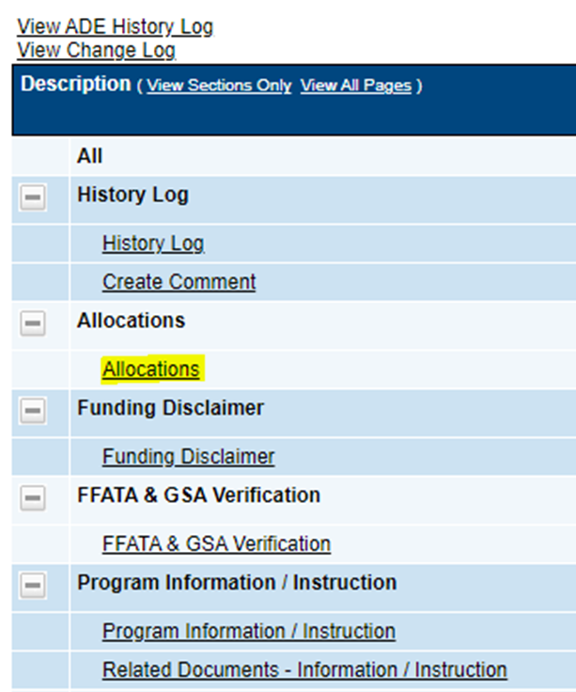
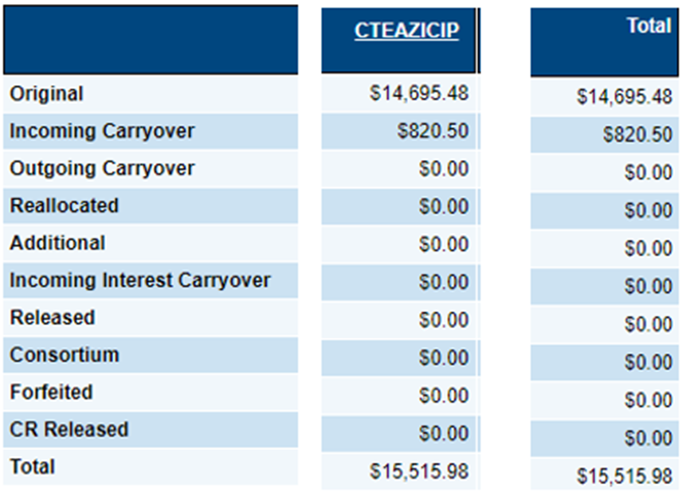

Slide 28
Bobby Neves, Director, Fiscal/Grant/Accountability
Bobby.Neves@azed.gov
(602) 542-5137
Thank You

Slide 29

CTE Accountability &
CTE Data Portal
CTE Administrators Meeting – Feb 2, 2023

Slide 30

Important Dates for FY 2022-2023
Deadlines
FALL term enrollment – February 28, 2023
  extended from the original deadline of January 15
SPRING term enrollment – June 15, 2023
Placement surveys for 2022 graduates – June 15, 2023
Credentials for LAST YEAR (2021-2022) – June 30, 2023
Credentials for THIS YEAR (2022-2023) – June 30, 2024
Data Capture/”Snapshot” Dates (NOT DEADLINES!)
Data capture dates replace the previously used 40th and 100th days
Fall term – October 15, 2022
Spring term – February 15, 2023

Slide 31
A few notes on enrollment reporting…
Data Capture/“Snapshot” dates are the dates on which a student must be enrolled in order to be included in your enrollment reporting.
Example – a student transfers into your CTE class on February 20, 2023. They should NOT be included in the Spring term enrollment as they were not yet enrolled on the spring data capture/“snapshot” date.
Students only need to be enrolled, not actually in attendance (including student absences, school breaks, and weekends)
Credits might not be available yet – create with zero credits or expected credits and update as needed.

Slide 32
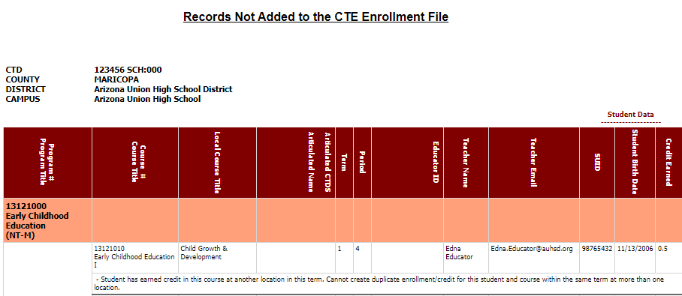
A new error in the Enrollment Upload
Student has earned credit in this course at another location in this term. Cannot create duplicate enrollment/credit for this student and course within the same term and more than one location.
Meant to ensure that students are reported only once per term, especially transfer students.

Slide 33
A new error in the Enrollment Upload
Student has earned credit in this course at another location in this term. Cannot create duplicate enrollment/credit for this student and course within the same term and more than one location.
Student can be reported in each course with credit at only one school per term.
Student can be reported in different courses within the same program with credit at more than one school per term.
Student can be reported in a single course (level) more than once and with credit in each instance at the same school in each term (such as multiple periods per day).
Contact CTE Accountability with any questions/concerns about this on a case-by-base basis, include the student’s ID number and the course info.

Slide 34

New Feature Announcement
Field users can now create, modify, and delete enrollment data directly in the CTE Data Portal (rather than through Excel file upload only).
Users can now:
  Create course records, including program, course, local course title, period, teacher, and course location.
  Modify local course titles and periods at any point.*
  Create student records, including SUID, credits earned, student type (and Student’s SOR for CTED records).
  Modify credits, student type, and SOR at any point.*
  Delete courses and/or student records.
  * During the reporting window

Slide 35
New Feature Announcement
The enrollment bulk upload feature has not been removed – it will work in conjunction with the regular/manual data entry screens. This means:
  If a user uploads enrollment data, it can be modified through the data entry screens/interface, including updating credits, adding students to the course, deleting students from the course, etc.
  If a user creates a course through the data entry screens/interface, more students may be added via the bulk upload feature.
  The bulk upload feature remains a “create-only” feature – all modifications must be done through the data entry screens/interface.

Slide 36
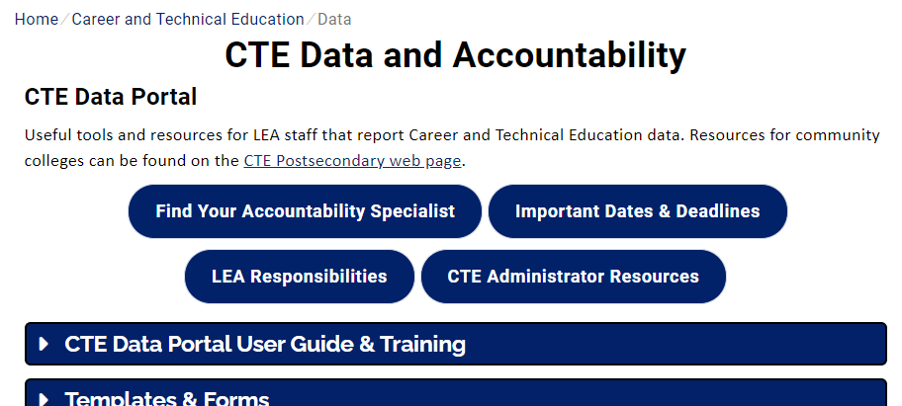
Districts & CTEDs now have an assigned CTE Accountability Specialist to serve as a single point of contact.
Assignments are by CTED – the CTED and each member district share a specialist to help foster collaboration.
Direct questions and concerns regarding CTE data reporting & the CTE Data Portal to your assigned specialist.
CTE Accountability Website: www.azed.gov/cte/data

Slide 37

What is CTE/ADE IT working on now?
ADE IT has just finished manual data entry for enrollment reporting (and other enrollment-related updates) in January.
ADE IT is now working on updating the Industry Credential bulk upload so that the “upload code” stays consistent from year to year.
Next, ADE IT will create the Opportunity Gap Analysis Report in the CTE Data Portal so that users may generate the report at any time and in real-time.
We are also looking at how fourth year funding for CTEDs will impact the CTE Data Portal system.

Slide 38

Tammie Chavez, CTE Enrollment Specialist
Tammie.Chavez@azed.gov
602-542-3839
Charles Jarvis, Education Program Specialist
Charles.Jarvis@azed.gov
602-542-3823
Donna Kerwin, CTE Business Analyst
Donna.Kerwin@azed.gov
602-542-7881
Janet Silao, Education Program Specialist
Janet.Silao@azed.gov
602-542-5485
Samuel Irvin, CTE Accountability Lead
Samuel.Irvin@azed.gov
602-364-1946
CTE Accountability Team

Slide 39

ACOVA Updates - The CTE Administrator’s Professional Organization
The professional association building community, advocacy, and leadership for Arizona Career Technical Education (CTE) Administrators
The ACOVA Board is here for YOU!
Coming soon-Updated ACOVA Website!

Slide 40

ACOVA- follow us on social media!

Slide 41

ACOVA- follow us on social media!

Slide 42
ACOVA Updates - The CTE Administrator’s Professional Organization
ACTEAZ MidWinter Conference later today.
Critical Issues - 2 PM Thursday
Mini M&M - 3 PM Thursday, 9AM Friday
Business Meeting – 7:30 AM Friday
Camp M&M @ Summer Conference - July 15, 2023

Slide 43
ACOVA Updates - The CTE Administrator’s Professional Organization
Nominate an AZ CTE Administrator for the 2023 Spirit of ACOVA
ACOVA Executive Board Openings - submit bio to: jayme.fitzpatrick@dvusd.org
President Elect - Open
Treasurer - Open
Member at Large (3) - Open

Slide 44
AOAC – Arizona OCCUPATIONAL
ADMINISTRATORS cOUNCIL
Representing Arizona Community Colleges’ Occupational | CTE | Workforce Programs
Manage CTE/Workforce funding including Perkins, Prop 301 (sales tax) STEM formula funding and private funding
Foster research (Ex: LMI) to improve CTE/Workforce education program offerings to meet Arizona’s workforce demands
Cultivate partnerships with business, industry, education and workforce agencies to inform program needs

Slide 45
AOAC – Arizona OCCUPATIONAL
ADMINISTRATORS cOUNCIL
Current Council Work:
AOAC/ADE – NAPE (National Alliance for Partnerships in Equity) – Equity Leadership Academy
AZ CTE Strategic Plan Committee – to inform Mission, Vision and Goals
Ear to the ground regarding the Governor’s proposed budget and legislative activity in CTE/Workforce areas

Slide 46
CTE Program Services
Updates
Cindy Gutierrez
Notes:
Good Morning, I am sharing with you today updates on New CTE programs on the FY 24 CTE Approved Program list, program monitoring updates and Industry Credentials.

Slide 47
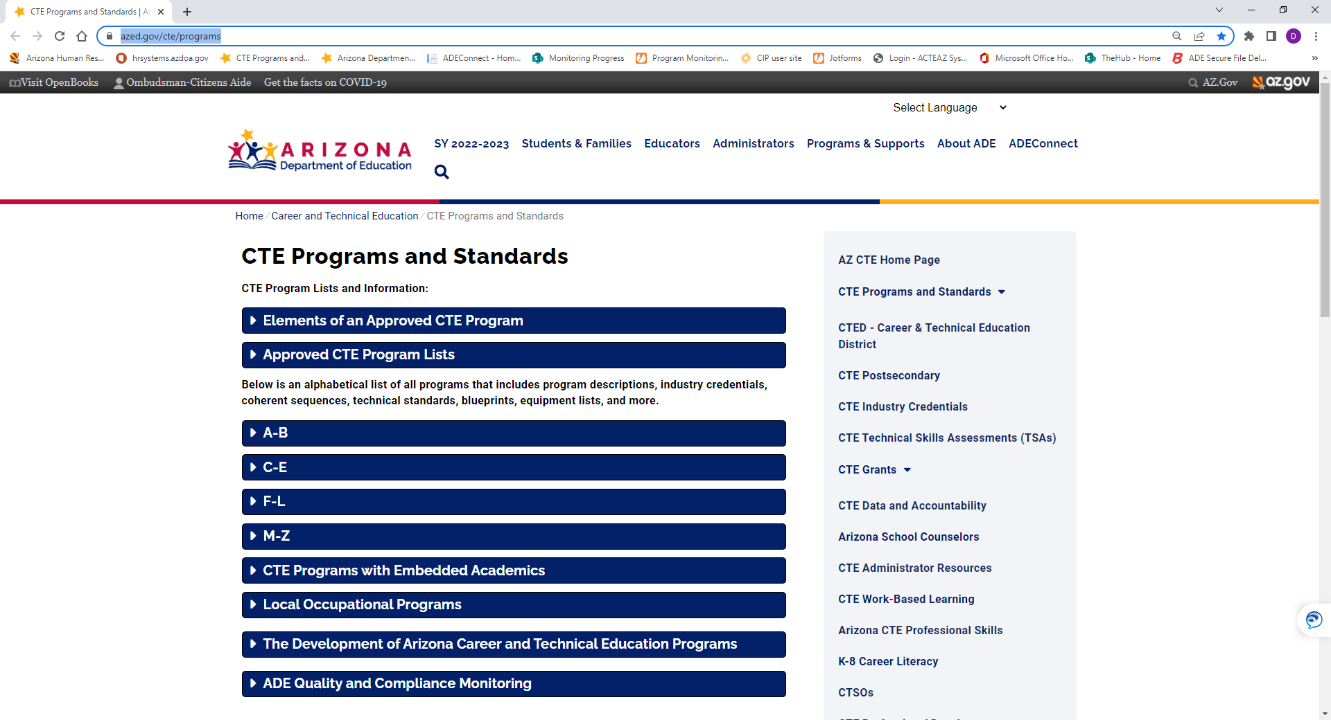

2024 CTE Approved Programs List
on the
CTE Programs and Services Webpage
https://www.azed.gov/cte/programs
2024
CTE Approved Programs List
with
Updated CIP Codes
and
Updated Program Names
Notes:
The CTE Approved Programs list is now available on the CTE Programs and standards webpage with new CTE programs, updated CIP Codes and updated program names programs,

Slide 48
2024 NEW CTE Approved Programs
Energy Systems (new) 47.0701.00
Heavy Industrial Maintenance (new) 47.0300.00
Approved CTE programs (formerly LOP)
Plumbing 46.0503.00
JROTC- Air/Space Force, Army, Navy/Marine
NOTE: A DISTRICT MUST FIRST BE APPROVED THROUGH THE FEDERAL MILITARY PROCESS PRIOR TO OFFERING ANY JROTC PROGRAM
New program descriptions will be added to the CTE Programs and Standards webpage
Two (2) brand new Programs
-----------------------
Plumbing
and
JROTC
no longer LOPs
Notes:
The list is on the CTE Program and Standards webpage and all changes have been made to the state course catalog for School year 2023-2024
Formerly LOP programs now on our list Approved list are Plumbing and JROTC
Program descriptions will be available on the CTE programs and standards webpage.

Slide 49
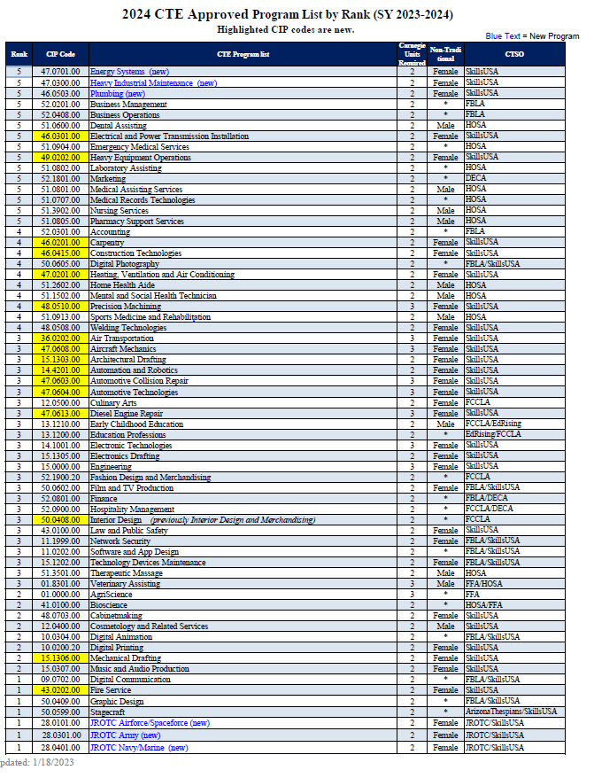
2024 NEW CTE Approved Programs
One Program Name Change:
Interior Design and Merchandising
to
Interior Design 50.0408.00
Name change
Interior Design
--------------------
New CIP Codes highlighted
Notes:
The list is on the CTE Program and Standards webpage and all changes have been made to the state course catalog for School year 2023-2024

Slide 50
CTE Program
Monitoring SY 23-24
Email:
CTELocalPrograms@azed.gov
Districts Scheduled for SY 23-24
CAVIT and member districts
EVIT and all member districts
Ray Unified School District
SY 23-24 District notifications and training:
Required Training held February 1, 2023
Specific CTED and member district only virtual meetings in April 2023
District submissions beginning May 2023
2023 Summer Conference Monitoring support session, Tentative, Monday, July 17, 2023,
8:00 am, Westin La Paloma
Notes:
Program Monitoring!
These are the districts that will be monitoring next year, in SY23-24
CAVIT and all member districts
EVIT and all member districts
Ray Unified School District
WE did hold the training yesterday with both the 23-24 and 24-25 districts
Please add CTE Local Programs @ azed.gov to your email contacts. All monitoring correspondence goes through this email

Slide 51
Cochise Technology District and member districts
Gila Institute for Technology and member districts
Pima JTED and member districts
Districts for SY 24-25
CTE Program
Monitoring school year 24-25
Notes:
These are the districts for the final round in SY 24-25

Slide 52
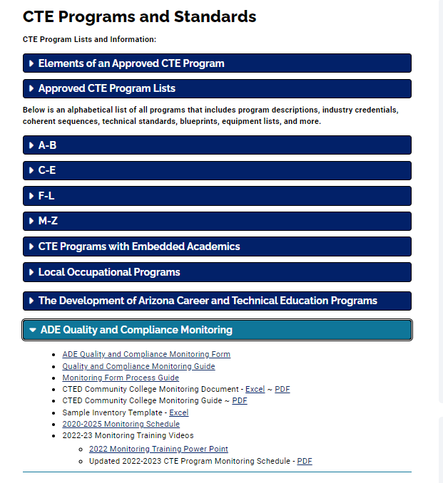
Monitoring
Resources
and
Guidance
https://www.azed.gov/cte/programs
Notes:
On the CTE program and standards webpage there is a blue ribbon reading: ADE Quality and compliance Monitoring
Under that ribbon are Monitoring resources including the
ADE Quality and Compliance Monitoring Form, guide and the monitoring Process Guide aka Jotforms guide

Slide 53
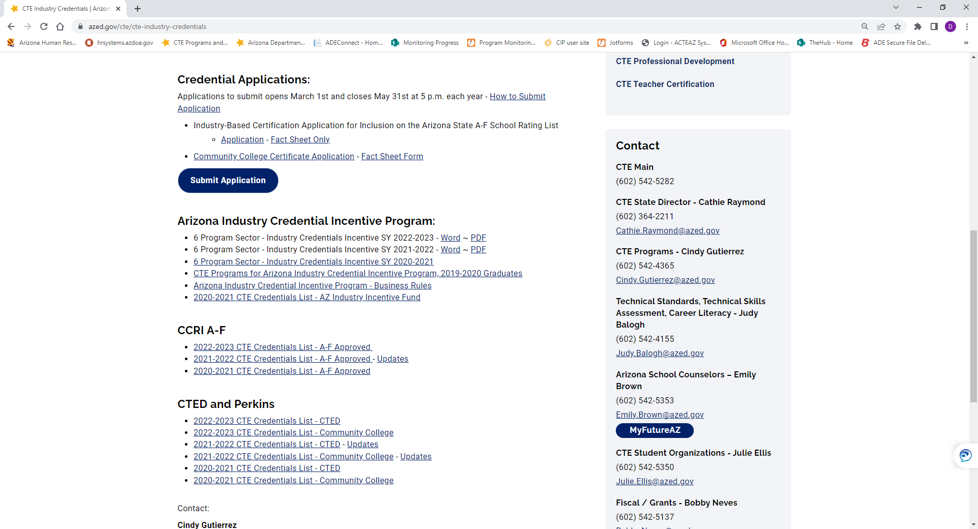

New Industry Credential Applications
Applications to submit a new credential opens March 1st and closes May 31st at 5 p.m.
Electronic process - link on Industry Credential webpage
Industry Credential Application
Must be submitted by a district or CTED
https://www.azed.gov/cte/ cte-industry-credentials
Notes:
Applications to submit a new credential opens March 1st and closes May 31st at 5 p.m.
Electronic process - link on Industry Credential webpage

Slide 54
Cindy Gutierrez, Director, CTE Program Services
Cindy.Gutierrez@azed.gov
(602) 542-4365
Thank You

Slide 55







Featured Benefits
ctecaz.org
Brought to you by:

Slide 56



CRAFTING CURRICULUM | CONNECTING EDUCATORS
Blueprint for Instruction & Assessment, Instructional Framework Project
Accounting
Education Professions
Electronic Technologies**
Emergency Medical Services
Fire Service**
Heavy Equipment Operations
Hospitality Management**
Laboratory Assisting
Marketing
Mechanical Drafting
Precision Machining
    **Pending Standards Revisions
Upcoming Events
Nomination Process
  Teacher Self Nomination
  Director/Administrator
Link to nominate will be available on Quarterly Newsletter and in the Administrators’ Group
Reach us: support@ctecaz.org
Follow on Social Media

Slide 57

Project CHANGE
Increase gender nontraditional CTE enrollment
Promote safe and healthy schools
Recruitment + Retention of Nontraditional students
Gender, CTE, and Nontraditional Career Success
Stop Sexual Harassment
Stop Cyberbullying + Promote Positive Digital Citizenship
CTE Awareness
tylerlepeau@email.arizona.edu
timwernette@msn.com

Slide 58

Project CHANGE
We are presenting in person! Or if requested, we can also offer remote:
Live online sessions on Zoom or Google Meet (works best with groups of about 10-40 participants).
Pre-recorded video presentations along with optional interactive Google slide activity.
Presentations and workshops are provided at no cost.
Educator presentations provide professional development hours.
Presentations run approximately an hour to accommodate a typical class period (shorter for pre-recorded video).

Slide 59
School Counselor Director Updates
Emily Brown

Slide 60

We are proud to say that we currently have over 50,000 users on My Future AZ.
Now offering 3 virtual trainings each month to support users.
To register for trainings, visit: https://www.azed.gov/ecap
My Future AZ

Slide 61
School Counselors Track: Monday and Tuesday
July 17th-18th
School Counselors Luncheon July 17th
11:30am-1:00pm
CTE Summer Conference

Slide 62
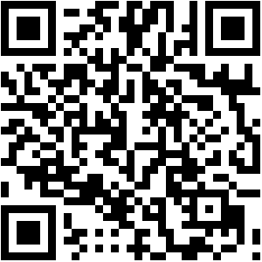
Restarted monthly School Counselor Connection Newsletter in January
Sign up here
https://forms.gle/qtYfvVukVsW9fRnn6

Slide 63
Emily Brown, School Counselor Director
Emily.Brown@azed.gov
(602) 542-5353
Thank You!

Slide 64
Technical Standards
Technical Skills Assessments
After School Online TSA Support
Annual CTE TSA Teacher Institutes

Slide 65
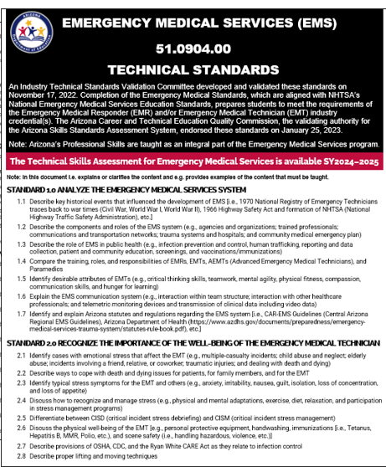
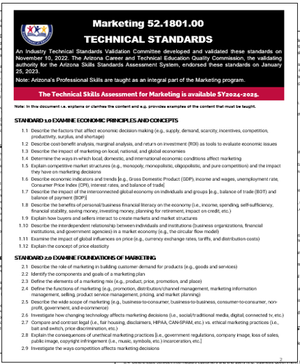
Current Technical Standards for Review
Aircraft Mechanics assembling a committee
Educations Professions committee is meeting
Electronic Technologies assembling a committee
Emergency Medical Services available on CTE website
Fire Service assembling a committee
Hospitality Management assembling a committee
Laboratory Assisting waiting for Commission approval
Marketing available on CTE website

Slide 66
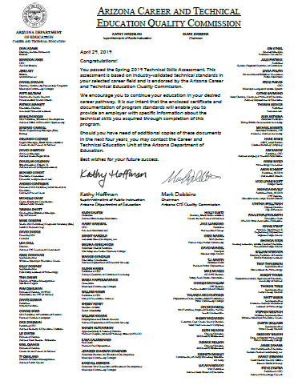
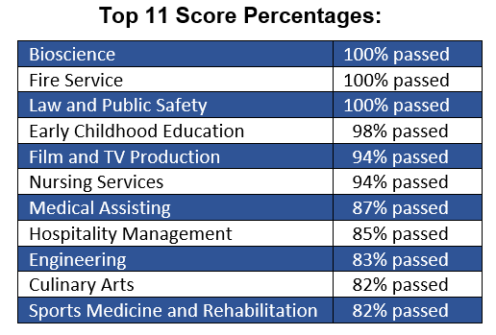
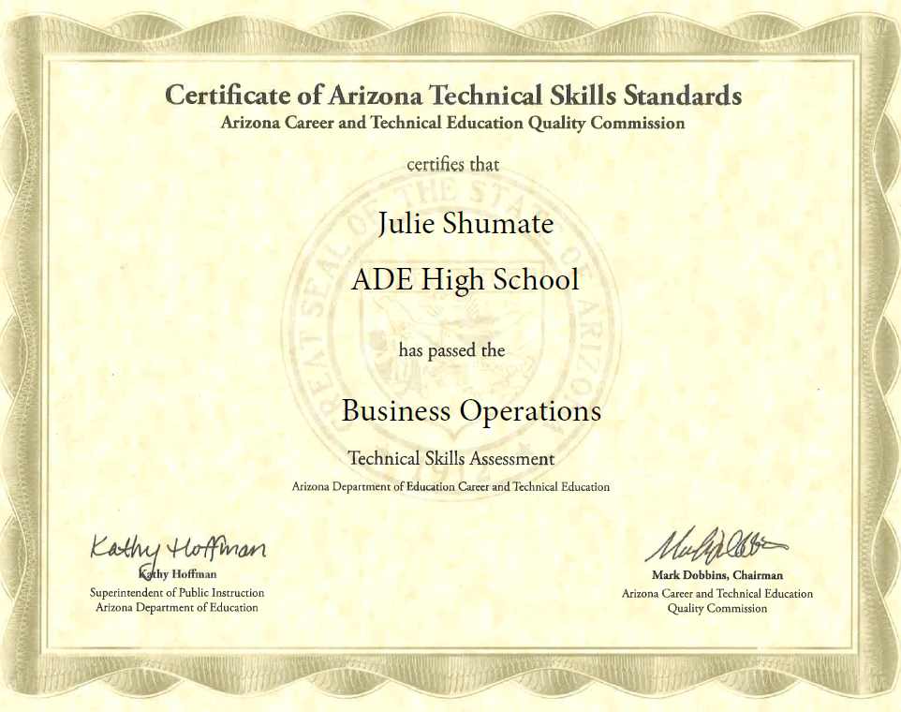
Fall 2022 Testing Scores
1,981 students in 33 programs tested
1,503 (76%) students passed the test
Spring 2023 Registration and Testing: February 27-May 5
Top 11 Scores:

Slide 67
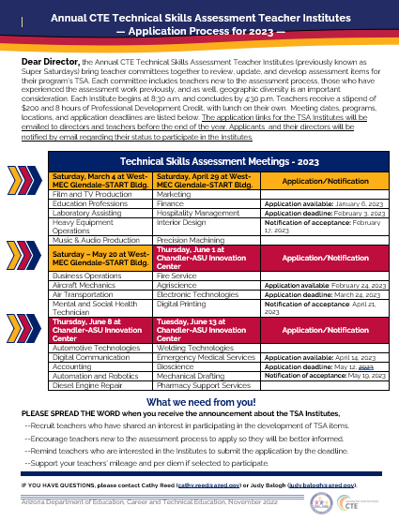

Annual CTE TSA Teacher Institutes
to work with Teacher Committees to review, edit, and develop assessment items will be held March through June.
After School Online TSA Support
offered 3 days in February for all CTE staff to learn all they need to know about the Technical Skills Assessment.

Slide 68

Staying for the Midwinter Conference?
Please join us this afternoon.
2:00 to 2:50 in Verde B
Let’s Talk about TSA Scores
3:00 to 3:50 in Verde B
Improve Student Assessment Results, a Best Practices Panel Discussion!

Slide 69
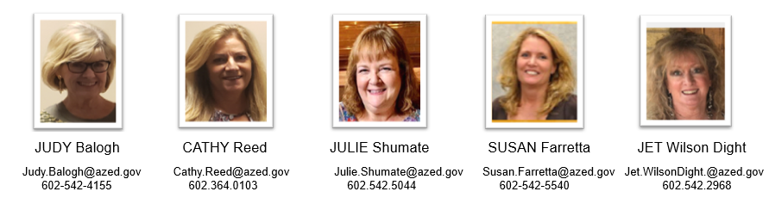
Standards-Assessment-Career Development Team
Thank You!

Slide 70

CTSOs
Notes:
This is a title page – please do not use for bulleted content

Slide 71









CTSOs
Notes:
This is a title page – please do not use for bulleted content

Slide 72

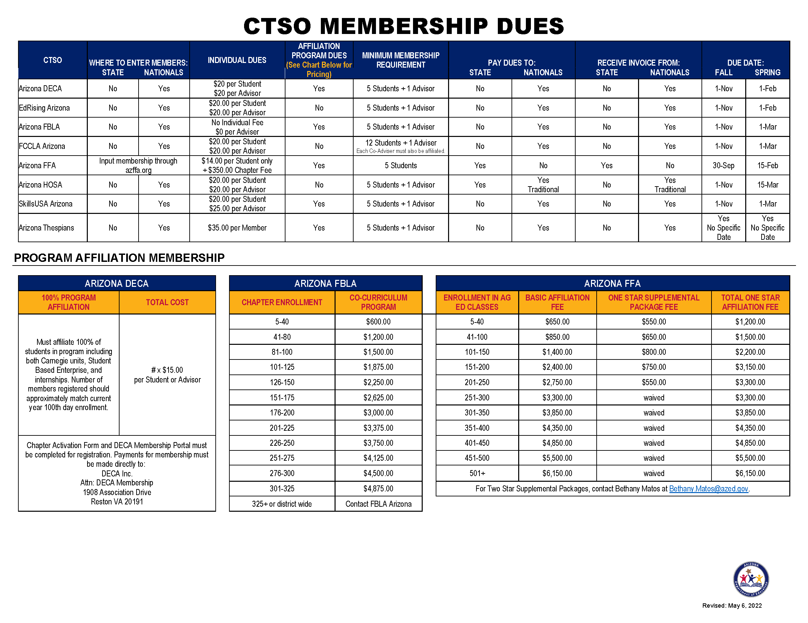
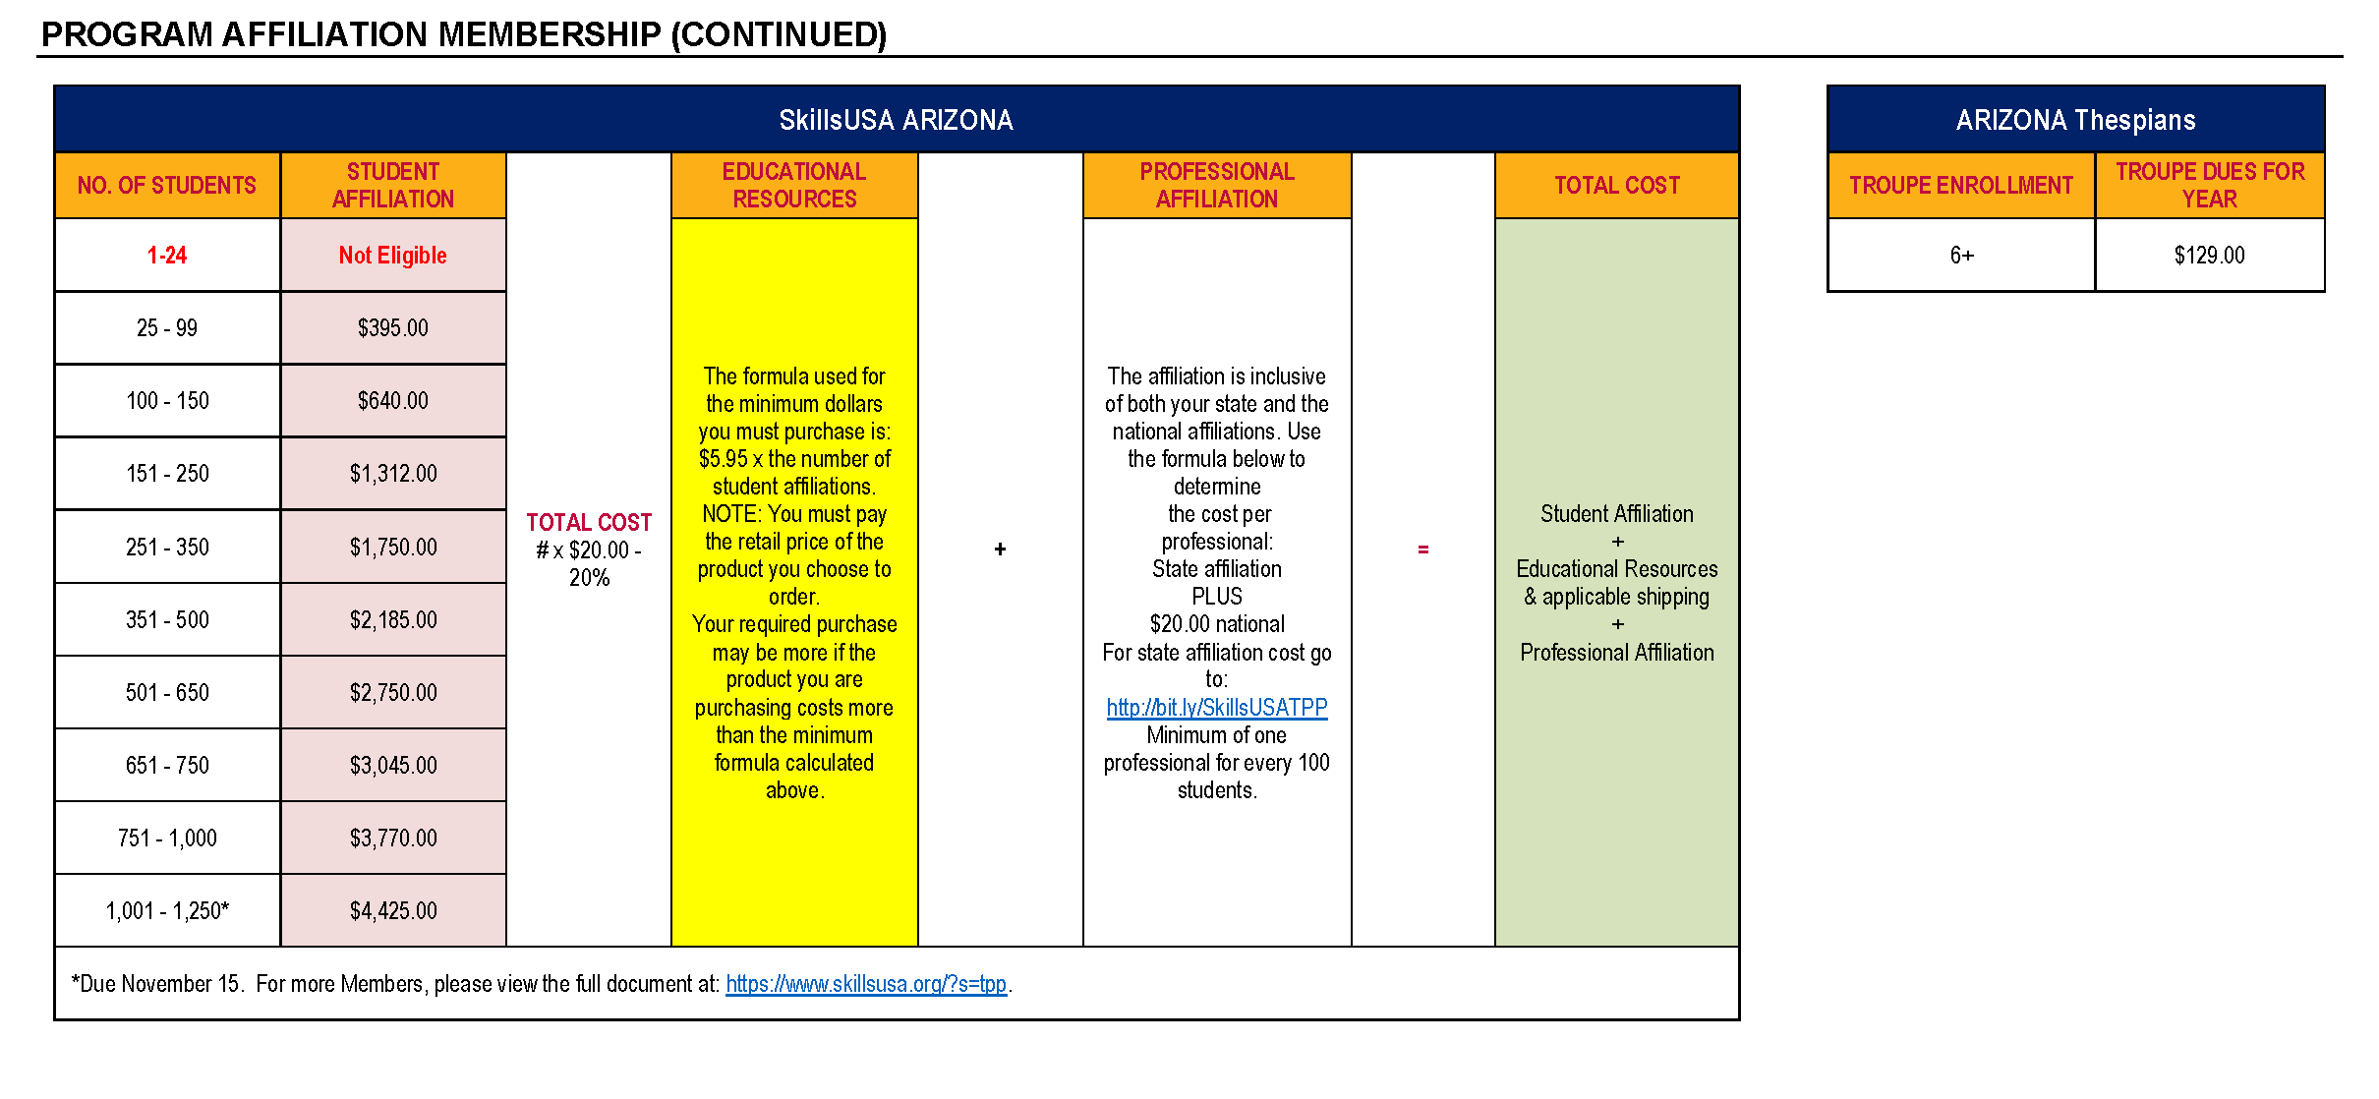

CTSO MEMBERSHIP
DECA and EdRising: February 15th
FBLA, FCCLA, HOSA, SkillsUSA:
March 1st

Slide 73
NEW ADVISOR
TRAINING DATES
Saturday, July 15th (Summer Conference)
Friday, August 2nd (at ADE)
Tuesday, September 6th (at ADE)
Saturday, October 14th (Virtual)
Wednesday, November 29th (at ADE)
ADVANCED
ADVISOR TRAINING
December 4th-8th 4pm-6pm (Virtual)

Slide 74


STATE LEADERSHIP CONFERENCES
February 23-25, 2023
March 27-29, 2023
March 27-30, 2023
April 29-31, 2023
April 3-5, 2023
April 11-12, 2023
Middle School – El Conquistador March 20-21, 2023
June 8-10, 2023
We have provided an All inclusive and add on for meals

Slide 75

WE NEED JUDGES !
DECA: DECA STATE CAREER DEVELOPMENT CONFERENCE
Dates: February 23-25, 2023
Location: Arizona Grand Resort & Spa
Link: https://www.cognitoforms.com/ArizonaDECA/_2023ArizonaDECAStateCareerDevelopmentConferenceJudgeRegistration
EDRISING: EDRISING STATE LEADERSHIP CONFERENCE
Dates: March 20-22, 2023
Location: El Conquistador Tucson, A Hilton Resort
Link: https://edrisingarizona.wufoo.com/forms/zc48uea1we1m8e/
FBLA: FBLA Middle Level State Leadership Conference
Dates: March 20-22, 2023
Location: El Conquistador Tucson, A Hilton Resort
Link: https://fblaarizona.wufoo.com/forms/pnn85bc04thlmx/
FBLA: FBLA State Leadership Conference
Dates: April 3-5, 2023
Location: Westin La Paloma Resort & Spa
Link: https://fblaarizona.wufoo.com/forms/pnn85bc04thlmx/
FCCLA: FCCLA STATE LEADERSHIP CONFERENCE
Dates: March 27-29, 2023
Location: Westin La Paloma Resort & Spa
Link: https://www.cognitoforms.com/ArizonaFCCLA/_2023EvaluatorsJudgesSignUp
FFA: FFA STATE LEADERSHIP CONFERENCE
Dates: June 8-10,2023
Location: Westin La Paloma Resort & Spa and the University of Arizona
https://arizonaffa.wufoo.com/forms/arizona-ffa-slc-judging-interest-form/
HOSA: HOSA STATE LEADERSHIP CONFERENCE
Dates: March 29-31, 2023
Location: Westin La Paloma Resort & Spa
Link: https://azhosa.wufoo.com/forms/q1bur0wx05urmac
SKILLSUSA: SkillsUSA State Leadership And Skills Conference
Date: April 11-12, 2023
Location: Phoenix, Convention Center

Slide 76
THANK YOU
STATE ADVISORS!
Lacy Beanland-Kirk
Missey Boucher-Goodman
Andy Kuntz
Bethany Matos
Sandra Oligny
Daniel Kelly

Slide 77
Questions, Concerns, Comments
Thank You
Julie Ellis, CTSO State Director
Julie.Ellis@azed.gov
Work: (602) 542-5350
Cell: (520) 465-3655

Slide 78

CTE Administrators Meeting
February 2023

Slide 79

Midwinter (Feb. 2 – 3, 2023)
23rd year
  22 years at Prescott Resort & Conference Center
Thanks to presenters for over 40 sessions
For more information, visit acteaz.org/events/mid-winter/

Slide 80

CTE Month®: February 2023
12 entries
Winning team or student will receive up to $500
Winning video will be featured at ACTEAZ Summer Conference
Governor Proclamation for CTE Month

Slide 81

ACTE Summer Conference
July 14 – 19, 2023 at Hilton El Conquistador & Westin La Paloma
Hotel rooms open March 13
Registration opens the week of March 20
For more info, visit https://arizonactecon.com/

Slide 82

ACTEAZ Awards
Due March 17
Members can self-nominate
Please nominate your colleagues or business partners to honor them
Thanks to Rick Knisley and Dick McManus from AZTECH for sponsoring & producing our awards last year
For more info: acteaz.org/awards

Slide 83

ACTEAZ Scholarships
Due March 17
New this year: scholarship video by Lori Luzier to help teachers & students fill out scholarship application
Scholarships for secondary and post-secondary students
Special thanks to all participating in ACTEAZ Fellows Scholarship Auction
For more info: https://www.acteaz.org/scholarships/

Slide 84
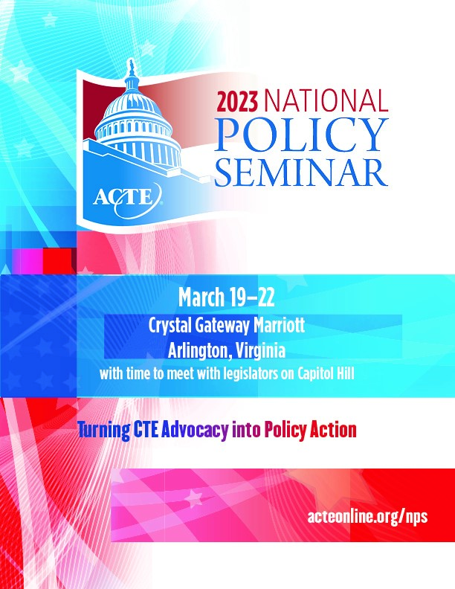
ACTE National Policy Seminar (NPS)
March 19 – 22, 2023 in Arlington, VA
For more info, visit https://www.acteonline.org/nps/

Slide 85

ACTE Region V Conference
April 12 – 15, 2023 in Fargo, ND
Region V awards announced at this conference
For more info, visit https://www.ndacte.com/region-v.html

Slide 86

ACTEAZ Comms
Started new monthly ACTEAZ newsletter in November
Job blast resumed in January
Job listings also posted on ACTEAZ website: https://www.acteaz.org/job-listings/
Keep an eye on your inbox for updates

Slide 87
Contact Us
Lindsay Duran
ACTEAZ President
lindsayduran@acteaz.org
Pam Ferguson
ACTEAZ Exec. Director
pamferguson@acteaz.org
Shelly York
ACTEAZ Asst. Exec. Director
shellyyork@acteaz.org
(623) 826-6399
Shelby Freytag
Premier Series
Coordinator
premierseries@acteaz.org
Alec Damiano
Marketing & Event Technology Manager
alecdamiano@acteaz.org
Kailyn Gillette
Administrative Assistant
eventsupport@acteaz.org

Slide 88

PREMIER SERIES

Slide 89


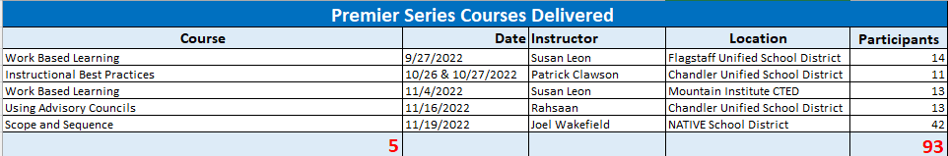
Premier Series Courses Delivered
Premier Series
FY 2022-2023 as of February 2, 2023

Slide 90
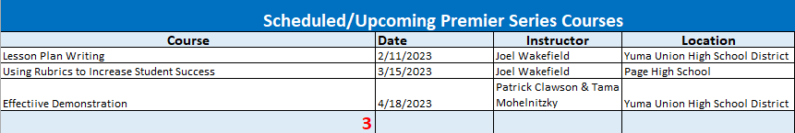
Scheduled/ Upcoming Premier
Series Courses
Premier Series
FY 2022-2023 as of February 2, 2023

Slide 91
What is new for ACTEAZ Premier Series?
ACTEAZ is in the process of taking a deep dive into researching the possibility of providing a portion of Premier Series Courses via an online learning platform.
A survey will be sent out to CTE and CTED Directors and to complete as our first step in researching how to best serve districts with the Premier Series Course offerings.
Premier Series
FY 2022-2023 as of February 2, 2023

Slide 92
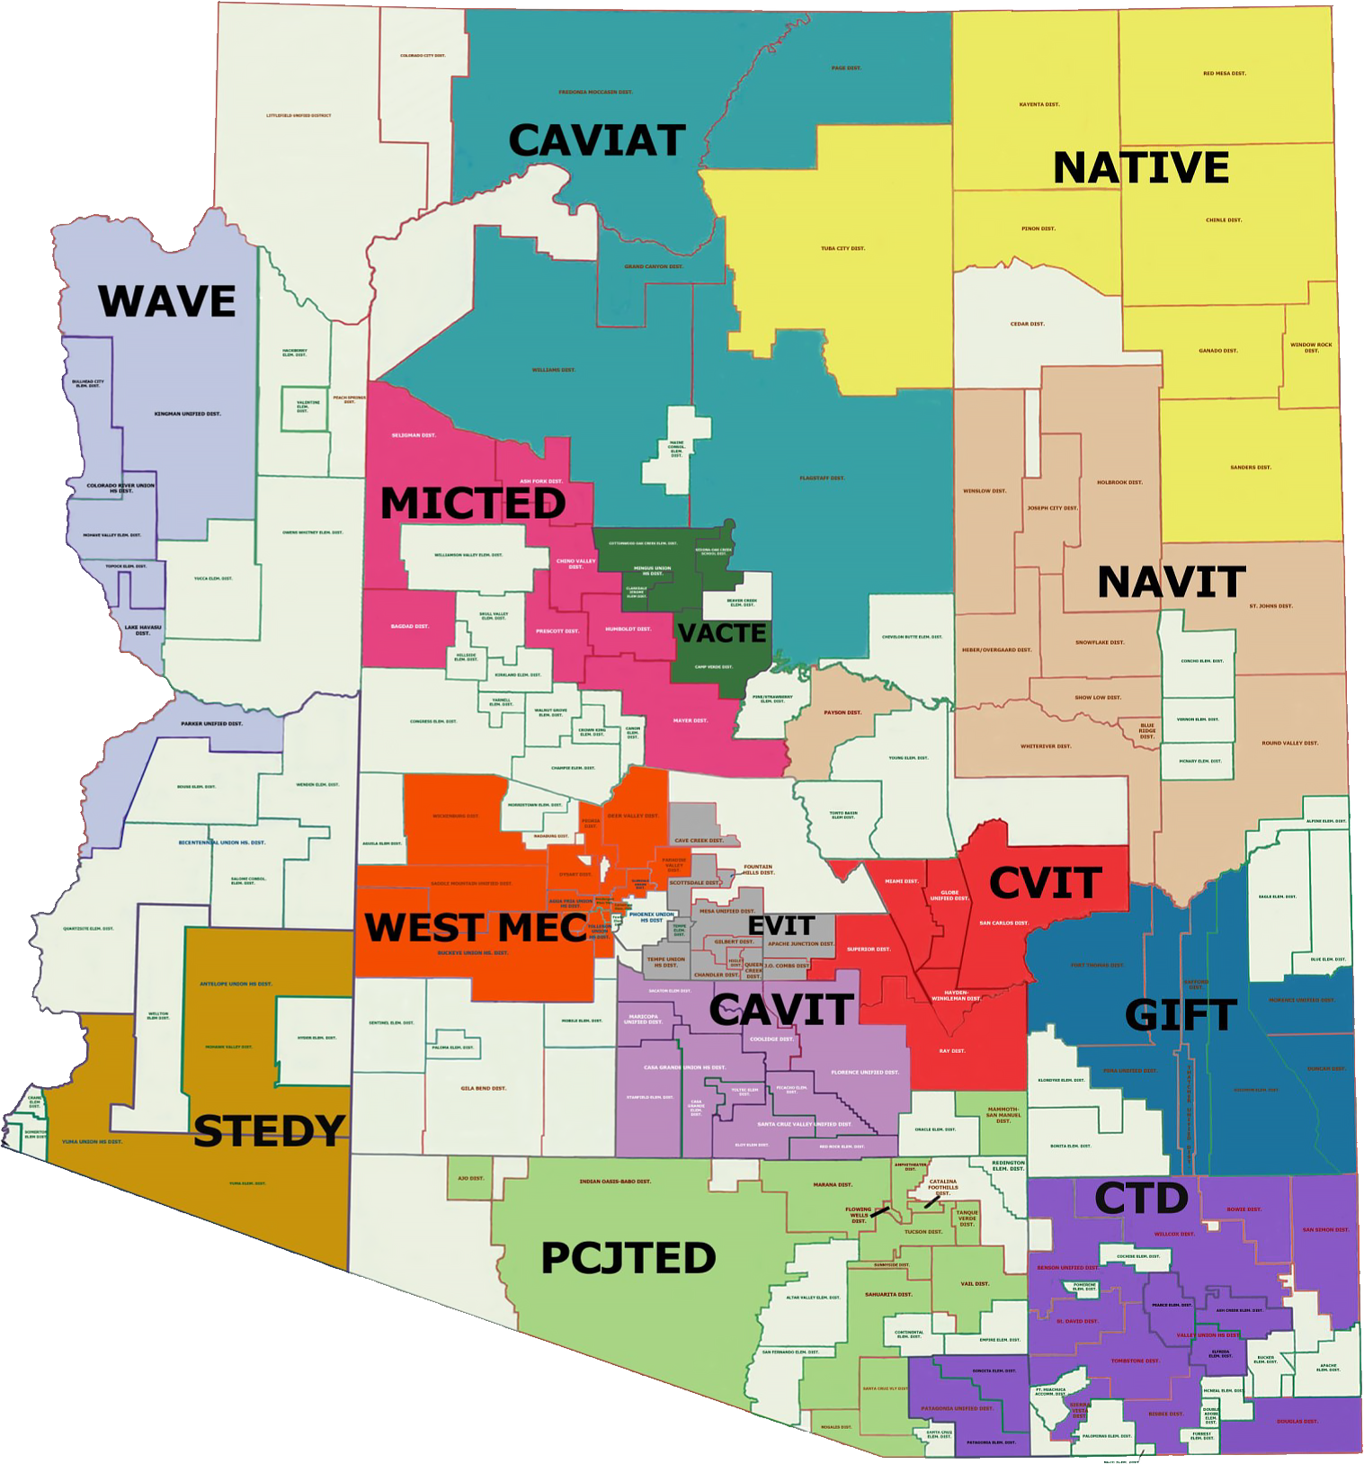
Statewide Partnerships
The Premier Series is offered throughout Arizona by:
  - ACTEAZ
  - Pima JTED
  - West-MEC
With a handful of courses available through:
  - CTD
  - NAVIT
  - EVIT
  - WAVE
Premier Series
FY 2022-2023 as of February 2, 2023

Slide 93
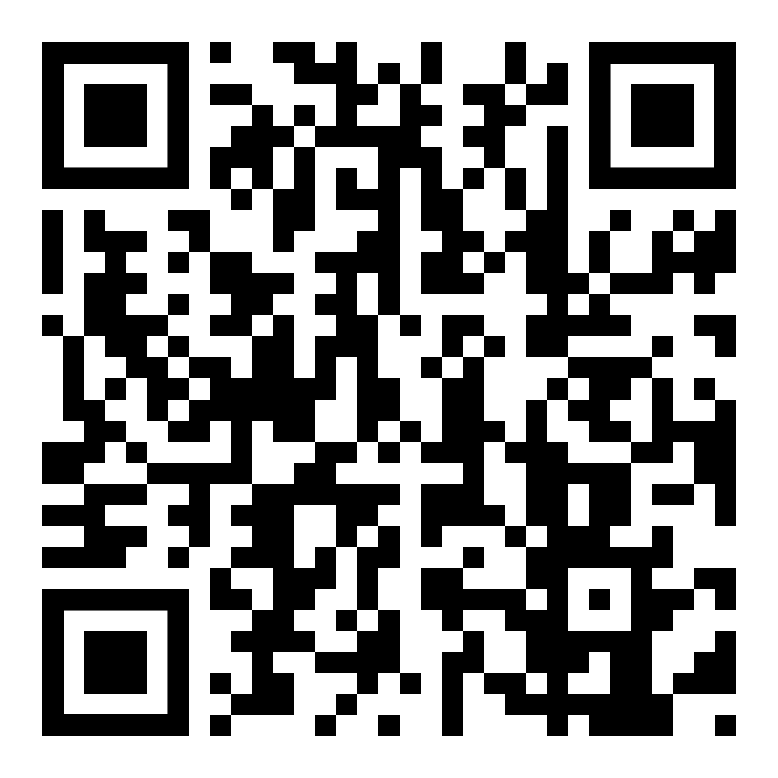
Course Offerings/ Calendar
For more information on ACTEAZ Courses & Course Calendar please visit the ACTEAZ Website.
https://www.acteaz.org/cte-leads-2/about-the-teacher-series/
Premier Series

Slide 94
How Can I Help?
For more information about the Premier Series or to schedule Premier Series classes for your instructors, please contact:
Shelby Freytag
Email: Premierseries@acteaz.org
Phone: (928) 941-0204
Premier Series

Slide 95
Our Next
CTE Administrators Meeting will be in
Tucson – 2023
Summer Conference

