Slide 1


+
How to Take the Technical Skills Assessments
+
Arizona Department of Education, Career and Technical Education

Slide 2
Welcome!
Today you will answer 100 multiple-choice questions about what you have learned in your CTE program. The assessment starts with 180 minutes and more time can be added (for a combined 360 minutes total).
You will have all the time you need to thoroughly read the questions and select the correct answers.
Arizona Department of Education, Career and Technical Education
Page 2

Slide 3

Remember!
DO NOT CLOSE THE BROWSER UNTIL YOUR TEST IS SUBMITTED (or paused).
When you finish, you will be able to view your results and send them to your school or personal email address.
Paper, pencils, and User ID cards will be turned in at the conclusion of the test. Now let’s talk about the assessment you will be taking.
Arizona Department of Education, Career and Technical Education
Page 3

Slide 4
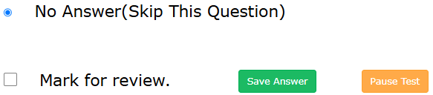
Sample Question
Question 1 of 100
What are the three colors of the American flag?
Red, white, and green
Red, white, and blue
Yellow, white, and black
Yellow, white, and purple
Arizona Department of Education, Career and Technical Education
Page 4

Slide 5
1. No Answer (Skip this Question) – this is the default answer.
There are three ways to answer assessment questions
2. Save Answer and Mark for Review – both will bookmark the question.
3. Correct Answer
Click the Save Answer button to advance the test to the next question.
Arizona Department of Education, Career and Technical Education
Page 5

Slide 6

Pause and Resume Test
Click the Resume Test button (without closing the browser) to return to where the test was paused.
Click the Pause Test button to interrupt (stop) the test.
Arizona Department of Education, Career and Technical Education
Page 6

Slide 7
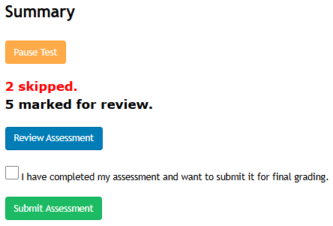
Summary and Review
The Summary screen displays when the last question is answered.
The Review Assessment screen gives you a final chance to answer all skipped or marked for review questions.
Arizona Department of Education, Career and Technical Education
Page 7

Slide 8
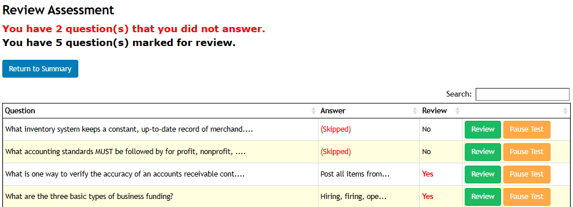
Review Assessment Screen
Look at the three columns below:
Question This is the original question.
Answer (Skipped) is the answer you selected.
Review Yes means you marked this question for review.
Click the green Review button to return to the original test question. Change or keep your answer. Click the Save Answer button to save your changes and return to the Review Assessment screen.
Arizona Department of Education, Career and Technical Education
Page 8

Slide 9
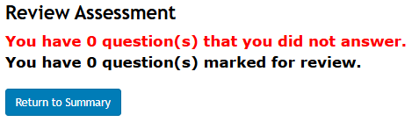
When all skipped and marked for review questions have been answered the two lines will display zeros.
Review Assessment
Click the Return to Summary button.
Arizona Department of Education, Career and Technical Education
Page 9

Slide 10
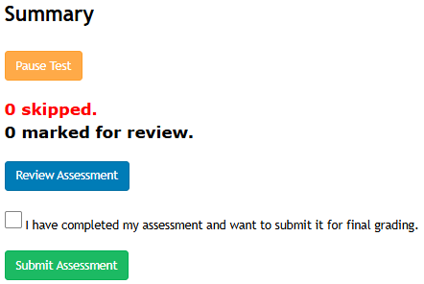

The Summary screen now displays zeros for skipped and marked for review questions.
Click inside the box when you have completed the test.
Click the Submit Assessment button to submit your test for final grading.
Summary Screen
Arizona Department of Education, Career and Technical Education
Page 10

Slide 11
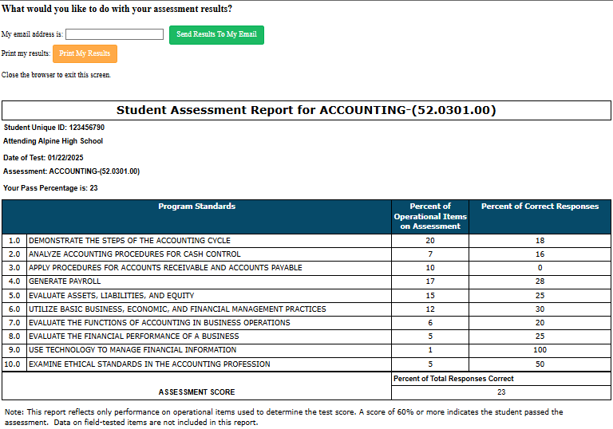
Student Assessment Report
You will receive your Student Assessment Report when you submit your assessment.
Your Assessment Score will be displayed in two places on the report.
You can enter one email address at a time and click the Send Results To My Email button. Once you are finished, close the browser entirely.
Arizona Department of Education, Career and Technical Education
Page 11

Slide 12
+
You are now ready to start the assessment.
Log onto this website to take the assessment.
https://ctetechnicalskillsassessments.azed.gov/student
+
Arizona Department of Education, Career and Technical Education
Page 12

Slide 13
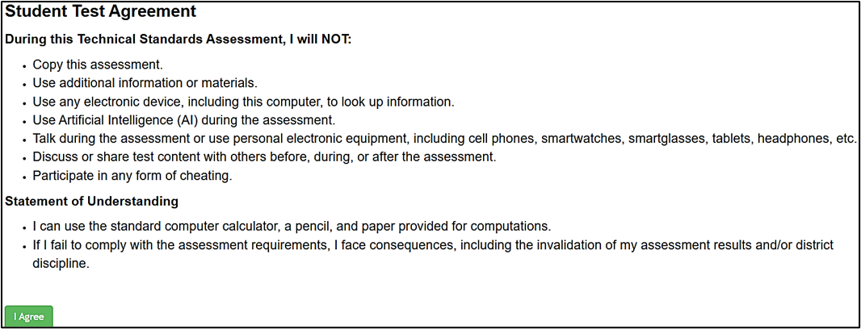
Student Test Agreement
Read the Student Test Agreement screen which states the rules for taking the assessment. You must click the I Agree button to move on.
Arizona Department of Education, Career and Technical Education
Page 13

Slide 14
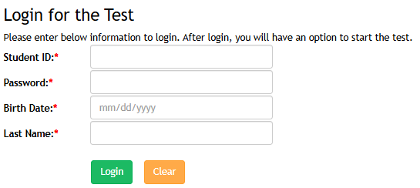
Logging into the Assessment
Enter your student ID, password, birth date, and last name. Your proctor will give you your User ID card.
Click the green Login
button.
Arizona Department of Education, Career and Technical Education
Page 14

Slide 15
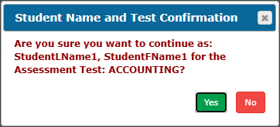
Logging into the Assessment
Please verify the name on your screen is your name (correctly spelled) and the correct assessment is listed. If both are correct, click the Yes button. If this is not your information, raise your hand. Once you click the Yes button, the first question will display and the test time will start.
Arizona Department of Education, Career and Technical Education
Page 15

Slide 16
+
Good Luck on the TSA!
+
Arizona Department of Education, Career and Technical Education
Page 16

