Slide 1


AASBO Update
ADE School Finance
05/08/2024

Slide 2

Agenda
ADM Update
FRPL ADM Reconciliation
FY24 Statewide Recalculation
Payment Update
Transportation
Budget Update
Title I funding

Slide 3

Average Daily Membership
AASBO Meeting Update

Slide 4
ADM Update
Average Daily Membership - April15th
 | FY 2024 4/15/2024 | FY 2023 4/15/2023 | % Change This Time Last Year
Regular ADM | 1,086,201 | 1,091,013 | -0.4%
SPED ADM | 139,745 | 136,726 | 2.2%
ELL ADM | 92,042 | 87,449 | 5.3%

Slide 5
ADM Update
Average Daily Membership – Final
 | FY 2024 4/15/2024 | FY 2023 Final | % Change Final FY 2023
Regular ADM | 1,086,201 | 1,096,554 | -0.9%
SPED ADM | 139,745 | 136,732 | 2.2%
ELL ADM | 92,042 | 87,782 | 4.9%

Slide 6
ADM Update
Regular ADM by Entity Type - April 15th
 | FY 2024 | FY 2023 | % Change
 | 4/15/2024 | 4/15/2023 | This Time
 |  |  | Last Year
District | 863,610 | 867,517 | -0.5%
Charter | 222,399 | 223,312 | -0.4%
Secure Care | 193 | 184 | 4.7%
Total | 1,086,201 | 1,091,013 | -0.4%

Slide 7
ADM Update
Regular ADM by Entity Type – Final
 | FY 2024 | FY 2023 | % Change
 | 4/15/2024 | Final | Final FY 2023
District | 863,610 | 874,962 | -1.3%
Charter | 222,399 | 221,411 | 0.4%
Secure Care | 193 | 182 | 6.1%
Total | 1,086,201 | 1,096,554 | -0.9%

Slide 8

FRPL ADM Reconciliation
AASBO Meeting Update

Slide 9
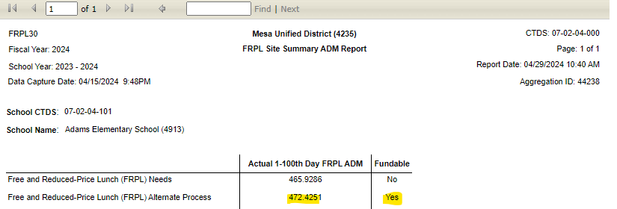
FRPL ADM Reconciliation
Free Reduced Price Lunch Add-on
  FRPL add-on funding has been distributed by the new payment system through BSA-55 since March payment.
FY 2024 FRPL report is now available in AzEDS portal.
    FRPL 30 – school site level report

Slide 10
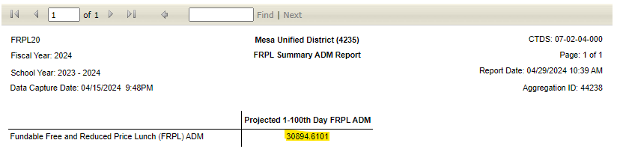
FRPL ADM Reconciliation
FY 2024 FRPL report is now available in AzEDS portal.
    FRPL 20 – school district level report
    BSA 55 – ADM Add Ons Section

Slide 11

FY24 Statewide Recalculation
AASBO Meeting Update

Slide 12
FY2024 Statewide Recalculation
The final student data capture for FY 2024 will be on 7/15.
The final payment calculation for FY 2024 will be completed in middle of August.
Any FY 2024 overpayments or underpayments from statewide recalculation will be applied as adjustments to FY 2025 payments.

Slide 13
Payment Update
AASBO Meeting Update

Slide 14
Payment Update
  FY24 Prop 123 Funds
    The remaining $37.5M will be paid in late May.
  300M one time supplemental
    The remaining $150M will be paid in late May.
  FY24 Gifted Add-on & Instructional Time Model Funding Adj.
    Will be finalized through FY24 statewide recalculation payment.
  FY24 Instructional Improvement Funds
    Will be distributed by end of June.

Slide 15
Payment Update
  H.B. 2173 (Type 03 district)
    Signed by the governor on April 10th ,2024.
    Off-set the county equalization adjustment in BSA-64 through May payment.
  Previous Law
    Head counts for type 03 high school student
    Countywide average per pupil funding for high-school pupils.
      Total HS equalization base/ total unweighted HS ADM
  New Law
    Average Daily membership for Type 03 high school student
    Statewide average per pupil funding for high-school pupils
      (Total unweighted HS ADM*1.268*(BLA+$549.33))/total unweighted HS ADM
    Tax monies collected shall be transmitted to the state treasurer for deposit in the state general fund to aid in school financial assistance.

Slide 16
Budget Update
AASBO Meeting Update

Slide 17
Budget Update
  Preliminary version of budget form for FY2025
    In conjunction with Auditor General’s office, the preliminary form can be expected by Thursday 5/23/2024.
  The final version of the budget form for FY2025
    Final budget forms with any changes in state law incorporated currently do not have a timeframe.
  A hot topic will be sent from School Finance

Slide 18
Transportation
AASBO Meeting Update

Slide 19
Transportation
  Transportation data is collected in ADEConnect
  Transportation – route data window
    The window is open now and will be closed by the end of this fiscal year (6/30/2024).
  Transportation – vehicle inventory window
    The window is open now from 5/1/24 – 7/15/24.
    Districts that fail to submit vehicle inventory will not have TSL calculated for FY2025.

Slide 20
Title I Funding Update
AASBO Meeting Update

Slide 21
Title I Funding Update
    FY2025 Title I-A and Title II-A Grants are loaded
    FY 2025 Title I-D and Title IV-A Grants are being finalized
    FY 2024 grants will be adjusted dependent upon any relinquished funds from LEAs in the next month
    FY 2025 grants will continue to be adjusted dependent upon FY 2024 adjustments and new or expanding charters
    For any questions, please contact Dr. Sarka White Sarka.White@azed.gov
    or Chris Brown Chris.Brown@azed.gov

Slide 22

Contact Us
  (602) 542-5695
  SchoolFinance@azed.gov
  http://www.azed.gov/finance/
School Finance
  http://helpdeskexternal.azed.gov
    Student Data
    School District Employee Report
    Instructional Calendars
    Transportation Reporting
    915s
SF Account Analysts
Phone Option 3
  SFPaymentTeam@azed.gov
    BSA District
    BSA Charter
    CSF
    IIF
SF Payments Team
Phone Option 1
  SFBudgetTeam@azed.gov
    Expenditure Budgets
    Annual Financial Reports
    BUDG25, BUDG75, BUDGAGD
SF Budget Team
Phone Option 2

Slide 23
Xin Liu, Deputy Associate Superintendent
Xin.Liu@azed.gov
(602) 364-2262
Thank You

