Slide 1



For
Equitable Services Beyond the Basics: Carryover, Pooling, Third Party Providers, Braiding Funds, and More!

Slide 2
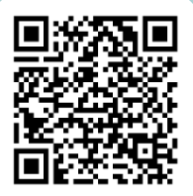
For
Questions

Slide 3


Session Objectives
Learning Goal:
Participants will be able to understand how to reduce burden and maximize equitable service funding.
Success Criteria:
Participants will understand the LEA’s responsibility to plan and implement programs during the year appropriated so that carryover is rare.
Participants will discuss how braiding funds can maximize the use of equitable share funds.
Participants will discuss different scenarios surrounding pooling funds and the use of third-party providers.
Participants will gain a better understanding of common misconceptions in equitable services.

Slide 4
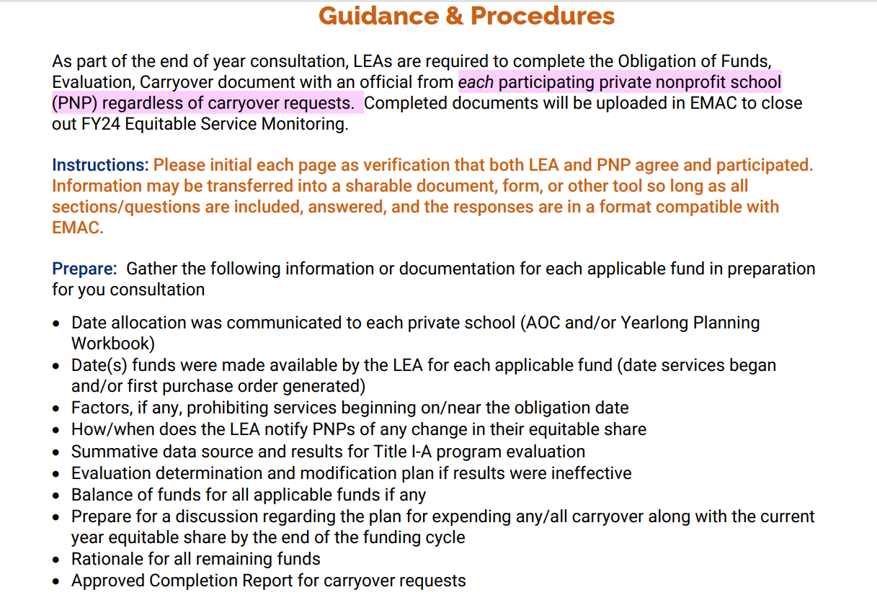
FY24 Obligation of Funds, Evaluation, & Carryover

Slide 5
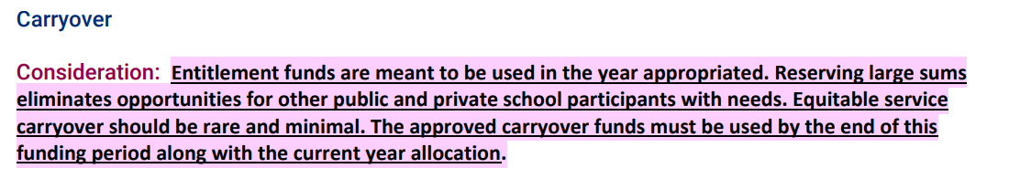
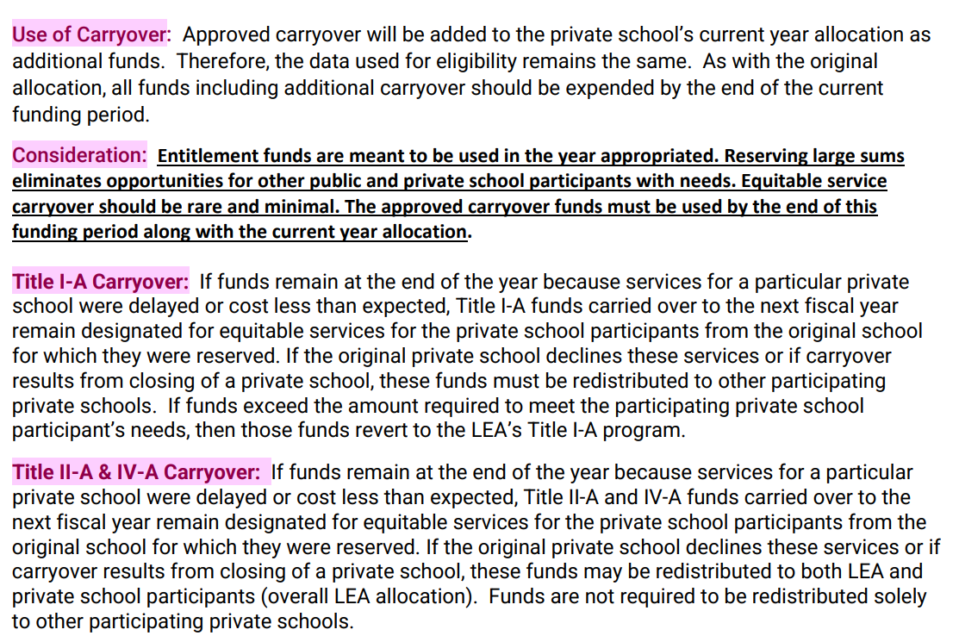
FY24 Obligation of Funds, Evaluation, & Carryover

Slide 6
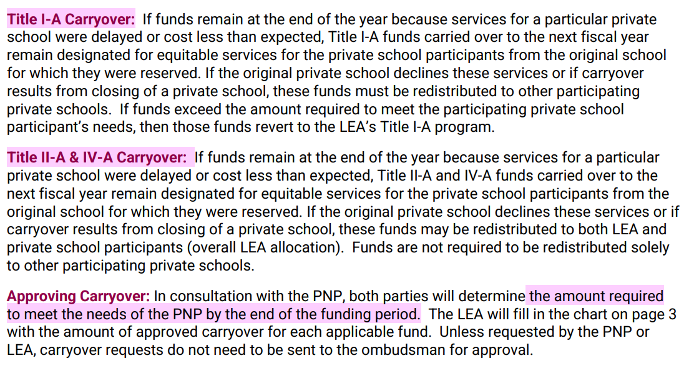
FY24 Obligation of Funds, Evaluation, & Carryover

Slide 7
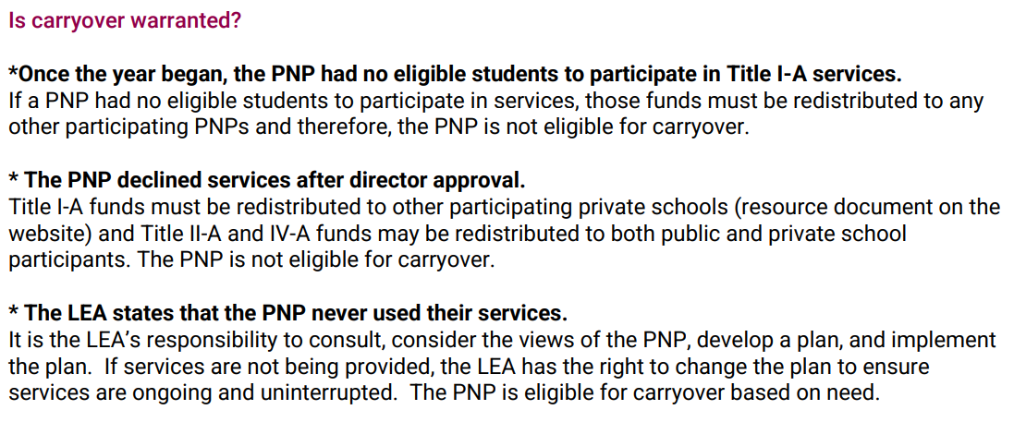
FY24 Obligation of Funds, Evaluation, & Carryover

Slide 8
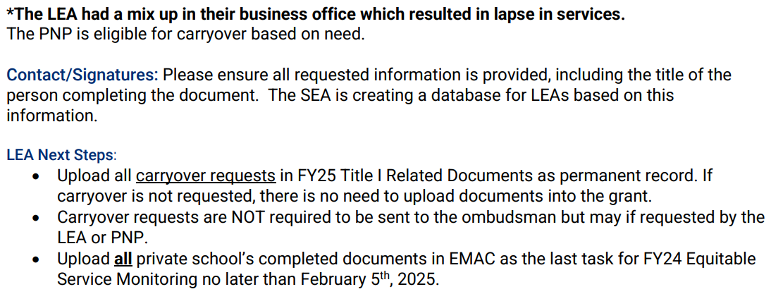
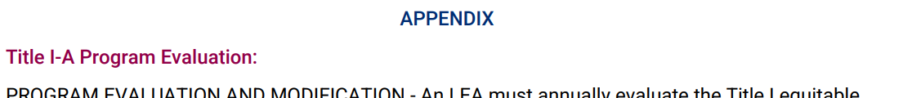
FY24 Obligation of Funds, Evaluation, & Carryover

Slide 9
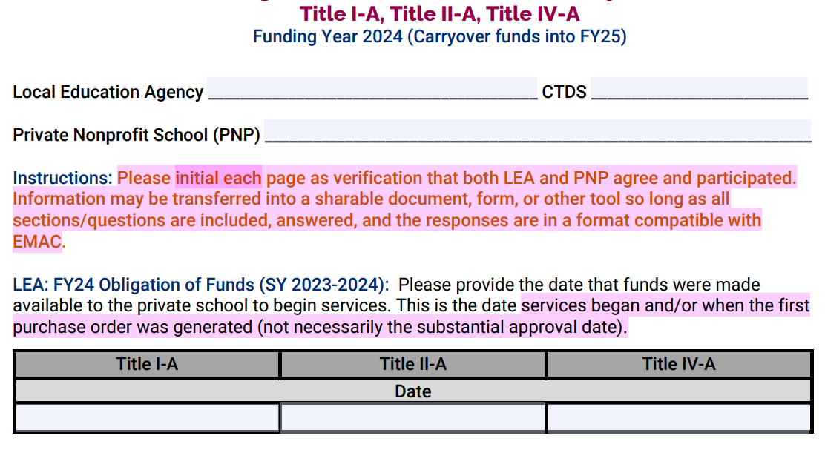
FY24 Obligation of Funds, Evaluation, & Carryover

Slide 10
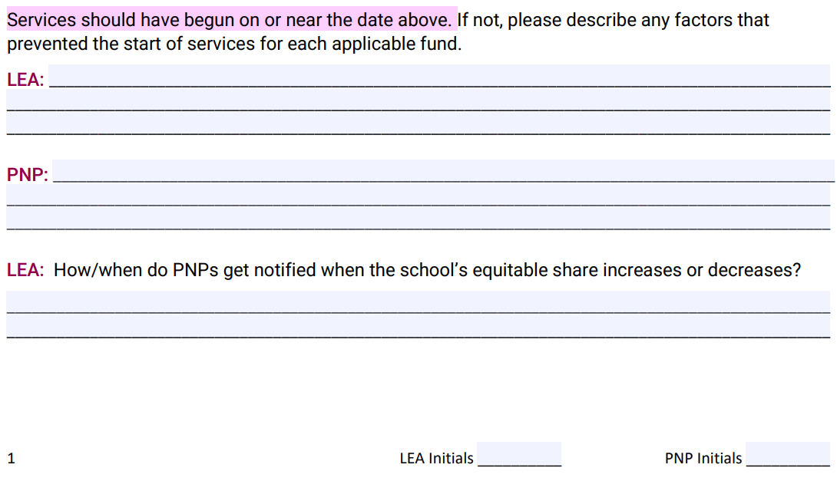
FY24 Obligation of Funds, Evaluation, & Carryover

Slide 11
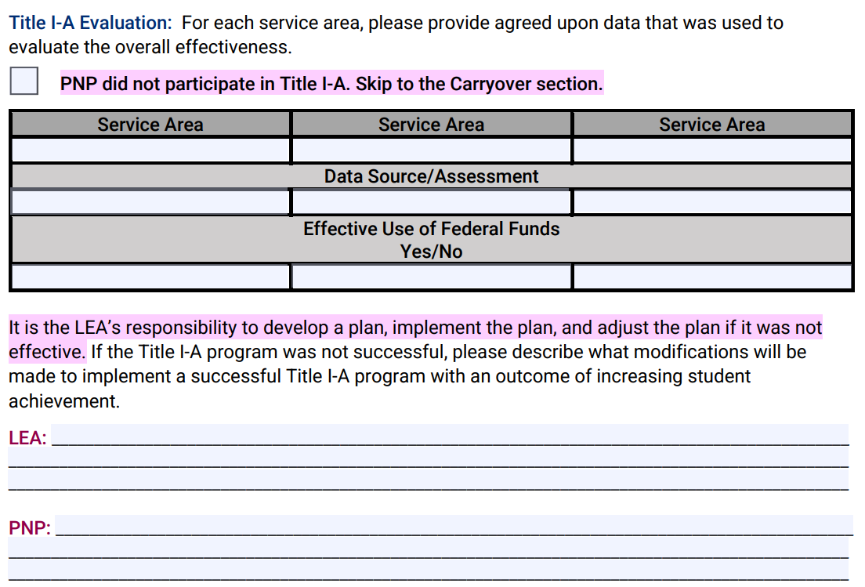
FY24 Obligation of Funds, Evaluation, & Carryover

Slide 12
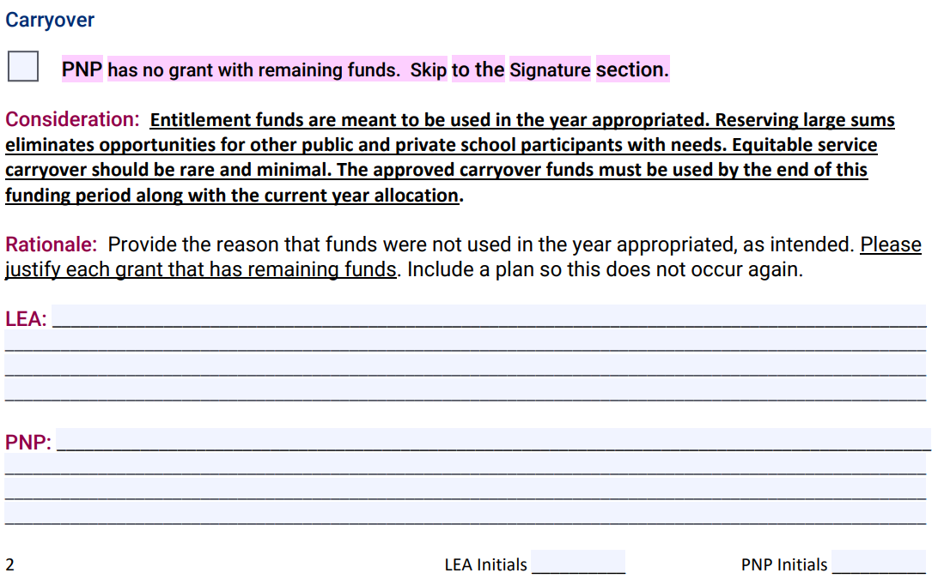
FY24 Obligation of Funds, Evaluation, & Carryover

Slide 13
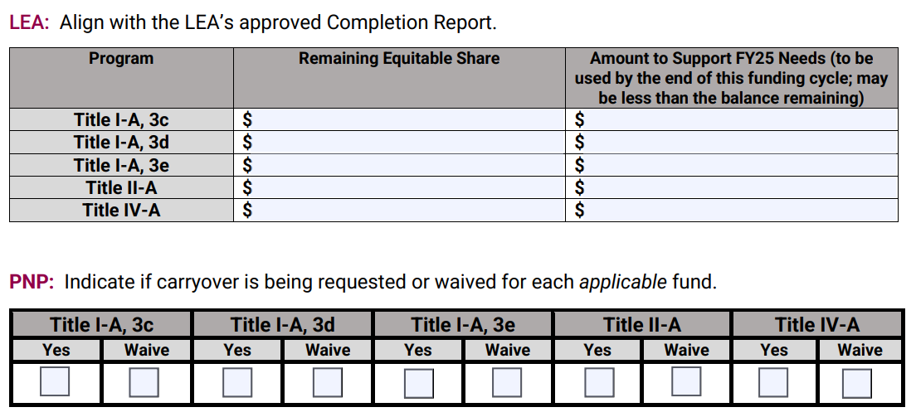
FY24 Obligation of Funds, Evaluation, & Carryover

Slide 14
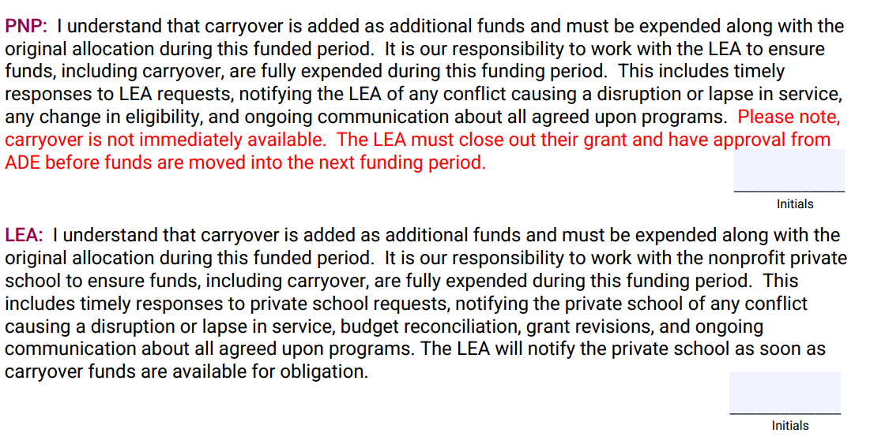
FY24 Obligation of Funds, Evaluation, & Carryover

Slide 15
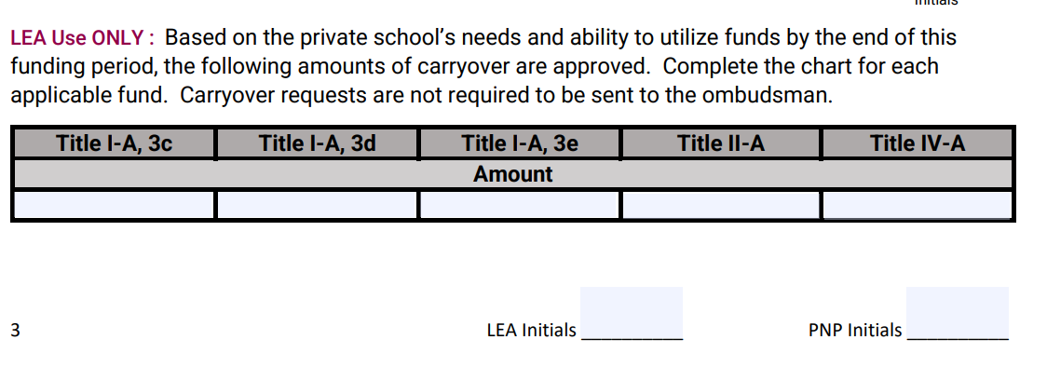
FY24 Obligation of Funds, Evaluation, & Carryover

Slide 16
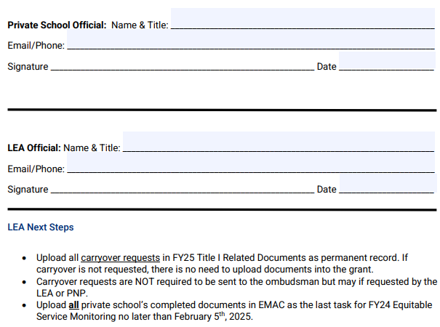
FY24 Obligation of Funds, Evaluation, & Carryover
Due February 4, 2025

Slide 17
Braiding Funds
Braiding: the coordination of funds from multiple sources to support a common goal
Upholds grant purpose
Maintains specific identity (not consolidating)
Ensures consistency
Eliminates duplication of services and wasteful spending
Aligns programs
Allows for more comprehensive support than would otherwise be available
Scenario: Address learning loss (specifically in reading) by holding a three-week summer reading program
Title I-A: Fund the instructional staff (teaching and planning)
Title II-A: Planning and PD – Science of Reading, aligning the summer program
Title III-A: Supplemental EL (only) materials aligned to the core reading program
Title IV-A: Fund enrichment staff (STEAM, Theater, Music)
To Braid or Not to Braid:
Does the LEA braid funds?
What is the benefit?
How could this be implemented with the LEA’s private school programs?

Slide 18
Pooling & Third-Party Providers
Who reaps the Benefits?
  ...at the District Level?
  ...at the Private School Level?
  ...at the Student Level?
Concerns/Reservations?
ADE Guidance to follow
  Texas and VA as models
LEA
  Maintain control of funds
  Open PO not to exceed
  Collect data
  Evaluate program

Slide 19
Pooling & Third-Party Providers
LEA
  Determine equitable share
  Write Grant
  Maintain control of funds
    Approve Plan
    Open PO not to exceed
  Evaluate/Adjust program
Third Party
  Ongoing consultation meetings
  Notice of Intent to Participate (NIP)
  Affirmation of Consultation (AOC)
  Yearlong planning budget
  Data collection (formative and summative)
  Service plan (initial and amendments as needed based on data)
  Procurement on behalf of the LEA
  Private school spend down (budget reconciliation) – report to private school & LEA
  End of year evaluation
  Carryover if applicable
  Update policies, procedures, and timelines annually as appropriate

Slide 20
Accurate?
The private school must provide the same services that the LEA provides (“equitable” services).
The purchase of materials or a program, such as IXL, is allowable for Title I-A.
Private schools own all materials purchased by grant funds.
Private schools are allowed to decline the use of funds for family engagement for grant over $500,000.00.
Family engagement activities may be used for schoolwide events at the private schools.
The purchase of an online subscription, that has both secular and non-secular material, is not allowable and may not be prorated.
Once a prorated amount is determined, it is only applied to the private school’s conference registration
An LEA may not wait to receive director approval before beginning programs at private schools.
The LEA may not determine how many time the private school revises their plan.
LEAs must collect Title I-A income eligibility data from private schools annually in order for those school to receive funding.
Students who qualified for funding are the same students who are eligible to receive services.
The private school may not change their intervention groups once the year begins.
Title I-A funds must only be used on instructional services.
All staff funded through ESEA must be appropriately certified.
A service provider may receive planning time to prepare for Title I-A, I-C, III-A, or IV-A instruction as applicable.

Slide 21


Questions? Want more?
JOIN US FOR OFFICE HOURS!
The 2nd Thursday of every Month
https://www.azed.gov/titlei/privateschools

