Slide 1



For
Equitable Service Program Requirements: Updates, Consultation, Program Allowability, and Monitoring

Slide 2
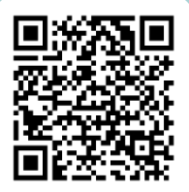
For
Questions

Slide 3


Session Objectives
Learning Goal:
Participants will be able to implement an equitable services for all required ESEA programs.
Success Criteria:
Participants will understand the consultation process and the different funding allowability restrictions and flexibilities.
Participants will understand the equitable service monitoring requirements.
Participants will acquire FY26 updates for equitable services.

Slide 4
Required Programs
Title I, Part A equitable services are governed under ESEA section 1117 and 8501
ESEA, Title VIII equitable services provisions cover the following programs:
Title I, Part C - Education of Migratory Children
Title II, Part A - Supporting Effective Instruction
Title III, Part A - English Language Acquisition, Language Enhancement, & Academic Achievement
Title IV, Part A - Student Support and Academic Enrichment
Title IV, Part B - 21st Century Community Learning Centers
Title IV, Part F - Project School Emergency Response to Violence (Project Serve)
*Private schools must be nonprofit (PNP)

Slide 5
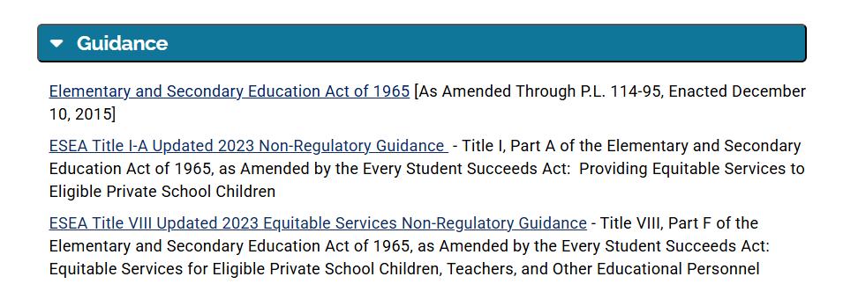
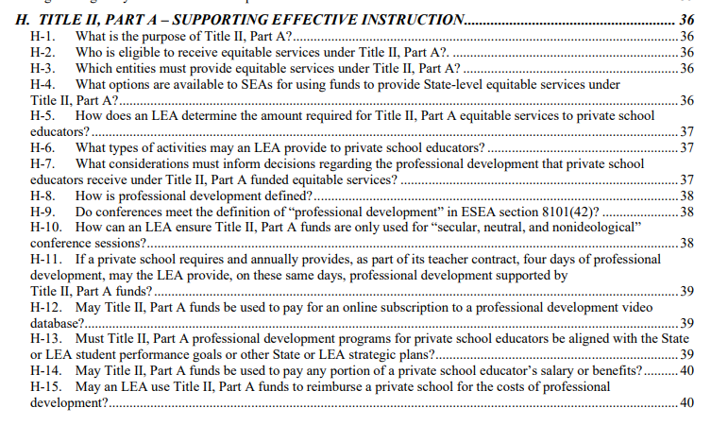
Non-regulatory Guidance
Title VIII
Sections A-F – All Title VIII programs
Sections F-L – Program specific

Slide 6
Consultation
Notice of Intent to Participate: Jan/Feb
Grants open March 1; Due May 1
Affirmation of Consultation & Yearlong Planning Template: Mid March
  Yearlong Planning Budget: Due to LEA mid April
  AOC due when the school year begins/EMAC 9/30/25
Data for services: August
Revise preliminary plan if needed: September/ongoing
Ongoing – See Sample Timeline for topics
*Private schools must be nonprofit (PNP)

Slide 7
Title I-A Equitable Share vs. Program Participation
Equitable Share = Student who lives in a Title I-A funded boundary (public LEA) + qualifies based on income
Program Participation = Student who lives in a Title I-A funded boundary (public LEA) + demonstrates an academic need
and/or
Staff who work directly with eligible Title I-A participants
and/or
Families of Title I-A participants

Slide 8
Title I-A
Instructional services provided by public school employees, private school teachers, or third-party contractors
Intervention during the day/pull out program (not private school employee)
Before/after school programs
Tutoring
Summer school programs including scholarships for paid programs through the LEA
Family literacy programs (families of eligible Title I-A students)
Special Title I-A family events/conferences
Professional development (teacher of eligible Title I-A students)
Counseling programs
Mentoring programs
Computer- assisted instruction
Home tutoring
Any combination of the above

Slide 9
Title I-A Family Engagement Requirement
LEAs receiving a Title I allocation of $500,000 or more must reserve 1% of the total equitable share for Title I parent and family engagement activities
LEAs have the responsibility to ensure private schools provide family engagement activities
Activities may not be school-wide
Only families of eligible Title I students may participate
Family Engagement Activity Examples
Parent meetings
Parent-teacher conferences
Communication between the Title I teachers and parents on students’ academic progress
Parent education
Parent library
Parent training activities on how to work at home with children on content and skills
Reasonable access to Title I staff to receive information about their child’s progress
Private school parent representation on a district-wide private school working group
Light refreshments for parents and families at Title I meetings

Slide 10
Title I-C
All Title I-A allowable activities
Drop out prevention
Postsecondary entrance exams/prep/training for staff
Postsecondary exploration (field trips, camps, family training)
Record retrieval (school, immunization, etc.)
Medical treatments affecting school performance
Parent resource center
Parent classes (nutrition, parenting skills, basic literacy, etc.)

Slide 11
Title II-A
Professional development registration/travel
Coaching
Recruitment fairs/activities
Professional books
New teacher orientation

Slide 12
Title II-A Prorating Professional Development
Professional development must be secular, neutral, and nonideological
Prorating
Determine the number of sessions of the conference that provide secular, neutral, and nonideological professional development
Private school attendee provide LEA titles and descriptions of sessions they expect to attend
LEA determines the percentage of the attendee’s overall time spent attending secular sessions
Apply to both registration and travel costs
Upon return, private school attendee provide LEA with attendance of sessions attended
LEA adjust prorated amount if necessary
Online Subscription for Professional Development/Video Database of PD
May not fund if not fully secular, neutral, and non-ideological
no way to guarantee that the user is only accessing the secular content
Prorating is not allowed

Slide 13
Title III-A
​AZELLA​
Tutoring before, during, or after school ​
Professional development ​
Summer school programs ​
Administration of an ELP assessment for identification or evaluating services ​
Assessment materials, training, and pay to administer assessments​
​
Title III, Part A subgrant for immigrant children and youth ​
Tutorials ​
Mentoring ​
Academic or career counseling ​
Curricular materials, educational software, and technologies ​
Instructional services​
Literacy services for family of eligible ELs ​
Parent and family outreach and training activities for families of eligible ELs ​
Supplemental instructional materials and supplies

Slide 14
Title IV-A 20/20 Rule
​LEAs receiving $30,000.00 or more
Must allocate at least 20% on Well-Rounded Education
Must allocate at least 20% on Safe and Healthy Students
May not allocate more than 15% on technology infrastructure
LEA Activities + Equitable Service Activities = the Percentage Requirements

Slide 15
Title IV-A Well Rounded
​Improving access, instruction and/or engagement in:
  Foreign language
  Arts
  Music
  STEM
  STEAM
  American History/Civics/Government
  Geography
  Economics
  Environmental education
Supporting college and career counseling
FAFSA support for students and families
Advanced Placement (AP) and International Baccalaureate (IB) programs, dual or concurrent enrollment programs and early college high schools

Slide 16
Title IV-A Safe & Healthy
Community and parent involvement activities (braid with TI family eng.)
Mental health services and counseling
Promoting supportive school climates
Dropout prevention
Implementing programs that support a healthy, active lifestyle (nutritional and physical education)
Bully and harassment prevention programs
Establishing community partnerships
School safety
Internet safety
Transition programs

Slide 17
Title IV-A Effective Use of Technology
Professional Development
Blended learning projects
Assistive technology
Virtual reality gear
Digital literacy workshops for parents

Slide 18
Title IV-B
Academic enrichment
Mentoring programs
Tutoring
Literacy education programs
Programs supporting a healthy and active lifestyle
Drug and violence prevention programs
STEM
Programs supporting local workforce or build career building competencies
Career readiness programs
*Fees, materials, transportation, and access costs, etc.

Slide 19
Title IV-B
LEA/CBO must consult on the equitable participation of children attending private schools
An equitable share is calculated
The private school accesses the 21st Program at the LEA/CBO
  *Does not constitute a separate program

Slide 20
Scenario Activity
Find a scenario (space out evenly)
Read the scenario as a group
Answer the questions below
Rotate/add/make suggestions as applicable etc.
Is there an issue or something missing with the scenario?
Is there anything that would correct the issue or make it allowable?
Is there a procedure and/or guidance that must be followed?

Slide 21
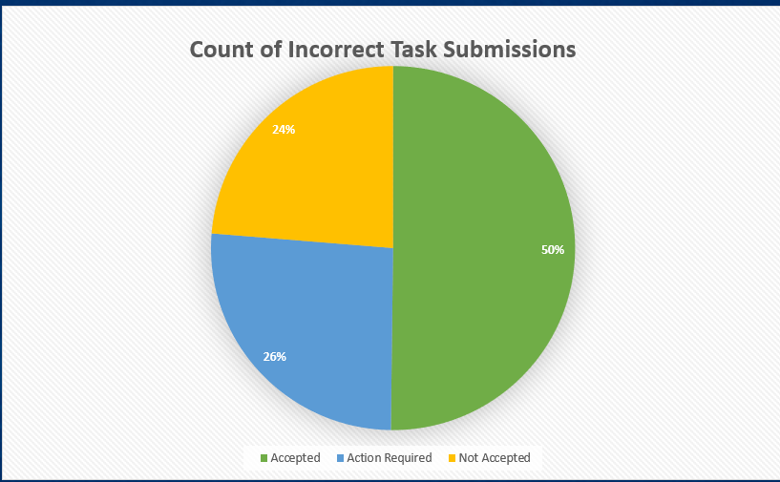
Equitable Service Monitoring

Slide 22
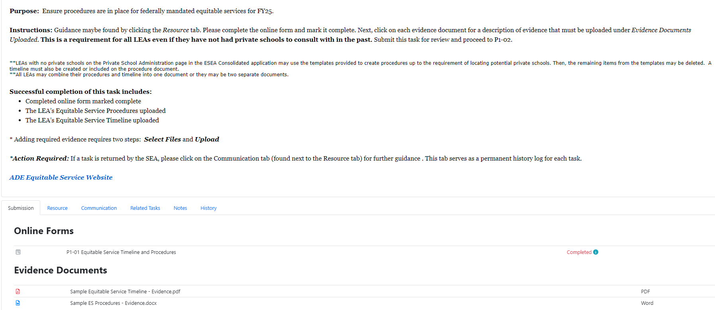
Equitable Service Timeline & Procedures

Slide 23
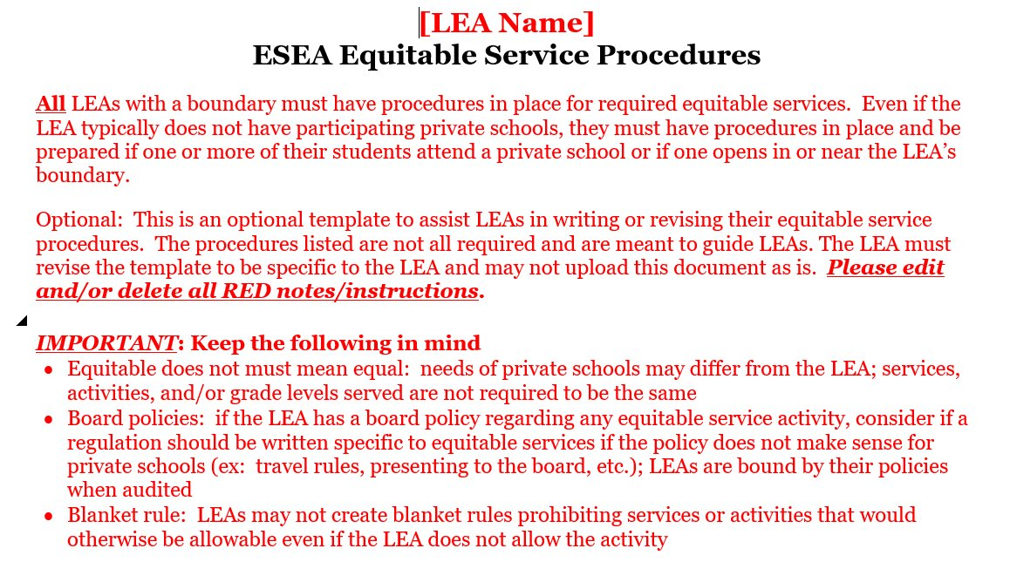
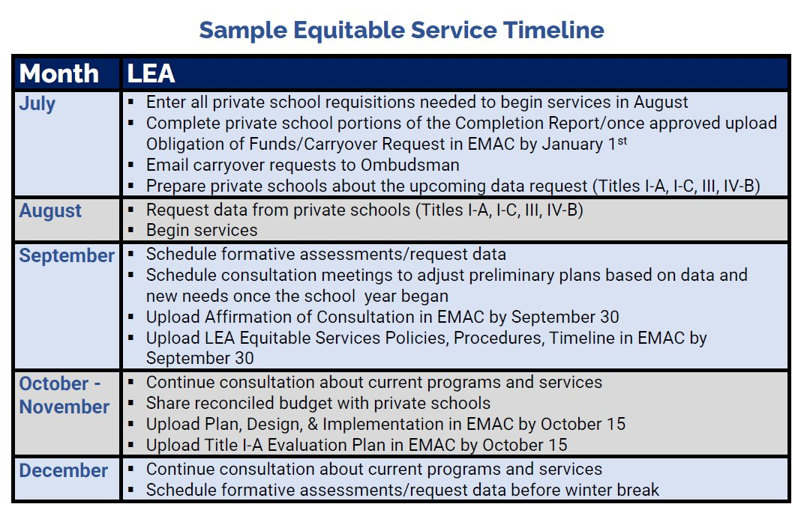
Equitable Service Timeline & Procedures

Slide 24
Equitable Service Timeline & Procedures
Most Common Return Reasons:
Missing the signature​
Missing a checkbox​ in the online form
No evidence submitted

Slide 25
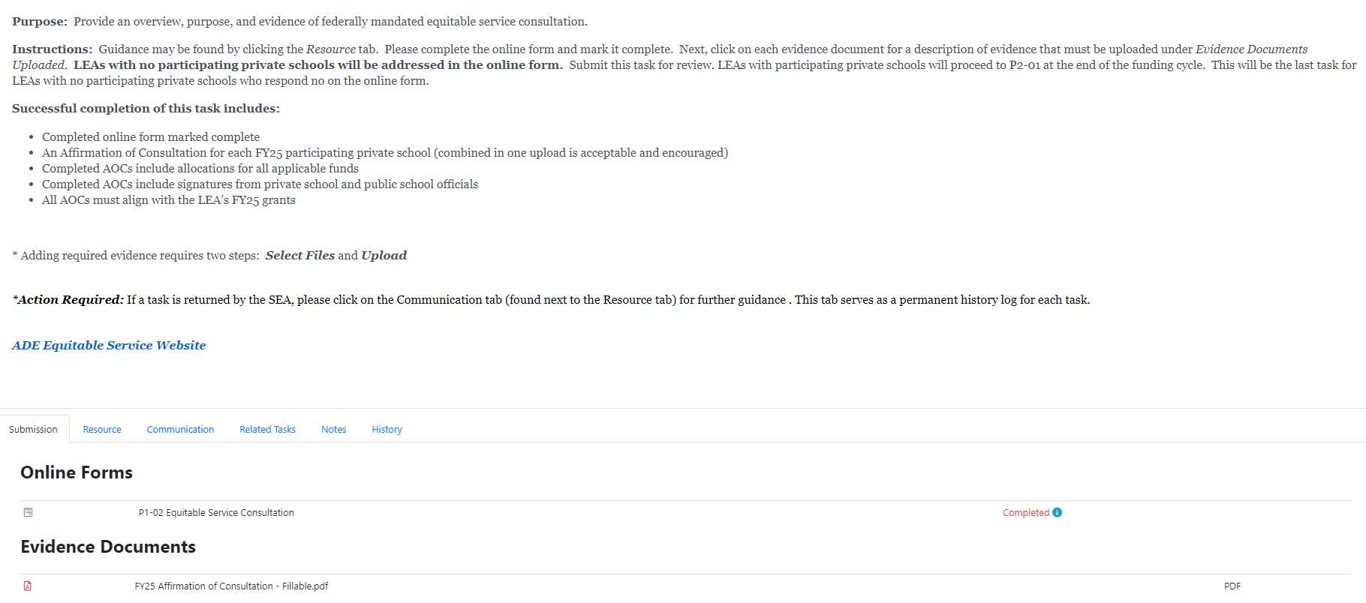
Equitable Service Consultation

Slide 26
Equitable Service Timeline & Procedures
Feedback Wanted
Participation vs. Program
How can we make it more understandable?
  LEAs that had private schools stop participating
  or
  LEAs did not have eligible students in August once they generated an allocation

Slide 27
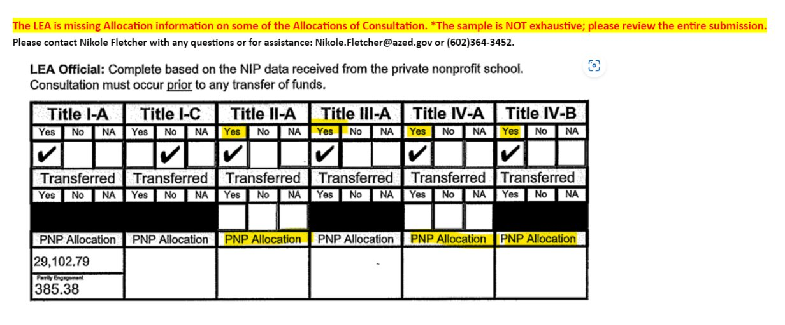
Equitable Service Consultation
Equitable share amount is required
Family engagement is required if the LEA receives over $500,000.00
  *LEA has the responsibility to ensure family engagement activities are provided at private schools

Slide 28
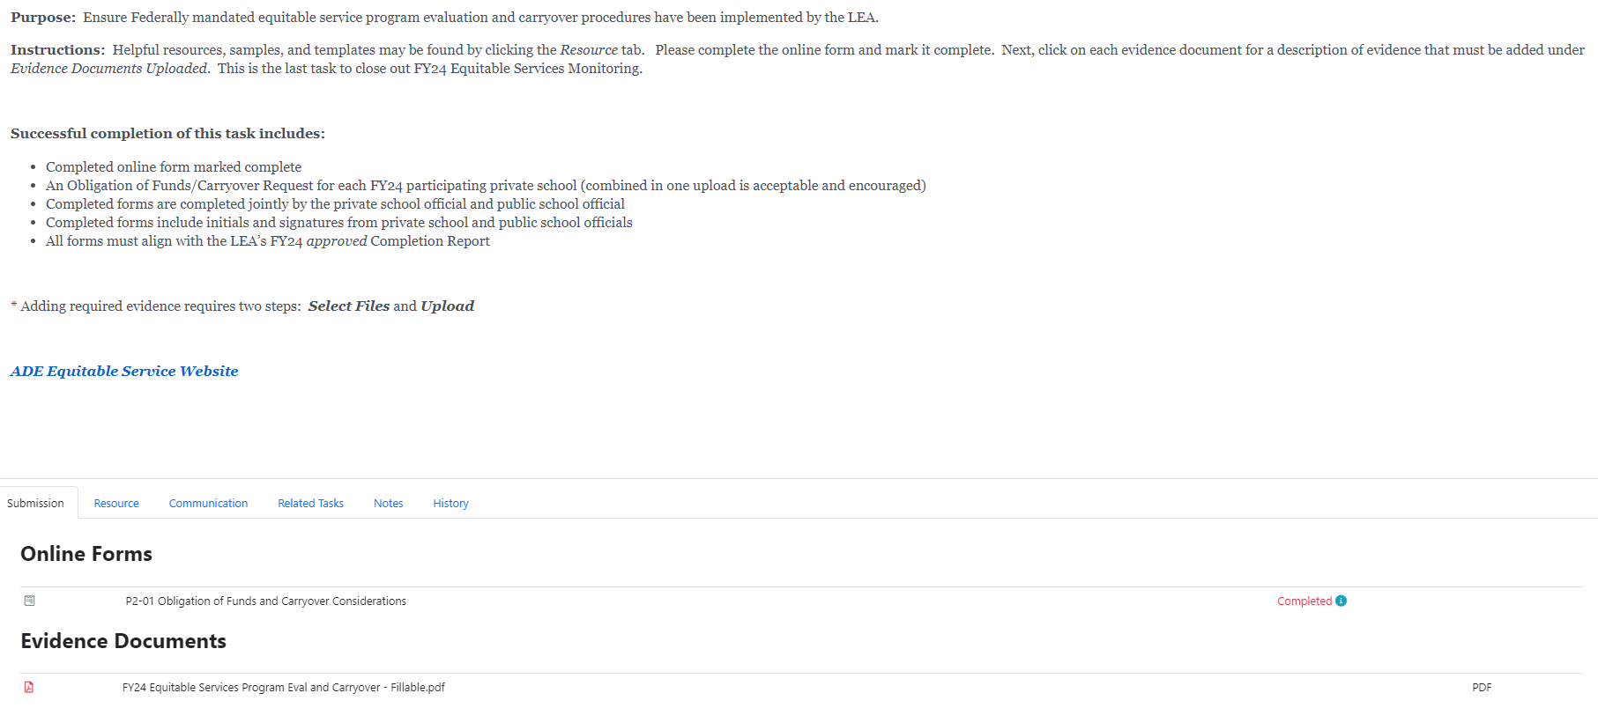
FY24 Obligation of Funds & Carryover

Slide 29
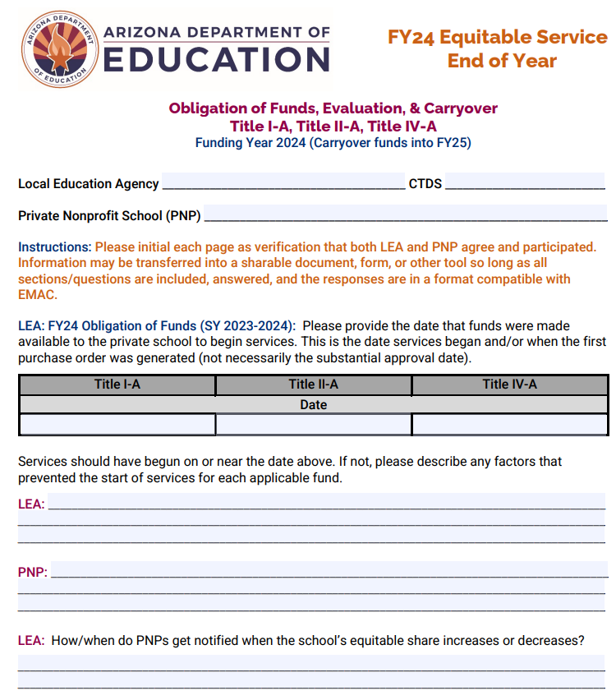
FY24 Obligation of Funds & Carryover
Due February 5, 2025
Must have a completed form for each FY24 participating private school regardless of carryover
End of year evaluation
Combine with NIP consultation
Review procedures attached to the form
Feedback will be requested

Slide 30
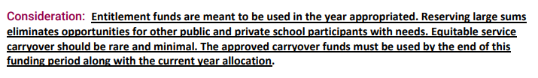
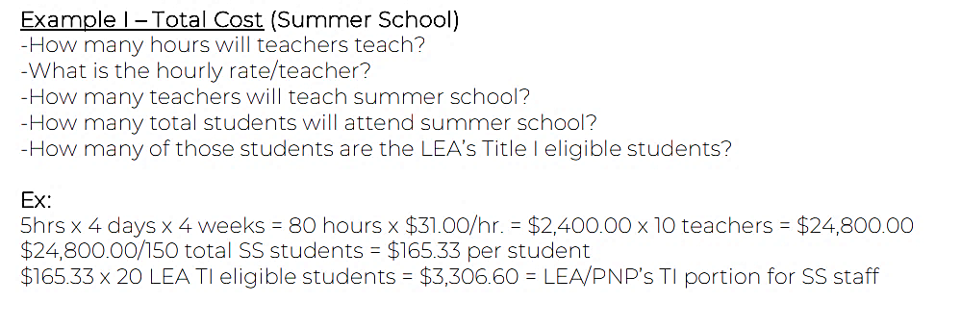
FY24 Obligation of Funds & Carryover
Budget through the summer
  Prorating Funded Services
  Current year equitable share + what
  may be needed through summer
Determine if funds are NEEDED
Carryover ONLY the NEEDED amount

Slide 31
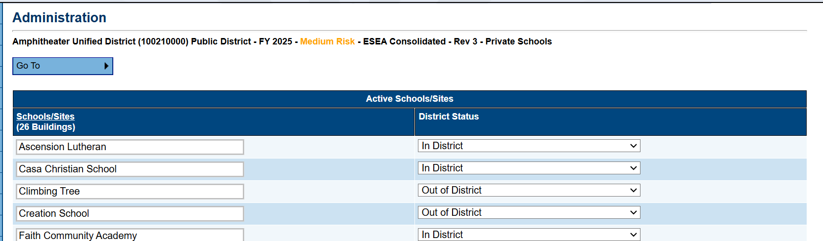
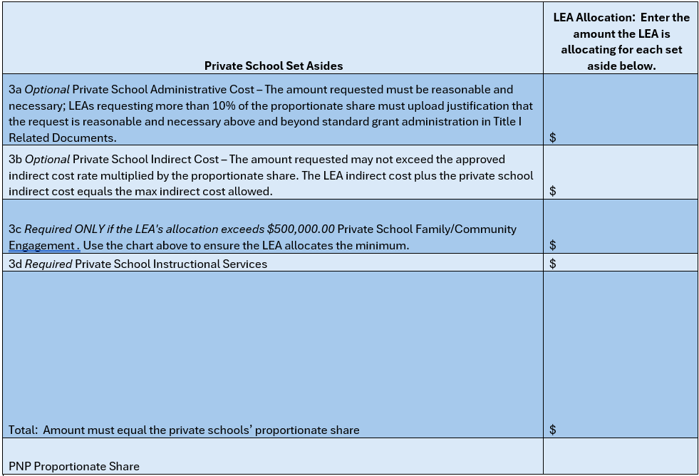
FY26 Updates Title I-A Equitable Services
Private School Administration Page
  Removed
Title I Related Documents
  Notice of Intent to Participate – moved to LEA
  Document Library
  In District Upload/Out of District Upload
Private School Proportionate Amount Page &
Private School Service Page Combined
  Minor changes in language/instructions
  Set Asides will be calculated
  Professional development eliminated as a set aside
Removed In/Out of District sections
Removed participation status
Added a carryover column (like Title II/IV)
Private school’s names will be typed by LEA

Slide 32
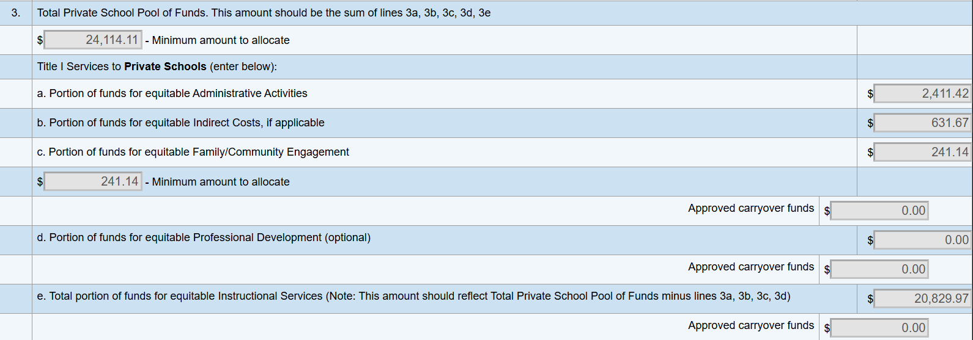
FY26 Updates Title I-A Equitable Services
Set Aside Page
  Set Aside 3 is collapsed
  LEA will ONLY add the total from chart on the Eligible Private School Service Page

Slide 33
FY26 Updates Equitable Services
Title II-A & IV-A Eligible Private School Service Page
  Private school’s names will be typed by LEA
  Minor changes in language/instructions
  Removed participation status
Migrant Ed Basic Grant & Title III LEP
Eligible Private School Service Page added
Migrant Ed Basic Consortium & Title III Consortium
Private School Workbook will be uploaded by each LEA as a related document

Slide 34
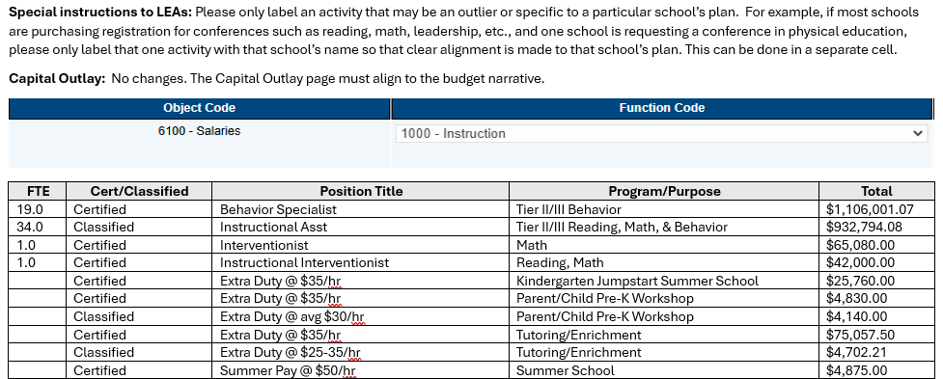
FY26 Updates

Slide 35
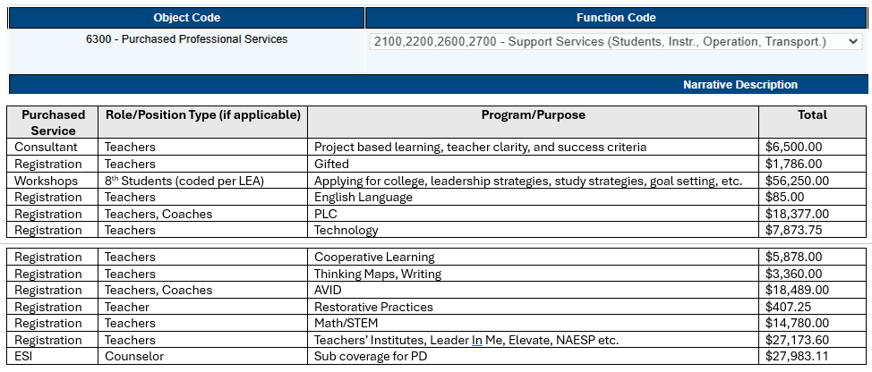
FY26 Updates

Slide 36
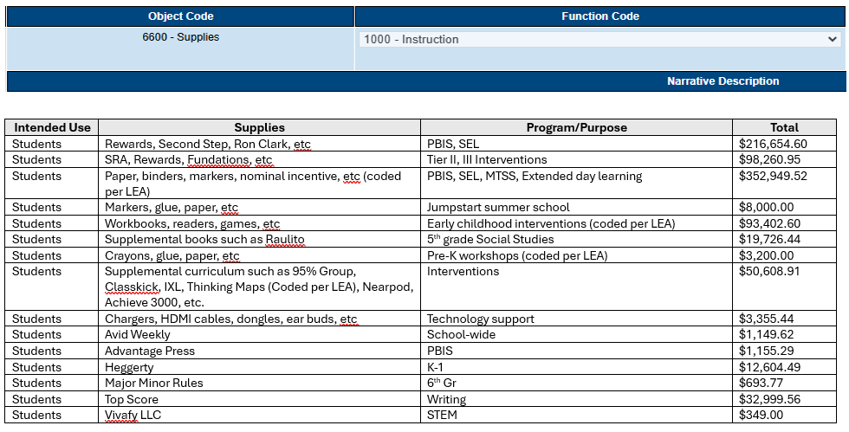
FY26 Updates

Slide 37

Department Training
Regional Trainings – March 2025
Pod Cast – March 2025
Asynchronous Opportunities – February 2025
JOIN US FOR OFFICE HOURS!
The 2nd Thursday of every Month
https://www.azed.gov/titlei/privateschools

Slide 38


