Slide 1



For
Equitable Services
for
Beginners

Slide 2
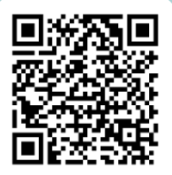
For
Questions

Slide 3


Session Objectives
Learning Goal:
Participants will be able to implement equitable services for all required ESEA programs.
Success Criteria:
Participants will understand which programs require equitable services.
Participants will understand the process of ongoing consultation.
Participants will understand the requirements of program evaluation and closing out a funding cycle.

Slide 4
Required Programs
*Private schools must be nonprofit (PNP)
Title I, Part A equitable services are governed under ESEA section 1117 and 8501
ESEA, Title VIII equitable services provisions cover the following programs:
Title I, Part C - Education of Migratory Children
Title II, Part A - Supporting Effective Instruction
Title III, Part A - English Language Acquisition, Language Enhancement, & Academic Achievement
Title IV, Part A - Student Support and Academic Enrichment
Title IV, Part B - 21st Century Community Learning Centers
Title IV, Part F - Project School Emergency Response to Violence (Project Serve)

Slide 5
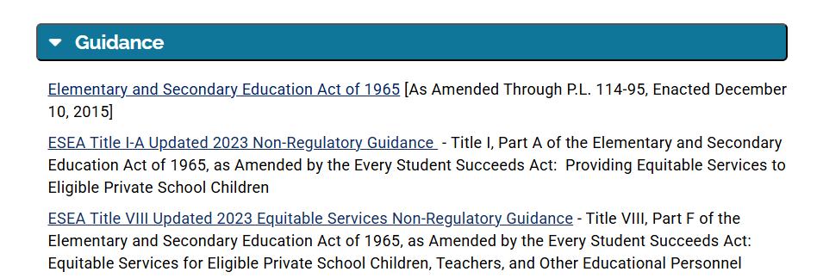
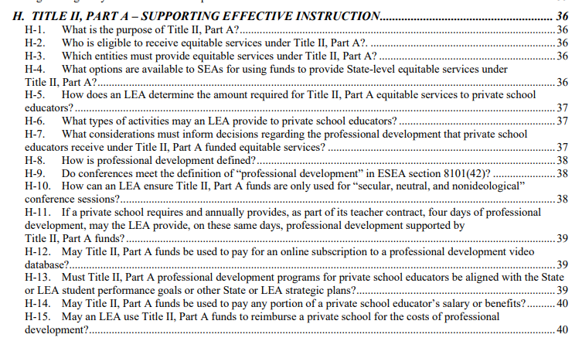
Non-regulatory Guidance
Title VIII
Sections A-F – All Title VIII programs
Sections F-L – Program specific

Slide 6
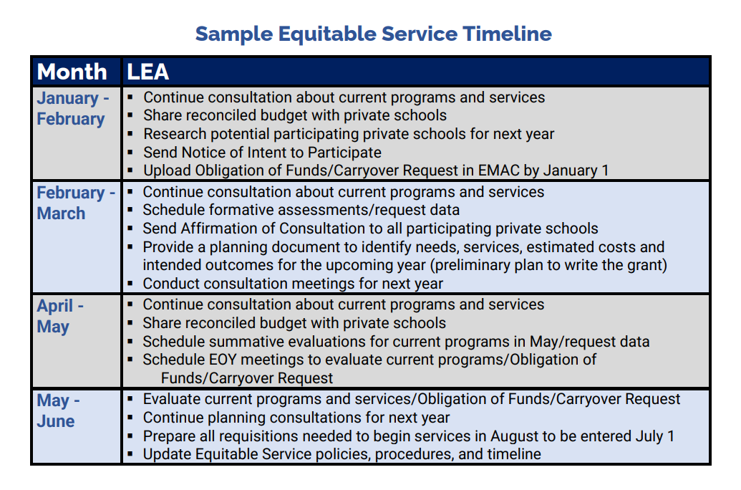
Timeline
Ongoing and Cyclical
Most grants open March 1: Begin the process in Jan/Feb
Evaluation/end of year and upcoming year consultation
Update to align with the LEA’s procedures
Must allow for private schools to revise their plans
May not restrict access to funds; Services must begin at the same time

Slide 7
Timely and Meaningful Consultation
Timely
all parties must have adequate notice or “time” to ensure they are prepared to make informed decisions
early enough so that services begin at the start of the year or the start of the funding period
Meaningful
all parties must have an opportunity to share visions and consider all viewpoints in the process
must continue throughout the funding period and does not end until the program has been evaluated
*An offer of services by an LEA without an opportunity for timely and
meaningful consultation with private school officials does not meet the
requirement of the law.
ESEA sections 1117(b)(3) and 8501(c)(3)

Slide 8
Timely and Meaningful Consultation
Eligibility
K-12 nonprofit private schools operating in accordance with state laws regarding private schools
Title I-A: students must live in a public district Title I-A funded school boundary and qualify based on income
Title VIII: private nonprofit address must be located in the boundary of a federally funded LEA
Private School Leaders
Determine the home school/district for all students
Locate contact information for each of those LEAs
Reach out to those LEAs (the Federal Programs Director/oversight of Title programs) and notify them that the PNP would like to consult on equitable services

Slide 9
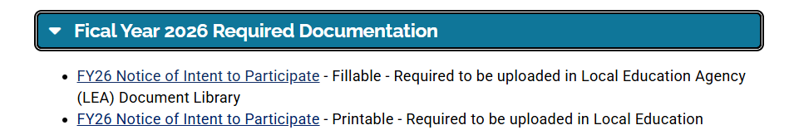
Notice of Intent to Participate (NIP)
*Begins the ongoing dialogue between LEA and Private School
*Occurs annually (required annually for in-district)
​
Notice of Intent to Participate Practice

Slide 10
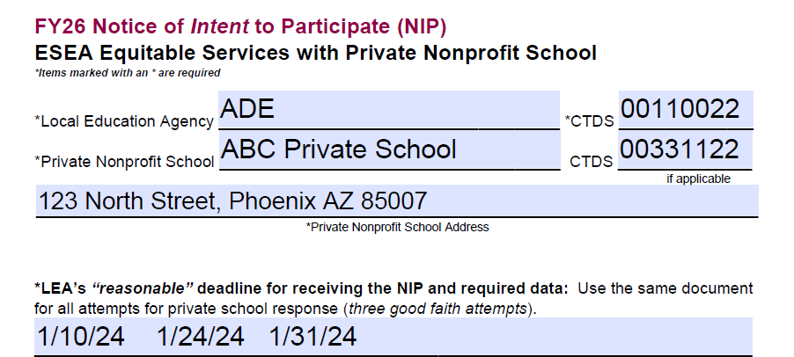
Notice of Intent to Participate (NIP)

Slide 11
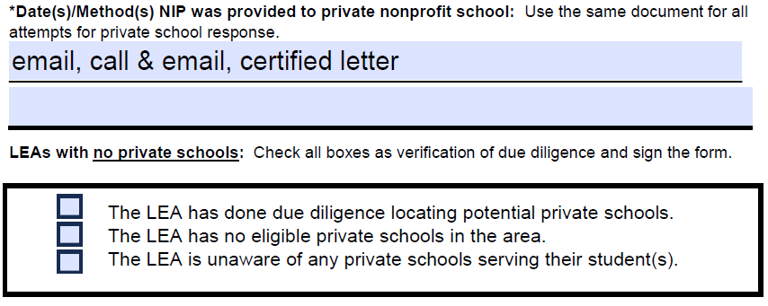
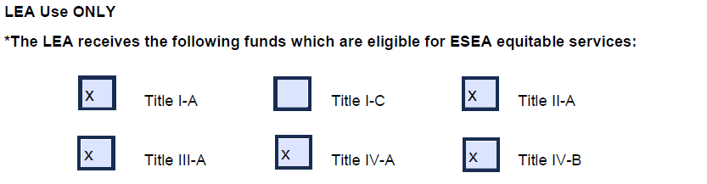
Notice of Intent to Participate (NIP)

Slide 12
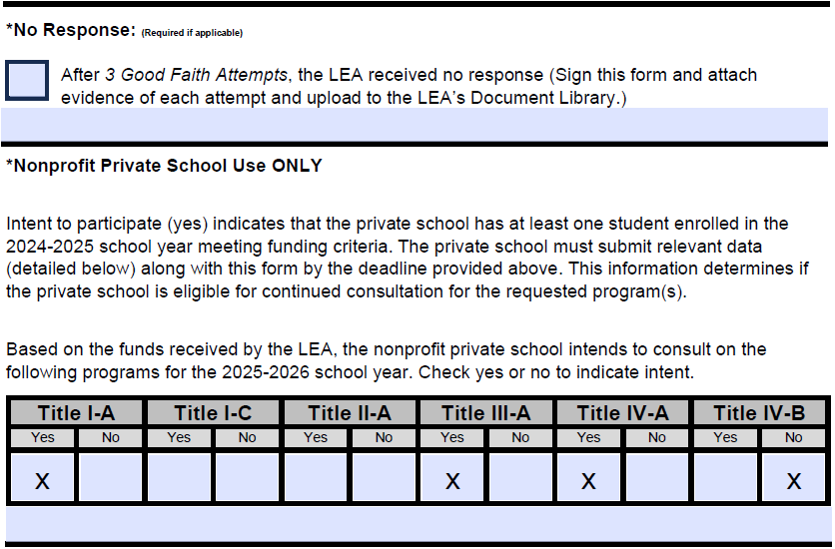
Notice of Intent to Participate (NIP)

Slide 13
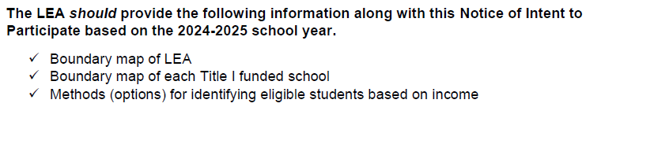
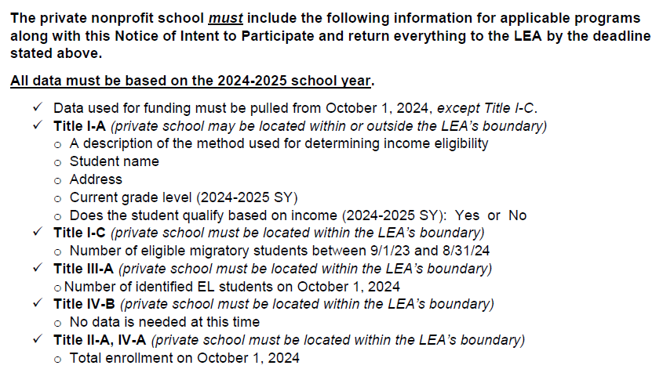
Notice of Intent to Participate (NIP)

Slide 14
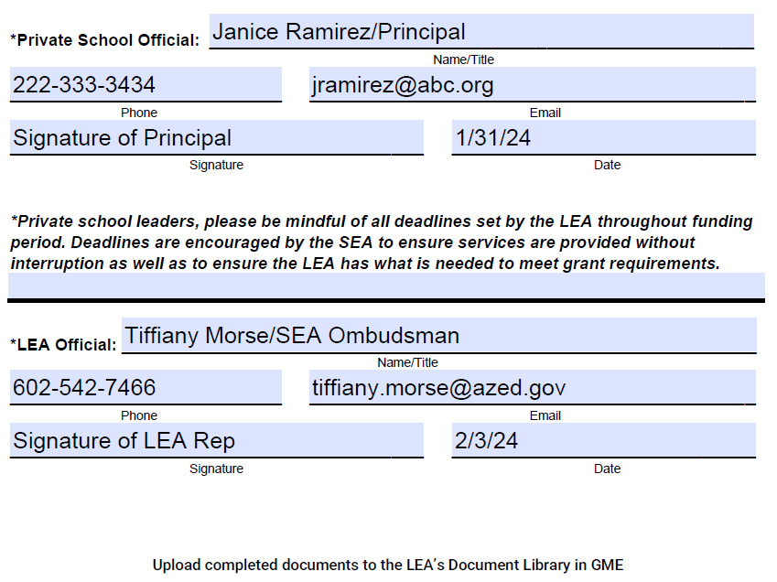
Notice of Intent to Participate (NIP)

Slide 15
NIP Cover Letter
Compose a Cover Letter
Introduction
Funds/Purpose
Reasonable deadline and consequence
How to participate
  What is included with the letter
  Next steps

Slide 16
NIP Cover Letter Example
Dear Mr./Mrs. Principal,
I would like to introduce myself. I am the Federal Programs Director for ABC LEA. Our LEA receives funding for Title I-A, II-A, III-A, IV-A, and IV-B. These programs require that we reach out to private schools in our area to see if they are interested and/or eligible to participate in equitable services. Equitable services allows students attending private schools to benefit from the same federal programs they would receive if they attended the public school.
Brief overall purpose of funds:
Title I-A: services to close the achievement gap
Title II-A: improve the effectiveness teachers, principals, and other school staff
Title III-A: ensure ELs, including immigrant children and youth, achieve English proficiency and high levels of academic achievement
Title IV-A: provide students access to a well-rounded education, improved conditions for learning, and digital literacy
Title IV-B: provide academic enrichment and/or enrichment opportunities to students
What is needed now:
Please reference the data section of the Notice of Intent to Participate(NIP). In order for our LEA to determine if the private school is eligible for a program for the upcoming year, this form must be returned along with applicable data for each fund referenced on the document by the deadline on the NIP.
What is included:
Boundary map of the LEA for Title I-A
Boundary map of each Title I-A funded school for Title I-A
Options for identifying eligible students based on income for Title I-A
Next steps:
Once received, the LEA will verify all addresses received by the private school
All eligible participating private schools will receive an Affirmation of Consolation (AOC) which will include the equitable share for each applicable program
All eligible participating private schools will receive a yearlong planning template which will allow the LEA to write each funding application based on the private school’s needs
This document will need to be returned by a specified deadline
The LEA will meet/consult with the private school to adjust plans if needed and collect participation data once the school year begins

Slide 17
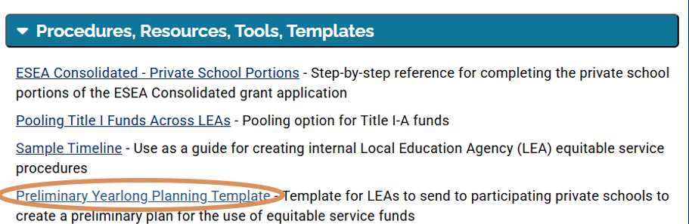
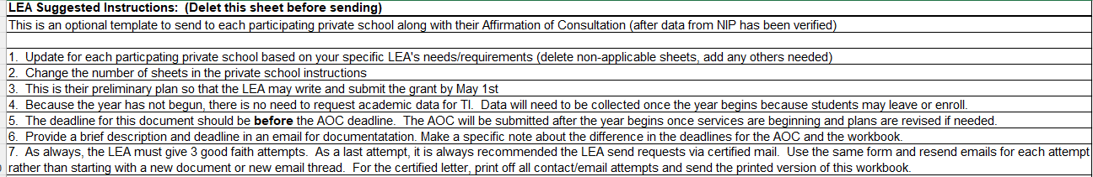
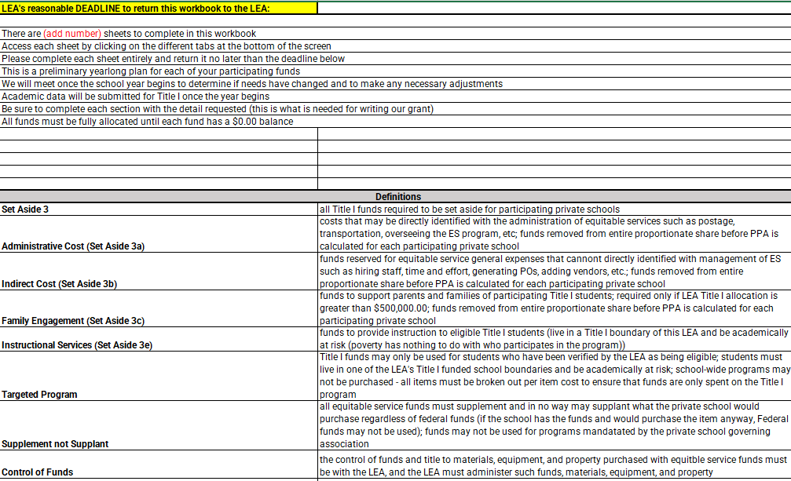
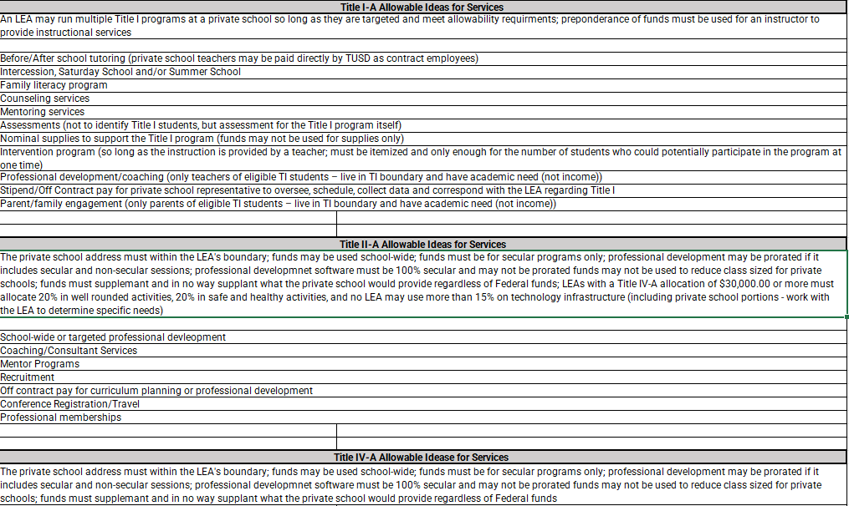
Yearlong Planning

Slide 18
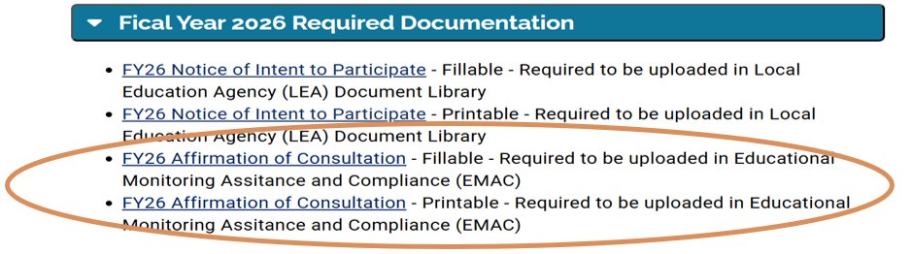
Affirmation of Consultation (AOC)
AOC Highlights:
Required according to statute
Only private schools that responded with verifiable data with their NIP
Include consultation topics discussed between LEA and private school
Due September 30 in EMAC
Equitable share
Family engagement equitable share

Slide 19
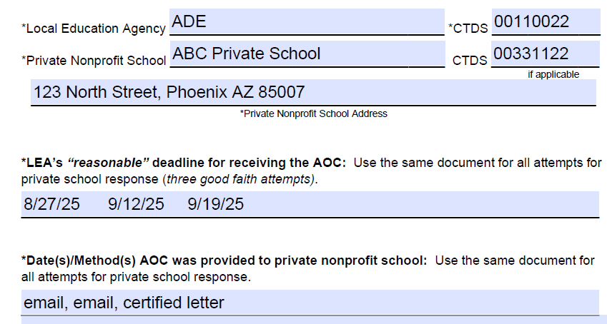
Affirmation of Consultation (AOC)
New
Affirmation of Consultation Practice: Required fields are marked with an *

Slide 20
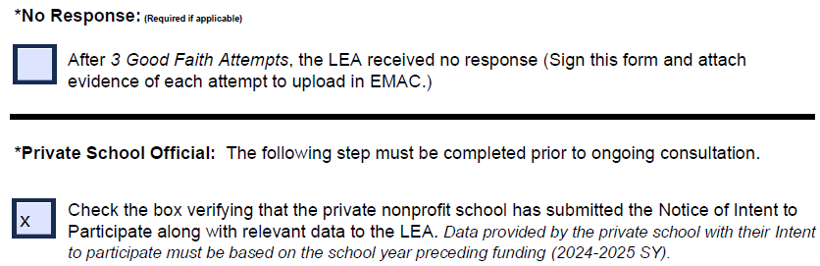
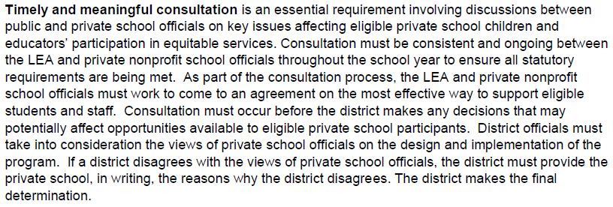
Affirmation of Consultation (AOC)

Slide 21
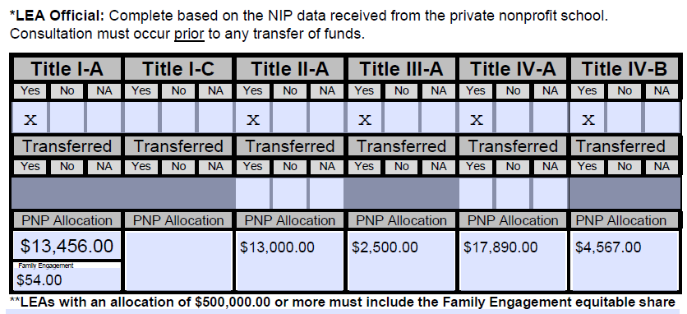
Affirmation of Consultation (AOC)

Slide 22
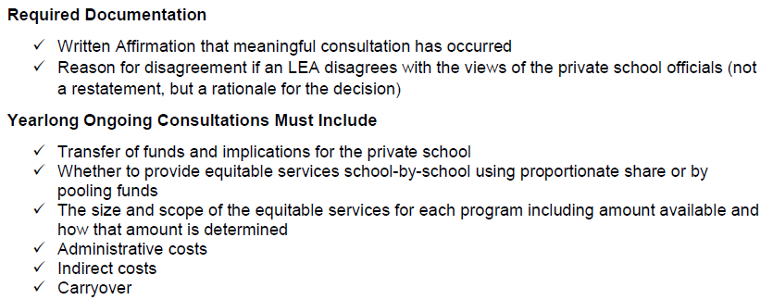
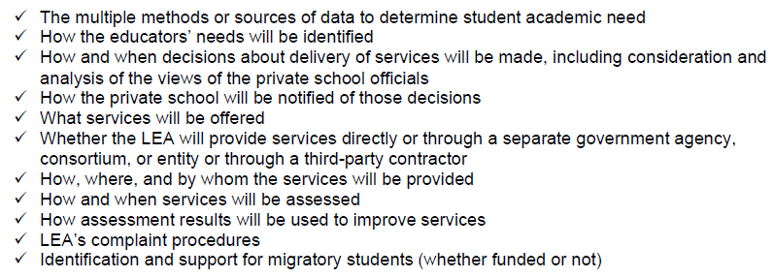
Affirmation of Consultation (AOC)

Slide 23
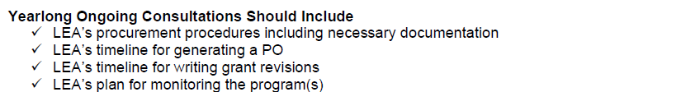
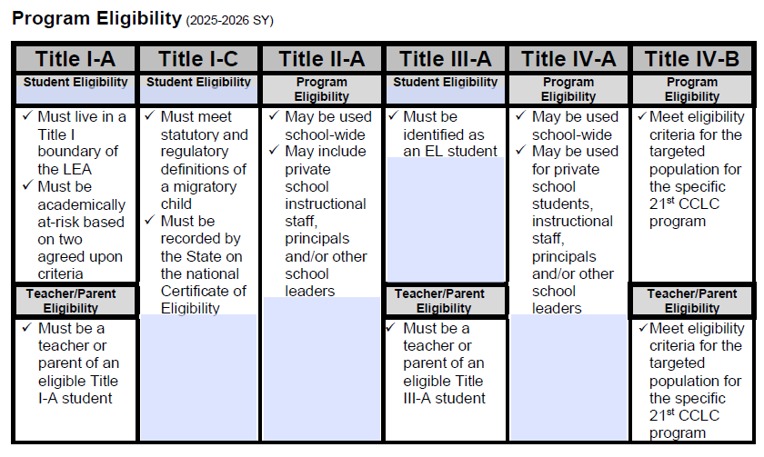
Affirmation of Consultation (AOC)

Slide 24
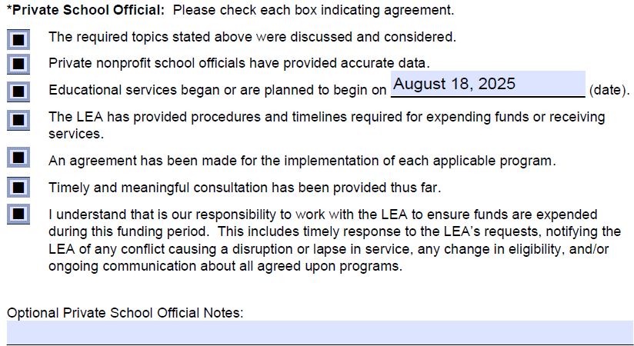
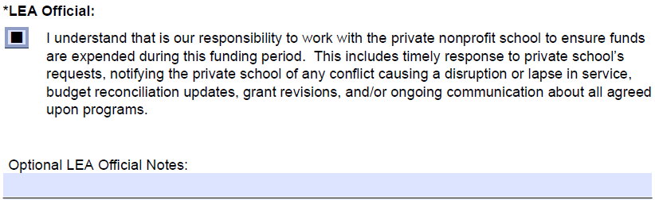
Affirmation of Consultation (AOC)

Slide 25
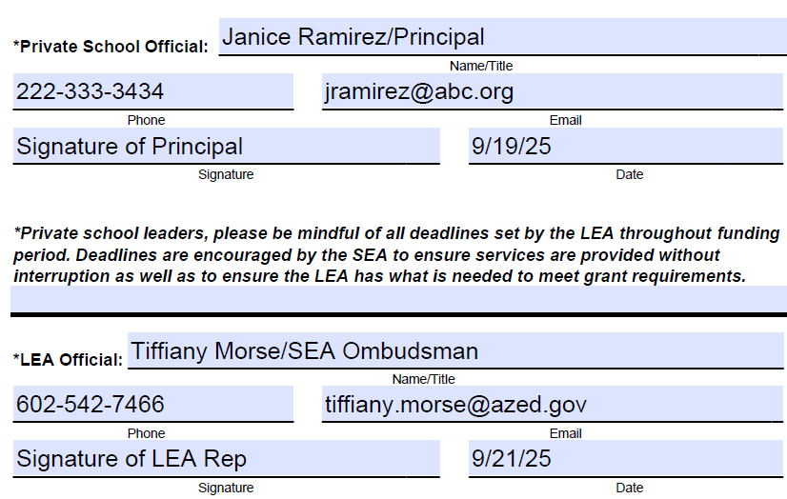
Affirmation of Consultation (AOC)

Slide 26
Public Control of Funds
The LEA must maintain control of federal funds including title to materials, equipment, and property.
Private nonprofits do not receive funds under ESEA
PNPs receive services procured through the LEA
The LEA obligates funds (make purchases) on behalf of the PNP
LEAs have varying procurement procedures
  The strictest policy prevails (local, state, federal)
  Must be communicated through consultation
ESEA sections 1117(d)(1) and 8501(d)(1)

Slide 27
Supplement not Supplant
Identify the Difference ​
Supplanting is always the presumption
Federal funds must add to (or supplement) and not replace (or supplant) other funds in providing general educational services
Funds may not benefit the private nonprofit school or be applied to general needs as a whole
Funds must supplement what a private school participant would receive without federal funds
Inquire
Are any of the services required under applicable (to private schools) state law or local policy?
Were local funds used in the prior school year to provide any of the services which are currently being requested using federal funds?
Are any of the same services to students participating in a program funded by federal dollars also being provided to non-participating students using local funds?

Slide 28
Ongoing Consultation
Continuous Alignment
Budget reconciliation
Data collection
Revisions/adapting program
*Waiting on grant approval is not allowed
Revolving participant eligibility data
*Develop a procedure for new students and collecting data
*If an LEA is not being billed for services, they are likely not
occurring, and follow-up is needed immediately.
**Resource: Sample Timeline

Slide 29
Services
Services Must Be…
Secular, neutral, and non-ideological
Supplemental
Allowable, reasonable, and necessary
ESEA sections 1117(a)(2) and 8501(a)(2); 34 CFR 299.8; and 2 CFR Part 200
Services May Be…
Pro-rated to fund portions of groups services, EX: conferences, small groups with other LEAs
Digital materials may not be prorated
Title I-A School Program vs. Student Program Eligibility
Students generate funds if they live in one of the LEA’s Title I-A funded boundaries AND qualify based on income
Students qualify for services if they demonstrate the agreed upon need AND live in one of the LEA’s Title I-A funded boundaries
  Income has nothing to do with services
  Students may move in and out of the program all year long based on need
  Students who move enroll late in the year may receive services if they live in a Title I-A funded boundary and demonstrate the agreed upon need

Slide 30
Independent Contractor
Providers must be independent of the private school and the employment or contract must be under the control and supervision of the LEA
LEAs may contract with individuals in public and private agencies, organizations, and institutions
LEAs remains responsible for oversight
ESEA section 1117(d)(2)

Slide 31
Evaluation
ESEA Requires LEAs to Evaluate Equitable Service Programs
Were services provided?
Were services timely?
Were services equitable?
Does the data demonstrate effectiveness?
If not, how will the plan be revised?
*Both parties must be involved throughout the entire funding
period for a program to be effective.

Slide 32
Carryover
Entitlement funds are meant to be used in the year appropriated.
Reserving large sums eliminates opportunities for other public and private school participants with needs.
Equitable service carryover should be rare and minimal.
The approved carryover funds must be used by the end of this funding period along with the current year allocation.
ESEA sections 1117(a)(4)(B) and 8501(a)(4)(B)
Rare
Reasonable deadlines are highly recommended
High reservation of funds eliminates opportunities for remaining students (public and private)
Federal funds expire (must be returned to the federal government)
Demonstrates lack of need = appropriation decreases
Title I-A: redistribute to remaining participating school
Title VIII: redistribute to both LEA and PNP participating schools

Slide 33
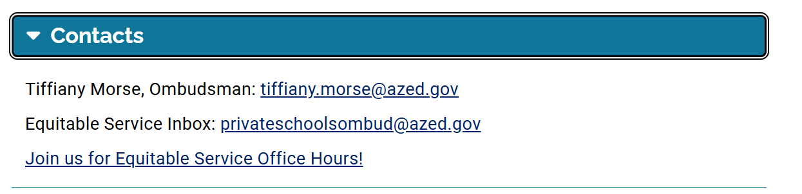
Department Training
Regional Trainings – March 2025
Pod Cast – March 2025
Asynchronous Opportunities – February 2025
JOIN US FOR OFFICE HOURS!
The 2nd Thursday of every Month
https://www.azed.gov/titlei/privateschools

Slide 34


