Slide 1


How to Access and Utilize the Technical Skills Assessment (TSA) Dashboard
+
+
Arizona Department of Education, Career and Technical Education

Slide 2
Login Instructions
DON'T HAVE ACCESS TO ADECONNECT?
The CTE Technical Skills Assessments are hosted in the ADEConnect Portal on the ADE website. Go to www.azed.gov and click on the ADEConnect link, then under Applications, click on the CTE Technical Skills Assessments link.
Contact your Entity Administrator to get access to ADEConnect and to assign
assessment roles and permissions.
To find out who your Entity Administrator is, click "Find an Administrator“ on the Help tab of ADEConnect.
REMEMBER! You must have access to ADEConnect with Level 1 permission to register students for the assessments and to access resources and reports.
Arizona Department of Education, Career and Technical Education

Slide 3

https://adeconnect.azed.gov/
Arizona Department of Education, Career and Technical Education
Page 3

Slide 4

Note for Entity Administrators
When adding a new user in ADEConnect, make sure the bullet “Login through ADEConnect” is selected:
How to add a new user tutorial is in ADEConnect - FAQ (azed.gov) ADEConnect>Help>FAQ>How to Add a New ADEConnect User
Note: SIS users login to ADEConnect through their SIS (Student Information System like Edupoint or Synergy). They will be authenticated to ADEConnect based on the trust between ADE and their system.
Non-SIS users can log into ADEConnect by providing their username and password via a browser.
Arizona Department of Education, Career and Technical Education
Page 4

Slide 5
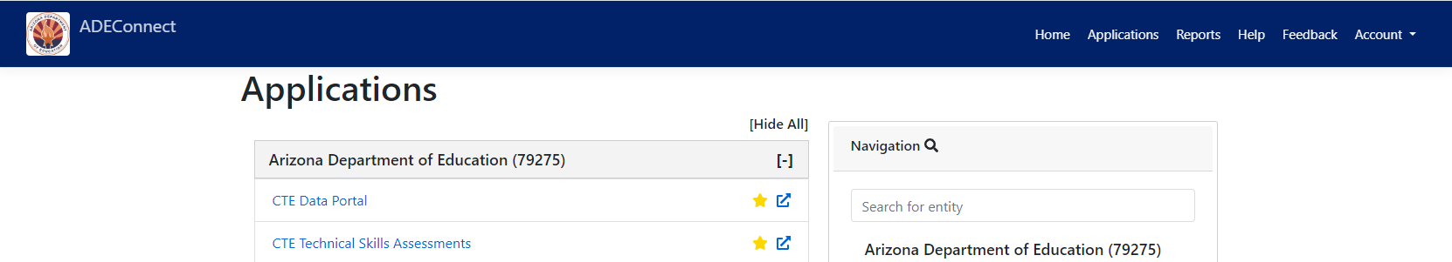
ADEConnect Home Page
Depending on your ADEConnect privileges, there may be more than one system listed. There are two systems shown here. Click on the CTE Technical Skills Assessments link.
Arizona Department of Education, Career and Technical Education
Page 5

Slide 6

+
When logging into the Technical Skills Assessments dashboard for the first time as a Level 1 permission holder, you will be asked to update the FedEx address (street address only, no PO box numbers) for mailing the TSA certificates. This is a yearly request.
Arizona Department of Education, Career and Technical Education
Page 6

Slide 7
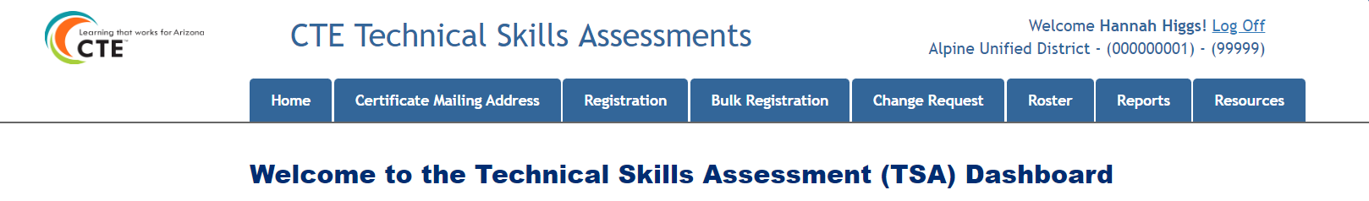
Technical Skills Assessment Dashboard
This is an example of a Level 1 permission dashboard.
Your name and district is shown at the top right corner.
Schools are listed in the Registration tab dropdown.
CTEDs, Districts, and Schools are listed in the Reports tab dropdown.
Arizona Department of Education, Career and Technical Education
Page 7

Slide 8


The 3 Assessment Permission Levels
Level 1
CTED/ District/ School Coordinator
Level 2
Teacher/Proctor
All permission levels have access to Reports.
Level 3
READ ONLY
CTED/District/School
Arizona Department of Education, Career and Technical Education
Page 8

Slide 9
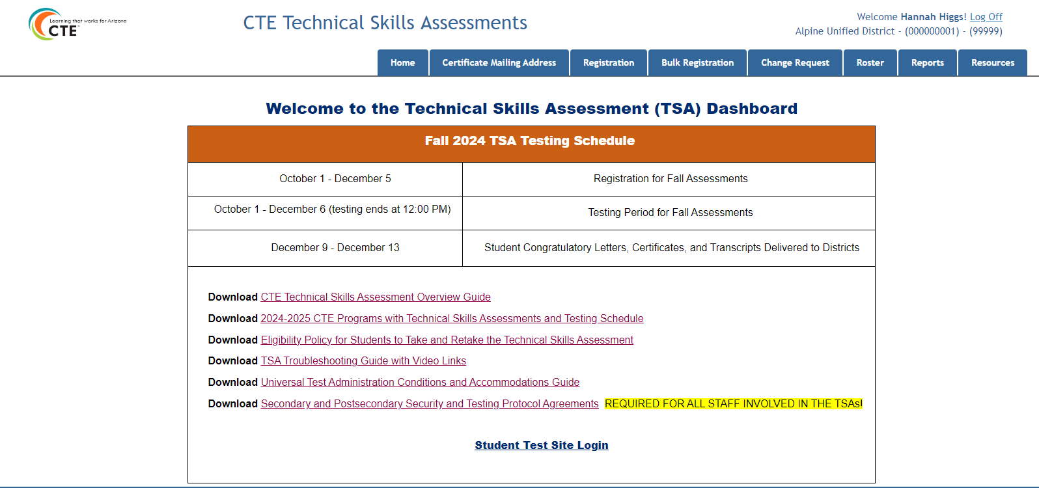
Home Tab
Arizona Department of Education, Career and Technical Education
Page 9

Slide 10
Security Agreements Available on the Home Tab
CTE Staff Security and Testing
Protocol Agreement
  Must be signed by all employees of CTEDs, districts, schools, and charter holders who come in contact with test materials or the secure test environment, who administer tests or monitor students during test administration, or who assist with testing.
District Assessment Coordinator Security and Testing Protocol Agreement
Must be signed by Superintendents and Charter Representatives, who are responsible for all testing activities and the security of the Technical Skills Assessments within their district or charter.
Arizona Department of Education, Career and Technical Education
Page 10

Slide 11
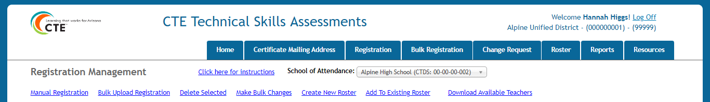
+
Registration Tab
Links for:
Manual and bulk upload registration Deletions and changes
Create new roster and add to existing roster
Download list of CTE teachers at your school
+
Arizona Department of Education, Career and Technical Education
Page 11

Slide 12
Student Naming Convention
The Technical Skills Assessments System pulls student names from AzEDS.
Student names on certificates come from student registration.
The person responsible for registering students for the assessments should check ALL names before creating rosters. Please check for correct capitalization (not in all caps) and punctuation (for example, McKenzie D’Amato Ruiz is correct; Mckenzie DAMATORUIZ is incorrect).
Student names are corrected through the District SIS (Student Information System) which will update AzEDS. Once names are changed in SIS, the updated names will be available for registration and the TSA certificates.
ADE does not manually change names on certificates.
Arizona Department of Education, Career and Technical Education
Page 12

Slide 13
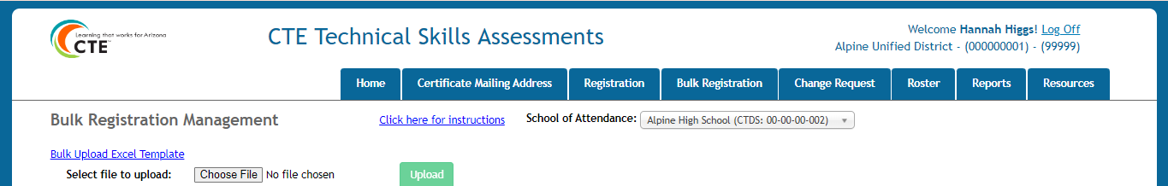
+
Bulk Registration Tab
Links for: Bulk upload template
Finding and uploading your file
Bulk upload help
+
Arizona Department of Education, Career and Technical Education
Page 13

Slide 14
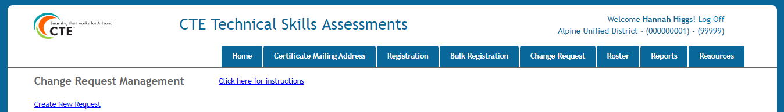
Change Request Tab
+
Request changes in system: Delete Assessment
Delete Registration
Reprint Certificate
Reprint Transcript
Other
+
Arizona Department of Education, Career and Technical Education
Page 14

Slide 15
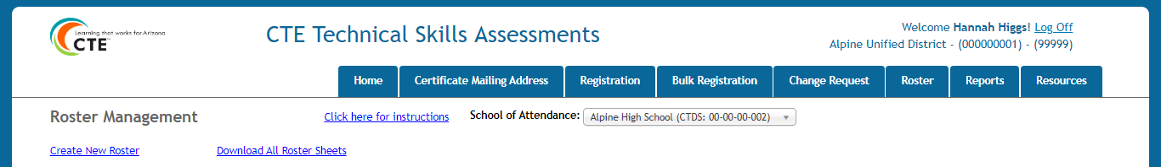
+
Roster Tab
Links for: Creating a roster
Creating a download roster file
Roster help
+
Arizona Department of Education, Career and Technical Education
Page 15

Slide 16
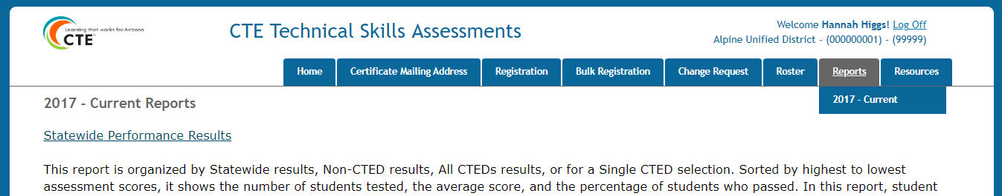
+
Reports Tab
Who has access to assessment reports?
+
A CTED user has access to all districts and schools under the CTED. If the school/district is NON-CTED, then access is only at the district or school level.
Arizona Department of Education, Career and Technical Education
Page 16

Slide 17
Select New Reports in the Reports Tab Dropdown
2017 - Current Reports
Statewide Performance Results
This report is organized by Statewide results, Non-CTED results, All CTEDs results, or for a Single CTED selection. Sorted by highest to lowest assessment scores, it shows the number of students tested, the average score, and the percentage of students who passed. In this report, student counts under 10 are suppressed (*). Administrators and teachers can view each school’s performance relative to other districts and schools that offered the same program.
Student/Program Assessment Results
This report is organized by a single student or a single program. The Student Report shows the percentage of correct responses for each standard and the overall assessment score based on the student’s total percentage of correct responses. The Program Report shows the percentage of correct responses for each standard based on the responses of all students. Administrators and teachers can review the results to make curricular changes in the scope and sequence and to identify program strengths to facilitate best practices among campuses.
Total Program Results
This multiple program report is organized by CTED, district, school, and teacher. It shows the Student Unique ID, program assessment, testing date, student score, school of attendance, gender, special population classification, grade level, and teacher email. Administrators and teachers can review the number of students tested and pass scores by program.
All reports are available in PDF and Excel formats.
Arizona Department of Education, Career and Technical Education
Page 17

Slide 18
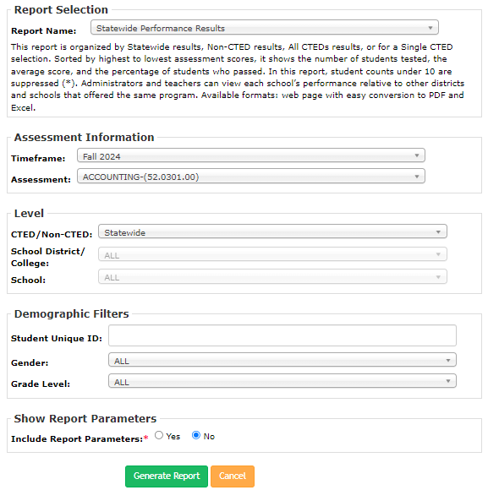
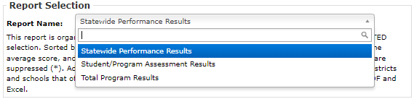
Once report filters are displayed, any report can be selected from the Report Name dropdown.
Once a report is selected from the Report Menu, the report filters screen will display.
Arizona Department of Education, Career and Technical Education
Page 18

Slide 19
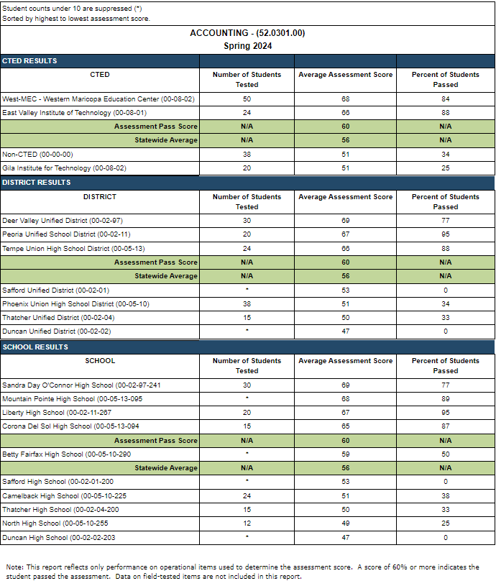
Statewide Performance Results
Note: In this report, student counts under 10 are suppressed (*). This applies to all four options selected for this report.
Option 1 – Statewide
Option 2 – Non-CTED
Option 3 – All CTEDs
Option 4 – Single CTED
Arizona Department of Education, Career and Technical Education
Page 19

Slide 20
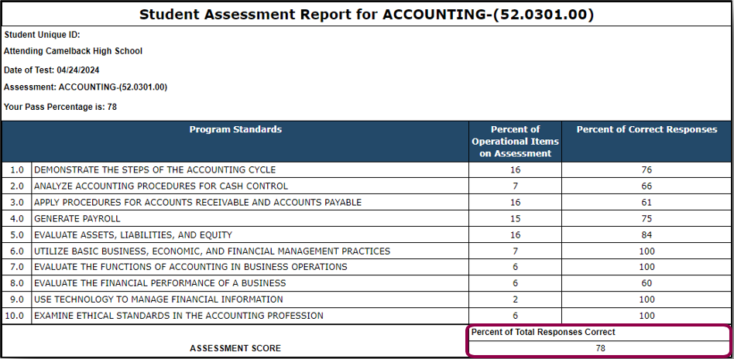
Student Assessment Results
This report shows the overall assessment score based on the student’s total percentage of correct responses on operational items. This report is sent automatically to the teacher when the student submits their test.
Arizona Department of Education, Career and Technical Education
Page 20

Slide 21
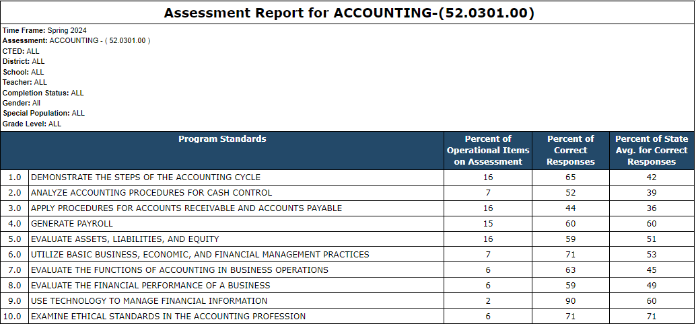
Program Assessment Results
This report shows the percentage of correct responses for each standard based on the responses of all students across the state.
Arizona Department of Education, Career and Technical Education
Page 21

Slide 22
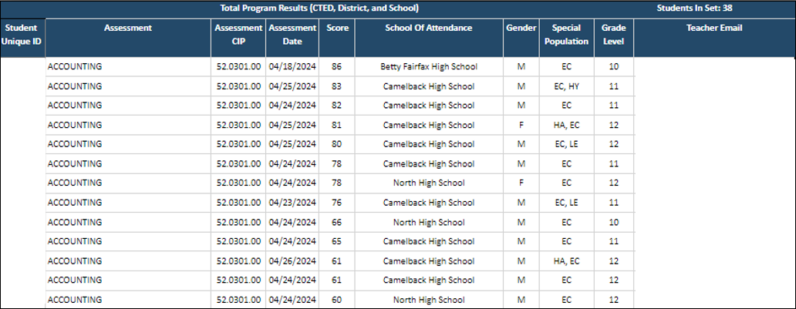
Total Program Results
This report is sorted by program from highest to lowest assessment scores
for a single school district.
Arizona Department of Education, Career and Technical Education
Page 22

Slide 23
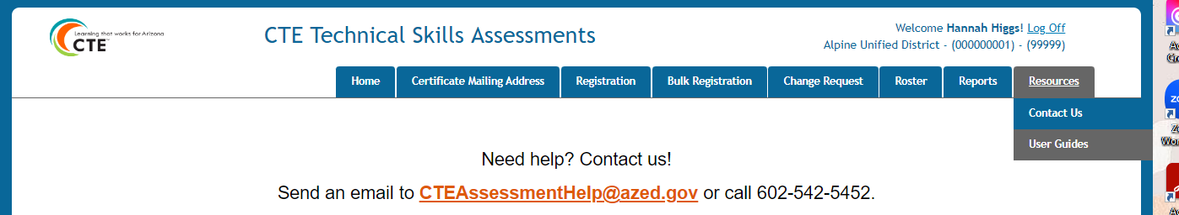
+
Resources Tab
There are 2 options under the Resources tab:
Contact Us (shown above) and User Guides.
+
Arizona Department of Education, Career and Technical Education
Page 23

Slide 24
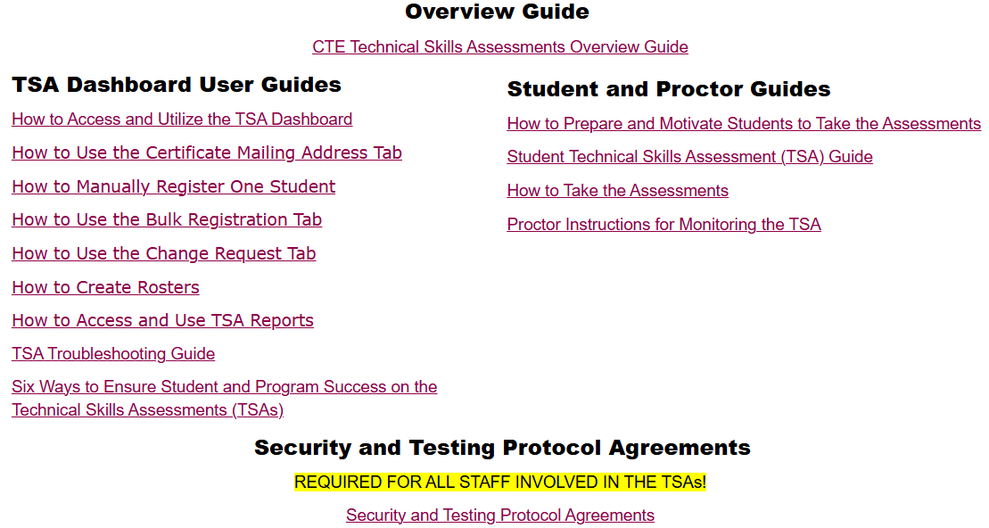
User Guides in the Resources Tab
Arizona Department of Education, Career and Technical Education
Page 24

Slide 25
+
Questions? Call or send us an email!
Assessment Helpline: 602-542-5452
Email: CTEAssessmentHelp@azed.gov
+
Arizona Department of Education, Career and Technical Education
Page 25

