Slide 1


+
How to Create Rosters for the CTE Technical Skills Assessment
+
Arizona Department of Education, Career and Technical Education

Slide 2
Level 1 access is needed to create rosters. You’ll need to use both the Registration tab and the Roster tab. There are two methods of creating rosters.
FYI
Arizona Department of Education, Career and Technical Education
Page 2

Slide 3
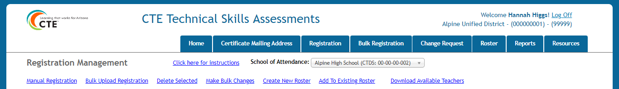
How to Access the Registration Tab
Go to the ADEConnect Portal at https://adeconnect.azed.gov/
Click on “CTE Technical Skills Assessments” application
Select the Registration tab
Registration Tab
VIDEO: Access Registration Tab
Arizona Department of Education, Career and Technical Education
Page 3

Slide 4
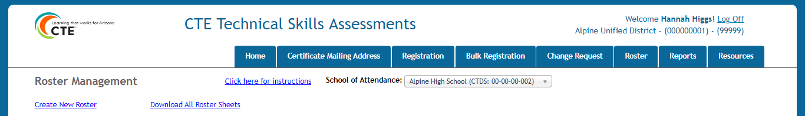
How to Access the Roster Tab
Go to the ADEConnect Portal at https://adeconnect.azed.gov/
Click on “CTE Technical Skills Assessments” application
Select the Registration tab
Roster Tab
VIDEO: Access Registration Tab
Arizona Department of Education, Career and Technical Education
Page 4

Slide 5


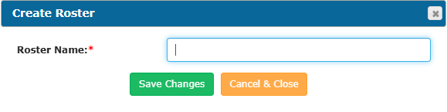
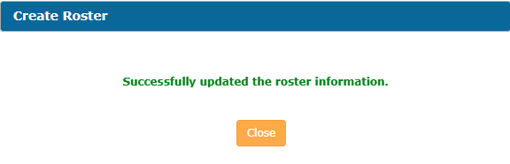

How to Create Rosters (Method 1)
Go to the Registration tab
Go
After students are registered, find student(s) row to be added to a new roster
Find
Click the box at the beginning of each student row (Selected rows will highlight in yellow)
Click
Click on “Create New Roster” link (Create Roster pop-up will appear)
Create
Enter roster name, click green “Save Changes” button
Enter
A pop-up window will appear; click the “Close” button
Close
Registration grid will show “Yes” in green in Roster column
Check
Click Roster tab and click roster name
Click
VIDEO: How to Create Rosters
Student(s) will now be included on the roster
Open
Arizona Department of Education, Career and Technical Education
Page 5

Slide 6
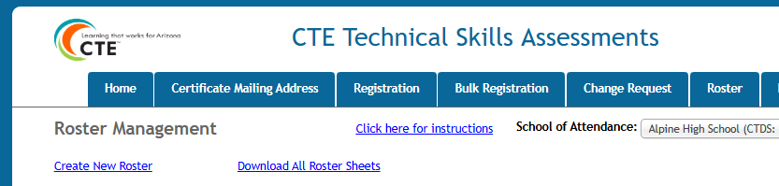
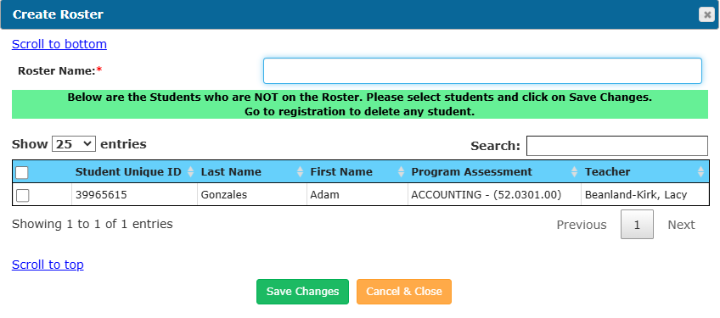
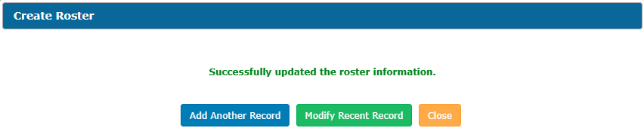
How to Create Rosters (Method 2)
Go to the Roster tab
Go
Click “Create New Roster” (Create Roster pop-up will appear)
Click
In the “Roster Name” field, enter roster name
Enter
A list of registered students will appear in the grid. Select the students to be added to the roster
Select
Click green “Save Changes” button, then click the “Close” button
12345678
Adams
Annie
Higgs , Hannah
Click
Student(s) will now be included on the roster
Open
Arizona Department of Education, Career and Technical Education
Page 6

Slide 7
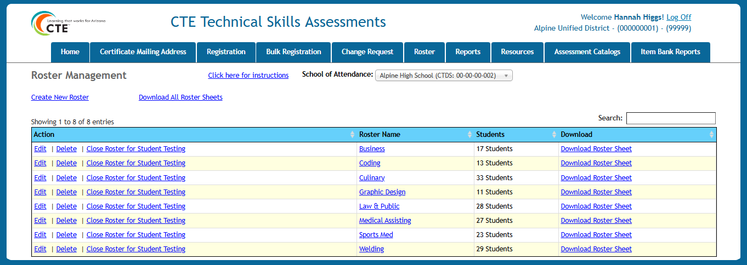
How to Download and Prepare Roster Sheets
Go to the Roster tab
Go
Find the row of the roster needed
Find
Click on the “Download Roster Sheet” link at the end of the row
Click
The roster will download to the computer; click to open Excel file
Open
Delete Column A (Roster Name) since it is not needed
Delete
VIDEO: How to Download and Prepare Roster Sheets
Highlight the contents of the spreadsheet
Select
On the toolbar, click “Print Area” then “Set Print Area”; next, click “Orientation” and choose “Landscape”
Click
Print 2 copies of the file. The first copy is the class roster for the Proctor. The second copy may be used to make Assessment Login cards for students. Simply cut out each row containing the Student Unique ID (SAIS ID), password, student name, and program assessment name and attach to the index card. Students will use this information to log into the assessment
Note: Remember to collect the Assessment Login cards at the end of the testing session!
Print
Arizona Department of Education, Career and Technical Education
Page 7

Slide 8
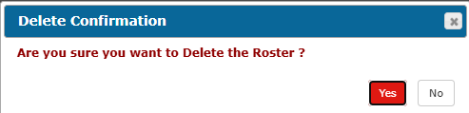
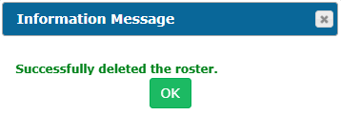
How to Delete Rosters
On the Roster Management grid, click the “Delete” link on the roster you’d like to delete
Delete
Pop-up window will appear; click the red “Yes” button under Delete Confirmation; click the green “OK” under Information Message
Click
On the Roster tab, student(s) will be deleted from the roster. Note: Student(s) will still be found on the Registration tabs
Return/
Check
Arizona Department of Education, Career and Technical Education
Page 8

Slide 9
+
Questions?
CTE Technical Skills Assessments Overview Guide
TSA Troubleshooting Guide
Assessment Helpline: 602-542-5452
Email: CTEAssessmentHelp@azed.gov
+
Arizona Department of Education, Career and Technical Education
Page 9

