Slide 1


+
How to Manually Register One Student for the CTE Technical Skills Assessment
+
Arizona Department of Education, Career and Technical Education

Slide 2
To avoid multiple errors, please go to the TSA Dashboard Registration tab and click on “Download Available Teachers”. Review the file and ensure each of your teachers’ emails have the correct access to the CTE Technical Skills Assessments application in ADEConnect.
First…
The Entity Administrator must grant access to each teacher at a school. Every 15 minutes this information is pulled from ADEConnect into the CTE Assessment System. This allows the teacher emails to automatically appear in the dropdown field during manual registration.
During bulk registration, the user must use the same email used to grant the ADEConnect access to the teacher; otherwise, registrations will be marked as partial.
The user does not have to delete the registration records to change the teacher, but the user can just use the Bulk Changes functionality to update information for all the records.
Once ADEConnect access is granted to a teacher, the bulk registration user must wait 30 minutes for the teacher to display in the dropdown to register a student.
VIDEO: How to Download Available Teachers
Arizona Department of Education, Career and Technical Education
Page 2

Slide 3
Contact your Entity Administrator — the only person who can enter teachers into the system.
When Teacher Email is Not Listed
To find your Entity Administrator, go to https://adeconnect.azed.gov/, click on the Help tab, then “Find an Administrator” to identify the person in your district/school to help you get access to ADEConnect and the CTE Technical Skills Assessments application.
Arizona Department of Education, Career and Technical Education
Page 3

Slide 4
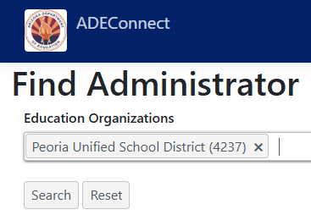
+
Enter the Entity ID, CTDS, or Entity Name
+
Arizona Department of Education, Career and Technical Education
Page 4

Slide 5
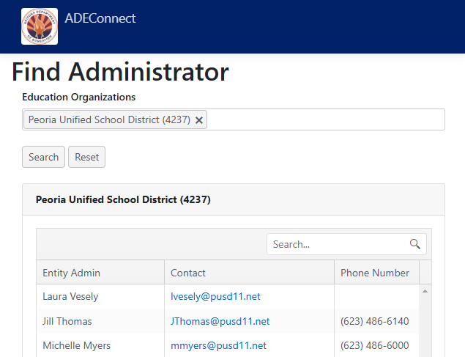
+
Your Entity Administrator(s) will appear
(see example for Peoria Unified School District)
Arizona Department of Education, Career and Technical Education
Page 5

Slide 6
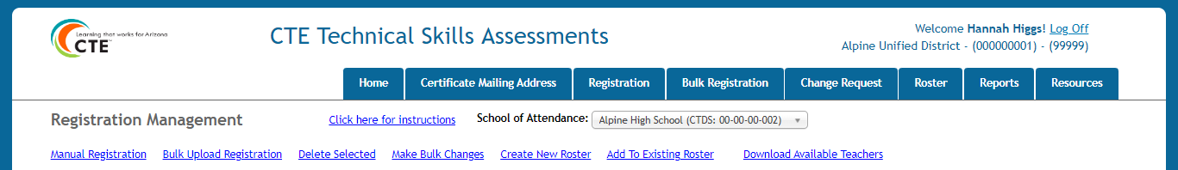
How to Access the Registration Tab
Go to the ADEConnect Portal at https://adeconnect.azed.gov/
Click on “CTE Technical Skills Assessments” application
Select the Registration tab
Registration Tab
VIDEO: How to Access the Registration Tab
Arizona Department of Education, Career and Technical Education
Page 6

Slide 7
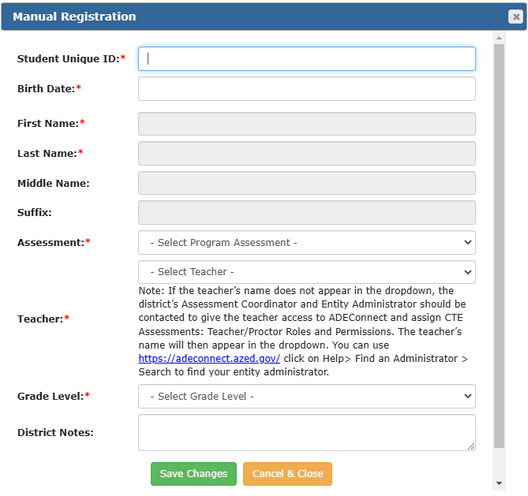
Manual Registration Process
Go
  Go to Registration tab and choose “Manual Registration”
Enter
  Enter the Student Unique ID (SAIS ID) and Birthdate
View
  First, Last, and Middle Name fields will populate. Note: Student information, including special populations, syncs with CTE’s Data Portal
Click
  Click dropdown boxes on all other fields
Save
  Click “Save Changes”
  If nothing happens, check these things:
    A skipped field will highlight
    No selection was made in a dropdown box
Correct
  Make corrections and click “Save Changes”
VIDEO: How to Manually Register One Student
Arizona Department of Education, Career and Technical Education
Page 7

Slide 8
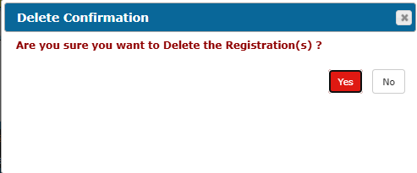
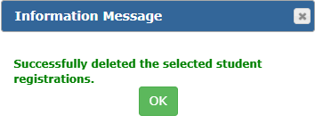
How to Delete Student Registration
  On the grid under your Registration tab, find the student row and click the box at beginning of row
    Row will highlight in yellow
    You can select multiple students
Find
Click the “Delete Selected” link
Delete
Pop-up window will appear; click the red “Yes” button under Delete Confirmation; click the green “OK” under Information Message
Click
On the Registration tab, student(s) will be deleted from the registration
Return/
Check
VIDEO: Delete a Single Student Record
Arizona Department of Education, Career and Technical Education
Page 8

Slide 9
Once the student(s) have been registered, the next step is adding the student(s) to a roster. Once added to a roster, you will find the student login information for their TSA on the roster.
FYI
Arizona Department of Education, Career and Technical Education
Page 9

Slide 10
+
Questions?
CTE Technical Skills Assessments Overview Guide
TSA Troubleshooting Guide
Assessment Helpline: 602-542-5452
Email: CTEAssessmentHelp@azed.gov
+
Arizona Department of Education, Career and Technical Education
Page 10

