Slide 1


+
How to Use the Change Request Tab for the CTE Technical Skills Assessment
+
Arizona Department of Education, Career and Technical Education

Slide 2
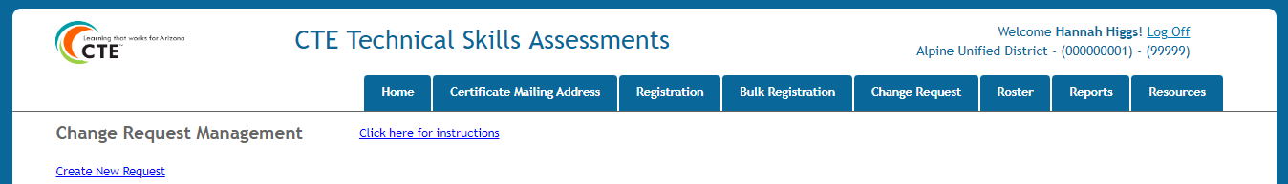
How to Access the Change Request Tab
Go to the ADEConnect Portal at https://adeconnect.azed.gov/
Click on “CTE Technical Skills Assessments” application
Select the Bulk Registration tab
Change Request Tab
Arizona Department of Education, Career and Technical Education
Page 2

Slide 3
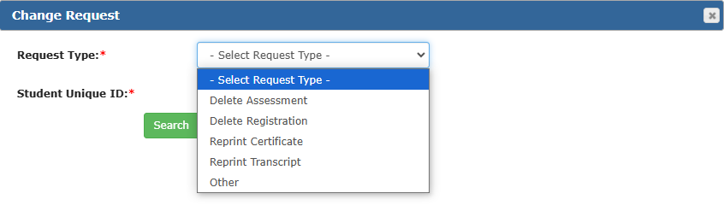
Change Request Options
The Change Request Tab is available to electronically request items related to the CTE Technical Skills Assessments. In the Request Type dropdown list, there are 5 options from which to choose.
Delete Assessment: Request to delete a student’s assessment score due to retesting or if a student is caught cheating. Provide details in the Justification box.
Delete Registration: Request to delete a student’s registration from a previous school year.
Reprint Certificate: Request a copy of an earned TSA certificate. Please include mailing address (no PO boxes) in the Justification box.
Reprint Transcript: Request a copy of the transcript listing the standards learned in the program in which the student passed their TSA. Please include mailing address (no PO boxes) in the Justification box.
Other: Contact us at 602-542-5452 or CTEAssessmentHelp@azed.gov.
Arizona Department of Education, Career and Technical Education
Page 3

Slide 4
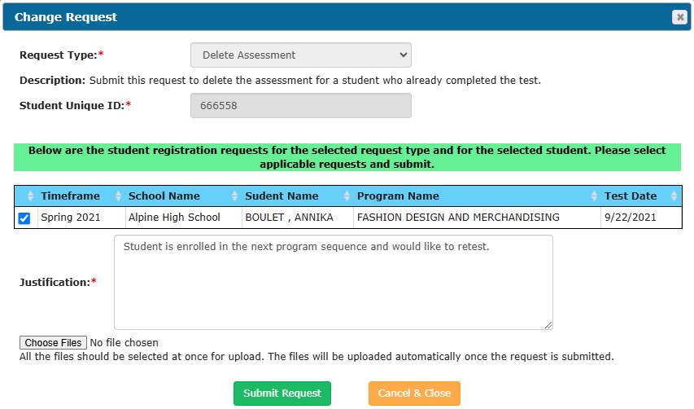
Go to the ADEConnect Portal at https://adeconnect.azed.gov/, click on “CTE Technical Skills Assessments” application, then click on the Change Request tab
How to Use the Change Request Tab
Go
12345678
Click on the “Create New Request” link; Change Request pop-up screen will appear
Click
Click the dropdown menu and choose the Request Type, i.e., Delete Assessment, Delete Registration, Reprint Certificate, Reprint Transcript, and Other
Adams , Annie
Select
Enter the Student Unique ID (SAIS ID); Click on the “Search” button (Change Request screen updates)
Enter
Verify grayed-out Request Type and Student Unique ID. Information is displayed below the green bar. Click in the box located at beginning of student row. In the Justification box, type in reason for request and/or additional information (i.e., student’s IEP allows retesting, registered for incorrect assessment, mailing address (no PO boxes), etc.). Upload any supporting documents. Click “Submit Request” button. You will be returned to the Change Request Management screen. Click on “View” by student name to see the pending change
Enter
Your Change Request will be reviewed by ADE CTE’s Assessment Program Specialist. You will receive a notification email when it’s approved/rejected
Notification
VIDEO: How to Use the Change Request Tab
Arizona Department of Education, Career and Technical Education
Page 4

Slide 5
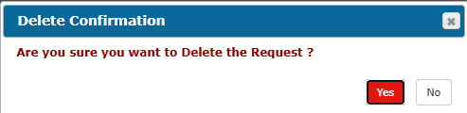
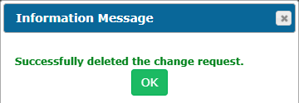
How to Delete a Change Request
  On the grid under your Change Request tab, find the student row of the pending request
Find
Click the “Delete” link at beginning of row
Delete
12345678
Adams , Annie
Pop-up window will appear; click the red “Yes” button under Delete Confirmation; click the green “OK” under Information Message
Click
On the Change Request tab, the request will be deleted from the grid
Return/
Check
Arizona Department of Education, Career and Technical Education
Page 5

Slide 6
+
Questions?
CTE Technical Skills Assessments Overview Guide
TSA Troubleshooting Guide
Assessment Helpline: 602-542-5452
Email: CTEAssessmentHelp@azed.gov
+
Arizona Department of Education, Career and Technical Education
Page 6

