Slide 1


For
Managing Day-to-Day
Equitable Services Programs on Behalf of LEAs

Slide 2


Session Objectives
Learning Goal:
Participants will be able to implement equitable services for all required ESEA programs on behalf of LEAs.
Success Criteria:
Participants will understand the requirements LEAs have regarding grants, procurement, and equitable services.
Participants will understand the process of ongoing consultation and the required components of equitable service programs.
Participants will understand funding allowability under each program.
Participants will understand how pooling can be implemented within and across LEAs.

Slide 3
What do you know? T/F
Private schools have the option to choose which vendor they would like to use for equitable services.
The rate LEAs pay for equitable services is up to the vendor chosen.
The private school must provide the same services that the LEA provides (“equitable” services).
The sole purchase of materials or a program, such as IXL, is allowable for Title I-A.
Private schools own all materials purchased by ESEA grant funds.
Private schools are allowed to decline the use of funds for family engagement for LEA grant awards over $500,000.00.
Family engagement activities may be used for schoolwide events at private schools.
The purchase of an online subscription software that has both secular and non-secular content is not allowable and may not be prorated.
Once a prorated amount is determined, it is only applied to the private school’s conference registration
An LEA may not wait to receive director approval before beginning programs at private schools.
The LEA may not determine how many times the private school revises their plan.
Students who qualified for funding are the same students who are eligible to receive services in ESEA programs.
The private school may not change their intervention groups once the year begins.
Title I-A funds must only be used on instructional services.
All staff funded through ESEA must be appropriately certified.
A service provider may receive planning time to prepare for Title I-A, I-C, III-A, or IV-A instruction as applicable.

Slide 4
What do you know? T/F
Private schools have the option to choose which vendor they would like to use for equitable services.
False – LEAs have the final say in all decisions. LEAs may have a contract with one vendor and must follow their procurement rules.
The rate LEAs pay for equitable services is up to the vendor chosen.
False – Activities paid using grant funds must be necessary, reasonable, and allocable. The rate must be the most prudent rate/fair market rate available.
The private school must provide the same services that the LEA provides (“equitable” services).
False – services are determined based on need and needs of a private school may be different.
The sole purchase of materials or a program, such as IXL, is allowable for Title I-A.
False – The purchase of materials alone does not meet the requirement under Title I-A. (This is allowed under Title III-A.)
Private schools own all materials purchased by ESEA grant funds.
False – LEAs maintain control of funds including title to all materials. LEAs follow their internal inventory controls.
Private schools are allowed to decline the use of funds for family engagement for LEA grant awards over $500,000.00.
False – It is the LEA’s responsibility to ensure that family engagement funds are properly expended for grants over $500,000.00.
Family engagement activities may be used for schoolwide events at private schools.
False – These activities are for parents/families of eligible students only.
The purchase of an online subscription software that has both secular and non-secular content is not allowable and may not be prorated.
True – The LEA cannot guarantee that the non-secular content will not be accessed.
Once a prorated amount is determined, it is only applied to the private school’s conference registration.
False – The prorated percentage will be applied to everything being funded such as travel, per diem, incidentals.
An LEA may not wait to receive director approval before beginning programs at private schools.
True – The LEA may not impede services due to internal policies or procedures.
The LEA may not determine how many times the private school revises their plan.
True – Private schools must have the opportunity to change plans and continue services throughout the entire funding period.
Students who qualified for funding are the same students who are eligible to receive services in ESEA programs.
False – Funding is based on prior year data. Services are based on currently enrolled students. Each program has different service criteria.
The private school may not change their intervention groups once the year begins.
False – Students may and should move in and out of groups all year long. Their eligibility must be verified prior to receiving services.
Title I-A funds must only be used on instructional services.
False – Funds may also be used for professional development for teachers of eligible students.
All staff funded through ESEA must be appropriately certified.
True and False – If staff are employees of the LEA, they must meet state certification requirements for the LEA. If staff are contracted employees or employed by a third party, they must meet state certification requirements for private schools. Arizona does not have state certification requirements for private schools.
A service provider may receive planning time to prepare for Title I-A, I-C, III-A, or IV-A instruction as applicable.
True – This is allowable and should be a regular part of the plan to allow teachers to be fully prepared. They should also be meeting with the child’s teacher.

Slide 5
Setting the Stage
C-23. May an LEA or a third-party contractor employ a private school teacher to provide services under a covered ESEA program to eligible private school children and educators?
Yes, provided certain conditions are met…..
Past Consortium – NOT ALLOWED
Who reaps the Benefits?
  ...at the District Level?
  ...at the Private School Level?
  ...at the Student Level?
  …vendors?

Slide 6
Independent Contractor
Providers must be independent of the private school and the employment or contract must be under the control and supervision of the LEA
LEAs may contract with individuals in public and private agencies, organizations, and institutions
LEAs remains responsible for oversight
ESEA section 1117(d)(2)

Slide 7
Background/Understanding
Public Procurement
Driven by government entities
Limitations to flexibility in spending and methods of spending
Must be transparent: regulation & reporting
Prudent
Approved Vendor/Contract
LEAs must follow state procurement rules
Approved vendor up to $10,000 aggregate value
*EANS – most were sole source due to nature of the fund (one supplier/unique capability to meet requirements of the entity/requires specific justification)
https://spointra.az.gov/resources/procurement-regulations

Slide 8
Background/Understanding
Request for Quotation (RFQ)
Request sent to suppliers with description & other information of the product, solution, and/or service needed
Predetermined due date
Exceed $10,000 but less than $100,000
Evaluation/Recommendation for award:
Best price (IFB – invitation for bid/competitive sealed bid)
Quality
Delivery
Service
Past performance
Reliability

Slide 9
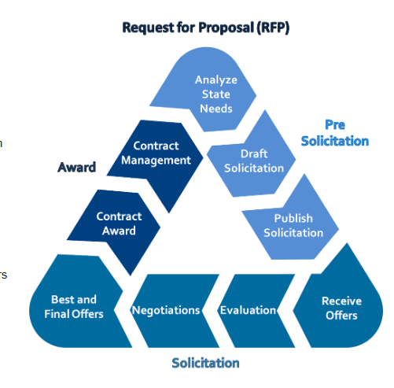
Background/Understanding
Request for Proposal (RFP)
Solicitation bid for product, solution, and/or service
$100,000 or greater in aggregate value
Typically, best value/lowest bid (State seeks best/lowest)

Slide 10
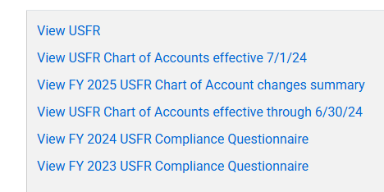
Background/Understanding
Uniform System of Financial Records for Arizona School Districts
Statewide framework governed by the Arizona Auditor General’s Office
Logical framework used to determine where monies originate and how they are used
Reduces burden in preparing financial reports
USFR Chart of Accounts – updated annually
  Use applicable year
  Recommend online
https://www.azauditor.gov/resources/school-districts/manuals-memorandums

Slide 11
Background/Understanding
Account Code Structure
LEAs have internal roll up codes that pertain to their LEAs
Fund (ex: Title I-A)
Program (ex: Regular education)
Function (ex: Instruction)
Object (ex: Purchased professional service)
Unit (ex: school number)

Slide 12
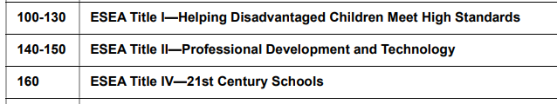
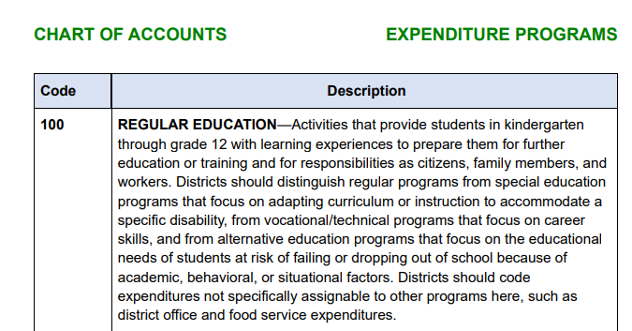
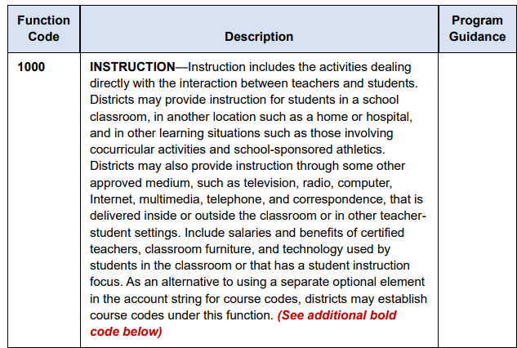
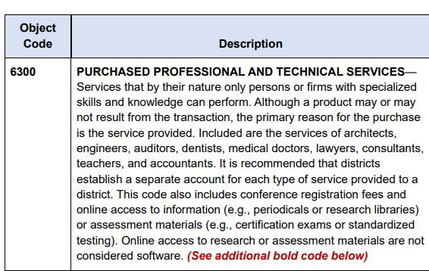
Background/Understanding
Fund Program
Function
Object

Slide 13
Background/Understanding
Title I-A tutoring services using a 3rd party for a school with unit number 231: 100-100-1000-6300-231
Fund: 100
Program: 100
Function: 1000
Object: 1000
Unit: 231
Title II-A professional development for instructional staff?
Travel?
Equipment/supplies?

Slide 14
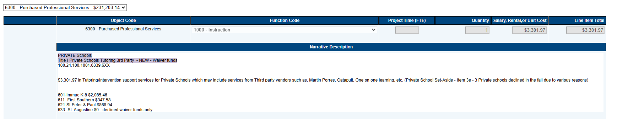
Background/Understanding
Funding Codes in the Grants
Function
Object
How can knowing the coding framework help you?

Slide 15
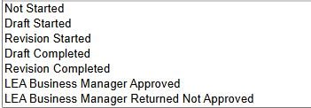
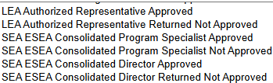

Background/Understanding
Grant Cycles
Allocation
Substantial Approval
Obligate funds
Director Approval
Reimbursement Requests (draw-downs)
Revision
Repeat

Slide 16
Background/Understanding
Grant Deadlines
Due May 1
  Title IV-B May 3
Project Start Date July 1
Project End Date September 30
FY26 Title I-A
August 18, 2025 - submit or forfeit
September 29, 2025 - Director approval or forfeit
What is needed from Private Schools for Submission?
Data returned with Notice of Intent to Participate
Yearlong plan (budgeted activities)
*if an LEA chooses to use a 3rd party to do it all, this step is not needed for grant
approval
*everything will be coded: 6300-1000 and/or 6300-2100/2300

Slide 17
Required Programs
*Private schools must be nonprofit (PNP)
Title I, Part A equitable services are governed under ESEA section 1117 and 8501
ESEA, Title VIII equitable services provisions cover the following programs:
Title I, Part C - Education of Migratory Children
Title II, Part A - Supporting Effective Instruction
Title III, Part A - English Language Acquisition, Language Enhancement, & Academic Achievement
Title IV, Part A - Student Support and Academic Enrichment
Title IV, Part B - 21st Century Community Learning Centers
Title IV, Part F - Project School Emergency Response to Violence (Project Serve)

Slide 18
Required Programs
Grant Names in Grants Management Enterprise
Titles I-A, II-A, & IV-A: ESEA Consolidated
Title III-A: Title III LEP, Title III Consortium, & Emergency Immigrant Education Program
Title I-C: Migrant Ed Basic Grant, & Migrant Ed Basic Consortium
Title IV-B: 21st CCLC (all)

Slide 19
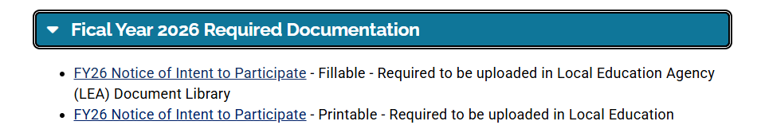
Required Components
Notice of Intent to Participate
*Begins the ongoing dialogue between LEA and private school
*Occurs annually (required annually for in-district)
*Most LEAs begin in Jan/Feb
​
https://www.azed.gov/titlei/privateschools

Slide 20
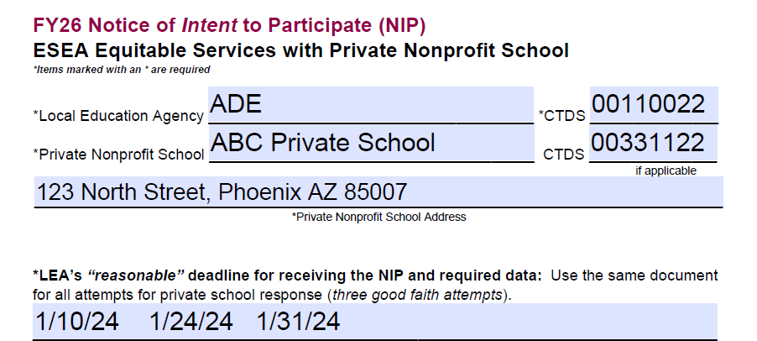
Notice of Intent to Participate (NIP)

Slide 21
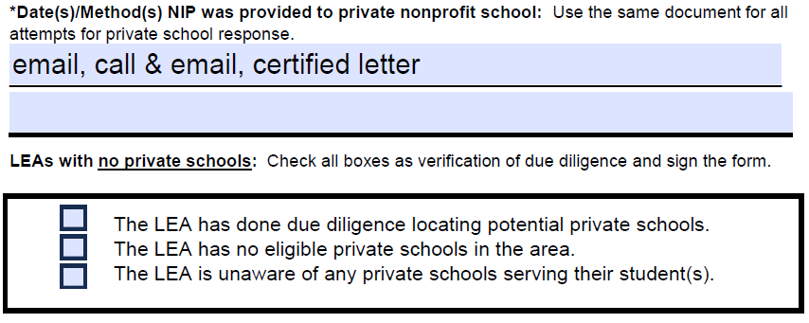
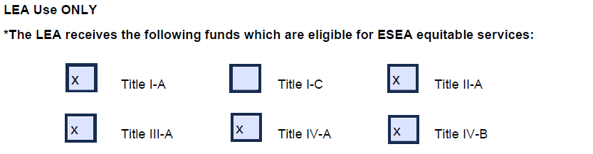
Notice of Intent to Participate (NIP)
transfers

Slide 22
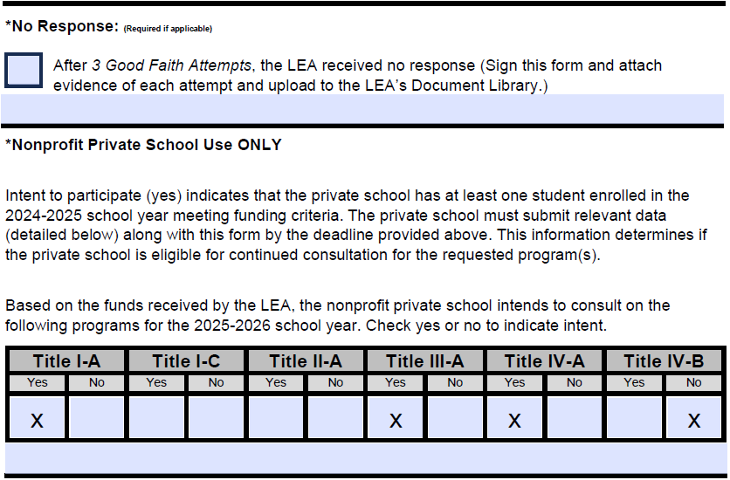
Notice of Intent to Participate (NIP)

Slide 23
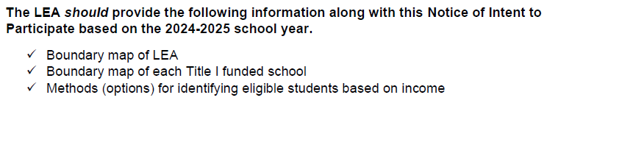
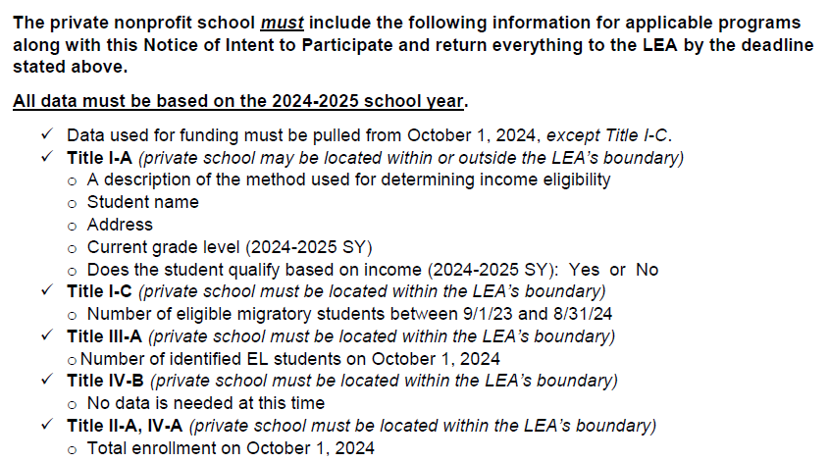
Notice of Intent to Participate (NIP)

Slide 24
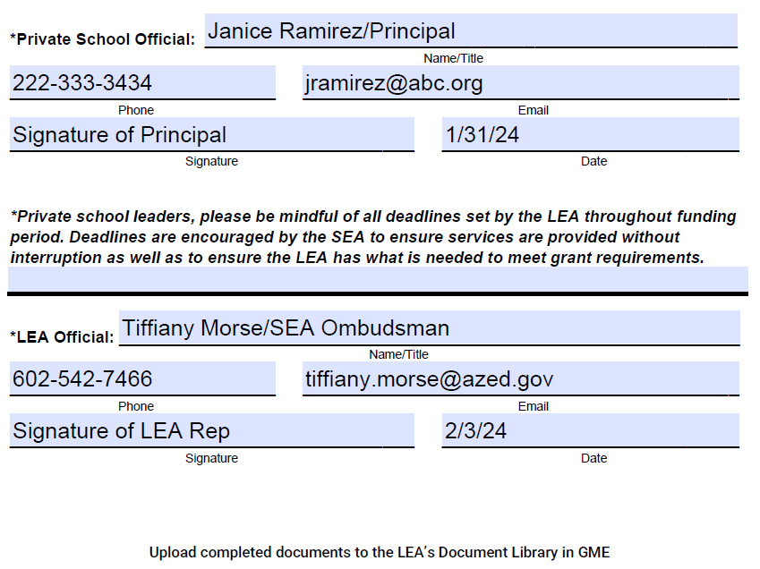
Notice of Intent to Participate (NIP)

Slide 25
Required Components
Data Used to Determine Equitable Share
Must be verified based on each program
  Title I-A: student address
  Title I-C: student names MIS2000
Add up the number of eligible LEA and private school students
Determine what percent of the total number of students are LEA students, and what percent of the total are private school students
Apply the percentage from step two to the allocation to determine how much of the total is the LEA’s share, and how much is the private school’s share
  The private school’s percentage is called the proportionate share
Divide the number of eligible private school students by the private school share to get the private school PPA
Multiply that PPA times the number of eligible students at each participating school (school’s equitable share)
*Data is not the same as what is used for determining service eligibility

Slide 26
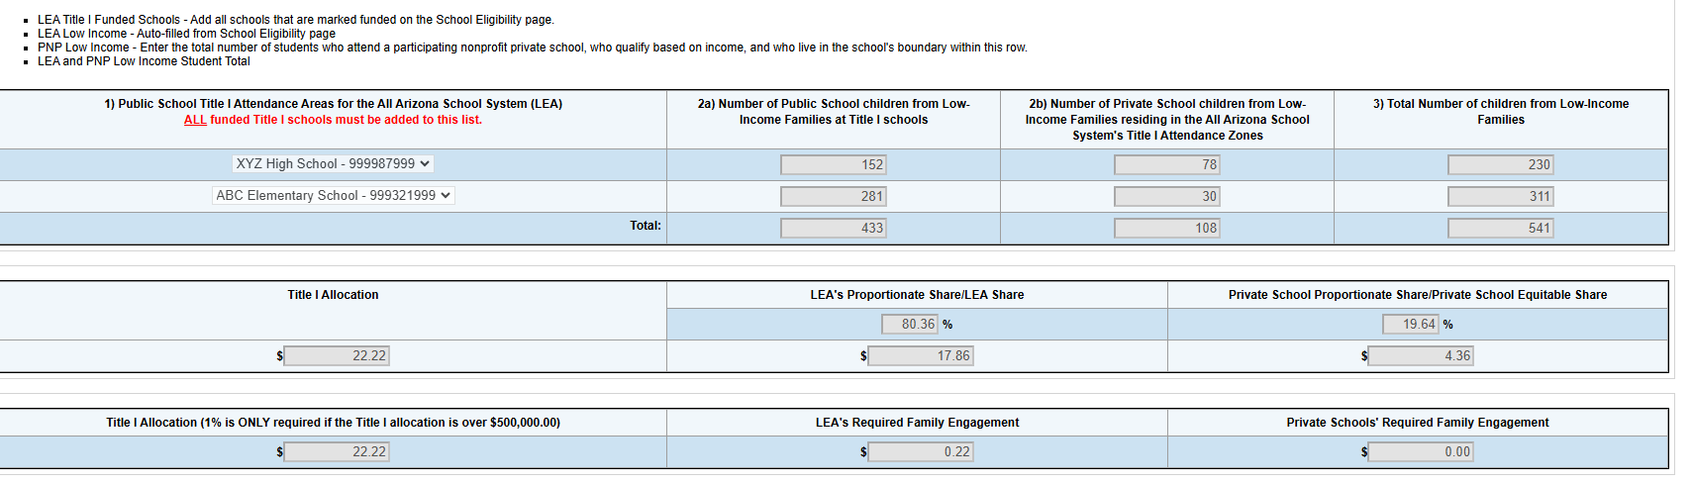
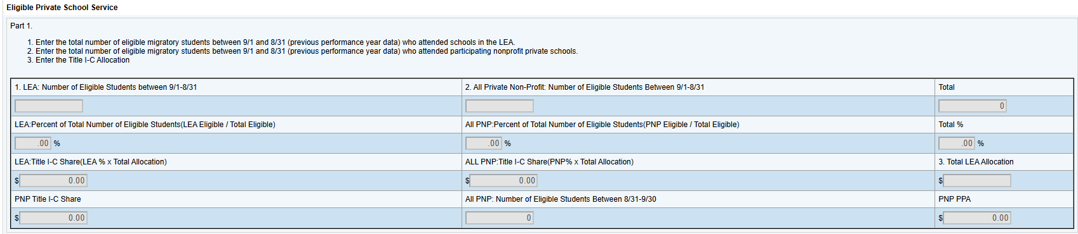
Required Components

Slide 27
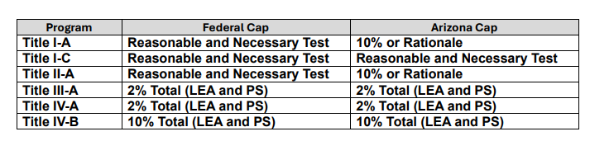
Required Components
ADE Equitable Service Administrative Cost Guidance
Policy: The preponderance of equitable service funds must be allocated to provide equitable services respective to each Title program. Administrative costs must be reasonable and necessary, and only a minor amount of funds may be dedicated to this function, which ensures the efficient performance of the grant award. LEAs requesting more than 10% of the proportionate share for equitable service administrative costs for Title I-A or Title II-A must demonstrate an administrative burden above and beyond the standard administration of the Title program, and of equitable services within the grant.

Slide 28
Timely and Meaningful Consultation
Timely
all parties must have adequate notice or “time” to ensure they are prepared to make informed decisions
early enough so that services begin at the start of the year or the start of the funding period
Meaningful
all parties must have an opportunity to share visions and consider all viewpoints in the process
must continue throughout the funding period and does not end until the program has been evaluated
*An offer of services by an LEA without an opportunity for timely and
meaningful consultation with private school officials does not meet the
requirement of the law.
ESEA sections 1117(b)(3) and 8501(c)(3)

Slide 29
Timely and Meaningful Consultation
Eligibility
K-12 nonprofit private schools operating in accordance with state laws regarding private schools
Title I-A: students must live in a public district Title I-A funded school boundary and qualify based on income
Title VIII: private nonprofit address must be located in the boundary of a federally funded LEA
Private School Leaders
Determine the home school/district for all students
Locate contact information for each of those LEAs
Reach out to those LEAs (the Federal Programs Director/oversight of Title programs) and notify them that the PNP would like to consult on equitable services

Slide 30
Ongoing Consultation
Continuous Alignment
Budget reconciliation
Data collection
Revising plan/adapting program(s)
*Waiting on grant approval is not allowed (*won’t be an issue if LEA chooses to use a 3rd party to do it all)
Revolving participant eligibility data
*Develop a procedure for new students and collecting data
**Resource: Sample Timeline

Slide 31
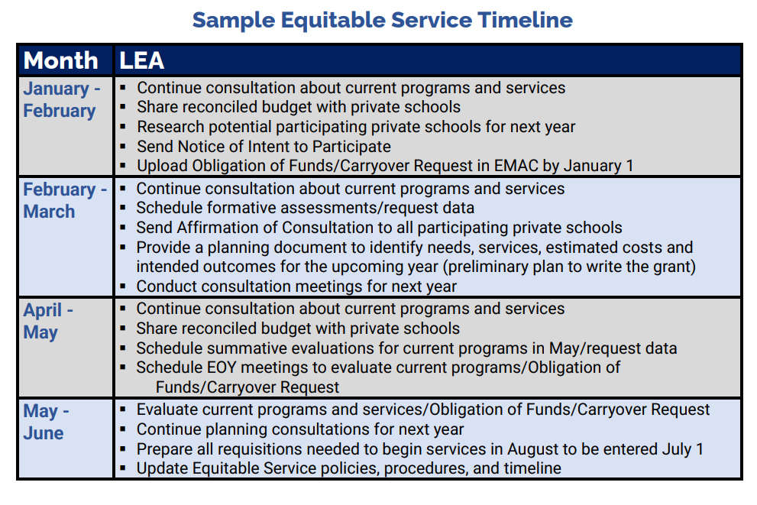
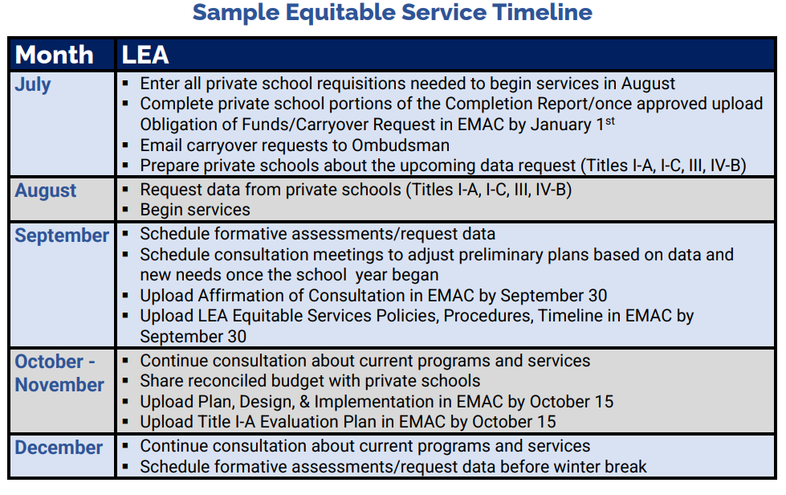
Ongoing Consultation

Slide 32
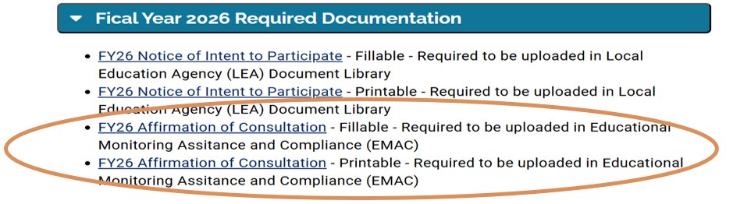
Required Components
AOC Highlights:
Required according to statute
Only private schools that responded with verifiable data with their NIP
Include consultation topics discussed between LEA and private school
Required for Equitable Service Monitoring by September 30
Equitable share
Family engagement equitable share

Slide 33
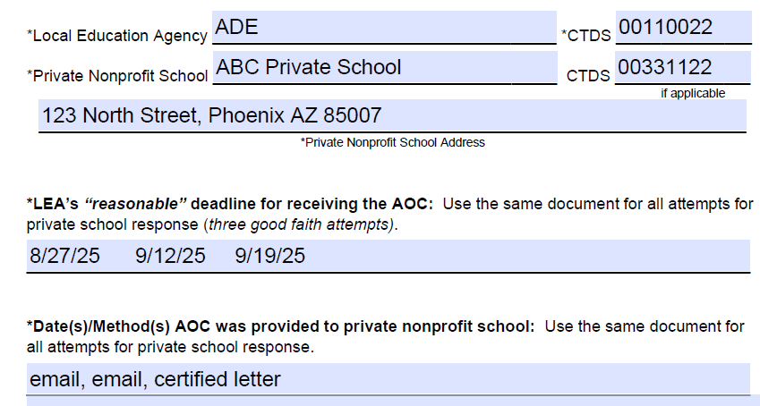
Affirmation of Consultation (AOC)
Affirmation of Consultation Practice: Required fields are marked with an *

Slide 34
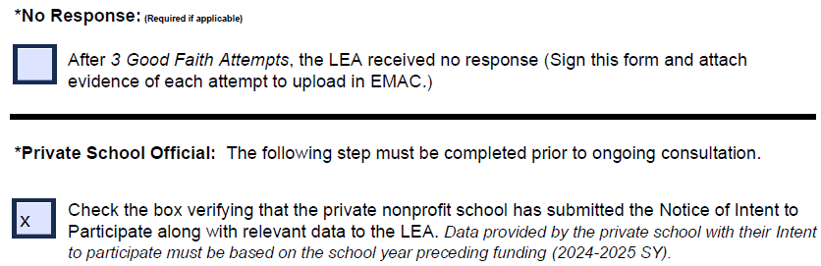
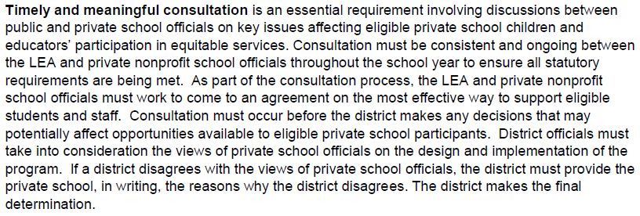
Affirmation of Consultation (AOC)

Slide 35
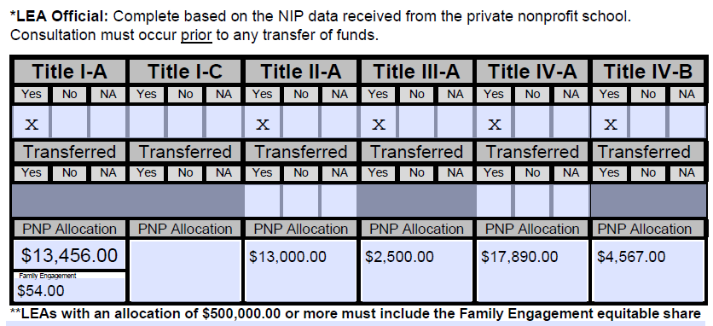
Affirmation of Consultation (AOC)

Slide 36
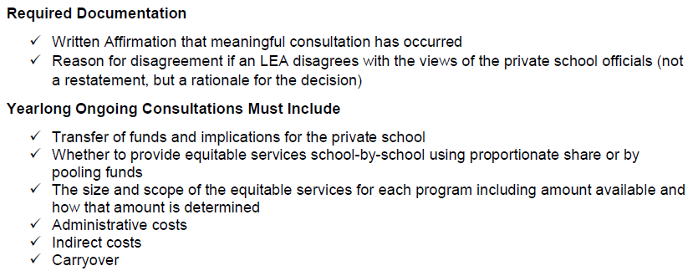
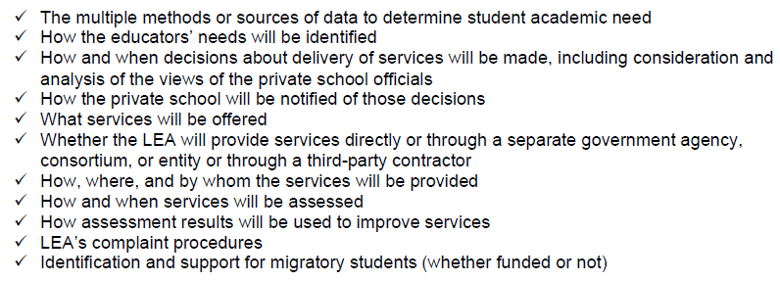
Affirmation of Consultation (AOC)

Slide 37
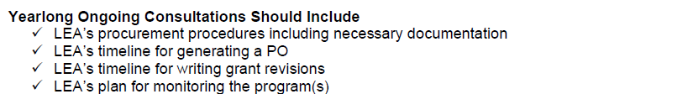
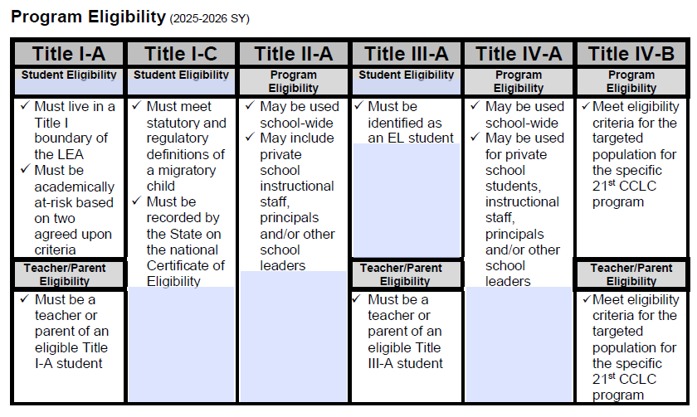
Affirmation of Consultation (AOC)

Slide 38
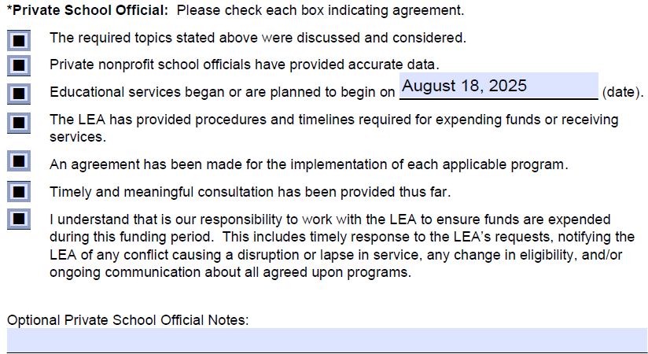
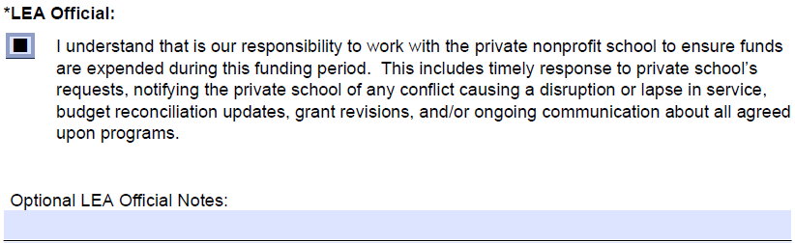
Affirmation of Consultation (AOC)

Slide 39
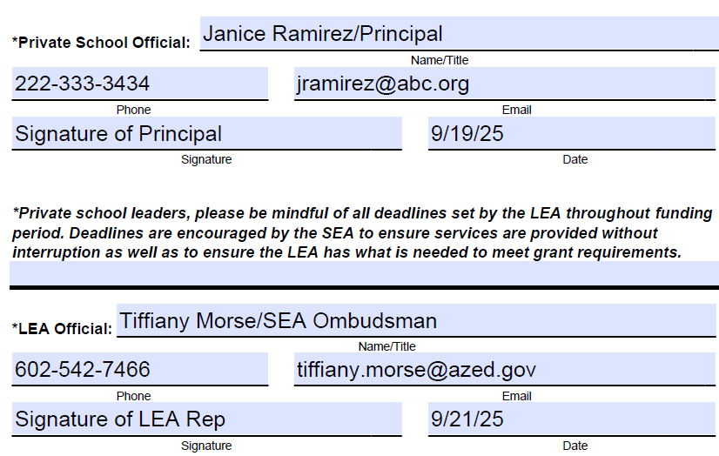
Affirmation of Consultation (AOC)

Slide 40
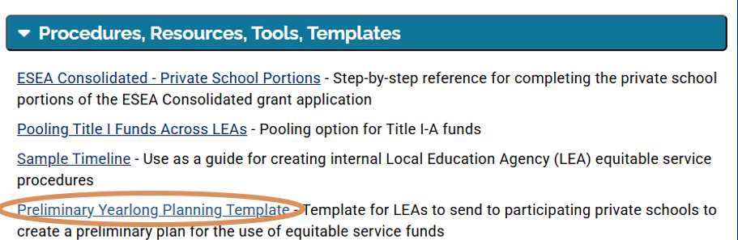
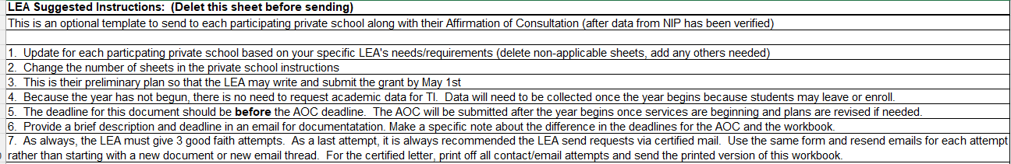
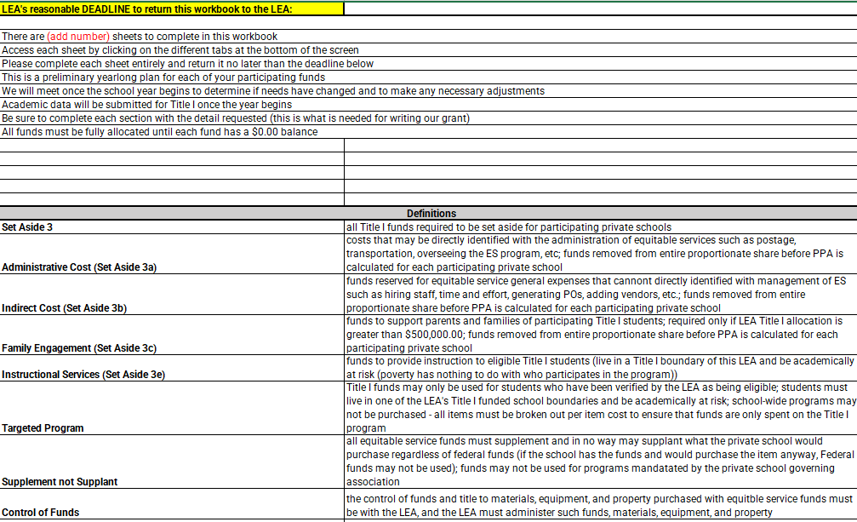
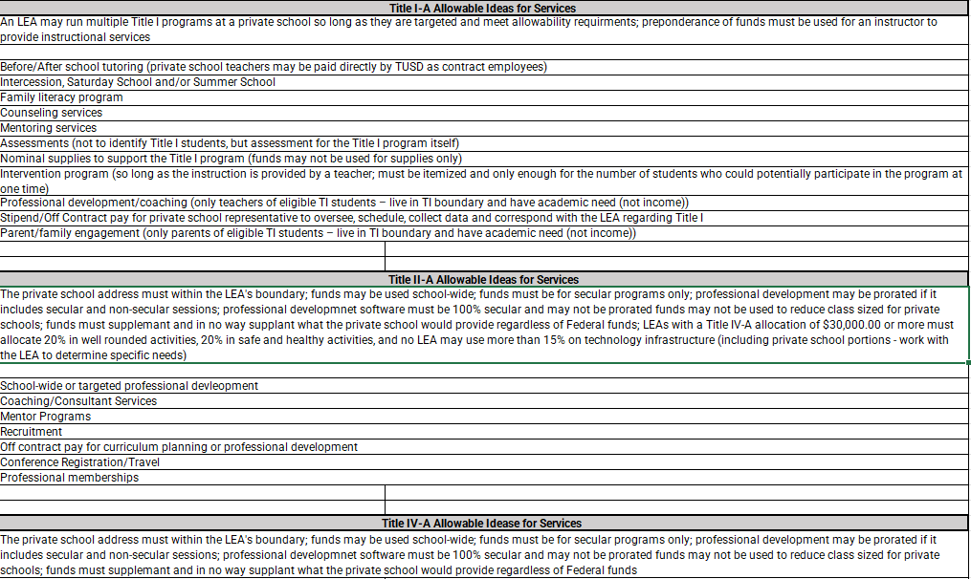
Yearlong Planning

Slide 41
New Data
Data for Services
Collected once the year begins and ongoing
Students may move in and out of the program as long as they are eligible
  Title I-A: live in a Title I-A funded boundary, evidence of need established (income has nothing to do with receiving services)
  Title I-C: verified in MIS2000
  Title III-A: eligible EL
Students must be verified BEFORE receiving services

Slide 42
Required Components
ESEA Requires LEAs to Evaluate Equitable Service Programs
Were services provided?
Were services timely?
Were services equitable?
Does the data demonstrate effectiveness?
If not, how will the plan be revised?
*Both parties must be involved throughout the entire funding
period for a program to be effective.

Slide 43
Required Components
Carryover
Entitlement funds are meant to be used in the year appropriated.
Reserving large sums eliminates opportunities for other public and private school participants with needs.
Equitable service carryover should be rare and minimal.
The approved carryover funds must be used by the end of this funding period along with the current year allocation.
ESEA sections 1117(a)(4)(B) and 8501(a)(4)(B)
Rare
Reasonable deadlines are highly recommended
High reservation of funds eliminates opportunities for remaining students (public and private)
Federal funds expire (must be returned to the federal government)
Demonstrates lack of need = appropriation decreases
Title I-A: redistribute to remaining participating school
Title VIII: redistribute to both LEA and PNP participating schools

Slide 44
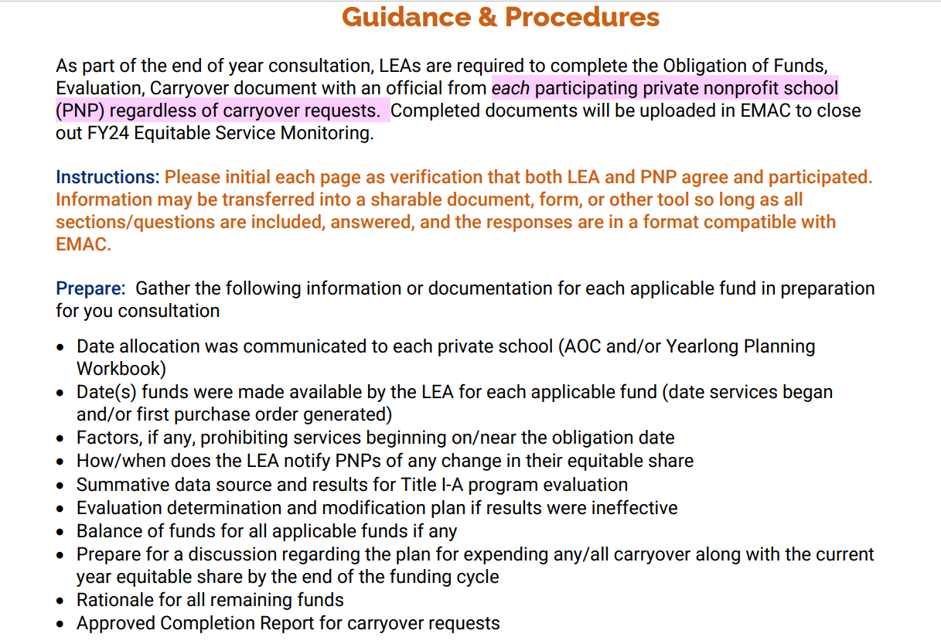
FY24 Obligation of Funds, Evaluation, & Carryover

Slide 45
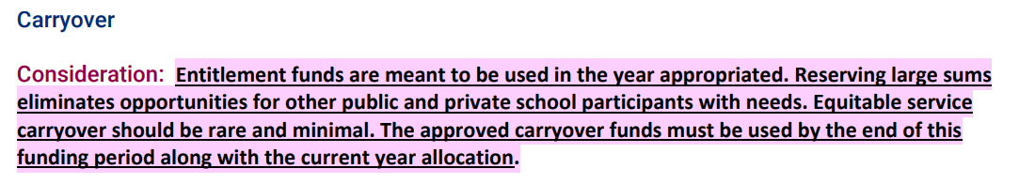
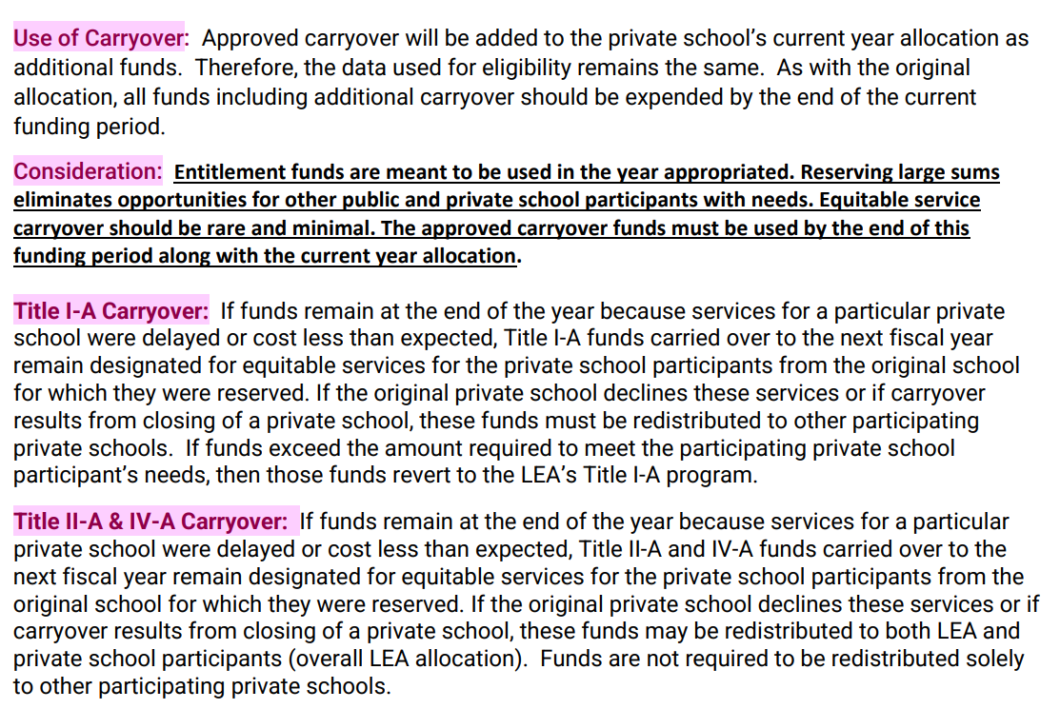
FY24 Obligation of Funds, Evaluation, & Carryover

Slide 46
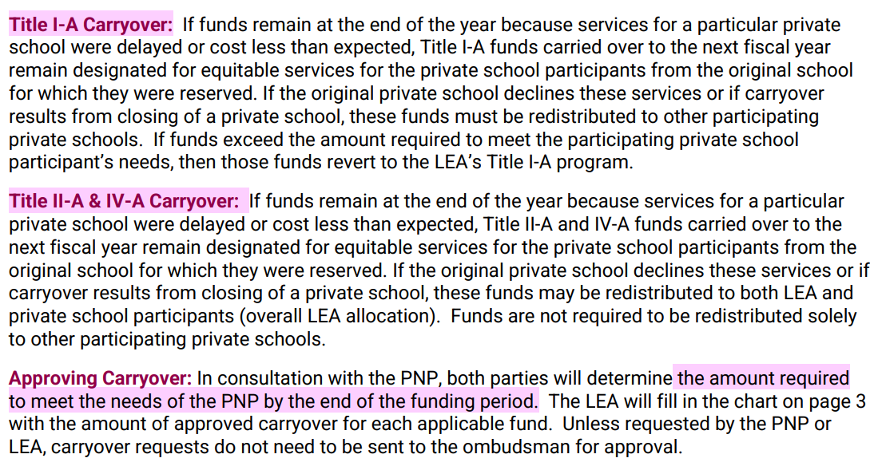
FY24 Obligation of Funds, Evaluation, & Carryover

Slide 47
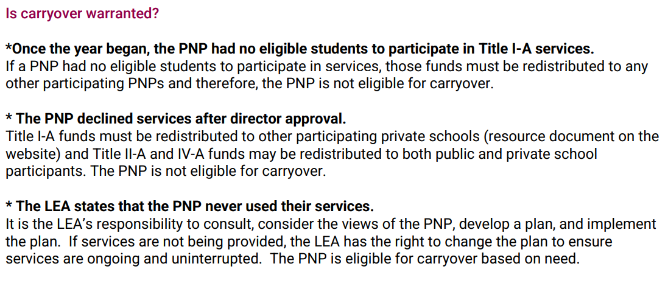
FY24 Obligation of Funds, Evaluation, & Carryover

Slide 48
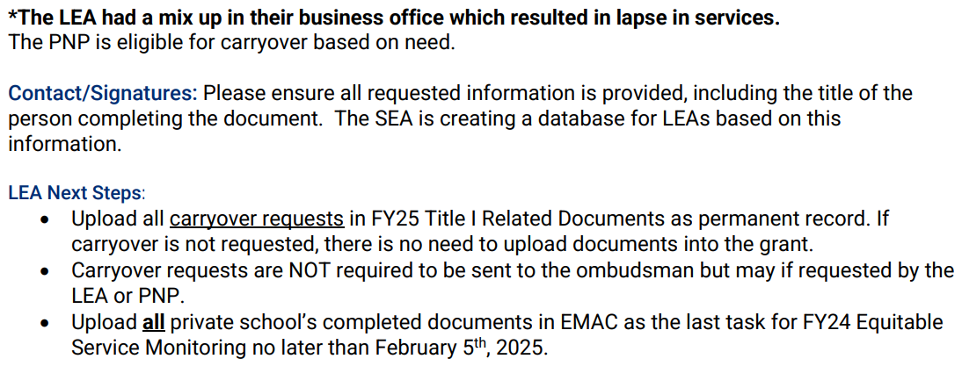
FY24 Obligation of Funds, Evaluation, & Carryover

Slide 49
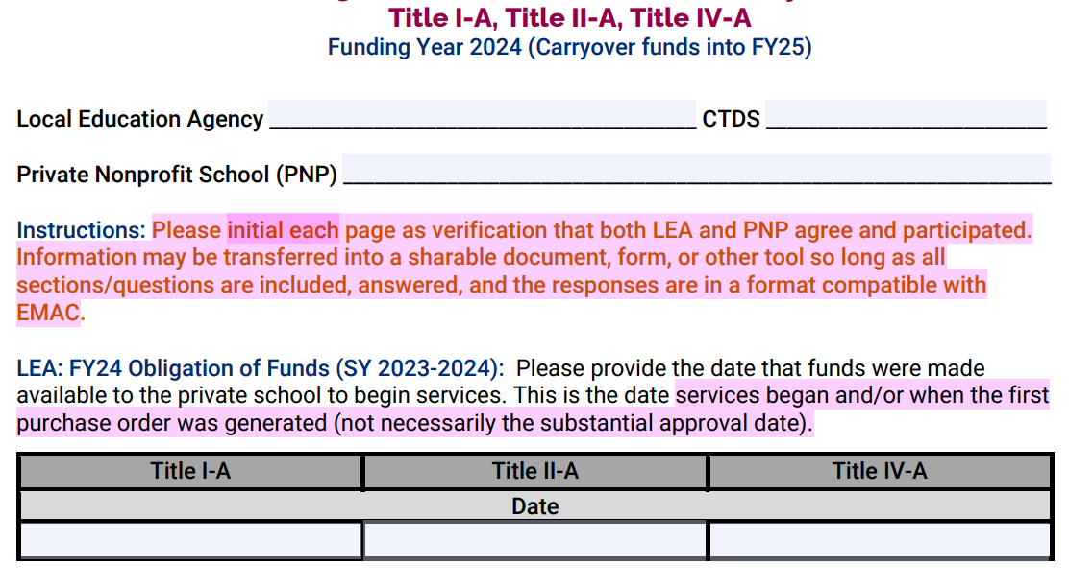
FY24 Obligation of Funds, Evaluation, & Carryover

Slide 50
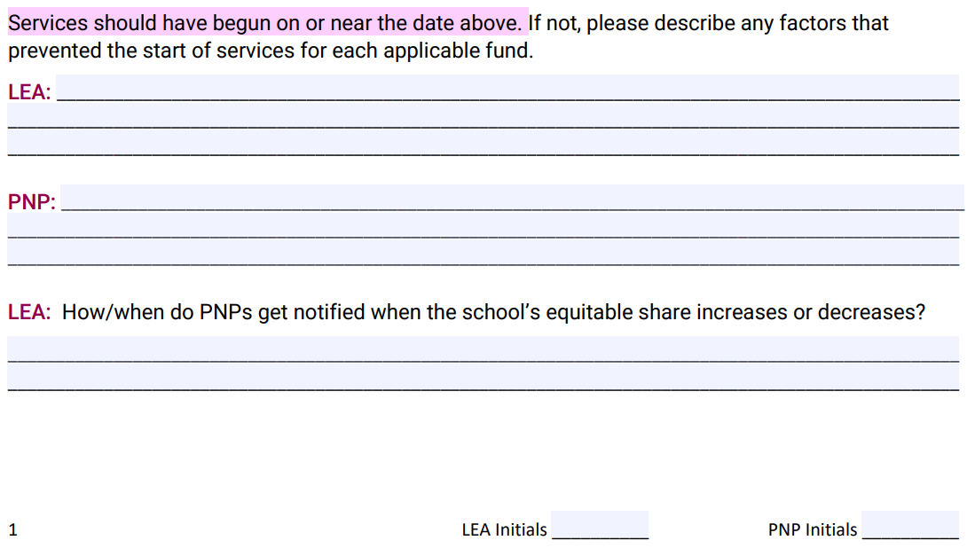
FY24 Obligation of Funds, Evaluation, & Carryover

Slide 51
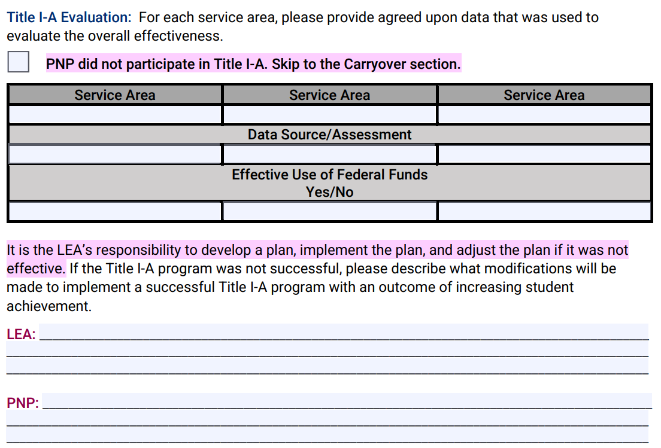
FY24 Obligation of Funds, Evaluation, & Carryover

Slide 52
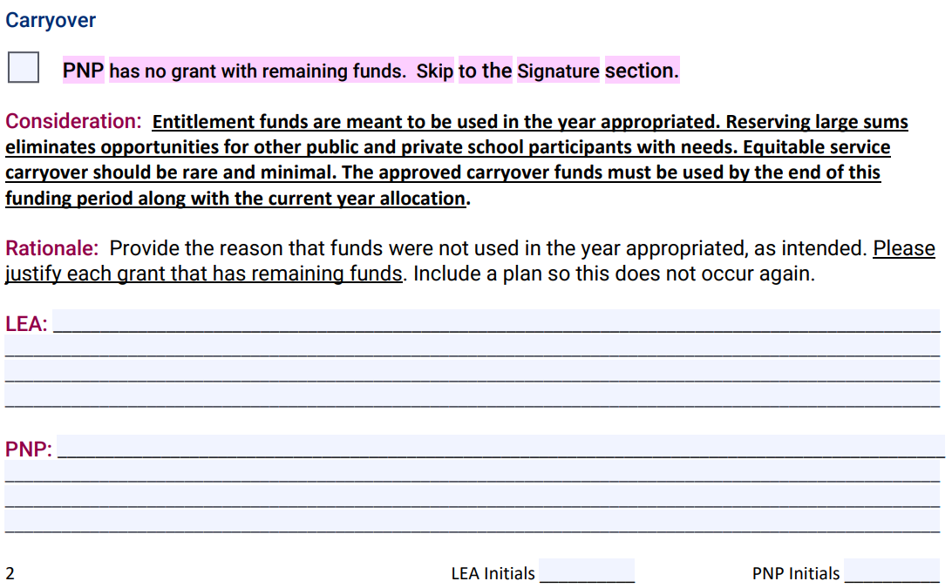
FY24 Obligation of Funds, Evaluation, & Carryover

Slide 53
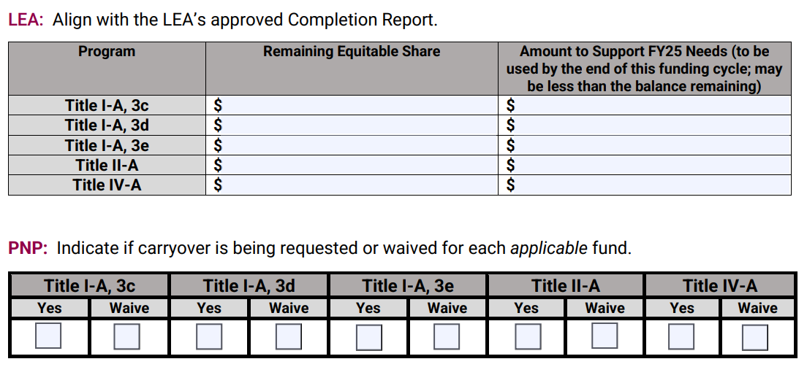
FY24 Obligation of Funds, Evaluation, & Carryover

Slide 54
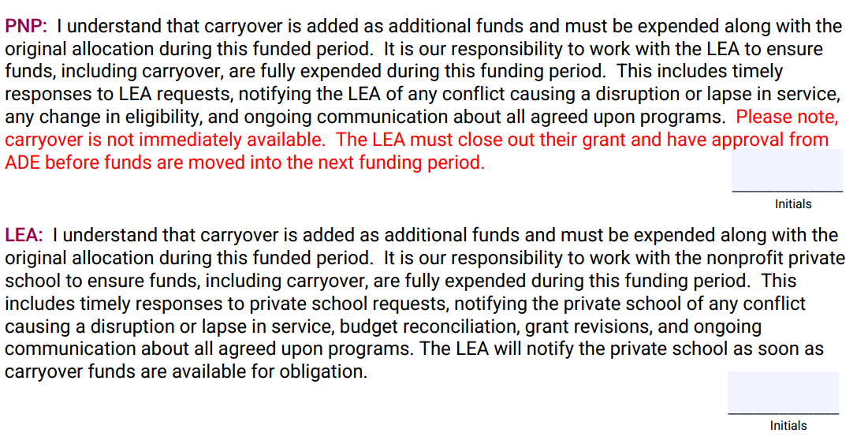
FY24 Obligation of Funds, Evaluation, & Carryover

Slide 55

FY24 Obligation of Funds, Evaluation, & Carryover

Slide 56

FY24 Obligation of Funds, Evaluation, & Carryover

Slide 57
Required Components
Private school officials, or any interested party, have the right to file a formal written complaint with an SEA if they believe that timely and meaningful consultation has not occurred, the LEA did not give due consideration to the views of the private school officials, or that equitable services have not been provided.
ESEA sections 1117(b)(6) and 8501(c)(6)
To help ensure that private school children, teachers, and other educational personnel receive services equitable to those in public schools, an SEA must designate an ombudsman to monitor and enforce Title I and Title VIII equitable services requirements.
                ESEA Sections 1117(a)(3)(B) and 8501(a)(3)(B)
primary point of contact for addressing questions and concerns from private school officials and LEAs regarding the provision of ESEA equitable services
monitor and enforce the equitable services requirements under Title VIII and ESEA sections 1117 and 8501
serve as a general resource regarding equitable service requirements for both LEAs and private school officials
respond to and resolve any complaints regarding equitable services
*All disagreements between LEA and private school must be provided in writing

Slide 58
Program Oversight
The LEA must maintain control of federal funds including title to materials, equipment, and property.
Private nonprofits do not receive funds under ESEA
PNPs receive services procured through the LEA
The LEA obligates funds (make purchases) on behalf of the PNP
LEAs have varying procurement procedures
  The strictest policy prevails (local, state, federal)
  Must be communicated through consultation
ESEA sections 1117(d)(1) and 8501(d)(1)

Slide 59
Prorating Services
Funds may be braided across Federal programs if the activity is allowable under each fund
Invoicing must align to the LEA’s eligible participants only
When to prorate
When one service provider is providing services using multiple Federal funding sources
  Counseling using Title I-A and Title IV-A
When one provider is providing services to participants from multiple LEAs
  Small group Title I-A services with students who live in different LEA boundaries
When conferences contain both secular and non-secular content
  Federal funds may not be used for software, online access, or subscription-based access that contains non-secular content (the public entity cannot monitor/verify that only secular content will be accessed)
  Applies to all costs (registration, travel, per diem)
*Wouldn’t be as time consuming if the vendor implemented a system using the same statewide coding framework down to each student (attendance)
Prorating Services

Slide 60
Billing
Draw Downs Matter
Public control = monthly invoices
  LEA verify services are happening
  Allowability
  Data collection
State Coding Framework (reminder)
*Must include student name for funds requiring eligibility
*Itemize invoices
*Include all pertinent data (some LEAs request progress data)

Slide 61

Monitoring

Slide 62
Monitoring
Timeline and Procedure 9/30
Affirmation of Consultation 9/30
Program Evaluation and Carryover Form 2/5
Next Year at Minimum: (being updated for FY26)
Include all ESEA Programs
Method for tracking private schools for each LEA

Slide 63
Services
Based on need
Equitable Equal
  Subjects do not have to be the same
  Rank and serve does not have to be the same
As long as it is the activity is targeted, supplemental, and allowable under that fund, it is allowable (if it is allowable for the LEA, it is allowable for the private school under certain conditions).

Slide 64
Supplement not Supplant
Identify the Difference ​
Supplanting is always the presumption
Federal funds must add to (or supplement) and not replace (or supplant) other funds in providing general educational services
Funds may not benefit the private nonprofit school or be applied to general needs as a whole
Funds must supplement what a private school participants would receive without federal funds
Inquire
Are any of the services required under applicable (to private schools) state law or local policy?
Were local funds used in the prior school year to provide any of the services which are currently being requested using federal funds?
Are any of the same services to students participating in a program funded by federal dollars also being provided to non-participating students using local funds?

Slide 65
Title I-A Equitable Share vs. Program Participation
Equitable Share = Student who lives in a Title I-A funded boundary (public LEA) + qualifies based on income
Program Participation = Student who lives in a Title I-A funded boundary (public LEA) + demonstrates an academic need
and/or
Staff who work directly with eligible Title I-A participants
and/or
Families of Title I-A participants
Common Misconception

Slide 66
Title I-A
Instructional services provided by public school employees, private school teachers, or third-party contractors
Intervention during the day/pull out program (not private school employee)
Before/after school programs
Tutoring
Summer school programs including scholarships for paid programs through the LEA
Family literacy programs (families of eligible Title I-A students)
Special Title I-A family events/conferences
Professional development (teacher of eligible Title I-A students)
Counseling programs
Mentoring programs
Computer- assisted instruction
Home tutoring
Any combination of the above

Slide 67
Title I-A Family Engagement Requirement
LEAs receiving a Title I allocation of $500,000 or more must reserve 1% of the total equitable share for Title I parent and family engagement activities
LEAs have the responsibility to ensure private schools provide family engagement activities
Activities may not be school-wide
Only families of eligible Title I students may participate
Family Engagement Activity Examples
Parent meetings
Parent-teacher conferences
Communication between the Title I teachers and parents on students’ academic progress
Parent education
Parent library
Parent training activities on how to work at home with children on content and skills
Reasonable access to Title I staff to receive information about their child’s progress
Private school parent representation on a district-wide private school working group
Light refreshments for parents and families at Title I meetings

Slide 68
Title I-C
All Title I-A allowable activities
Drop out prevention
Postsecondary entrance exams/prep/training for staff
Postsecondary exploration (field trips, camps, family training)
Record retrieval (school, immunization, etc.)
Medical treatments affecting school performance
Parent resource center
Parent classes (nutrition, parenting skills, basic literacy, etc.)

Slide 69
Title II-A
Professional development registration/travel
Coaching
Recruitment fairs/activities
Professional books
New teacher orientation

Slide 70
Title II-A Prorating Professional Development
Professional development must be secular, neutral, and nonideological
Prorating
Determine the number of sessions of the conference that provide secular, neutral, and nonideological professional development
Private school attendee provide LEA titles and descriptions of sessions they expect to attend
LEA determines the percentage of the attendee’s overall time spent attending secular sessions
Apply to both registration and travel costs
Upon return, private school attendee provide LEA with attendance of sessions attended
LEA adjust prorated amount if necessary
Online Subscription for Professional Development/Video Database of PD
May not fund if not fully secular, neutral, and non-ideological
no way to guarantee that the user is only accessing the secular content
Prorating is not allowed

Slide 71
Title III-A
​AZELLA​
Tutoring before, during, or after school ​
Professional development ​
Summer school programs ​
Administration of an ELP assessment for identification or evaluating services ​
Assessment materials, training, and pay to administer assessments​
​
Title III, Part A subgrant for immigrant children and youth ​
Tutorials ​
Mentoring ​
Academic or career counseling ​
Curricular materials, educational software, and technologies ​
Instructional services​
Literacy services for family of eligible ELs ​
Parent and family outreach and training activities for families of eligible ELs ​
Supplemental instructional materials and supplies

Slide 72
Title IV-A 20/20 Rule
​LEAs receiving $30,000.00 or more
Must allocate at least 20% on Well-Rounded Education
Must allocate at least 20% on Safe and Healthy Students
May not allocate more than 15% on technology infrastructure
LEA Activities + Equitable Service Activities = the Percentage Requirements

Slide 73
Title IV-A Well Rounded
​Improving access, instruction and/or engagement in:
  Foreign language
  Arts
  Music
  STEM
  STEAM
  American History/Civics/Government
  Geography
  Economics
  Environmental education
Supporting college and career counseling
FAFSA support for students and families
Advanced Placement (AP) and International Baccalaureate (IB) programs, dual or concurrent enrollment programs and early college high schools

Slide 74
Title IV-A Safe & Healthy
Community and parent involvement activities (braid with TI family eng.)
Mental health services and counseling
Promoting supportive school climates
Dropout prevention
Implementing programs that support a healthy, active lifestyle (nutritional and physical education)
Bully and harassment prevention programs
Establishing community partnerships
School safety
Internet safety
Transition programs

Slide 75
Title IV-A Effective Use of Technology
Professional Development
Blended learning projects
Assistive technology
Virtual reality gear
Digital literacy workshops for parents

Slide 76
Title IV-B
Academic enrichment
Mentoring programs
Tutoring
Literacy education programs
Programs supporting a healthy and active lifestyle
Drug and violence prevention programs
STEM
Programs supporting local workforce or build career building competencies
Career readiness programs
*Fees, materials, transportation, and access costs, etc.

Slide 77
Title IV-B
LEA/OEE must consult on the equitable participation of children attending private schools
An equitable share is calculated
The private school accesses the 21st Program at the LEA/OEE
  *Does not constitute a separate program
  *OEE-Other Eligible Entity

Slide 78
Pooling
Pooling within an LEA
Group of private schools (such as a group of schools under the authority of a single organization) pool funds generated in an LEA
Must establish criteria to determine the eligible private school students in greatest educational need to receive services
Services are based on educational need
MOU established by LEA in consultation

Slide 79
Pooling
Pooling Across LEAs
Must establish criteria to determine the eligible private school students in greatest educational need to receive services
Services are based on educational need
MOU established by LEA in consultation

Slide 80
What do you know? T/F
Private schools have the option to choose which vendor they would like to use for equitable services. F
The rate LEAs pay for equitable services is up to the vendor chosen. F
The private school must provide the same services that the LEA provides (“equitable” services). F
The sole purchase of materials or a program, such as IXL, is allowable for Title I-A. F
Private schools own all materials purchased by ESEA grant funds. F
Private schools are allowed to decline the use of funds for family engagement for LEA grant awards over $500,000.00. F
Family engagement activities may be used for schoolwide events at private schools. F
The purchase of an online subscription software that has both secular and non-secular content is not allowable and may not be prorated. T
Once a prorated amount is determined, it is only applied to the private school’s conference registration. F
An LEA may not wait to receive director approval before beginning programs at private schools. T
The LEA may not determine how many times the private school revises their plan. T
Students who qualified for funding are the same students who are eligible to receive services in ESEA programs. F
The private school may not change their intervention groups once the year begins. F
Title I-A funds must only be used on instructional services. F
All staff funded through ESEA must be appropriately certified. F
A service provider may receive planning time to prepare for Title I-A, I-C, III-A, or IV-A instruction as applicable. T

Slide 81

Equitable Service Office Hours
2nd Thursday of Every Month from 10:30-11:30

Slide 82
Resources
Arizona Department of Administration Procurement
https://spo.az.gov/
Auditor General’s Office USFR Chart of Accounts
https://www.azauditor.gov/resources/school-districts/manuals-memorandums
State of Arizona Accounting Manual (Travel 50/Max Reimbursement Rates)
https://gao.az.gov/state-arizona-accounting-manual-saam
Arizona Corporation Commission (nonprofit status of private schools)
https://ecorp.azcc.gov/EntitySearch/Index
ADE Private School Page
https://www.azed.gov/titlei/privateschools
Arizona Digital Educators Library
https://adel.azed.gov/home
U.S. Department of Education Office of Non-Public Education
https://www.ed.gov/birth-to-grade-12-education/alternatives-traditional-public-education/overview

Slide 83
Thank You
Nikole Fletcher
Equitable Service Specialist
nikole.fletcher@azed.gov
Sara Shaffer
Equitable Service Specialist
sara.shaffer@azed.gov
Ombudsman
Privateschoolsombud@azed.gov

