Slide 1

CTE Administrator’s Meeting
July 2025

Slide 2
Kevin Imes
“As we look ahead into the next century, leaders will be those who empower others.”
Bill Gates
Deputy Associate Superintendent for Career and Technical Education

Slide 3
Samuel Irvin
"Information is power only if you can take action with it."
Daniel Burrus
Data and Accountability Director

Slide 4
Timeline
Big due date:
August 8th, 2025
CTE Data Portal is open for edits until August 8, 2025.
Preliminary funding and performance measures are available now.
Final funding and performance measures available in late August/early September.

Slide 5
Preliminary Performance (Secondary)
Indicator | Numerator | Denominator | Performance Level | SDLP | Met
1S1 Graduation Rate | 30067 | 31091 | 96.7% | 95.75% | Yes
2S1 Reading | 12461 | 29716 | 41.9% | 40.83% | Yes
2S2 Math | 10265 | 29717 | 34.5% | 43.68% | No (PMIP)
2S3 Science | 7485 | 29431 | 25.4% | 22.62% | Yes
3S1 Placement | 20254 | 28293 | 71.6% | 70.61% | Yes
4S1 Nontraditional | 12663 | 43577 | 29.1% | 32.25% | No
5S1 Industry Credentials | 13775 | 16101 | 85.6% | 85.92% | No
5S4 Technical Skills Assessment | 22287 | 26871 | 82.9% | 76.27% | Yes
SDLP - State Determined Level of Performance
Postsecondary performance measures not available until January.

Slide 6
Perkins V Performance Measures
FY 2025 performance measures are based entirely on FY 2025 concentrators in the CTE Data Portal.
FY 2025 state determined levels of performance (SDLP) are different than the past four years and are different than the recently approved Perkins V State Plan for FYs 2026 – 2028.
Perkins grant recipients must meet at least 90% of the SDLP; must submit a performance measure improvement plan (PMIP) if not meeting the 90% threshold. PMIPs are submitted in Grants Management (GME).
Full description of performance measure calculations, business rules, and SDLP chart are available on our website at www.azed.gov/cte/data under “Secondary Accountability”.

Slide 7
Preliminary Data for FY 2025
Category | Value
Student Enrollment | 161,160
Number of Districts | 144
Number of Schools | 326
Number of school-level programs | 2,514
Students with Credentials | 25,226
Credentials earned | 33,097
Students with placement | 20,930 (out of 29,849)
Registered for TSA | 43,514
Took TSA | 41,999
Passed TSA | 33,390
Cohort Concentrators | 32,671

Slide 8
Julie Ellis
"We want all employees to feel as though it's their name on the door and that they are empowered to do whatever it takes for them to serve the customer on their terms."
- Blake Nordstrom
Career and Technical Student Organization State Director

Slide 9
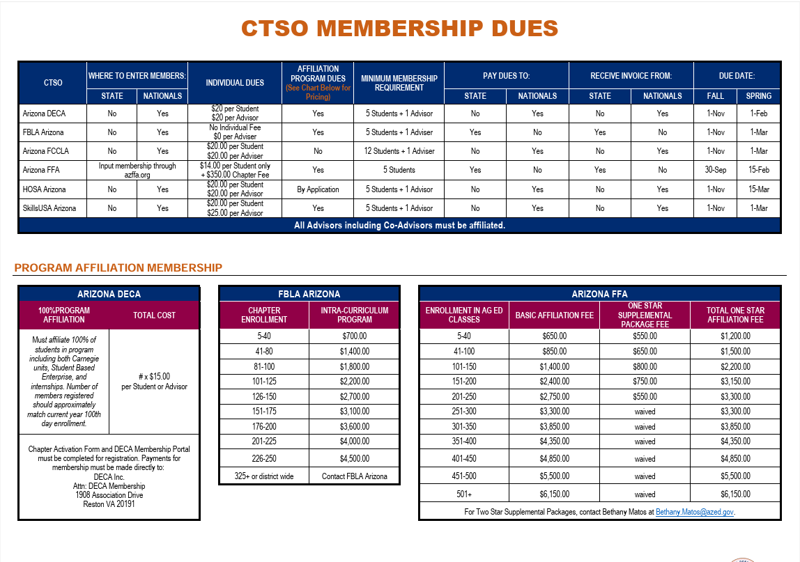
Membership
FBLA – Pay State
FCCLA – Pay Nationals
FFA – Pay State
HOSA – Pay Nationals
SkillsUSA – Pay Nationals

Slide 10
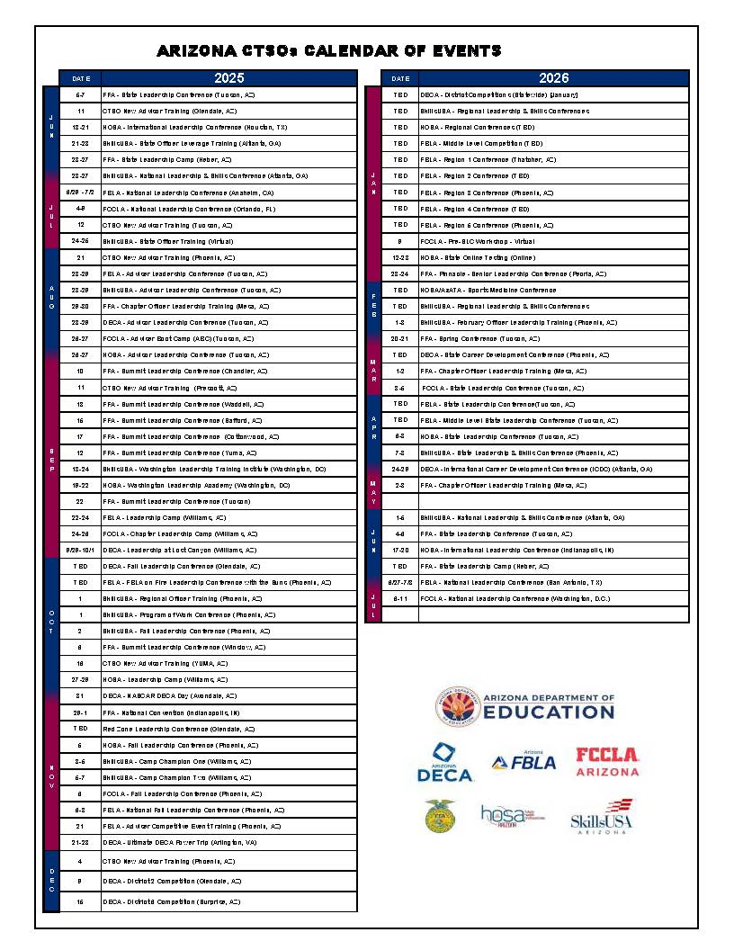
Calendar of Events
Updated throughout the year
Can also be found on the ADE CTSO page

Slide 11
2025 Conference Recap
12,800 attendees at state conferences
Over 2,000 Arizona competitors at all national conferences
Thank you for your state conference feedback!

Slide 12

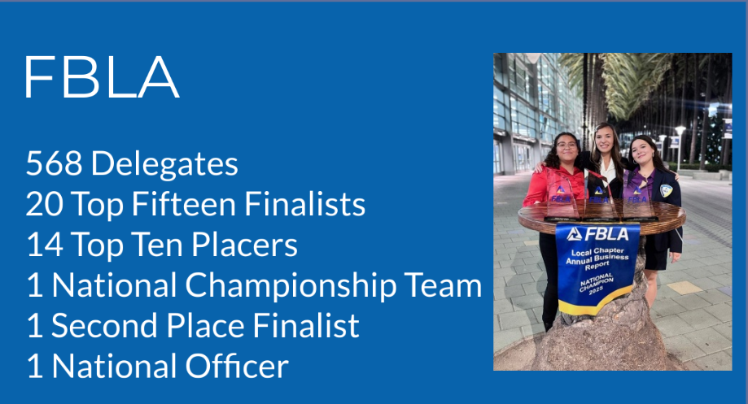
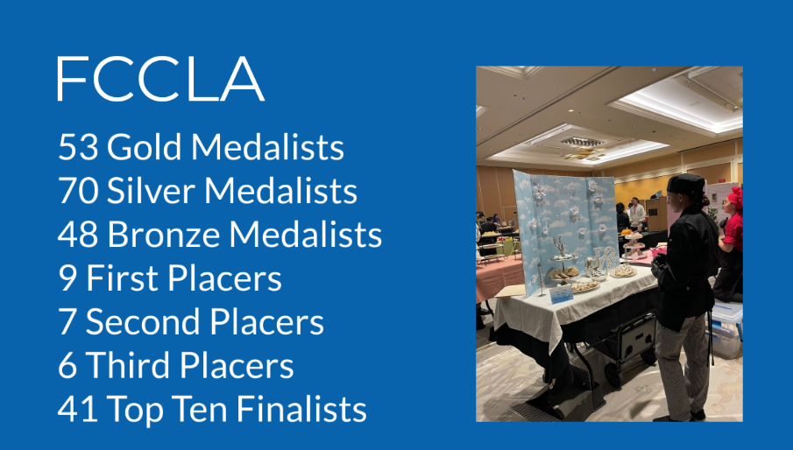
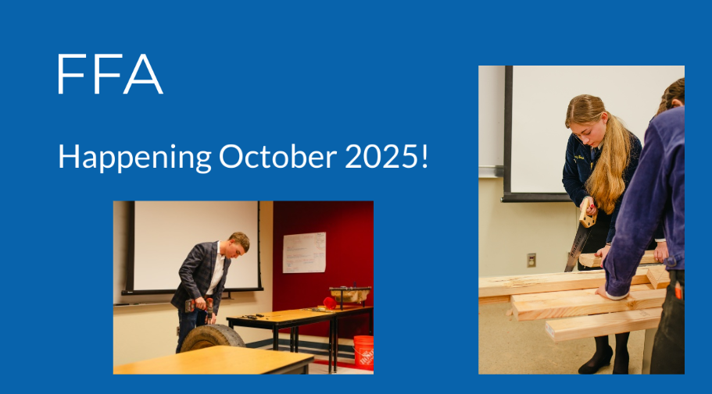
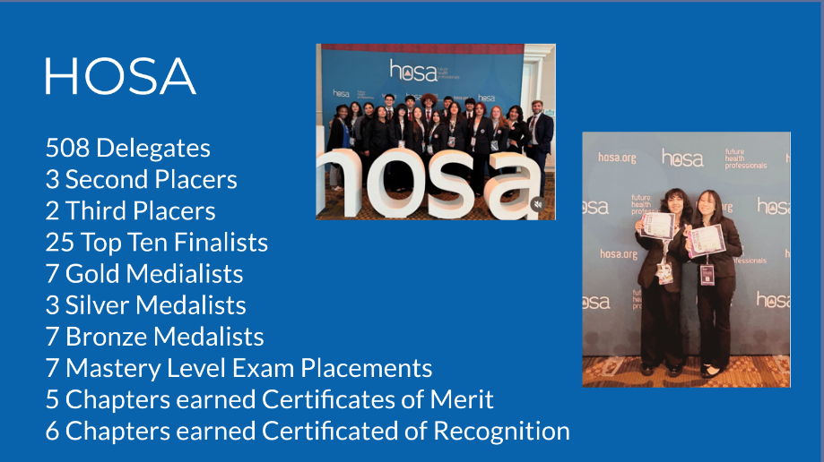
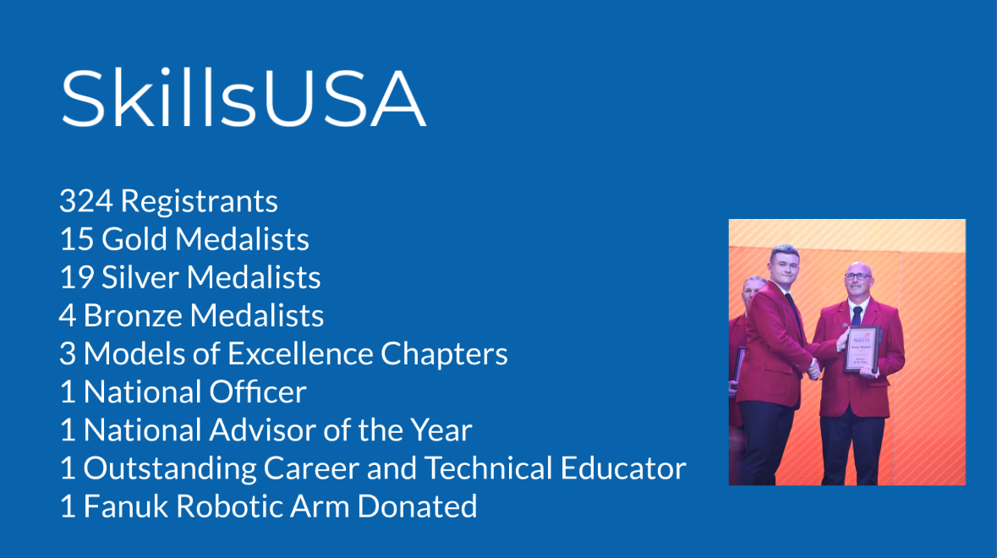
2025 National Conference Recap

Slide 13
New Advisor Training Recap
9 trainings in the 2024-2025 SY
5 locations
  ADE, PimaJTED, Summer Conference (Tucson), STEDY, West-MEC
  More locations to come!
Approximately 200 advisors served!

Slide 14
What's New?
Annual Chapter Submission form is moving to the CTE Data Portal!
  Available early August
2 additional requirements for annual chapter submissions
  Meeting minutes
  Bylaw revision date
Walkthrough will be available on the ADE website prior to the submission link going live
New and revised Program of Work template
  Our goal is to guide and help advisors use a program of work effectively as well as making the process more seamless

Slide 15
Invoices
TRI Leadership will be at the Westin registration desk on Monday and Tuesday for any financial questions, especially:
open invoices
account contact information changes
general changes

Slide 16
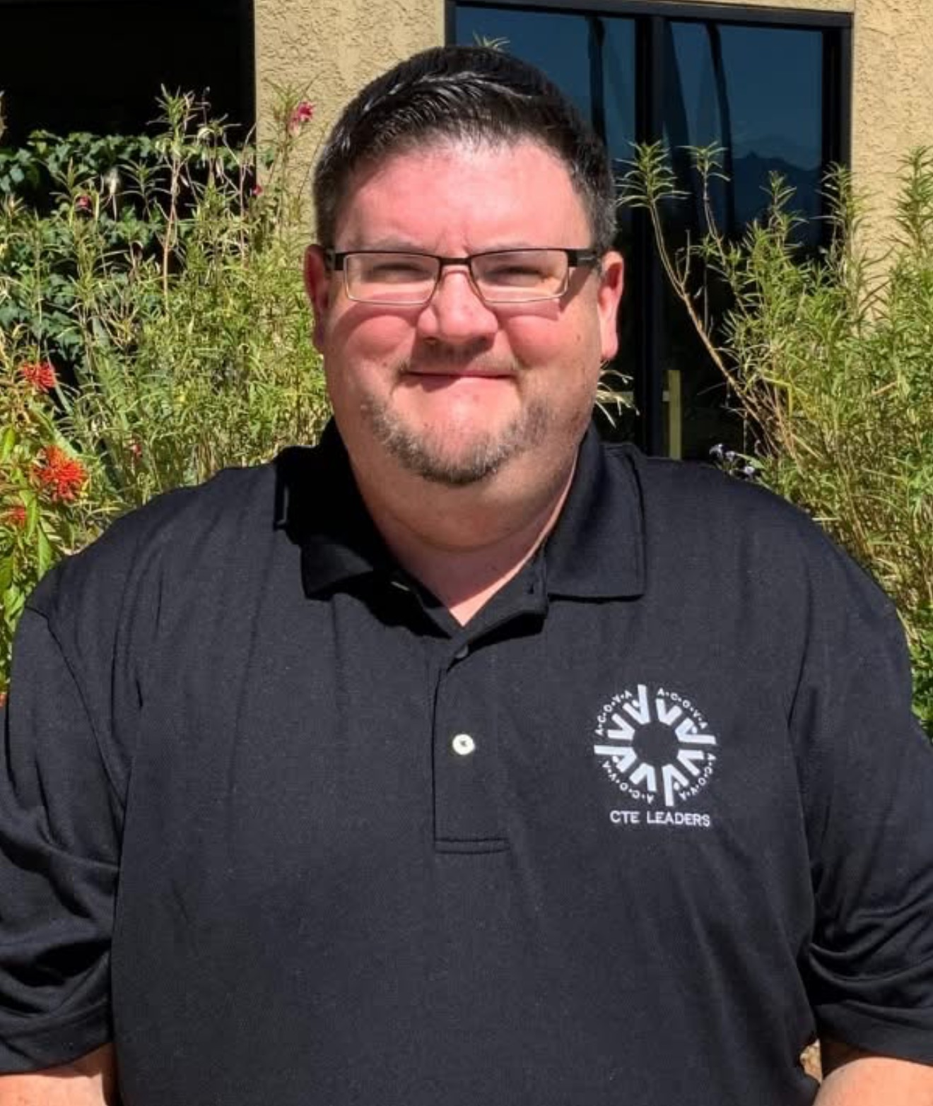
CTSO Champion Award:
Inaugural Recipient
In recognition of your outstanding leadership, advocacy, and extrodinary commitment to student success in CTSOs
Eric Sorenson Tempe Union HSD

Slide 17
Judy Balogh
“Success is not final; failure is not fatal; it is the courage to continue that counts.”
-Winston Churchill
Technical Standards, Technical Skills Assessment, and Career Development Team Lead

Slide 18
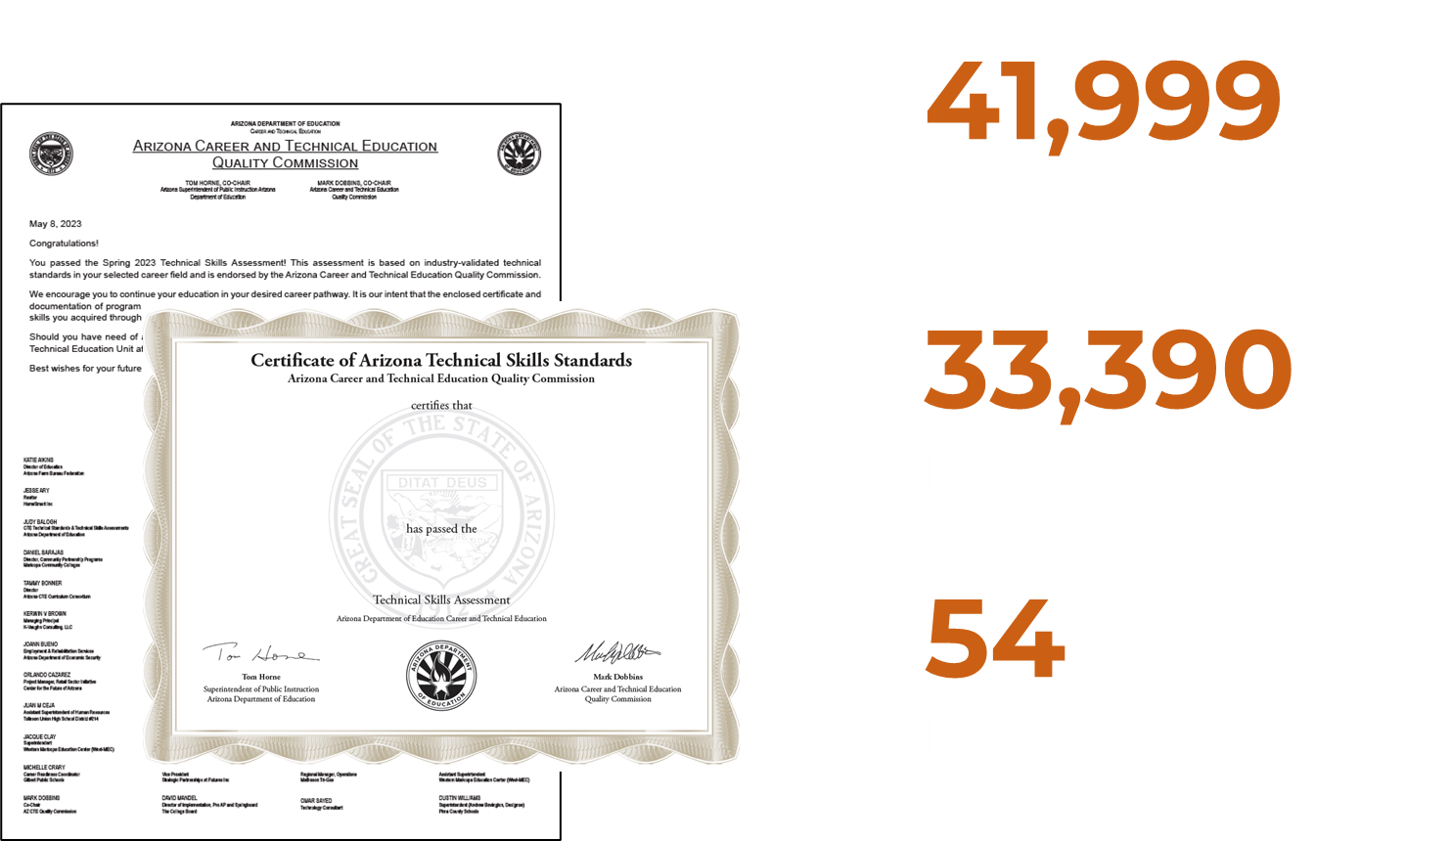
Technical Skills Assessment Results for 2024-2025

Slide 19
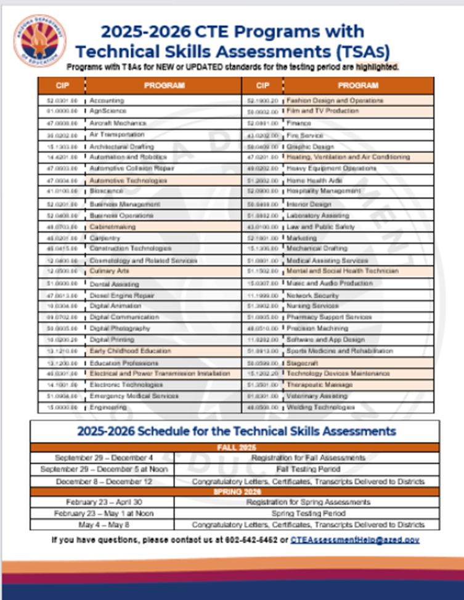
TSA Resources
CTE Technical Skills
Assessment Webpage:
www.azed.gov/cte/assessents
TSA Dashboard (ADEConnect)
Helpline: 602-542-5452
Email: CTEAssessmentHelp@azed.gov

Slide 20
Let's Talk!

Slide 21
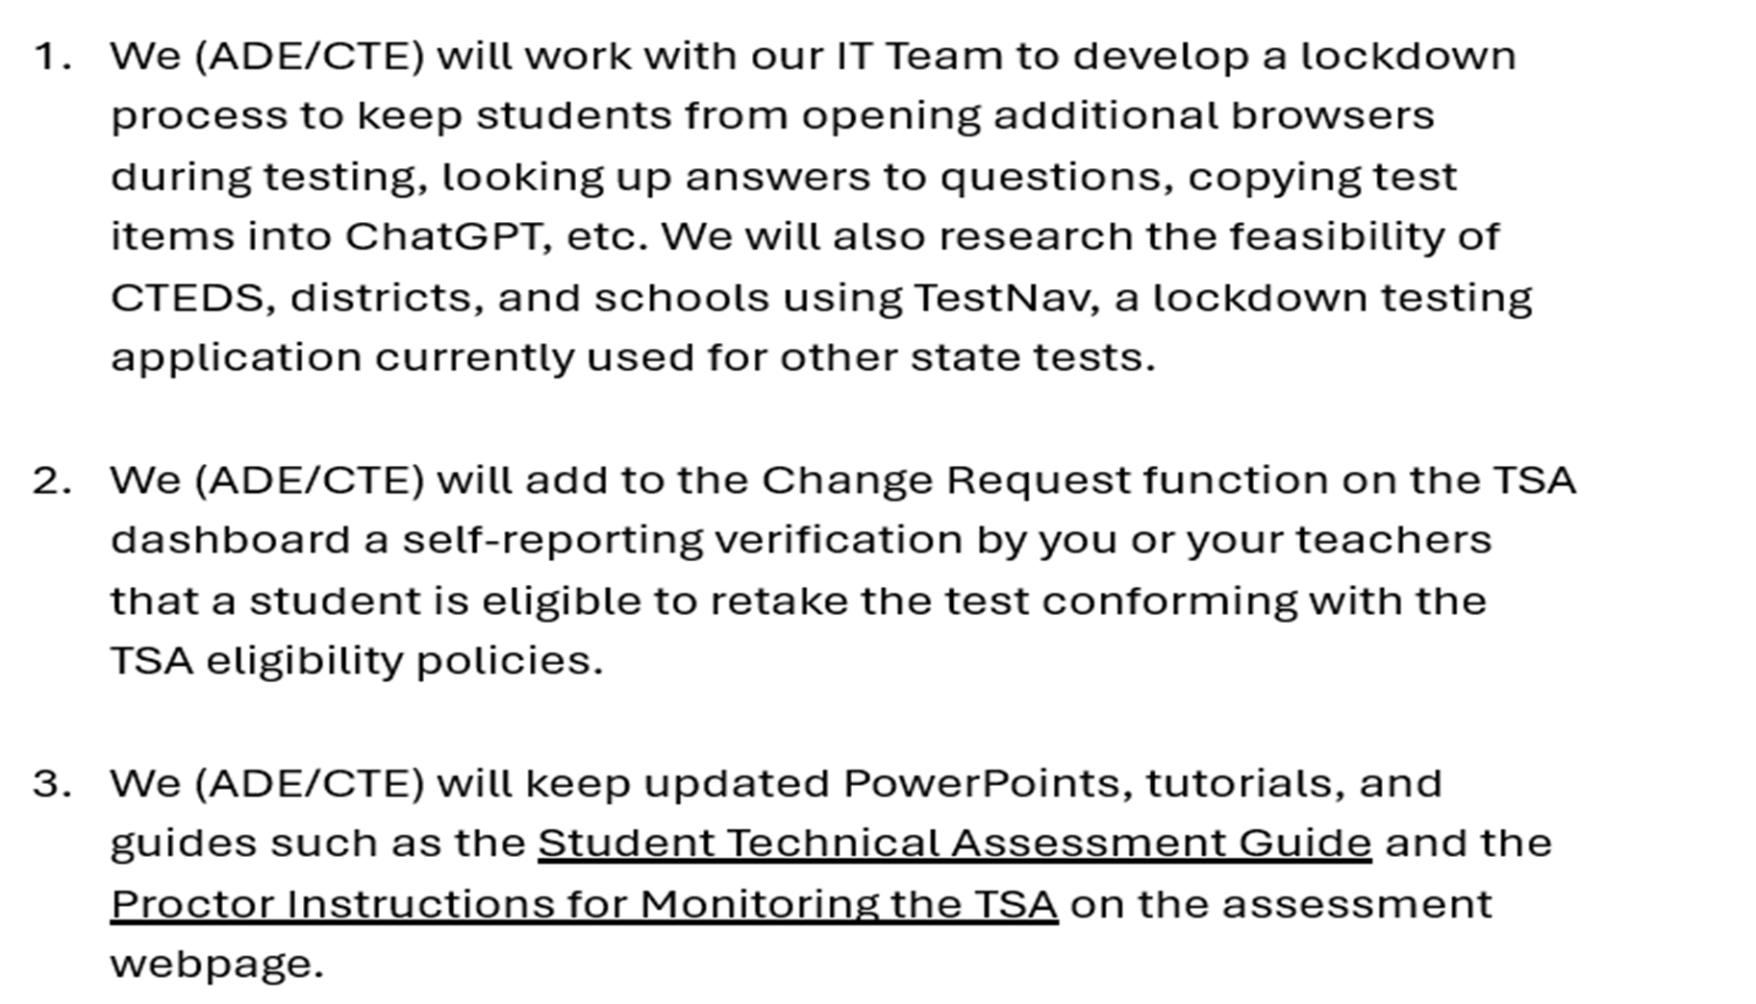

Slide 22
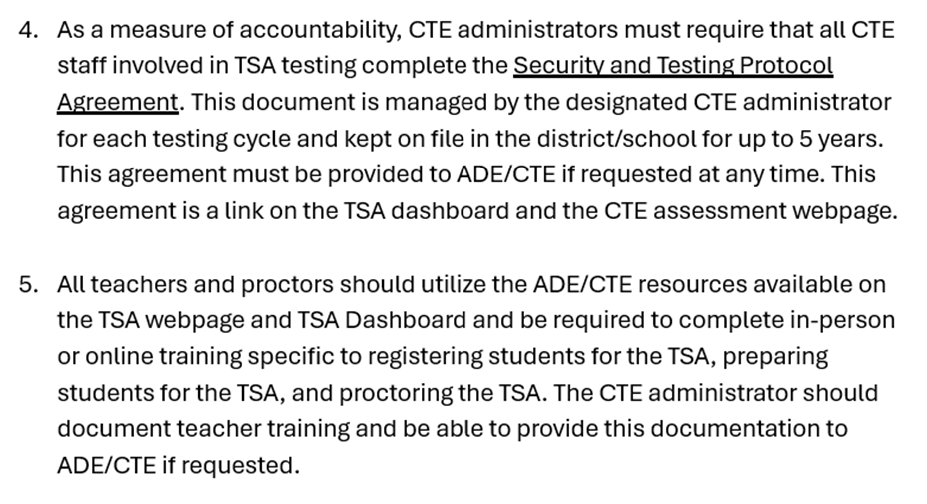

Slide 23
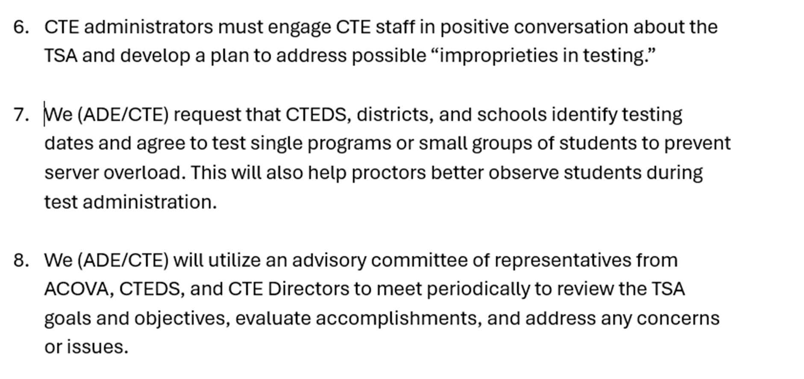

Slide 24
Judy Balogh
ADE/CTE Lead for Standards, Assessment, Career Development
602-542-4155, judy.balogh@azed.gov
Hannah Higgs
ADE /CTE Assessment Program Specialist
602-542-5044, TSA Hotline: 602-542-5452, hannah.higgs@azed.gov

Slide 25
Michelle Martinez
"To Infinity and Beyond!"
Buzz Lightyear
Career and Technical Education Programs Director

Slide 26


Slide 27
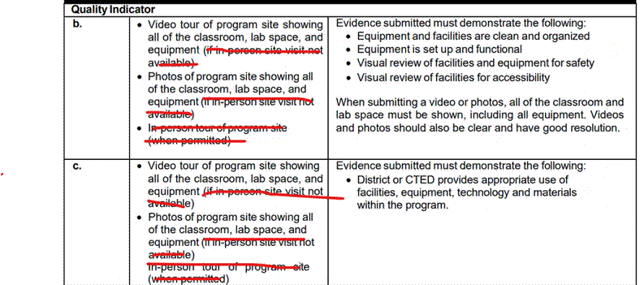
Program Services: Monitoring Update
On the Quality and Compliance Monitoring Guide & Samples document for 4B and 4C, this statement “if in-person site visit not available” in the evidence column has been removed from the guide and this option will no longer be available to use to get the quality points for 4B (program level quality point) or 4C (district level quality point).

Slide 28
Program Services: Monitoring Update

Slide 29
Program Services: Monitoring Update
District administrators must add pictures and/or videos to indicators 4b and 4c for quality points.
Site visits are intended to confirm evidence submitted.

Slide 30
Program Services: Best Practices
Pictures/Videos do not need to be professional grade. Just clear enough to show the classroom, lab areas, and industry equipment.
Districts have either created a full video (by school – by program) to show the program classrooms or looped pictures together to show each program.
Some create a Google (or other digital platform) drive with folders, by school- by program, and include pictures or video, then add those accessible (open link that does not require log-in or approval to access evidence) drive links to 4b/4c indicator.
The use of district folders/drive individual program submissions are acceptable, provided that the images/videos are separated by school - by program.
Tip: some programs have leveraged students/teachers in film or photography program to help create these videos or take pictures.

Slide 31
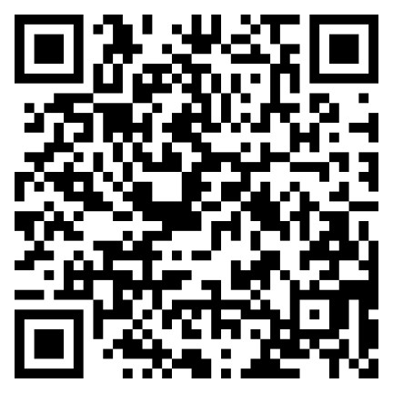
Program Services: Feedback

Slide 32
Gina Schmitz
"Alone we can do so little; together we can do so much."
-Helen Keller
Career and Technical Grants Supervisor

Slide 33
$34,395,271
allocated to Arizona

Slide 34
FY 2025 CTE Federal Perkins Allocation Breakdown
Secondary | $24,624,676.08
Postsecondary | $5,407,611.93
Reserve (Innovative Grant) | $621,000
State Leadership | $2,125,000
Basic Administration | $1,606,982.99

Slide 35
FY 2025 CTE State Priority Allocation Breakdown
Arizona | $11,576,300.00
Secondary | $9,000,942.00
State Administration Match | $2,575,358.00

Slide 36
CTE Federal Perkins Grant
Marie Jarrett | Cindy Tucci | Audrey Dieken | Gina Schmitz
CAVIAT | CVIT | EVIT | CTE Industry Credential Grants
CAVIT | NATIVE | GIFT | State Leadership Grants
Mountain Institute CTED | Pima JTED | WAVE | State Innovative Grants
NAVIT | West-MEC | All Postsecondary Schools | State Institutions
STEDY | Charters | Charters
VACTE
Charters & Phoenix Union

Slide 37
FY 2025 Perkins Reminders
Grant Final Narratives & Performance Measure Improvement Plan Final Summaries were due June 30th. Will be going on a Programmatic Hold until submitted
Continue to submit reimbursements
Grant end determined by District: June 30th or September 30th
Completion Report opens on October 1st.

Slide 38
CTE Grants 101 Workshops
Monday, July 14th
1:30 – 3:00
Tuesday, July 15th
10:00 – 11:30
Comprehensive Local Needs Assessment
Grants Management Enterprise (GME)
  Application
  Budgeting
  Revisions
  Performance Improvement Plans
Grant Deadlines

Slide 39

Grants Management Conference
Information on GME Home Page

Slide 40
Emily Brown
"If I cannot do great things, I can do small things in a great way."
Martin Luther King Jr
School Counselor Director

Slide 41
School Counseling Updates
Construction Career Day: September 30 from 9:00 am – 1:00 pm
School Profile Webinar: September 23 from 10:00 am – 11:00 am
Snack Pack Sessions: option 1 – September 17, option 2 – October 22 from 11:30 am – 1:30 pm
Funding Webinar: save the date for September 24 from 1:00 pm – 2:00 pm
School Counselor Retreat: full day of sessions at the ACOVA Fall Conference
School Counselor Newsletter: get signed up for all the latest updates

Slide 42

Construction Career Day
September 30, 2025, 9:00am-1:00pm at Sundt Construction in Phoenix.
See their facilities, participate in activities (concrete, heavy equipment, pipefitting, and welding), and learn more about their career opportunities.

Slide 43
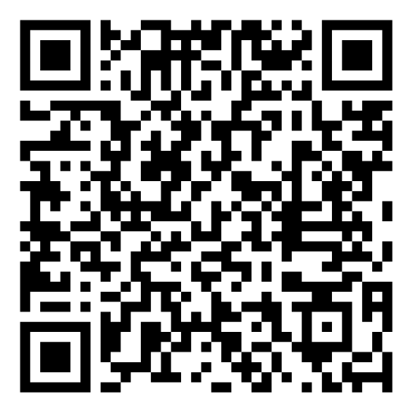
School Profile Webinar
Join Making Caring Common for a free webinar on building school profiles. This training is targeted toward high school counselors supporting college applications.

Slide 44
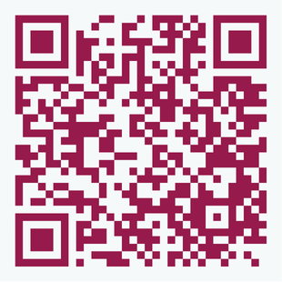
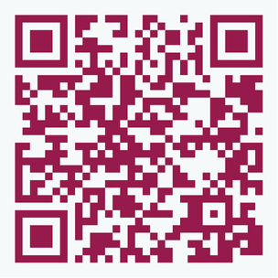
Snack Pack Sessions
Option 1
September 17
11:30AM-1:30PM
Join us for bite-sized, professional learning brought to you by the Arizona Department of Education, the Arizona Board of Regents, and the Arizona College Attainment Network.
These webinars are virtual only.
Registration is required, closes 24 hours prior.
Slide decks and materials will be shared with registrants.
Option 2
October 22
11:30AM-1:30PM

Slide 45

Get Connected
Emily Brown, School Counselor Director
Emily.Brown@azed.gov
Heather Anderson, School Counselor Specialist
Heather.Anderson@azed.gov

Slide 46


Robert Garcia
Work Based Learning Director

Slide 47
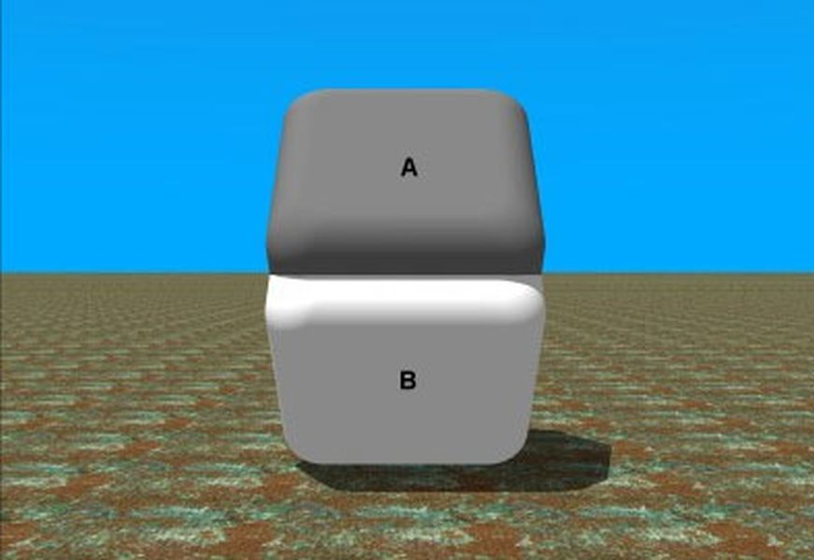
Work-Based Learning Updates
“If everyone is thinking alike, then somebody isn’t thinking.” – General George S. Patton

Slide 48
Updates Cont.
So, Far.....
ADE Regional Ecosystem for Workforce Development Collaborative
Launch of the Student Industry Partnership (SIP)
Work-Based Learning Advisory Committee
Coming Up.....
Website redesign
Work-Based Learning Guidebook update
Enhanced Commuinication Tools
Continue Statewide Collaboration

Slide 49
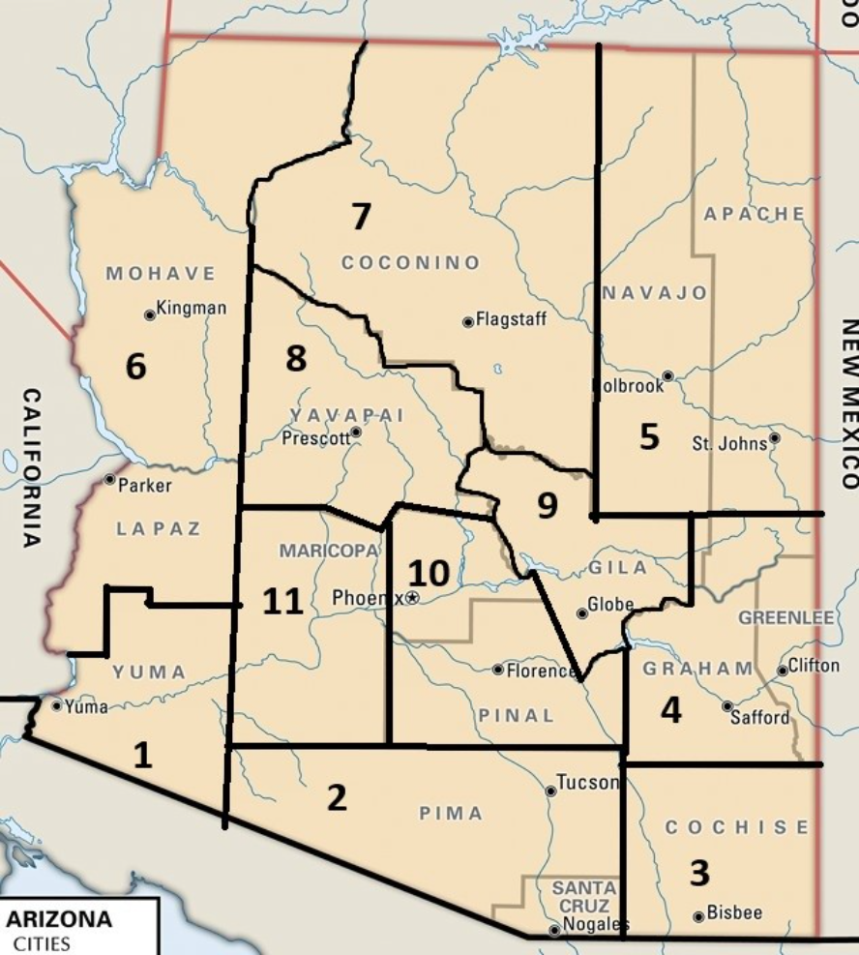
Regional Ecosystem for Workforce Development Collaborative

Slide 50
Regional Ecosystem for Workforce Development Collaborative Cont.
Many regions show a strong preference for apprenticeships and internships
Recommendations received Examples;
  Assure programs are industry led (Program)
  Stay current with employer credential validation (Partnership)
  Champion CTE in the community and with students (Communication)
Next Steps......
Over 200 Attendees
260 improvement recommendations
90% found the meeting to be valuable

Slide 51
Thank you

