Slide 1
§15-915 Process- AFR & Budget

Slide 2
What is a 915?
Prior year final data correction
  Budget
  AFR
  ADM
  Transportation
Can go back up to three fiscal years prior
  Current maximum is FY2022

Slide 3
915 due to Expenditure Budget
You will notice that you may need to do a 915 for a prior year Expenditure Budget after reviewing your final Budg-25
  Final Budg-25 Report is produced after SRC is completed in September
  However, final revisions are due 5/15
Most values come from pages 7 and 8
2 ways to tell you are missing budget capacity
  Your budget limit applied capacity is less than the ADE optimized amount
  If Budget-25 has positive value in “Difference” column for the following line items:

Slide 4
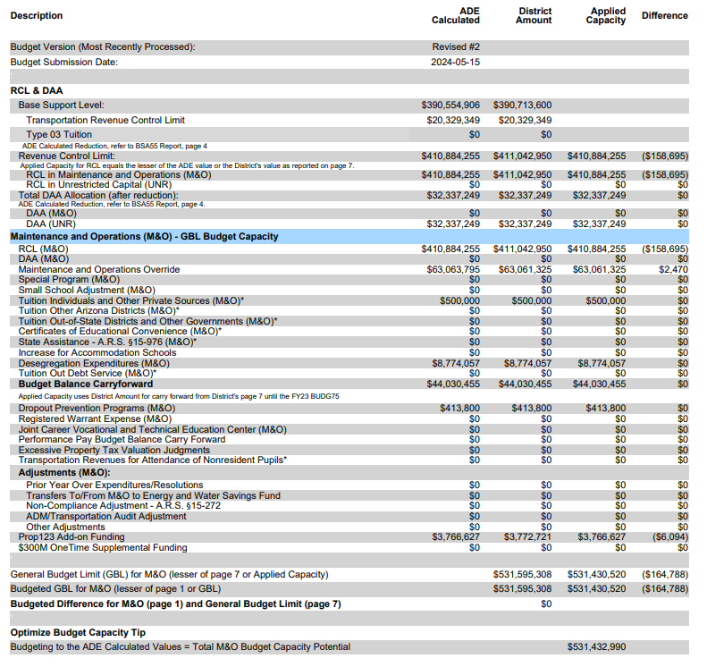

Slide 5
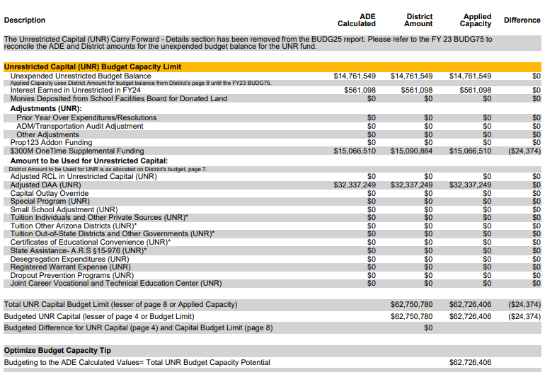

Slide 6
915 due to AFR
AFR data is used by the following:
  Within ADE
    Grants Management
    Exceptional Student Services (ESS)
    School Report Card
  State Agencies
    Governor’s Office
    Joint Legislative Budget Committee
    Legislature
    Auditor General
  Federal Agencies
    Federal Department of Education
    Census Bureau

Slide 7
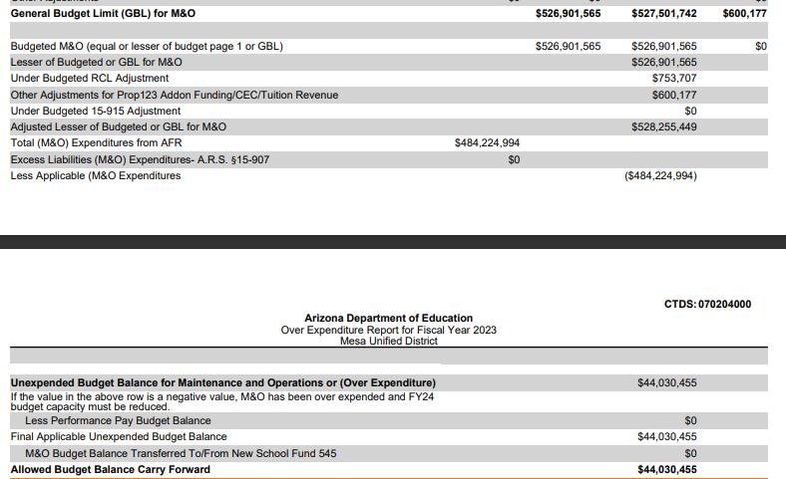
915 due to AFR
Impacts budget capacity for next fiscal year:
  Maintenance & Ops
  Unrestricted Capital

Slide 8
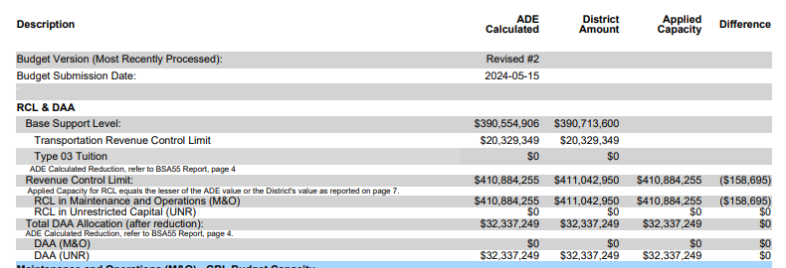
915 due to ADM
Note that current integrity rules are retrospective with 915
Adjusts your Base Support Level, which will affect your Revenue Control Limit (RCL)
  Increases in ADM lead to increases in RCL
    Make-up funding paid out in the next month’s state aid payment
  Decreases in ADM lead to decreases in RCL
    Decreased current year funding

Slide 9
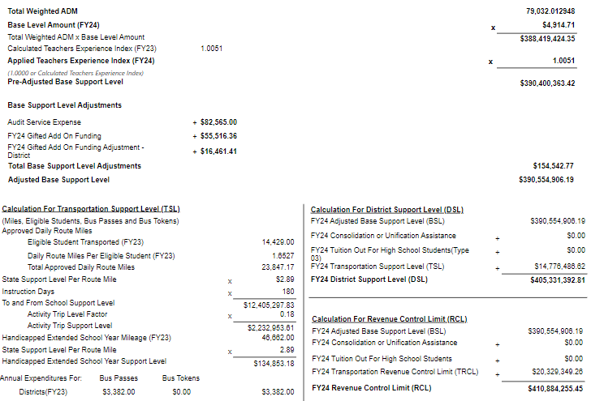

Slide 10
915 due to Transportation
Route Miles
  Impact on state aid funding for the next fiscal year
    FY24 Transportation data will impact FY25 funding through DSL
    Fewer miles will lead to negative impact on state aid payment
    More miles will lead to positive impact on state aid payment
  Rare impact on RCL
Vehicle Inventory
  May impact state aid funding
    Impact on DSL
  Rare impact on RCL

Slide 11
How to submit a 915
Help Desk
  All 915s are now down via Help Desk
What to include for AFR/Budget 915 in Help Desk ticket:
  Formal letter (with letterhead) signed by business manager and superintendent must include:
    Date, LEA name, entity ID, contact name, title, phone number, fiscal year, forms
    All changes made to file with cell and page references
    Reason for changes
Next steps:
  Budget Team will review change and open window for submission
  Evaluate all changes and compare to letter
  Process file

Slide 12
Reminder to Validate and Calculate
Make sure you validate all the changes you make and calculate the anticipated impacts
Oftentimes LEAs make changes and are surprised by the changes to either budget capacity or payment

Slide 13
Questions?

