Slide 1
Payment and Budget Reports
ADE School Finance
4/10/2025
Notes:
This is a title page – please do not use for bulleted content

Slide 2

Agenda
Introduction to School Finance
Payment Reports
Budget Reports
Questions

Slide 3

Introduction to School Finance
ADE SCHOOL FINANCE REPORTS
SECTION 1
Notes:
This is a title page – please do not use for bulleted content

Slide 4
Introduction to School Finance
School Finance distributes about $7B in state funding for education each year in accordance with formulas in state law
15 staff divided between two teams
One team focuses on collecting the data necessary to calculate payments and related reporting
  Help Desk or (602) 542-5695
One team uses the data to calculate and process payments and manages the collection of budgets/financial reports and corresponding reporting
  SFBudgetTeam@azed.gov
  SFPaymentTeam@azed.gov

Slide 5
Introduction to School Finance
State funding is determined primarily by current year student enrollment
Student-specific, district-specific, and charter-specific factors affect funding:
  Add-on funding for students with special education needs, English learners, and certain grades
  Small districts/charters receive more per pupil
  TEI, base level adjustments (200-day calendar)

Slide 6
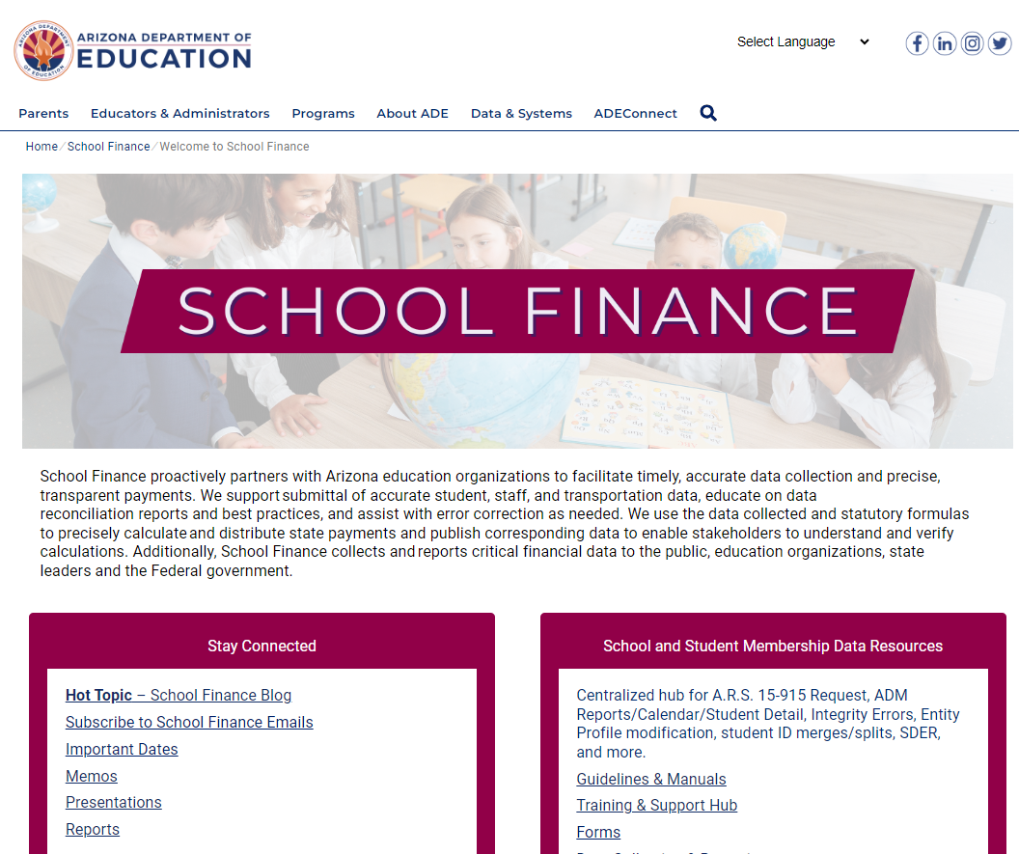
www.azed.gov/finance

Slide 7
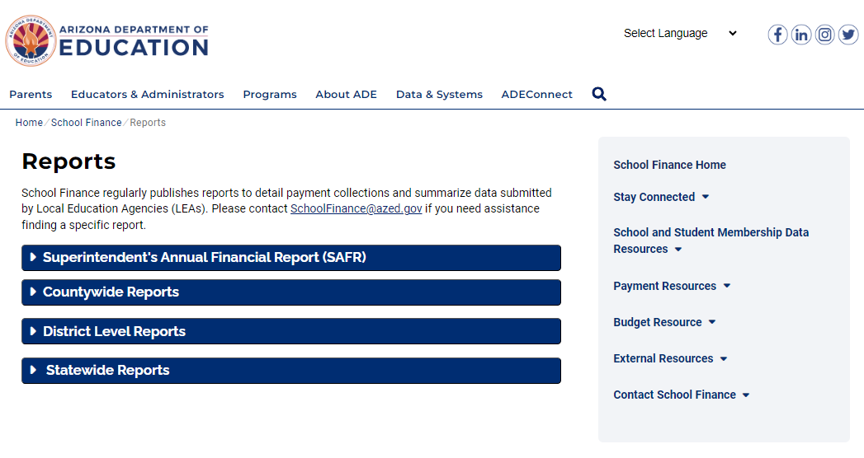
School Finance Reports

Slide 8
Payment Reports
ADE SCHOOL FINANCE REPORTS
SECTION 2
Notes:
This is a title page – please do not use for bulleted content

Slide 9

Payment Reports
Basic State Aid Reports
  BSA55 – Basic Calculations for Equalization Assistance
  BSA64 – Equalization Assistance and State Aid Payment Details
  BSA21- Weighted ADM per School with Monthly Comparison
Other Payment Reports
  Classroom Site Fund
  Instructional Improvement Fund

Slide 10
Payment Reports
BSA 55-1: District Equalization Report
  Summarizes annual equalization base and equalization assistance calculation based on student data and district characteristics
BSA 64-1: Equalization Payment Schedule Detail
  Summarizes each monthly payment calculation based on annual equalization assistance, amounts received in prior months, and any adjustments

Slide 11
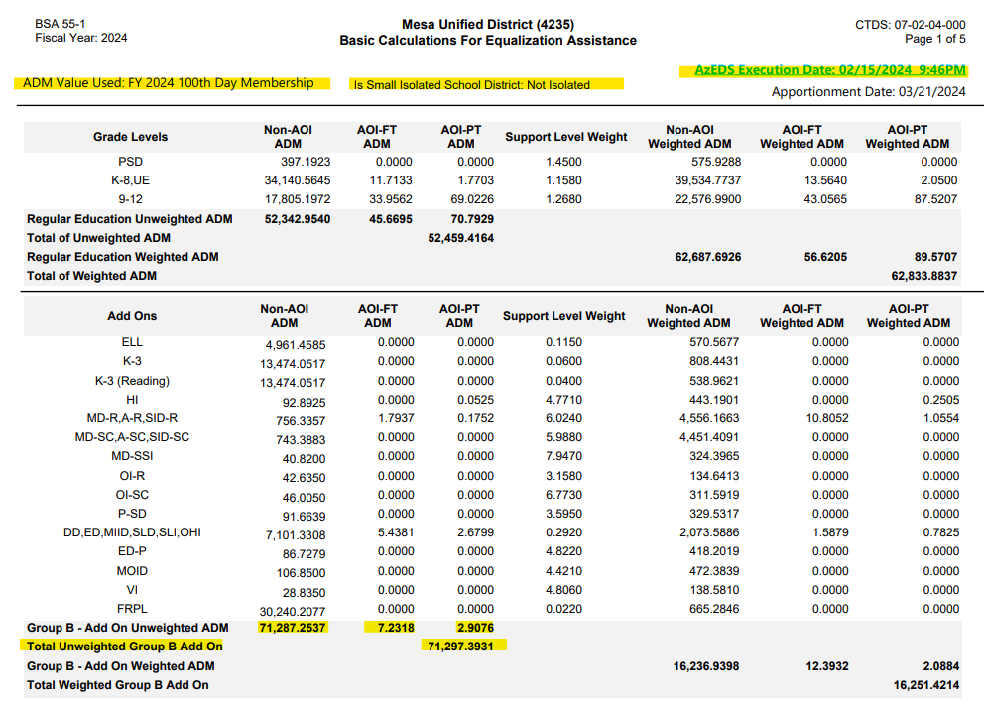

Slide 12
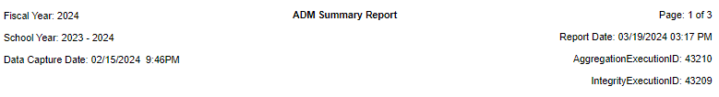
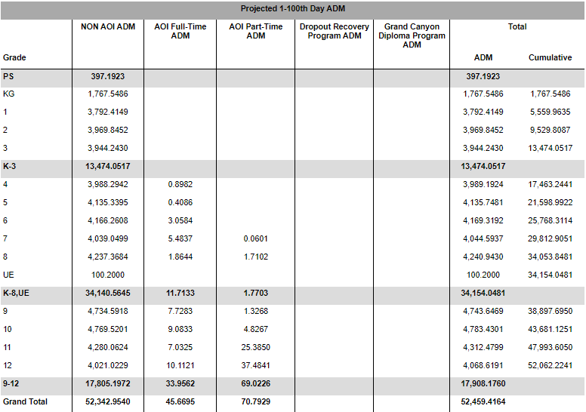

Slide 13
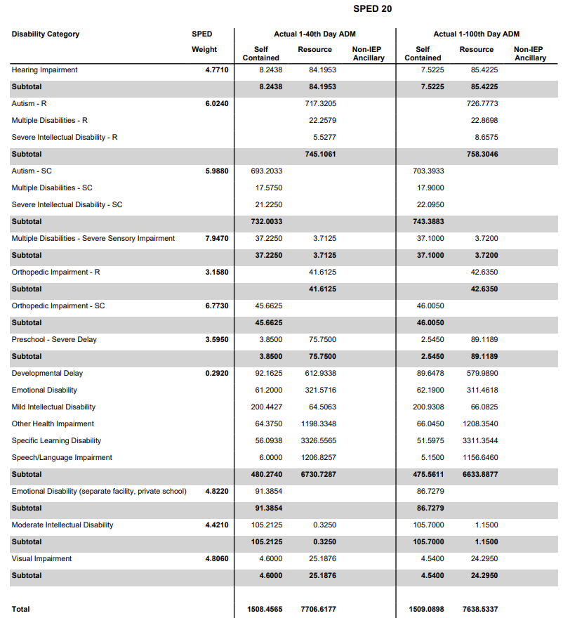

Slide 14
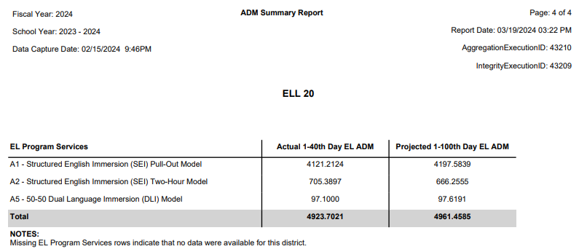

Slide 15
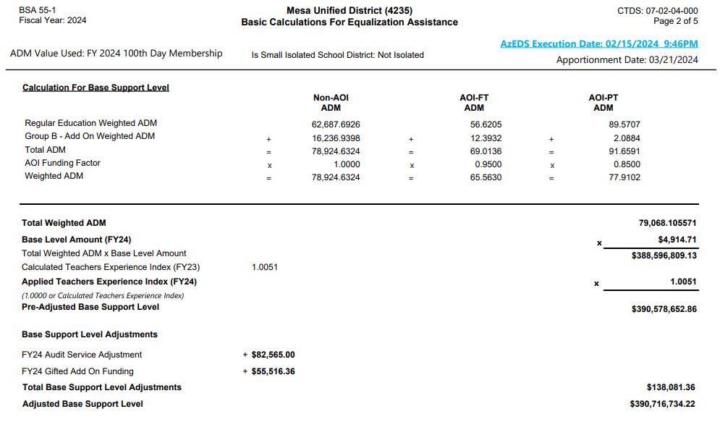

Slide 16
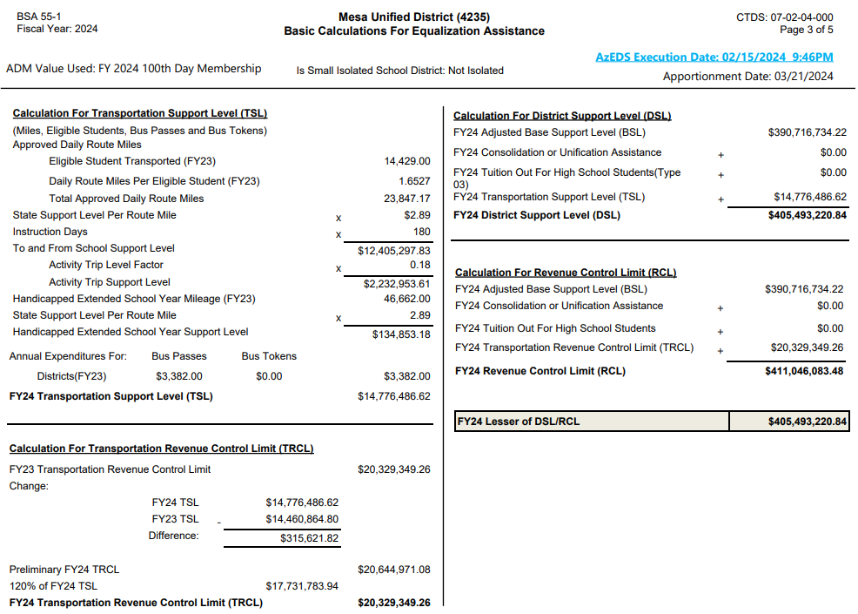

Slide 17
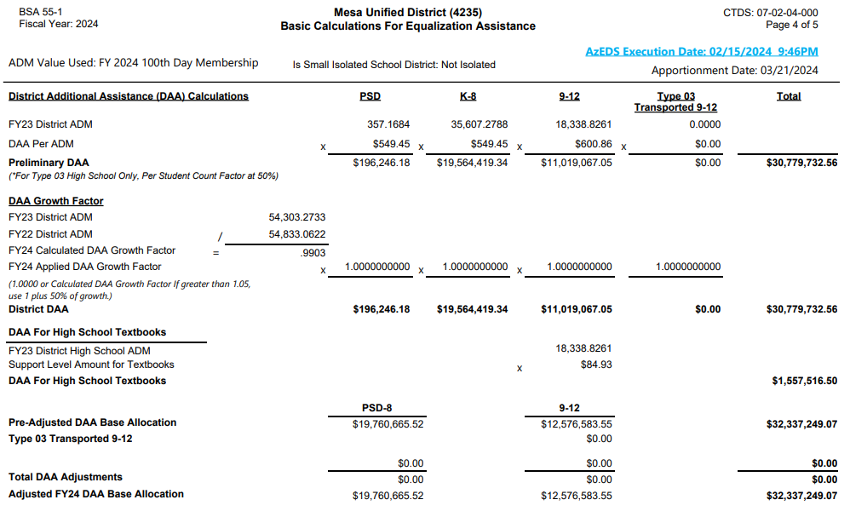





Slide 18
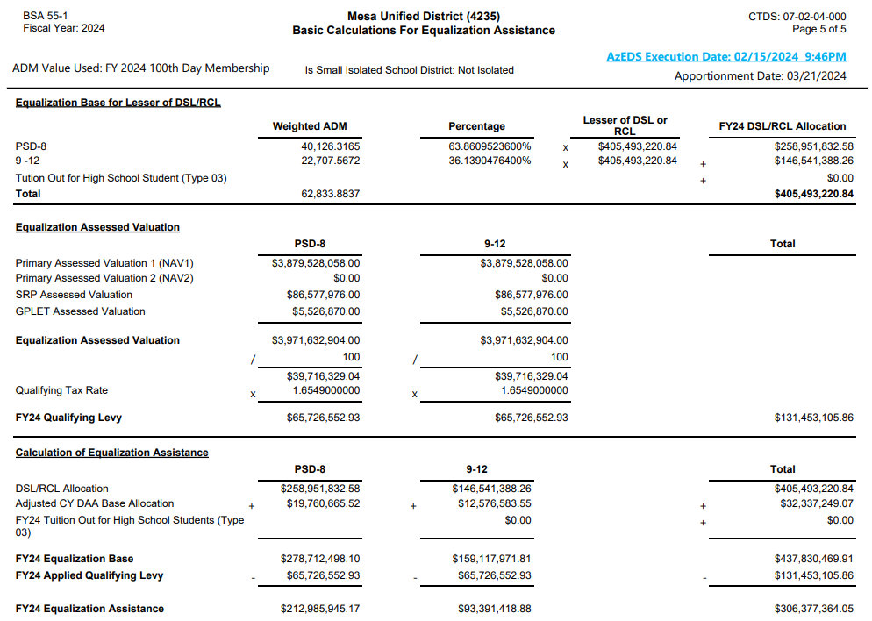







Slide 19
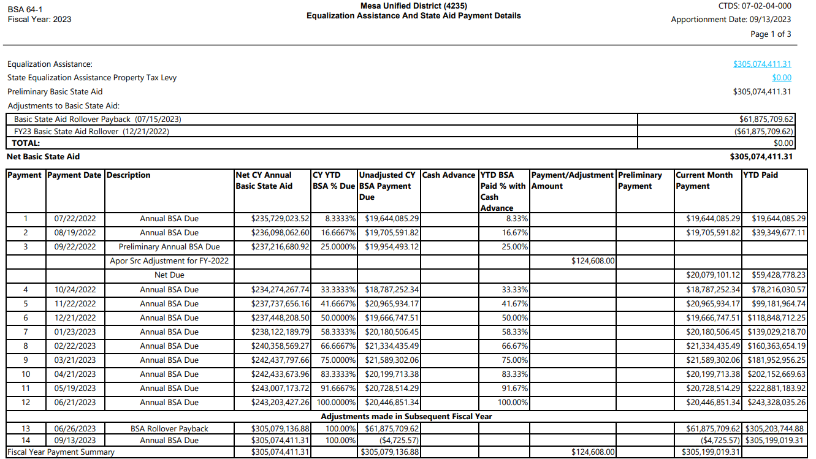
Unadjusted CY BSA Payment Due:
Net CY Annual Basic State Aid * CY YTD BSA % Due for a payment period - Sum of Prior positive Unadjusted Due Value

Slide 20
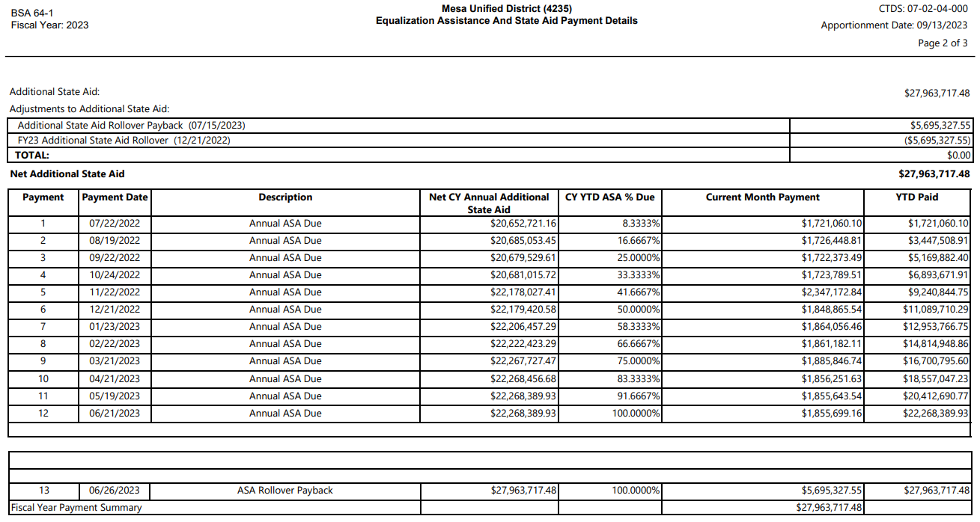

Slide 21
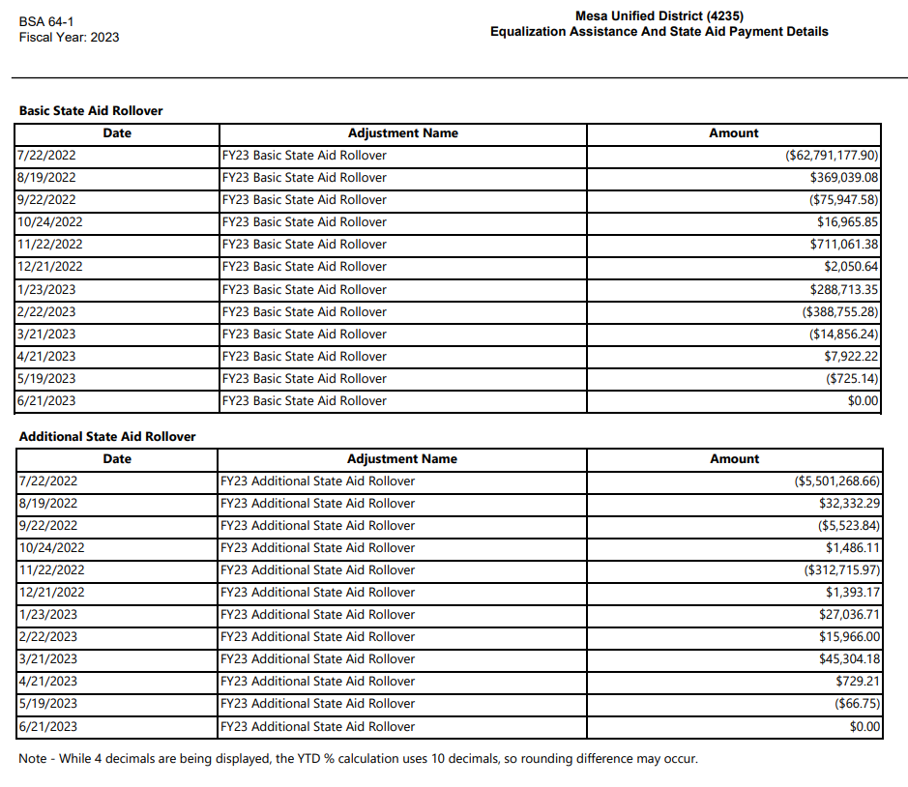
Calculations may be displayed with 4 decimals for YTD due %; however, they are performed using 10 decimals.

Slide 22
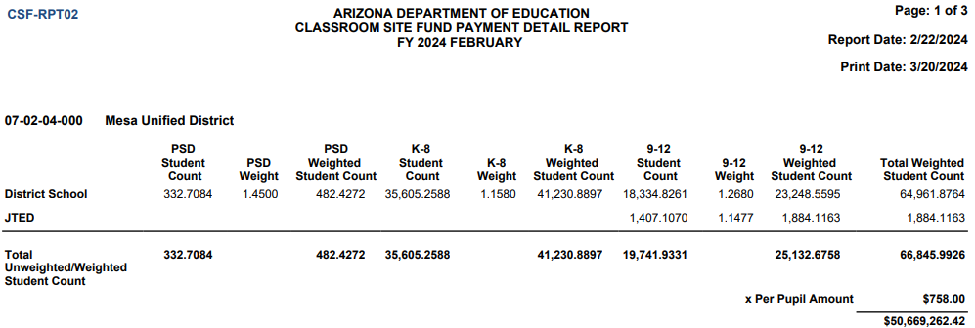
Classroom Site Fund (CSF)
Monthly payments based on prior year attending weighted student count

Slide 23
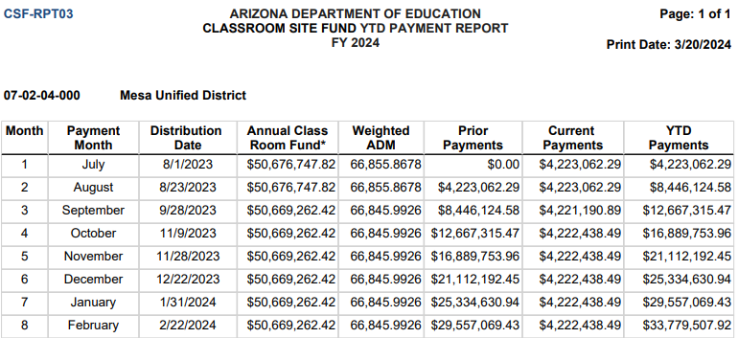
CSF Year-To-Date Monthly Payments

Slide 24
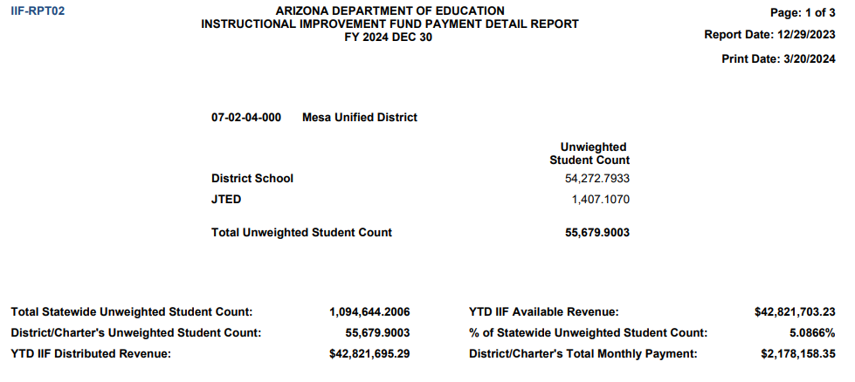
Instructional Improvement Fund (IIF)
Two payments per year; Based on unweighted student count

Slide 25
Budget Reports
ADE SCHOOL FINANCE REPORTS
SECTION 3
Notes:
This is a title page – please do not use for bulleted content

Slide 26

Budget Reports
BUDG-25
  Compares budget to ADE calculations for the current fiscal year
BUDG-75
  Compares actual expenditures for the previous fiscal year to the budget
BUDG-AGD
  Shows district share of expenditures subject to the Aggregate Expenditure Limit and at-risk expenditures

Slide 27
BUDG-25
To comply with A.R.S. 15-905
Compares budget to ADE calculations for the current fiscal year
First report is published in October, then will be updated monthly after each state aid payment cycle
BUDG-25 report compares the district’s budgeted expenditures to ADE calculated values and expenditure limits for the district
The BSA 55 report can be used to assist districts in aligning their student counts, TRCL, and RCL to ADE calculated values
BUDG-25 Letters are published in October and notify of over/under-budgeted expenditures

Slide 28
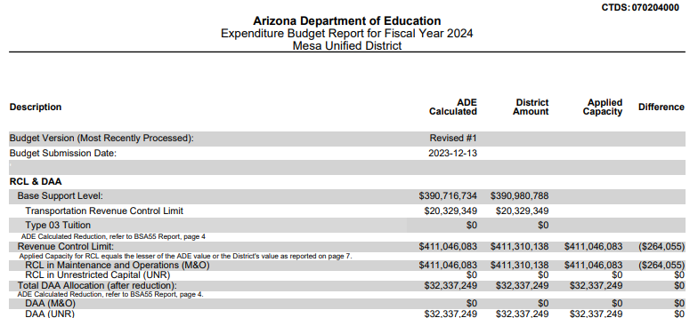
BUDG-25 Report

Slide 29
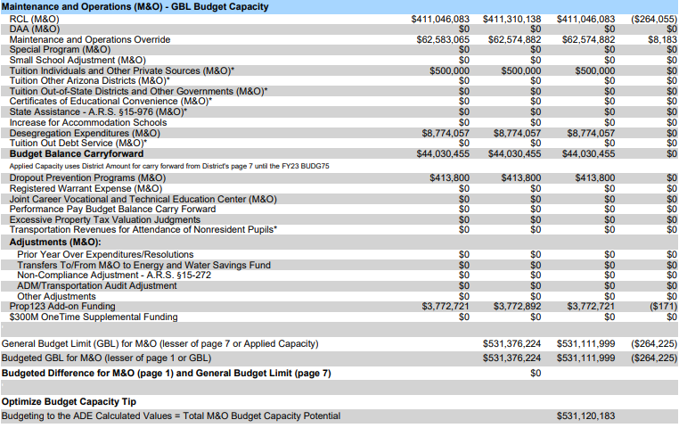
BUDG-25 Report

Slide 30
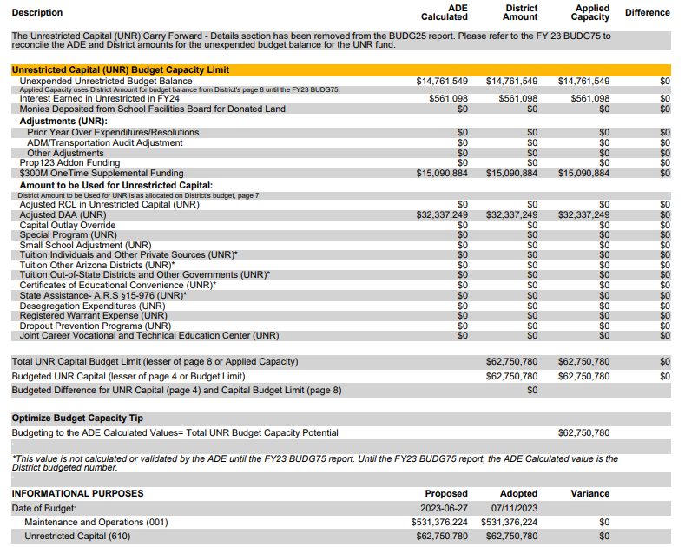
BUDG-25 Report

Slide 31
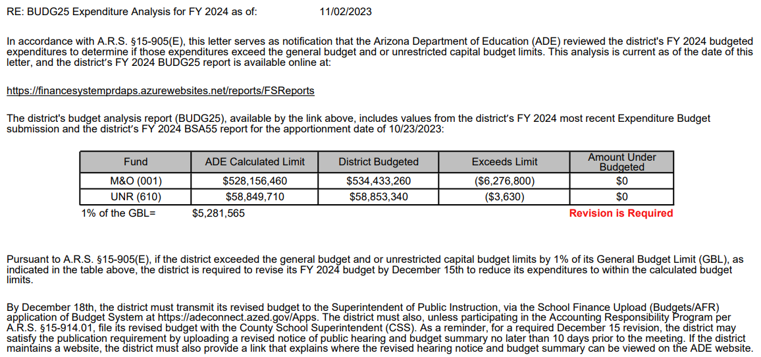
BUDG-25 Letter

Slide 32

BUDG-75 Reports
BUDG-75 reports are published in November of the next fiscal year. This is the first notification of over expenditure for districts.
Compares Districts Actual Expenditures from the AFR to ADE calculated actual expenditure limits for the district.
Important for budget balance carryforward values.
Published in early November

Slide 33
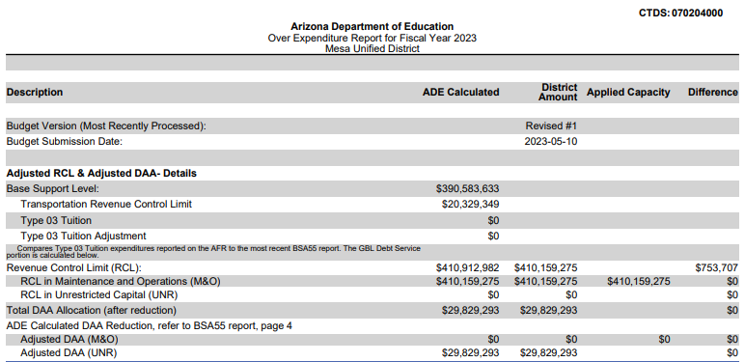

Slide 34
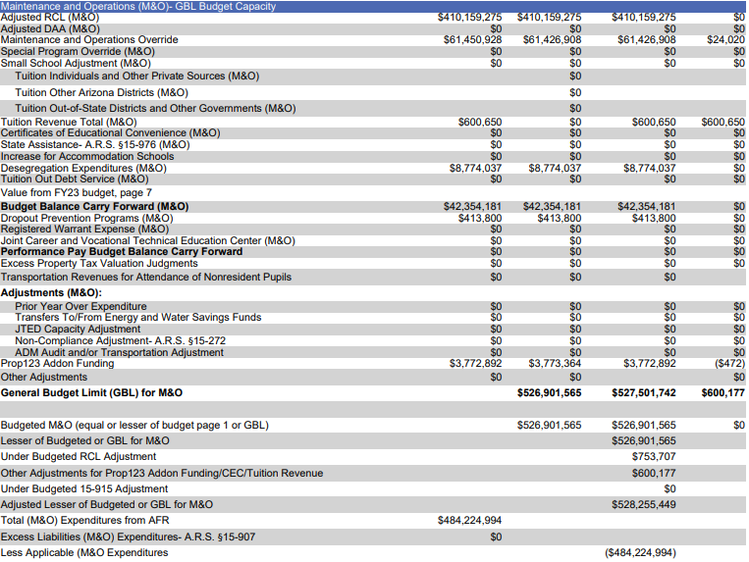
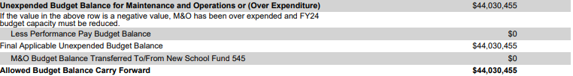

Slide 35
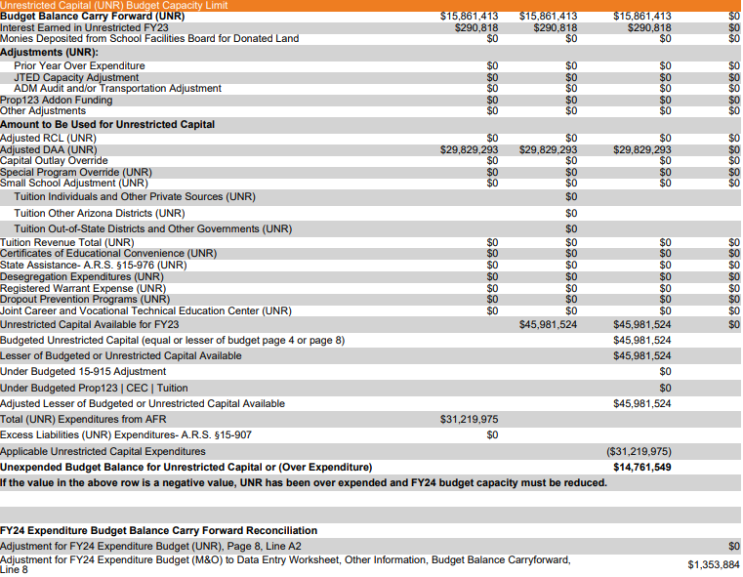

Slide 36

BUDG-75 Letters
BUDG-75 Letters are published in early February and notify districts of over/under of actual expenditures
If AFR Corrections are needed, please reach out to the SF Budget Team: SFBudgetTeam@azed.gov
Reduction in current year
Hardship Application: https://www.azed.gov/sites/default/files/2021/07/hardship-application1.pdf
Helpful Hot Topic on Correcting AFRs and School Level Reports: Correcting AFRs and School-Level Reports For FY23 AFR & FY24 Budget Files & Later | Arizona Department of Education (azed.gov)

Slide 37
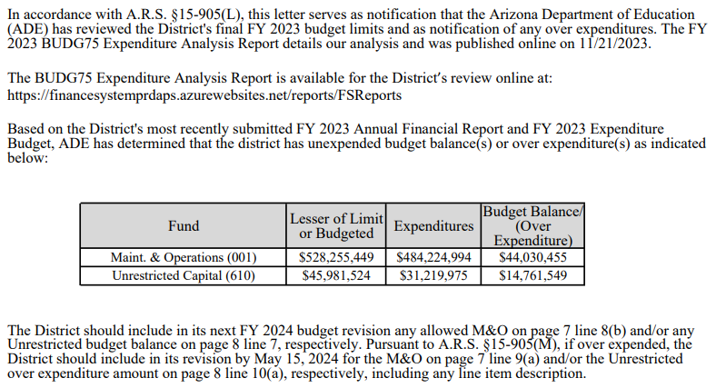

Slide 38
BUDG-AGD Report
Top of the report summarizes the calculation of applicable budgeted expenditures (expenditures subject to AEL)
  Those that come out of the State of Arizona’s general fund
Bottom shows statewide values
  Includes:
    Calculation of at-risk expenditures
    Constitutional limit
    Projection of budgeted expenditures under/over constitutionally provided limit for the fiscal year

Slide 39
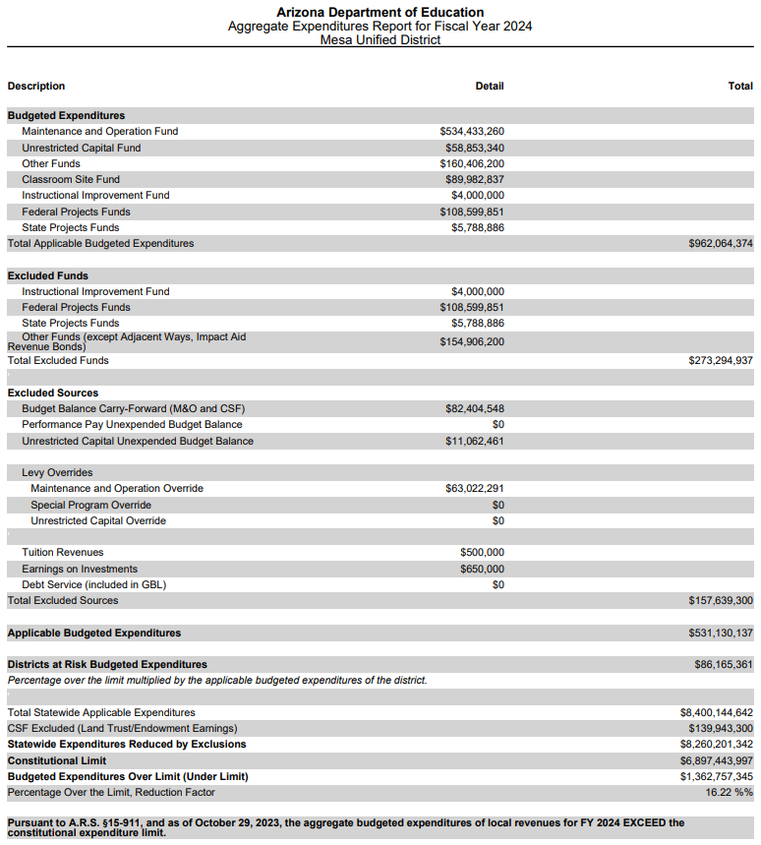

Slide 40
Truth in Taxation (TNT)
Districts are required to hold a Truth in Taxation Hearings if any one of the following conditions exists (§15-905.01):
  Total Budgeted Expenditures in Dropout Prevention, Joint CTE VocEd Programs, and Small School adjustment exceed the any previously total expended on these programs (TNT Base Limit)
    Desegregation is no longer included (moved to Secondary Tax in 2019)
  Any Expenditures designated as Excess Liabilities (§15-907)
  Adjacent Ways levied in the budget year (§15-995)

Slide 41
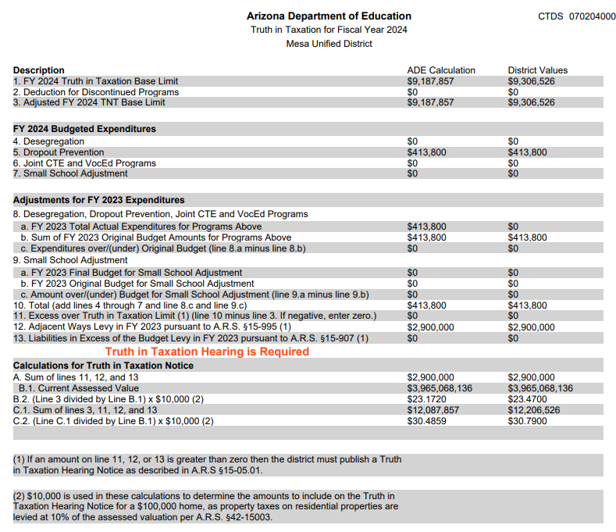

Slide 42
Thank you
ADE School Finance Reports
Ryan Young, Director of Fiscal Operations
ryan.young@azed.gov
(602) 542-8244

