Slide 1
Payment and Budget Reports
ADE School Finance
7/18/2025
Notes:
This is a title page – please do not use for bulleted content

Slide 2

Agenda
Introduction to School Finance
Payment Reports Reconciliation
Budget Reports Reconciliation
Common File Upload Issues
Questions

Slide 3

Introduction to School Finance
ADE SCHOOL FINANCE REPORTS
SECTION 1
Notes:
This is a title page – please do not use for bulleted content

Slide 4
Introduction to School Finance
School Finance distributes about $8B in state funding for education each year in accordance with formulas in state law
14 staff divided between two teams
One team focuses on collecting the data necessary to calculate payments and related reporting
  Help Desk or (602) 542-5695
One team uses the data to calculate and process payments and manages the collection of budgets/financial reports and corresponding reporting
  SFBudgetTeam@azed.gov
  SFPaymentTeam@azed.gov

Slide 5
Introduction to School Finance
Payment System
  Calculate $8 billion state funding for both school districts and charter districts
Budget System
  Collect budget files and calculate the maximum budget capacity
Arizona Education Data Standards (AzEDS)
  Data standardization and improved processing lead to more accurate reporting at all levels
Education Organization System
  Manage all public and non-public entities that receive state or federal funding through ADE

Slide 6
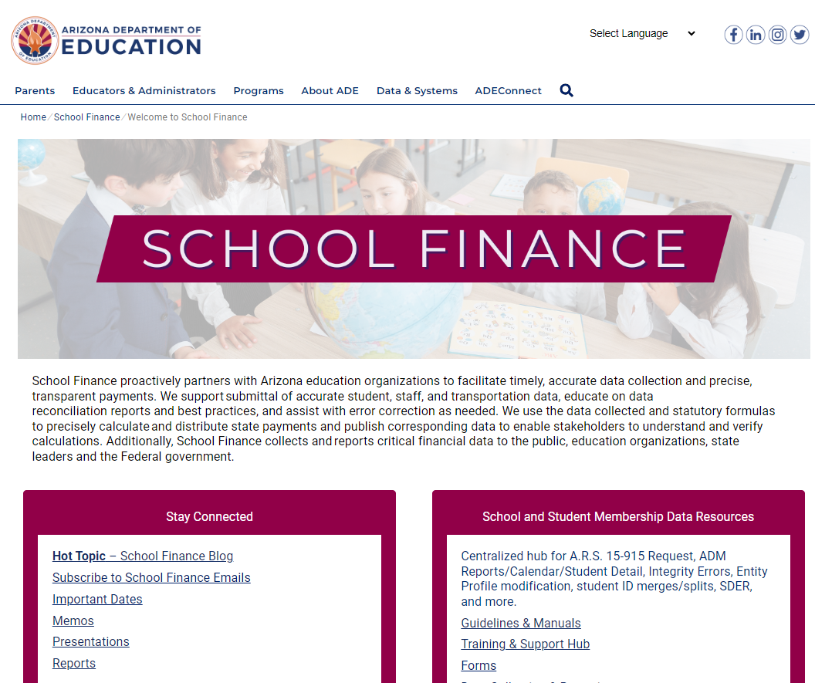
www.azed.gov/finance

Slide 7
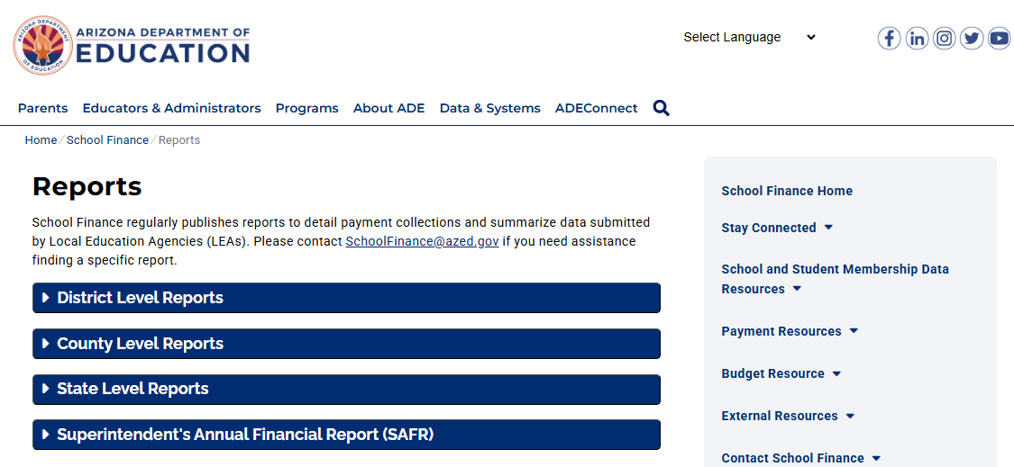
School Finance Reports

Slide 8
Payment Reports
ADE SCHOOL FINANCE REPORTS
SECTION 2
Notes:
This is a title page – please do not use for bulleted content

Slide 9

Payment Reports
Basic State Aid Reports
  BSA55 – Basic Calculations for Equalization Assistance
  BSA64 – Equalization Assistance and State Aid Payment Details
Other Payment Reports
  Classroom Site Fund

Slide 10
Payment Reports
BSA 55: District Equalization Report
  Summarizes annual equalization base and equalization assistance calculation based on student data and district characteristics
BSA 64: Equalization Payment Schedule Detail
  Summarizes each monthly payment calculation based on annual equalization assistance, amounts received in prior months, and any adjustments

Slide 11
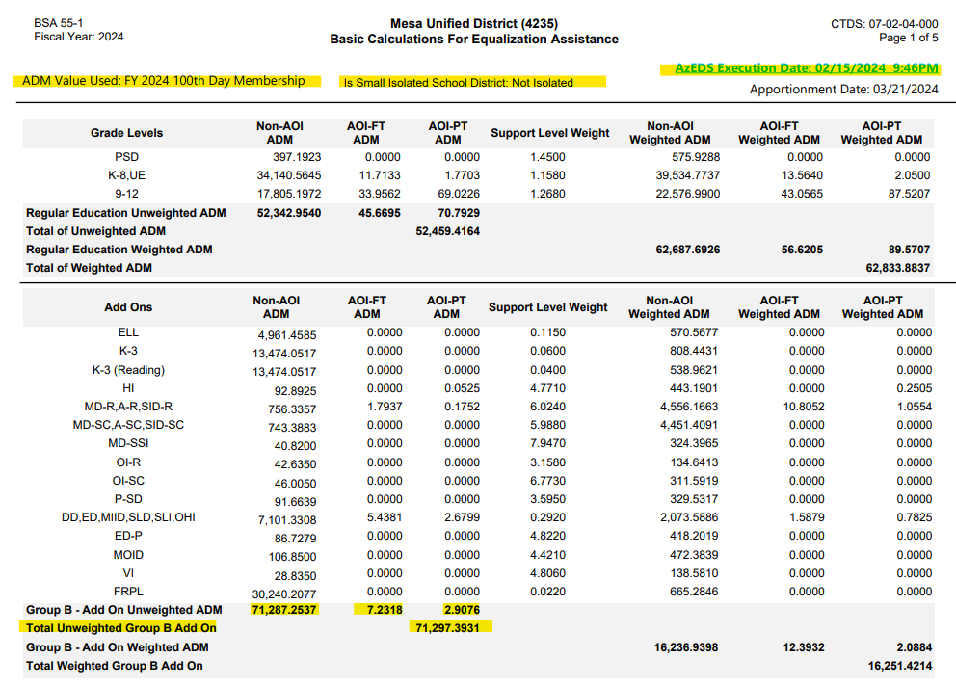
ADM20
ELL20
SPED20
FRPL20

Slide 12
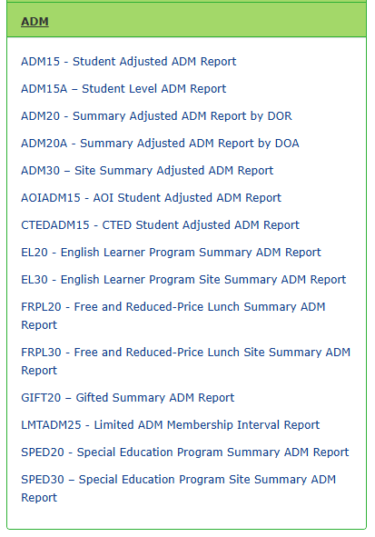
Reports are available in ADE Connect’s AzEDs Portal
Always select district of residence ADM if prompted for BSA-55 reconciliation

Slide 13
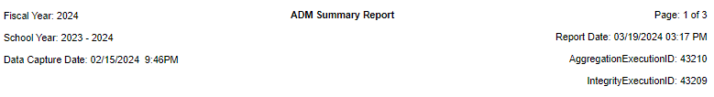
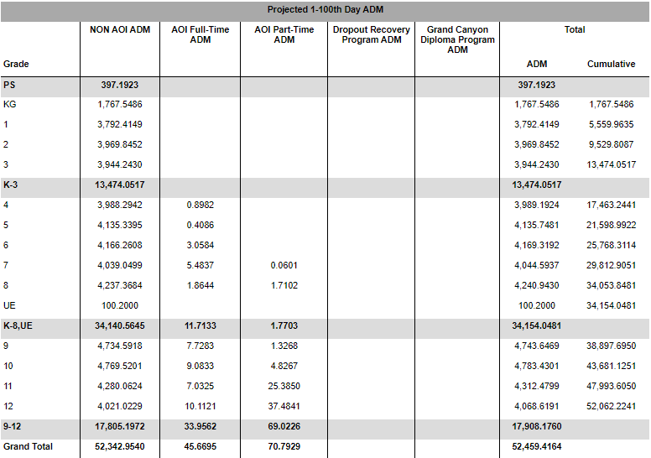

Slide 14
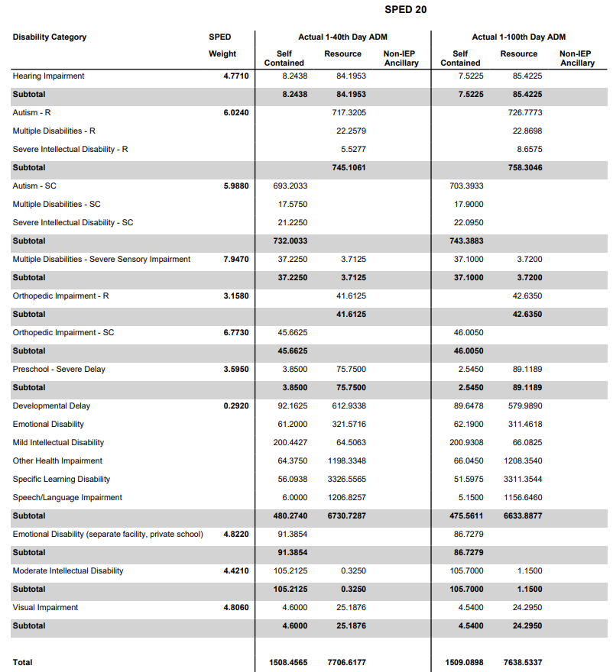

Slide 15
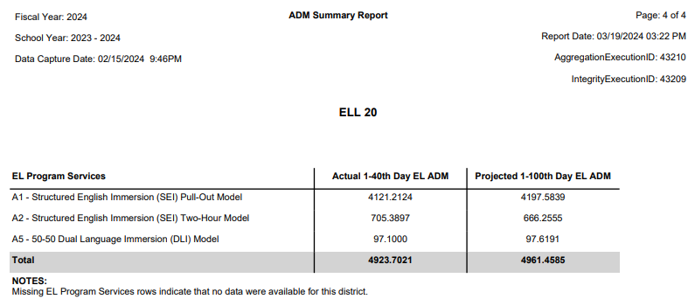

Slide 16
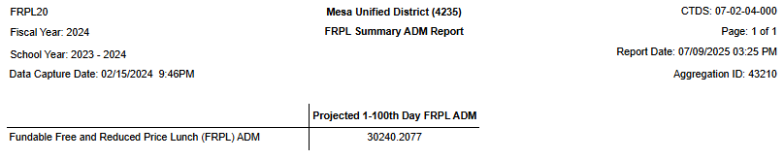
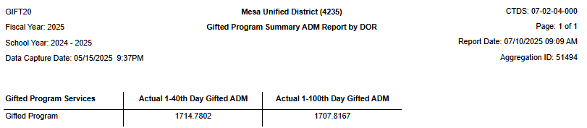

Slide 17
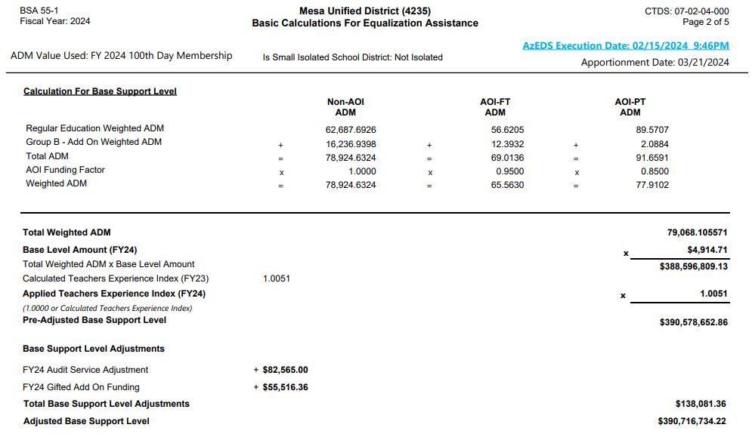
Prior year SDER-96
2 years prior AFR
Same month’s Budg-25

Slide 18
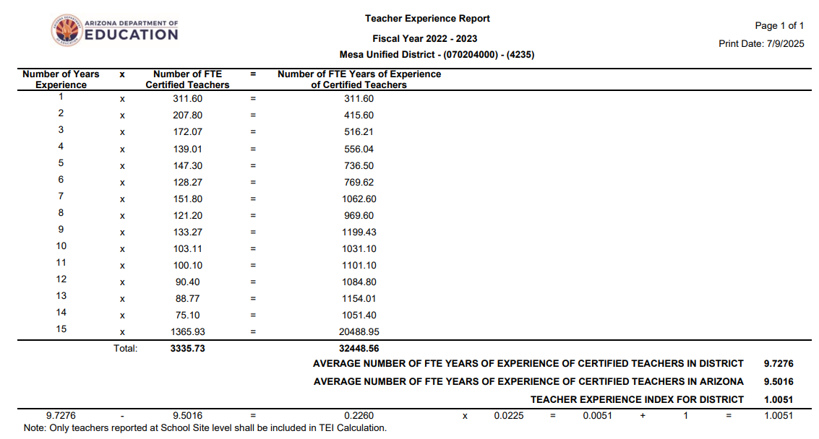

Slide 19
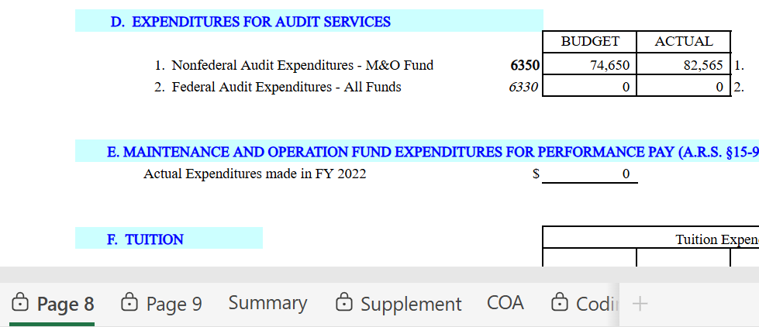
Validate that nonfederal audit expenditures are also budgeted on the current year Expenditure Budget on both the Data Entry and Page 2 tabs

Slide 20
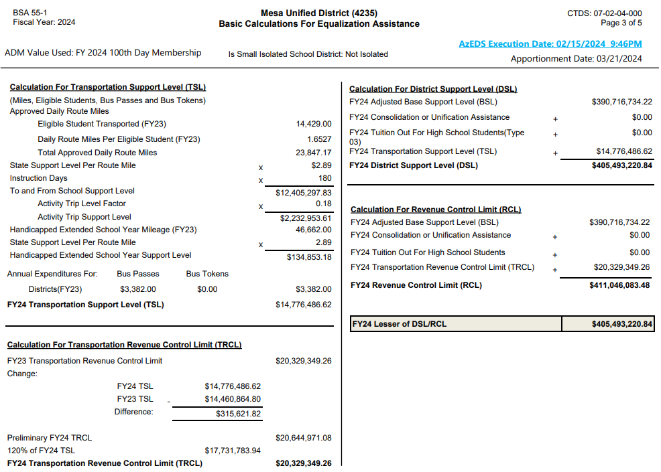
Prior Year
Trans-55
Same month’s Budg-25
Same month’s Budg-25

Slide 21
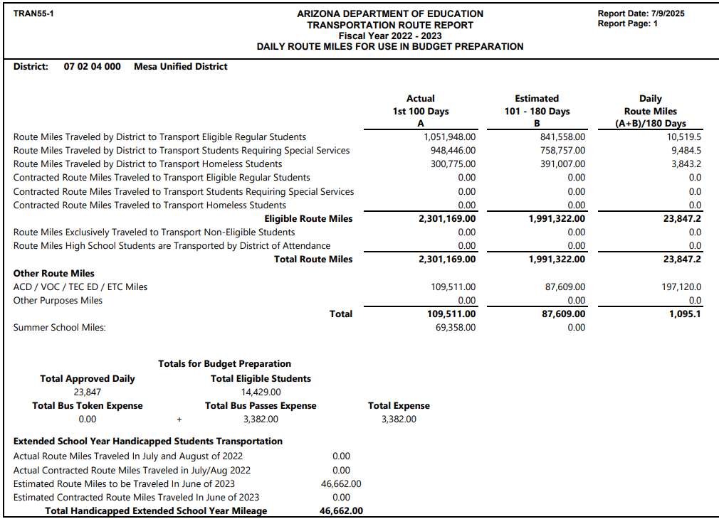
If this does not match BSA-55, you may not have submitted vehicle inventory miles (Trans-03 Report)

Slide 22
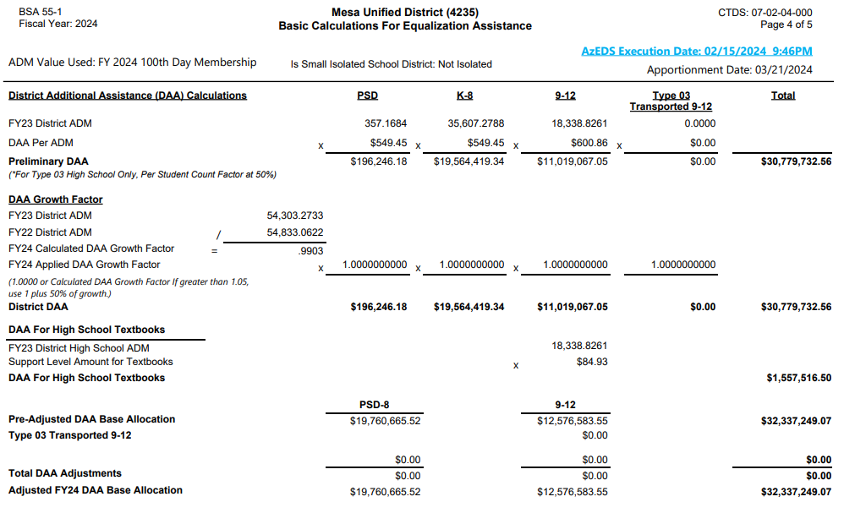




Prior year SRC/915 BSA-55
Prior year & 2 years prior SRC/915 BSA-55
Same month’s Budg-25

Slide 23
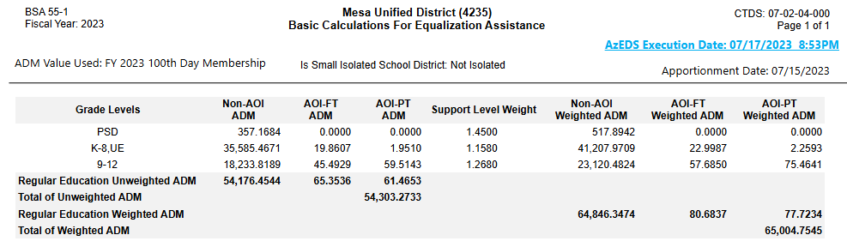

Slide 24
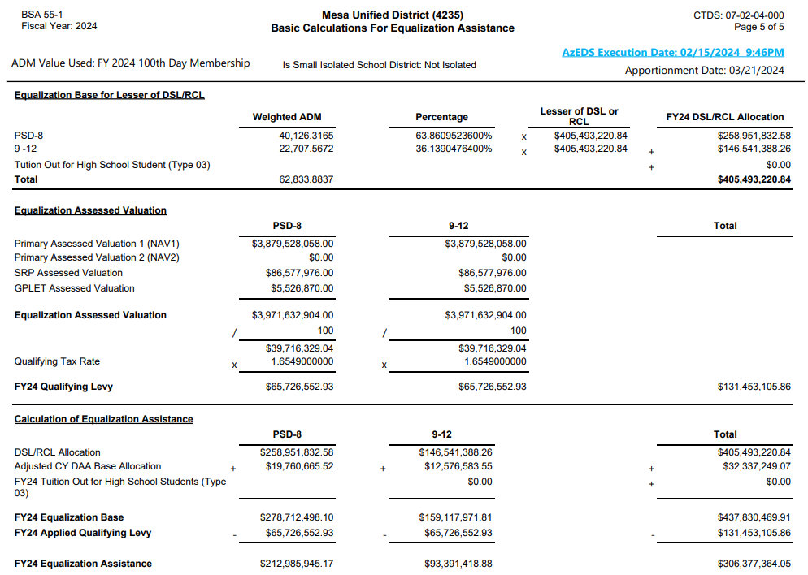



Same month’s BSA-64

Slide 25
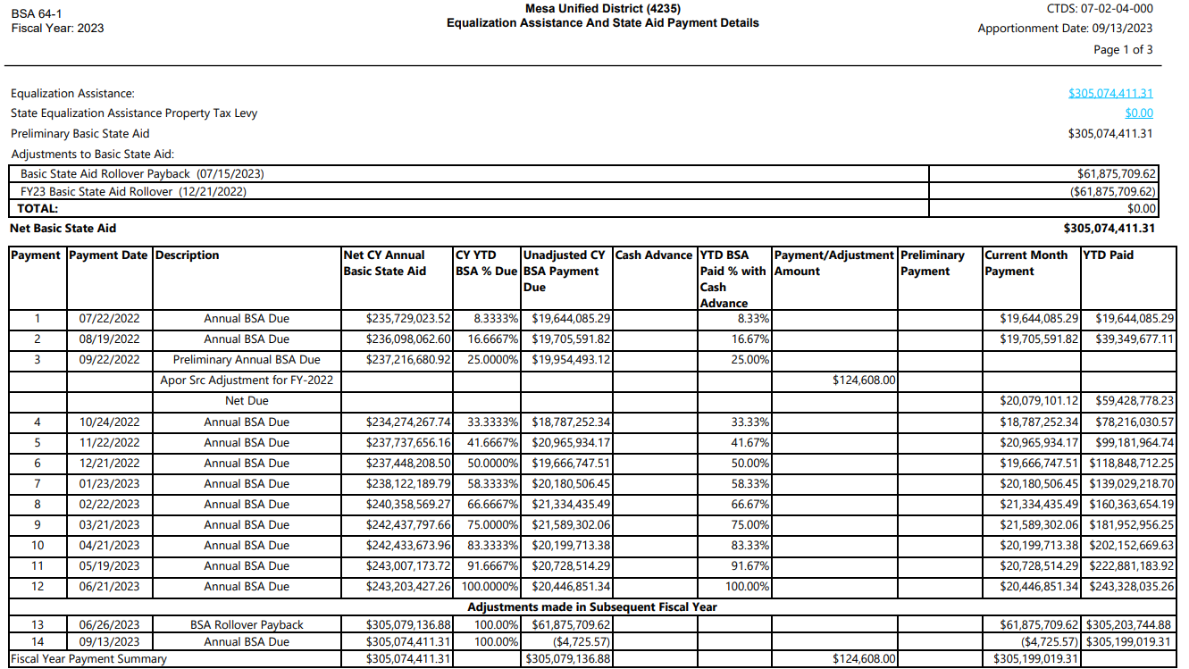
Same month’s BSA-55
Applicable prior month’s BSA-64

Slide 26
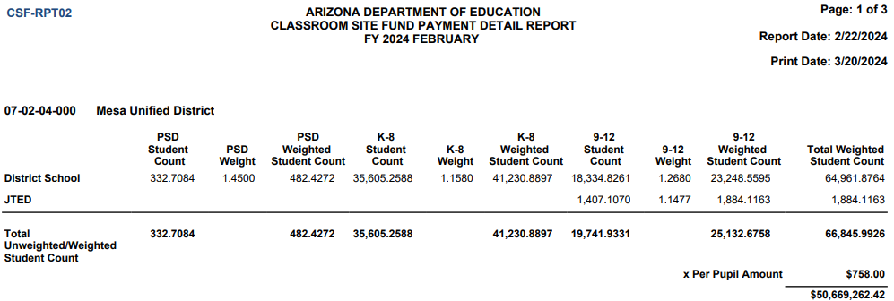
Classroom Site Fund (CSF)
Prior year SRC/915 ADM20A
Prior year SRC/915 ADM30
Monthly payments based on prior year attending weighted student count

Slide 27
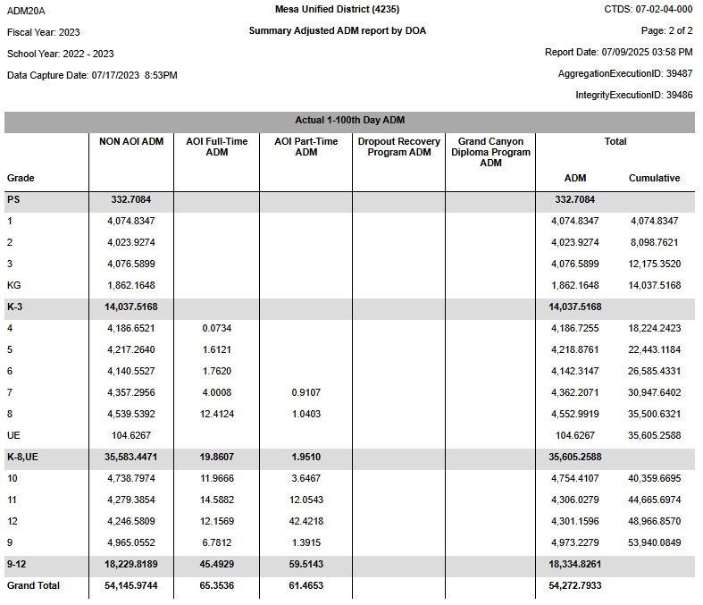

Slide 28
Budget Reports
ADE SCHOOL FINANCE REPORTS
SECTION 3
Notes:
This is a title page – please do not use for bulleted content

Slide 29

Budget Reports
BUDG-25
  Compares budget to ADE calculations for the current fiscal year
BUDG-75
  Compares actual expenditures for the previous fiscal year to the budget

Slide 30
BUDG-25
To comply with A.R.S. 15-905
Compares budget to ADE calculations for the current fiscal year
First report is published in October, then will be updated monthly after each state aid payment cycle
BUDG-25 report compares the district’s budgeted expenditures to ADE calculated values and expenditure limits for the district
The BSA 55 report can be used to assist districts in aligning their student counts, TRCL, and RCL to ADE calculated values
BUDG-25 Letters are published in October and notify of over/under-budgeted expenditures

Slide 31
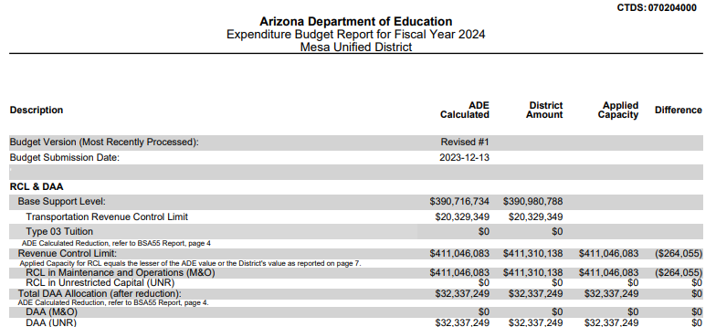
BUDG-25 Report
Often takes lesser of ADE Calculated & District Amount
Same month’s BSA-55
Most recent Expenditure Budget- Page 7

Slide 32
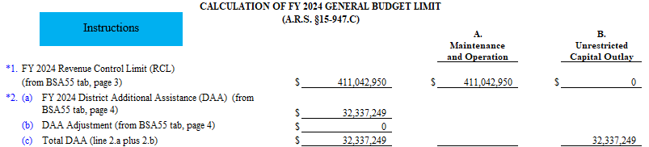
Pulls from BSA-55 tab, which calculates from data inputs on Data Entry tab. Validate inputs on Data Entry tab if RCL value appears incorrect.

Slide 33
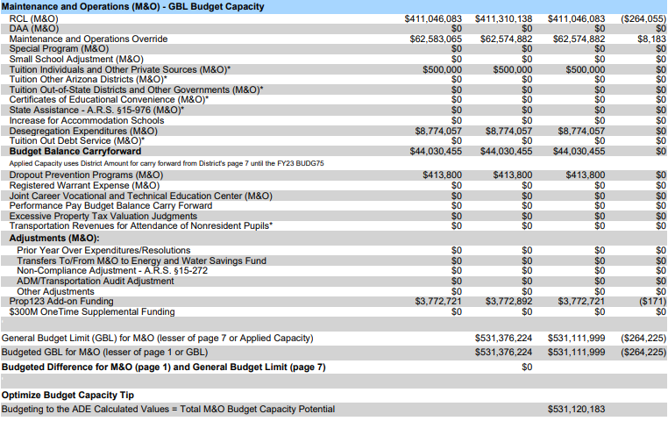
Most recent Expenditure Budget- Page 7
CEC payment amounts
Lesser of Exp. Budget, Deseg. Budget, 2009 Deseg. Budget
Prior year Budg-75
BSA-64 Report
School Finance Hot Topics
Sum of ADE Calculated column

Slide 34
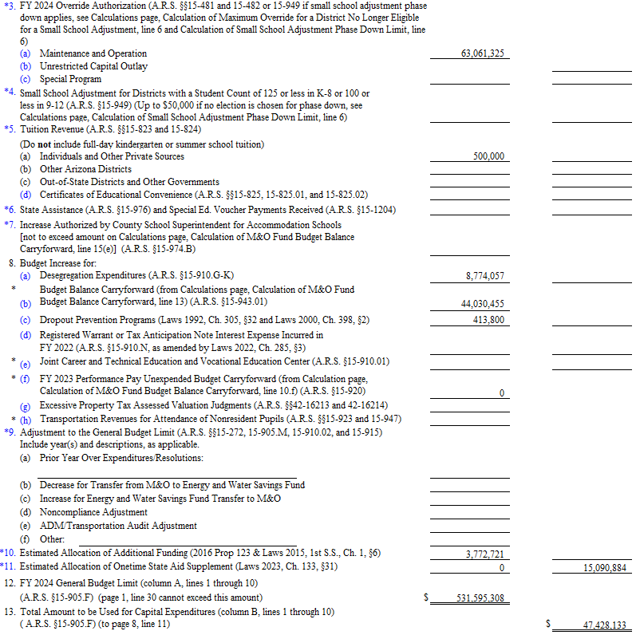

Slide 35
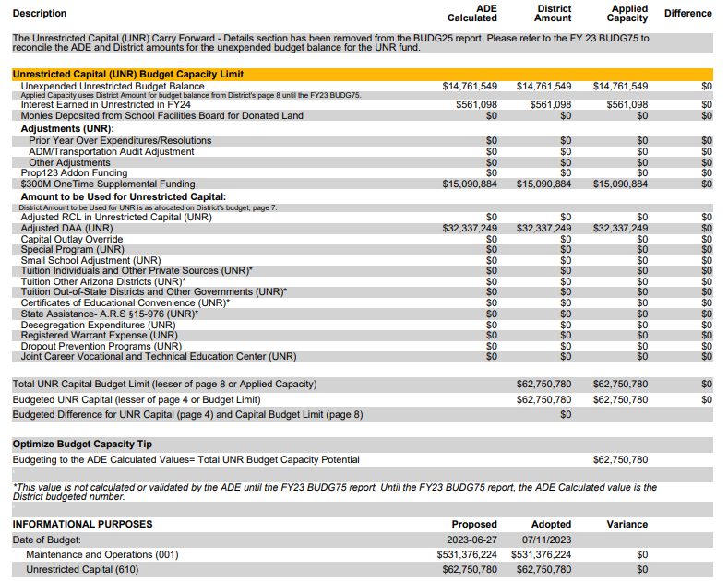
Most recent Expenditure Budget- Pages 7 & 8
Prior year Budg-75
Prior year AFR- Page 1
School Finance Hot Topics
CEC payment amounts
Lesser of Exp. Budget, Deseg. Budget, 2009 Deseg. Budget
Sum of ADE Calculated column

Slide 36
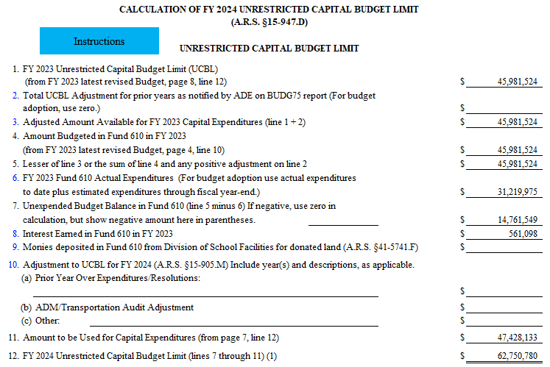

Slide 37

BUDG-75 Reports
BUDG-75 reports are published in November of the next fiscal year. This is the first notification of over expenditure for districts.
Compares Districts Actual Expenditures from the AFR to ADE calculated actual expenditure limits for the district.
Important for budget balance carryforward values.
Published in early November

Slide 38
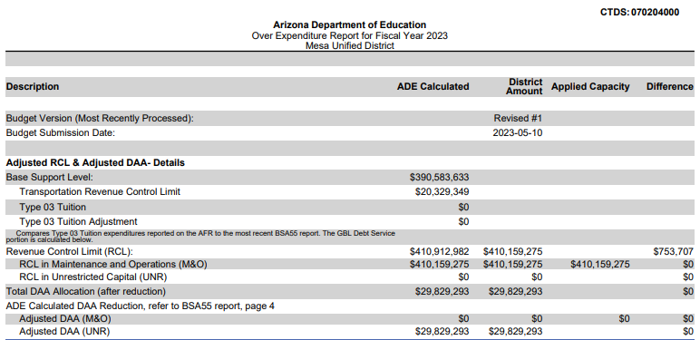
BUDG-75 Report
Prior year SRC/915 BSA-55
Only changes from Budg-25 Report are indicated

Slide 39
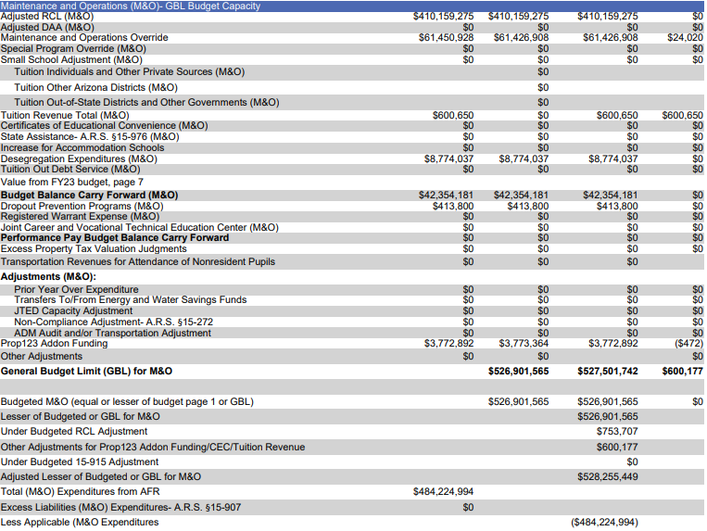
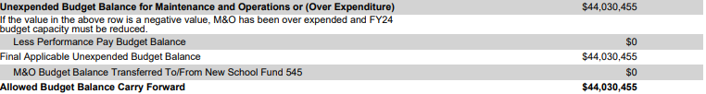
Same fiscal year AFR- Page 1
Lesser of Exp. Budget, Deseg. Budget, 2009 Deseg. Budget, AFR, Deseg. AFR
Lesser of Exp. Budget & AFR
Same fiscal year AFR
Same fiscal year AFR
Next fiscal year Budg-25

Slide 40
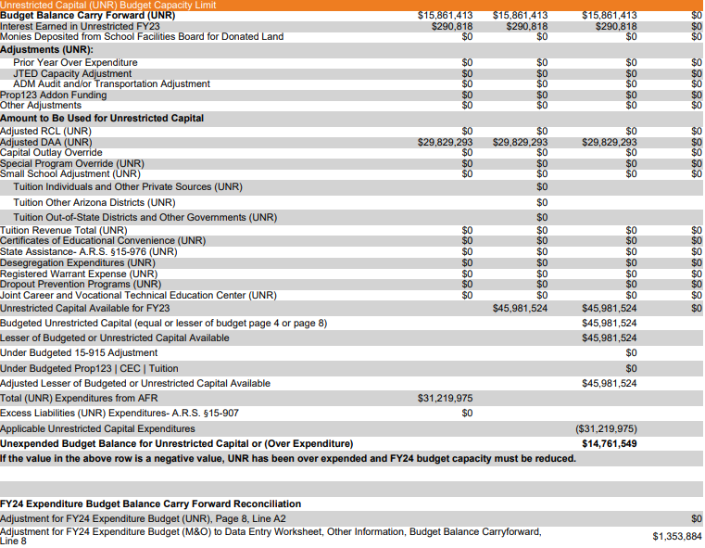
Same fiscal year AFR
Lesser of Exp. Budget, Deseg. Budget, 2009 Deseg. Budget, AFR, Deseg. AFR
Same fiscal year AFR
Next fiscal year Budg-25

Slide 41
Common File Upload Issues
ADE SCHOOL FINANCE REPORTS
SECTION 4
Notes:
This is a title page – please do not use for bulleted content

Slide 42

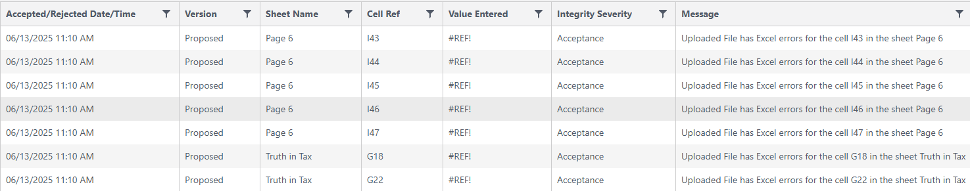
Review the “View Log” Screen
Click “View Log” next to files with status of either “Rejected” or “Processed with Warning(s) or Informational”
Review grid and fix errors in file for reupload.

Slide 43
“Rejected” File Status
Incorrect CTDS
No LEA name
Incorrect data type
  i.e. text in a cell where a numeric value is expected
  Any Excel errors
Wrong file
  “Invalid File/Template” or “GUID” error
  Download latest file from AG’s website for most up-to-date file

Slide 44
“Processed with Warning(s) or Informational” File Status
Missing nonfederal audit value(s)
  Expenditure Budget: Page 2 cell O8
  Expenditure Budget: Data Entry cell L67
  AFR: Page 8 cell O20
Values are outside of IDEA Maintenance of Effort (MOE) criteria
  Expenditure Budget: Page 1 cell L34 compared to Page 2 cell G16
M&O budgeted total does not match M&O budget limit
  Expenditure Budget: Page 1 cell L44 compared to Page 7 cell J54
UNR budgeted total does not match UNR budget limit
  Expenditure Budget: Page 4 cell L21 compared to Page 8 cell K32

Slide 45
Other File Upload Issues
Special characters not allowed in file names
Not having permissions to Budget System
  Work with your ADE Connect designated administrator(s) to assign role
  https://adeconnect.azed.gov/FindEA
Cover Page and Audit PDFs get uploaded on a different page
  Select “PDF Upload” at the top of the page
Scroll all the way to the right for “Upload” button
  Smaller screens may hide it
  Clear cache and cookies from browser if it does not appear still

Slide 46
Thank you
ADE School Finance Reports
Ryan Young, Director of Fiscal Operations
ryan.young@azed.gov
(602) 542-8244

