Slide 1


AASBO Update
ADE School Finance
01/07/2026

Slide 2

Agenda
ADM updates
FY25 Superintendent Annual Financial Report
Payment & Budget Updates
Non-fundable Interval
Inaccessible Cash

Slide 3

Average Daily Membership
AASBO Meeting Update

Slide 4
ADM Update

Slide 5
ADM Update

Slide 6
ADM Update

Slide 7
ADM Update

Slide 8

FY25 Superintendent Annual Financial Report
AASBO Meeting Update

Slide 9
FY2025 Superintendent Annual Financial Report
    The Superintendent's Annual Report provides a comprehensive summary of statewide financial and student data in accordance with A.R.S. 15-255.
    This report is compiled using data submitted by school districts and charter districts through FY25 Annual Financial Report.
    The report is available on School Finance website:
      https://www.azed.gov/finance/data-collection-reporting-budget#:~:text=%C2%A0Superintendent%27s%20Annual%20Reports

Slide 10
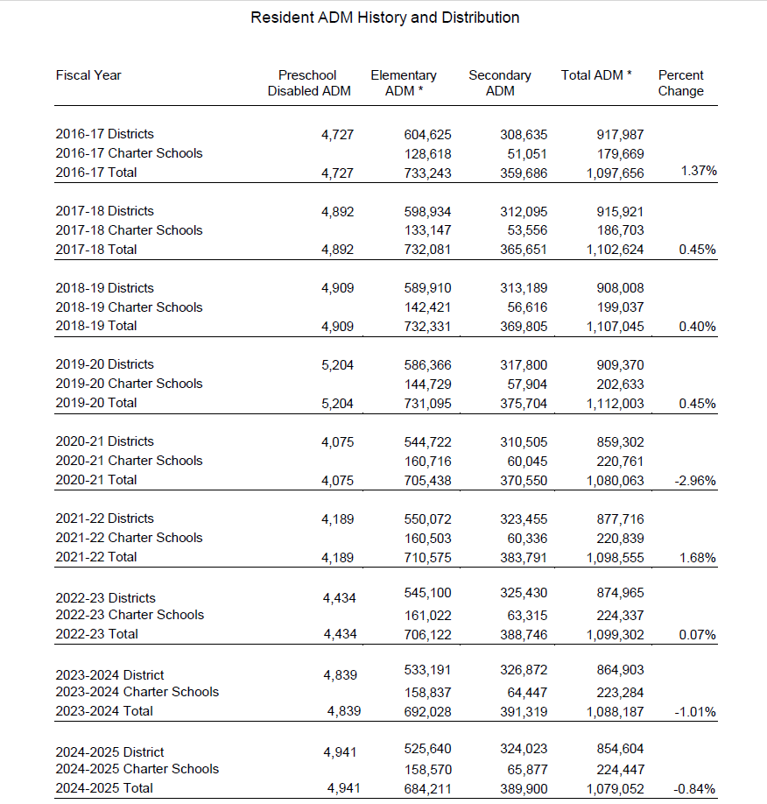
FY2025 Superintendent Annual Financial Report

Slide 11
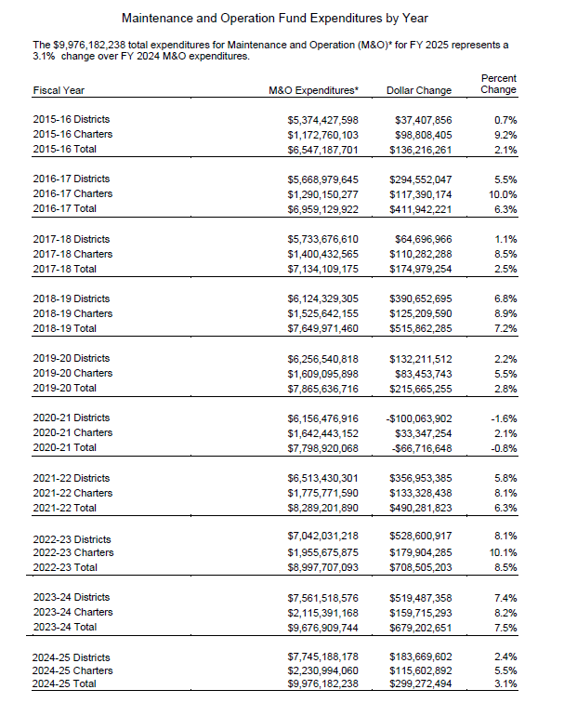
FY2025 Superintendent Annual Financial Report

Slide 12
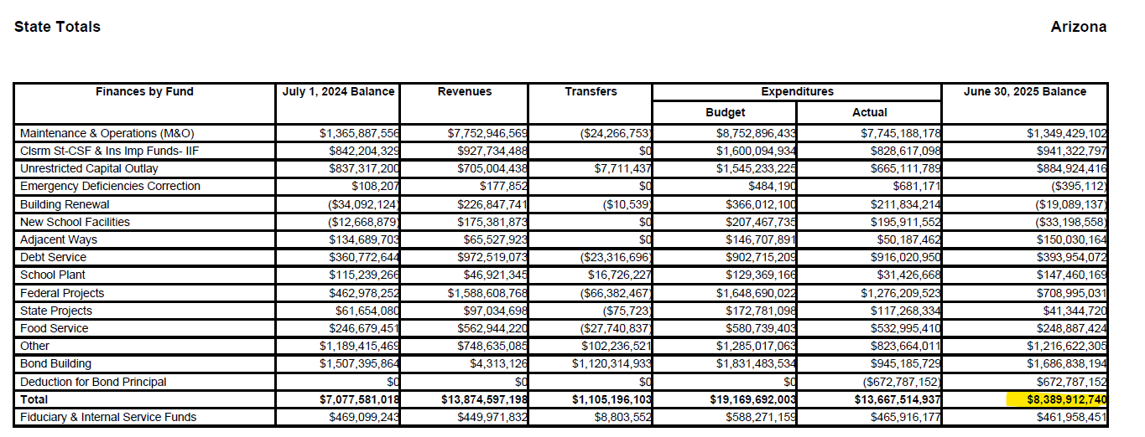
FY2025 Superintendent Annual Financial Report

Slide 13

Inaccessible Cash
AASBO Meeting Update

Slide 14
Inaccessible Cash
Total Statewide Amount: $437,189,814.12
Inaccessible cash calculations:
  If M&O cash balance > M&O budget balance carry forward → inaccessible cash
  If M&O cash balance < M&O budget balance carry forward →short of cash
  If UNR cash balance > UNR budget balance carry forward →inaccessible cash
  If UNR cash balance < UNR budget balance carry forward → short of cash

Slide 15
Payment & Budget Updates
AASBO Meeting Update

Slide 16
Payment & Budget Updates
  One-time supplemental funding for District Additional Assistance (DAA)
    DAA statewide amount: 23,142,000
    Manual calculation based on FY2025 SRC/915 ADM
  One-time supplemental funding for Free Reduced Priced Lunch (FRPL)
    FRPL statewide amount: 37,000,000
    Manual calculation based on FY26 FRPL ADM
  Prop 123 Payment 1
  IIF payment 1
  Budget 25 report for December will be posted by end of this week

Slide 17
Non-fundable Interval
AASBO Meeting Update

Slide 18
Non-fundable Interval
    NFI will be calculated for the first 100th day ONLY
    Recorded webinar is available on School Finance website under:
    School Finance Guidelines & Manuals | Arizona Department of Education (see section: Excused Absences)
    Total statewide (district & charter) calculated estimated amount based on data capture on 12/15/2025: $7M

Slide 19

Contact Us
  (602) 542-5695
  SchoolFinance@azed.gov
  http://www.azed.gov/finance/
School Finance
  http://helpdeskexternal.azed.gov
    Student Data
    School District Employee Report
    Instructional Calendars
    Transportation Reporting
    915s
SF Account Analysts
Phone Option 3
  SFPaymentTeam@azed.gov
    BSA District
    BSA Charter
    CSF
    IIF
SF Payments Team
Phone Option 1
  SFBudgetTeam@azed.gov
    Expenditure Budgets
    Annual Financial Reports
    BUDG25, BUDG75, BUDGAGD
SF Budget Team
Phone Option 2

Slide 20
Xin Liu, Deputy Associate Superintendent of School Finance
Xin.Liu@azed.gov
(602) 364-2262
Thank You

