Slide 1


TEST SECURITY AGREEMENT PORTAL
2026-2027
Notes:
Starting in the 2026-2027 school year, the previous workflow for designating a District Test Coordinator (DTC) for each of ADE’s assessment programs (Achievement Assessments, Alternate Assessments, and AZELLA) will be replaced by the ADEConnect Assessments Portal Test Security Agreement application. This will allow all DTC Test Security Agreements to be submitted electronically.

Slide 2
ADEConnect Roles
Two roles that can initiate a Test Security Agreement
  Entity Administrator
  Superintendent/Charter Representative
District Test Coordinators (DTC)
    AZELLA - This role is responsible for English Language Proficiency test administrations.
    Achievement - This role is responsible for AASA, AzSCI, ACT Aspire, and ACT test administrations.
    Alternate - This role is responsible for MSAA and Alt ELPA test administrations.
Notes:
The new Test Security Agreement process requires the participation of the Entity Administrator, Superintendent or Charter Representative, and the DTC for AZELLA, Achievement, and Alternate Assessments. Each person in this process must have an active ADEConnect account with the correct user role assigned prior to starting the process. The Entity Administrator or Superintendent/Charter Representative will initiate the process by creating a Test Security Agreement in the Assessments Portal. A separate Test Security Agreement is required for each program (AZELLA, Achievement, and Alternate Assessments) for each district or charter.
The contact information for the Entity Administrator and Superintendent are available in the Assessments Portal. DTCs can use the contact information to directly contact the Entity Administrator and/or the Superintendent/Charter Representative concerning any part of the Test Security Agreement process. It is possible that there are multiple Entity Administrators assigned to a district. If this is the case, then districts will need to internally determine who the correct Entity Administrator is for this process.
If the Entity Administrator creates the Test Security Agreement, then they will need to designate both the Superintendent/Charter Representative and the DTC within the application. If the Superintendent/Charter Representative creates the Test Security Agreement, then they will need to designate the DTC.
After the Test Security Agreement has been initiated, then the DTC for each of the programs can sign the form electronically to complete the process.

Slide 3
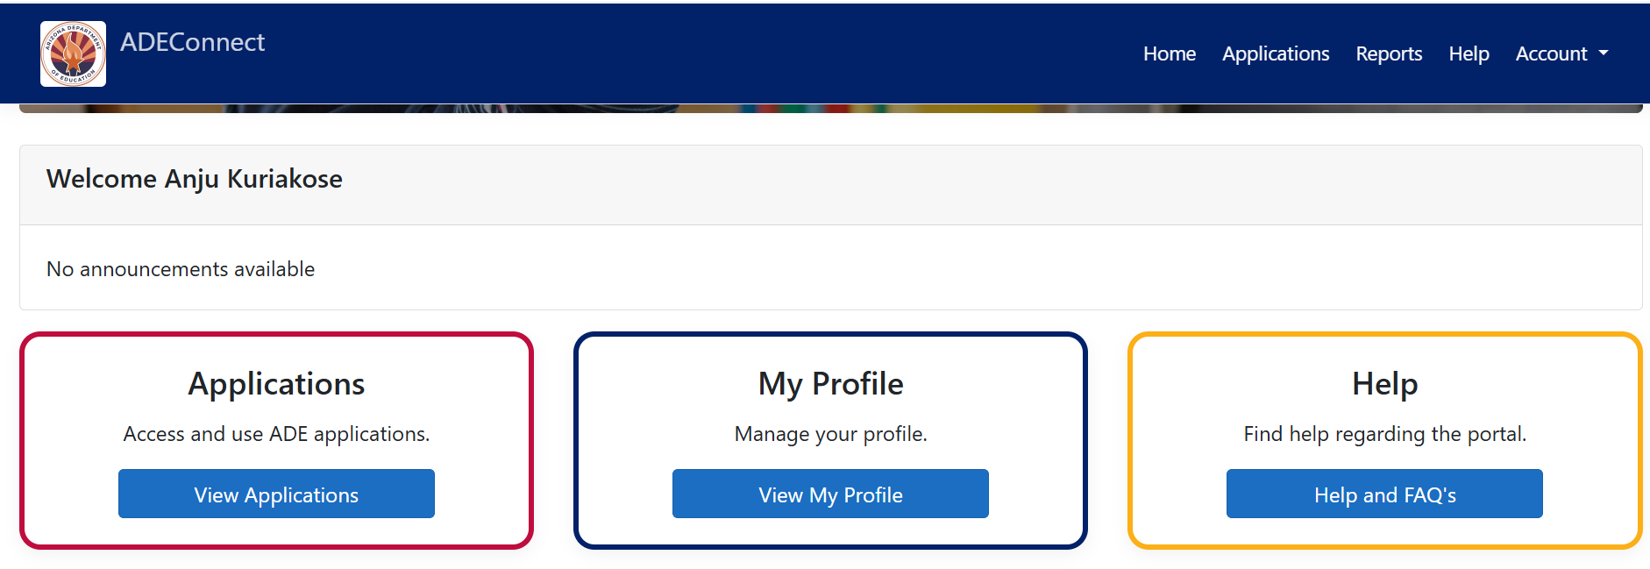
ADEConnect
ADEConnect - https://adeconnect.azed.gov
Notes:
The new Test Security Agreement will need to be completed in the Assessments Portal, which is an ADEConnect application. To access the Assessments Portal, navigate to ADEConnect. The link to ADEConnect can be found on the slide or on ADE’s homepage (www.azed.gov). Click on ADEConnect and then select View Applications.

Slide 4
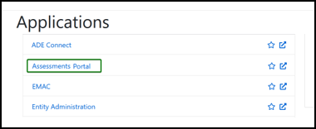
Assessments Portal
Notes:
On the Applications screen, select the Assessments Portal from the list.

Slide 5
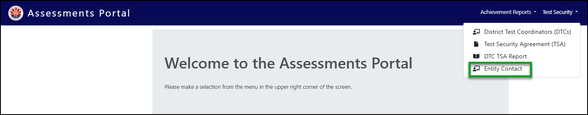
Assessments Portal
Notes:
To access the contact information for the Entity Administrator and Superintendent, select the Test Security drop-down in the upper right-hand corner, and select “Entity Contact.”

Slide 6
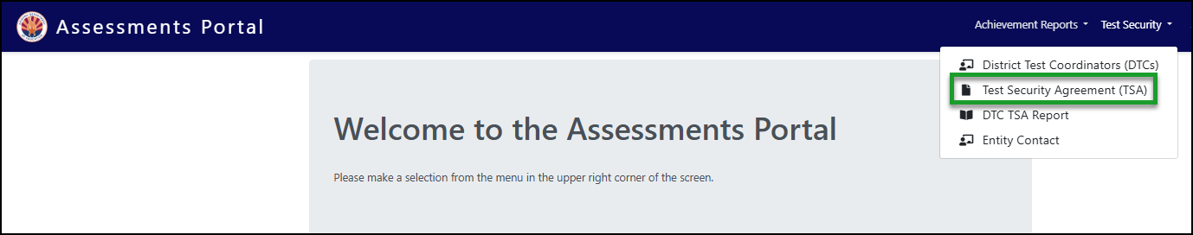
Assessments Portal
Notes:
To create or sign a Test Security Agreement, select the Test Security drop-down in the upper right-hand corner, and then select “Test Security Agreement.”

Slide 7
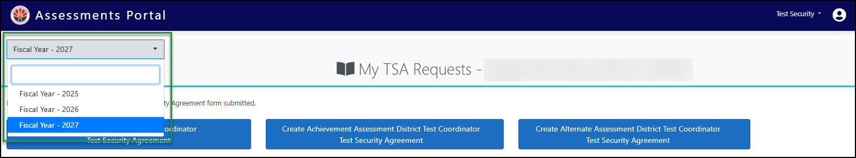
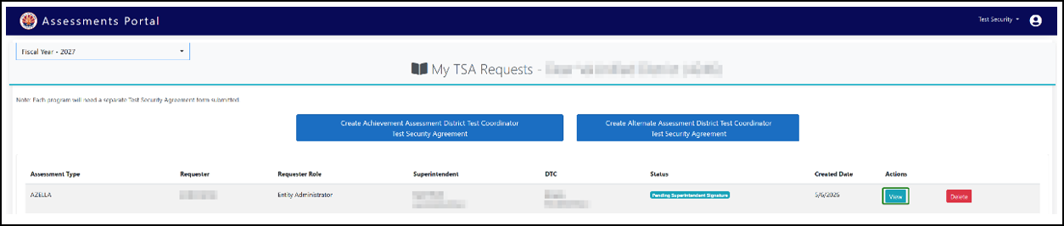
Assessments Portal
Notes:
After selecting the Test Security Agreement, users are navigated to the My TSA Requests screen. Select Fiscal Year 2027 from the drop-down in the upper left-hand corner.
The “My TSA Requests” screen is where a Test Security Agreement can be created or signed. To create a new Test Security Agreement, the Entity Administrator or Superintendent/Charter Representative will select the blue button for the AZELLA, Achievement, or Alternate Assessment program. To sign a pending request, the Superintendent/Charter Representative or DTC can scroll down and select “View” next to the existing request.

Slide 8

District Test Coordinator (DTC) Test Security Agreement (TSA) Workflow
Step 1: ADEConnect
Confirm that the Entity Administrator, Superintendent/Charter Representative, and DTCs have an active ADEConnect account with the correct User Role assigned.
Step 3: Designate Superintendent/Charter Representative
The Entity Administrator appoints the Superintendent or Charter Representative in the application.
Step 2: Create a new DTC Test Security Agreement
Create a new DTC Test Security Agreement for the AZELLA, Achievement, or Alternate Assessment DTC.
Step 6: DTC Signature
Once the Superintendent/Charter Representative has signed the agreement, the appointed DTC receives an email notification and signs the Test Security Agreement.
Step 4: Designate DTC
The Entity Administrator or the Superintendent/Charter Representative appoints the DTC for the respective assessment program in the application.
Step 5: Superintendent/ Charter Representative Signature
The appointed Superintendent/ Charter Representative receives an email notification and signs the Test Security Agreement.
* Each assessment program will require a separate Test Security Agreement to be submitted.
* Upon completion of the Agreement, a PDF copy can be generated.
Email: AZELLA@azed.gov, Testing@azed.gov, AlternateAssessment@azed.gov
Notes:
Here is a quick overview of the new workflow in the Assessment Portal for the new Test Security Agreement process. This is outlined step-by-step in the Assessments Portal Test Security Agreement User Guide. The Entity Administrator, Superintendent, and each assessment program DTC need an active ADEConnect account with the correct user role assigned to them. Either the Entity Administrator or Superintendent can initiate the TSA process by creating a new DTC Test Security Agreement for the AZELLA, Achievement, or Alternate Assessment DTC. Once the DTC has been designated, they will receive an automated email notification and can electronically sign the agreement. Once the Test Security Agreement has been completed, a PDF copy of the agreement can be generated.

Slide 9

CONTACT INFORMATION
Email our inboxes:
Testing@azed.gov
AZELLA@azed.gov
AlternateAssessment@azed.gov
User Guide: https://www.azed.gov/sites/default/files/2026/05/TSA_User_Guide.pdf
Notes:
We are here to support you through this process and make this transition to electronic Test Security Agreements in the Assessments Portal as seamless as possible. We request that you review the user guide before you email us with any questions. You will be able to find the answers more quickly by going through the process outlined in the user guide. We cannot assign ADEConnect roles. This must be done by your Entity Administrator. If you have any questions, please email the Testing inbox if you are the Achievement DTC, the AZELLA inbox if you are the AZELLA DTC, or the Alternate Assessment inbox if you are the Alternate Assessment DTC. Emailing the correct inbox will help us to get you answers faster. This is a change and we understand that it will take some time, but we are here to support you through this process.
Thank you.

